Slide 1
Cantilever re - style
See the notes on the left margin of many of these slides for instructions on their use.
Subtitle
Speaker name and title

Slide 2
Cantilever re – style
Intent is review all structures drown on XS01 test pattern, clean up the ones we don’t use and introduce new ones;
Scope of new structures will be give the possibility to study more in details some material characteristics (for both SD and PM)/new deposition methods, we are thinking to introduce the following structure:
BRIDGE structure: to study ion migration in materials during programming pulse;
STARNET structure: to study Vth variation with T and with both T and programming pulse;
SAG (self aligned growth): to study selective ALD deposition method (this is still at embryonal step because the actual work is only at morpho level to understand the better path for successful growth).
These are what we are proposing any other suggestions/idea on other structures are welcome to evaluate the feasibility on XS01.

Slide 3
What is needed:
Some masks re-layout and some new masks (there is under evaluation the possibility to maintain for all structures the cantilever PAD approach or the needed to move to “standard” PAD flow);
Some process development: chalcogenide etch, via2/PAD etch if we go on “standard” PAD approach
^{(*) masks needing re – layout}
^{New masks needed (via2} and PAD only if we don’t follow cantilever PAD approach

Slide 4
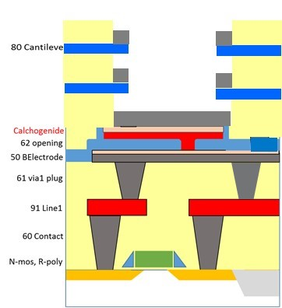
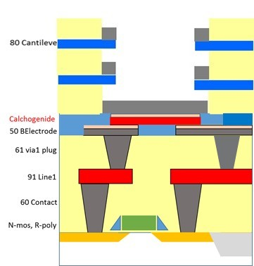
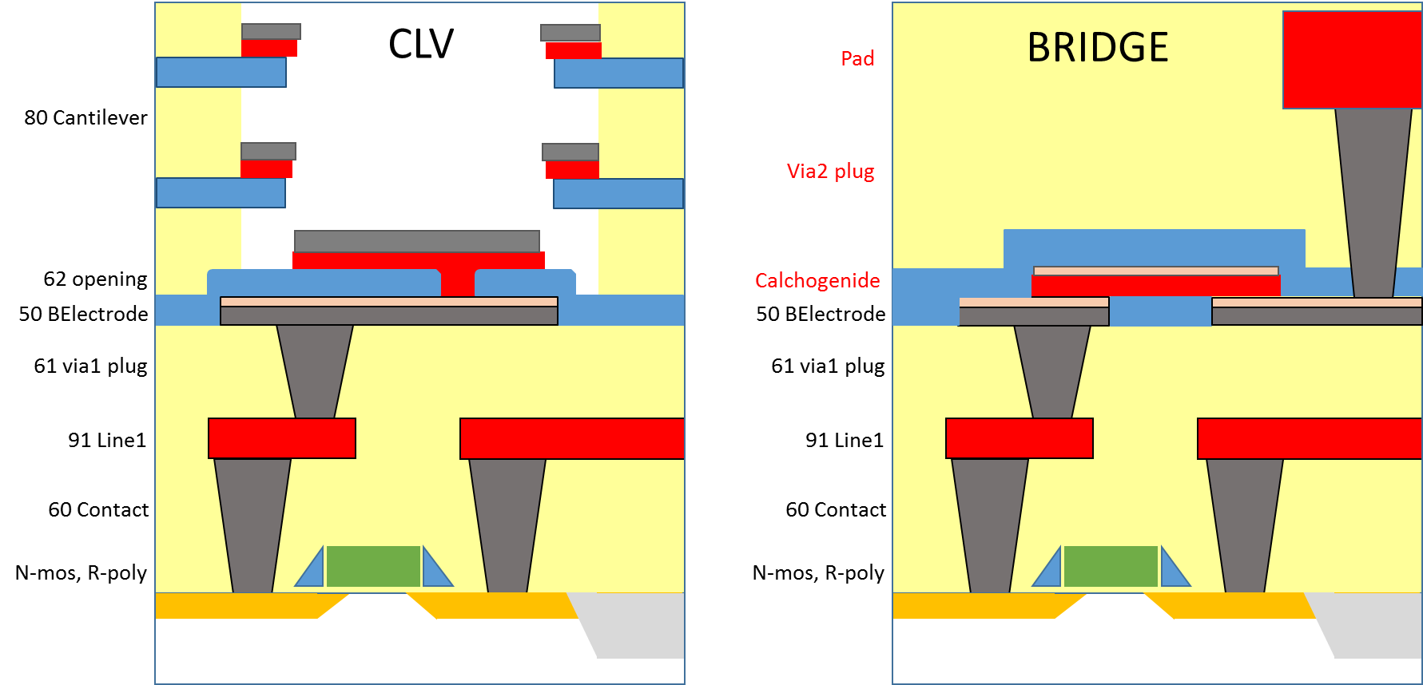
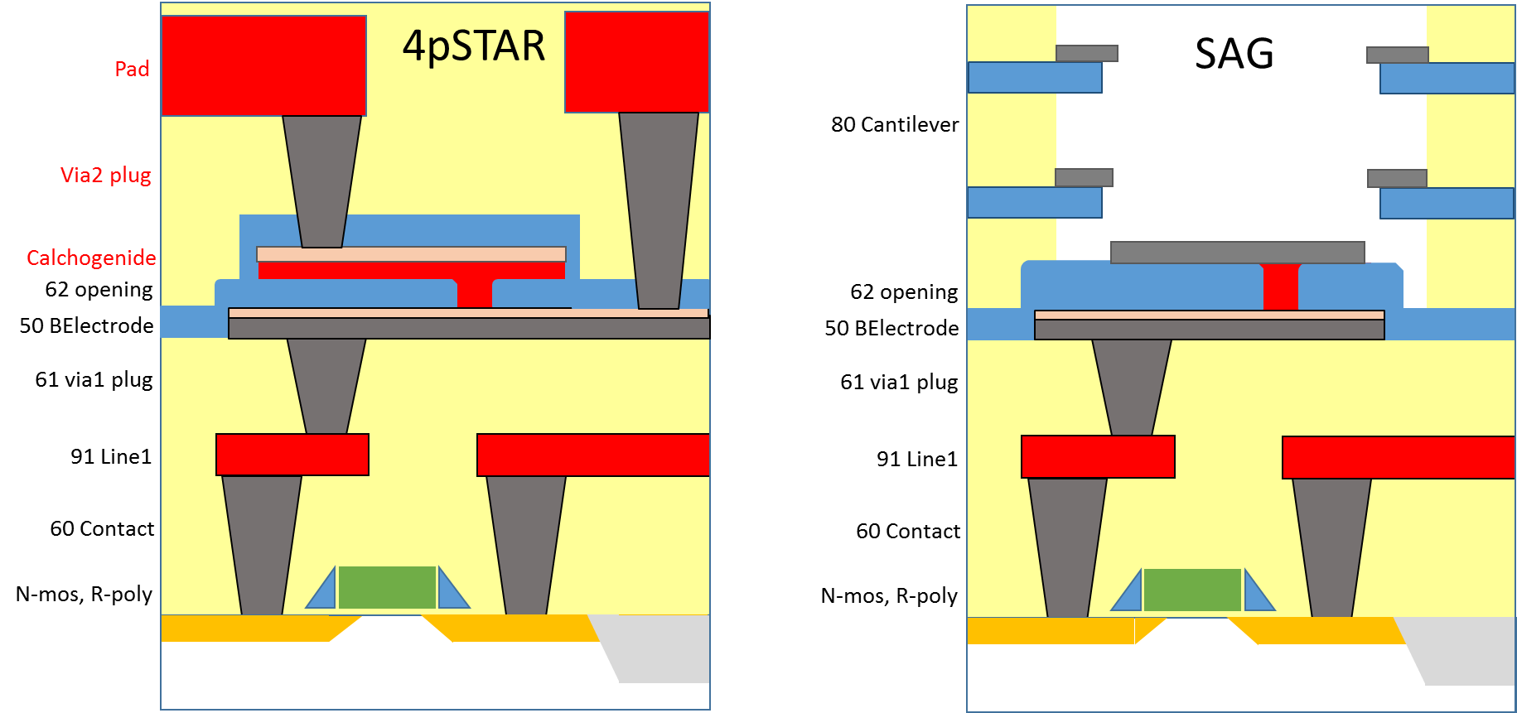
Structures sections

Slide 5
Structures layout
BRIDGE
STARNET
Chal
Chal
Heater
Via1
2 PAD structure
Via1
4 PAD structure

Slide 6
Timeline
We are working to:
list structures on XS01 and identify the ones we don’t use;
define the structures’ layout we want to introduce;
define process changes needed
prepare the file for the mask designer group
In the meanwhile we will contact Tony Liu group to inform them about this work and understand their timeline to draw masks needed.
Mid/second half of June

