Slide 1
XPS Core levels and valence band analysis of SD
Deeper insights on moisture and annealing effects in SD
Kent Zhuang, Swapnil and Paolo

Slide 2
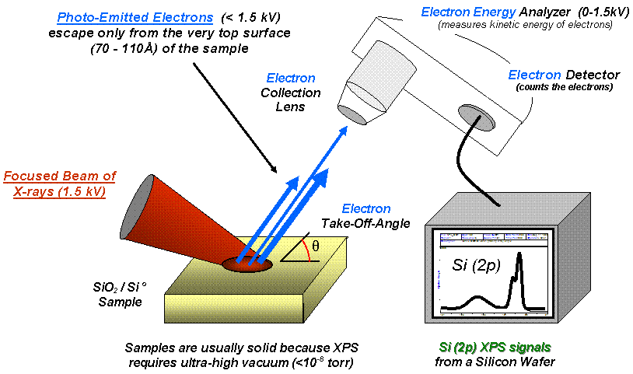
Experimental
3 SiSAG films have been analyzed thru XPS:
  One w/o Ge, the other two with ~9% (similar to our POR) and 19% Ge
35 nm SiSAG films were deposited on bare Si wafer and capped with 3 nm Carbon
Compositions 2 and 3 have been analyzed both after dep and after annealing at 280°C for 30 min in vacuum
High resolution of C1s, O1s, Si2p, Ge3d/Ge2p3, As3d/As2p3 and Se3d core levels and the valence band spectra were acquired with two different at 45 and 85º take-off angles (TOAs)
Element | 1 | 2 | 3
As | 35.9 | 31.4 | 28.5
Se | 57.4 | 53.1 | 46.6
Ge | 0.0 | 9.0 | 19.0
Si | 6.6 | 6.5 | 5.9
45º TOA is more surface sensitive, while 85º TOA is more bulk sensitive

Slide 3
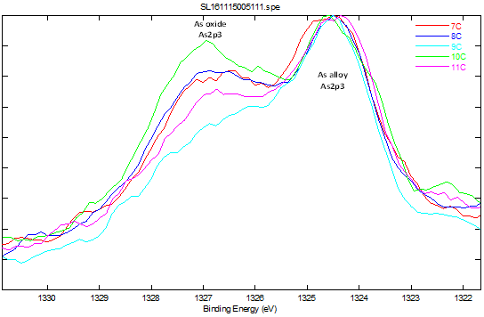
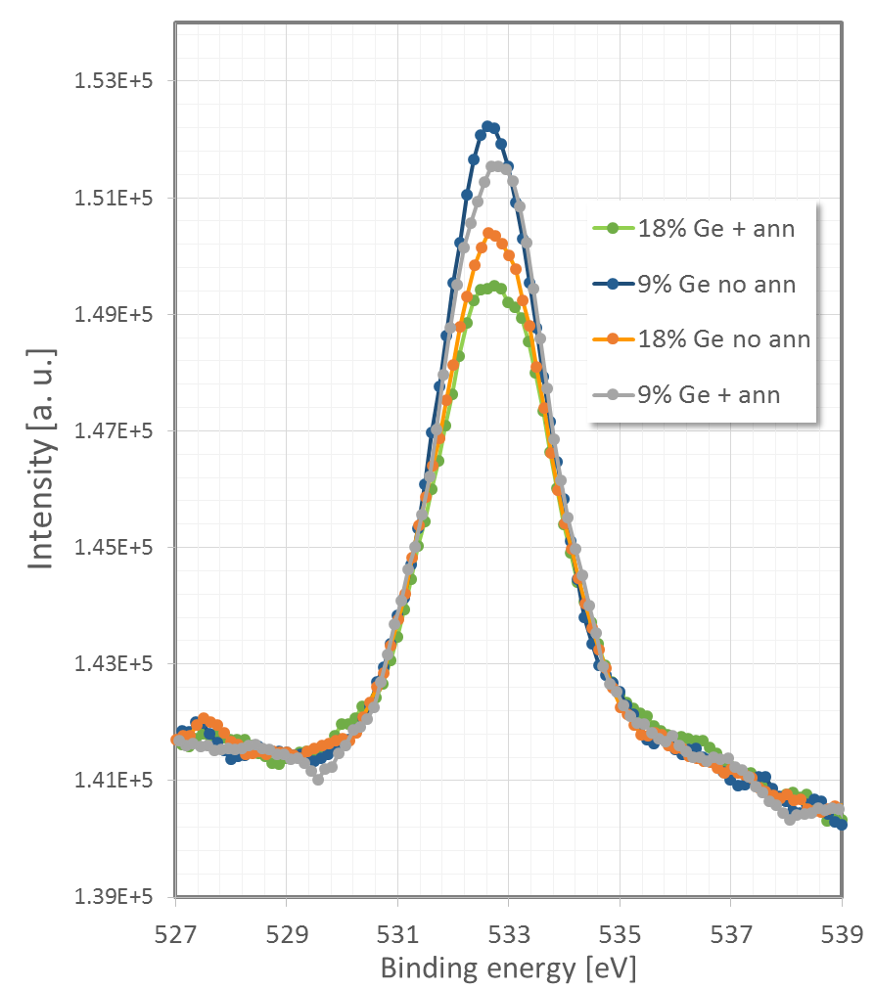
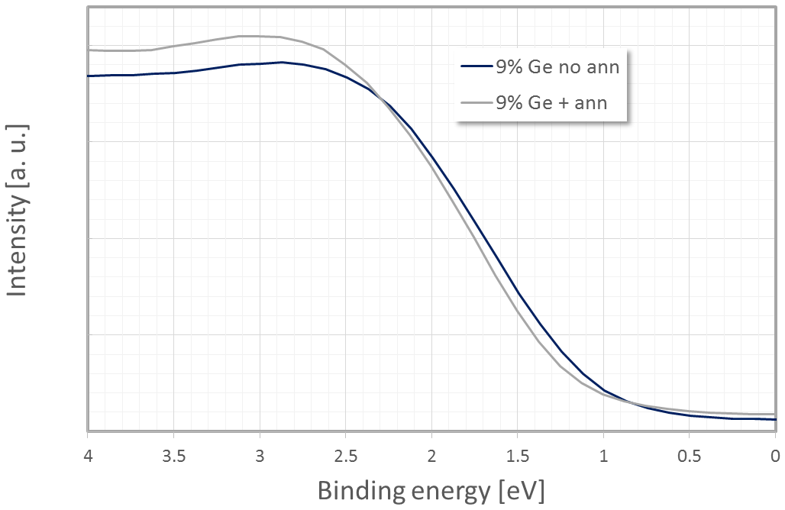
Key results summary:
As 2p_{3/2} core level
As 2p_{3/2} core level
As 2p_{3/2} core level allows identifying the presence of As2O3 or As(OH)3 in the film. Spurious peak at higher BE.
Carbon capped SiSAG SD film incorporates moisture
Annealing (280°C for 30 min in vacuum) effects:
  likely converts As(OH)3 to As₂O₃ (evidenced from reduced Oxygen post anneal in the As 2p_{3/2} peak) and oxides Ge (Ge3d shift at higher BE)
  Moisture is partially released after annealing (evidenced from reduced O 1s peak intensity post anneal)
  Annealing shifts the valence band maximum toward higher binding energy, thereby widening the band gap which is consistent with independent optical measurements (see next slide)
Sample | Film | Anneal
07 | ~As2Se3 | No
08 | 9% Ge, SiSAG | No
09 | 9% Ge, SiSAG | Yes
10 | 18% Ge, SiSAG | No
11 | 18% Ge, SiSAG | Yes
Ge 3d core level
O 1s core level
Shift at higher BE with annealing indicates more GeOx
Decrease of Ox peak w/ ann supports moisture loss
Top of the VB
The retire of the VB is coherent w/ optical BG widening
Doc link

Slide 4
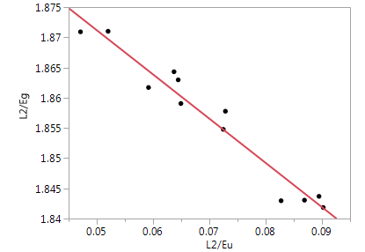
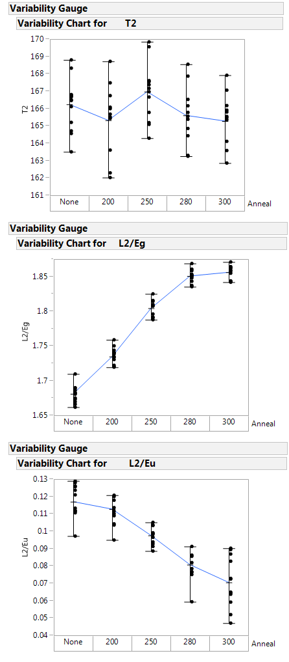
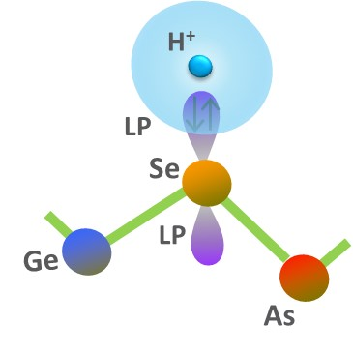
Link w/ independent optical characterizations
By J. Hauck
Doc link
E_{G} increases w/ ann temperature
E_{u} decreases w/ ann temperature
Lot X985963.003
E_{G} and E_{u} have a linear relationship for each material. Fit line gives the bandgap energy of the “perfect”/clean material (E_{u} = 0).
The highest energy state (A₁) of the Electronic DoS of SAG is ascribed to Se LP
We could speculate that H⁺ ions bond with Se LP shifting up their energy and then narrowing the BG
As a consequence of annealing moisture release will lead to the retire of the top of the VB previously stretched by H⁺ ions accumulation
A₁
Top of the VB
Ab-initio simulations need to check this proposed model

Slide 5
Study of annealing effects
As2p3 core level
The chemical shift of the As2p3 binding energy as a consequence of oxidation allowed monitoring the oxidation levels of the films
0% Ge – No Ann
9% Ge – No Ann
9% Ge – With Ann
19% Ge – No Ann
19% Ge – With Ann
The As oxidized core level component appears depressed as a consequence of the annealing process → Annealing likely converts As(OH)3 to As2O3 (evidenced from reduced Oxygen post anneal)

Slide 6
XPS Valence band spectra
Wafer ID | Film | Anneal
7353-07 | ~As2Se3 | No
7353-08 | 9% Ge, SiSeAsGe | No
7353-09 | 9% Ge, SiSeAsGe | Yes
7353-10 | 18% Ge, SiSeAsGe | No
7353-11 | 18% Ge, SiSeAsGe | Yes
Features of the valence band spectra are in good agreement with literature for the SAG system [R. Golovchak, J. Non-Cryst. Solid 357, 3454 (2011)]
  The Ge 4p and As 4p electronic states of the atoms participating in Ge–Ge, Ge–As and As–As bonding should contribute to the peak around ~3-4 eV, but it could be partially overlapped also with stronger Se 4p band (5-6eV) shifted towards lower binding energy because of decreased number of Se–Se bonds as per specific composition.
A shift at lower BE of the top of the valence band is observed as a consequence of the annealing process

Slide 7
3d Core level spectra
Se3d
As3d
Wafer ID | Film | Anneal
7353-07 | ~As2Se3 | No
7353-08 | 9% Ge, SiSeAsGe | No
7353-09 | 9% Ge, SiSeAsGe | Yes
7353-10 | 18% Ge, SiSeAsGe | No
7353-11 | 18% Ge, SiSeAsGe | Yes
Ge3d
Shift to lower BE for the higher Ge film due to “wrong” bond formation (As, Ge)-As-(Ge, As) *
*
Shifts to lower BE with higher Ge likely due to homo-polar Ge-Ge or “wrong” bond Ge-As formation
Topology and chemical order in AsxGexSe1−2x glasses: A high-resolution X-ray
photoelectron spectroscopy study
R. Golovchak a,b, O. Shpotyuk c, M. Iovu d, A. Kovalskiy a, H. Jain a

