Slide 1
Hydrogen in PM
See the notes on the left margin of many of these slides for instructions on their use.
Ab-initio simulation (from Marco Bernasconi Uni. Bicocca collaboration)

Slide 2
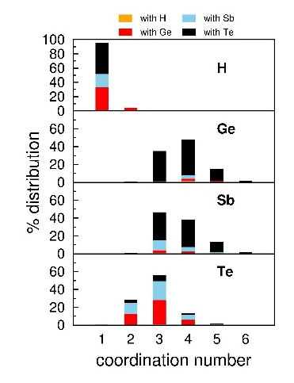
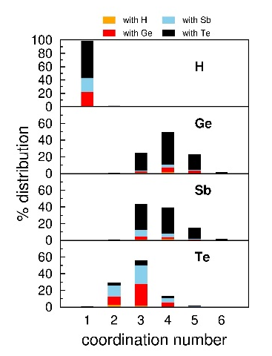
Ab-initio simulation (GST-225 + H)
Low (5%)
high (10%)
No significant prevalence of hydrogen bonded with Te but also with Ge and Sb: bonding fraction among Ge, Sb Te is roughly similar to composition, suggesting similar bonding energy.
Hydrogen presence:
Ge: increased coordination (3-coordination down, 5-coordination up)
Sb: decreased coordination (3-coordination up, 4-coordination down)
Overall Ge+Sb coordination increase => more wrong bonds (Ge/Sb-Ge/Sb), especially Ge-Ge.

Slide 3
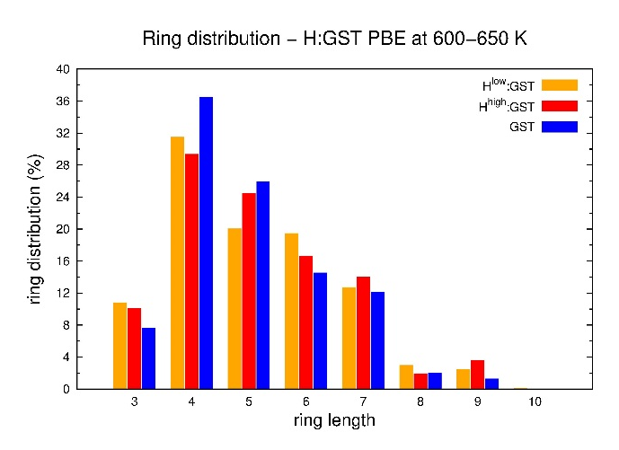
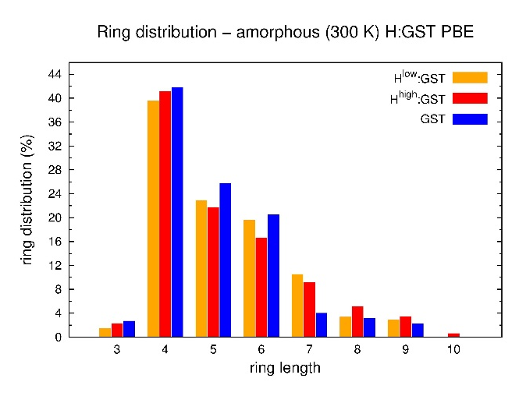
Ab-initio simulation (GST-225 + H)
liquid
amorphous
overall liquid and amorphous ring structure (including the 4-rings) is not weakly modulated by H presence, as well tetrahedral Ge fraction: embryo distribution modification seems not to be the root cause for crystallization speed degradation (nucleation should be not an issue)
Further calculation are on-going to evaluate Eg, energy barrier and crystalline/amorphous states energies, as other possible factors for crystallization speed modulation (i.e. how much does it cost to separate H from Ge and Sb to enable crystal structure?).

