Slide 1
FIB Preparation and TEM analysis of SXP Samples
SXP Team of Micron TEM Lab
(Prepared by John Jin, Feb 21, 2017)

Slide 2
Part 1: Sample Preparation using FIB
Radiation damage caused by focused ion beam
Composition change due to preferential FIB milling
Artifacts caused by localized charging effect
Artifacts caused by heating effect
Proposed sample preparation procedure for SXP samples

Slide 3
Radiation damage caused by focused ion beam
The FIB milling not only removes surface material but also leads to ion implantation and causes severe radiation damage to the remaining bulk of the material.
The damage layer is in the form of complete amorphization for covalent materials such as Si and PM materials used for SXP memory cells.
This radiation damage not only occurs when ions impinge at normal incidence onto the sample top surface but also occurs when ions mill the sample sidewall at glancing angles of <1º. While the top surface can be protected by sacrificial layers, the sidewall damage is generally inevitable, but can be reduced.

Slide 4
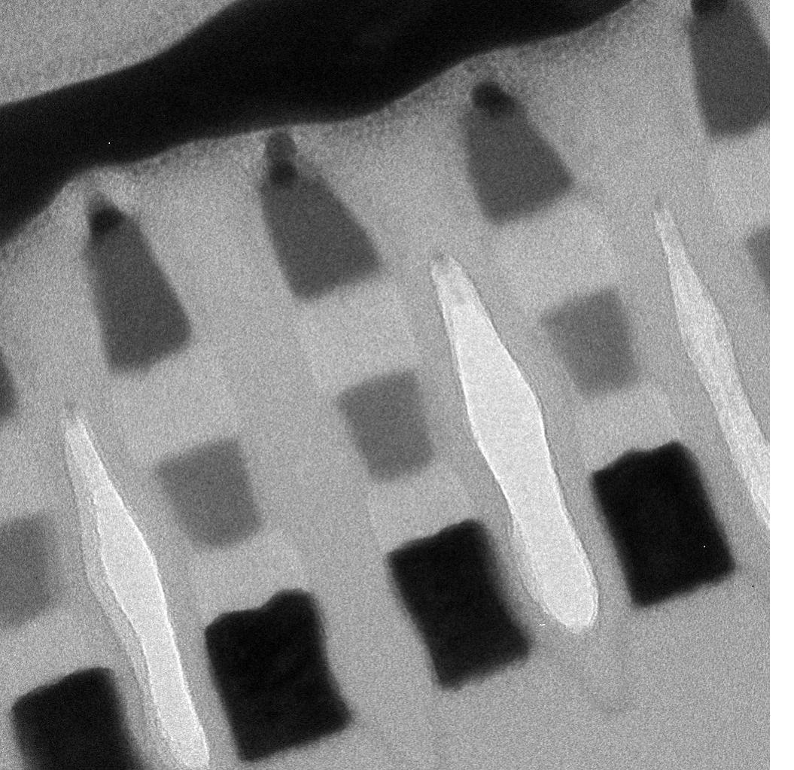
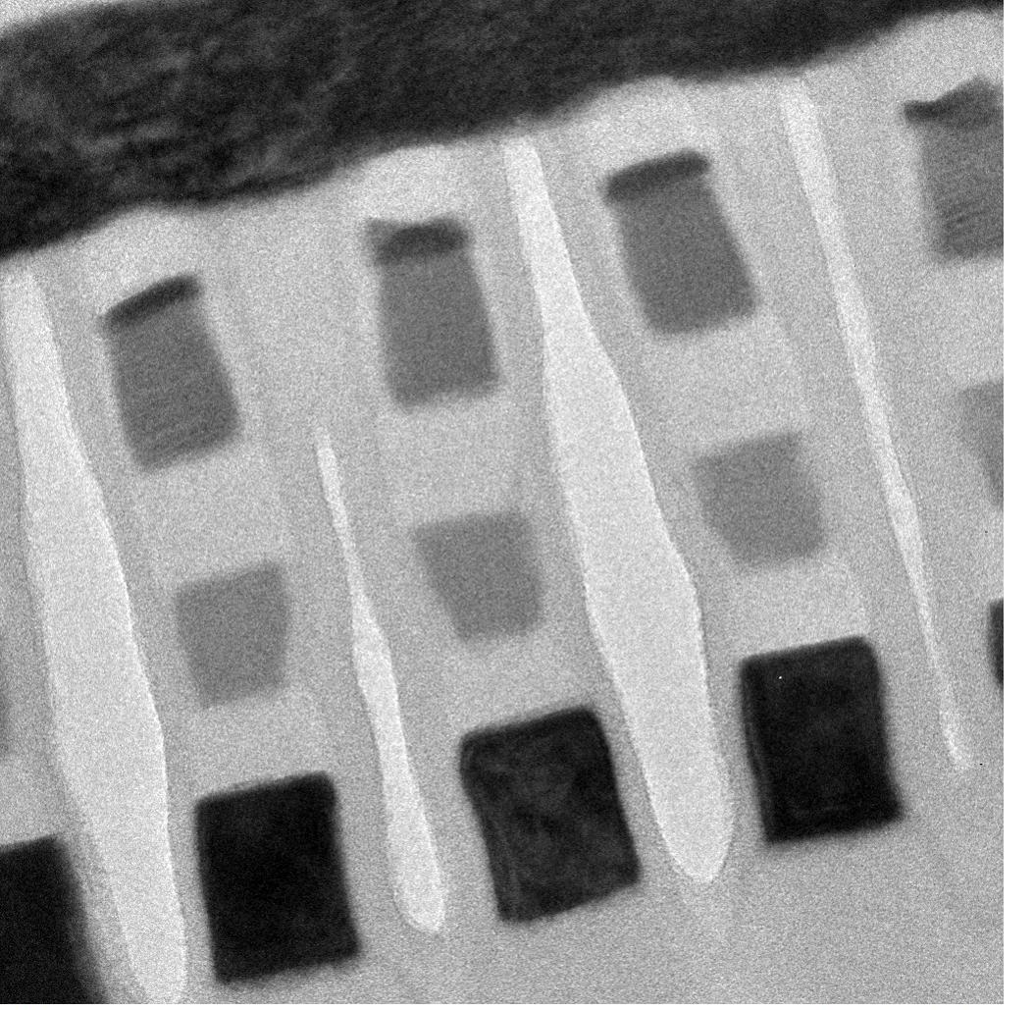
Top surface damage with direct I-beam Pt deposition
W bitline
W bitline
C
PM
W lamella
C
SD
C
20 nm
20 nm
Top surface damaged: Direct I-beam Pt deposition
Well protected: E-beam TEOS, E-beam Pt and I-beam Pt deposition
Without thick enough layer(s) above the area of interest, the feature of interest can be easily damaged if I-beam Pt is directly deposited as protective layer.

Slide 5
Sidewall amorphization of PM materials caused by FIB milling
STEM
Amorphous damage layer
STEM
Amorphous damage layer
STEM
Amorphous damage layer
16 nm
6 nm
28 nm
Crystalline PM
Crystalline PM
Crystalline PM
FIB finish at 30kV, 40pA
FIB finish at 16kV, 23pA
FIB finish at 5kV, 7pA
The sidewall damage layer thickness mainly depends on the voltage used in final milling. The higher the voltage, the thicker the amorphous damage layer, roughly 1 nm per 1kV.
Compared with the voltage, the FIB current plays a minor role in determining the damage layer thickness.

Slide 6
Key learning from radiation damage
Sidewall radiation damage in FIB milling causes surface amorphization of crystalline PM cells and milling at high kV (>10kV) could change crystalline PM cells (~20 nm thick) into 100% amorphous phase.
For current FIB tools, 5kV final milling or subsequent low angle Ar milling is recommended to reduce the damage.
Further reduction of the radiation damage would require even lower kV for final milling. The new generation FIB is capable of milling at 500V, which significantly reduces damage layer to <1nm each side.

Slide 7
Composition change due to preferential FIB milling
Preferential FIB milling refers to different milling rate for atoms of different types due to their different response to the incident Ga ions.
The result of preferential milling is that the sample material will not be milled stoichiometrically. Thus the composition near the surface is modified compared to the bulk composition.
When the sample is relatively thick (for example, a few rows thick), the composition change near the surface may not have obvious effect on the overall composition of the PM and SD cells.
When the sample is vey thin (for example, single row samples as required for specific bit analysis), the surface composition change, if present, may have non-negligible effect on the overall composition analysis of both PM and SD cells.

Slide 8
Preferential milling experimental design
Front
side
Back
side
Front
side
Back
side
Dielectric material
Dielectric material
PM
PM
PM
PM
PM
PM
PM
PM
PM
PM
C
C
C
C
C
C
C
C
C
C
SD
SD
SD
SD
SD
SD
SD
SD
SD
SD
Sample thickness
Sample thickness
Single row sample
Partial row sample
Two types of TEM specimens were used to verify the preferential milling phenomenon. One is single row specimen which contains a whole row of memory cells sealed between dielectric material, and the other is called partial row specimen which has cell materials partially milled at least from one side of the specimen.
To achieve statistical significance, multiple specimens from adjacent locations of the same die are prepared to ensure enough number of bits for analysis.

Slide 9
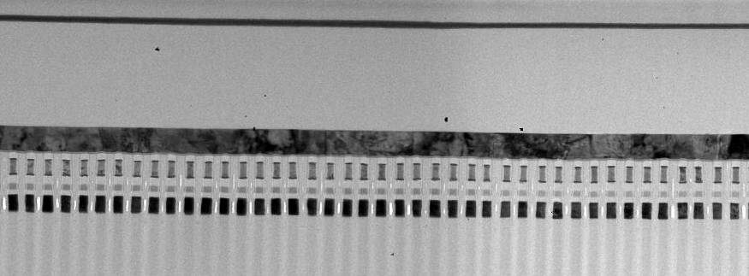
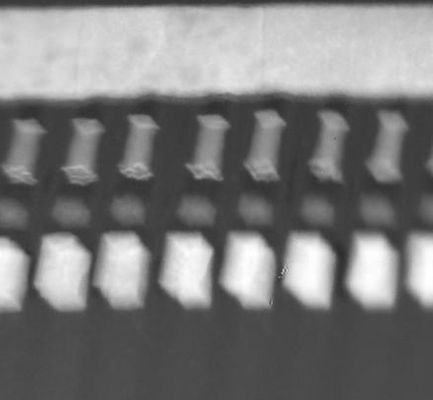
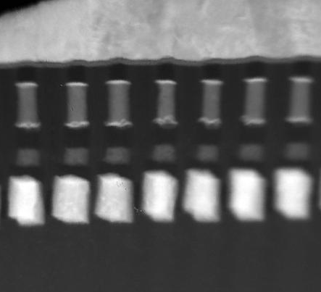
TEM sample preparation
BF TEM image
single row area
partial row area
DF STEM image
DF STEM image
100nm
100nm
Single row, specimen tilt 15º
Partial row, specimen tilt 15º
To avoid location variation of the composition, both single row and partial row specimens were prepared from the same membrane. Specimen was tilted about 15º to confirm the area having single row or partial row of memory cells.

Slide 10
End point control in FIB milling
Backscattered electron image (SEM)
Backscattered electron image (SEM)
bitline
bitline
1 μm
1 μm
Cut into dielectric material between cells
Cut into cell material
The key to successful sample preparation relies on end point control in FIB milling. This is achieved by using FIB marks and monitoring the obvious contrast change of backscattered electron image when the focused ion beam cut through the cell material or between the cells in the dielectric material.
For X-direction cut, bit line is used for image contrast monitoring and for Y-direction cut, word line is used for image contrast monitoring.

Slide 11
Comparison of composition analysis results
Mean values of PM and SD compositions obtained by averaging 10 bits per sample
PM
SD
Compared with single row sample, the partial row sample shows higher concentration of Ge in both PM and SD and lower concentration of Te and Se in PM and SD respectively. The result indicates that preferential sputtering occurs in both PM and SD.

Slide 12
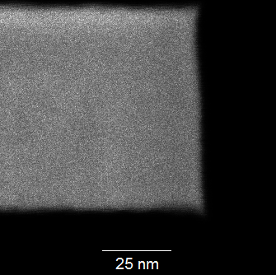
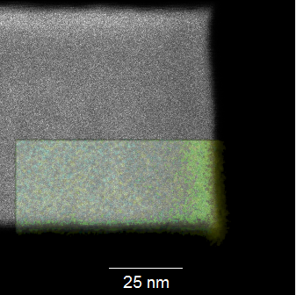
Direct observation of Ge enrichment in the damage layer
Ge/Te map overlay showing
Ge rich at the FIB milling surface
PM
EDS mapping area
Damage layer
The composition within the surface damage layer is modified mainly due to preferential sputtering of Te compared with other elements, resulting in increased Ge concentration near the FIB milling surface.

Slide 13
Chemical bond approach to structures of PM and SD
Compositions of PM and SD are simplified respectively as Ge₁₈Sb₂₇Te₅₅ and Ge₁₈As₂₇Se₅₅ based on experimental measurements of current PM version.
It is assumed that Ge bonds tetravalently, As and Sb trivalently, Se and Te divalently [1]
In covalently bonded random network model for glass structure [2], it is usually assumed that bonds between atoms of different type take place more easily than between the atoms of same type. Bonds between like atoms will then only occur if there is an excess of a certain type of atom. These bonds are formed in the sequence of decreasing bond energy until all available valences of atoms are saturated.
If stoichiometry permits, in PM, each Ge and Sb atoms are preferentially bonded to each other and they are also surrounded by Te atoms. Similar situation applies to SD when Sb and Te are replaced by As and Se respectively.
Te
Se
Ge
Ge
Sb
As
[1] J. BICERANO and S. R. OVSHINSKY, Journal of Non-Crystalline
Solids 74 (1985) 75-84
[2] W.H. Zachariasen, J. Am. Chem. Soc. 54 (1932) 3841.
PM
SD

Slide 14
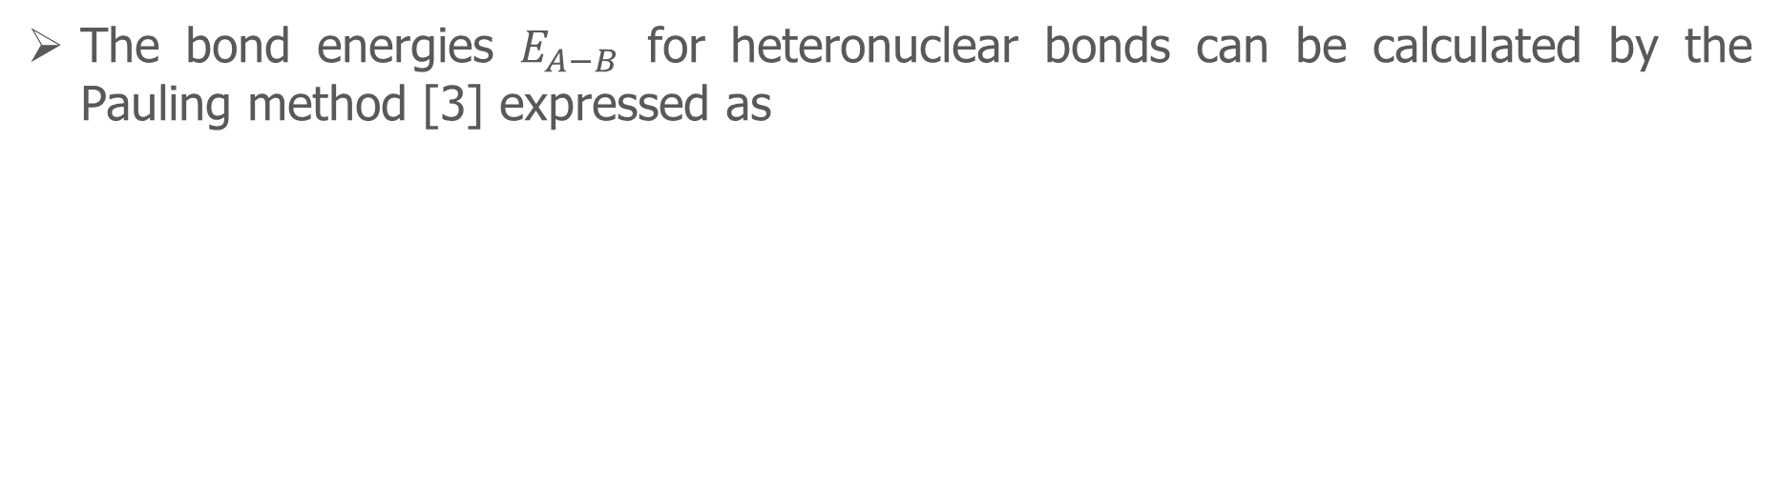
Bond energy calculation for PM and SD
The bond energies $E_{A−B}$ for heteronuclear bonds can be calculated by the Pauling method [3] expressed as
$E_{A−B}=(E_{A−A}∙E_{B−B})^{1/2}+30∙(χ_{A}−χ_{B})^{2}$
Homonuclear bond energy of atom A
Electronegativity of atom A
Calculated energies of expected bonds to occur in PM and SD
Homonuclear bond energies and electronegativity values can be found in [4]
[3] L. Pauling, The Nature of the Chemical Bond, 3rd ed. (Cornell University Press, 1960) p. 91.
[4] https://www.webelements.com/periodicity/enthalpy_atomisation/

Slide 15
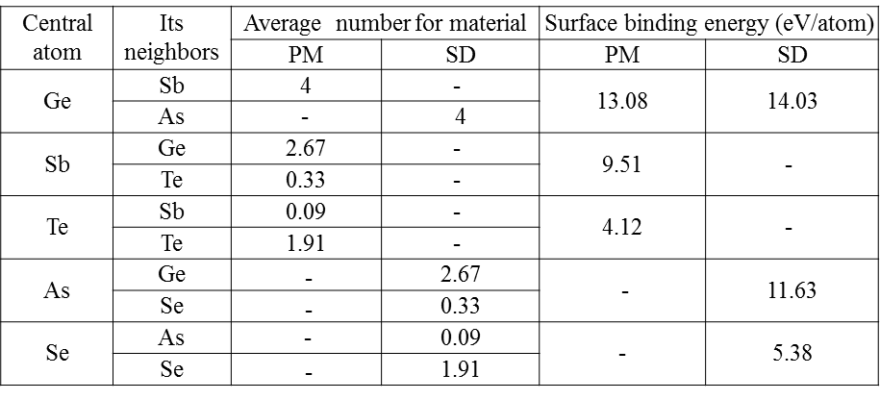



Surface binding energy calculation for PM and SD
The surface binding energy ($U$) of atom A may be calculated through the bond structure of the atom
$$U_{A}={\sum_{i=1}{X_{i}}E}_{A−B_{i}}$$
$X_{i}$: Average number of atom $B_{i}$ around atom A
$E_{A−B_{i}}:$Bond energy between A and B
Average expected number of neighbors and the surface binding energy

Slide 16
Explanation of the preferential milling in PM and SD
Milling (or sputtering) only occurs when the energy transferred from the incident Ga ion to the target atom near the surface exceeds a critical value, which is the surface binding energy.
Ge has the highest surface binding energy in both PM and SD, so the milling rate is expected to be lower than the other elements. The result is that Ge is enriched at the surface.
Te in PM and Se in SD have the lowest surface binding energy so that their milling rate is higher, leading to lower concentration of Te in PM and Se in SD in the surface region.

Slide 17

Key learning from FIB preferential milling
Dielectric material
PM
Layer of cells
Dielectric material
SD
Sample thickness
Desirable sample geometry
FIB preferential milling will affect the overall composition analysis of PM and SD cells.
Accurate composition analysis requires that the sample be prepared with memory cells sealed in dielectric material to prevent preferential milling. End point control is critical for successful sample preparation.

Slide 18
Localized charging created during FIB milling
Ion beam irradiation of poorly conducting materials may result in the trapping of charge within the irradiated specimen.
The degree of charging is influenced by a number of different processes including implantation, non-stoichiometric sputtering from compounds, secondary electron emission and trapping, secondary ion re-attraction and trapping, etc..
The localized residual charging, depending on its spatial distributions, can cause electric potential difference between different areas across the sample. This potential difference or electric field may drive migration of certain elements during FIB milling, causing structural or composition artifacts.

Slide 19
The Origin of Charge Build up during FIB Milling
Ga⁺
e⁻
e⁻
Solid
e⁻
Sputtered particle
The Sputtering Process and Ion-Solid Interaction
The charge build up is generally positive within the interaction volume due to the positive contribution from Ga ions and the release of secondary electrons.

Slide 20
Charge Distribution across a SXP Sample during FIB Milling
The charge distribution across a SXP sample depends on the local material and its geometry.
For metal line perpendicular to the sample thickness, the charge is likely built up continuously throughout the milling process.
For metal line embedded within the sample and parallel to the sample thickness, there may be no charge build up if the ion beam is not milling to the metal line. Even if the milling occurs to the metal line, the grounding post should be able to neutralize the positive charges through connecting to the Si substrate and the Pt protective layer.
For insulating filling materials (e.g., SiOx), the charge build up is limited to the surface region of a few nanometers in thickness.

Slide 21
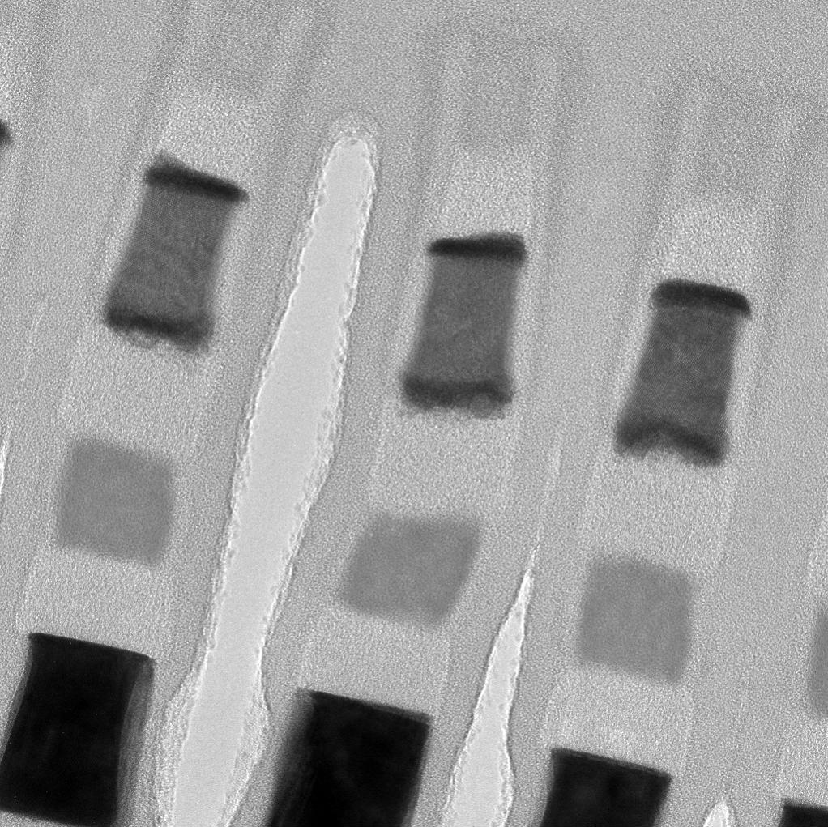
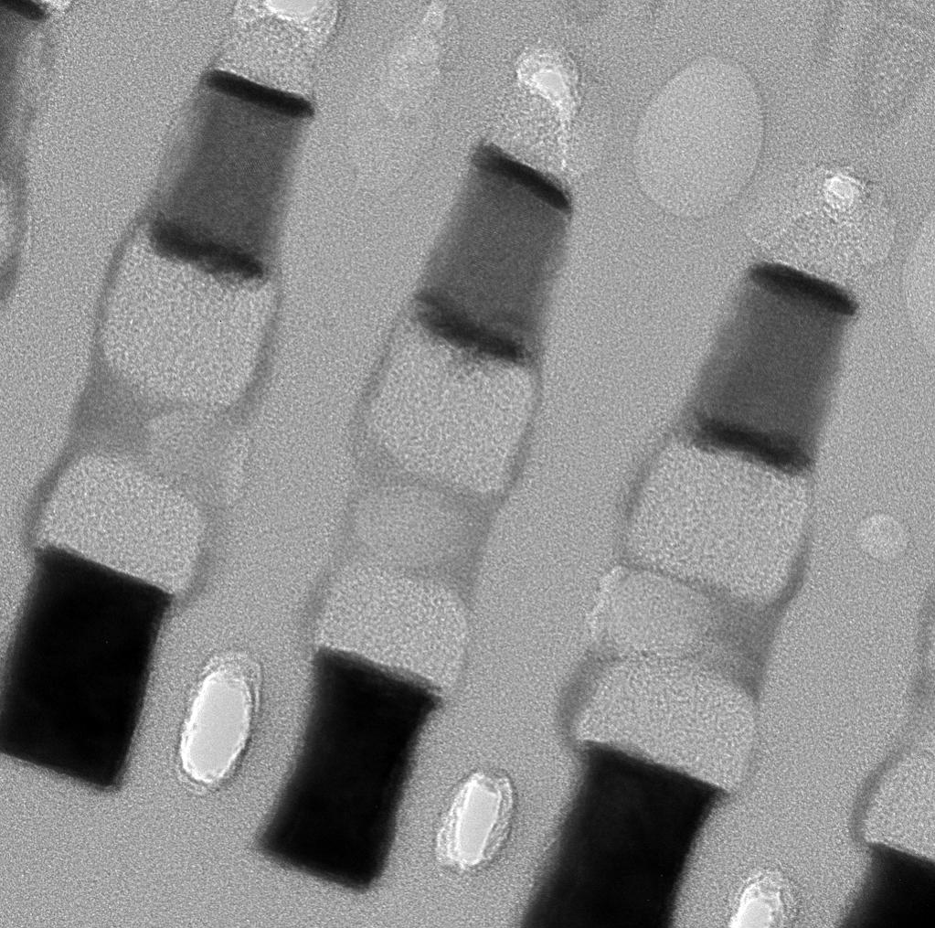
Structural damage caused by charging effect in FIB
Good
Bad
PM
void
SD
20 nm
20 nm
Sample prepared with grounding post
Sample prepared without grounding post
Without using a grounding post during sample preparation, structural artifacts were observed in TEM imaging such as voids in SD and element out-diffusion from SD along the sidewall of the cell stacks.

Slide 22
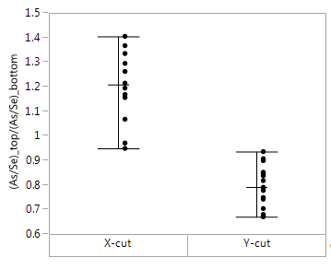
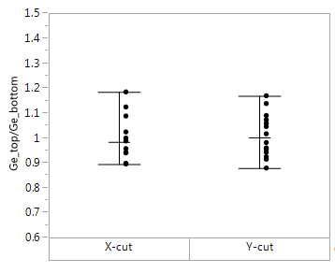
Cut direction dependence of elemental redistribution in SD
(TL160915004)
(TL160915004)
As, Se redistributed
Ge non-redistributed
There exists obvious difference between X-cut and Y-cut samples in terms of ratio of (As/Se)_top half/(As/Se)_bottom half.
Ge concentration is essentially no change between top half and bottom half, independent of cut direction of the sample.

Slide 23
Possible Explanation of the Elemental Redistribution in SD
+
+
+
+
+
+
+
+
E-field
+
+
+
+
+ + + +
- - - -
TE
E-field
SD
As
Ge
Se
As
Ge
Se
Se
As
- - - -
BE
+ + + +
As
Se
+
+
+
+
+
+
+
+
+
+
+
+
X-cut
Y-cut
The intuitive explanation is that an electric field is generated across SD (non-conducting) so that As is driven against the field and Se is driven along the field and Ge remains unaffected. X-cut and Y-cut create an electric field of different direction.
Consider that C electrodes and PM are all conductors, the memory cell structure can be simplified as an capacitor. Under an electric field, ionic movement is possible.

Slide 24
Explanation Based on the Atomic Structure of SD Material
Se
Ge
Central atom | Its neighbors | Average number | Binding energy (eV/atom)
Ge | As | 4 | 14.03
As | Ge | 2.67 | 11.63
 | Se | 0.33
Se | As | 0.09 | 5.38
 | Se | 1.91
Element | Electronegativity
Ge | 2.02
As | 2.2
Se | 2.48
As
Calculated based on Ge₁₈As₂₇Se₅₅
Even though SD has a covalent bonding instead of an ionic bonding, the electronegativity value determines more or less an atom has positively charged nature or negatively charged nature. As is more like positively charged and Se is more like negatively charged.
The Ge has the most positively charged nature, but the binding energy is the highest with the neighboring atoms, which may prevent it from moving under the electric field.

Slide 25
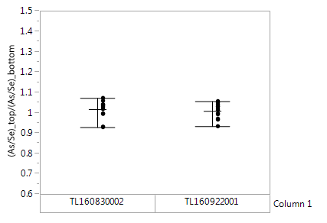
Blanket Wafer Structure
Pt deposition layer
Pt grounding post
TL160922001 (D1), grounded
TL160830002, grounded
For blanket wafer samples, the electrodes on either side of SD layer are connected so there is no electrical field formed. Thus, it is expected that no redistribution occurs for As and Se within SD, which is confirmed by experiment.

Slide 26
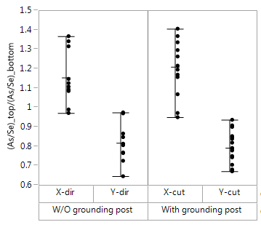
Patterned Structure: Case 1: TL160915004
Pt deposition layer
Pt deposition layer
+
+
+
+
+
+
+
+
Pt grounding post
Pt grounding post
X-cut, grounded
Y-cut, grounded
+
+
+
+
+
+
+
+
Si substrate
Si substrate
+
+
+
+
+
+
+
+
X-cut, not-grounded
Y-cut, not-grounded
+
+
+
+
+
+
+
+
For general single deck sample, both the X-cut and Y-cut will create electric field across SD, thereby causing As/Se redistribution, regardless if there is a grounding post or not.

Slide 27
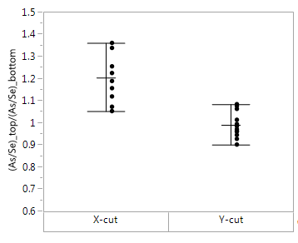
Patterned Structure: Case 2: TL160922001
Unpatterned W layer
Unpatterned W layer
Pt grounding post
Pt grounding post
+
+
+
+
+
+
+
+
+
+
+
+
X-cut, grounded, E-field formed
Y-cut, grounded, no E-field
Even with grounding post, the X-cut still forms E-field due to isolated WL while the Y-cut sample has the BL and WL electrically connected. So the Y-cut sample does not show As/Se redistribution within SD while X-cut does.

Slide 28
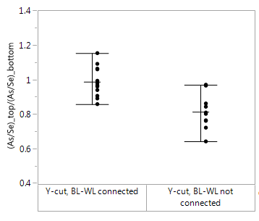
Patterned Structure: Case 3: TL160915004
Pt deposition layer
Pt grounding post
TL160915004
It is achievable to avoid elemental redistribution in SD caused by charging in FIB by de-processing to BL followed by e-beam Pt and WL and BL grounding.

Slide 29
Key learning from FIB charging effect
Pt deposition layer
BL
C
PM
Pt grounding post
C
SD
C
WL
Si substrate
To eliminate the charging effect, a Pt post is needed to connect the BL and WL to obtain equal potential across the SD cells.

Slide 30
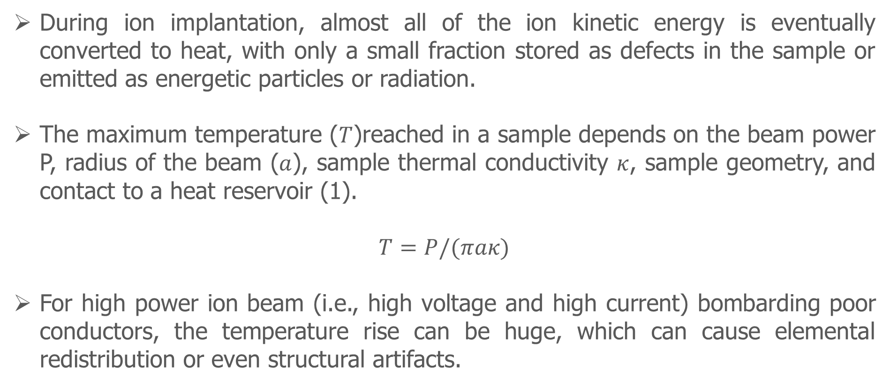
Heating effect during the FIB preparation process
During ion implantation, almost all of the ion kinetic energy is eventually converted to heat, with only a small fraction stored as defects in the sample or emitted as energetic particles or radiation.
The maximum temperature ($T$)reached in a sample depends on the beam power P, radius of the beam ($a$), sample thermal conductivity $κ$, sample geometry, and contact to a heat reservoir (1).
$T=P/(πaκ)$
For high power ion beam (i.e., high voltage and high current) bombarding poor conductors, the temperature rise can be huge, which can cause elemental redistribution or even structural artifacts.

Slide 31
Proposed sample preparation procedure for SXP samples
1. Wafer piece depressed to the BL level
2. FIB marks to identify a single row of array structure in the desired area.
3. Grounding post created
A hole of 1.5µmx1.5µm is milled 3µm deep into the sample from surface near the area
of interest using I-beam at 30kV, 0.43nA, then filled by Pt using I-beam at 30kV, 40pA.
4. Protective layer deposition
Protective layers of Pt are deposited with Pt overlapping with grounding post
The sequence of depositions (area: 10µm x2µm) are as follows:
(a) E-beam Pt: 3kV, 0.4nA, ~5min (~200 nm thick)
(b) I-beam Pt: 30kV, 24pA, ~5min (~400nm thick)
5. Lift-out and bulk milling
Lift out the area of interest using 30kV, 65nA.
Remove the lift-out and attach it to a dummy grid using ominiprobe
FIB mill the lift-out to ~500nm using 30kV, 2.5nA.
6. Final milling and cleaning
Use 16kV, 23pA for final milling to ~80nm followed by 5kV, 5pA milling/cleaning on both sides until the FIB marks show up.
FIB marks ensure the ending point to avoid preferential milling.
Grounding post to connect BL and WL to avoid charging effect.
5kV final milling to reduce radiation damage layer.

Slide 32
Part 2: TEM Analysis
PM crystallinity analysis
Radiation damage mechanisms in TEM/EDS analysis
Strategies for reducing beam damage in EDS analysis
Composition estimate for PM and SD cell materials
Si composition estimate in SD
O analysis in PM and SD

Slide 33
PM crystallinity analysis
The crystalline state of PM cells determines the resistance of the memory cells. Thus, it is important to understand the crystallinity of PM cells at various states including set, reset and partially set, etc.
There are several ways that can be used for crystallinity analysis of PM cells.
High-resolution TEM/FFT
STEM diffraction contrast dark-field imaging
Nano-beam diffraction mapping
TEM tableau dark field imaging
While each method mentioned above has its own advantages and disadvantages, TEM tableau method is recommended for full analysis of crystallinity of PM cells.

Slide 34
High resolution TEM/FFT method
PM
(amorphous)
PM
(crystalline)
HRTEM images and their FFT can be used to identify the crystallinity of PM cells.
The disadvantage of this method is that at a given sample tilt, only crystalline areas with favorable diffraction conditions will show lattice structure in the image or diffraction spots in FFT.

Slide 35
Crystalline/amorphous ratio estimate using HRTEM/FFT
11
12
13
The FFT patterns were obtained from the red square area (around 4nmx4nm) one by one in whole HRTEM image.
According to the FFT patterns, the crystalline and amorphous ratio can be estimated.
21
22
23
31
32
33
41
42
43
51
52
53
61
62
63
71
72
73
81
82
83
HRTEM image of a PM cell

Slide 36
STEM diffraction contrast dark field imaging method
Electron probe
Specimen
Scattered electrons
Annular dark
field detector
With an electron probe rastering across the area of interest and an optimum camera length in STEM mode, an annular dark field STEM image showing diffraction contrast can be formed to show crystallinity of the PM cells.
The disadvantage of this method is that at a given sample tilt, only crystalline areas with favorable diffraction conditions will show bright contrast in the image.

Slide 37
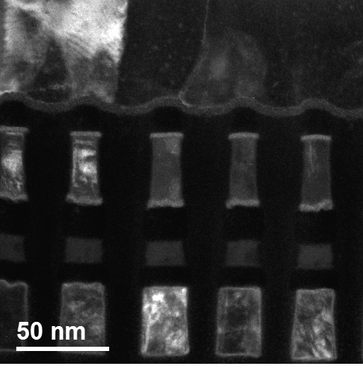

TEM tableau dark field imaging method
Electron beam
Optical axis
Click image and then press play button
below the image to watch the movie
δ = objective aperture angle
Specimen
θ
δ
θ = Zenith angle
Objective aperture
α = precession angle
α
φ = Azimuth angle
φ
With an objective aperture fixed in the center while the electron beam is tilted according to a pre-defined pattern (both θ and φ can be changed), a series of dark-field TEM images are formed.

Slide 38
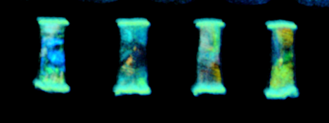
Crystalline/amorphous ratio estimate in TEM Tableau method
Overlay of DF images at different beam tilts
The crystalline/amorphous ratio can be estimated by using tableau DF images overlay. All the colorful areas will be counted as crystalline and black areas will be counted as amorphous.

Slide 39
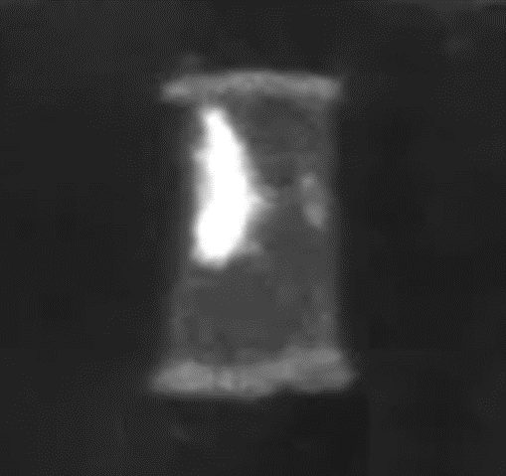
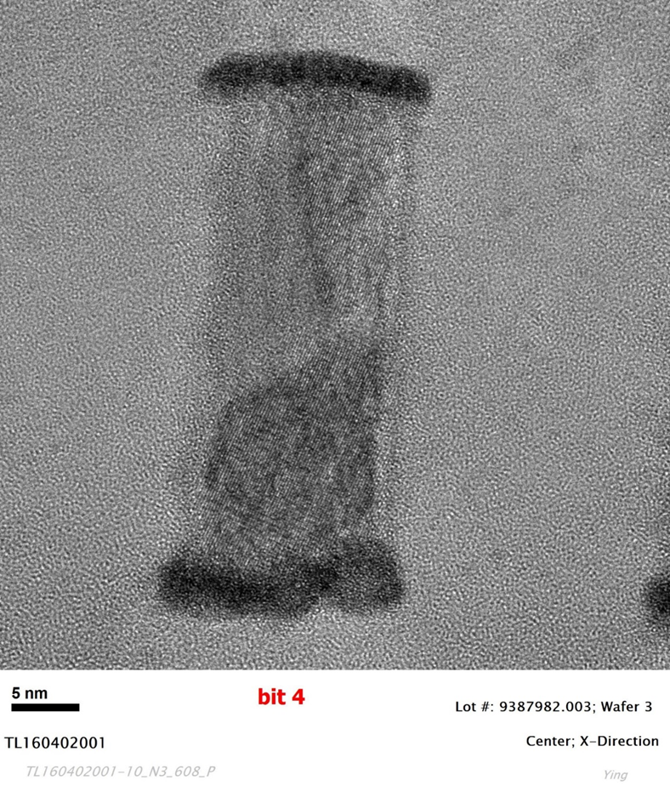
Comparison between HRTEM/FFT and TEM tableau DF
5 nm
One Tableau DF image
Corresponding HRTEM image
The area enclosed by red curves was shown as amorphous in the HRTEM image, but it shows as crystal in one Tableau DF image.
The reason is that this area is not in a favorable orientation at the condition for collecting HRTEM image.

Slide 40
Comparison between STEM DF and TEM tableau DF
Click image and then press play button
below the image to watch the movie
Bit 1
Bit 2
Bit 3
Bit 4
Bit 1
Bit 2
Bit 3
Bit 4
STEM DF image
TEM tableau DF image
At a given specimen tilt, STEM DF image does not provide complete information on crystallinity of PM cells.
Through a series of beam tilts, TEM tableau DF images can provide more complete information on PM crystallinity. For example, the apparent partially crystallized bits in STEM DF image (left) are actually fully crystallized as shown in TEM tableau DF images (right).

Slide 41
Comparison of various methods in PM crystallinity analysis
Analysis method |  | Tableau DF imaging | HRTEM/FFT | DF-STEM imaging | Nano-beam diffraction mapping
Capability to distinguish crystal/amorphous |  | Yes, crystals in favorable orientation show bright contrast in central DF images | Yes, crystals generate diffrcation spots in FFT from HRTEM images | Yes, crystals in favorable orientation show bright contarst in DF-STEM iamges | Yes, crystals in favorable orientation show diffrcation spots in nano-beam diffraction patterns.
Possibility to get qunatitative results |  | Yes, percentage of lightened area in tableau DF images overlay represents crystal ratio | Yes, percentage of the unit area with diffraction spots represents crystal ratio | Yes, percentage of lightened area in DF-STEM image represents crystal ratio | Yes, percentage of the unit area with diffrcation spots represents crystal ratio
Error analysis in qunatification | Overestimation (crystal ratio) | Yes, at the condition that PM includes crytstalline/amorphous overlapping areas | Yes, at the condition that PM includes crytstalline/amorphous overlapping areas | Yes, at the condition that PM includes crytstalline/amorphous overlapping areas | Yes, at the condition that PM includes crytstalline/amorphous overlapping areas
 | Underestimation (crytsal ratio) | No, the tableau DF images could cover the crystals by collceti9ng more central DF images | Yes, at the condition that the crystlas in PM are not in the favorable orientation with the HRTEM image | Yes, at the condition that crystals in PM are not in the favorable orientation in the DF-STEM image | Yes, at he condition that crystals in PM are not in the favorable orientation in the nano-beam diffraction pattern
 | Uncertainty (crystal ratio) | Yes, crystallization and amorphization in PM induced by TEM sample preparation | Yes, crystallization and amorphization in PM induced by TEM sample preparation | Yes, crystallization and amorphization in PM induced by TEM sample preparation | Yes, crystallization and amorphization in PM induced by TEM sample preparation
Radiation damage |  | low | low | low | High
data collection for 4 bits |  | 20-30 minutes | 10 minutes | 10 minutes | N/A
data processing time for 4 bits |  | 30 minutes | 15-20 minutes | 15-20 minutes | N/A

Slide 42
Summary on PM crystallinity analysis
HRTEM/FFT method provides a quick way to estimate the crystalline/amorphous status, but it may overestimate (amorphous/crystal overlapping area) and underestimate the crystal ratio (crystal which is not in favorable orientation).
Diffraction contrast DF-STEM images provide another quick way to examine the crystalline/amorphous status of PM cells. However, this method can not show all the crystals of PM even at optimum imaging conditions by adjusting the sample tilt and camera length and apertures.
Nano-beam diffraction mapping is capable of crystallinity analysis, but this method may cause unacceptible beam damage to subsequent analysis and fail to recognize crystal areas due to unfavorable orientations.
TEM Tableau DF imaging is considered as the best among the various methods in PM crystallinity analysis. By acquisition of a series of DF images, all crystalline areas in a PM cell can be identified.

Slide 43
Radiation Damage Mechanisms in TEM/EDS Analysis
Electron-radiation damage
Electron-nucleus scattering
Electron-electron scattering
Atomic displacement
Heating
Knock-on
E-beam sputtering
Charging
Atomic displacement
Radiolysis
Atomic desorption
Radiation damage is caused by either elastic or inelastic scattering of the incident electrons with the sample material.
Heating is generally insignificant since temperature increase in most cases is at most a few degrees.

Slide 44
Proposed Damage Mechanisms for SXP Materials
For conducting PM materials, the dominant radiation damage mechanism is knock-on damage.
For non-conducting SD materials, the dominant damage mechanisms depend on the composition and structure of the SD materials.
For SD1 with only Ge, As and Se, the observed experimental phenomena suggest that the damage mechanism is mainly radiolysis (or ionization) damage.
For SD delta with Si, Ge, As and Se, the observed experimental phenomena suggest that the damage is mainly caused by electro-static charging.

Slide 45
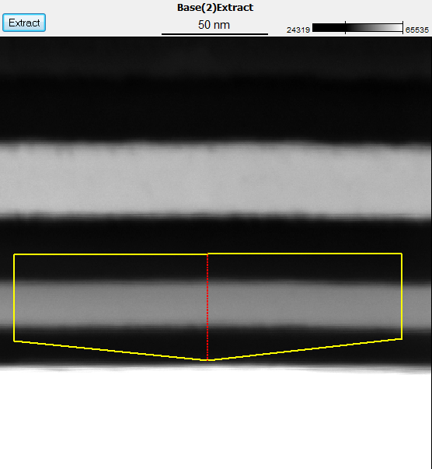
EDS line scan across SD1 layer in a blanket wafer sample
(200kV, TL131023001)
PM
SD
Vertical line scan profile shows no elemental redistribution during STEM/EDS analysis

Slide 46
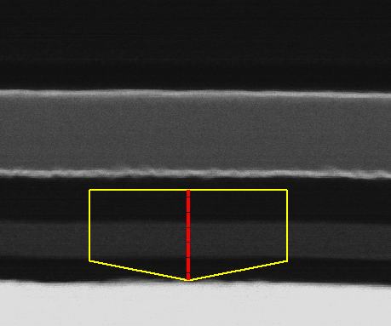
EDS line scan across SD delta layer in a blanket wafer
(200kV, TL150209001)
PM
SD
EDS line scan indicates that As and Se move to the SD/C interfaces and Si and O move to the center of SD layer while there is essentially no movement for Ge atoms.

Slide 47
EDS elemental maps for SD delta in a blanket wafer
O map
Si map
In map
Sb map
Te map
As map
Ge map
Se map
EDS maps show that As and Se move to the SD/C interfaces and Si and O move to the center of SD layer while there is essentially no movement for Ge atoms.

Slide 48
EDS elemental maps for cells using SD delta
O map
Si map
In map
Sb map
Te map
Ge map
As map
Se map
EDS maps show that As and Se move to the edge and Si and O move to the center of SD cells while there is not much change for Ge atoms.

Slide 49



Electrostatic charging during TEM analysis
Illuminated area
Illuminated area
$$E_{p}=\frac{ρ}{4πε_{0}ε_{r}r_{p}}$$
r_{p}
+
+
+
+
+
$$I_{A}$$
(Attracted electrons)
+
t
$$I_{E}$$
+
(Secondary and Auger electrons)
$$dρ/dt=I_{E}−I_{A}$$
TEM specimen
Illuminated area in STEM analysis can be considered as a nano-column with positive charges. These positive charges come from emission of secondary and Auger electrons, which can be compensated by the electrons attracted towards the illuminated area based on Ohm’s law.
The charge accumulation is determined by the beam intensity, dwell time and resistivity of the material being analyzed.

Slide 50
Effect of electron dose on elemental redistribution
of a blanket wafer sample
2 nA, 5 frames
2 nA, 10 frames
2 nA, 50 frames
0.2 nA, 50 frames
0.2 nA, 100 frames
0.2 nA, 500 frames
Vertical line scan across a SD delta layer in a blanket wafer sample
The SD beam damage during EDS mapping seems to be controlled by the electron dose only.
Small beam current seems to have negligible effect on reducing the beam damage in SD.

Slide 51
Effect of electron dose on elemental redistribution
of a patterned sample
As map
Emission current 5μA, 10 frames
As map
Emission current 13-14μA, 10 frames
As map
Emission current 13-14μA, 51 frames
The magnitude of elemental redistribution (e.g., As) during EDS mapping increases with the
electron dose.

Slide 52
Effect of using cold stage on beam damage
20 frames
(50us dwell time, 200kV)
50 frames
(50us dwell time, 200kV)
100 frames
(50us dwell time, 200kV)
150 frames
(50us dwell time, 200kV)
Room temperature
Room temperature
Room temperature
Room temperature
-180ºC
-180ºC
-180ºC
-180ºC
Structural damage of SD is controlled by electron dose.
The use of cold stage to cool down the specimen does not seem to help reduce the damage.

Slide 53
Key learnings from radiation damage of SXP materials
Radiation damage in SXP samples causes both elemental redistribution and structural distortion especially for SD materials.
This radiation damage seems to be mainly controlled by the electron dose. Within the current beam intensities used for analysis, the effect of dose rate seems negligible.
Decrease in specimen temperature does not seem to help reducing the beam caused damage.
Based on the proposed damage mechanisms, reducing the beam voltage is likely to help reducing the knock-on damage on PM, but may not help in reducing the damage on SD since the latter is controlled either by ionization damage or charging.
The key for SXP sample analysis is to maximize the signal while minimizing the electron dose.

Slide 54
Strategies for reducing beam damage in EDS analysis
Incident beam optimization
Lower TEM voltage
Increase collection efficiency
Maximize signal collection
Minimize beam damage
The ultimate goal is to get enough signal before the specimen is beam damaged.

Slide 55
Effect of lower TEM voltage
Estimated ratio of ionization cross section at 80kV and 40kV over that at 200kV
Elements | Si-K | Ge-K | As-K | Se-K | In-L | Sb-L | Te-L
Q₈₀/Q₂₀₀ | 2.01 | 1.74 | 1.72 | 1.70 | 1.94 | 1.93 | 1.92
Q₄₀/Q₂₀₀ | 3.29 | 2.33 | 2.27 | 2.21 | 3.04 | 3.00 | 2.97
The lower voltage increases interaction between incident electrons and specimen,
therefore generating more signals for a given specimen.
Using elements in SxP samples as an example, TEM operated at 80kV and 40kV can
increase the X-ray generation by 2 to 3 times compared to TEM operated at 200kV.
The lower voltage can reduce the knock-on damage in the specimen.

Slide 56
Experimental confirmation of beam voltage effect
Similar area of a pure Si sample (40 nm thick) was used to collect Si-K x-rays at both 80kV
and 200kV for the same electron dose.
The total x-ray counts at 80 kV is roughly twice of that at 200kV.

Slide 57
How to maximize X-ray collection?
Maximize x-ray collection
Increase the collection angle
Optimize the probe condition
Optimize the EDS collection process
Increase the collection angle. In our new ARM, two EDS detectors are installed, thus
double the collection angle, or collection efficiency.
Optimize the microscope operating parameters, looking for the best probe condition to
maximize the x-ray collection efficiency.
Optimize the EDS process time to achieve higher counts without sacrificing the energy
resolution.

Slide 58
Optimizing the probe condition
Test 1 on pure Si sample
Test 2 on a SxP sample
Similar area is used to evaluate the effect of various probe currents on total X-ray
counts collected over the same dose.
There exist optimum values for probe currents (100PA-250PA) which generate
maximum X-ray counts for the same dose.

Slide 59
Comparison of elemental distribution after EDS mapping
ARM-SF, dual SDD detectors operating at 80kV (new ARM)
ARM-CF, single SDD detector operating at 200kV (old ARM)
New ARM
Old ARM
For similar amount of x-ray counts collected, dual EDS detectors at 80kV in new ARM
shows significantly less damage than single EDS detector 200kV at 200kV in old ARM.

Slide 60
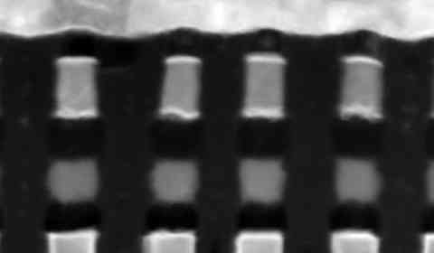
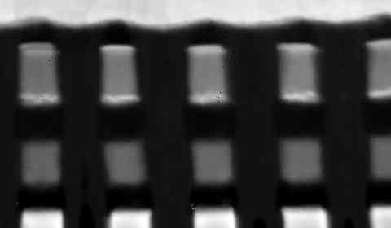
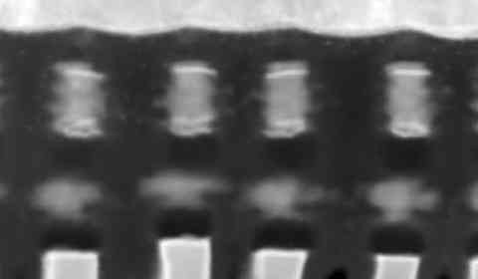
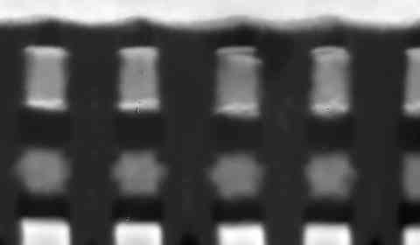
Comparison of e-beam damages after EDS mapping
ARM-CF, single SDD detector operating at 200kV (old ARM)
ARM-SF, dual SDD detectors operating at 80kV (new ARM)
Before EDS Mapping
After EDS Mapping
Total net counts: 269,985
Total net counts: 277,827
Note: Total net counts were calculated within the yellow box with the same elemental setting

Slide 61
Summary on strategies of SXP EDS analysis
Lower TEM voltage and increase in signal detection efficiency can solve the problems caused by continuously shrinking devices and beam sensitive materials introduced in new memory devices.
The new ARM with dual EDS detector operated at 80kV with optimum probe condition significantly reduces the beam damage. Compared with the old ARM with single EDS detector operated at 200kV with large but non-optimized probe, only ~1/5 of electron dose is needed to obtain the similar amount of x-ray counts.
For future TEM samples <10 nm, 30-40kV TEM is recommended to ensure enough signals are generated.

Slide 62
Composition estimate for PM and SD cell materials
Why using EDS for composition estimate of chalcogenide elements?
Disadvantage of using EELS
Choice of X-ray lines
Factors affecting the precision of composition estimate results.
Effect of box size used for composition estimate
Effect of elements involved in X-ray intensity calculations

Slide 63
Disadvantages of using EELS for composition estimate
The elements involved in composition analysis are heavily overlapped in EELS spectrum. Conventional background subtraction method is not suitable to extract the signals
The required dwell time for data acquisition is usually long enough to damage the sample significantly.
Even though the MLLS fitting method can be used to extract the signals, the reliability of fitting and the limited counts usually result in larger errors than EDS analysis.

Slide 64
Advantages of using EDS for composition estimate
Operation is simple and straightforward.
The commercial software is very mature in signal deconvolution and great progress has been made in recent years in terms of improving the multichannel pulse processor and increase the collection angle of the detector. The use of windowless detector also enables detection of light elements such as B.
The dwell time for EDS data collection can be very small (e.g., 1 us). This is helpful in reducing beam caused damage.
Data processing is straightforward with less inputs from operator. This ensures that the results are independent of the operator, which is critical for maintaining consistent results between different operators.
Composition estimates are possible since the results can be independent of the sample thickness if appropriate X-ray lines are chosen for quantification in the material system used for PM and SD.

Slide 65
Choice of X-ray lines for composition estimate
EDS composition estimates from same area of PM material
Correct choice of X-ray lines
Wrong choice of X-ray lines
X-ray lines used for quantification should be: Ge-K, As-K, Se-K, In-L, Sb-L and Te-L. These lines have comparable X-ray absorption within the specimen, independent of specimen thickness.

Slide 66
Effect of box size on composition estimate results
Box 7
Reliable data
PM cell
Box 1
Box 11
EDS is chosen to quantify chalcogenide elements (Ge, Sb, Te, As, Se) in SxP samples with appropriate X-ray lines used for each element.
To obtain reliable data, all elements having overlap with elements of interest are taken into consideration for peak deconvolution and the box size used for quantification has to be a few nanometer larger than the cell size.

Slide 67
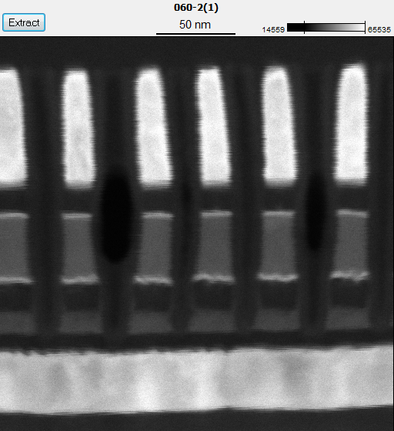
Effect of box size on contamination analysis: Se in PM
TL160419008
Element | Atom %
Ge K | 18.37
As K | 0.48
Se K | 1.36
In L | 3.51
Sb L | 27.16
Te L | 49.13
Total | 100
TL160419008
Element | Atom %
Ge K | 19.59
As K | 0.59
Se K | 0.55
In L | 2.67
Sb L | 26.43
Te L | 50.17
Total | 100
5 nm
5 nm
Larger box than the cell
Smaller box than the cell
Reliable analysis of Se in PM requires box size larger than the cells be used for quantification analysis (left). Experimental evidence was found that Se tends to segregate to the W/PM interface. The choice of the central part of PM only for contamination analysis would underestimate the Se concentration (right).

Slide 68
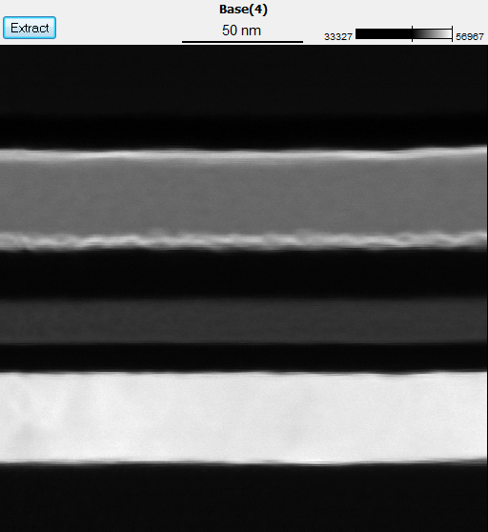
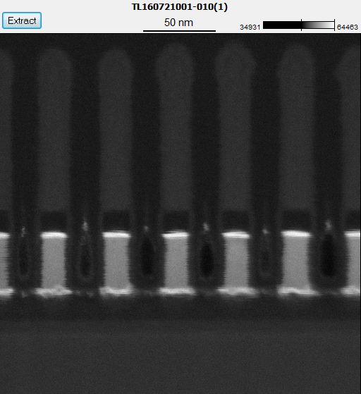
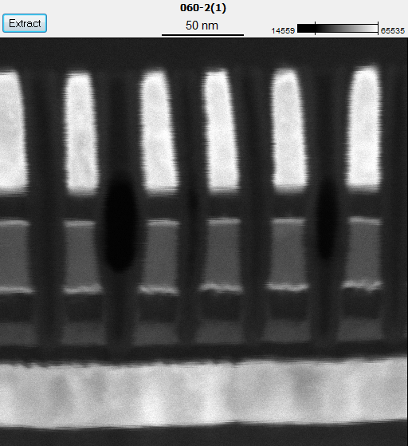
Does larger box size overestimate Se in PM?
Blanket wafer
PM only
PM and SD, patterned
TL150209003
Element | Atom %
Ge K | 23.15
As K | ---
Se K | ---
In L | 4.23
Sb L | 29.65
Te L | 42.97
Total | 100
TL160721001
Element | Atom %
Ge K | 21.54
As K | ---
Se K | ---
In L | 4.31
Sb L | 29.07
Te L | 45.08
Total | 100
TL160419008
Element | Atom %
Ge K | 18.37
As K | 0.48
Se K | 1.36
In L | 3.51
Sb L | 27.16
Te L | 49.13
Total | 100
50 nm
50 nm
50 nm
The composition analyses of blanket wafer and PM only samples show zero percent of Se in PM. This indicates that the Se presence in PM, if detected, of patterned PM+SD cells are real and caused by processing. The box size larger than the cell used for composition analysis would include the W lamella, which should not overestimate the Se contamination.

Slide 69
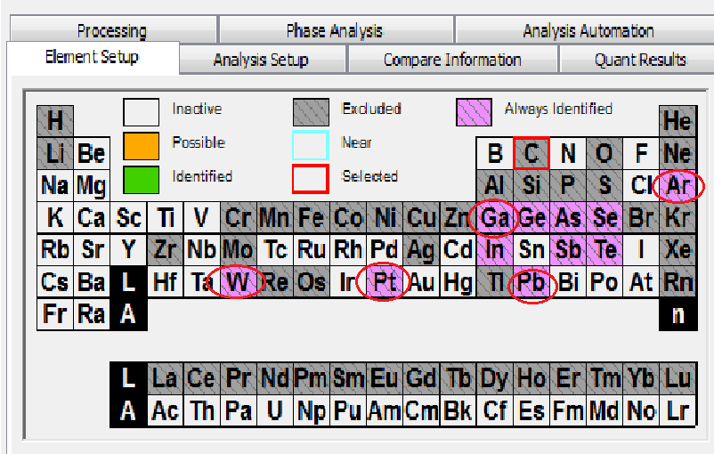
Selecting elements involved in X-ray intensity calculations
Although only six chalcogenide elements are required in composition estimates, all other elements present in the area of analysis (e.g., circled) which have peak overlap with these six elements are required to take into consideration when calculating the x-ray intensities of the six elements.

Slide 70
Example: effect of Ga and Pt on PM composition analysis
Without considering the Pt from protective layer deposition and Ga from Ga source, the results may not be reliable, especially when the Pt and Ga are high on sample surface.

Slide 71
Si quantification in SD delta for SxP samples
Si in SD can not be analyzed using EDS due to X-ray fluorescence effect.
Ge, As and Se are heavily overlapped in EELS analysis, which makes conventional EELS quantification difficult.
A new approach is developed to quantify the SD delta composition. Using EELS to obtain the Si atomic percent by treating the other elements as one single element SAG, then using EDS to get composition of Ge, As and Se.
In the above equation used for EELS analysis, is determined using conventional EELS method while Δ (3.947) is determined from calibration of a standard sample of known Si at%.

Slide 72
Examples of EELS analysis of Si in SD delta
TL141029004
TL141029005
SD (at.%) | Box 5 | Box 6 | Box 7 | Box 8
Si | 3.56 | 3.90 | 5.57 | 4.24
Ge | 12.83 | 12.79 | 12.56 | 12.74
As | 29.26 | 29.15 | 28.65 | 29.05
Se | 54.17 | 53.98 | 53.04 | 53.79
In | 0.00 | 0.00 | 0.00 | 0.00
Sb | 0.06 | 0.06 | 0.06 | 0.06
Te | 0.13 | 0.13 | 0.13 | 0.13
SD (at.%) | Box 5 | Box 6 | Box 7 | Box 8
Si | 4.91 | 5.90 | 3.56 | 4.24
Ge | 13.26 | 13.12 | 13.45 | 13.35
As | 28.96 | 28.66 | 29.37 | 29.16
Se | 52.82 | 52.27 | 53.57 | 53.19
In | 0.00 | 0.00 | 0.00 | 0.00
Sb | 0.04 | 0.04 | 0.04 | 0.04
Te | 0.01 | 0.01 | 0.01 | 0.01
TL141029007
TL141029008
SD (at.%) | Box 5 | Box 6 | Box 7 | Box 8
Si | 3.90 | 5.24 | 4.58 | 6.55
Ge | 13.55 | 13.36 | 13.45 | 13.17
As | 30.65 | 30.22 | 30.44 | 29.81
Se | 51.85 | 51.13 | 51.49 | 50.42
In | 0.00 | 0.00 | 0.00 | 0.00
Sb | 0.01 | 0.01 | 0.01 | 0.01
Te | 0.03 | 0.03 | 0.03 | 0.03
SD (at.%) | Bit 5 | Bit 6 | Bit 7 | Bit 8
Si | 7.19 | 7.51 | 8.14 | 7.82
Ge | 13.00 | 12.96 | 12.87 | 12.91
As | 27.21 | 27.12 | 26.93 | 27.02
Se | 52.01 | 51.83 | 51.48 | 51.66
In | 0.01 | 0.01 | 0.01 | 0.01
Sb | 0.06 | 0.06 | 0.06 | 0.06
Te | 0.51 | 0.51 | 0.51 | 0.51

Slide 73
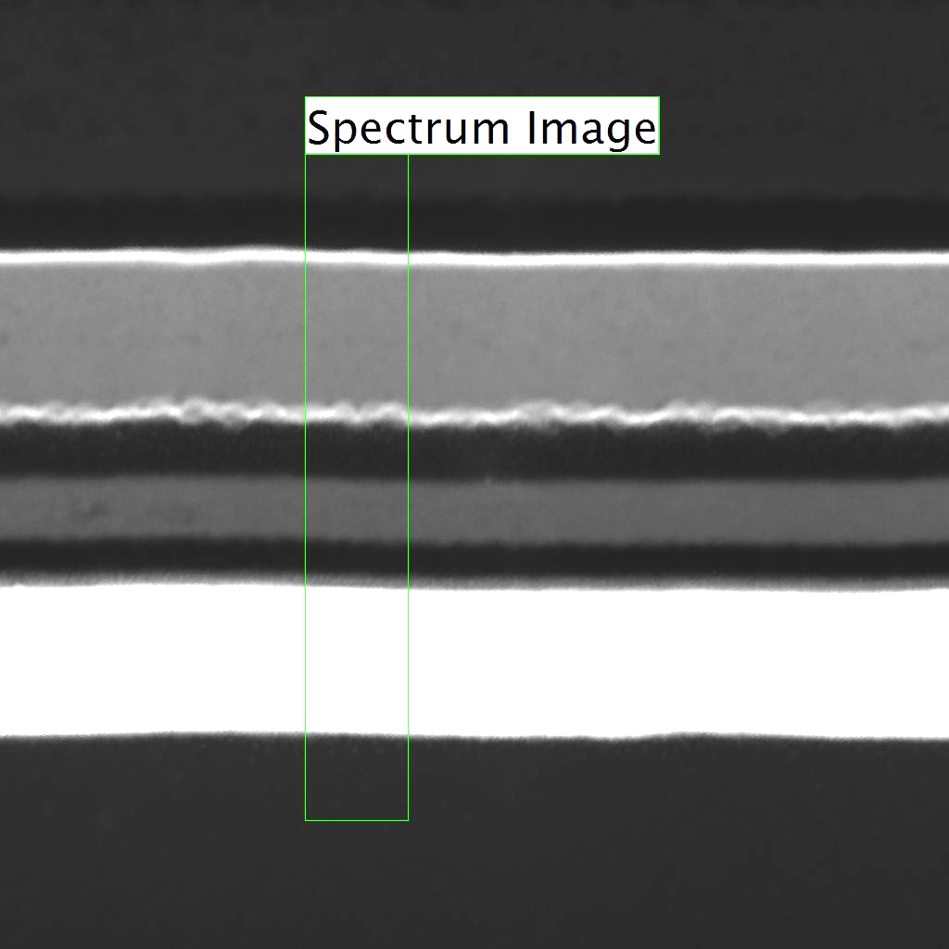
EELS analysis of O in PM
O-K
SiN
PM
SD
WSiNOx
SiO₂
O-K edge is superimposed at the onset of Sb-M_{4,5}.
When analyzing O in PM, the EDS results may not be reliable due to X-ray fluorescence effect. EELS can be employed for this type of analysis using a fresh TEM sample.

Slide 74
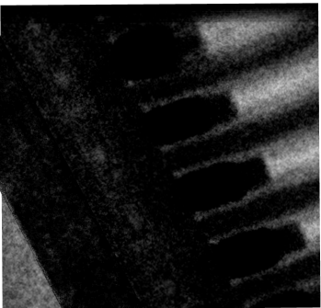
Analysis of O in SD using EFTEM/EELS
TEM image
O map
Si map
SD delta
SD delta
SD delta
EFTEM maps before EELS SI data collection
20 nm
TEM image
O map
Si map
SD delta
SD delta
SD delta
EFTEM maps after EELS SI data collection
20 nm
The combination of EFTEM/EELS can be used to analyze the presence and distribution of O in SD, assuming that EFTEM provides much less damage compared with EELS spectrum imaging.

Slide 75
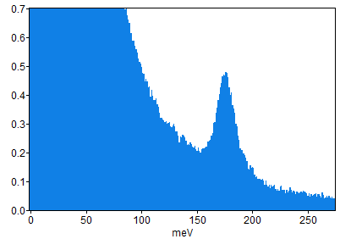
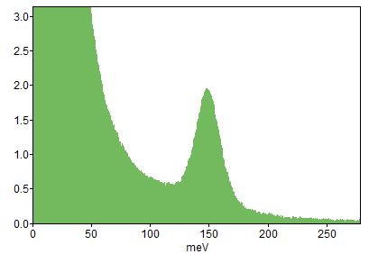
Exploring low loss EELS applications in SXP TEM analysis
The current EDS analysis has limitations in providing structural information on PM and SD.
The current EELS system does not have good enough energy resolution (~0.3eV to be best), which prohibits reliable low loss analysis that potentially provides structural and compositional information of PM and SD.
The ideal EELS system should have very high energy resolution (0.01eV) with enough currents so that certain low loss analysis can be conducted
Band gap map to measure crystalline/amorphous ratio in PM (no tilting needed)
Vibrational spectroscopy to measure structural change within SD.
Low loss spectrum can be collected with very short time (e.g., 0.001s or less dwell time) so that beam damage may not be an issue.
173
150
Top: Hexagonal BN with stronger bonds
Bottom: Cubic BN with weaker bonds.
Quentin Ramasse, Fredrik Hage (Daresbury SuperSTEM), Rebecca Nicholls (Oxford) and Keith Refson (Rutherford Appleton Labs)

