Slide 1
State of art about the TEM characterization of chalcogenides-based cells
Hefei Hu, Rohini Sankaran, Mary Alexander, Dan Baumbach, John Nugent
Intel Folsom TEM lab

Slide 2
Outline
Structural analysis by (scanning) electron diffraction
Detection of nucleation site (small nano-crystal)
Amorphous transition on dual deck
Analysis of amorphous diffraction ring
Determination of amorphous thickness by combing NBD and DF-STEM
EDX analysis of PM
Bit-level correlation (segregation and contamination)
Electrical distance (ED) dependent segregation
Challenge of EDX analysis of SD
FIB prep induced segregation in SD
Si% quantification in SD delta – planar view sample prep
Electron energy loss spectroscopy (EELS)

Slide 3
Structural analysis by electron diffraction - Phase identification

Slide 4
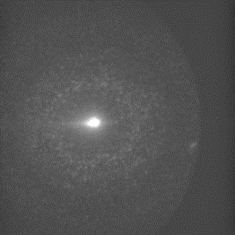
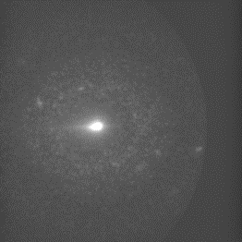
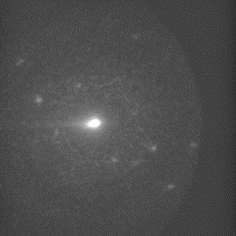
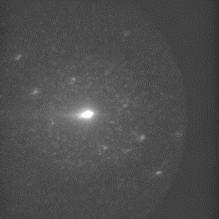
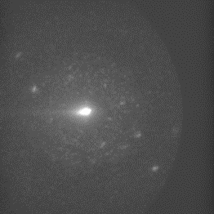
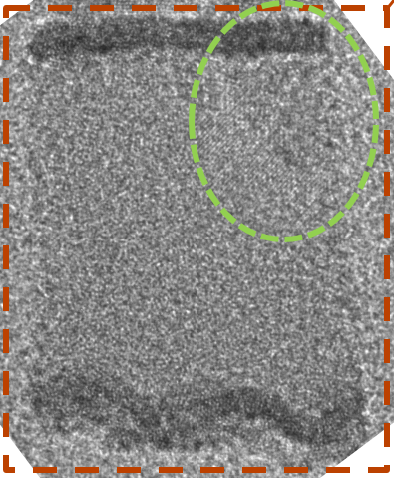
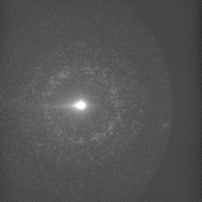
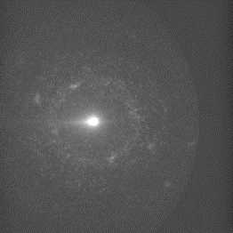

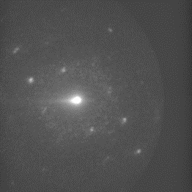
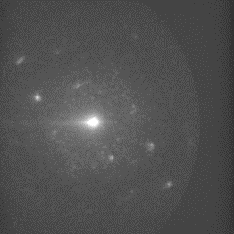
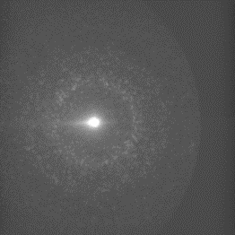


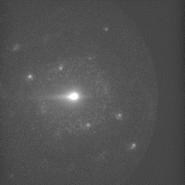
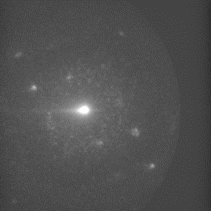
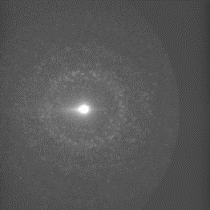
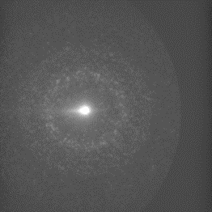

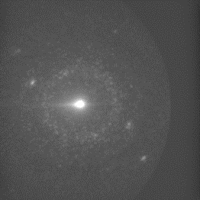
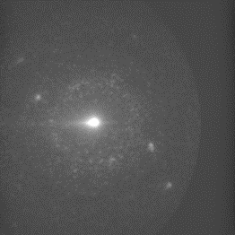


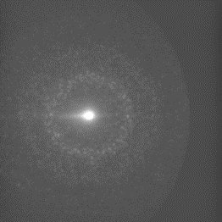



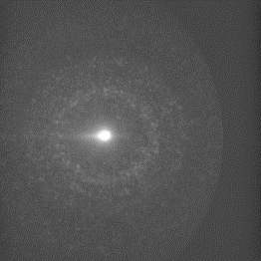

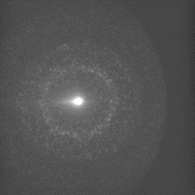
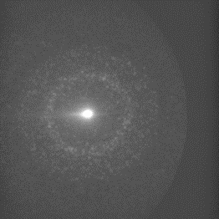
Detection of nucleation site
5nm probe size, scanning capability
Provides a definitive answer on crystallinity (compared to HRTEM)

Slide 5
Amorphous transition
2D0
2D1
2D0
2D1
+
-
+
-
W
TEC
Cooler
High Melting temperature
Te rich
Sb/Ge rich
Low Melting temperature
PM
Hotter
Low Melting temperature
Te rich
Sb/Ge rich
High Melting temperature
MED
SD
-
+
-
+
TEC
Hongmei/Yao-Feng
Thermal profile
Element
2D0 and 2D1 has opposite element segregation direction because of polarity.
However, the thermal profile in the PM are matched between decks because stack is matched.
5

Slide 6
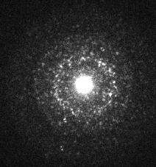
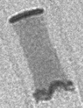
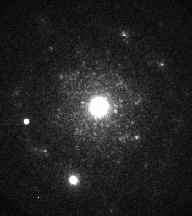
Amorphous transition
Amorphous start from Sb rich area for both decks.
2D1
2D0
2D1
2D0
2D1
2D0
2D1
-
+
-
+
+
-
W
TEC
Cooler
High Melting temperature
Te rich
Sb/Ge rich
Low Melting temperature
PM
Hotter
Low Melting temperature
Te rich
Sb/Ge rich
High Melting temperature
2D0
MED
SD
-
+
-
+
-
+
TEC
Hongmei/Yao-Feng
Thermal profile
Element
Amorphousizing
2D0 and 2D1 has opposite element segregation direction because of polarity.
However, the thermal profile in the PM are matched between decks because stack is matched.
6

Slide 7

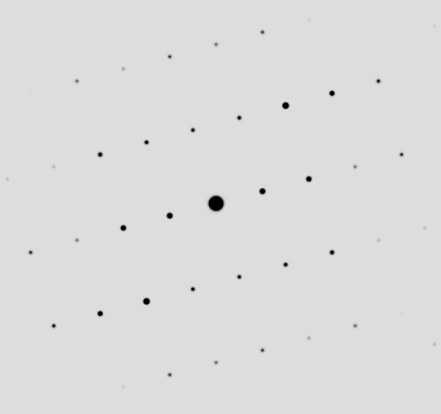
Phase identification
PFA-347 Group 3 FCC [3 -1 2]
PFA-302 sample 3 66 HCP [3 4 -2]
Simulation
d₂*
d₁*
d₂*
d₁*
Measured d₁= 1/d₁* = 1.38 Å (1 -3 -3)
Calculated d₁ = 1.38 Å, 0.0 % difference
Measured d₂ = 1/d₂* = 3.45 Å (-1 -1 1)
Calculated d₂ = 3.48 Å, 0.9 % difference
Measured d₁ = 1/d₁* = 3.354 Å (0 -1 -2)
Calculated d1 = 3.368Å, 0.4% difference
Measured d₂ = 1/d₂* = 2.087 Å (2 -1 1)
Calculated d2 = 2.097Å, 0.5% difference

Slide 8
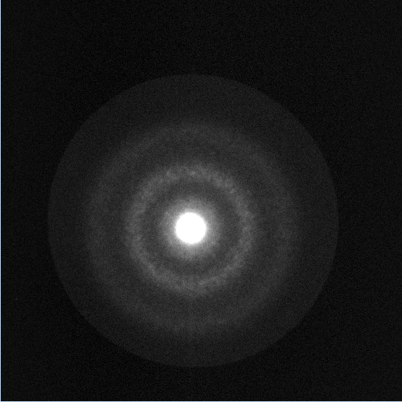

Quantitative analysis of amorphous rings
 | PFA number | Ge% | As% | Se% | Si%
SD1 | PFA-560 | 26.1 | 29.3 | 44.4 | 0
SD2 ver10 | PFA-591 | 15.4 | 29.9 | 48.3 | 6.5
SD1
Electron diffraction
SD v10
Electron diffraction

Slide 9
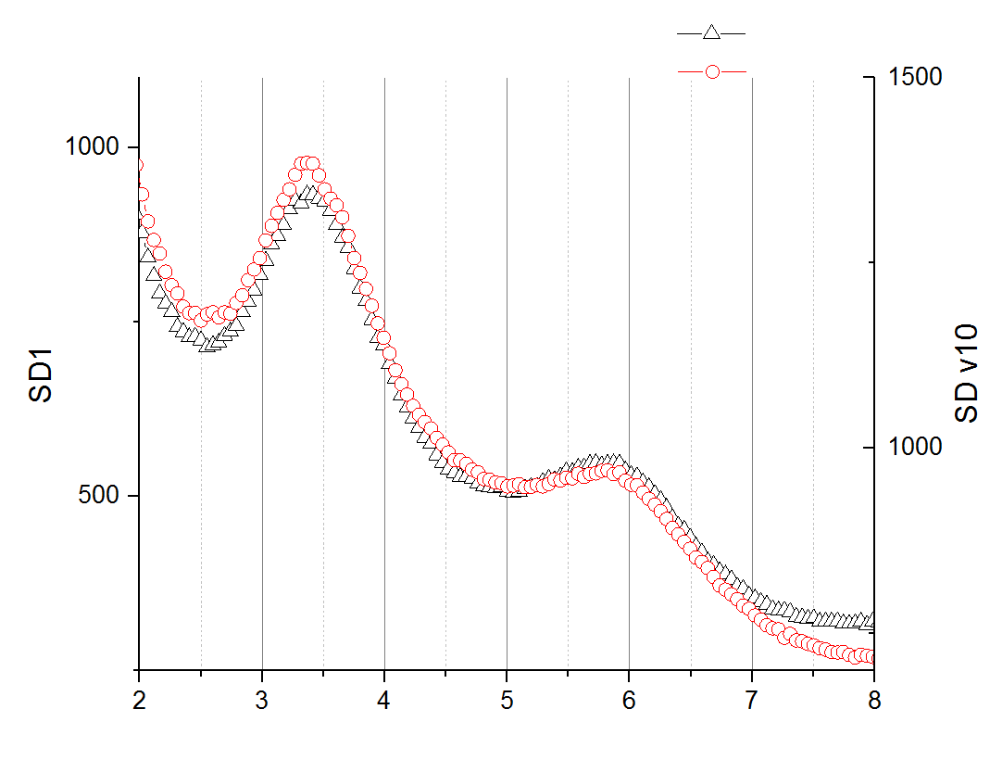
Quantitative analysis of amorphous rings
 | PFA number | Ge% | As% | Se% | Si% | Peak 1 (1/Å) | Peak2 (1/Å)
SD1 | PFA-560 | 26.1 | 29.3 | 44.4 | 0 | 3.43 | 5.81
SD2 ver10 | PFA-591 | 15.4 | 29.9 | 48.3 | 6.5 | 3.43 | 5.78
SD1
Electron diffraction
SD1
Peak 1
SD v10
Curve fitting:
background: exponential decay
Peak 1: Lorentzian function
Peak 2: Gaussian function
Peak 2
No obvious difference between SD1 and SD v10
SD v10
Electron diffraction
1/Å

Slide 10
Determination of amorphous thickness by combing NBD and DF-STEM

Slide 11
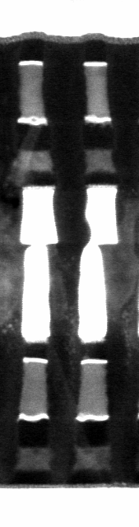
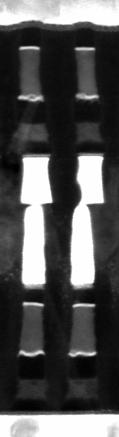
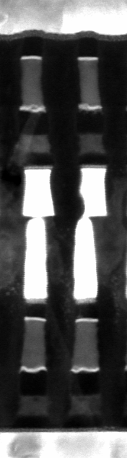
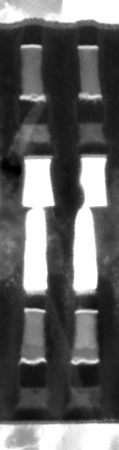
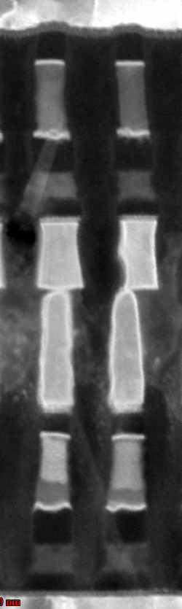
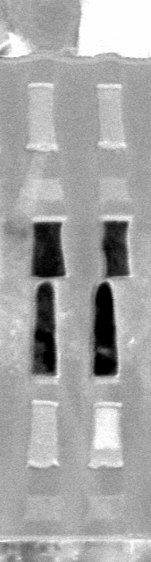
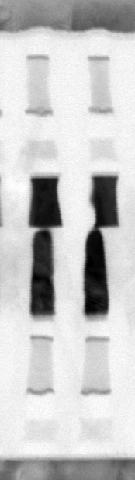
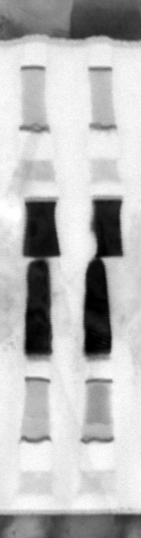
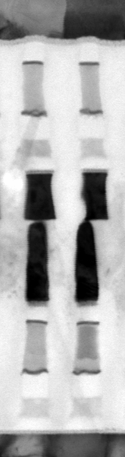
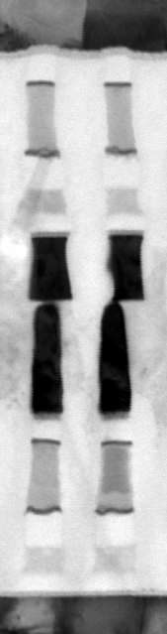
Optimization of camera length (tested on 4 partially crystalline/amorphous bits)
cl=150mm
cl=200mm
cl=300mm
cl=490mm
cl=680mm
cl=970mm
cl=1850mm
cl=3000mm
cl=4000mm
cl=4500mm
amorphous
amorphous
crystalline
crystalline
90 uA/0/(31)
90 uA/1e6/(30)
crystalline
amorphous
HAADF STEM – Z contrast
DF STEM – diffraction contrast
BF STEM – diffraction+thickness contrast
HAADF STEM provides difference in contrast only for bit 30 on 2D1 (cl 150mm), but not for the other 3 bits.
BF STEM provides some contrast difference between crystalline and amorphous phase, but thickness contrast washes it out a little bit.
DF STEM leads to better diffraction contrast, providing contrast difference for all the other 3 bits (cl 680mm)
cl 680mm was used to take DF STEM images for this sample.

Slide 12
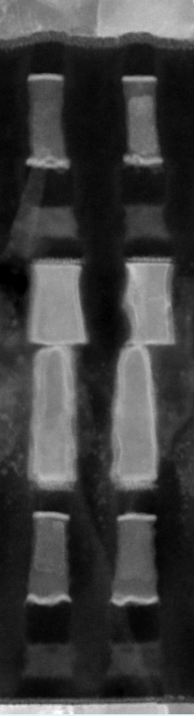
Orientation-dependent contrast of DF STEM images (cl 680mm)
No tilt
5° beta tilt
amorphous
amorphous
With cl 680mm at 5° beta tilt, the bit that doesn’t show contrast at zero tilt shows good contrast between amorphous and crystalline areas.
Tilt of 5°/10°/15° in beta direction and tilt of 10° in alpha direction were used to image all the bits
crystalline
crystalline
90 uA/0/(31)
90 uA/1e6/(30)
crystalline
amorphous

Slide 13
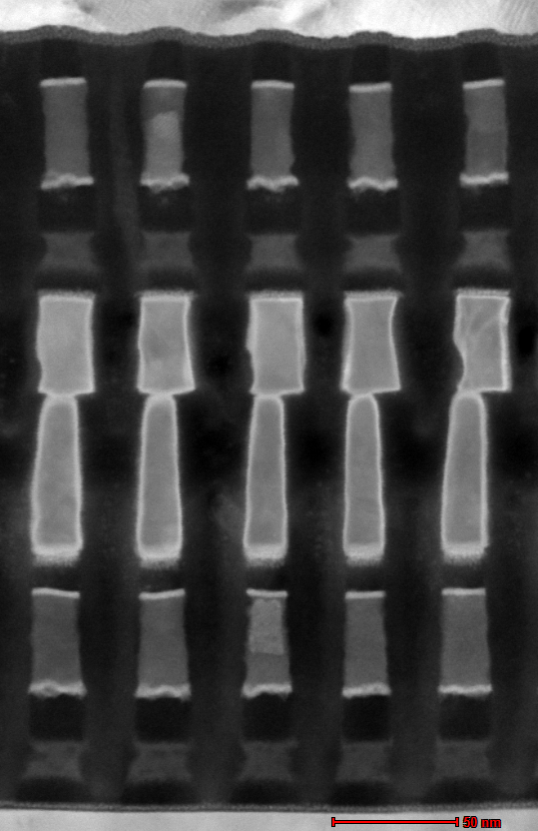

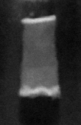
90uA
0
90uA
1e6
All the partially amorphous bits show clear contrast difference between amorphous and crystalline phases at different tilt angles.
Caution: either amorphous or crystalline phase could show brighter contrast than the other phase due to the nature of diffraction contrast (bit 07 vs bit 06 on the left image). Hence, scanning NBD is needed to provide determinate phase information (whether it’s crystalline or amorphous, and phase identification). NBD study of this sample can be found here: https://intelweb.micron.com/sites/sxp/10s/SXP%20Cell%20Sync%20Meeting/Intel%20TEM%20Folder/pfa-942/PFA-942%20FM%20TEM%20Report.pptx
Once phase information is determined by NBD, contrast of DF STEM can be correctly interpreted (whether it’s amorphous or crystalline). Amorphous thickness or fraction can be measured using DF STEM images.
10° tilt
124108
124107
124106
124104
c
a
5° tilt
c
a

Slide 14
EDX analysis of PM - Bit-level correlation (segregation and contamination)

Slide 15
Set probability PFA (LQ 54)
Wafer | Die | Partition | Slice | Tile | X_Addr | Y_Addr | Phys WL | Phys BL | Phys Slice | Phys Quat. Tile | set prob | Final State | npt
9423612.0D3 w23 | 1,10 | 12 | 2 | 3 |  |  | 207329 | 260577 | 50 | 250 |  | virgin
9423612.0D3 w23 | 1,10 | 12 | 2 | 3 | 89 | 67 | 207329 | 260578 | 50 | 250 | 0.65 | rst | LQ47FA_even.npt
9423612.0D3 w23 | 1,10 | 12 | 2 | 3 | 89 | 99 | 207329 | 260579 | 50 | 250 | 0.45 | set | LQ47FA_odd.npt
9423612.0D3 w23 | 1,10 | 12 | 2 | 3 | 89 | 68 | 207329 | 260580 | 50 | 250 | 0.65 | rst | LQ47FA_even.npt
9423612.0D3 w23 | 1,10 | 12 | 2 | 3 | 89 | 100 | 207329 | 260581 | 50 | 250 | 0.65 | set | LQ47FA_odd.npt
9423612.0D3 w23 | 1,10 | 12 | 2 | 3 | 89 | 69 | 207329 | 260582 | 50 | 250 | 0.85 | rst | LQ47FA_even.npt
9423612.0D3 w23 | 1,10 | 12 | 2 | 3 | 89 | 101 | 207329 | 260583 | 50 | 250 | 0.35 | set | LQ47FA_odd.npt
9423612.0D3 w23 | 1,10 | 12 | 2 | 3 | 89 | 70 | 207329 | 260584 | 50 | 250 | 0.25 | rst | LQ47FA_even.npt
9423612.0D3 w23 | 1,10 | 12 | 2 | 3 | 89 | 102 | 207329 | 260585 | 50 | 250 | 0.3 | set | LQ47FA_odd.npt
9423612.0D3 w23 | 1,10 | 12 | 2 | 3 | 89 | 71 | 207329 | 260586 | 50 | 250 | 0.5 | rst | LQ47FA_even.npt
9423612.0D3 w23 | 1,10 | 12 | 2 | 3 | 89 | 103 | 207329 | 260587 | 50 | 250 | 0.5 | set | LQ47FA_odd.npt
9423612.0D3 w23 | 1,10 | 12 | 2 | 3 | 89 | 72 | 207329 | 260588 | 50 | 250 | 0.15 | rst | LQ47FA_even.npt
9423612.0D3 w23 | 1,10 | 12 | 2 | 3 | 89 | 104 | 207329 | 260589 | 50 | 250 | 0.35 | set | LQ47FA_odd.npt
9423612.0D3 w23 | 1,10 | 12 | 2 | 3 | 89 | 73 | 207329 | 260590 | 50 | 250 | 0.25 | rst | LQ47FA_even.npt
9423612.0D3 w23 | 1,10 | 12 | 2 | 3 | 89 | 105 | 207329 | 260591 | 50 | 250 | 0.25 | set | LQ47FA_odd.npt
9423612.0D3 w23 | 1,10 | 12 | 2 | 3 | 89 | 74 | 207329 | 260592 | 50 | 250 | 0.2 | rst | LQ47FA_even.npt
9423612.0D3 w23 | 1,10 | 12 | 2 | 3 | 89 | 106 | 207329 | 260593 | 50 | 250 | 0.9 | set | LQ47FA_odd.npt
9423612.0D3 w23 | 1,10 | 12 | 2 | 3 | 89 | 75 | 207329 | 260594 | 50 | 250 | 0.35 | rst | LQ47FA_even.npt
9423612.0D3 w23 | 1,10 | 12 | 2 | 3 | 89 | 107 | 207329 | 260595 | 50 | 250 | 0.6 | set | LQ47FA_odd.npt
9423612.0D3 w23 | 1,10 | 12 | 2 | 3 | 89 | 76 | 207329 | 260596 | 50 | 250 | 0.55 | rst | LQ47FA_even.npt
9423612.0D3 w23 | 1,10 | 12 | 2 | 3 | 89 | 108 | 207329 | 260597 | 50 | 250 | 0.55 | set | LQ47FA_odd.npt
 |  |  |  |  |  |  | 207329 | 260598 | 50 | 250 |  | virgin
The shortest pulse was used
Each bit was tested for 20 times

Slide 16

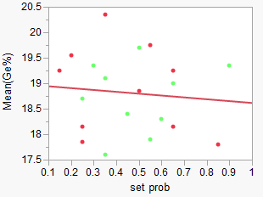
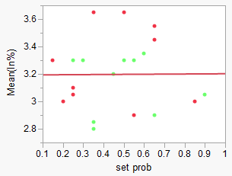
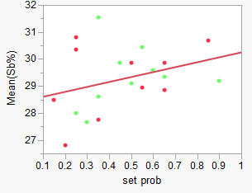
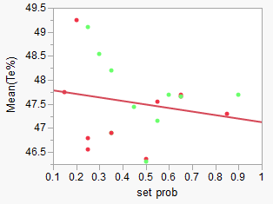
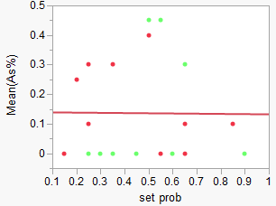
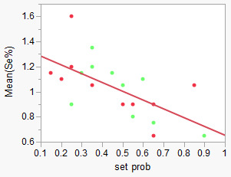
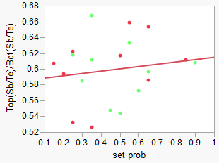
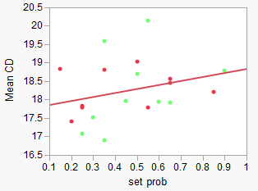
Set probability PFA (Set prob vs composition (LQ 54) )
Se contamination in PM shows correlation to SET probability.

Slide 17
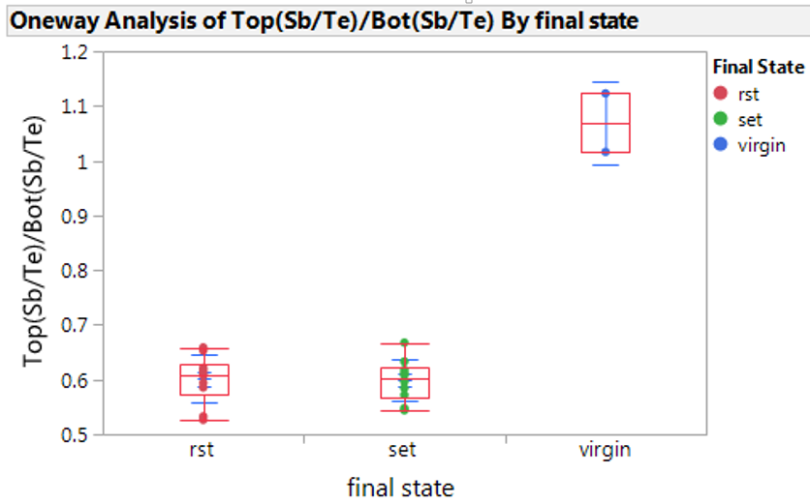
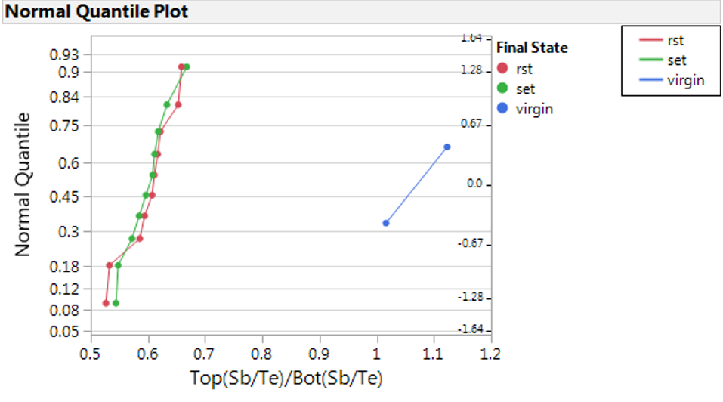
Set probability PFA (set vs rst (LQ 54))
Te/Sb occurs similar for set and rst.

Slide 18







T_{growth} PFA
Virgin + placement
PFA Result:
“Gradual” element segregation builds up for both decks from virgin to a few cycles. No significant difference between decks up to probe condition.
From probe to 1million cycle, D1 has larger segregation increase than D0
Test Result:
Growth time shows significant deck-to-deck difference in 1-2 cycles after virgin.
At probe condition, usually 30ns tgrow deck to deck difference
Crystallization 1-> 7
PFA 1029 Yao-Feng Rohini Hefei Lu Hongmei
E-test Result:
tgrow vs cycle from virgin
B
A
B
A
0: Virgin + test (reset + set + RO)

Slide 19
EDX analysis of PM - Electrical distance (ED) dependent segregation

Slide 20



PM segregation at NN/MM/FF on 2D0 and 2D1
Vt window seems to be anti-correlated to PM segregation index
FF has the smallest window, which is probably not seasoned properly. Trim by ED has been implemented.
Top vs bottom EDX analysis doesn’t show much difference at different ED.

Slide 21



PFA-942 sample 3 raw EDX linescan (2D0)
Ge
In
No flattop
Sb
8nm
Sb saturated
7nm
Sb saturated
Te
12 bits of each location (NN/MM/FF) on 2D0 are averaged to improve statistics.
On 2D0,
At NN/MM, Sb is found to be saturated in the area of 8nm/7nm from bottom W lamella.
At FF, Sb is not saturated at PM bottom, which can be explained by its larger electrical distance from the driver.
Sb saturation is consistent with Vt window. FF has the smallest window, which is probably not seasoned properly. Trim by ED has been implemented.

Slide 22



PFA-942 sample 3 raw EDX linescan (2D1)
Te saturated
7nm
Te saturated
4nm
No flattop
Ge
In
Sb
Te
12 bits of each location (NN/MM/FF) on 2D1 are averaged to improve statistics.
On 2D1,
At NN/NN, Te is found to be saturated in the area of 7nm/4nm from bottom W lamella.
At FF is not saturated at PM bottom, which can be explained by its larger electrical distance from the driver.
Te saturation is consistent with Vt window. FF has the smallest window, which is probably not seasoned properly. Trim by ED has been implemented.

Slide 23
Challenge of EDX analysis of SD - FIB prep induced segregation in SD

Slide 24



Sample prep challenge for SD delta
Sample prep induced Se/As segregation in SD delta was a long-standing problem, making it impossible to see the true signal of Se/As segregation from electrical programming.
This Se/As segregation was shown experimentally to be cut-direction dependent, as demonstrated in the figure below:
on x-cut, Se moves towards SD bottom and As moves towards SD top.
on y-cut, Se and As move in an opposite direction.
Ga⁺
Ga⁺
+
+
+
+
+
+
+
+
E-field
E-field
E-field
E-field
As⁺
As⁺
Se⁻
Se⁻
Se⁻
Se⁻
As⁺
As⁺
+
+
+
+
Wafer information: Rev 6.7 WL BGM, WLWSiN, 65NCMP PL6118, virgin die
X-cut: floating WL
Y-cut: floating BL

Slide 25


Grounding method (single deck)
e⁻
e⁻
e⁻
e⁻
e⁻
e⁻
e⁻
e⁻
Pt cap
+
+
+
+
+
+
+
+
+
+
+
+
+
+
+
+
+
+
+
+
+
+
+
+
WL is connected to BL through Pt cap, making WL and BL equal potential.

Slide 26




Segregation vs cycling/final state (LQ67)
PM
SD
1. Segregation in PM remains more or less the same with cycling. No obvious difference between SET/RST states except for 1e7 cycling which showed strong segregation for RST bits
2. Segregation in SD clearly increases with cycling. RST bits showed stronger segregation than SET bits.
PM
SD
*Note: 1. cycling of “-1” means virgin bits
2. The sample is properly grounded, but it is noted that virgin SD showed Se/As index of 1.1. It’s possible that chemical gradient existed in virgin bits.

Slide 27

Grounding method (dual deck)
Pfa-956 xcut
Properly
grounded
Not properly
grounded
No grounding
Pfa-956 ycut

Slide 28



Segregation in SD delta on dual deck (submitted by Fuga)
SD delta
SD1
SD top is Se rich and As poor on 2D1, which is opposite to our previous observation in SD1.
Overall, in terms of final state, segregation in SD shows the same trend as seen in PM: Untouched < SET < Seas_SET < RST

Slide 29
Challenge of EDX analysis of SD - Si% quantification in SD delta

Slide 30

Planar-view sample prep – quantification of Si in SD delta

Slide 31




EDX analysis of SD delta - linescan
Lateral EDX scan
vertical EDX scan
vertical EDX scan
Lateral EDX scan
There is a flat area of Si in SD which is from SD.

Slide 32

SD v10 – composition as a function of acquisition time
Si map
Quantification box
Quantification without Si
Quantification with Si
EDX quantification was done every 1 minute to monitor composition change.
Se% was found to be gradually decreasing and Si% was increasing during EDX mapping. There was also a small increase in Ge%

Slide 33






SD v12 – EDX mapping over acquisition time
1min
2min
4min
6min
8min
10min
Se was gradually moving out of the cell during EDX mapping, while Ge and As maps showed no obvious change.

Slide 34




Comparison of EDX collection efficiency
~ 1.2 cps/eV at Se peak
Tecnai 200kV
 | Tecnai (200kV) | Osiris (200kV) | Themis (200kV) | Themis (80kV)
Beam current (nA) | 1.0 | 0.31 | 1.0 | 1.0
Se peak count rate (cps/eV) | 1.2 | 0.8 | 5.4 | 9.0
Efficiency (cps/eV/nA) | 1.2 | 2.6 | 5.4 | 9.0
Themis 200kV
~ 5.4 cps/eV at Se peak
Comparison method:
Spectra from the same size of area on SD are extracted from different TEMs/settings for efficiency comparison.
Se peak counts are taken as a reference
Conclusion: Compared to Tecnai 200kV in Folsom, Themis 200kV provides ~4.5 times more efficiency and Themis 80kv provides 7.5 times more efficiency.
~ 9 cps/eV at Se peak
Themis 80kV
~ 0.8 cps/eV at Se peak
Osiris 200kV

Slide 35
Electron Energy Loss Spectroscopy (EELS)

Slide 36

Electron energy loss spectroscopy in ADF-STEM
Electron probe
Specimen
ADF detector
ΔE
EELS spectrometer
R. Egerton, Electron Energy-loss Spectroscopy in the Electron Microscope, 3rd Edition, Springer, 2011

Slide 37


Fine structures of different carbon materials
Low-loss EELS
Core-loss EELS
R. Kuzuo et al., Phys. Rev. B, 49 (1994)

Slide 38

SD core loss
Ge/As/Se all have broad peaks with no fine structures
Hongqi Li, Micron

Slide 39


SD low loss
Plasmon peak
SD1
SD1
SD v10
1
SD v10
2
3
1
2
3
Plasmon energy is the same for SD1 and SD delta v10
Three transitions (peak 1, 2 and 3) were observed in low-loss region. No much difference between SD1 and SD delta v10 was observed.

Slide 40




EELS mapping of SD
Spectrum from
liner
Spectrum from
Carbon electrode
B
liner
plasmon
ϖ+σ
plasmon
A
ϖ plasmon
C
Carbon ϖ and σ bonding are observed in carbon electrode, reflected by two plasmon peaks (~5eV and ~23.6eV).
Plasmon energy of SD (~18 eV) is lower than that of carbon electrode (~23.6 eV).
Ge-M_{4,5} and As-M_{4,5} edges are observed in SD low-loss spectrum.
Edge A and B are observed in seal, but not identified yet.
liner
SD
Spectrum from SD
SD plasmon
Ge-M_{4,5}
As-M_{4,5}

Slide 41




EELS mapping of SD - continued
Carbon ϖ plasmon (4-6 eV)
Liner edge A (10-11 eV)
C
seal
SD
SD (17-19 eV)
Overlay

Slide 42
Conclusion
Electron diffraction can be used to identify phase information of crystalline PM and study amorphous PM and SD.
Contrast between amorphous and crystalline areas can be distinguished by DF-STEM imaging with optimized CL. Diffraction may be needed to determine whether it’s contrast of amorphous phase or crystalline phase.
Bit-level correlation between composition and electrical signals is generally not clear. So far, the only clear trend is that Se contamination in PM decreases PM set probability.
EDX analysis of SD delta is very challenging. Grounding method has been developed to get rid of FIB induced segregation. However, SD segregation direction is not polarity dependent, which needs to be further verified. Planar-view sample prep is developed to quantify Si%, but beam damage causes composition change during data collection.
EELS may be useful for future experiments.

