Slide 1
On the superposition of time, temperature and cycling effects on the V_{TH} stability
Building a strategy the V_{T} control
Paolo and DerChang

Slide 2
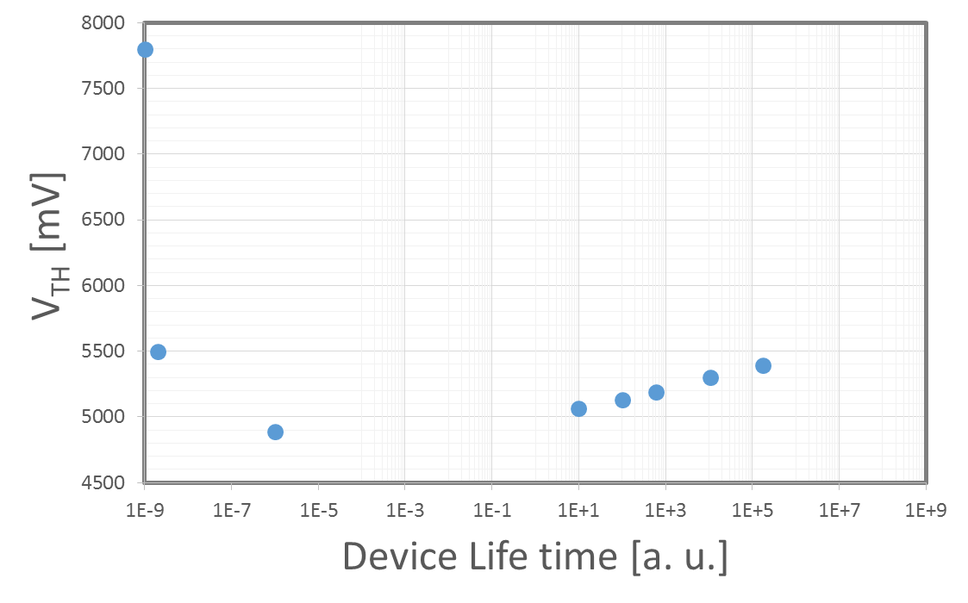
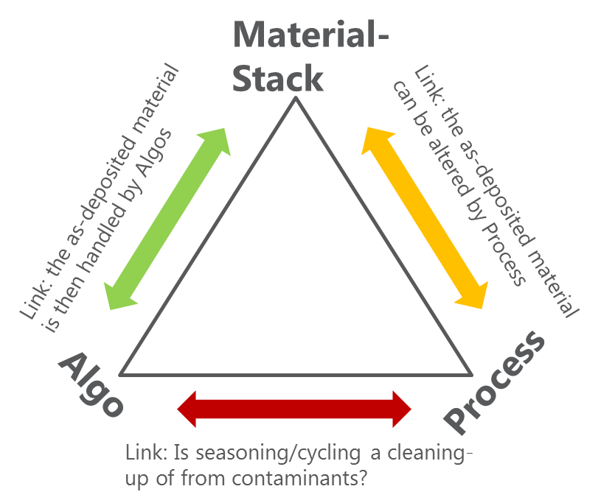
V_{TH} trend vs the device life time: a holistic figure
The overall figure of the V_{TH} evolution returs a wide V_{T} range (>3 Volts!) spanned over the entire device life time
To scale down the SxP technology we need to learn how to control better and better the V_{T} evolution
This aim can be reached only with a well addressed 360° MAP strategy
Stress
time
Recovery time
FF
Permanent loss in 10 yrs @85°C
Segr + Drift + E/I forming
Drift
Contaminants +…
induced Cyc degradation
SF
T
Cycling

Slide 3
Key-points of the strategy to control the V_{TH}
Develop a physics-based switching model allowing to indicate the physical quantities modulating the switching [link]
How does the process manipulate or is neutral with respect to SD material? In S15 a huge impact of the process is captured, however the microscopic understanding is still incomplete [link]
More stable SD materials (In-SiSAG is a candidate – see last meeting)
Algo: the role of readout Algo (tsense); better understanding of Seasoning and cycling effects [V_{T} evolution huddle]
to Goal

Slide 4
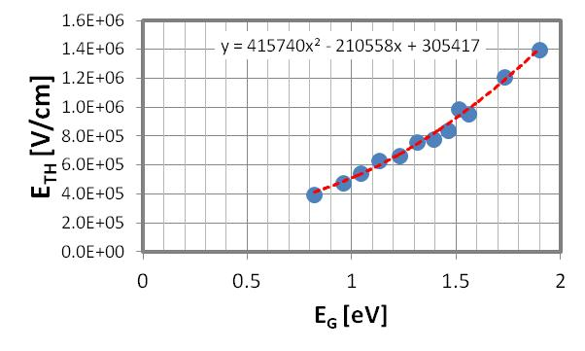
Switching model understanding
The relationship between V_{TH} and the SD film optical band-gap has been highlighted and verified on variuos vehicles/cell rev
The gap dependence of V_{TH} has been also physically explained in terms of avalanche phenomena at switching
However, a complete physics-based model of switching is still under scrutiny
Highest II probability for holes
Holes energy
+
-
We are addressing this also thru the collaboration with Politecnico of Milano (update scheduled for next month)
SD thickness
back

Slide 5
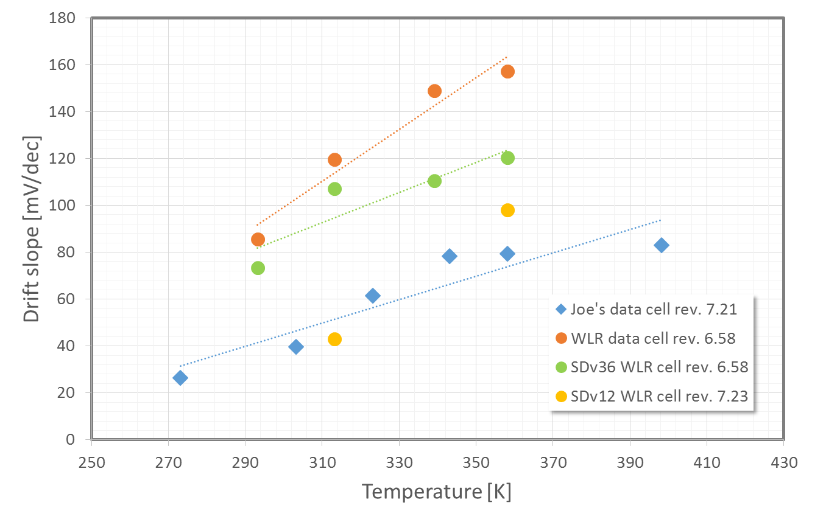
The key role of the process on drift performances
The pronounced impact of the cell rev. is captured, neglecting the same SDv12 film that Swapnil deposited!
The role of SD film is observable, but the process impact is huge
We need to enhance our ability to invetigate microscopically how process alterates the SD cell
SDv12 – old cell rev
SDv12 – new cell rev
85°C
40°C
At the next meeting Hefei will give the picture of the State of the Art about the TEM characterization of chalcogenides-based cells
back

Slide 6
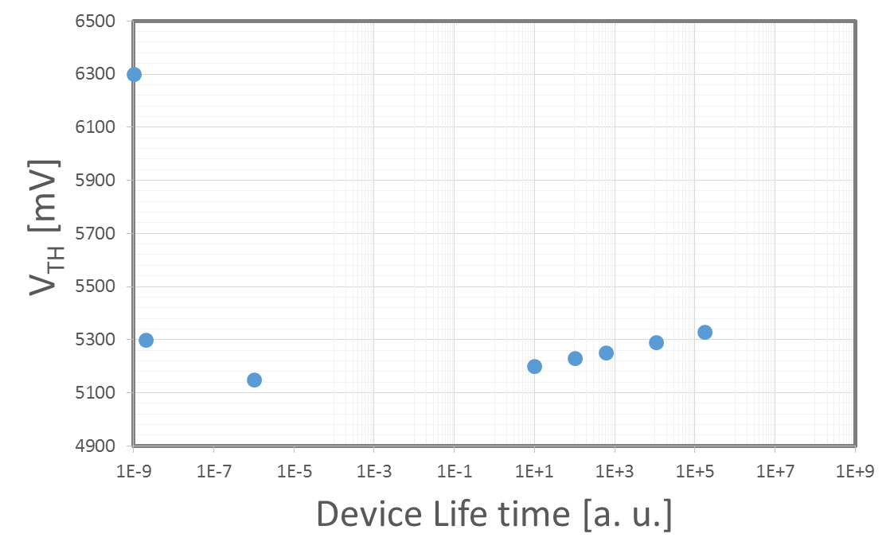
V_{T} evolution: 30S goal
Today the key-points of the learnt lesson from S15 to mitigate drift thru the process are reported (Jenny, Dany, Darren, DerChang)
The goal of 30S is to strongly tighten the V_{T} evolution
Some seminal ideas:
Stress
time
Recovery time
Forming limited:
Al₂O₃ laminas
Bi-layered SD
Cycling degradation limited:
H-k seal Cell iso
Drift limited:
In-SiSAG film
Process optimization

Slide 7
Integrated 30s Pathfinding Strategy
Expanding scorecard with probe-able single chal L1D.
L1E: Electrical testable L1D → this is what we called L2 in the past
Physical (L1D) and Electrical (L1E) scorecard to be developed to rank the integrity of stack and material sensitivity to the architecture.
Effectively building pathing finding collateral using other JDP projects
5 JDP projects – S15 PG4, S15 PG1, S26, SSM, S37
Cell architecture learning comes from S15 and S26 – what to test and how to score
Fully exploit SSM to build pathfinding collateral of scaled cell (L1E)

