Slide 1
Predictability of the V_{TH} drift as superposition of time and temperature effects
…towards reliability models for the V_{T} control
Paolo and Joe

Slide 2
Summary
Long time Drift predictability is a key parameter to be considered in the RWB computation given the peculiar specs of different SxP applications
Here we conclude that the so called ‘Energy front’ model is the correct one modeling approach to predict the long time drift at a certain T_{ref} required by the product/application
Use temperature accelerated drift measurements and predict the long time drift at T_{ref} by means of the Energy front model normalization
Continue the modeling activity to better understand the super-linear relation between Drift and equivalent time
Recommendation

Slide 3
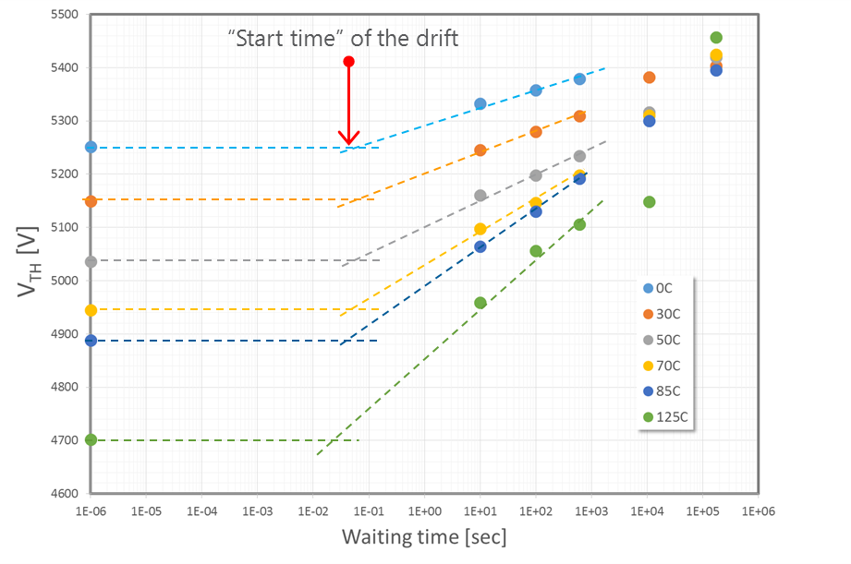
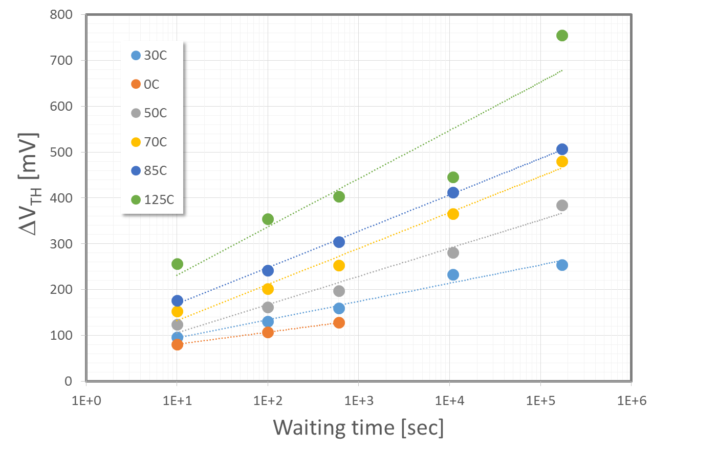
Experimental
Experimental data of V_{T} drift have been collected at different temperatures (0, 30, 50, 70, 85, 125°C) – and subsiquently also at higher temperature (150, 250°C) in a wide range of tmes: 10s up to 48hrs sec
Readout of V_{TH} was at the same temperature of annealing for T<125°C → this is not an issue, since the V_{T} tempco is not affected by drift
Some features coming out from data:
1μs V_{TH} linearly decreases increasing T (see back-up slide)
The piece wise trend up to 10 min returns an approximatively temperature independent start time
The drift coefficient increases (~ linearly) with T
These data have been used to for the cross t and T V_{T}-drift

Slide 4
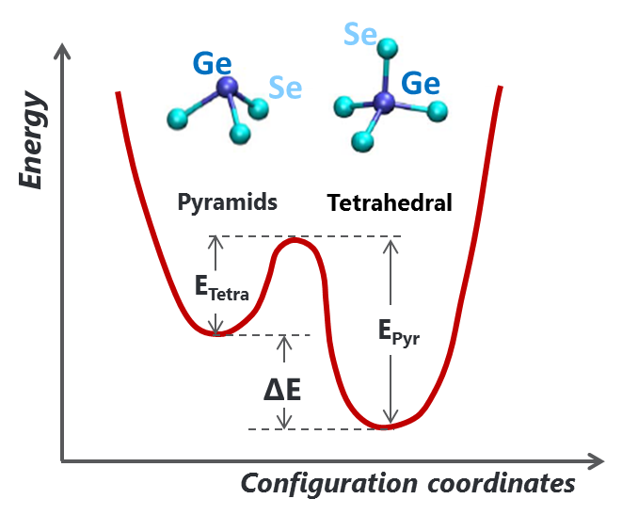
Two different models in comparison:
Single E_{A} model:
Energy front model:
The basic assumption of this model is to have a unique Two-Level-System (TLS) for SR with ONLY ONE activation energy E_{A}:
The basic assumption of this model that the amorphous network is an ensemble of Two-level-Systems (TLS) with a continuous spectrum of E_{A}:
DoS
Relaxed states
Remaining excited states
g₀
Front energy
here E_{A}= E_{Tetra}
E_{A}
The continuous E_{A} distributed spectrum (here as uniform distribution) is spanned by the energy front that proceeds as: , that will promote relaxation, at the beginning of the lower energy ‘defects’, then, progressively, of the higher energy defects
Ref. D. Ielmini et al., APL 92, 193511 (2008)

Slide 5
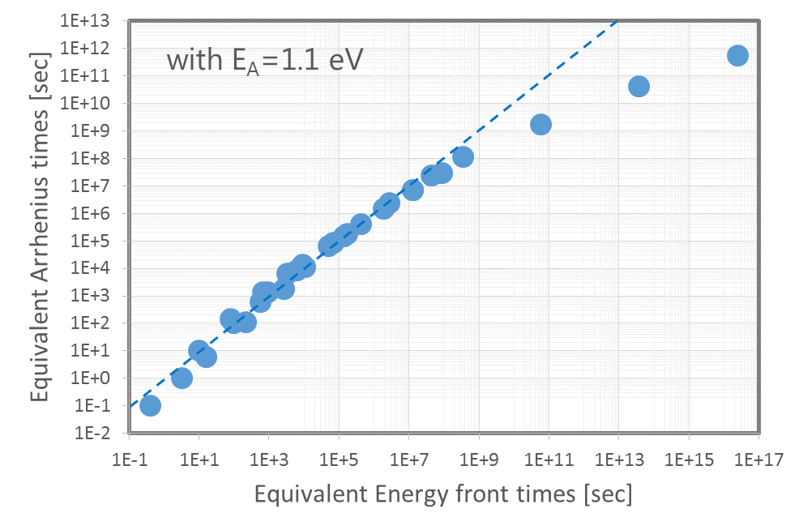
Implications of the two different models:
Single E_{A} model:
Energy front model:
This model leads to the following computation of equivalent time:
This model leads to the following computation of equivalent time:
The implication of the two models is that they lead to two different equivalent times normalization of the drift at a reference temperature T_{ref}
Although the two models are basically different – in terms of the physics basis assumptions – the computed equivalent times are very similar, when E_{A}=1.1 eV, for a wide range of times.
However, a more and more pronounced deviation in between is obtained for long times (> ~1e7 sec ~ one year).
In particular, from that time, the equivalent time computed with the energy front model becomes much more slower, thus predicting a much more favorable long term reliability result.
For this reason it is difficult to discriminate the correct model, just on the basis of the plot of the drift vs equivalent times up to ~1e7 sec. Both modeling approaches are expected to return similar results/trends – see next slide.

Slide 6
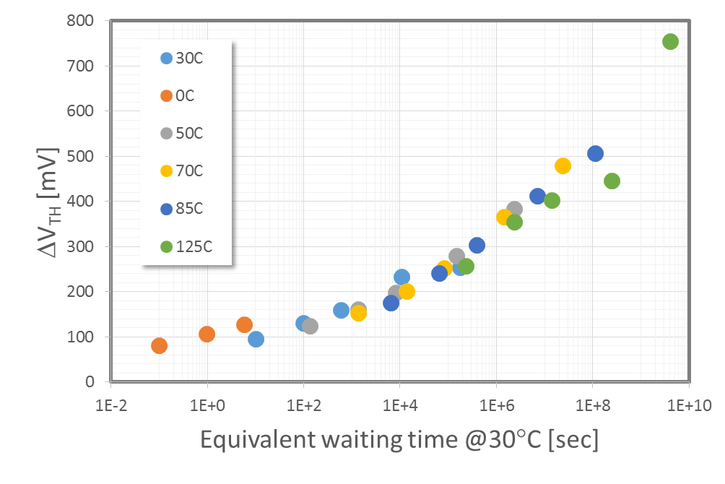
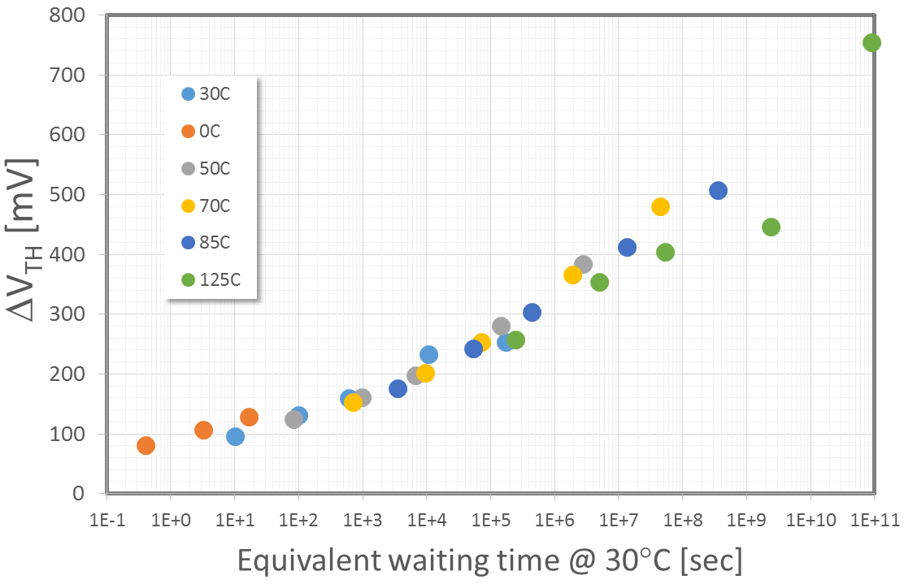
Long time drift projections accordingly the two models
Single E_{A} model:
Energy front model:
At this stage of data elaboration is difficult to discriminate the two models: we could just say that both are valid

Slide 7
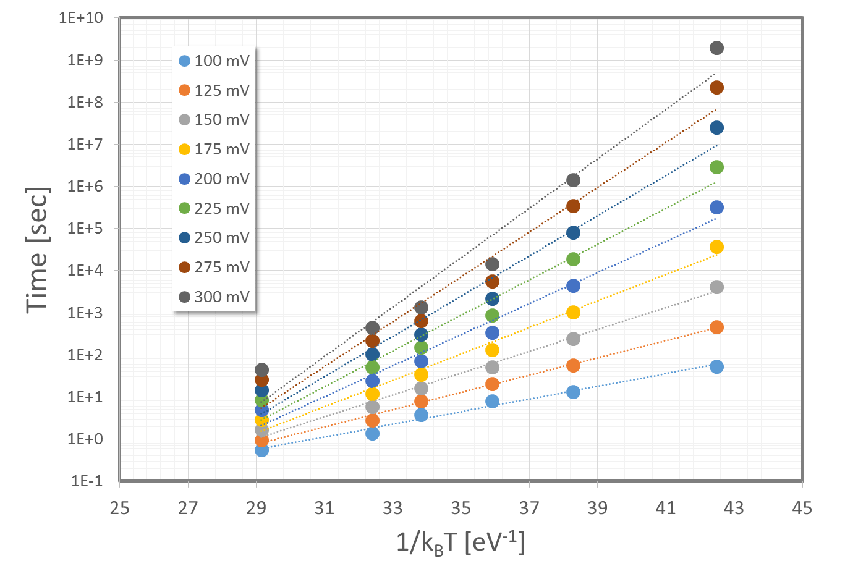
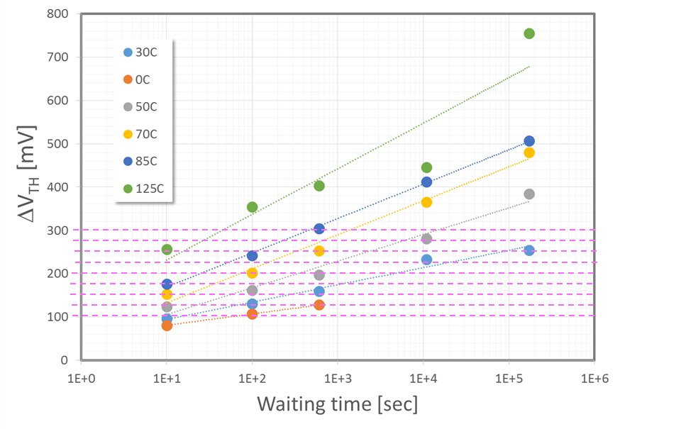
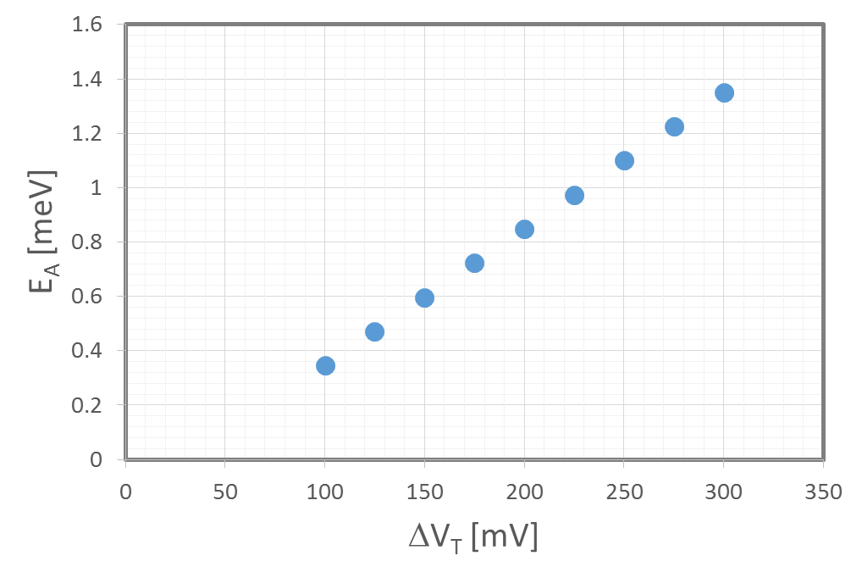
Is E_{A} of SR constant or distributed?
Experimental data of ΔV_{T} at different T allow extracting E_{A} for drift:
The times to get the same ΔV_{T} at the different T vs 1/k_{B}T return the E_{A} of the process
The increase of the slopes of this plot increasing the ΔV_{T} cut is telling us that there is a continuous spectrum of E_{A}. Lower ΔV_{T} involves faster states with lower E_{A}, higher ΔV_{T} involves slower states with higher E_{A}. As further support of this thesis we recall that the distributed E_{A} model is necessary to interpret the Bias-accelerated drift [APL 102, 253505 (2013)].

Slide 8
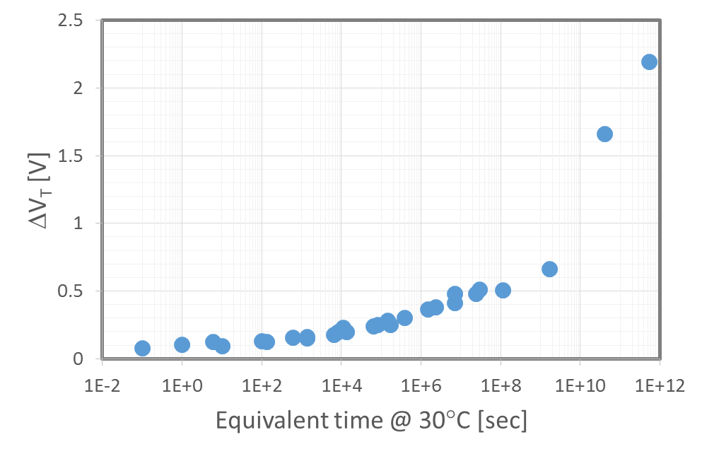
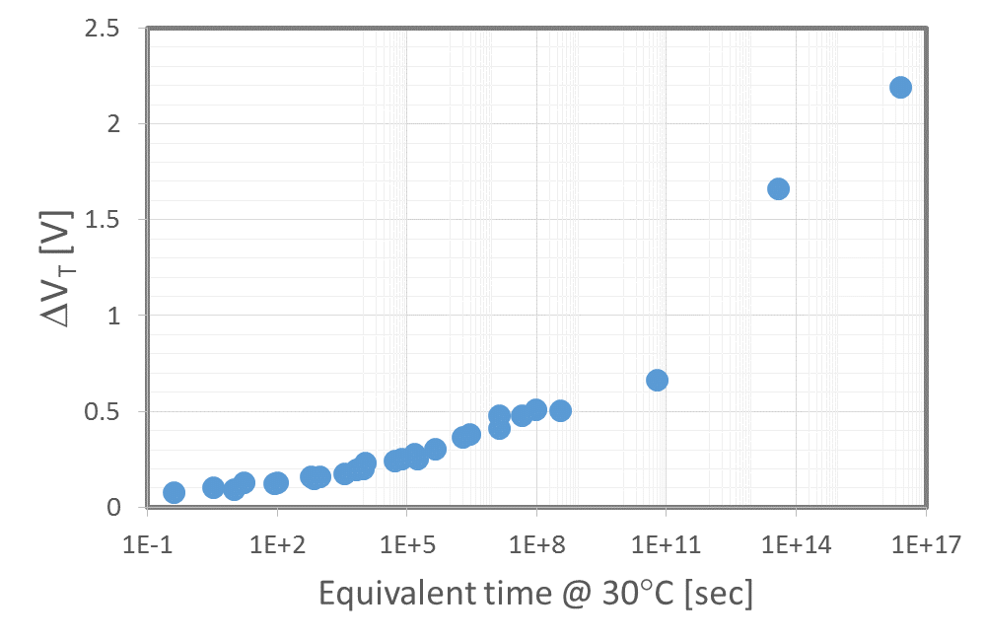
Predictions at very long times:
Single E_{A} model:
Energy front model:
The introduction of higher temperature data (drift after 150, 200 and 250°C annealing) highlights that the single E_{A} strongly contracts the x-axis and produces a piecewise trend. On the contrary, the Energy front model returns a more continuous fashion of the Drift and strongly relax the x-axis at longer times coherently with slide #5.

