Slide 1
Review of the robustness of In-SAG/In-SiSAG value proposition
Summary of results from different campaigns
30S Material Pathfinding team

Slide 2
Review of the robustness of In-SAG/In-SiSAG value proposition
Long-Time drift, accelerated by thermal annealing, from different In-SAG/In-SiSAG alloys:
K camp (In-SAG) in F14
J camp (In-SAG) in F4
K camp (In-SiSAG) in F4
are returning very good drift stability when compared with actual POR
Thus, the value proposition for the V_{T} Drift stability of In-SiSAG alloys appears strong
These data also support the value of the light In-doping activity (v.4+InSe) running on co-sputter that is moving to the L1D

Slide 3
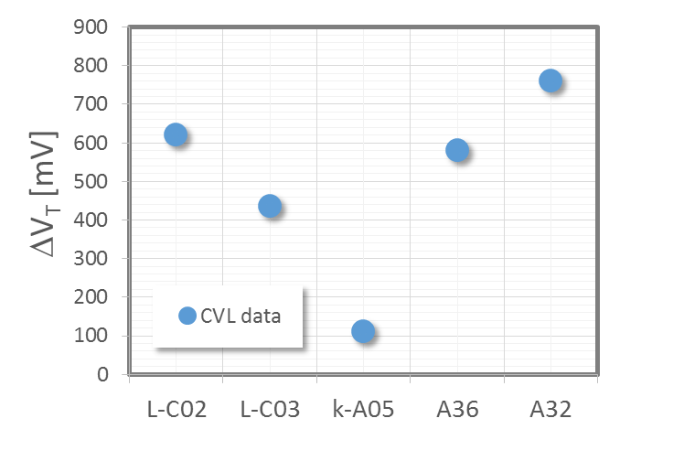
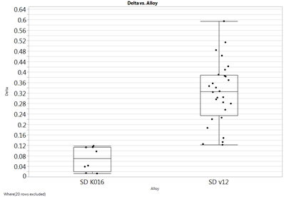
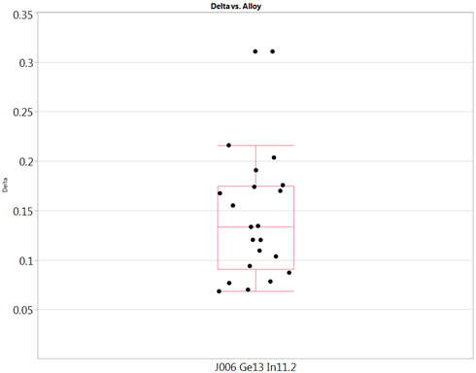
Data of LT-Drift at high temperature from CLV
CLV F14 – V_{T} drift after 3 dd @ 90°C
CLV F4 – V_{T} drift after 3 hrs @ 85°C
CLV F4 – V_{T} drift after 3 hrs @ 85°C
In-SAG SD-Κ A005
In-SiSAG SD-Κ A016
In-SAG SD-J A06
Se% | As% | Si% | Ge% | In% | CN | Se poor/rich
53.0 | 21.8 | 1.1 | 13.0 | 11.1 | 2.72 | -30
Se% | As% | Si% | Ge% | In% | CN | Se poor/rich
53.2 | 24.7 | 6.1 | 5.2 | 10.8 | 2.69 | -28
Se% | As% | Ge% | In% | CN | Se poor/rich
52 | 24.4 | 13.1 | 10.4 | 2.69 | -32
All available CLV data return a good V_{T} stability against Drift for In-SAG/In-SiSAG:

