Slide 1
Problem Solving Rank Oder |  | Level–1: Yield/functionality |  |  |  | Level–2: Performance |  |  | Level–3: Rel
 |  | RWB gap widens due to PM vertical scaling | Read energy reduction using V_{HH} , consistent with Set Vt DTS | Read functionality RBER and RD (G) due to Non-scalable I_{hold} | Memory Effects empirical, model & success criteria | 10 uA reset current scaling beyond DTS | 80ns Read Latency – 10ns T_{sense} reduction | Nucleation time increases with scaled nucleation volume | RD due to eSSR current delivery | R2R Write Disturb to meet 512 NW
Strategy | Issues
Risk |  | 1.5 | 3 | 2.5→3 | 2.5 | 1.5 | 2 | 1.5 | 3 | 1.5
Reduce Set Vt by -350mV (CR7.76 ) with 5X inhibiting leakage reduction |  |  | X
10s based silicon RWB assessment, all components, fresh to EOL |  |  |  |  |  |  | X
Design WL/BL transient to match S15 |  |  |  |  |  |  | X
Improve I_{SSR} current delivery |  |  |  | X
Segment/Quantify RBER gap incurred due to I_{hold} > I_{SSR} |  |  |  | X
Segment/Quantify RDG gap incurred due to resnap I_{hold} > I_{SSR} (Resnap) |  |  |  | X
Quantify eSSR current delivery requirement by ED |  |  |  |  |  |  |  |  | X
Ensure eSSR resnap only if iSSR snapped |  |  |  |  |  |  |  |  | X
Quantify 14nm t_{nuc} gap |  |  |  |  |  |  |  | X
Transfer function matches with 10s level capability thru Ambient/liner/seal/fill/anneal |  | X |  |  | X |  |  | X |  | X
New PM material |  | X |  |  | X | X |  | X |  | X
Write Algo to double nuclei density |  |  |  |  |  |  |  | X
Optimize/reallocate write completion overhead |  |  |  |  |  |  |  | X
Quantify/Segment S15 based memory effects in RWB and Rel & scaling |  | X |  |  | X | X
New SD material |  | X | X |  | X | X | X
Thermal profile engineering thru vertical electrical/thermal resistance |  |  |  |  | X |  |  |  |  | X
Write-2-Write spec relaxation |  |  |  |  |  |  |  |  |  | X
Explore memory effects |  | X

Slide 2
Issue: Write Energy reduction | Owner: Andrea/Kolya/Raj/Jaydip/Ross/Rex | Risk: 1.5
Goal/Actual | Model/Knobs/Strategy | Results/Next Steps | ECD
Goal: DTS goal IRST max < 63/70 uA @85C (pre/post), corresponding to 91.57 pJ/bit (post) Final write energy spec. 64 pJ/bit (post) Gap to Goal No IRST gap to DTS based on TCAD scaling and CD skew projections Energy Gap=27.57 pJ/bit (sensitivity to IRST is 1 pJ/uA) No data available @14nm | Model/assumptions: Energy impacted by IRST, Von, R parasitic and CMOS logic Strategies: Enable noWSiN via flow (~5% reduction) Develop a cell roadmap for additional 10 pJ/bit reduction (10 uA) Reduction of interconnect resistances (W recipe and seed layer optimization) (~10% potential rho WL/BL resistance reduction) Residual to be managed by design | Results: CD skew projections and TCAD sim support DTS0.5 spec. matching Defined a POR for noWSiN via flow XLR2 recipe promising result shown for 1st cut W rho reduction (~10%) Plans: Develop noWSiN via flow on S26/S36X Enable integration of S36X for single cell 14 nm IRST characterization W recipe optimization through Cu-pad flow (XLR, seed layer) Start electrode exploration after S36X L3 is ready Synch to design plan Help needs Design team simulation to support process dev TCAD simulation for proper cell design More silicon/PI bandwidth to explore different electrodes | ww31/ww39 ww34 ww26 Q4-2018 WIP

Slide 3
Issue: Write Energy: IReset, reduction to 60uA @ 85C post cycles | Owner: Andrea//Rex/Pavan/Sid | Risk: 1.5
Goal/Actual | Model/Knobs/Strategy | Results/Next Steps | ECD
Goal: Final goal IRST max < 60 uA @85C (post) Gap to Goal IRST gap2goal 10 uA | Model/assumptions: Achievable by thermal profile engineering Strategies: Evaluate alt-PM working point @14nm Thermal profile engineering by development a proper roadmap (e.g., electrodes) | Results: NA Plans: Enable integration of S36X for single cell 14 nm IRST characterization Enable alt-PM integration of S36X for single cell 14 nm IRST characterization Start electrode exploration Help needs TCAD simulation for proper cell design More silicon/PI bandwidth to explore different electrodes | ww 34 ww 44 TBD

Slide 4
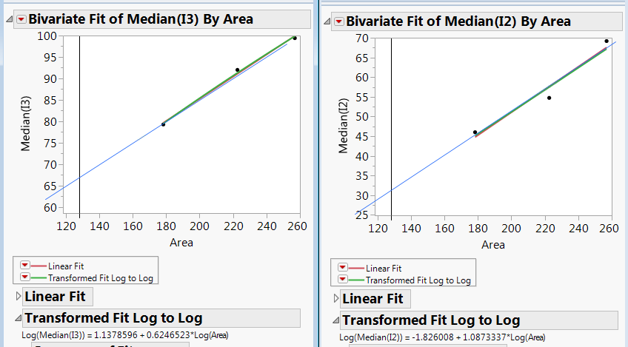
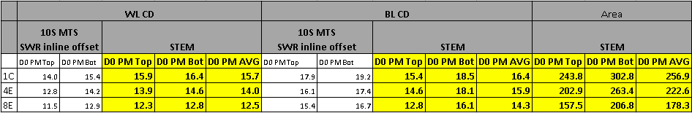
IRST projections based on S15
Courtesy of Lu
1) Three S15C CD skew lot run in F2 (one S26 lot running in F4)
2) Cell area is calculated from STEM AVG PM CD from 2nd CD skew lot
3) IRST almost projections follow expected TCAD sim trend (0.65X instead of 0.6X)
4) I2 larger decrease not consistent with simulations is under segmentation (but it is confirmed on all the 3 lots)

Slide 5
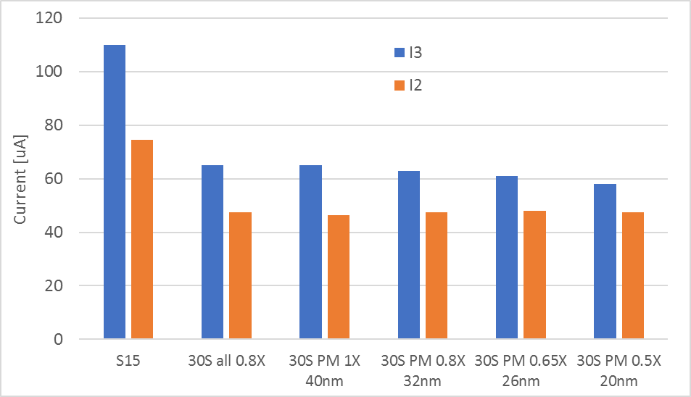
TCAD I3 current simulation
0.6X
Different scaling options
Electro-thermal simulation including ion motion effects
Courtesy of aghetti
Different scaling options considered, all lateral loss dominated
I3 decrease is almost independent from the scaling approach since it is dominated by lateral loss
Dependence from PM thickness is very weak: -0.35uA/nm
Notes:
FULL_CELL/sim_TCAD_Detailed_Rev7.41_sensitivity.xlsx, 30S_scaling

Slide 6
Design team write energy considerations
4kX4k Quilt Array VIA Resistance | iRST Scaling Strategy |  | Post Cycle |  |  | Pre Cycle |  |  | vSUPPLY
 |  |  | TT/85 | SS/85 |  | TT/85 | SS/85 |  | simulated
 |  |  | iRST uA | iRST uA |  | iRST uA | iRST uA |  | hpvpp-hnwrite
RVIA=RWiSN | Actual 30s DTS |  | 69.0 | 69.0 |  | 63.0 | 63.0 |  | 10.1
RVIA=RWiSN | IRST 10% reduction |  | 69.0 | 62.4 |  | 63.0 | 58.0 |  | 9.3
RVIA=500 Ohm | IRST 10% reduction |  | 69.0 | 62.4 |  | 63.0 | 58.0 |  | 8.8 (tt limited)
RVIA=500 Ohm | IRST 16% reduction |  | 58.0 | 58.0 |  | 53.0 | 53.0 |  | 8.0
IRST 10% red
No WSiN via
This is final target for DT
eNERGY = vSUPPLY * K1 + Cwire *K2 + C → vSUPPLY (tile supply) redux helps energy.
IRST 10% reduction buys us vSUPPLY margin 10.1V - 9.3V = 0.8V
Reducing Array Via Resistance from (7k/6k/5k*1.6) → 500 ohms buys us 9.3V-8.8V = 0.5V
Need additional reduction in path resistance to reduce supply or changes in Cell spec to get us to Goal.
Courtesy of Balaji

Slide 7
Issue: RWB: PM thickness vs. Thermal disturb | Owner: AndreaR/Bob/Aghetti/Agotti/Kiran | Risk: 1.5
Goal/Actual | Model/Knobs/Strategy | Results/Next Steps | ECD
Goal: WD capability to meet R2R 512 NW Gap to Goal MTS0.0 (PM thickness 39 nm) 0.4X in capability | Model/assumptions: Need to reduce heat lateral loss and promote heat evacuation from metals Same 20nm HP interface and bulk electrical/thermal properties assumed Deck2deck polarity driven asymmetry same as S15/S26 Strategies: Reduce PM thickness from 39nm to 32 nm, 0.8X as a first step (capability gains 0.4X → 0.58X) Thermal path optimization: Reduce Es thickness of ~0.8X as well (0.58X → 0.75X) Thermal path optimization: additional improvement by alt-fill Write-to-write inter pulse delay relaxation | Results: Roadmap built based on TCAD sim results. No data or projections available at this point Plans: Continue S36X module integration with reduced PM thickness to enable first WD assessment PI/DE/CMP on paper work to evaluate possible TE/ME/BE thinning (-2/3 nm each) Continue L0 exploration/screening of possible alt-filling Continue TCAD work for proper cell design Help needs Array/design team to consider if additional product/algo strategy can be considered Needs support for alt-fill L0 screening (Kth optical measurements) | ww34 ww24 WIP WIP

Slide 8
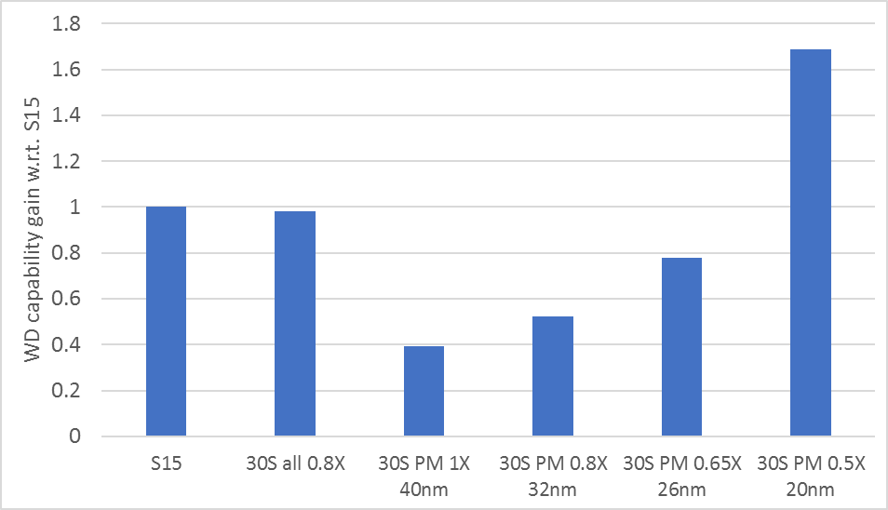
Thermal disturb vs PM thickness
Courtesy of aghetti
Same OR in all the cases, 1.1X
Other stack elements
thinning
PM thick. reduction
Shrinking all vertical thicknesses by 0.8X is enough to match S15 WD
Shrinking only PM thickness exponential improvement of WD
matching S15 WD requires ~0.55X reduction (~24nm PM thickness)
Proposal to move to 32nm to leverage programming window and then reduce other stack element thickness, E thickness (0.8X)
Notes:
FULL_CELL/sim_TCAD_Detailed_Rev7.41_sensitivity.xlsx, 30S_scaling

Slide 9
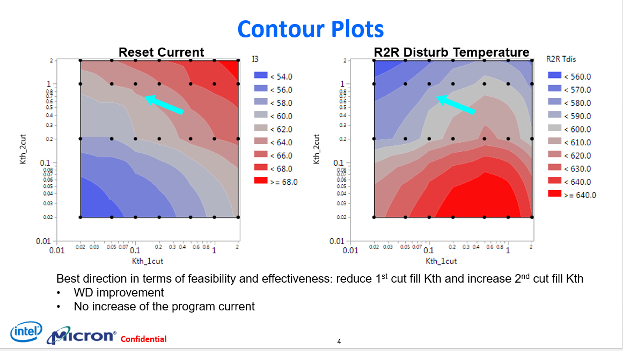
Filling impact on WD
Unbalance between 2nd cut and 1st cut showing most favorable cell operating condition (k_{th,2nd} >> k_{th,1st})
Alf-filling material investigation on-going
Minor impact expected on IRST
Evolution of filling thermal parameter to be considered for L0 screening
Need optical bench for film and interface Kth characterizations
Courtesy of aghetti
Notes:
FULL_CELL/sim_TCAD_Detailed_Rev7.41_sensitivity.xlsx, 30S_scaling

Slide 10
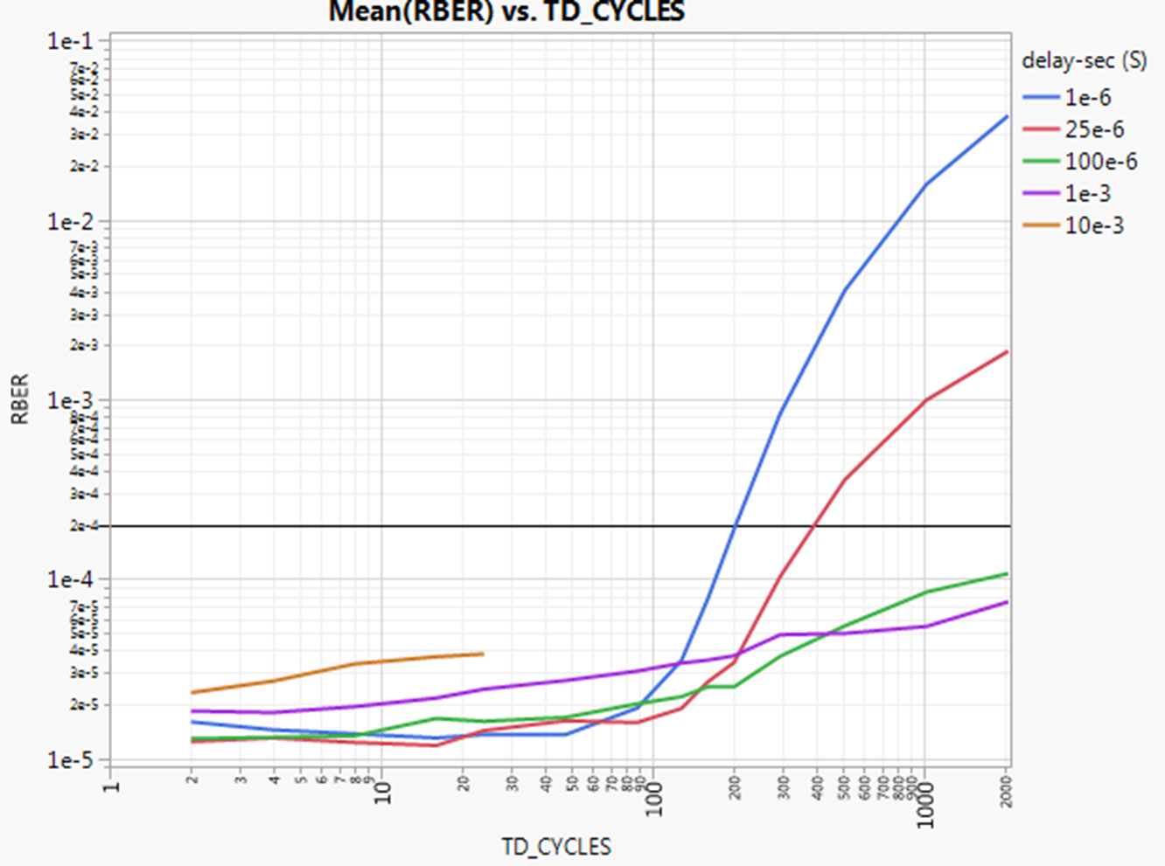
WD dependence from inter pulse delay
Clear gain on capability by managing the inter pulse delay on the aggressor

Slide 11
Issue: RWB, i.e. PM thickness reduced | Owner: Andrea/Lorenzo/Steve/AndreaG/Gurpreet/Lu | Risk: 1.5
Goal/Actual | Model/Knobs/Strategy | Results/Next Steps | ECD
Goal: Match same S15/S26 RWB Gap to Goal Actual 7 nm PM thickness reduction to help WD translate in ~230 mV RWB reduction | Model/assumptions: Thickness reduction needed to mitigate thermal disturb RWB to be recovered by median window, sigma or reliability Scaling can help in window recovery Strategies: Explore new alt-PM material with higher Eth Exploit SD/PM Memory effects once demonstrated Assess scaling effect on PM/SD windows Reduce variability e.g., VT sigma Improve reliability (e.g., drift, E2 TA) | Results: SD Memory effect toggles on new alloys explored for SSM show encouraging results with feasibility to recover ~100-150 mV Clear sigma improvement with alt-SD demonstrated on SD-only Scaling projections (S15 CD skew and from PTX) foresee a ~150 mV increased window (but at the expense of a worse set-ability, so not included in the RWB gap2goal) Plans: Enable new S26 alt-PM L3 for window-set trade off evaluation and CD skew for projections at 14nm HP Decision for ‘go’/’no go’ on SD Memory effect usage Integrate SD K1 on S26 FS to validate window benefit (sigma and memory effect) Includes alt PM/SD in 30s cell Skew PM dopants (and/or BEOL anneals) to calibrate the exact working point for window-set ability trade-off Help needs More focus on L3 integration of alt-PM/SD Enable full ambient control | ww36 ww24 ww30 Q1-2019 Q1-2019

Slide 12
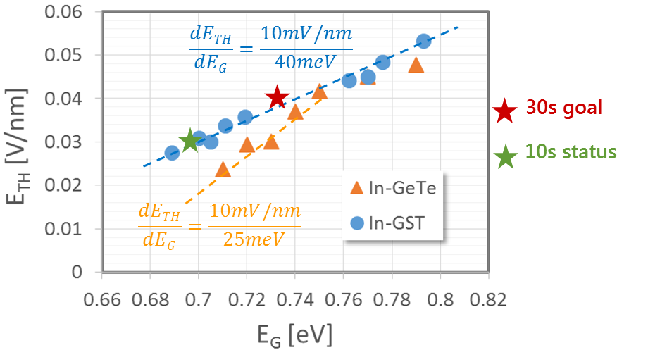
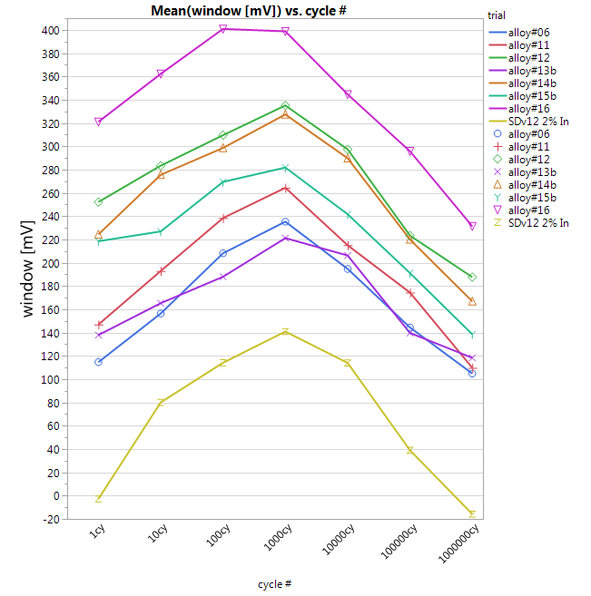
Window recovery due to PM thick. reduction
New PM alloy investigations
New SD alloy investigations
QTT SD-only data
Courtesy of pfantini
Courtesy of aconti
About 210 mV (7 nm x 30 mV/nm) to be recovered → two path envisioned to recover missing window:
Path1: alt-PM with increased switching field. Goal: Match same S26 window with same set-ability
Path2: alt-SD with increased memory window. Goal: Increase Memory effect without leakage penalty and reduced thickness
Notes:
FULL_CELL/sim_TCAD_Detailed_Rev7.41_sensitivity.xlsx, 30S_scaling

Slide 13
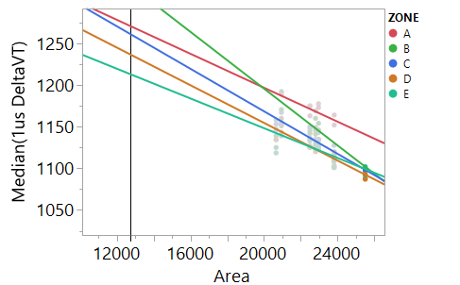
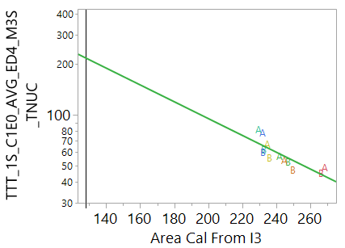
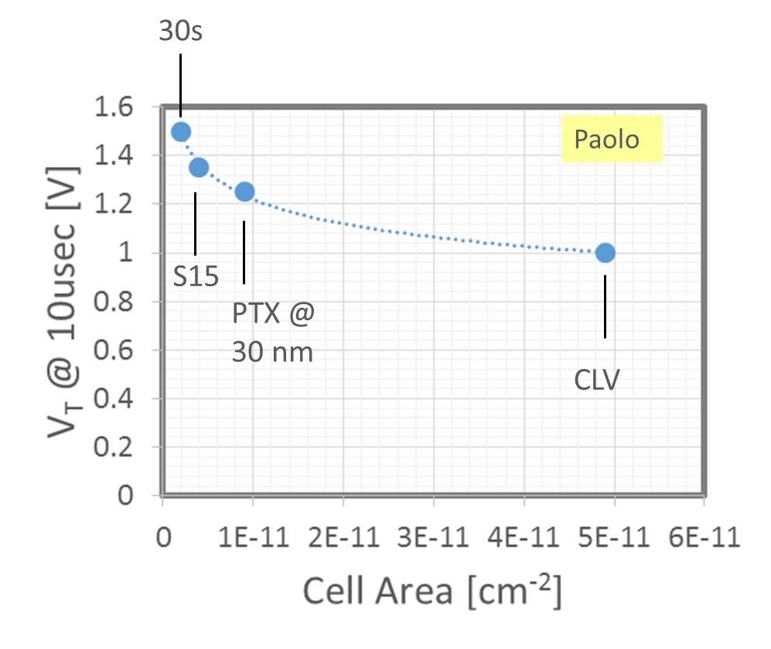
Window vs set-ability scaling
CD skew lot projections show clearly 3/5X worsening in nucleation time and +150 mV gain in window
Need to rebalance window vs set-ability trade-off to match 30s DTS set time request
Old PTX data support shown trends
Courtesy of Lu

Slide 14
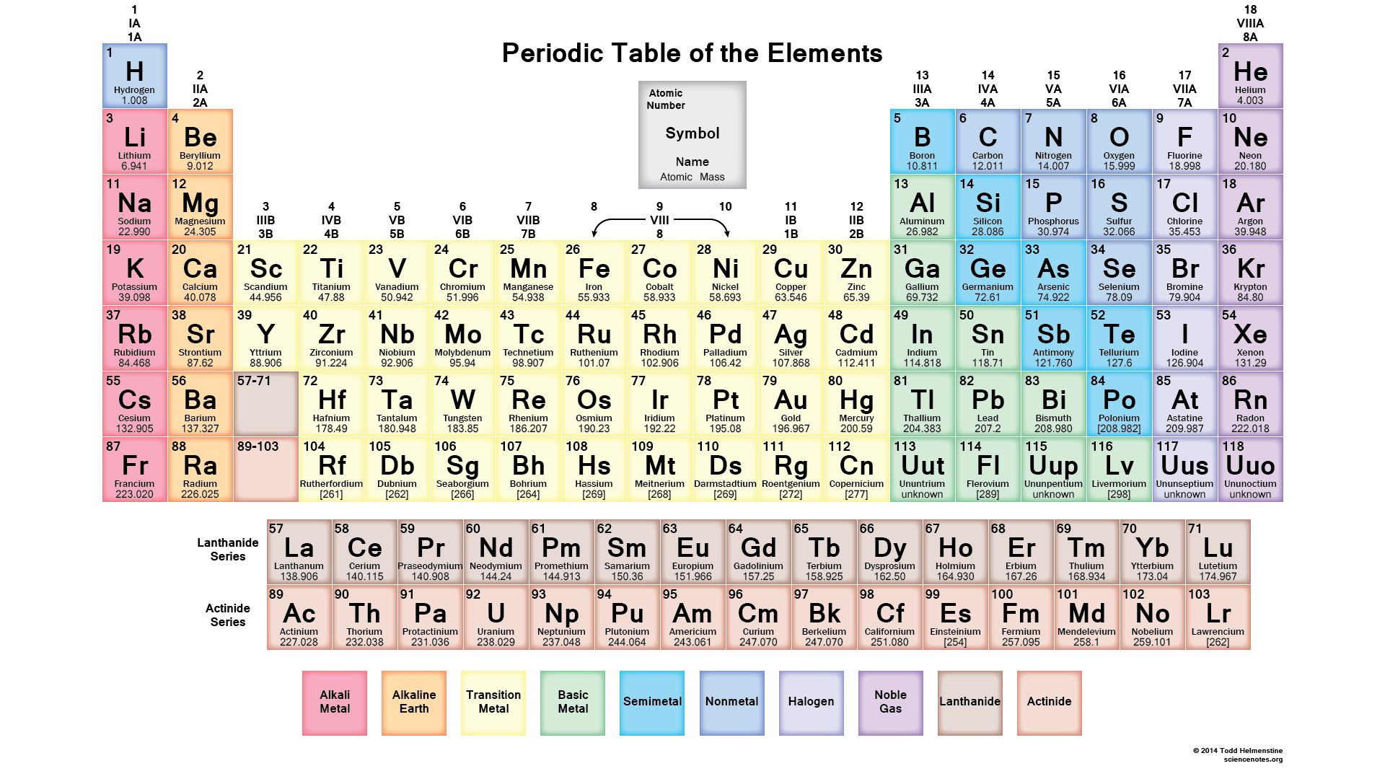
Alt-PM → VT vs. set-ability trade-off improvement
For a given thickness
Alt-PM
Alt-PM
Re-tuning by dopants
or anneal
Set speed
Set speed [a.u.]
Alt-PM
Set spec.
scaling
PM2A3
ΔV_{T}
ΔV_{T} [mV]
Two step approach for alt-PM:
Demonstrate better Window vs set-ability trade off with alt-PM
Use doping concentration or anneals to optimize working point for set speed
Courtesy of pfantini

Slide 15
Issue: Read Latency: 10ns effective t_{sense} reduction, in order to delivery 80ns read latency, results in potential RWB loss. | Owner: Cell(Lu/Andrea)/Design(Jaydip)/Array(Nevil)/Material(Lorenzo)/Integration(Max/Steve) | Risk: 2
Goal/Actual | Model/Knobs/Strategy | Results/Next Steps | ECD
Goal: Reduce read latency 90ns [t_{sense}= 35ns] to 80ns [effective t_{sense} reduces by 10ns and equal or better transient time] Gap to Goal: 10s data with 25ns t_{sense} compared to 35ns POR: ZoneA: Time 0 RWB: -100mV E2 vdm1 margin: -200mV E3 vdm1 margin: +100mV Post cycle RWB: -60mV, less risk ZoneDE: Vt shift and RWB loss due to t_{sense} reduction of 10ns is <=10mV | Model/assumptions: Vdm ramp time and actual voltage delivery Threshold delay statistics interacting with SD composition, thickness, CD, etc… Strategies: Larger volume data collection in 10s to explore variation of t_{sense} and cell scaling impact including 48 hours drift. assess 30s vs 20/10s in simulation according to capacitance/resistance assumptions in DTS. Ensure transient time is no worse in 30s. Explore read window budget improvers to overcome possible RWB loss due to t_{sense} reduction. | Results: 10s RWB data shows that 25ns tsense does not impact read functionality with up to 100mV RWB loss. Plans: RWB WLR data collection on selected silicons Transient time simulation based on 30s DTS and compare to 10s Help needs WLR resources for volume data and drift data collection. | ~WW25 WW30

Slide 16
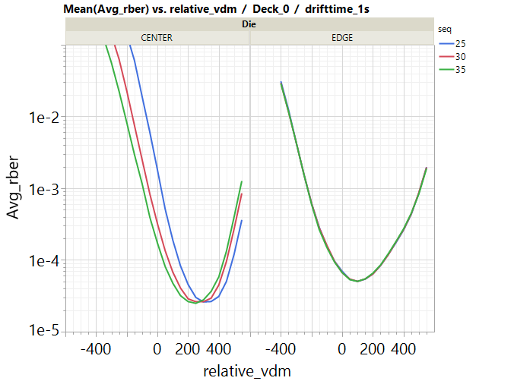
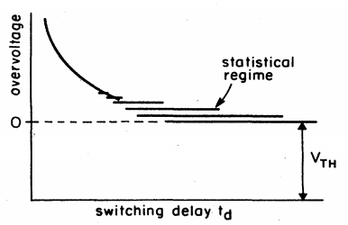
t_{sense} Impact
Center:
for SET bits, with decreasing Tsense by ~10ns, the Vt increases by ~ 150mV for 2E-4_RBER
for RESET bits, the Vt increases by ~ 100mV for 2E-4 RBER resulting in 50mV RWB loss
this is expected as the ‘overvoltage’ (Vt) increases when the switching delay is decreased
Edge:
Tsense has no effect on the VDM
the origin of this effect is not determined yet
Physical (SD composition) or Electrical (CMOS)?
Physical:
the Vt / t_delay correlation could be shifted near the edge due to a variation in SD composition.
TEM analysis required
Electrical:
the trim for 25, 30 & 35ns could be shifted near the edge
probing signals required
Sebastian
Center die
Edge die
Adler et al. Rev.mod.phys, 50, 2, 1978

Slide 17
Issue: PG1T1 Write Completion time Projected nucleation time of 30s cell makes write completion time exceed spec | Owner: Cell(Lu/Andrea)/Array(Nevil/Doug)/Design(Jaydip)/Integration(Kumar) | Risk: 1.5
Goal/Actual | Model/Knobs/Strategy | Results/Next Steps | ECD
Goal: Fit write completion time [overhead + set timings] into spec [475ns] Gap to Goal: grow time and setback time does not increase. Assume overhead remains the same. nucleation time: 10s/20s PG1 EOL: 95ns theoretical calculation for 30s: 190ns 10s CD skew projection for 30s EOL: 600ns [precycle is 200ns] | Model/assumptions: Effective nucleation volume is reduced by ~50% resulting in nucleation time. Skin effect due to oxidization is more significant for smaller CD causing worse time0 tnuc and faster degradation. Process transfer function is different when scaling the cell. Potential Inuc - Ihold violation may enlarge the gap in 30s if Ihold does not scale with CD reduction. Strategies: Validate the models in S36X and S15C/S26A CD scaling lots. Seek for better ambient control, liner/seal encapsulation and transfer function match. New PM material exploration. Reduce overhead time with S37A learnings/steppings. Explore algorithm options to reduce nucleation time [reset termination, etc…] | Results: S15C CD scaling lot shows tnuc data in gap to goal session EDX shows end of line composition differs from POR with smaller CD split in S15C. 7.76 shows less lateral segregation and amorphous skinning layers near TEC of D0 than 7.71. Plans: Work on another STEM/EDX for scale lot and validate the CD and composition change. Validate the quantification and optimize set timing allocation at s36X. New PM material exploration in S36X and decision making. Help needs | WW25 Q4 2018 Q4 2018

Slide 18
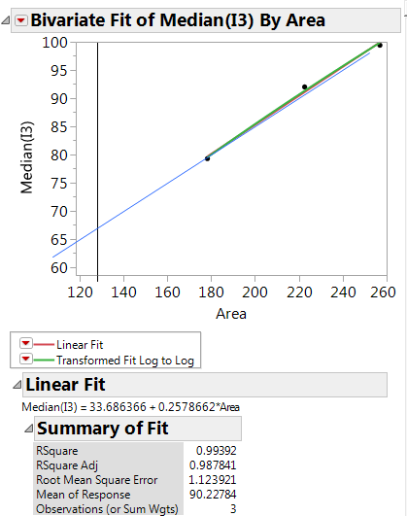
Tnuc with “Stem Correction”
1st lot 0178302 tnuc vs stem area calculated from equation from left. 200ns is consistent with previous estimation.
2nd lot 0187932 I3 vs stem measured PM area

Slide 19
t_{nuc} vs Dimension Scaling – Expectations
The chance for single nuclei V>=V_{crit} after time t
p(a*t), a is the nucleation rate as a function of material properties. p -> 1 when t is infinity.
Here we do not assume the exact form of p(a*t).
Considering n nuclei’s independent of each other, success rate of nucleation with at least one nuclei’s successfully passes V_{crit}
P(a*t) = prob(success>=1) = 1- prob(success<1) = 1 – (1-p(a*t))^{n}
Thus for n=n1 and n=n2 to get the same P, i.e, success chance:
1 – (1-p(a*t1))^{n1} = 1 – (1-p(a*t2))^{n2}
Here it is a complicated equation and we need make some assumptions to simply it.
Assume p(a*t) follows Poisson distribution
p(a*t) = 1 - Poisson.cdf(k<1) = 1 - Poisson.pmf(0) = 1-e^{-a*t}
So, exp(-a*t1*n1) = exp(-a*t2*n2) => t~1/n
n ~ proportional to effective volume.
Effective volume depends on:
Lateral area. if area scales 50%, t increases by 2x.
Thickness of the part with favorable composition for nucleation speed. PM thickness study in S15C shows a very weak dependence between tnuc and total thickness.
Area reduces by 50%
Thickness participates nucleation
Total thickness reduces by 70%, less segregated
=> ?

Slide 20
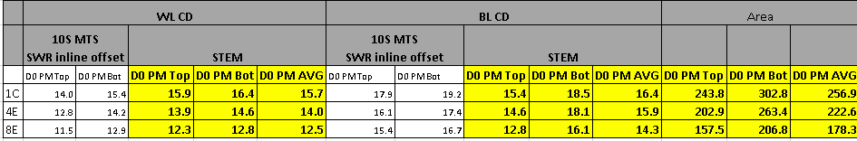
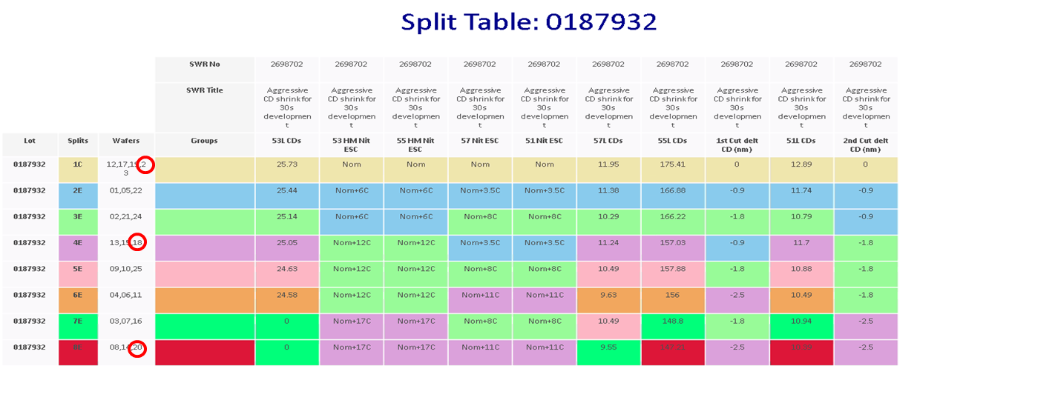
Transfer Function vs Dimension Scaling
Label | D0 PM pfa-1459 8E | D0 PM pfa-1459 4E | D0 PM pfa-1459-1C | D0 SD pfa-1459 8E | D0 SD pfa-1459 4E | D0 SD pfa-1459-1C | D1 PM pfa-1459 8E | D1 PM pfa-1459 4E | D1 PM pfa-1459-1C | D1 SD pfa-1459 8E | D1 SD pfa-1459 4E | D1 SD pfa-1459-1C
Ge | 18.02 | 18.96 | 19.83 | 15.48 | 15.69 | 15.62 | 17.81 | 18.94 | 20.34 | 15.73 | 15.31 | 15.77
Te | 50.37 | 50.19 | 50.27 | 0.53 | 0.29 | 0.34 | 49.82 | 49.31 | 48.85 | 0.52 | 0.29 | 0.48
Sb | 26.70 | 26.79 | 26.01 | 0.51 | 0.39 | 0.40 | 27.90 | 27.96 | 26.35 | 0.34 | 0.47 | 0.32
In | 2.86 | 2.46 | 2.71 | 6.81 | 6.40 | 5.17 | 2.76 | 2.43 | 3.32 | 6.27 | 6.78 | 5.30
Se | 1.16 | 0.81 | 0.69 | 48.48 | 47.99 | 48.73 | 0.98 | 0.77 | 0.60 | 48.57 | 48.51 | 48.80
As | 0.88 | 0.78 | 0.49 | 28.17 | 29.19 | 29.74 | 0.77 | 0.61 | 0.53 | 28.56 | 28.63 | 29.34
PM seg | 1.50 | 1.52 | 1.60 |  |  |  | 1.46 | 1.65 | 2.06
Observations:
More Ge loss is observed for smaller CD. It is consistent in D0 and D1 and trends well with CD.
Se increases by 0.3-0.5% in PM for smaller CD.

Slide 21
Issue: RWB: memory effect success criteria | Owner: Lu/Andrea/Hongmei/Derchang | Risk: 2.5
Goal/Actual | Model/Knobs/Strategy | Results/Next Steps | ECD
Goal: Establish requirement of memory effect goal. Quantification: ~230mV 1us DVT2 metric for 7.76, need additional 230mV to overcome 10ns PM vertical scaling. Empirical scaling coefficient: [-0.75mV/A per SD CD and 2.5mV/A per SD thickness] Up to 25% loss is observed at 4M NW. WD, RD, Drift risk WIP | Model/assumptions: SD phase segregation due to electrical pulse Memory effect contribution from electrode Threshold point modulated by electrical pulse beyond phase segregation. Strategies: 1) define memory effect metrics 2) pick key silicons for assessment including SD material, geometry, BOEL, etc. 3) validate the scalability of memory effect | Results: SD only endurance data agrees with FS DVT2 data to the first order. FS S15C WLR DVT2 data mining delivers scaling sensitivity. Slope 1 signal agrees with DVT2 in terms of scaling sensitivity. Plans: Develop WD and drift test based on DVT2 and slope1 method. Validate DVT2 and slope 1 method through TEM Data mine memory effect toggle s15C SWR lot. Define calculation sheet for 30s memory effect success criteria Validate the criteria on S36X RWB and reliability Help needs WLR resources after developed test method for volume data. | WIP,WW22 ~WW28 WIP WW22 WIP,WW23 Q42018

Slide 22
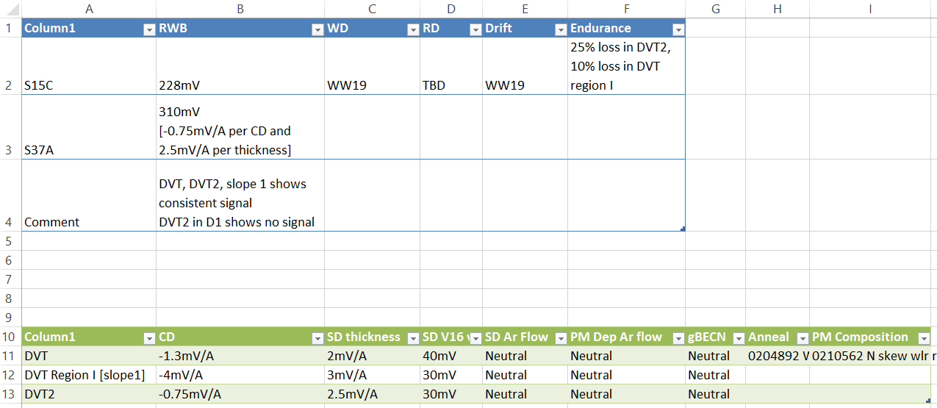
S15C Memory Effect Metrics

Slide 23
Issue: Read Functionality: E2 RBER – Ihold impact to ISSR. Cell read current delivery is lower than Ihold at near region causing potential issues in (1) read functionality (2) read disturb. | Owner: Cell(Lu)/Array(Nevil)/Design(Jaydip/Balaji) | Risk: 2.5->3
Goal/Actual | Model/Knobs/Strategy | Results/Next Steps | ECD
Goal: ensure sufficient ssr current for snap detect functionality and read disturb. Gap to Goal: 30s NN ISSR vs Ihold: Pre-cycle: Near: Ihold 21uA, ISSR delivery [@target 25uA] 22.4uA Far: Ihold 16uA, ISSR delivery [@target 25uA] 15.2uA Post-cycle: 2-4uA increase in Ihold ~-300mV reduces in Von VDM reduces by 0-50mV. Estimation WIP | Model/assumptions: 30s pheriphery circuit path R increases compared to 20s due to die size reduction. Ihold is expected to stay unscaled for 30s compared to 20s. Cell may turn off in the duration of read with ISSR<Ihold. Potential resnap may cause additional source of read disturb generation. Potential cell turning off during tsense may cause incapability of starting grow and setback. Strategies: Improve I_{SSR} current delivery and reduce the gap from design optimizations of BL/WL periphery. Comprehensively evaluate the RWB and reliability risk of low limit of I_{SSR} including read disturb generation and setback from both device and circuit. Validate 10s and simulation learnings with S36X. | Results: 10s data shows no read functionality issue with ISSR 10uA lower than cell Ihold. BER does not change. Optimize the PMOS Vgs and rebalance supply voltage to improved I_{SSR} delivery. Plans: Emulate/simulate the circuit response to the scenario cell turns off. Read disturb data collection with skewing ISSR and understand the resnap risk on thermal disturb. Characterize the read disturb generation versus CD scaling. Help needs Uprobe trace of ISSR skew | ~WW25 WW23 WW23

Slide 24
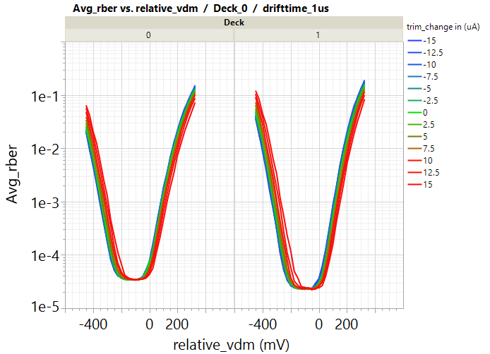
I_{SSR} Impact
Use ISSR mirror to emulate higher path resistance limiting DC current lower than Ihold in 10s emulating 30s scenario.
SET_Vt & RESET_Vt decreases with decreasing ISSR for 2E-4_RBER
Further study including read disturb is WIP.
Sebastian

Slide 25
Issue: Read Reliability: RD – eSSR current delivery | Owner: Cell (Lu) /Design (Jaydip/Ved) | Risk: 3
Goal/Actual | Model/Knobs/Strategy | Results/Next Steps | ECD
Goal: Ensure eSSR grow current delivery and read disturb Gap to Goal: 39uA at ED3-4. eSSR will be used for ED<=33% total decoder distance. Further quantification WIP | Model/assumptions: PM amorphization in read snap and crystal regrowth at eSSR. Strategies: Evaluate eSSR current requirement for read disturb. Evaluate the maximum current delivery capability of essr current. | Results: Design’s initial estimation shows eSSR delivery capability is 39uA. Set grow current will be <=36uA for the cell dimension of S37A. Plans: Use 20s silcon data to get empirical relationship between essr current and set grow current or VTI I2 and project 30s essr current requirement. Simulate max eSSR current delivery based on 30s array RC and periphery. Help needs Simulation focus on eSSR estimation and periphery optimization. | WW23 WIP

Slide 26
Issue: Read Energy (VHH – VNN) vs. Set Vt DTS (VDM and Vinh): Design self-consistent read configuration between DTS cell Vt and voltage supply favorable for read energy. | Owner: Cell (Lu)/Design (Jaydip/Ashraf)/Array(Nevil) | Risk: 3
Goal/Actual | Model/Knobs/Strategy | Results/Next Steps | ECD
Goal: Vhh – Vnn supplies demarcation voltages for 2sigma die yield. Gap to Goal: Calculation based on 10s 7.66 [consistent with DTS] and simulation: Vhh-Vnn = 6.6V drifted VDM 85C: 6.29V[2sigma vdm + vdm2 drift + circuit overhead - cascode drop] vhh->vpp transition temperature: 25C with scenario above t_{sense} increase VDM < 200mV * 7.76 shows -350mV vdm1 than 7.66 * Every 50mV Vnn is 0.18pJ/bit for read and 0.5pJ for write * Every 50mV vhh is 0.18pJ/bit for read and 0.3 pJ/bit for write. | Model/assumptions: N/A Strategies: Evaluate the viability and DTS change to 7.76 including -350mV vdm change, and 5x inhibit leakage reduction. | Results: 10s data mining provides the Vt variability and evolution trajectory towards PG1T1. Design’s estimations provide the sensitivity of read/write energy vs vhh vnn. 10s CD scale lot suggests 50% area reduction reduces leakage by 50%. Plans: Work on pre-por DTS for design team to simulate leakage requirement and room of Vdm reduction. Data mine for leakage and Vt data to explore path of leakage reduction. Help needs | WIP, WW22 WW23

Slide 27
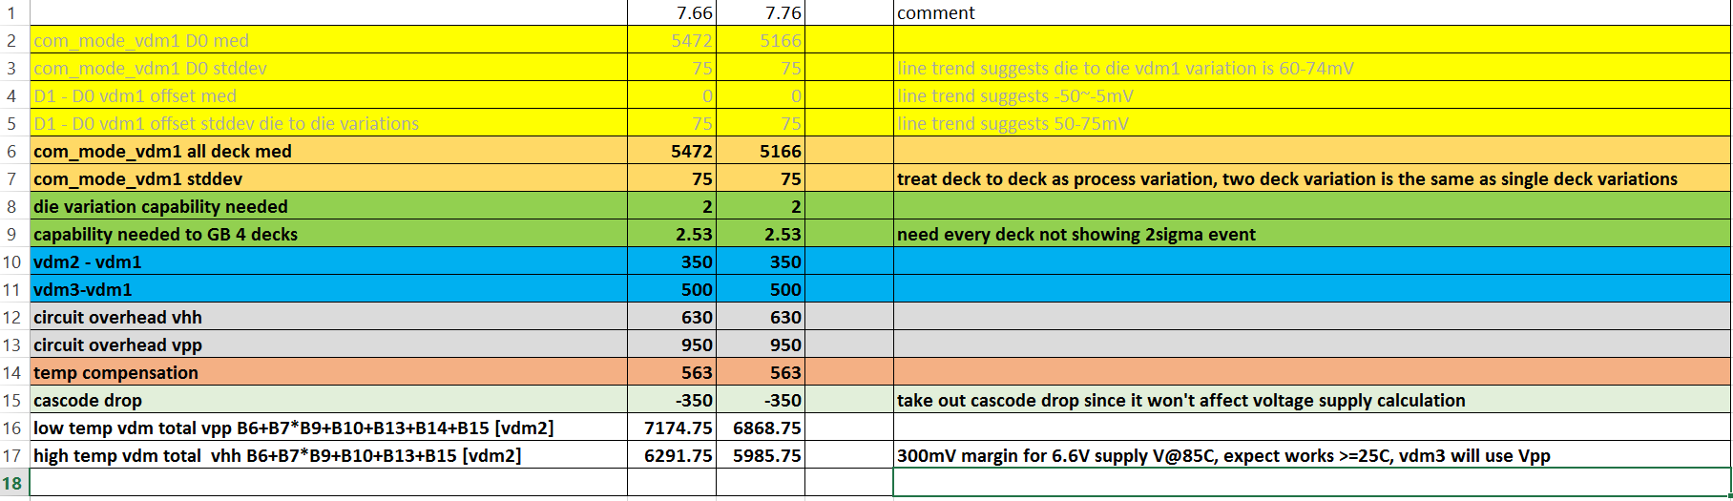
30s VDM Projection

Slide 28
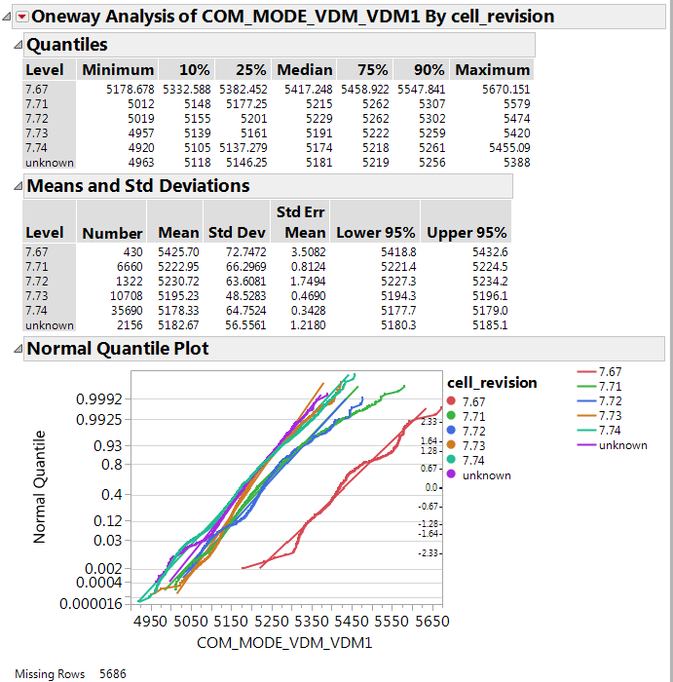
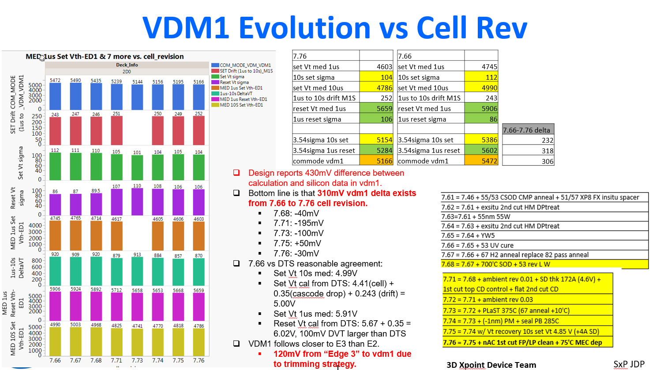
VDM Evolution and Variability

Slide 29
Back up

Slide 30
Nucleation as random process
Stochastic events:
MC algorithm
tseed
setKnee
Assumption: the number of nucleation events that happen in a given time step follow a poissonian distribution (discrete events)
Assumption: Nucleation rate is time-independent (steady-state nucleation)
If 1 and 2 holds the “waiting times” between two events are distributed as negative exponential distributions →”waiting times” pdf
Thus the probability that a nucleation event happens in a given time is the cumulative distribution function of the “waiting times” pdf
More details: JKALB Analytical model (wk51)

Slide 31
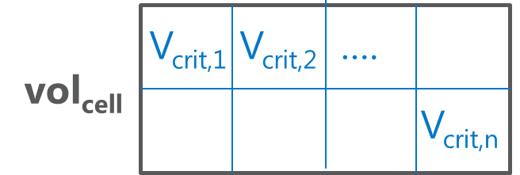
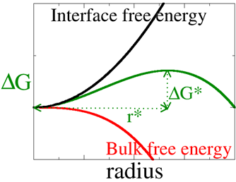
Nucleation Rate overview
Adding photo to standard slide:
Place photo against three sides of slide (recommended resolution: minimum of 800x600.
Adjust right margin of text placeholder, or use line breaks (Shift+Enter) to shorten each line as needed to fit.
Max number of critical nuclei inside the cell
Nucleation rate of a cell of volume vol_{cell}
Nucleation rate of a critical nucleus
kinetic term
thermodynamic term
D ➔ atom diffusion (fragility → Stoke-Einstein or Arrhenius)
Δg ➔ Gibbs energy gain from liquid/under cooled to crystalline nucleus
V_{crit} ➔ critical volume (below that the nucleus is not stable)
critical radius

Slide 32
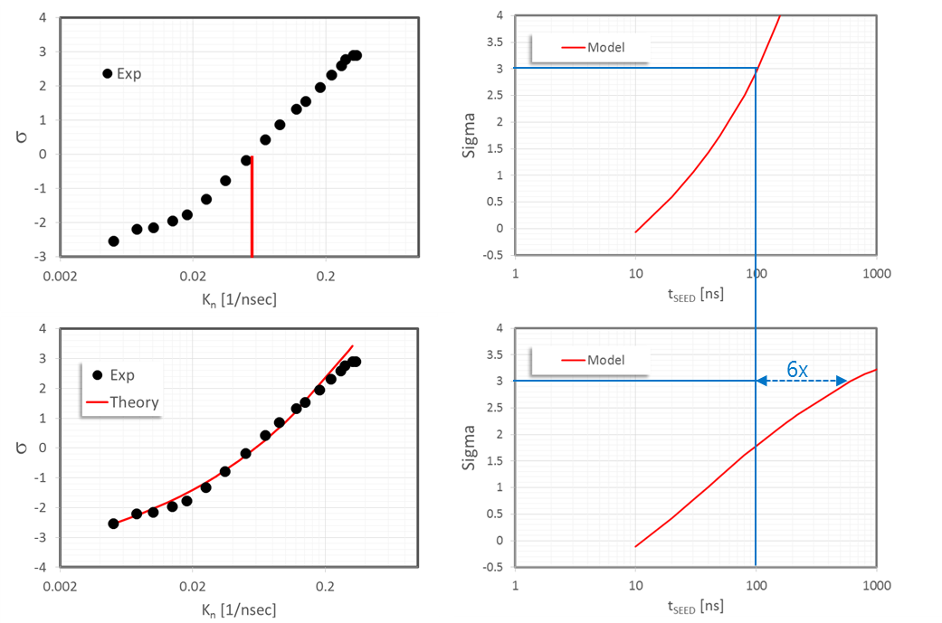
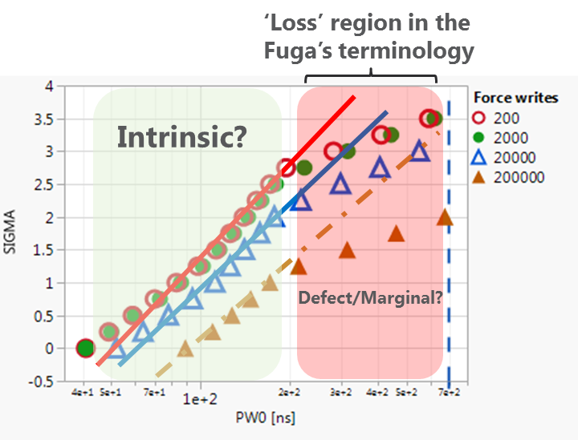
Cell by cell K_{N} fluctuations
PFantini JET meet WW26-2016 (link)
without K_{N} fluctuations
WLR data
with K_{N} fluctuations
Tseed outbreak @ hi set knee if spreading of the nucleation rate is included

Slide 33
30s T_{seed}: same spreading of 10s, just volume scaling
Assuming the same distribution of nucleation rate the t_{seed} to ensure the same set knee of 10s in scaled cell follows the ratio of the cell volumes
The t_{seed} degradation may be much worse if the k_{n} spreading becomes more severe
10s median cell has t_{seed} < 10 ns, but the 4σ one has t_{seed} > 200 ns

Slide 34
30s T_{seed}: heterogenous nucleation
R_{c}
nucleation
R_{c}
nucleation
b
a
Heterogenous nucleation: nucleation occurs mainly within a critical radius from the electrode interfaces
In the case of heterogenous nucleation at interfaces the t_{seed} degradation due to scaling follows the ratio of the surface area where the nucleation occurs

Slide 35
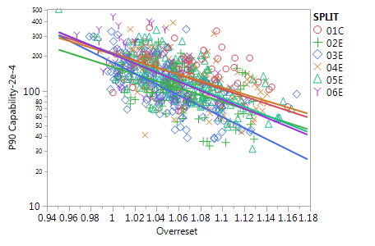
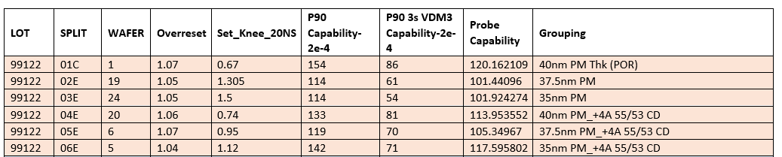
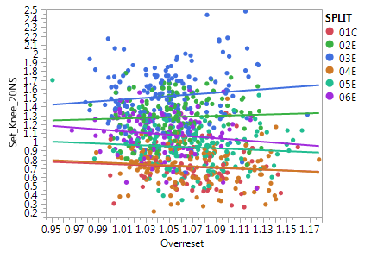
PM thickness WLR data
Data collected by WLR show a opposite thickness dependence
Normalization through the OR confirms the trend
Set knee clearly show a degradation with PM thickness potentially due to:
Unwanted CD effects
Enhanced segregation at higher thickness worsening the alloy set-ability
Recommendation to evaluate those effect on final PM composition
Notes:
FULL_CELL/sim_TCAD_Detailed_Rev7.41_sensitivity.xlsx, 30S_scaling

Slide 36
IRST DTS summary

