Slide 1
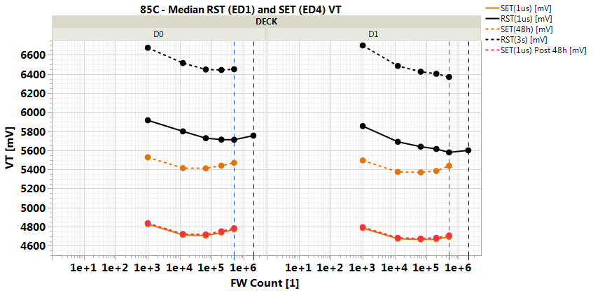
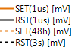
VT: Write Endurance & Operating range
S15C - r7.67 (B55B)
Array init. (‘seasoning’) ~ 60min/deck
E3 VT evol. (@3.54σ) | 1-20 k NW | Proj. 1k-1M NW | Array init
Goal (w/ dyn. Vdm) | <120 mV | <150 mV | Meet PRB TT
r7.67 (QW1) status | 125/155 mV | 170/250 mV | 620/560 mV
VT ‘drift’ (@0σ) | E2 1us-10s | E2 3s-48h | E3 1us-3s
Goal | 240 mV | 455 mV | 550 mV
r7.67 status (t0) | 242/251 mV | 500/555 mV | 760/845 mV
SF VT
SF VT
~ 700 mV
PRB
(EOS)
PRB
(EOS)
VT,min
Current operating VT range for PG1T2 S15C Vdm1/3 operation spans ~ 700 mV post single FF operation^.
^ Single SET pulse application

Slide 2
Energy Reduction Ideas
 | Read Energy | Write Energy | PAD VPP/VHH/VNN | Comments
Phase 1 target | 26 | 59 | 4.3/3.3/-3.3/-4.2 | One stage +/- pumps for Write
Lower read/write supply by ~1v | - 4 | - 7 |  | 0.4pj/bit for read; 0.7pj/bit for write
20% Lower K di-electric | - 1.5 | - 4 |  | Low K dielectric
30% WL/BL cap reduction | - 1 | - 1
Lower Vcc by ~100mv | - 1 | - 2
No eSSR | - 1 | - 1
Control signal scheme improvements | - 1 | - 1 |  | Either simplify or find ways to further optimize cost of toggling signals
Total if ideas pan out | 16.5 | 43

Slide 3
BACK-UP

Slide 4
E3 shift process integration vectors and proj.
*Roadmap to be further refined in line w/ write endurance TF
Editable version

Slide 5
ww39
E3 VT evolution component Macro categorization | PI /Algo recommendations (w/ further understanding needed) | E3 shift 1-20 k NW | Proj. E3 shift 20k-1M NW |  | Next reads / Comments
Goal |  | 120 mV | 150 mV |  | Notes: In () confidence in toggle; D0/D1 values by /
Status[0] - r7.67 (QW1) |  | 110/150 | 170/240
PI[1]: Time-zero chal. ‘health’ composition preservation by ‘contaminants’ (etch residuals and beyond) minimization | 1st cut LP CLN opt. (e.g. dNH4OH) | -15/-25 (M) | -25/-40 (M) |  | - 1st cut LP 2-steps clean (Amm+Cit): 0084012 (WLR ww39) - Other lot to be funded based on 0084012 WLR results (ww43+)
 | 2nd cut LP CLN opt. (e.g. dNH4OH) | -25/-5 (L) | -20/-5 (L)
 | 2nd cut LP DE opt. (e.g. O2 flash) | -5/-5 | -20/-40
PI[2]: VT evolution pre-consumption | MECN1.1 (or graded equivalent) | -20/-70 (H) | -20/-90 (H) |  | DE opt. Si @WLR (107422) for EOL OPEN fix (ww40)
PI[3]: Cell ‘encapsulation’ robustness upon cumulated e-pulse stimuli (and related thermo-mechanical stress, etc.) | L-treat optimization (both cuts) | TBQ (funded) |  |  | Funded lot 0154142 (@prb) based on L1D
 | High-K Seal Ox @2nd cut | ~ 0 mV |  |  | ~105/40 mV reduction in ‘seasoning’ VT shift, large reduction in Assembly VT shift (@Burn)
 | Seal thick. ratio (Nit/Ox) opt. | ~ 0 mV |  |  | ~130/165 mV reduction in ‘seasoning’ VT shift
PI[4]: Suppression of sources for mobile contam.t species from cell surrounds (speculatively “moisture”, H complexes) | Post Nit dep 2 uwave anneal | -5/-15 (M) |  | 0/-25 (M) | WLR in B55 (ECD iww39)
 | Opt. of 82L, 67L (64L) T-anneals, including TEOS var’s | -20/-10 |  | -25/-15 | 290C 82L Vs 310C quantification reported
Algo[1]: Under-RST mitigation | I_{RST,TBD} placement opt. & WCbin | ~0 (H) |  | ~30? [H] | Strategy still in validation; PFA submitted (ww41)
Process Integration analysis: L0/L1D char. for opportunities (&implementation path) identification, speculatively around (i) SD element (composition/etch/ clean interaction) & (ii) unwanted SD/PM interaction w/ unknown 'contaminants‘ (cell encapsulation & critical layers for transparency/generation/gettering)
Algo: RST algo component break-down and opportunities being identified, supported by EFA/PFA analsysis
Link to identified process toggled (full PI and model table)

Slide 6
PG1T1 Drift Gap to Goal
Rev7.67 B55B PC12Z probe
PD12A probe
 |  | DTS | 2D0 | 2D1
VDM1 (1us-10s 85C) | Gap to Goal | 0 | +2mV | +11mV
 | Total Drift (UD) | 240mV | 242 | 251
VDM2 (3s-48hr 85C) | Gap to Goal | 0 | +45mV | +100mV
 | Total Drift | 455mV | 500 | 555
 | Unbiased Drift | 380mV | 400 | 415
 | BD from RWB | 75mV | ~100mV | ~140mV
2D0 | 2D1
+2mV | +11mV
242 | 251
+40mV | +85mV
495 | 540
400 | 415
~95mV | ~125mV
Current gap2goal limited by 2D1 VDM2 is ~35mV UD and ~50mV BD.
Project gap reduced by ~15mV with PD12A (T1 reduced from 52.5ns to 7.5ns)
Roadmap:
48hr drift read for seal skews expected WW42.2
Project gap reduced by ~15mV with uWave anneal post nit dep2
How much more BD degradation can be recovered from algo, CMOS, or process improvements for current delivery?

Slide 7
Rev7.67 PG1T2 Drift Roadmap
Zones A/B
 |  | VDM3 UD |  | VDM3 BD |  | Other Risk | Next Step/Read | Reference
 | Element | 2D0 | 2D1 | 2D0 | 2D1
Microwave Anneal | uWave anneal (post nit dep2) | -8mV | -5mV | -12mV | -11mV | 2D0 E2 knee 500kcy, 2D1 tgrowth -3ns | Rev7.67 0116282, 0127662 (2E vs 1C) 2D1@WLR, B55 0115202,0115222 (3E vs 1C) | Rev7.64 0075622 (3E vs 1C) PG4 showed VDM3 UD +5mV/-15mV
 | uWave anneal (post seal) | +7mV | -5mV | +5mV | +2mV | VDM knee 2D0 zone C/D degraded | Rev7.67 0116282, 0127662 (3E vs 1C) 2D1 only @ WLR, B55 0115202,0115222 (2E vs 1C) @ probe, B54 0107432 (4E vs 2E)
Ambient control | Ambient control | Matched | +11mV | Matched (SET VT norm) | Matched (SET VT norm) |  |  | Rev7.64 0000902 (3E/4E vs 1C) Rev7.64 0035282 (3E/4E vs 1C)
Electrode | BMECN1.1 | -40mV | +44mV | -12mV | -15mV | E1 knee, TD, opens @ 2M | 0107422.002 (2E vs 1C, fwd 4E vs 1C) | Rev7.67 0083992 (3E vs 1C)
 | BECN1.2 | Matched for matched SET VT |  | 0 | -12mV | E1 knee, TD, and current delivery |  | Rev7.67 0083992 (2E vs 1C)
 | G-TECN V4 | Matched for matched SET VT |  | -12mV | 0 | 2-5X RD 2D1, SET VT +85/+118mV | Rev7.67 0091792 (5E vs 1C) @ WLR | Rev7.67 0083992 (4E vs 1C)
Etch | 55L BKM7 + RevL W | +20mV | 0 | 0 | 0 | Not head to head | 0149422 @ RDR1PP (4E vs 1C) | YW10 0113682/0118292 vs QW1
Seal | 285C 5.67min prbk, 280C dep | -1mV/dec @ probe | -5mV/dec @ probe | -3mV @ probe | -8mV @ probe |  | Rev7.66 0121152 (2E vs 1C) @ RDR3PP
 | 280C 5.67min | -2mV/dec @ probe | -6mV/dec @ probe | -18mV @ probe | -11mV @ probe |  | Rev7.66 0114652 (5E vs 1C) 2D1 only @ RDR2PP Rev7.66 0121152 (5E vs 1C) @ RDR3PP
PL | 280C PL (no in-situ TRT NH3-) | -18mV | 0 | 0 | 0 | DVT -40mV |  | Rev7.64 0068302.002 (5E vs 1C)
SD | 2% In doped SD | -30mV | -37mV | -20mV | -75mV | NOBL 10X, E1 -0.5s, TD 0.8X, VDM1 drift +20mV, E3+50mV | New lot 0143272.002 @55L (with BGM3.2) | Rev7.66 9912532 (5E vs 1C)
Algo | AXN -> VHH | 0 | 0 | +20mV | +25-30mV |  | Recover with C22 or process
 | PD12A T1 from 52.5ns to 7.5ns | 0 | 0 | - 4mV | - 15mV
Notes:
GTECN V4 => VDM3 drift +18mV/+48mV (from SET VT +85/118mV) on 2D0/2D1

Slide 8
30s Energy Reduction Ideas
 | Read Energy | Write Energy | PAD VPP/VNN | Confidence | Comments
‘1H 2016 snap shot | 39 | 92 | 4.3/-3.3 |  | One stage +/- pumps for Write
DTS 0.3 | + 7 | + 20 | 4.3/-4.8 |  | Higher Von; Higher Ireset; Higher drift; -40C; Worst case array/CMOS corner
Lower Icell & Via res reduction | - 6 | - 16 | 4.3/-3.9 | Med | VNN supply limited by Read
Lower supply for Read at high temp | - 2 | -7 | 4.3/-3.3 | Med | Needs design path finding & architecture input for energy vs temp
Low K di-electric | - 5 | - 10 | 4.3/-3.9 | Med | Low K dielectric + Thin metals
IO/PL Improvements | - 2 | - 5 | 4.3/-3.3 | Med | Logic power optimization
WL Desel architecture | - 1 | - 2 | 4.3/-3.3 | Med
Contact cap reduction | - 1 | - 2 | 4.3/-3.3 | Med | Reduce # of contacts per transistor
Level shifter improvement | - 2 | - 4 | 4.3/-3.3 | Low | Requires special transistors
All circuits fit under one tile | - 1 | - 2 | 4.3/-3.3 | Low | Reduces routing cap
Add extra PAD supply | - 1 | - 6 | 4.3/-3.3/-4.2 | Med | No -ve pump for write
SDIO/CMD/ADDR/RED improvement | - 1 | - 1 | 4.3/-3.3/-4.2 | TBD
Total if all High/Med ideas pan out | 28 | 63

Slide 9
V_{T} evolution – Current Status Intro
Problem Statement (r7.67)
1. VT evolution not completed post FF (first pulse), in the range of ~-820/-780 mV in D0/D1 toward EOL (500k FW), resulting in - needed 'array initialization' (aka 'seasoning') to bring device to operable point for SET(RST) VT [~-620/-560 mV w/ 120 min/die test-time] - residual evolution (gap) during op. life, subject to test conditions (e.g. write ipd, etc.) [~-190/-290 mV @10ms write ipd, PG1T2 EOL – WLR flow]. MED and M354S are generally close on baseline material (no tail formation), but in some specific case tail formation is possible (e.g. thinner PL) 2. VT operating point subject to T-bake steps (e.g. 'burn' process), in the range of ~ + 200/+150 mV (@0σ) in D0/D1, resulting in - needed 're-initialization' within component 'burn' to recover VT shift through assembly T-cycle [~230 min/unit test-time] - needed additional 'init' steps within manufacturing chain [e.g. SMT --> > 10h/system test time] (see 3DxP Sync. Meeting, ww25)
focus
Empirical learning: ED1 D1 is the limiter post probe array init (‘seasoning’)
Pre-consumption of V_{T} evolution needed for stable/operable RWB, dependent on (i) cumulated ON time and (ii) write ipd
V_{T} shift affected by under-RST / RST latency increase w/ cycles, manifested by over-RST dep. & ‘slope3’ increase post ~ 20k NW
Contribution mode | Algo options | ID process areas
VT evolution (rate) [ > ~130/180 mV] | array initialization dynamic Vdm | (i) SD health (comp./etch/clean) (ii) SD/PM interaction w/ unknown 'contaminants‘ (cell encapsul.)
write ipd depend. [~ 70 mV: 100 ms → 100 ms @10k NW] |  | MECN1.1 trials showing the largest toggle to balance D1 to D0 write ipd dependence
Under-RST [30-50 mV?] | - RST placement - WCbin enable | - Quantification WIP by EFA/PFA - VT-I based quantification gives 30 mV loss in 2D1 on r7.67 die (PB12X)

Slide 10
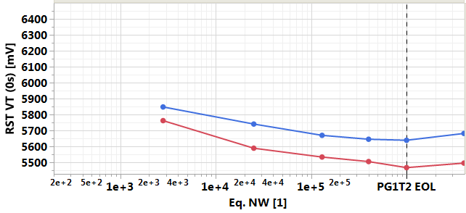
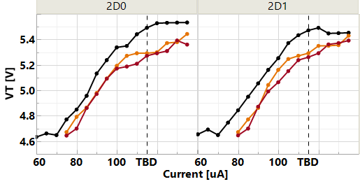
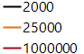
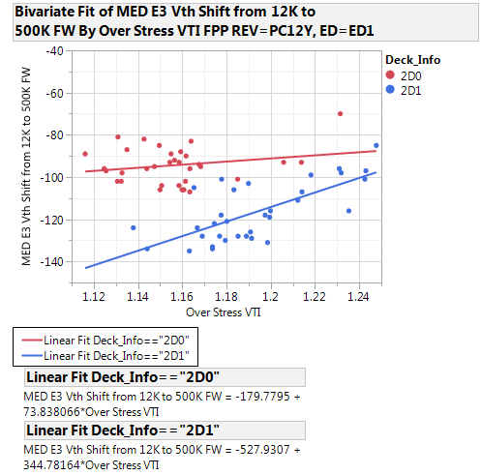
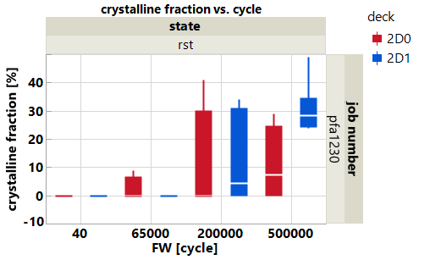

E3 VT evolution
Fuga – VT Evolution Huddle
Intro: Underlying VT evolution (including ‘seasoning’)
2. Observation: Program Curve ‘degradation’ (‘slope3’)
3. Segmentation: EFA/PFA -> under-rst component? (WIP)
Array init. (‘seasoning’)
~ 60min/deck
Prob mon
+ WLR
Problem statement: E3 displays median V_{T} lowering upon cycling
Empirical learning: ED1 D1 is the limiter post ‘seasoning’
Pre-consumption of V_{T} evolution needed for stable/operable RWB, dependent on (i) cumulated ON time and (ii) write ipd
V_{T} shift affected by under-RST / RST latency increase w/ cycles, manifested by over-RST dep. & ‘slope3’ increase post ~ 20k NW
SF VT
 | 1-20 k NW | Proj. 1k-1M NW | Array init
Goal (w/ dyn. Vdm applied) | 120 mV | 150 mV
r7.67 (QW1) status | 125/155 mV | 170/250 mV | 620/560 mV
PRB
(EOS)
Quantification @ ~50 ms write ipd
RWB
AO ON
r7.67
VT evol.
WCbin
opportunity
‘Slope3’
Contribution mode | Algo options | ID process areas
VT evolution (rate) [ > ~130/180 mV] | array initialization dynamic Vdm | (i) SD health (comp./etch/clean) (ii) SD/PM interaction w/ unknown 'contaminants‘ (cell encapsul.)
write ipd depend. [~ 70 mV: 100 μs → 100 ms @10k NW] |  | MECN1.1 trials showing the largest toggle to balance D1 to D0 write ipd dependence
Under-RST [30-50 mV?] | - RST placement - WCbin enable | - Quantification WIP by EFA/PFA - TBD
@ -3σ
20k-1M NW
E3 VT shift [mV]
Link to full PI and model table
Over-RST [1]
Notes:
Tail formation in 2D0 post C2C TD has been shown in some MECN1.1 lots and is being monitored and segmented

Slide 11
V_{T} evolution – Current Status Intro
Problem Statement (r7.67)
1. VT evolution not completed post FF (first pulse), in the range of ~-820/-780 mV in D0/D1 toward EOL (500k FW), resulting in - needed 'array initialization' (aka 'seasoning') to bring device to operable point for SET(RST) VT [~-620/-560 mV w/ 120 min/die test-time] - residual evolution (gap) during op. life, subject to test conditions (e.g. write ipd, etc.) [~-190/-290 mV @10ms write ipd, PG1T2 EOL – WLR flow]. MED and M354S are generally close on baseline material (no tail formation), but in some specific case tail formation is possible (e.g. thinner PL) 2. VT operating point subject to T-bake steps (e.g. 'burn' process), in the range of ~ + 200/+150 mV (@0σ) in D0/D1, resulting in - needed 're-initialization' within component 'burn' to recover VT shift through assembly T-cycle [~230 min/unit test-time] - needed additional 'init' steps within manufacturing chain [e.g. SMT --> > 10h/system test time] (see 3DxP Sync. Meeting, ww25)
focus
Empirical learning: ED1 D1 is the limiter post probe array init (‘seasoning’)
Pre-consumption of V_{T} evolution needed for stable/operable RWB, dependent on (i) cumulated ON time and (ii) write ipd
V_{T} shift affected by under-RST / RST latency increase w/ cycles, manifested by over-RST dep. & ‘slope3’ increase post ~ 20k NW
Contribution mode | Algo options | ID process areas
VT evolution (rate) [ > ~130/180 mV] | array initialization dynamic Vdm | (i) SD health (comp./etch/clean) (ii) SD/PM interaction w/ unknown 'contaminants‘ (cell encapsul.)
write ipd depend. [~ 70 mV: 100 ms → 100 ms @10k NW] |  | MECN1.1 trials showing the largest toggle to balance D1 to D0 write ipd dependence
Under-RST [30-50 mV?] | - RST placement - WCbin enable | - Quantification WIP by EFA/PFA - VT-I based quantification gives 30 mV loss in 2D1 on r7.67 die (PB12X)

Slide 12
Phenomenological Category* | Supporting experimental signatures | Conflicting/weaknesses | Next steps
SD bulk conduction change evolution due to ‘incorporation’/’release’ of mobile ‘contaminants’ (etch residual/foreign elements) favored by Joule heating (?) w/ op. pulses w/ ‘seal’ films impacting ‘transfer’ process Elemental redistribution within SD bulk by current flow during cumulated operations Note: - Relations 1.↔2. to be decoupled - interaction w/ vertical and lateral interfaces to be broken-down | VT shift & write ipd dep. observed also in SD-only (S15C/S26A) E3 & E2 shift correlated in 1-12k FW (die/bit level) VT evolution dependence on total cumulated ON time @ > ~I_{RST}, leading to current ‘seasoning’ approach (‘pre-consumption’) E’s SWR showing relatively large toggle (e.g. MECN1.1. in D1) AC I-V shows ~ parallel shift (STS ~ const.) through cycles w/ low-field current increase w/ cycles, while IT ~ const. (?) Evolution 'rate' dep. on op. T (higher T, shallower evolution) explained w/ VT tempco change (monotonic ↓ w/ cycles) VT evolution shown to be T-bake recoverable up to nearly FF VT value (w/ some residual ~300-400 mV post 300C-100h) T-bake shift ~ insensitive on SET VT, but prop. to VT evol. SD composition/etch/ clean interaction (1st/2nd cut), T-anneals (82L, SOD-CCMP, 67L TEOS dep., …), cell encapsulation & critical layers for transparency/generation/gettering RST/SET showing != elemental profile, w/ RST showing stronger gradient than SET Elem. re-distribution minimized post high T-bake (250C,2h) [more data needed], apparently in line w/ T-bake VT shift | Physical Analysis methods (TEM, TOF-SIMS, EELS, …) limited capability – need breakthrough Main elem. profile movement driven by first e-pulse, w/o clear change through cycles (differently from μ-gap model based proj.) No clear deck differential in SD elem. (SET/RST) distributions (not in line w/ the differences in SET state VT shift 'bake-recovery') No clear interlink w/ write inter-pulse delay dependence evidence (on observed time scale) | Continuous SWR analysis and funding based on Cell-PI model table (link), w/ particular focus on fully segmenting T-anneals impacts and related break-down (link) for any opportunity identification Next key reads: L-trt opt. (154142 @probe) High-level table in next slides L0/L1D: T-anneals impact on cell stack material properties segmentation (Sachin J. /Andrea G.) – Seal film role itself to be decoupled See dedicated table Exploration of ‘seasoning’ conditions w/ opt. currents (?)
PM(SD?) under-RST due to: Electro-thermal efficiency reduction (R-balance evol.) leading to ↑ RST current PM(SD) mass-transport upon electrical (and cumulated) pulses impacting elem. profile and RST latency Note: SD/PM progr. response 'weakening' (beyond electro-thermal) to be included/decoupled | VT shift affected by under-RST / RST latency increase w/ cycles, manifested by over-RST dep. & ‘slope3’ increase post ~ 20k NW Dies w/ larger RST latency (larger VT sensitivity w/ progr. PW) also show steeper ‘slope3’ (more sensitivity w/ progr. curr.) VT-I I2, I3 evol. shown to be 'irreversible' post T-bake (250C,2h) VT-I Pareto shows D1 PM amorph. element degradation > 12k FW RST algo changes impact: PC12V->PC12W ~ +25 mV E3 shift in 2D1 (I_{RST} change) Corr. runs: VT evol. ↓ in 12k-500k when over-RST increased 12k-500k E3 shift correlating w/ I3 at bit-level r7.67 PFA showing D1 PM cryst. fraction up to ~35% @500k FW (PC12V), located in middle PM (suggesting relation w/ lateral loss) T-bake recover ‘slope3’ (‘slope1’) evolution (besides VT evol.) Limited PFA suggesting flatter PM Te/Sb elem. profile (D1) in RST state w/ longer PW (more data needed) VT-I Pareto shows loss of non-PM amorphization related DVT | Previous r7.64 PFA not showing PM amorphization marginality (need reconciliation) Electrical to physical correlation not fully aligned w/ expectations (35% PM un-amorphization should translated in more that 30-50 mV) No clear tail formation, but need to check RST VT sigma degradation w.r.t. VT value (slight degradation) - | Re-targeting of WC bin through RWB/ULR runs (and implementation in WLR) ~ 30 mV opportunity Segmentation of 2D1 under-RST WLR Data-mining: VT sigma Vs. VT, I3 shift (VTI mon.), RST PW dependence w.r.t. key SWRs PFA (volume): (i) Review recent RST state movie through cycles (POR); (ii) RST Current / PW impact; (iii) SS R2S to correlate w/ EFA learning on window closure segmentation EFA: SS R2S VT-I based pareto on key splits: bMECN, 2-step clean, seal opt., In-doped SD
… 1/2

Slide 13
Phenomenological Category* | Supporting experimental signatures | Conflicting/weaknesses | Next steps
Dielectric ('sealing‘/’fill’) bulk 'incorporation'/ 'release' of mobile charges from/to cell surroundings, affecting electrostatic and cell VT | BD ‘stress’ impacts RST VT, similarly to ‘cycling’ (only preliminary observation) VT evolution is independent on its VT, as well as T-bake shift (which is still proportional to VT evolution) | Notes: VT evolution not normalized by total charge Note: PM/SD high-non-equilibrium, low viscosity in ON state regime expected to bring to charge neutrality | Datamining on existing WLR data (~30mV shown post 100min BD) EFA: (i) RWB data collection/ WLR eng. run w/ Bias stress time skew; (ii) VT evolution Vs. B/C-cell bias of adjacent cell (?)
SD(PM) 'bulk' subject to mechanical stress evolution within overall cell stack environment (E's, 'seal', …) | L0 data showing PM density differential between cryst./amorph. (no data on SD) PG1T1 EOL PFA showing systematic difference in tSD (PM) for SET/RST states (preliminary data) | VT evolution displayed also by SD in different integration scheme (CLV, …) VT evol. at short ipd ~ normalized by total time spent at I_{RST} (not dependent on SET pulse) | Systematic PFA char. [Yao-Feng C.] systematic analysis on available material from cycling movie [ww40.5] key SWRs (In-doped SD, MECN1.1, …) identified based on L0 ‘mechanical’ properties char (‘stress’, …) TCAD thermo-mechanical stress sims requested for expectations estimates before submission [Andrea Gh.]
E's bulk, E/SD, E/I R-like component ('irreversible') evolution (transformation) by cell stack Joule-heating, leading to VT reduction | E’s Rs(T) L0 char. showing irreversible resistance (rho) decrease w/ (T,t) I2/I3 increase through cycles not recovered by High-T bakes (250C,2h), suggesting ‘irreversible’ change in cell electro-thermal progr. efficiency | Not fully explaining contribution from ‘slope3’ evolution, due to its T-bake (250C,2h) recoverability | -
Formation of a parallel conductive path along cell side-walls (etch residuals, such as W, etc.) | PFAs highlighting Process integration marginalities (e.g. E1 ‘knee’ PFA w/ adjacent low-VT/high-VT bits fingerprint) | - | - PFA on pre-bake ambient meterial. Is E3 tail formation to be attributed to residual along cell walls?
Old VT evolution model scorecard (2017-Jan) – more detailed (to be updated): link
2/2

