Slide 1
Ihold vs Electrical Distance
See the notes on the left margin of many of these slides for instructions on their use.
S15C QTT
asebasti

Slide 2
Summary
Lot 9993272 wf 9 cell rev 7.64
Ihold vs. ED (Electrical Distance) vs Deck vs. Cycles
  Ihold increases with lower access resistance (lower ED)
  Ihold on Deck 1 lower than Deck 0
  Ihold increases with cycles
Ihold vs. buffer capacitance
  With same ED, cells with WL buffer connected to LWL have Ihold higher than cells with buffer connected at HNREG (+1.2uA on virgin cells, +2.3uA after 10Kcycles)
Ihold vs. LWL voltage
  Small trend of decreasing Ihold with lower LWL (from 13.5uA to 12.4uA, when LWL goes from 3.6V to 1.7V)
Ihold vs ON-IV slope (ramp down)
  Lower ramp down time → lower Ihold (from 20us to 500ns (POR is 2us) → Ihold from 14.4uA to 12.3uA (with very fast ramp rates, there could be detection problems)
Next: I hold vs Temperature

Slide 3
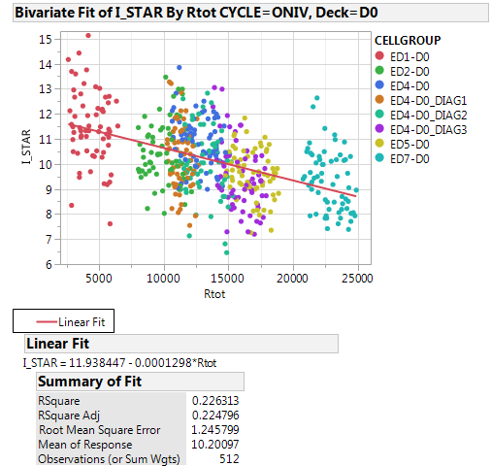
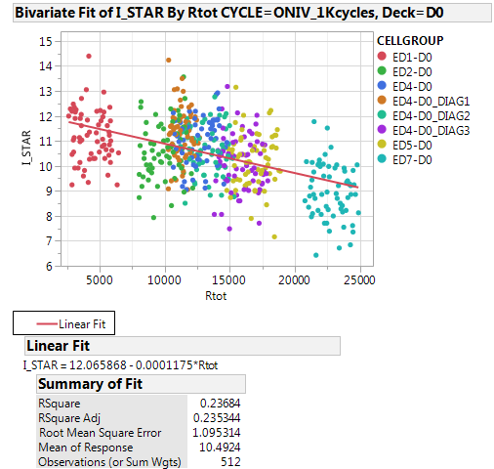
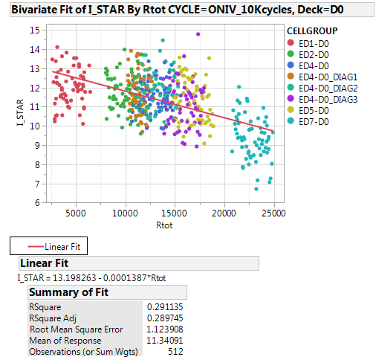
9993272 wf 9 cell rev. 7.64 : Deck 0
Virgin
1Kcycles
10Kcycles
Values of R used for Rtot calculation: WL : R ~10; BL : R ~ 4.5
Ihold increases with lower access resistance
Ihold increases with cycling
ED4-D0, ED4-DO_DIAG1, ED4-DO_DIAG2, ED4-DO_DIAG3 are ED4 cells in different positions in the QTT, trying to imbalance WL and BL length

Slide 4
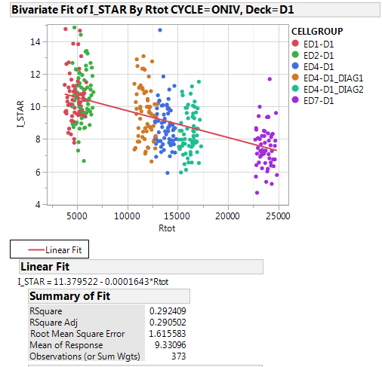
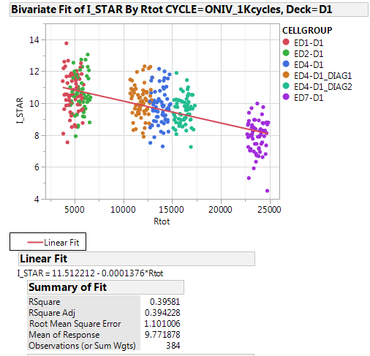
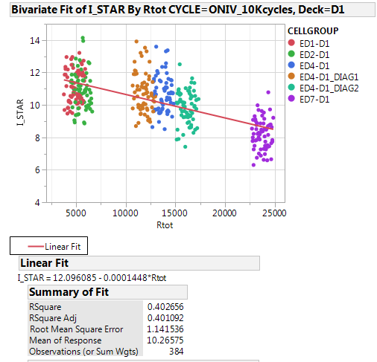
9993272 wf 9 cell rev. 7.64 : Deck 1
Values of R used for Rtot calculation: WL : R ~10; BL : R ~ 4.5
Ihold increases with lower access resistance
Ihold increases with cycling
Ihold of D1 lower than D0

Slide 5
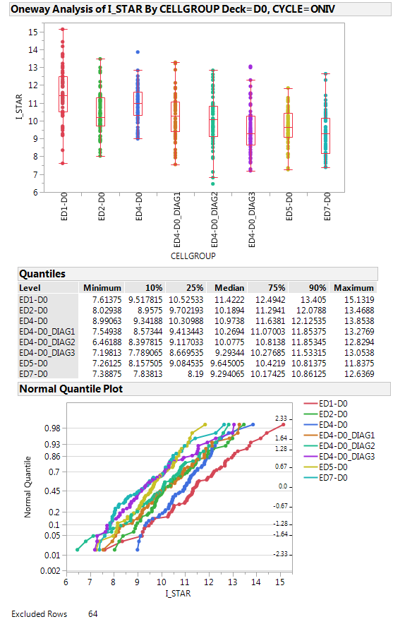
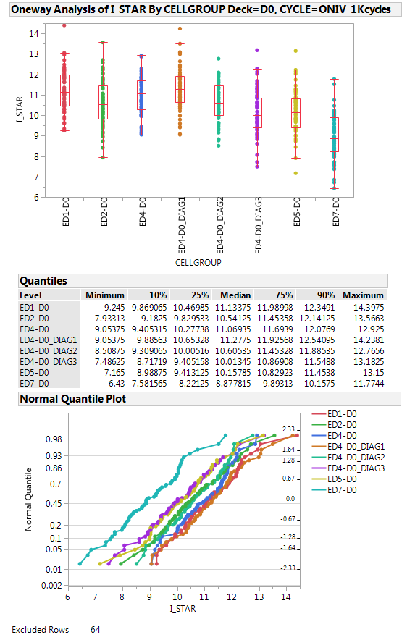
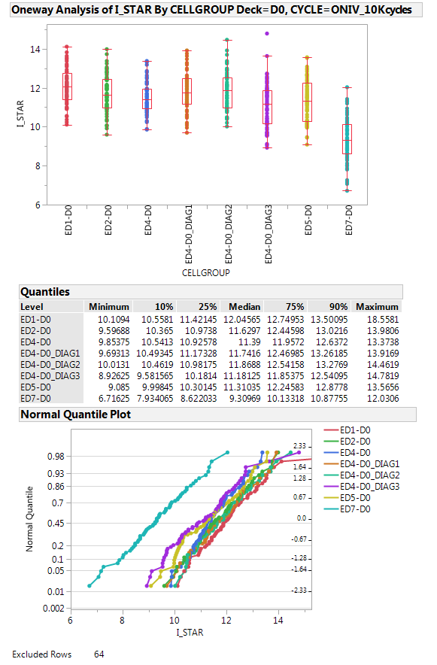
Ihold on D0: data

Slide 6
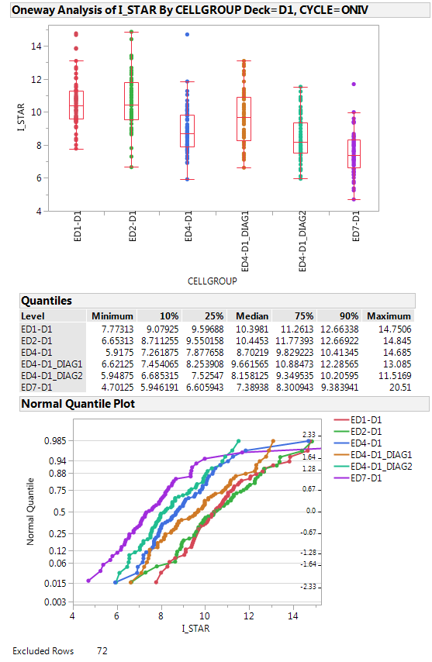
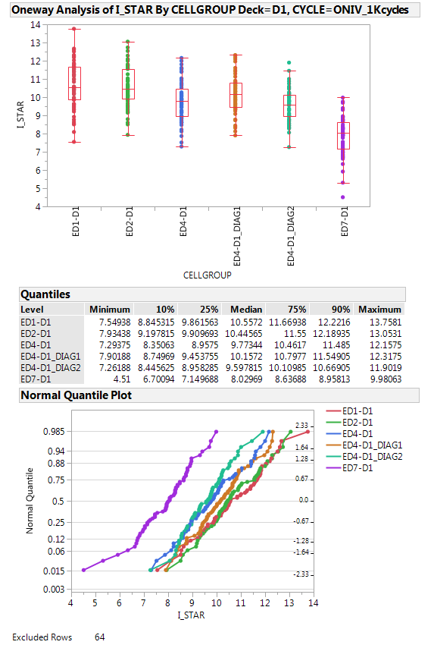
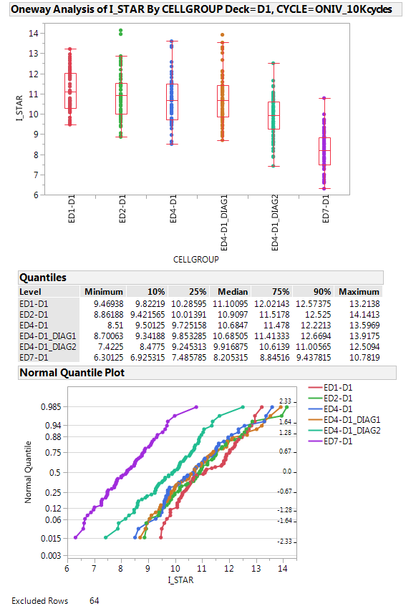
Ihold on D1: data

Slide 7
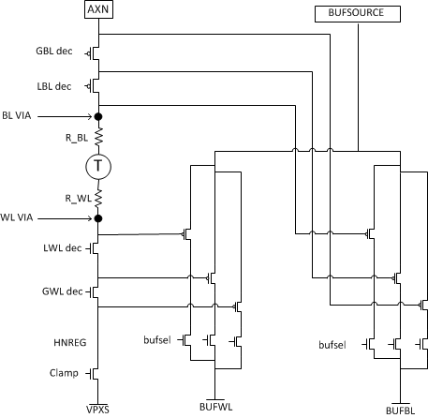
ON-IV characterization
Array path
Scheme of WL buffer connections:
Local buffers
Global buffers
AXN/HNREG buffers

Slide 8
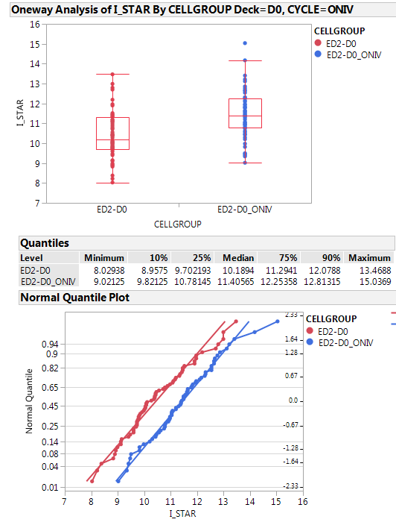
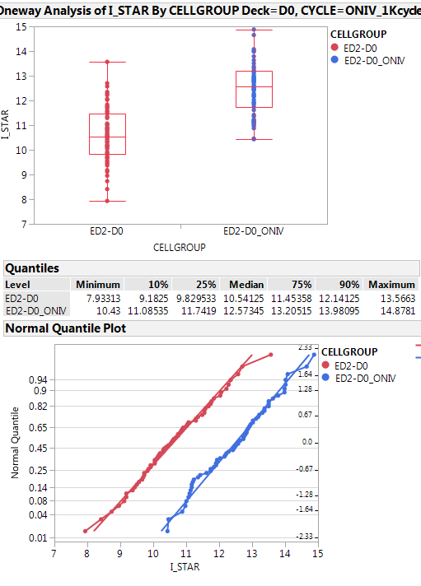
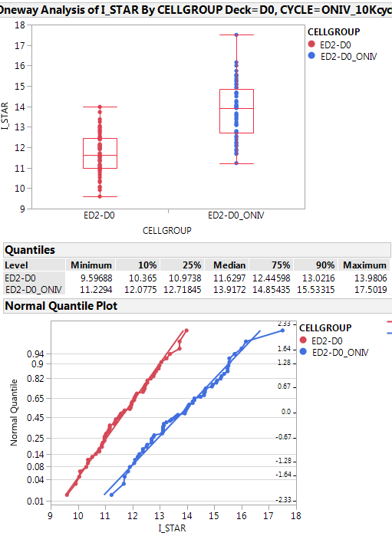
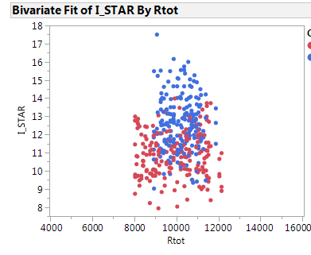
Effect of WL buffer capacitance
Ihold vs. access resistance → same ED !!
ED2-ONIV cells: WL buffer connected at LWL (higher capacitance) → higher Ihold
ED2 cells: WL buffer connected at HNREG ( lower capacitance seen by the cell)

Slide 9
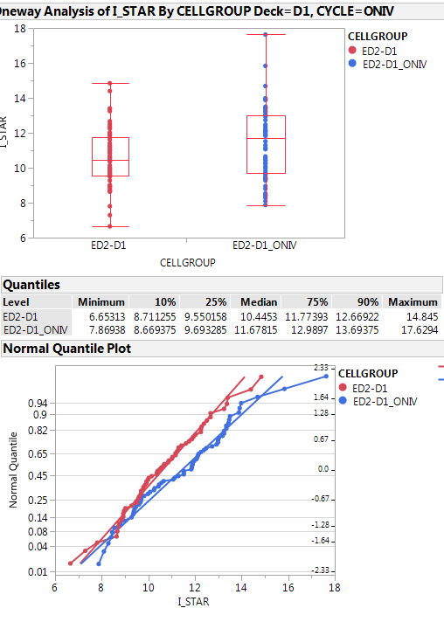
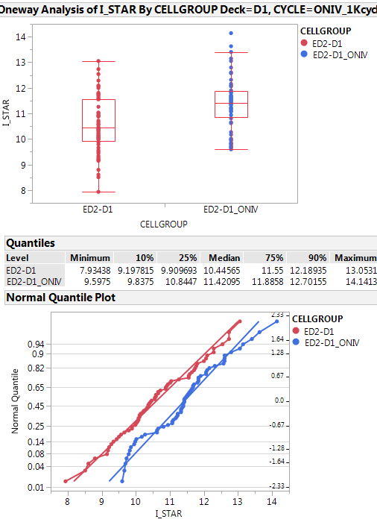
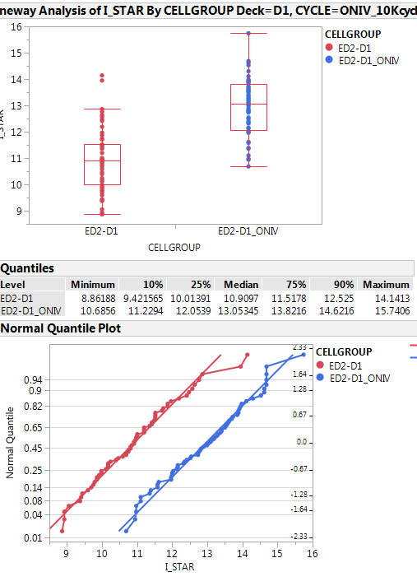
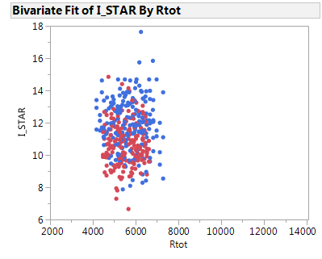
Effect of WL buffer capacitance (deck 1)
Ihold vs. access resistance → same ED !!
ED2-ONIV cells: WL buffer connected at LWL (higher capacitance) → higher Ihold
ED2 cells: WL buffer connected at HNREG ( lower capacitance seen by the cell)

Slide 10
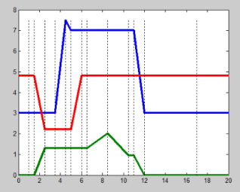
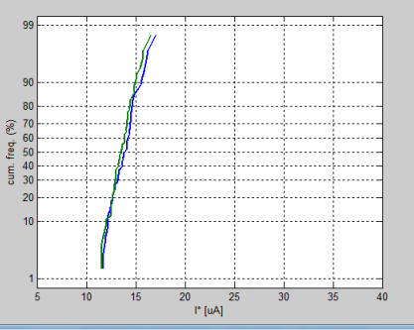
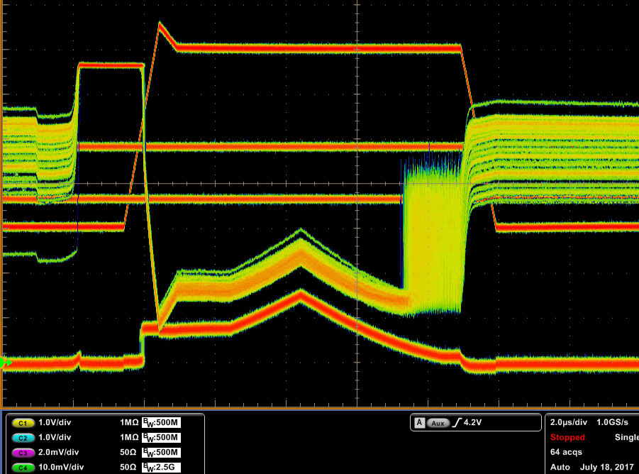
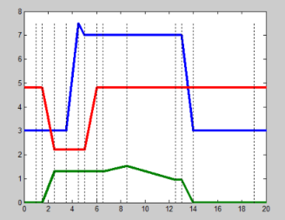
Imax and LWL segmentation (ED2-ONIV cells after 10kcycles)
std
Same median value
Imax =60

Slide 11
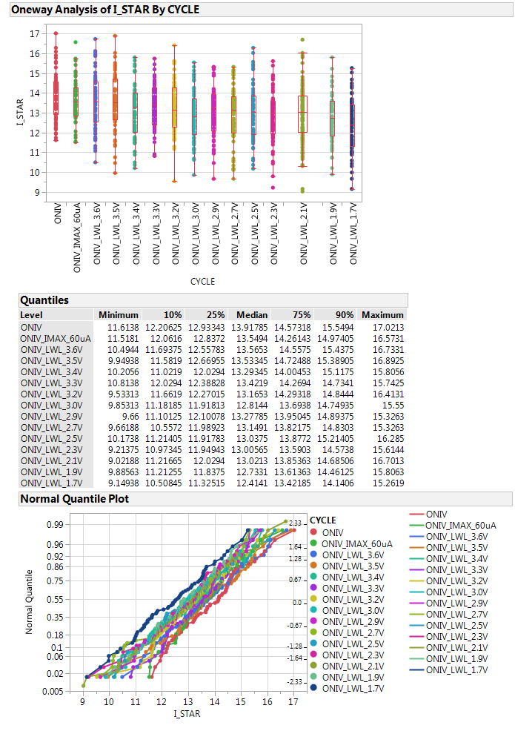
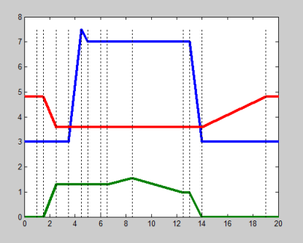
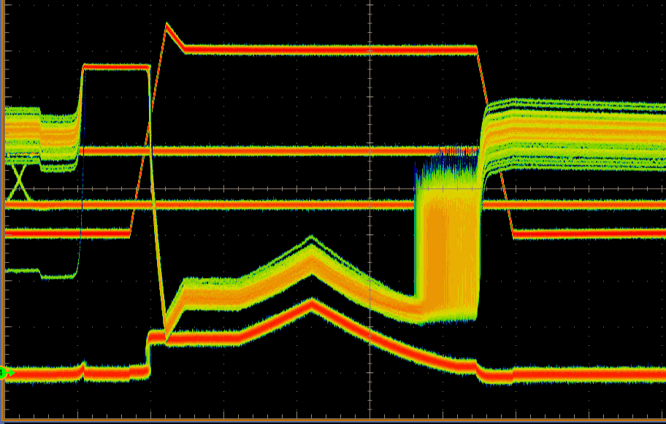
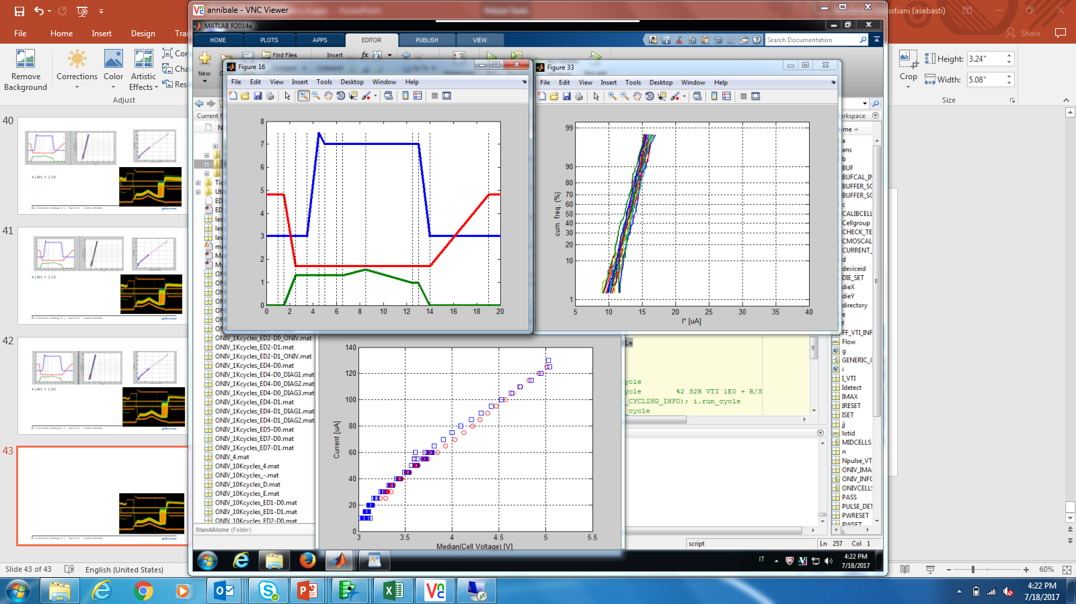
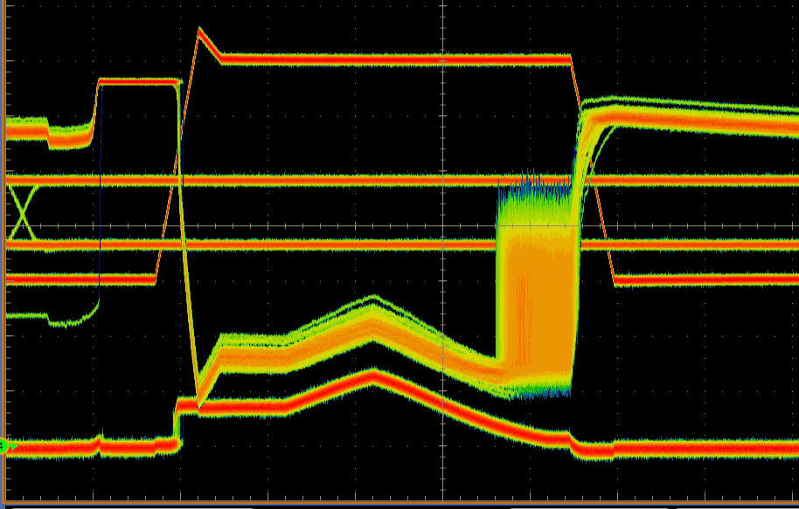
LWL=3.6V
LWL=1.7V
Imax=60uA
LWL is low for all the ON-IV measure
LWL: from 3.6V to 1.7V
Ihold shows a small decrease (from 13.5uA to 12.4uA, when LWL goes from 3.6V to 1.7V)
ON-IV full curve

Slide 12
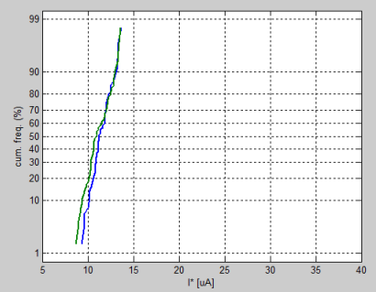
ED2-CELLS after 10Kcycles
Repeat same experiment of previous slides (LWL segmentation) on std cells (WL buffer connected at HNREG)
std
Imax =60

Slide 13
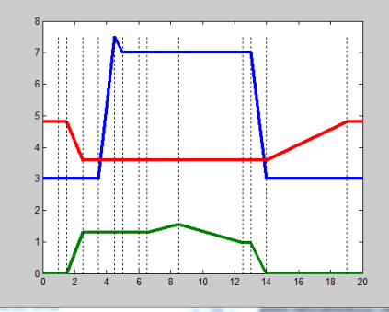
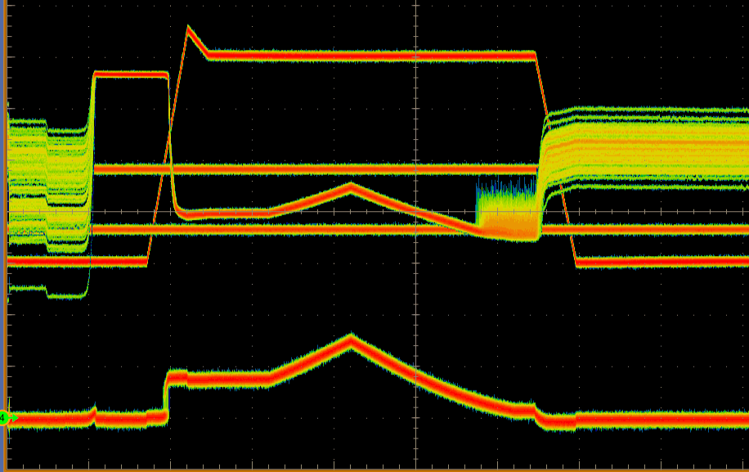
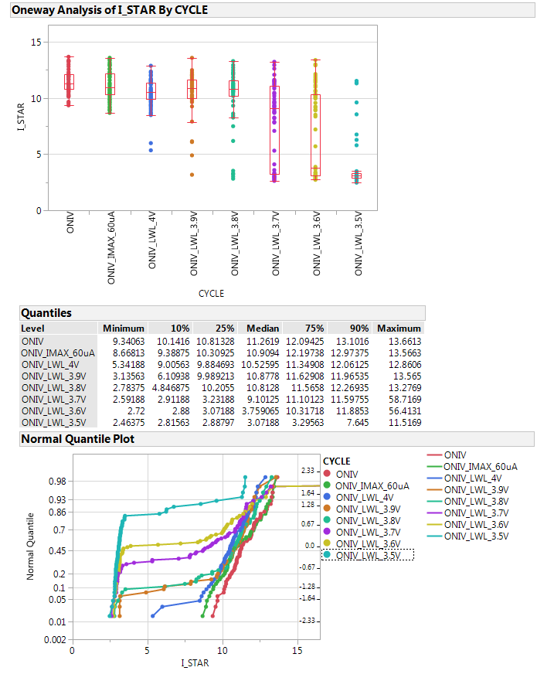
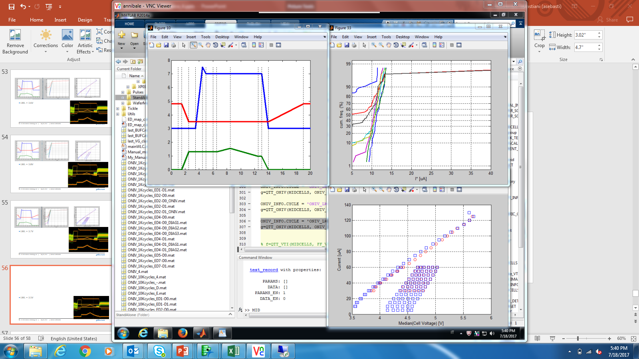
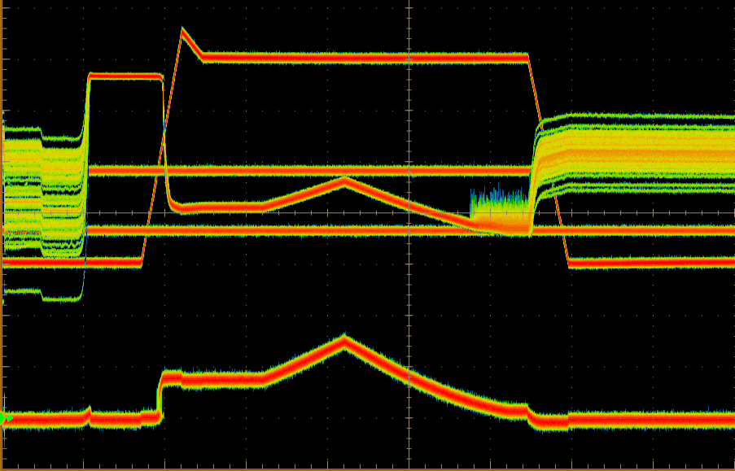
LWL=3.6
LWL=3.5
Detection problem
Detection issue on these cells, when LWL is low
ON-IV
Decreasing LWL, higher series resistance and voltage drop at HNREG

Slide 14
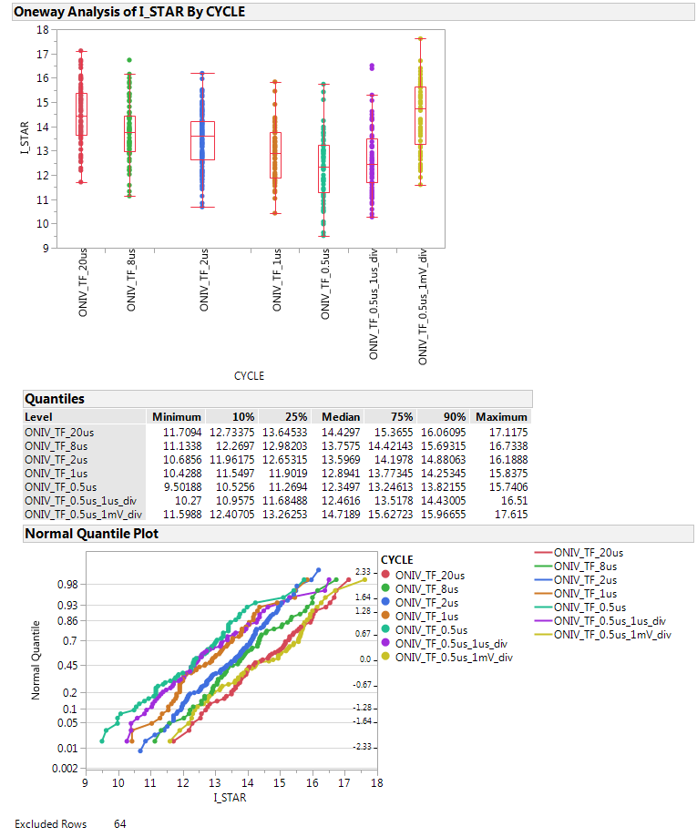
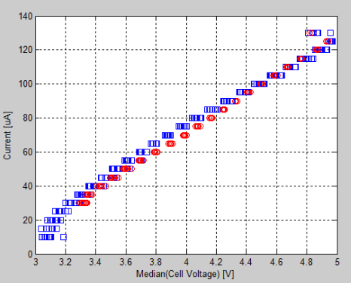
Ihold vs ramp down (ON-IV slope)
ED2-D0_ONIV cells, 10Kcycles
VPXS trace: 2mV/div
ON-IV: all curves
(red: ramp up
Blue: ramp down)
Lower ramp down time → lower Ihold
(from 20us to 500ns; POR is 2us)
No effect on ON-IV curve
With 500ns time, there is an impact of scope resolution of time axis
( small increase of Ihold with 1us/div instead of 2us/div, +0.12uA)
VPXS trace: 2 mV/div (POR conditions). With 1 us, Ihold is higher (+2.3uA)

Slide 15
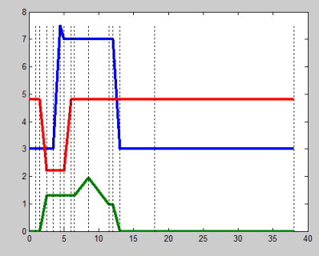
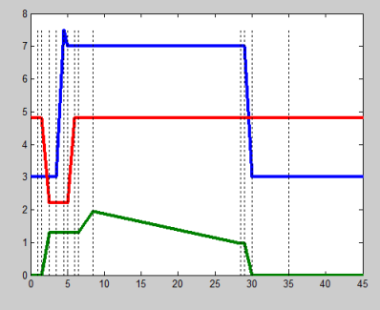
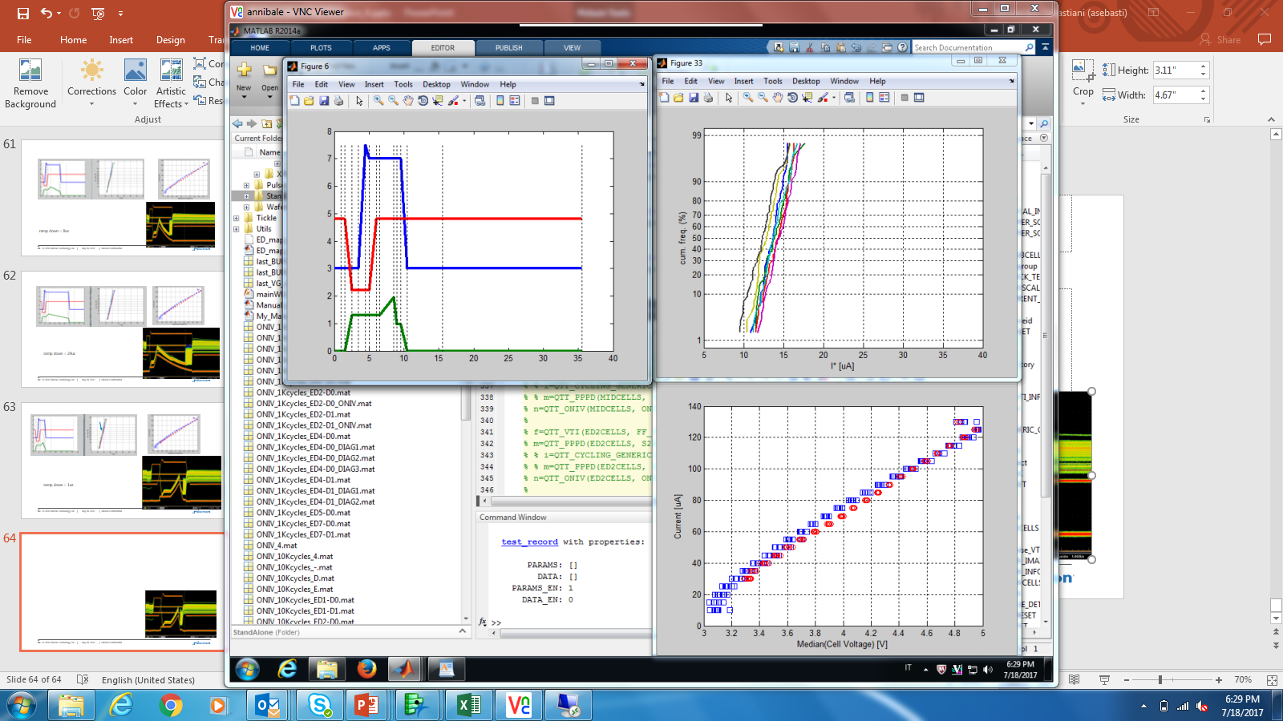
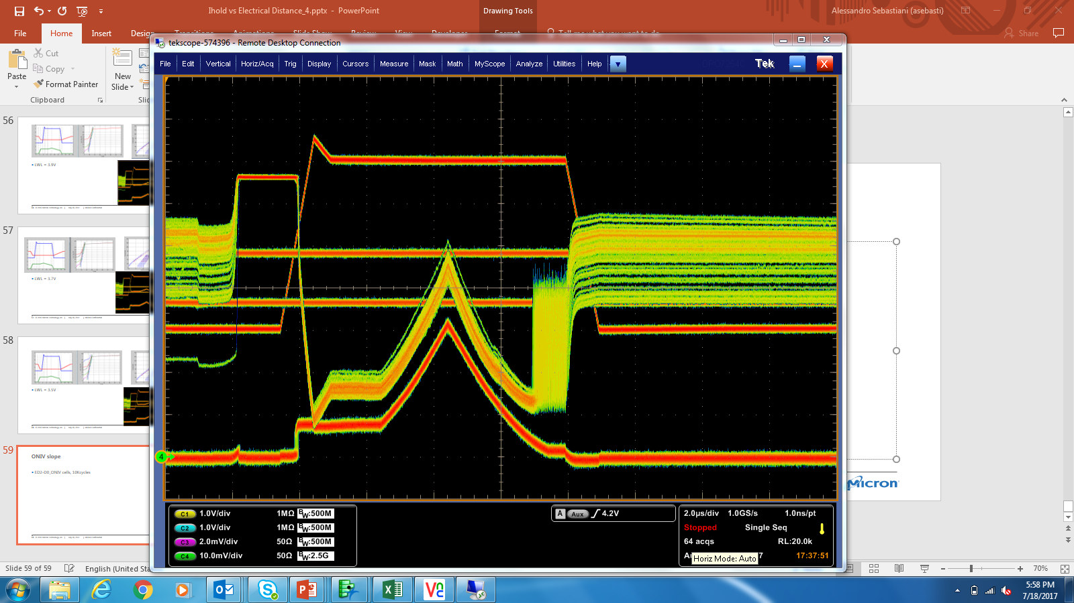
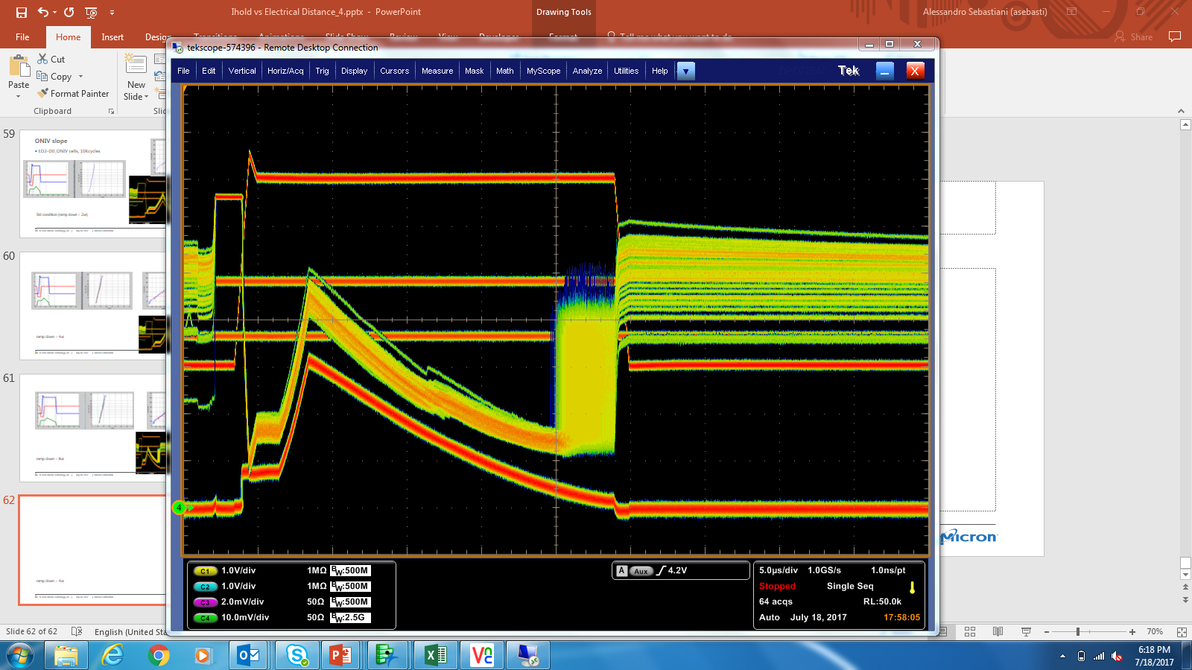
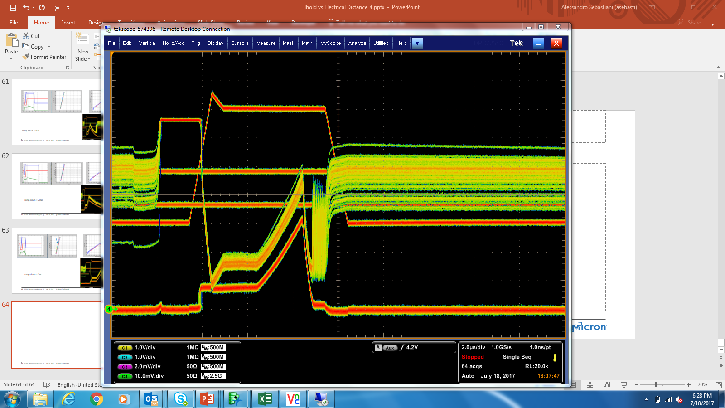
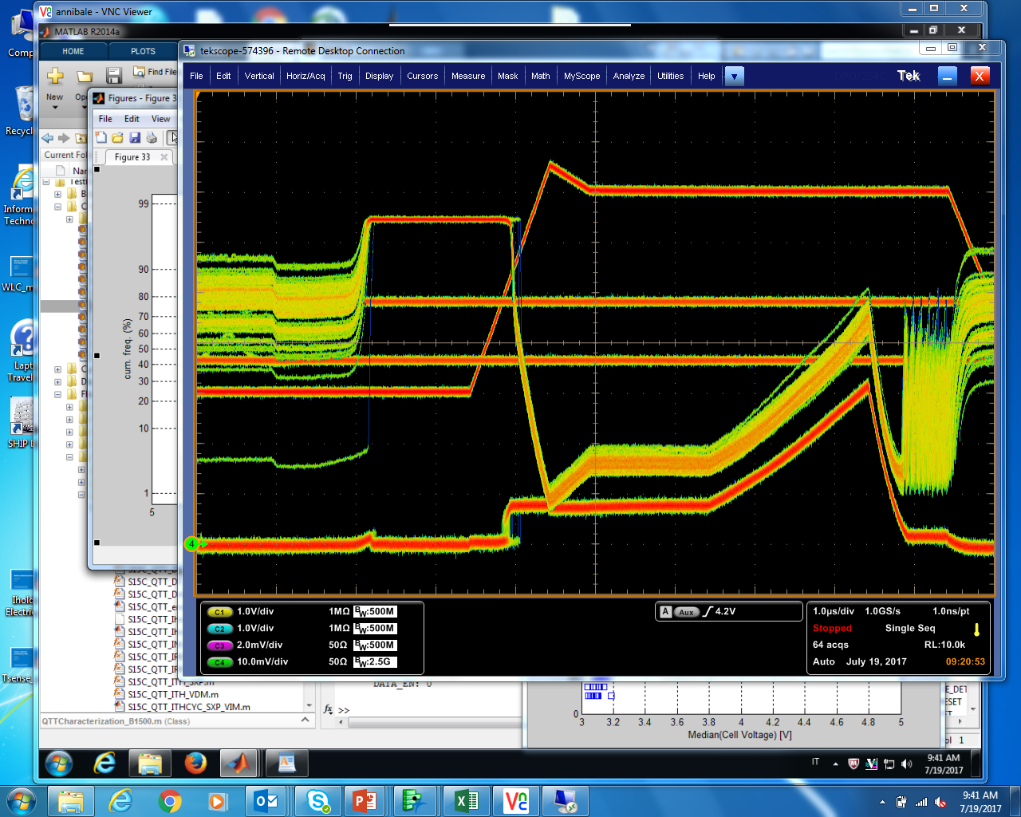
ramp down = 20us
Std condition (ramp down = 2us)
ramp down = 500ns
ramp down = 500ns

Slide 16
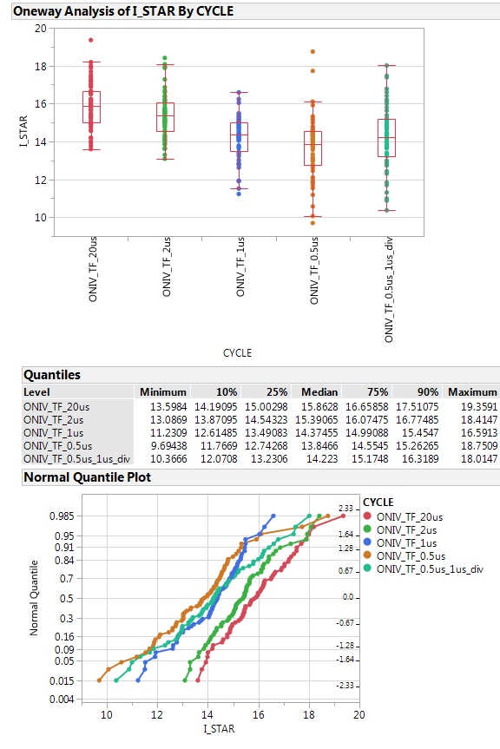
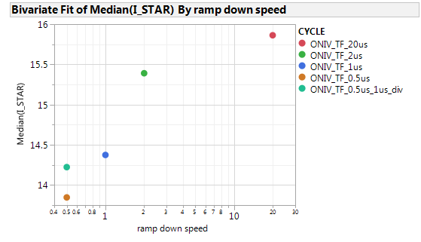
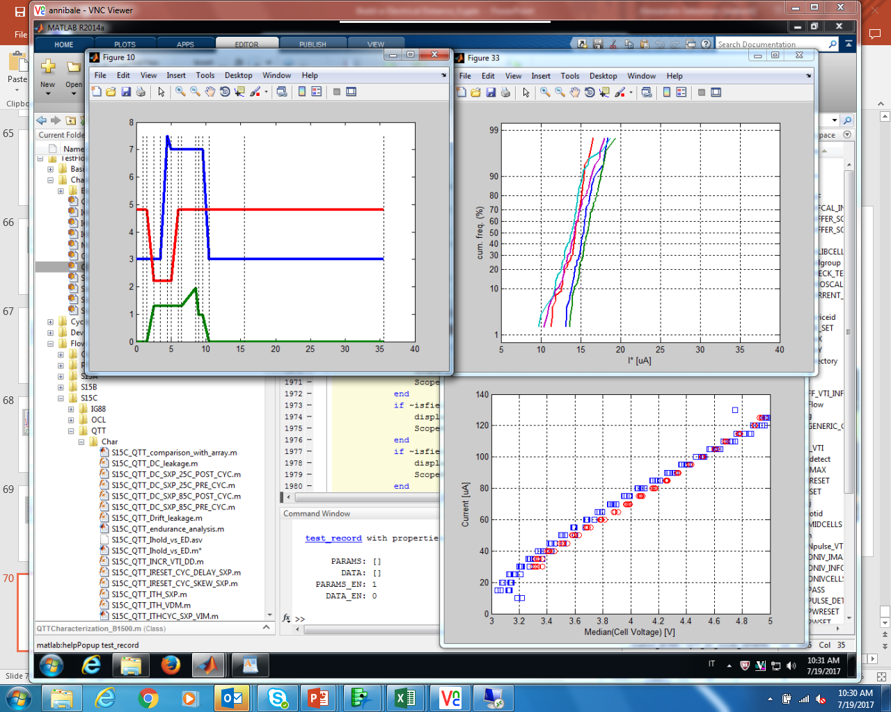
Ihold vs ramp down (ON-IV slope)
ED2-D0_ONIV cells, 10Kcycles
VPXS trace: 1mV/div
Median values
Lower ramp down time → lower Ihold
(from 20us to 500ns; POR is 2us)
No effect on ON-IV curve
With 500ns time, there is an impact of scope resolution of time axis
(Ihold increases with 1us/div instead of 2us/div, + 0.37uA)
ON-IV: all curves
(red: ramp up
Blue: ramp down)

Slide 17
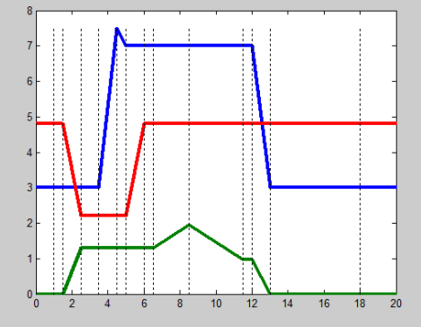
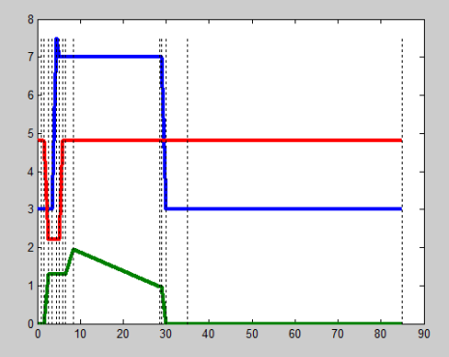




Ihold vs ramp down : waveform and traces
2us
20us
1us

Slide 18



Ihold vs ramp down : waveform and traces
500ns
500ns
Scope 1us/div

Slide 20


LWL = 1.6V

Slide 21


LWL = 1.4V

Slide 22


LWL = 1.2V

Slide 23


LWL = 1V

Slide 24


LWL = 0.8

Slide 25


LWL = 0.6V

Slide 26


LWL = 0.4V

Slide 27


LWL = 0V

Slide 28
Next
Misure su ED2-ONIV e ED2-std
Misure dopo 1Kcycles
Valutare dipendenza da capacita’
LWL dependence ? → 1
Deck 1 ?
Aumentare statistica ?
Cell rev piu’ recente ? (7.64?)
Misurare a pari BL resistance e varie WL che coprono I vari ED
Slope della ON IV !!!!!!!! (up, down, up/down) → 2
Cell rev. trend chart

Slide 29

Ihold vs. ED: preliminary data
S15C QTT
Lot 9922922 wf #1
Cell rev. 7.45; CMOS rev. C17
Flow:
  FF
  ON-IV
Ihold decreases with higher
electrical distance
Data only from D0; test @ 25C
Scope traces (not reported here) are ok.

Slide 30



9993272 wf 9 cell rev. 7.64
Trend of First Fire with access resistance

Slide 31




Slide 32


WL : R ~10
BL : R ~ 4.5

Slide 33




Slide 34

Vt detection (Second Fire routine)
Ilim=12uA (all cells have oscillations)

