Slide 1
V_{T} sigma: scaling projections
For the DTS of 30S
Paolo

Slide 2
V_{T} sigma: scaling rules
The most evident scaling rule of the sigma V_{T} is with the SD thickness (t_{SD}):
related with elemental composition fluctuation
In fact, being:
related with SD thickness fluctuation
V_{T} distribution includes both the b2b variability and Bounce:
where:
The E_{TH} fluctuation term is related with the E_{G} variability and in this model does not scale with area. In the past we obtained reasonable modeling with 1% stoichiometry fluctuation for each element of the SD (link at JET meeting)

Slide 3
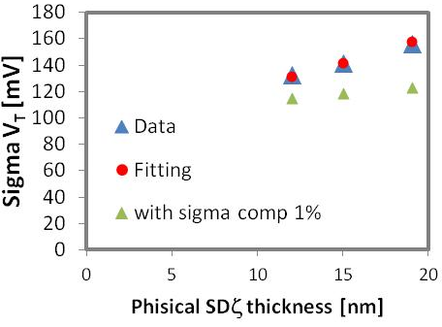
V_{T} sigma: PTX – 10S comparison and 30S projection
S15 data reports today the sigma V_{T} ~120 mV in reasonable agreement with PTX data (array PTX data are also a bit worse as a consequence of the not optimized process control)
Coherently with model (previous slide) we can conclude that we do not expect a worsening scaling of the sigma V_{T} with cell area scaling
Key point: for 30S we propose to assume 120 mV as target value for sigma V_{T} of DTS
S15 data
PTX

Slide 4
Back-up

Slide 5
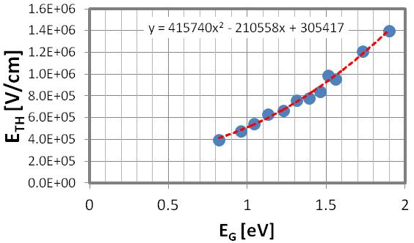
Sigma E_{G}:
Then we can computed the sigma of E_{G} due to the statistical fluctuation of the elemental concentration α_{i}:
From the experimental trend (obtained also on S15):
This local fluctuation (die level) of the elemental composition cannot be experimentally measured. We can suppose it in the range of 1%.
It is a % fluctuation, so it does not scale with volume/area.

Slide 6
Possible influence of discreetness nature
If we suppose a Poissonian distribution of the number of traps (N_{T}) inside the SD
N_{T} fluctuation will be correlated with a variation of the activation energy for conduction E_{A} inside the SD
;
Dividing member-by-member:
Only with a value of N_{T} inside the SD < 25 the Poissonian spread of N_{T} is expected to play a role. Reasonable values for N_{T} are in the range of thousands (on 10⁵ atoms).

