Slide 1
Ihold vs Electrical Distance
See the notes on the left margin of many of these slides for instructions on their use.
S15C QTT
asebasti

Slide 2
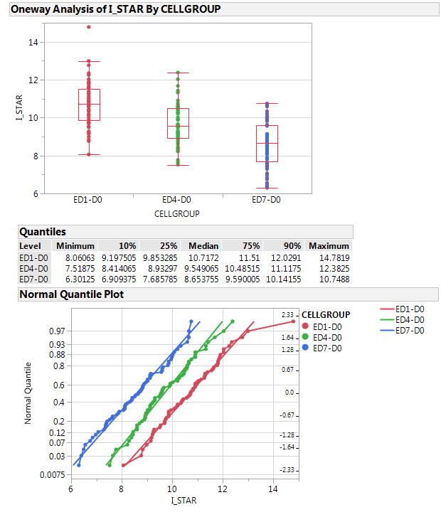
Ihold vs. ED: preliminary data
S15C QTT
Lot 9922922 wf #1
Cell rev. 7.45; CMOS rev. C17
Flow:
FF
ON-IV
Ihold decreases with higher electrical distance
Data only from D0; test @ 25C Scope traces (not reported here) are ok.

Slide 3
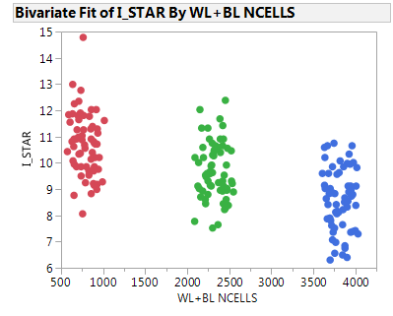
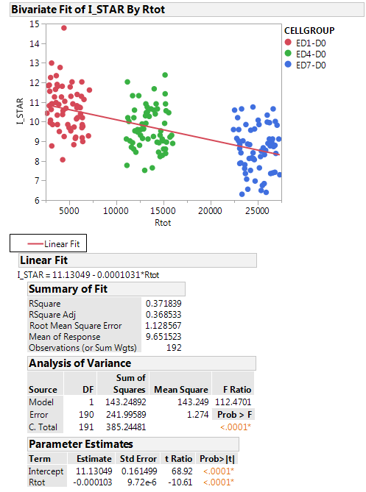
Tot WL+BL length in number of equivalent cells
(WL length * ~12Ohm/sq + BL length * ~4.5Ohm/sq)
Slope : -0.1uA / Kohm

Slide 4
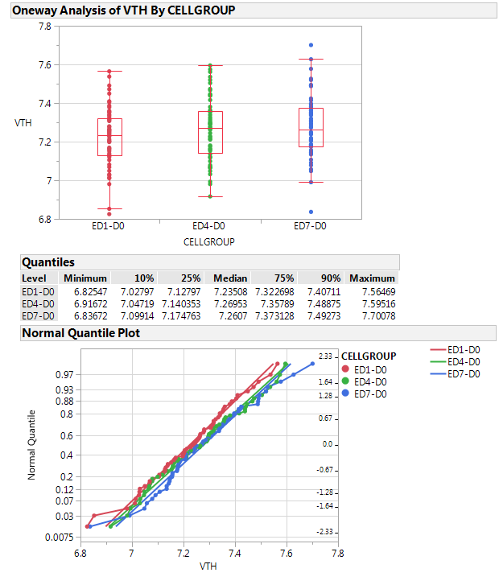
First fire
No trend of First fire with ED

