Slide 1
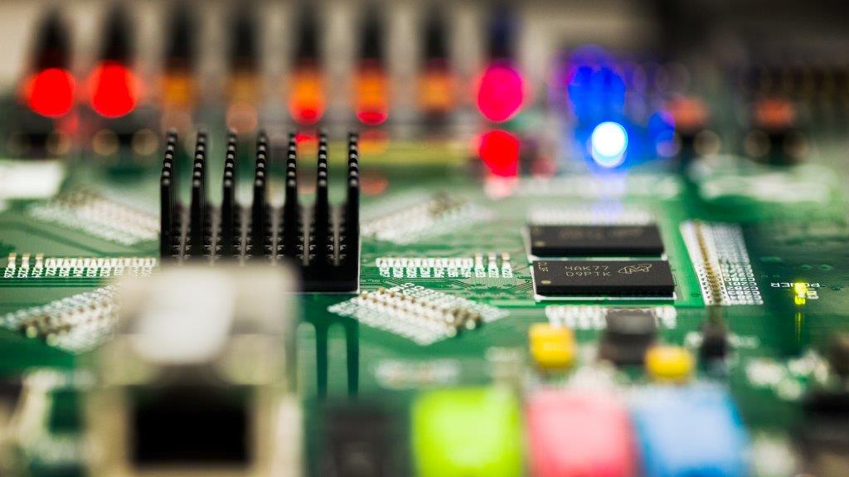
WC top lamina
To create this effect:
From Selection Pane, hide Tinted Rectangle.
Use Change Picture command to place photo. Or replace it with a Clipboard paste or a drag and drop from a folder.
Unhide Tinted Rectangle and set it to desired level of transparency. (25% usually works well.)
From the Title Slide layout, copy and paste the circuit line and the logo onto this slide.
See the notes on the left margin of many of these slides for instructions on their use.
Subtitle
Speaker name and title
©2016 Micron Technology, Inc. All rights reserved. Information, products, and/or specifications are subject to change without notice. All information is provided on an “AS IS” basis without warranties of any kind. Statements regarding products, including regarding their features, availability, functionality, or compatibility, are provided for informational purposes only and do not modify the warranty, if any, applicable to any product. Drawings may not be to scale. Micron, the Micron logo, and all other Micron trademarks are the property of Micron Technology, Inc. All other trademarks are the property of their respective owners.

Slide 2
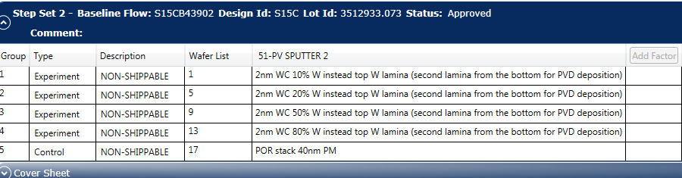
Movie after Wlam1 etch
AUS:
AUS-17-F4-13524
AUS-17-F4-13525
AUS-17-F4-13526

Slide 3
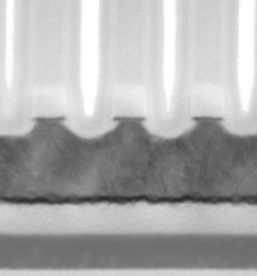
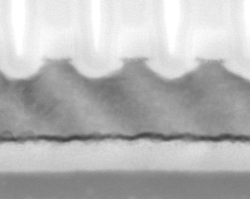
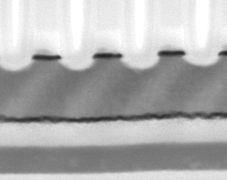
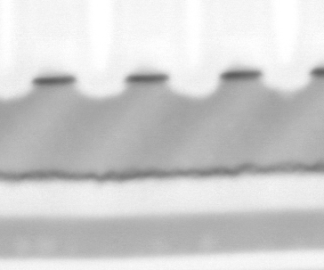
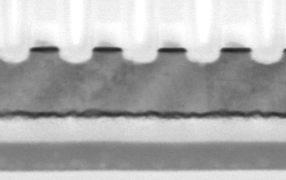
Images
WC- 20% W
WC- 10% W
WC- 50% W
WC- 80% W
POR W lamina

Slide 4
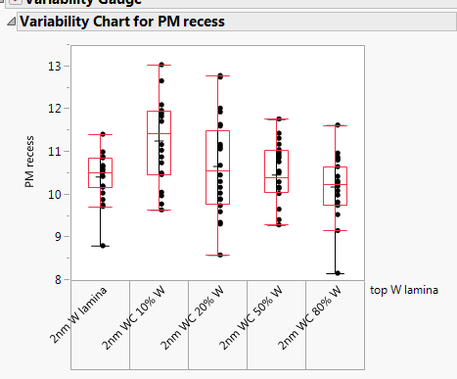
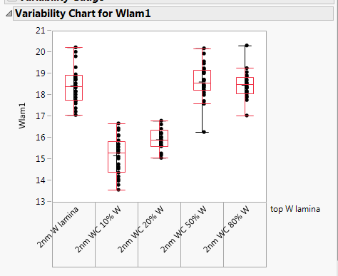
Measurements
Recess into the PM is roughly matched ( only the low W amount has 1nm more recess)
The Wlam CD for the 10%/20% W is reduced, need to readjust the time for that 2 compositions

Slide 5
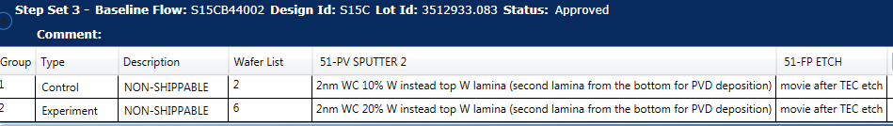
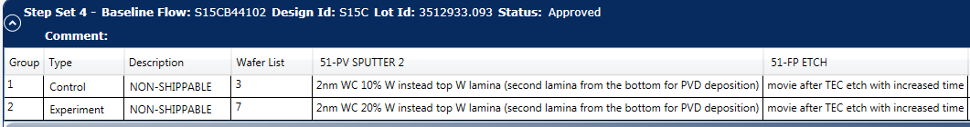
Follow-up for lowest W content alloys
Since the etch time for W lamina is already at the edge of tool capability it was decided to skip the Wlam etch doing a time skew on TEC etch time to clean up possible recess in EoT areas

Slide 6
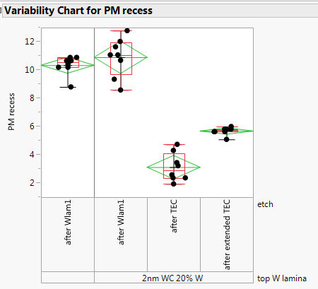
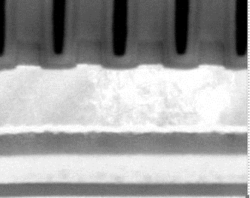
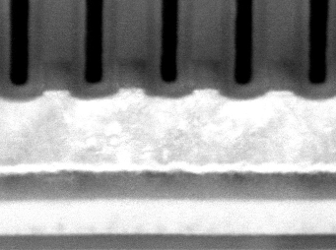
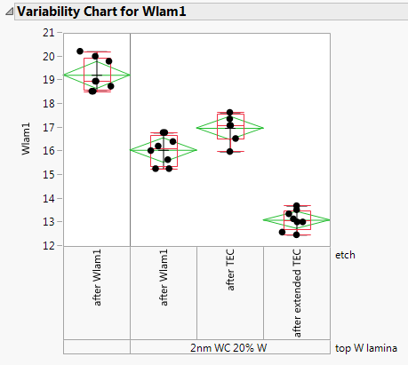
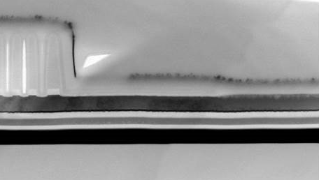
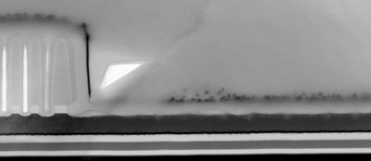
Results after TEC etch
POR TEC
Extended TEC
On 20% W also skipping the Wlam etch we always have a lateral OR of the lamina
EoT areas are clear

Slide 7
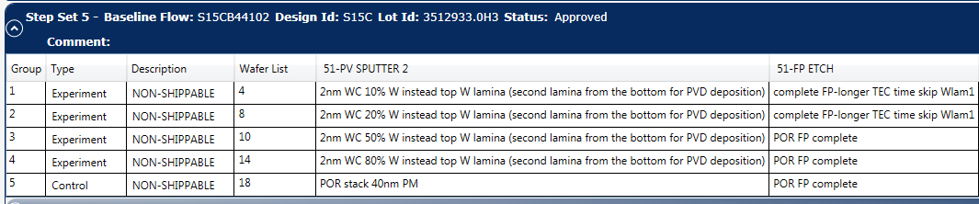
Complete cut after FP etch after

Slide 8
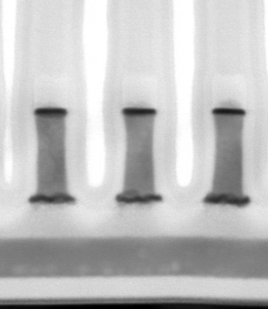
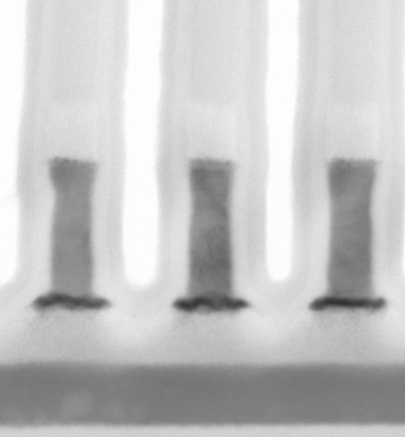
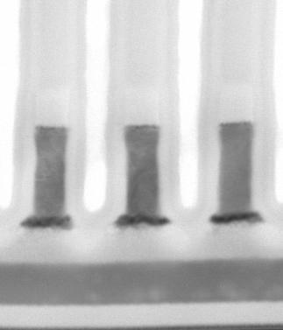
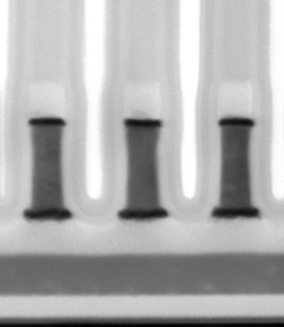
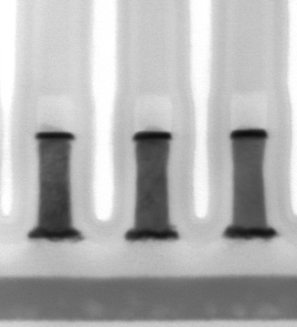
Images
POR 2nm W
WC 10% W
WC 20% W
WC 50% W
WC 80% W
On lowest W splits lamina
Is not able to protect the PM from
Lateral OE

Slide 9
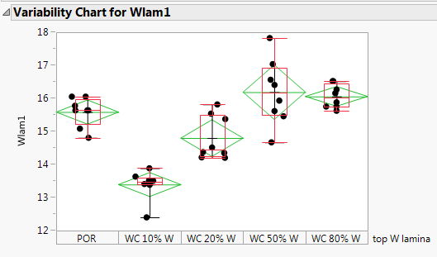
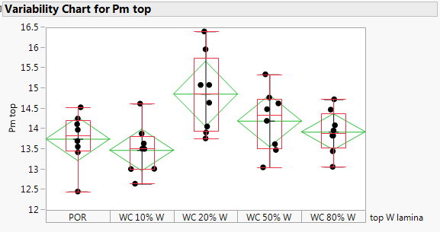
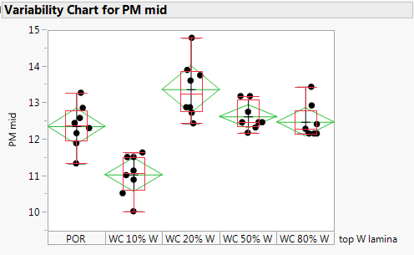
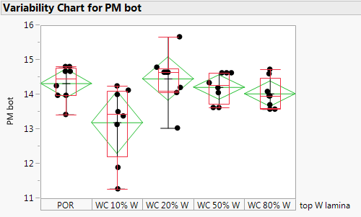
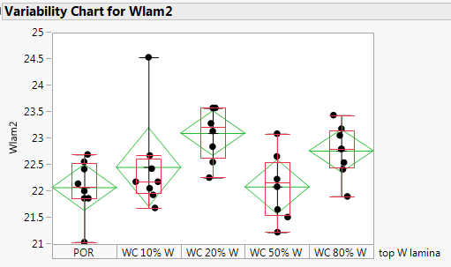
Manual measurements at CoW
10% W has too narrow PM min out coming
20% is marginal
50/80W splits are aligned with POR stack

Slide 10
Follow-up
Decision is to focus the L3 trial only on WC with more than 50% W
Running L1D wafers to 2nd cut to verify the etch at 55 (ECD WW28)

