Slide 1
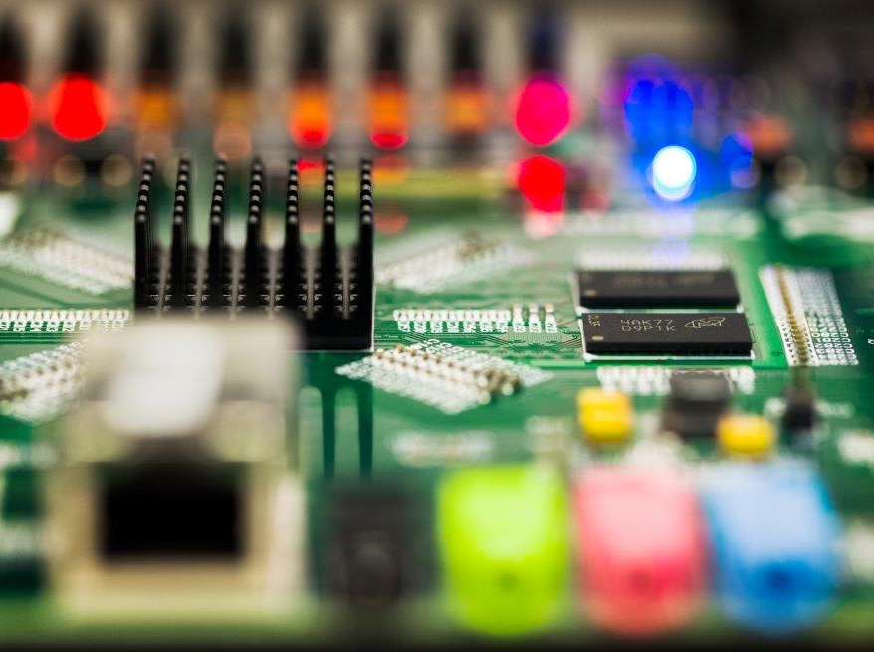
S26A bench char – Delta Vth considerations
To create this effect:
From Selection Pane, hide Tinted Rectangle.
Use Change Picture command to place photo. Or replace it with a Clipboard paste or a drag and drop from a folder.
Unhide Tinted Rectangle and set it to desired level of transparency. (25% usually works well.)
From the Title Slide layout, copy and paste the circuit line and the logo onto this slide.
See the notes on the left margin of many of these slides for instructions on their use.
Mario/Enzo
VM ArrayCharTeam
©2015 Micron Technology, Inc. All rights reserved. Information, products, and/or specifications are subject to change without notice. All information is provided on an “AS IS” basis without warranties of any kind. Statements regarding products, including regarding their features, availability, functionality, or compatibility, are provided for informational purposes only and do not modify the warranty, if any, applicable to any product. Drawings may not be to scale. Micron, the Micron logo, and all other Micron trademarks are the property of Micron Technology, Inc. All other trademarks are the property of their respective owners.

Slide 2
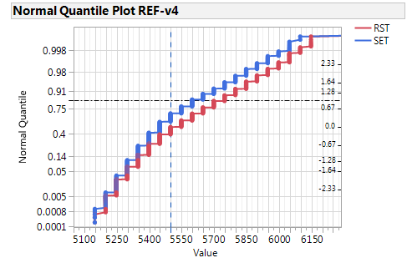
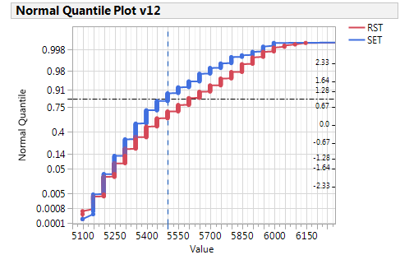
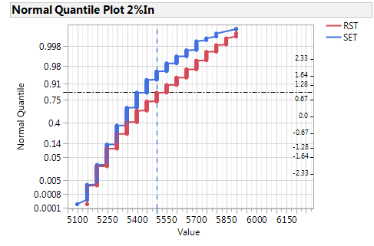
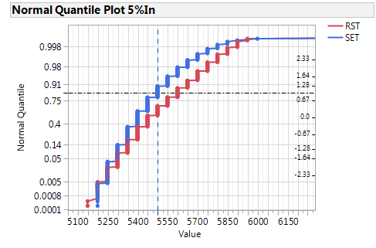
SD memory effect by split (SD-only lot 9897002)
Sd thikness=17nm
100mV window@1sig
SDv4
SDv12
SDv4+2%In
SDv4+5%In

Slide 3
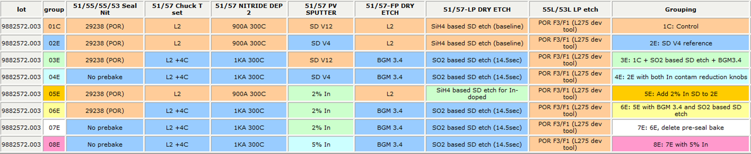
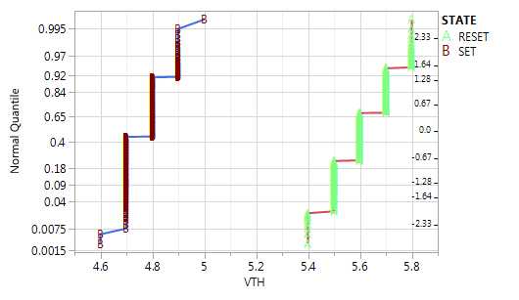
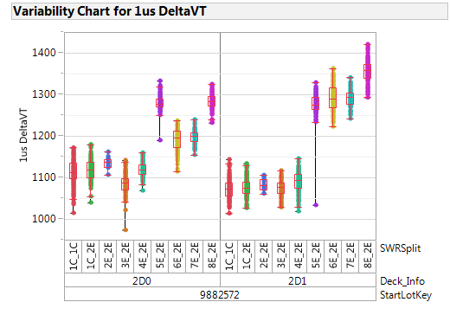
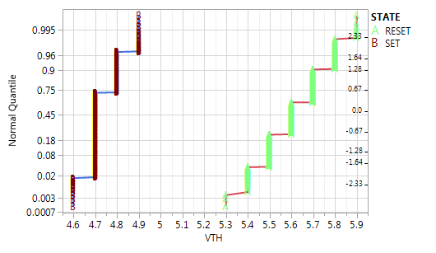
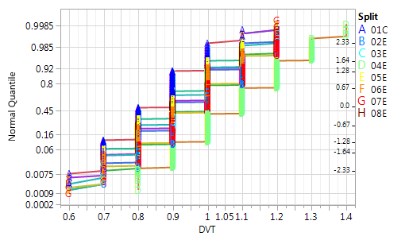
QTT window data on lot 9882572
Joe
QTT,
1C, deck0
Array
QTT,
5E, deck0
QTT pulsed window @ 1us
4E, deck0
All window very similar on QTT, in any case no 1:1 correspondence with In doped split

Slide 4
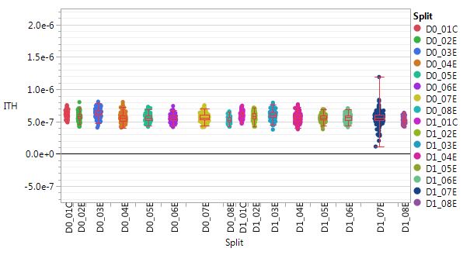
Ith mesures on lot 9882572 (QTT)
No Ith toggle with In-Doped SD

Slide 5
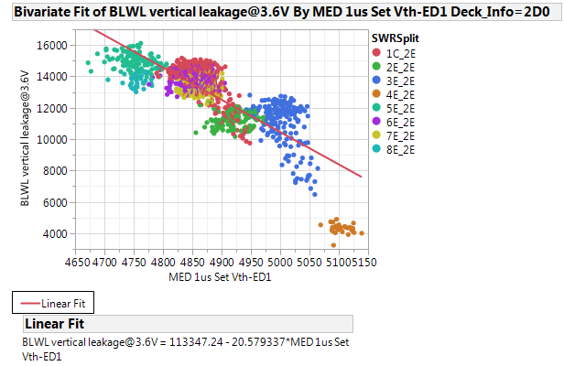
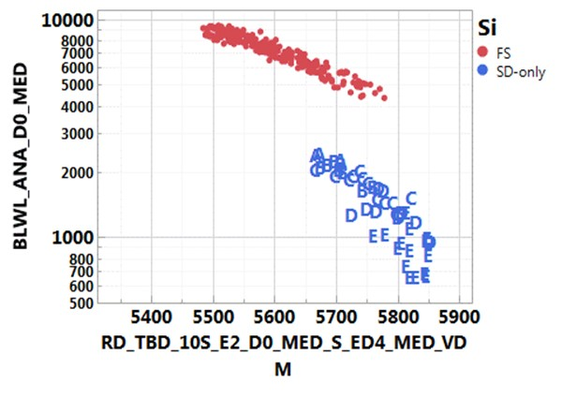
Vertical Leakage @ 3.6V
Full stack lot 9882572 with In-doped SD trials (Joe)
SD only V12 vs Full stack (Koushik)
In contamination reduction
Even if full stack data with In doped trials does not show clear leakage toggle, SD only data show a clear leakage tradeoff with full stack that can suggest some role of In in defining leakage. Larger leakage can lead to larger spurious window in array…

Slide 6
Conclusions/Possible follow up
No clear smoking gun about delta Vth increase for In-doped SD split in full stack array looking at SD only memory effect
QTT does not track array data
Possibility is that leakage is playing a role in delta Vth measure. Possible follow up is to measure vertical leakage on In-Doped split on SD only (probe or bench czn?)

Slide 8
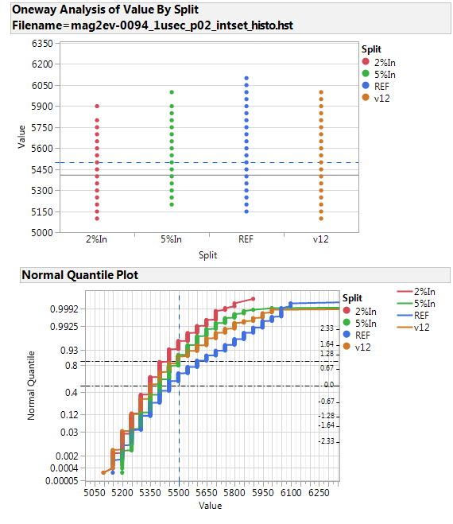
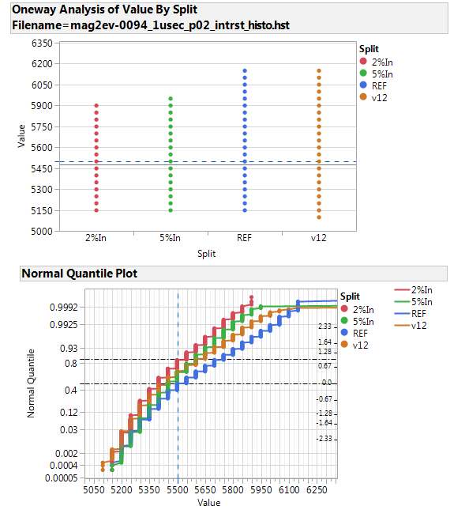
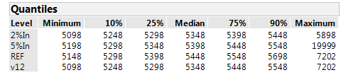
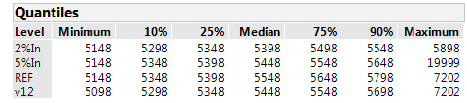
Set and Rst distributions – interlaced histo 1us
SET
RST
Reset PA=130uA
Read issue
Read issue
250mV
sigma
With Vth correction
Sigma(0,1)=170mV
(Sigma extracted only for SDv4)
Also FS shows same distortion under 5.5V (look at slide4)

Slide 9
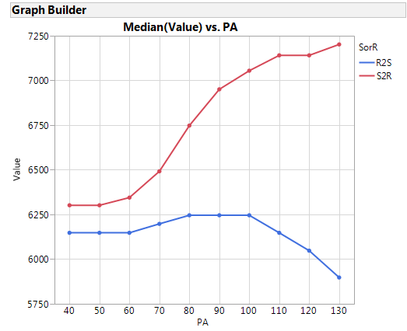
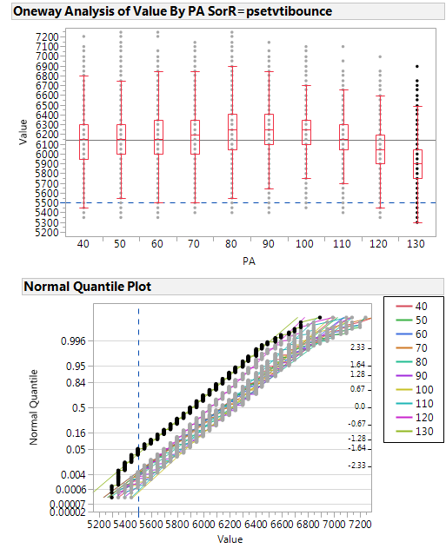
R2S from FullStack
Preconditioning RST pulse amplitude
Distortion is also visible for lower tail of the POR Set distribution (under ~5.5V)

