Slide 1
Kelvin ON-IV on 2xCMOS for electrode understanding lcrespi, aredael

Slide 2
2xCMOS structure – ON I-V
VPYS
SCOPE CH1
1000 cycles for cell stabilization
500ns ramp up/down
Up to 200uA – 220uA
Deck 0 only, in both polarities
Kelvin measurement
VPP = 7.5 V
VCC = 4.4 V
VSS = 3.0 V
VNN = 0 V
POL:
4.4V FWD, 3.0V REV
POL_HI
POL_HI_B
BUF_SOURCE
VSS
BUF_SOURCE
WL
BL
BUF_WL
VCC
BUF_BL
SCOPE CH3
SCOPE CH4
POL_LO
POL_LO_B
CLAMP
VPXS
SCOPE CH2

Slide 3
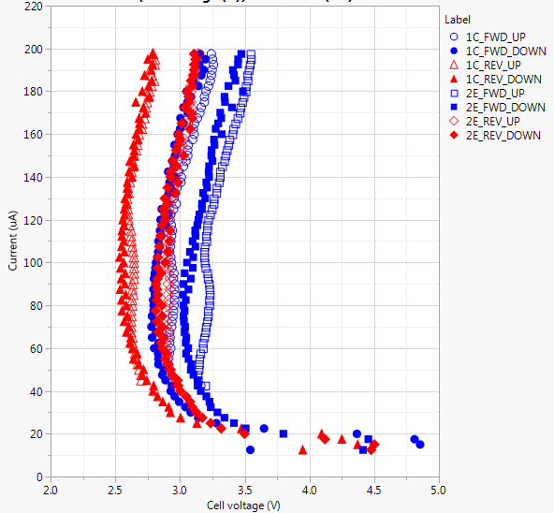
ON I-V curves direct/reverse, electrode trials
Electrode effect (CN)
ON I-V for Deck 0, both splits, both polarities; curves start from 40uA, ramp up, then ramp down to 10 uA
ON-IV highlight interesting features to be better investigated:
  An hysteresis is observed, likely due to the crystalline to liquid transition, and the subsequent liquid to crystal state SD only testing needed for better understanding
  Polarity effect points to SD/E interfaces effect
High current regime could be used to extract the electrode resistance
Polarity effect
Hysteresis: PM effect?
1C MEC/TEC
2E MEC: 150A HUCN +50A HUC/TECN-G4

Slide 4
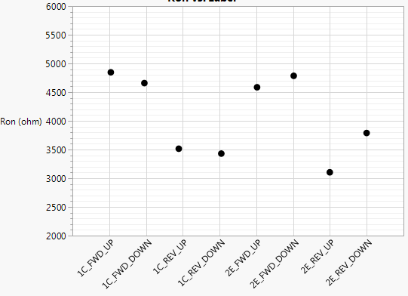
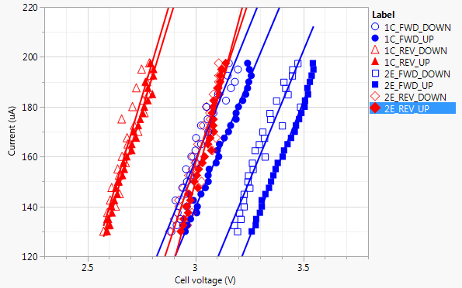

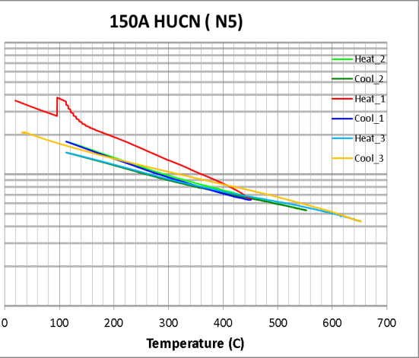
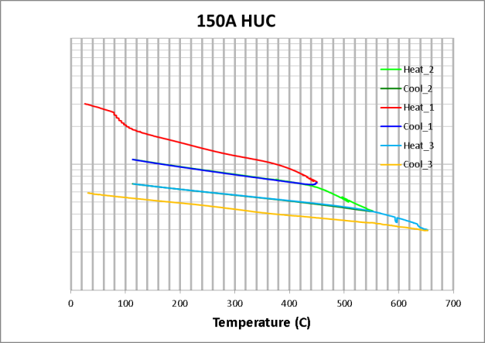
ON I-V curves fit
~4.7 kΩ
Polarity
High current curve fitting is indicative of the effective resistance of the electrodes under the specific conditions
Polarity
~3.5 kΩ
No big difference in the electrode resistance between the two splits
Extracted resistivity is 3 mOhm cm - forward (2.2 mOhm cm - reverse). These numbers are consistent with Rs(T) L0 measurements
E-only CLV needed to improve this learning

Slide 5
Follow-up
E-only CLV needed to check the ON-IV of the C and CN
Test SD-only that is available on S26 (SSM lots)
  To clarify the hysteresis on the ON-IV
  To confirm the polarity effect on the ON-IV
Extend the 220 uA ON-IV characterization to other S15 Es/SD/PM trials
Further extend the current range to get closer to RD spike regime

