Slide 1
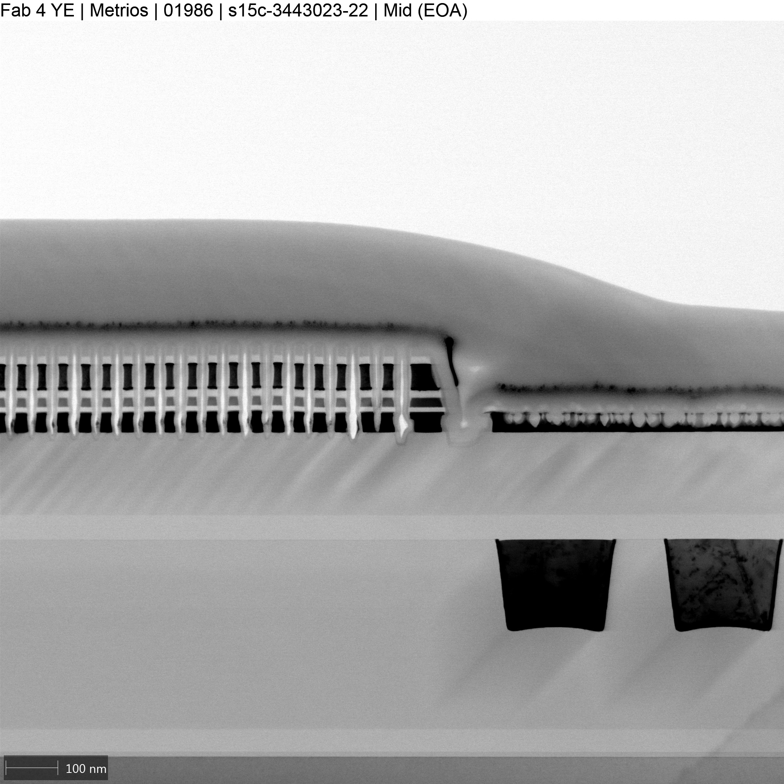
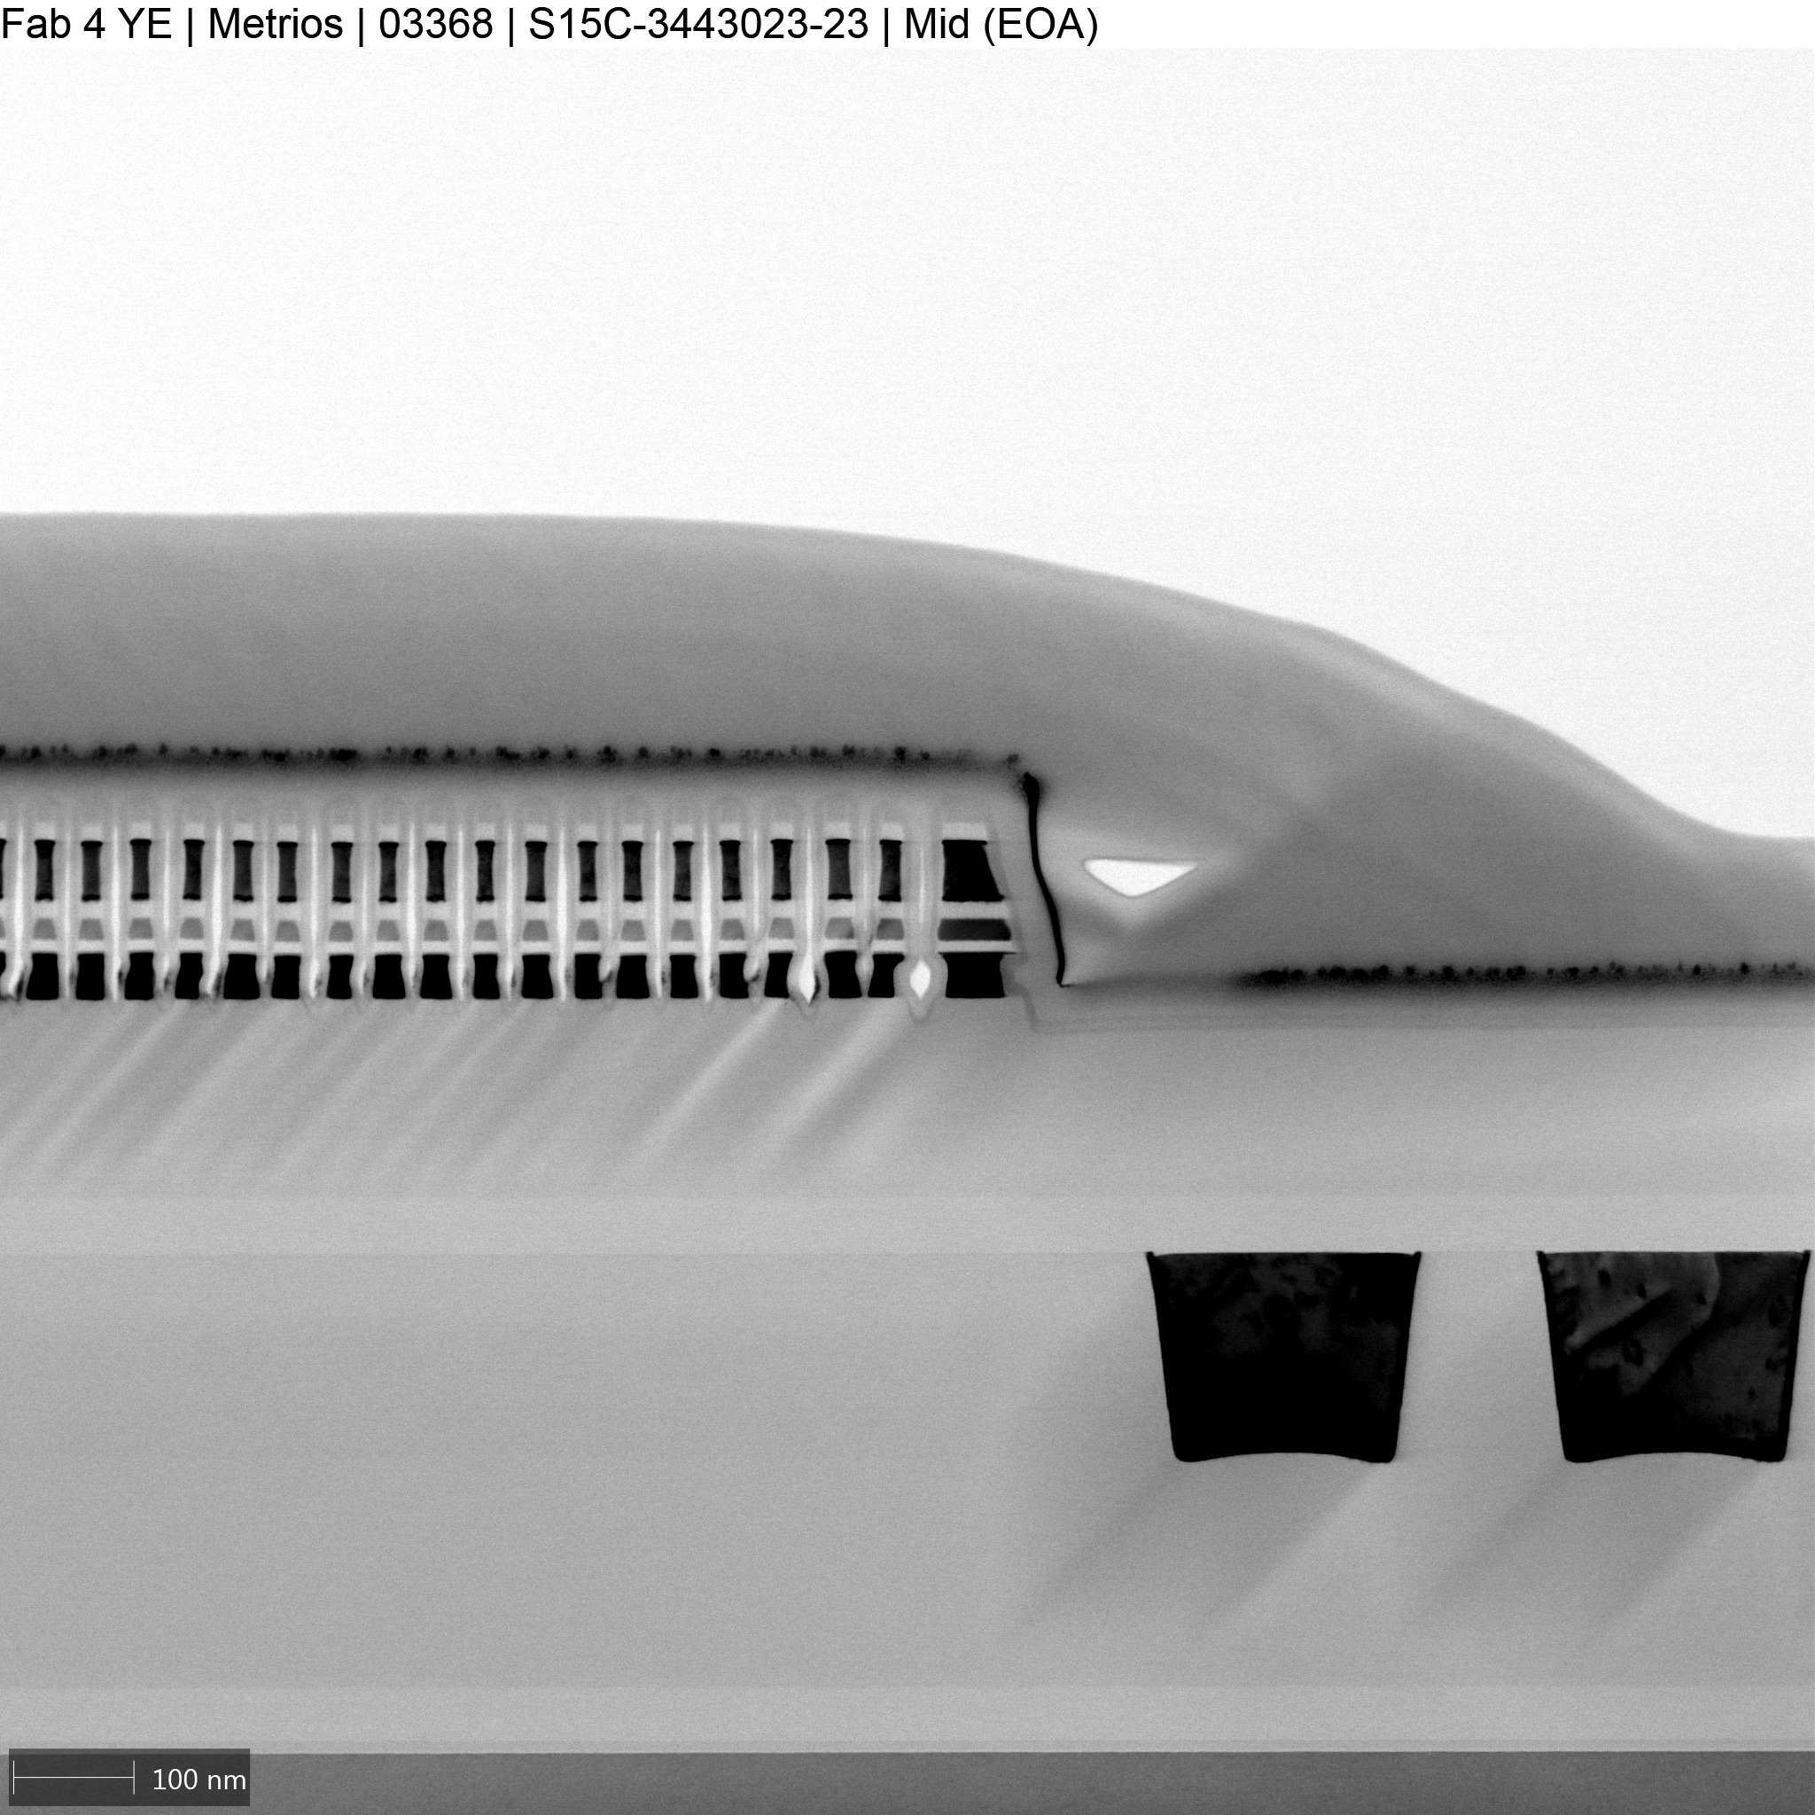
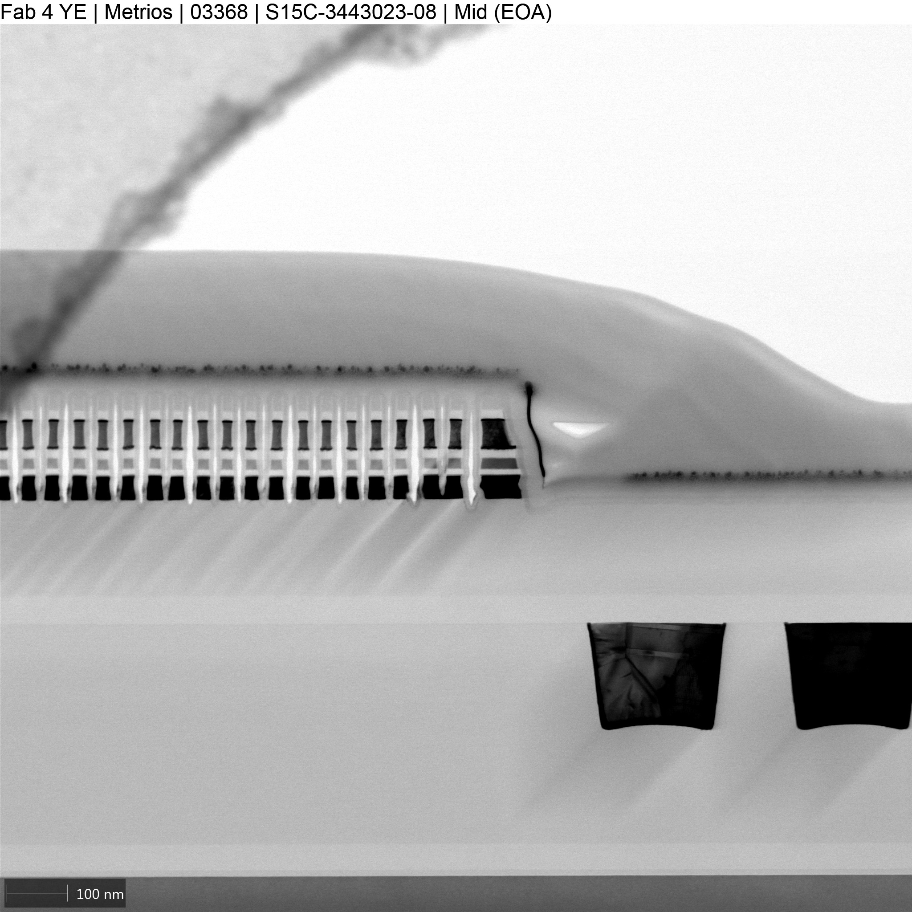
Previous L1D developments- EoT fingerprint
For high-In content alloys (>2%) we was forced to use different SD chemistry (So2) in order to clean-up EoT areas
5% In (continuous co-sputter)
5% In (continuous co-sputter)
SD Etch: SiH₄ 32s (POR)
SD Etch: SO₂ 19.5s
For 2% In we was able to used the POR chemistry
2% In (laminate co-sputter)
SD Etch: SiH₄ 32s (POR)

Slide 2
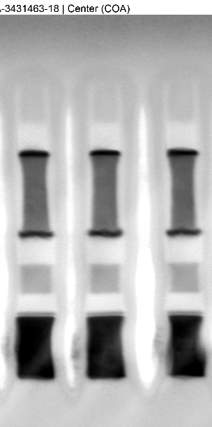
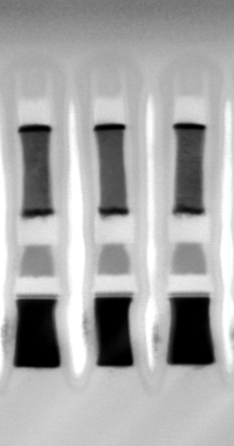
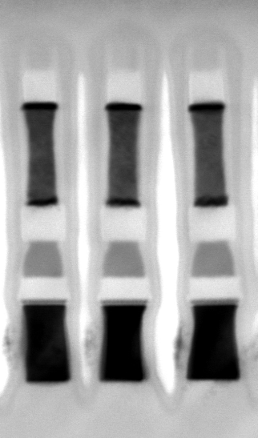
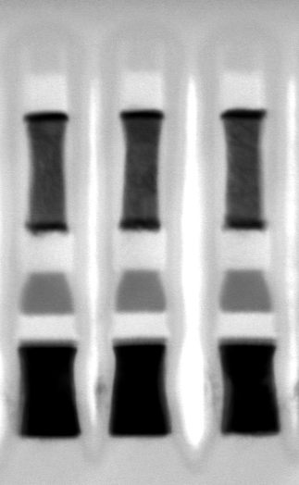
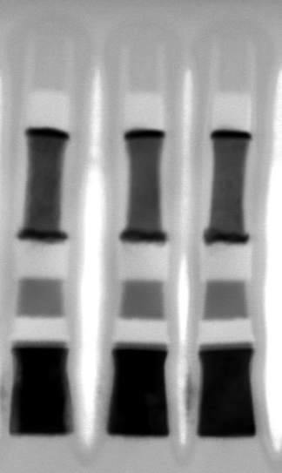
CoA Images characterization
2% In S02 etch
POR BGM2.2 at LP
3.5% In S02 etch
5% In S02 etch
2% In SiH4 etch
SO2 chemistry creates a notching of the SD on the upper part
SD profile for 2% In with POR chemistry is close to POR profile

Slide 3
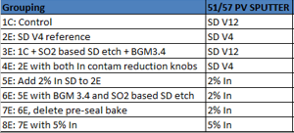

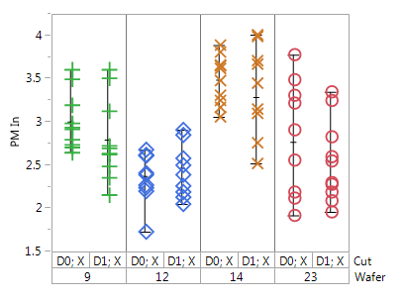
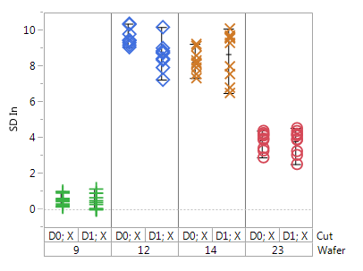
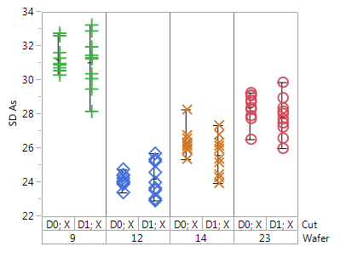
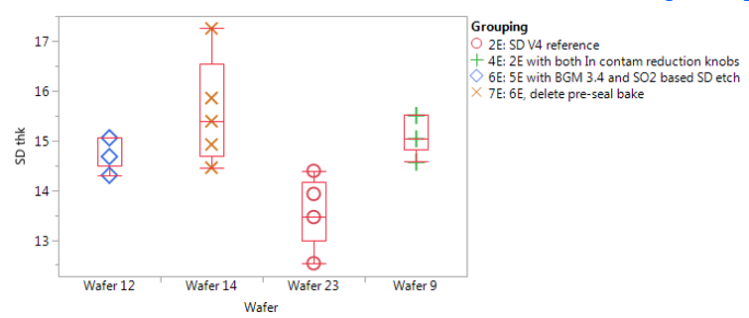
Main FA results
Cuts available now: Groups 2E-4E-6E and 7E, pending analysis on group 5E
In into PM
4% In
8% In
In into SD
9% In
< 1% In
Pre-seal bake deplete PM from In
30mV delta Vt window lower with seal bake (group 2E Vs 4E)
Id doped SD has high In content than expected.
Running TEM calibration on as dep samples
In substitute the As EoL amount, no movements on Se and Ge
Seal pre bake on POR SD
In-doped SD is more mechanical stable respect to POR SD when exposed to 280C seal pre-bake
(not or very low thinning of SD observed)
Seal pre bake on 2% In SD
Plots from Kyuchul, Sachin report

Slide 4
Problem statement
1st L3 lot results shows open/knee downside on all In-doped SD split, likely related to the Ver4 SD base used for cosputter deposition.
Hypothesis for bad OPEN BER on Ver4 are:
Ver4 SD has too high Si content
low confidence, small target deposition
Priority 1 is to demonstrate that with Ver12 based composition In doping can drive same advantages observed in the previous lot without the endurance downside
Target configuration proposal
1 small monolithic Ver 12
1 small monolithic Ver12 4% in
That target configuration permit to skew the In (window of 0-4%) for L1D development and in the same time run an L3 SWR on the Ver12 2% In without any additional L1D
Plan is to run L3 lots in F4 due to PG1T2 priority for F2 JDP wip and also due to contamination concern for the LP etch chamber

Slide 5
Follow-up on In doped SD
L0 activities (Swapnil):
TEM analysis on flat stack (W/SD/C) of this samples:
Ver4 2% In
Ver4 5% In
Ver4 2% In with extra anneal (300C 5 min)
Ver4 Only?
Wrinkle test already performed, need report
L1D Activities (Andrea/Sachin)
Further developments on LP DRY etch to handle >2% In without any tapering issue
TEM movie for “contamination segmentation”
L3 proposal and target configuration for copsutter chamber in the following slides

Slide 6
Plan
fastest readiness to try to intercept PG1T1 roadmap
Notes:
-In parallel to follow up L3 we’ll continue to work on L1D integration for high In content alloys
Next L3 PROD SWR proposal

Slide 7
Main L3 results
Detailed Observations:
Drift in 1us to 10s (VDM1) range actually increases for In dopes SD splits, while drift across 3s to 48hr (VDM3) range
Bias drift component reduced with In doping
Split with no intentional In doping and with In contam reduction knobs (4E; no seal prebake and BGM 3.4) showed significantly higher drift across all times
Observe 100mv+ increase in delta Vth from In doped SD splits (not anticipated)
Splits with In doping + BGM3.4 (6E-8E) showed significant increase in cycling opens at 2M FW
At time zero, In doped SD splits (particularly without BGM3.4; 5E) show net window upside vs unintentionally doped splits
Primarily for VDM3 due to combination of higher delta Vth and lower drift
However, all In doped SD splits have cycling performance issues
Extract from Joe report

Slide 8

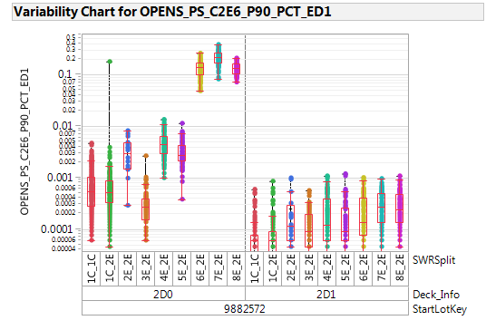
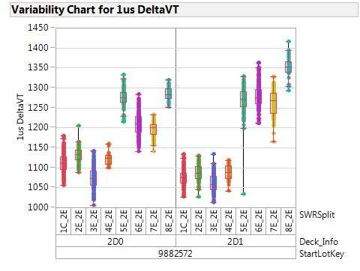
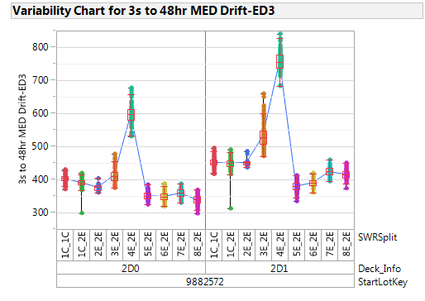
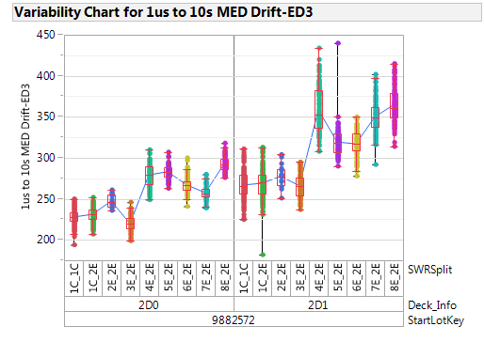
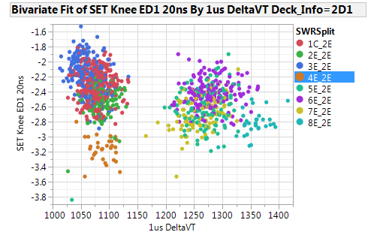
Main plots
OPEN at 2M cycle
Comparing group 4E Vs 5E no degradation
Within same SD ver adding In
Worst degradation seems coming from
Ver4 base composition (group 2E Vs 4E)
No correlation between Set knee and delta Vt across splits (do see correlation within a splits on 2D0)
VDM3
VDM1
Extract from Joe report

