Slide 1
30s ww16

Slide 2
Summary of S3X Platform Asks so far
>30% active energy reduction (pj/bit) compared to S26 to enable higher bw
Read BW 2133-2400 MB/s ( S26 Read BW is 1600 MB/s)
Write BW 1100 MB/s ( S26 Write BW is 800 MB/s)
Read Latency = 80ns ( S26 Read Latency spec is 95ns)
Write BW for S36 >= Write BW for S26

Slide 3
30s Architecture Considerations
 | 20s: 4Kx4K | 30s: 4Kx4K (tile re-layout for chop) | 30s: 4Kx4K (simple chop) | 30s 4Kx8K
# of partitions | 32 | 32 | 32 | 32
# of slices per partition | 1 | 2 | 2 | 1
Write BW (MB/s) | 800 (power limited) | 1100 | 1100 | 1100
Write BW of Chop (MB/s) | 550 | 1100 | 1100 | 550
Die Size (sq mm)* | 193 | 177 | 177 | 170
Die Size of Chop (sq mm)* | 105 | 130 (tile re-floor plan) | 105 (simple chop) | 97
WL/BL res (ohms per cell) requirement for reset current delivery | 1x (13.6/5.4) | <1.7x | <1.7x | <1.4x
HV CMOS area scaling requirement to fit under the tile | 1x | <0.85x | <0.67x | <0.95x
HV CMOS current drive requirement for same Z | 1x | >1.3x | >1.3x | 1x
WL/BL cap for Spike |  | 1x | 1x | >1.4x
*Die size numbers are preliminary, only for comparison purposes

Slide 4
30 series: fitting CMOS under a 4x4 tile
Design Rule | Occurrences | Total Width
Contact to gate | 56 | 95
Contact | 42 | 59
Channel Length | 28 | 196
Contact enclosure | 28 | 31
Diff spacing | 14 | 31
TWN to P spacing | 2 | 85
Misc (inv etc.) | 1 | 37
Total |  | 534 (patch size 633)
Gap to Needed space |  | 100 lambda
32 word lines
20's
 | X | Y
s26 WL patch TS | 907 | 146 | 132422
s26 WL patch BS | 907 | 113 | 102491
s26 BL patch LS | 163 | 904 | 147352
s26 BL patch RS | 129 | 904 | 116616
white space
area one tile |  |  | 3,991,048
30's
 | X | Y
30sWL patch TS | 633 | 65 | 41145
30sWL patch BS | 633 | 40 | 25320
30s BL patch LS | 60 | 633 | 37980
30s BL patch RS | 40 | 633 | 25320
white space
area two tiles |  |  | 2,076,240

Slide 5
Architecture Roadmap Options
 | 20s | 30s | 40s | 50s
Tile Size | 4Kx4K | 4Kx4K | 4Kx8K | 4Kx8K
# of partitions | 32 | 32 | 64 | 64
# of slices/partition | 1 | 2 | 1 | 2
Write BW (MB/s) | 800 | 1100 | 1600 | 2200
Chop Write BW | 550 | 1100 | 1100 | 1600
Option 1
Tile Size | 4Kx4K | 4Kx8K | 8Kx8K | 8Kx16K
# of partitions | 32 | 32 | 32 | 32
# of slices/partition | 1 | 1 | 1 | 1
Write BW (MB/s) | 800 | 1100 | 1100 | 1100
Chop Write BW | 550 | 550 | 550 | 550
Option 2
Tile Size | 4Kx4K | 4Kx8K | 4Kx8K | 8Kx8K
# of partitions | 32 | 32 | 64 | 64
# of slices/partition | 1 | 1 | 1 | 1
Write BW (MB/s) | 800 | 1100 | 1600 | 2200
Chop Write BW | 550 | 550 | 1100 | 1100
Option 3

Slide 6
30s Periphery process path finding requests
  HV CMOS area scaling
  HV CMOS drive current improvement
  ( If we use 6.7/7 select devices as in 4Kx4K tile, we have to improve drive current)
  Interconnect scaling (M4@4F; M1-M3@8F; On pitch via)
  Lower routing cap (Low K di-electric )
  LV CMOS performance improvement to hit 2400 IO rate
  Lower voltage LV CMOS (1.1v)
Reset path resistance | 20s | 30s allowed resistance (assume 40% lower Ireset) | 30s 4Kx4K Requirement | 30s 4Kx8K Requirement
Array | 40K | 67K | Per cell resistance < 1.67x 20s | Per cell resistance < 1.4x 20s
HV CMOS | 21K | 35K | > 30 % drive current improvement on average for same Z (Since drawn device resistance is ~ 47K based on 10s/20s transistors) | 20s CMOS will work
Vias | 4K | 7K
Total | 65K | 109K

Slide 7
Preliminary Die Size
Item | 15.5nm - 256 x 32 4Kx4K array limited | 14nm - 256 x 32 4Kx4K array limited | 14nm - 256 x 32 4Kx4K CMOS limited (No CMOS scaling) | 14nm - 128x32 4Kx8K array limited | 14nm - 128x32 4Kx8K2 CMOS limited (No CMOS scaling) | Comments
Litho (nm) | 15.5 | 14.0 | 14.0 | 14.0 | 14.0
Number of active WL's | 1024 | 1024 | 1024 | 2048 | 2048
Number of redundant WL's | 16 | 16 | 16 | 16 | 16
Number of Dummy WL's | 20 | 20 | 20 | 20 | 20 | 8 next to the socket; 4 at the edge of the X/Y decoders
Number of active BL's | 1024 | 1024 | 1024 | 1024 | 1024
Number of redundant BL's | 8 | 8 | 8 | 8 | 8
Number of Dummy BL's | 20 | 20 | 20 | 20 | 20
Socket Size (lambda) | 50 | 50 | 50 | 50 | 80
Patch Size (WL Direction) | 702.24 | 639.12 | 709.12 | 639.12 | 669.12
Patch Size (BL Direction) | 707.2 | 643.6 | 713.6 | 1217.04 | 1247.04
Patch Area (um^2) | 1241.6 | 1028.3 | 1265.1 | 1944.6 | 2086
Number of patches (WL Direction) | 64 | 64 | 64 | 64 | 64
Number of patches (BL Direction) | 64 | 64 | 64 | 32 | 32
Number of patches in termination (WL Direction) | 5.6 | 5.6 | 5.6 | 4 | 4
Number of patches in termination (BL Direction) | 4 | 4 | 4 | 3 | 3
PCU Area per partition (um^2) | 108000 | 108000 | 108000 | 108000 | 108000
Partition Area (mm^2) | 5.984 | 4.975 | 6.095 | 4.736 | 5.073
Partitions | 32 | 32 | 32 | 32 | 32
Core Area (mm^2) | 191.5 | 159.2 | 195 | 151.6 | 162.3
Periphery (mm^2) | 11.25 | 11.25 | 11.25 | 11.25 | 11.25
PADs (mm^2) | 3.52 | 3.52 | 3.52 | 3.52 | 3.52
Scribe & Seal Ring (mm^2) | 3 | 3 | 3 | 3 | 3
Best case Die Area (mm^2) | 209 | 177 | 213 | 169 | 180 | Low confidence we can hit these best case numbers; Fitting diffusion and routing will be a challenge

Slide 8
BACK UP

Slide 9
Key Challenge: Active Energy (pj/bit)
Component | S26 Write | S26 Read | S37 Write | S37 Read | Comments
Address | 19 | 19 | 15 | 15 | Lower VPP/VNN
Controls Pre Read | 9 | 9 | 7 | 7 | Lower VPP/VNN
Controls Write | 7 |  | 6 |  | Lower VPP/VNN
Selection Pre Read | 4 | 4 | 3 | 3 | Lower VPP/VNN
Selection Write | 5 |  | 3 |  | Lower VPP/VNN
Pulse SET | 21 |  | 12 |  | Lower Cell Current
Pulse RESET | 11 |  | 7 |  | Lower Cell Current
Pulse SSR | 7 | 7 | 4 | 4 | Lower Cell Current
Misc Tile H/W | 7 | 4 | 6 | 3
PCL | 7 | 2 | 7 | 2
SDIO | 2 | 2 | 2 | 2
PL | 9 | 4 | 9 | 4
IO | 5 | 2 | 5 | 2
HV_Regulators | 2 | 1 | 2 | 1
TOTAL | 115 | 54 | 88 (Goal < 79) | 43 (Goal < 36)
Supply | S26 Write Energy | S26 Read Energy
Vcc | 38 | 20
Vhh | 11 | 3
Vpp | 25 | 13
Vnn | 42 | 17
100% LV blocks
Lower VPP/VNN idea and lower cell current gets us part of the way; Need more ideas

Slide 10
S37 Read/Write Bandwidth
  Current thinking on R/W Bandwidth: 2400/1100 on S37 vs 1600/800 on S26
  S37 array assumptions: 32 partitions; 128 tiles per partition; Each tile is 4K x 8K * 4 decks
  Thoughts/issues:
  Will platforms be able to take advantage of higher SxP BW capability
    (ASIC power may not come down at the same rate as memory)
  It is important to predict this since 2400 MT/s IO expected to require new LV transistors (according to Mike A.)
  S36 Write BW will be 550MB/s if S36 is S37 chopped in half (16 partitions)
  ( This is an issue since S26 is 800 MB/s)

Slide 11
WL Sense Architecture

Slide 12
20s/30s Array Architecture
WL
BL
35
35
35
PM
PM
PM
SD
SD
SD
35
65
PM
PM
PM
35
35
35
SD
SD
SD
PM
PM
PM
35
35
35
SD
SD
SD
35
35
35
35
PM
PM
PM
SD
SD
SD
65
35
PM
PM
PM
65
SD
SD
SD
PM
PM
PM
35
35
35
SD
SD
SD
Isolation
35
35
35
Isolation
1 BL Sockets
2 WL Sockets
2 BL Sockets
2 WL Sockets
S15B
20s/30s WL First, 4-Decks
Thicknesses are for 20 series;
Will be different for 30 series

Slide 13
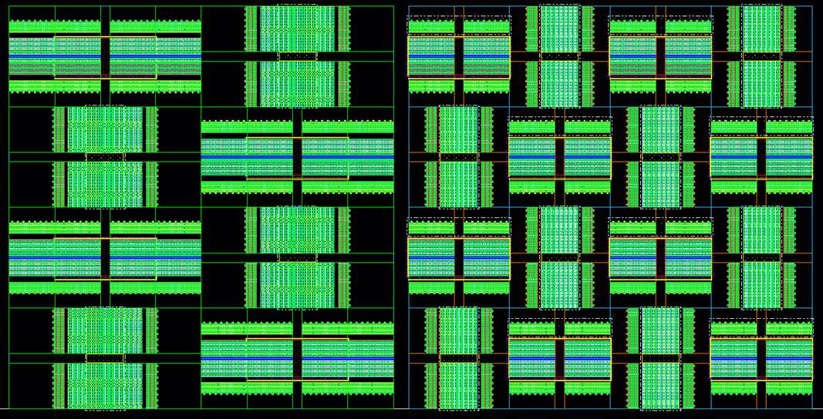
Key Challenge: Fitting CMOS in 30 series
14nm 4Kx8K 1/2Tile
14nm 4Kx4K Tile
4Kx4K Tile: About 50% of area of 20s for tile circuits (assuming slice of 2 tiles)
  One idea being looked at is NN-PP select-deselect structure to make more room
  ( not good for energy; layout study in progress)
4Kx8K Tile: About 80% area as 20s for tile circuits (Preferred option with current CMOS)

Slide 14
Prelim window
Column1 | 20s POR | 20s Lower Vt | 30 Series 4Kx4K same leakage as 20s | 30 Series 4Kx8K same leakage as 20s | 30 Series 4Kx8K 10x lower leakage as 20s
WL resistance | 30000 | 30000 | 60000 | 48000 | 48000
WL path resistance | 7500 | 7500 | 15000 | 15000 | 15000
BL resistance | 10000 | 10000 | 20000 | 32000 | 32000
BL path resistance | 10000 | 10000 | 25000 | 15000 | 15000
Median SET Vt | 4.8 | 4.3 | 4.6 | 4.8 | 4.3
Delta VT | 1.4 | 1.4 | 1.4 | 1.4 | 1.4
Median Reset VT | 6.2 | 5.7 | 6 | 6.2 | 5.7
Max Set VT | 5.5 | 5 | 5.3 | 5.5 | 5
Max Reset VT | 7.3 | 6.8 | 7.1 | 7.3 | 6.8
Inhibit bias | 3.6 | 3.2 | 3.3 | 3.4 | 3.3
Vt sigma | 0.1 | 0.1 | 0.1 | 0.1 | 0.1
C-cell bias | 0.8 | 0.8 | 0.8 | 0.8 | 0.8
Inhibit bias as a % of set Vt | 0.75 | 0.74 | 0.71 | 0.7 | 0.76
Ith | 2.00E-07 | 2.00E-07 | 2.00E-07 | 2.00E-07 | 2.00E-08
Set Drift | 0.2 | 0.2 | 0.2 | 0.2 | 0.2
Reset Drift | 0.6 | 0.6 | 0.6 | 0.6 | 0.6
Reset Read Disturb | 0.1 | 0.1 | 0.1 | 0.1 | 0.1
Write
Row leakage drop | 0.094 | 0.081 | 0.104 | 0.072 | 0.017
WL path leakage drop | 0.188 | 0.162 | 0.209 | 0.181 | 0.043
Column leakage drop | 0.062 | 0.054 | 0.069 | 0.193 | 0.046
BL path leakage drop | 0.251 | 0.217 | 0.349 | 0.362 | 0.087
E1 Margin | 0.318 | 0.256 | 0.3165 | 0.3415 | 0.29
E4 Margin | 0.622 | 0.3325 | 0.2135 | 0.1675 | 0.5685
# of Cells needing c-cell (sigma) | -2 | 1 | 2 | 2 | -1
(VPP-VNN) for Selection | 7.624 | 7.126 | 7.624 | 7.832 | 6.878
Read
WL/BL bias | 2.8 | 2.7 | 2.7 | 2.8 | 2.55
Bias as percentage of Set VT | 0.58 | 0.62 | 0.58 | 0.58 | 0.59
E2/E3 margin | -0.01 | -0.05 | -0.09 | -0.1 | -0.01
Lower leakage translates to lower Vt’s => Lower spike and lower energy

Slide 15
Key Challenge: Selection Spike
  Selection Spike resulting in Read Disturb and over-reset expected to be a big challenge on 30 series due to reduced thermal latency, lower programming current and larger tile size
  Some potential options:
  Lower selection voltage window
  Lower array capacitance
  Cell magic
  Smaller tile (CMOS limits this)

Slide 16
Key Challenge: Active Energy
Goal : 30% lower energy than 20 series
  Lower cell current should get us ~10%
  Need to figure out strategy for the rest
One key idea is :
  Use lower VNN and VPP external supplies (e.g. +/- 4v in place of +/-5v)
  Generate higher VNN and VPP internally ( +/- 5v)
  Use external supplies (high efficiency) most of the time
  Use internally generated supplies (low efficiency) a small fraction of the time (e.g. for far ED Reset current delivery and high Vt SET selection)
(High supply voltage is needed rarely i.e. for reset current delivery for far ED’s and for selection of high Vt cells; Most of the time, lower supply is all that is required. Lots of details to analyze for feasibility. This idea could potentially reduce energy by another ~10%)
Other potential enablers:
  Lower routing metal cap (low K di-electric)
  Better CMOS ( LV/HV )
  Lower supply requirement (selection window & reset current voltage)
  Further optimization

Slide 17
Key Challenge: WL/BL resistance
Max Array Resistance = (Max cross point voltage – Voffset)/Icell
= (6.8 – 2)/(105*0.6) = ~ 76K
( 20nm array resistance for 4Kx4K tile size = 40K
WL resistance = 30K; BL resistance = 10K with Quilt benefit )
=>
For 14nm 4Kx4K tile:
WL/BL Resistance per cell < 1.9x 20nm WL/BL Resistance per cell
For 14nm 4Kx8K tile size:
WL/BL Resistance per cell < 1.5x 20nm WL/BL Resistance per cell
On S26 Reset delivery limits the voltages, the lower we can keep WL/BL resistance per cell, better it is for meeting energy requirements

Slide 18
Platform requests
  Read Latency < 80ns (Key challenge)
  Faster write band width (Reset only write, split write into two commands etc.)
  ECC support
  Memory vs storage

Slide 19
SXP Component Roadmap
2012
2013
2014
2015
2016
2017
2018
S15A
DBR
S15B
DBR
S15C
DBR
S15C 16GB
Storage
Qual
Memory
Qual
TODAY
S26A
DBR
S26A 32GB
S25A
DBR
S25A 16GB
Start Pathfinding
S37A
DBR
S37A 64GB
Q4’14 NVM Component Internal Roadmap
Milestones for 30s development (Need to discuss):
Paper Specs (Rev -1 DTS, MTS,??) - Q2 ’15
Preliminary silicon based on S35X (Rev0) – Q4’15 (When is S35X expected to TO?)
Updated Silicon based specs (Rev1) – Q2’16
Final specs for S37A Silicon (Rev2) – Q4’16
Co-ordination among different functions (What should we do different on 30 series compared to 10s and 20s )

Slide 20
High Level Specs
Item | S1x | S2x | S3x | S4x
Capacity | 16GB | 32GB/16GB | 64GB/32GB | 128GB/64GB
Rd/Wr pj/bit | 71/157 | 52/118 | 36/79 | 26/55
Rd/Wr latency | 95ns/475ns | <95ns/475ns | <80ns/475ns | <80ns/475
Max Rd/Wr BW per SXP (GB/s) | 1.6/0.55 | 1.866/0.8 | 2.4/1.1 (+ Reset write or split write in 2 for lower latency ) | 3.2/1.6 (1.1 for chop)
Partitions | 16 | 16/32 | 32 | 32 to 64
RBER | 5E-5 | 5E-5 | 2E-4? | 4-8E-4?
Max Interface Speed controller/SXP (MT/s) | 1600 | 1866 | 2400 | 3200
Write Endurance | 1e7 | 1e7 | <=1e7 | <=1e7
DPM | 500 | 500 | >=500 | >=500

Slide 21
Architecture Roadmap Options
 | 20s | 30s | 40s
Tile Size | 4Kx4K | 4Kx4K | 4Kx8K
# of partitions | 32 | 32 | 64
# of slices/partition | 1 | 2 | 1
Write BW (MB/s) | 800 | 1100 | 1600
Chop Write BW | 550 | 1100 | 1100
Option 1
Tile Size | 4Kx4K | 4Kx8K | 8Kx8K
# of partitions | 32 | 32 | 32
# of slices/partition | 1 | 1 | 1
Write BW (MB/s) | 800 | 1100 | 1100
Chop Write BW | 550 | 550 | 550
Option 2
Tile Size | 4Kx4K | 4Kx8K | 4Kx8K
# of partitions | 32 | 32 | 64
# of slices/partition | 1 | 1 | 1
Write BW (MB/s) | 800 | 1100 | 1600
Chop Write BW | 550 | 550 | 1100
Option 3

Slide 22
Summary of S3X Ask So far
Platforms | Server CR2
1. Lower energy | >30% power improvement for higher BW
2. Read BW | 2133-2400MT/s
3. Latency (read latency total path for code word) | Read Latency < 95ns (TBD) Server ask =80ns
4. Write BW for chop | BW/GB ISO gen-gen S25 & S37 would be used for low density segment & can’t fall below S15 baseline S36=1100MB/s with 32GB density

Slide 23
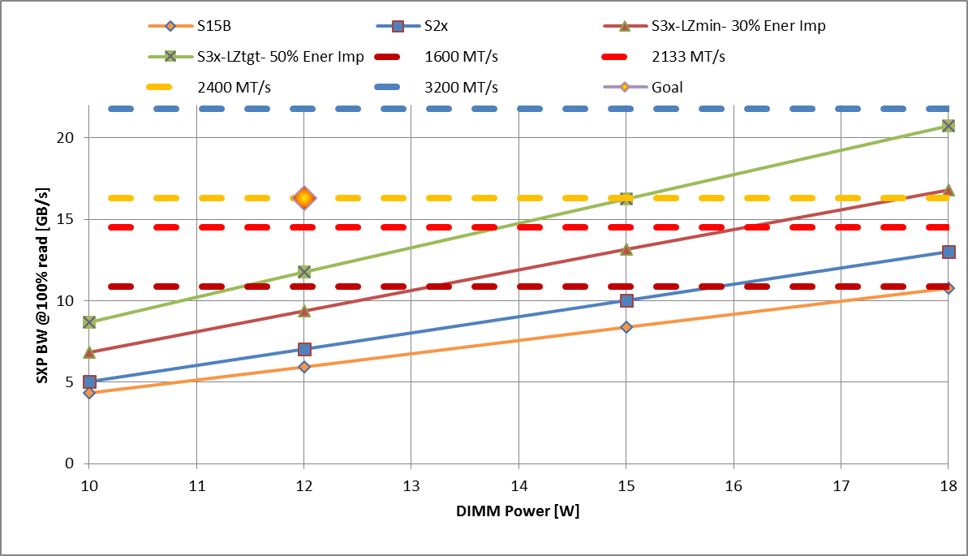
Server – Power vs BW
Increase BW @ ~same power envelope
Server BW is power limited. Lower power to enable higher SXP BW in 12 & 15W DIMMS

Slide 24
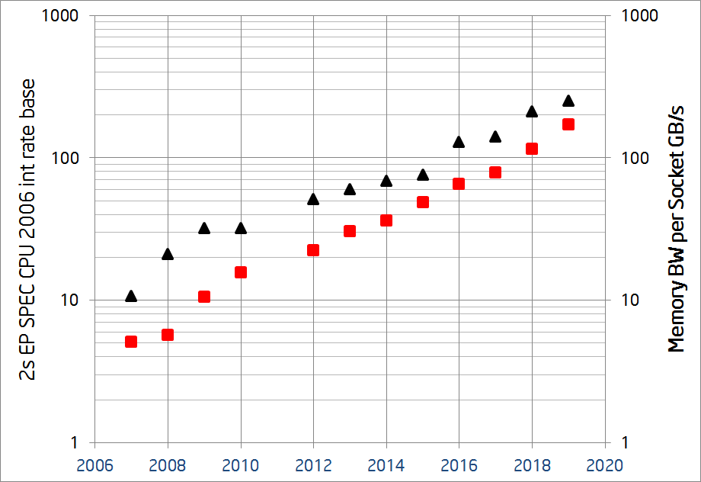
Platform performance vs. Memory Bandwidth On Server
Memory Bandwidth vs. Platform Performance
Memory Bandwidth on Server Platforms
Memory BW GB/s
ICX-TIC
Platform Performance
ICX-TIC
ICX
Desirable
ICX
DDR4 EOL
ICX
CNX
CNX
BDX
SKX
HSX
SNB
IVB
NHM
WSM
IVB
BDX
NHM
Source: Server Perf Team
Source: Server Perf Team
Platform Performance = f (Memory Bandwidth)
Memory BW Scaling wall beyond CNX
Today’s best answer: DRAM(1LM) BW increase 30-50% per CPU gen & 2LM needs to keep up with 1LM
Notes:
Performance = f(Memory Bandwidth)
Direct correlation between Platform Performance & Memory Bandwidth
Higher BW/core required to keep up with - Efficient cores, AVX (VHPC segment will lead requirement)
Performance CAGR
Projecting 50% performance CAGR in 18+
Requires similar CAGR for Memory BW
Historical Bandwidth Strategy
Higher DDR Speeds every generation
Higher Memory Channels every other gen
Bandwidth scaling wall in ’18+
DDR4 EOL speed projected in ’18
Scaling channels not a sustainable strategy

Slide 25
Read Latency break down on Server
Server:
  2LM latency <= 1LM latency
  1LM latency (DRAM): 100-200ns
  Today the best case FM access latency: 289ns
Need to reduce read latency on CPU, controller & SXP to reduce overall latency by >89ns
SXP Read Latency on S15: 101.25ns or 82.5ns + 15tck (tck=1.25ns)
  Projected read latency on S2X = 95ns
Scaling & higher clk will buy us some improved latency

Slide 26
Write BW issue on SXP
SXP Architecture on chopped product is broken for memory usage
  Chopping at Partition causes write BW reduction for same configuration on two SXP generations
Full Write:
  Memory density requirement is not increasing as the same rate as the SXP cadence
  Using next gen shows write BW reduction at platform level
  Need to explore platforms option for fast write (two stage write)
DRAM density on average doubles every ~3years
SXP density is doubling every 6 quarters
 | S15 | S26 | S25 | S37 | S36
Density | 16GB | 32GB | 16GB | 64GB | 32GB
Read BW (MB/s) | 1600 | 1600 | 1600 | 2133-2400 | 2133-2400
Write BW (MB/s) | 550 (partition limited) | 800 (power limited) | 550 (Partition Limited) | 1100 (partition limited) | 550 -> 1100? (Partition Limited)

Slide 27
2LM configuration vs BW
S25 to S36 BW
reduction
S25 to S36 BW
reduction

