Slide 1
Pathfinding on material stack / cell architecture (DerChang’s feedback)
Maintain AR by reducing ~ 40nm in height
Electrode thermal/electrode resistivity therefore thickness reduction
Upto 100% PM E_{TH} increment with higher E_{G} (~1.5eV) material
Some opportunity in SD3 threshold field improvement with CD scaling
SD electrode/interface to increase I_{TH} therefore V_{TH}
Thermal profile management ➔ Improve electro-thermal efficiency and Thermal disturb immunity
Electrode resistance gradient
Hot spot management – ME or PM
Liner/Seal/gapfill thermal boundary resistance improvement
Upper deck WL tungsten heat removal
SET Strategy –
Homogenous nucleation or heterogeneous nuclearation?
If HomoG nuke ➔Thermal profile decision – symmetry (center hot spot) vs. asymmetry thermal profile (grow from edge)
Ig HeteroG nuke -- where is the seed layer therefore hot spot management?

Slide 2
SXP Project 30s SxP: on the cell architecture September 21st, 2015
30s Team

Slide 3





From 10s to 30s: Scaling options
10s SxP
5 nm
30s SxP hypothesis:
TE
15 nm
30s must double the density:
$$F2⇒\frac{F2}{2}$$
PM
37 nm
$$AR=\frac{106}{20}=5.3$$
$$F⇒\frac{F}{\sqrt{2}}$$
ME
20 nm
$$20nm⇒14.1 nm$$
SD
16 nm
BE
10 nm
$$70\% scaling of each quantity$$

Slide 4


From 10s to 30s: Scaling options (1/2)
10s SxP
$$AR=\frac{106}{20}=5.3$$
30s SxP
Isotropic scaling
5 nm
TE
15 nm
$$AR=\frac{78}{14}=5.6$$
Considering a perfect isotropic scaling by 70% of each quantity (apart laminas)
5 nm
TE
10 nm
PM
37 nm
PM
26 nm
20 nm
ME
7 nm
ME
SD
12 nm
BE
7 nm
SD
16 nm
BE
10 nm

Slide 5


From 10s to 30s: Scaling options (2/2)
30s SxP
Isotropic scaling
30s SxP
More reasonable scaling
$$AR=\frac{78}{14}=5.6$$
$$AR=\frac{72}{14}=5.14$$
5 nm
5 nm
TE
10 nm
TE
7 nm
Saving A/R from electrodes and giving more room to PM
PM
26 nm
PM
30 nm
ME
14 nm
ME
7 nm
12 nm
SD
12 nm
SD
BE
7 nm
BE
7 nm

Slide 6


Chances for a more thermally symmetric structure
30s SxP
Plausible scaling
30s SxP
Symmetrizing the nr of interfaces below and above PM
5 nm
TE
7 nm
5 nm
5 nm
TE
5 nm
PM
Note:
We could think to thinner flash lamina recovering 2 nm allowing a PM height = 32 nm
30 nm
PM
30 nm
ME
7 nm
SD
12 nm
ME
7 nm
BE
7 nm
SD
12 nm
BE
7 nm
$$AR=\frac{72}{14}=5.14$$
$$AR=\frac{75}{14}=5.4$$

Slide 7
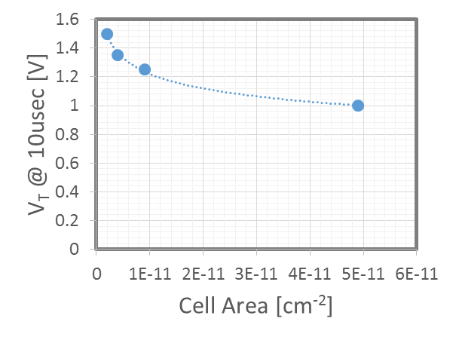
V_{TH} scaling
30s
Very rough-preliminary data extrapolation – just to have a first idea
We could hypothesis to re-gain the ~150 mV in V_{T} due to the lower PM thickness as a consequence of the V_{T} increase with cell area scaling
S15
PTX @ 30 nm
CLV

