Slide 1
14nm BL/WL Resistivity using S26A Pitch Quad Mask
Kolya, Tony, Shafqat and DerChang, WW41/2017
S26A Pitch Quad L1D current Status
Proposal on resistance evaluation with single damascene copper layer
Critical path and help needed

Slide 2
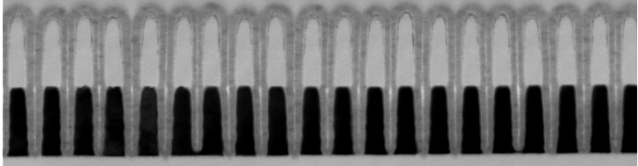
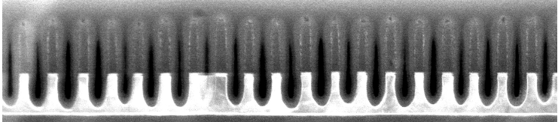
W only L1D Status, WW41
2nd cut like:
  55nm W;
  after WMMP etch:
  HM has to be adjusted (down);
  Over-etch increased.
1st cut like:
  37nm W + 25A WSiN;
  after 20s W1 etch only:
  CDs are too low; HM might need to be adjusted (down)
  Need to balance the over-etch vs undercut
  Some local blocked W etch.

Slide 3
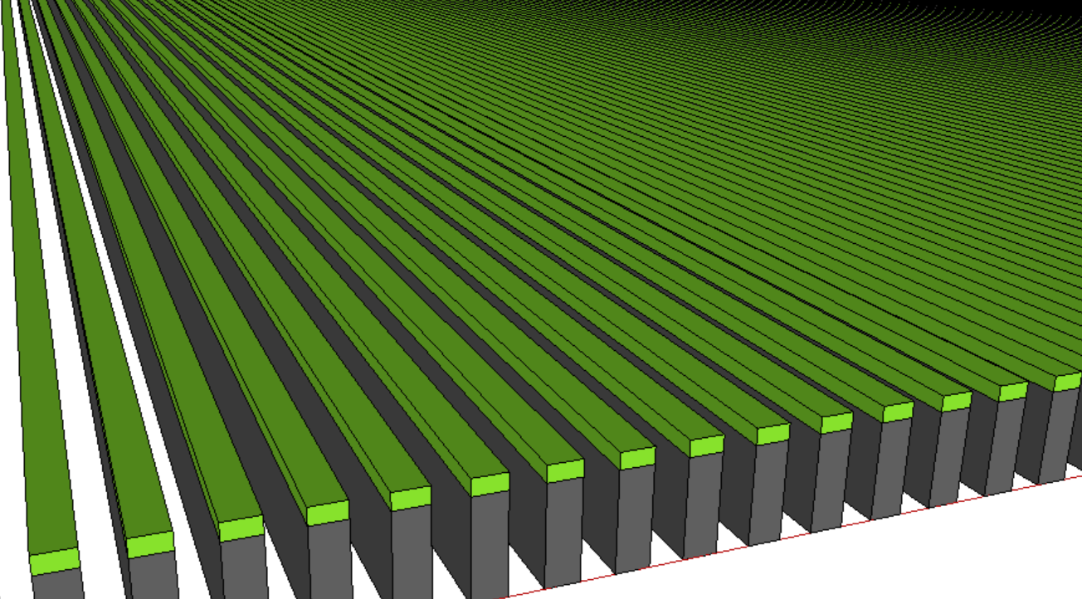
W only L1D Expectation
1st Cut: 37nm W / CD: 12 to 16nm
2st Cut: 55nm W / CD: 10 to 14nm
Nitride

Slide 4
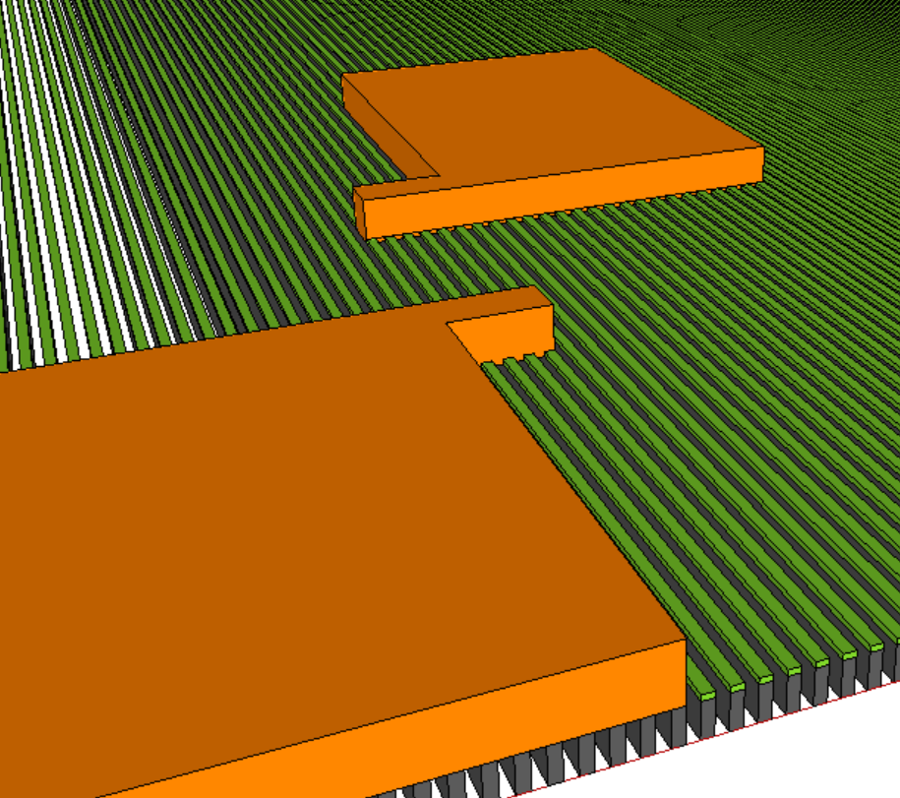
Single Damascene Copper Layer
Probe Pad -2
Length of fingers
Number of fingers
Probe Pad -1

Slide 5
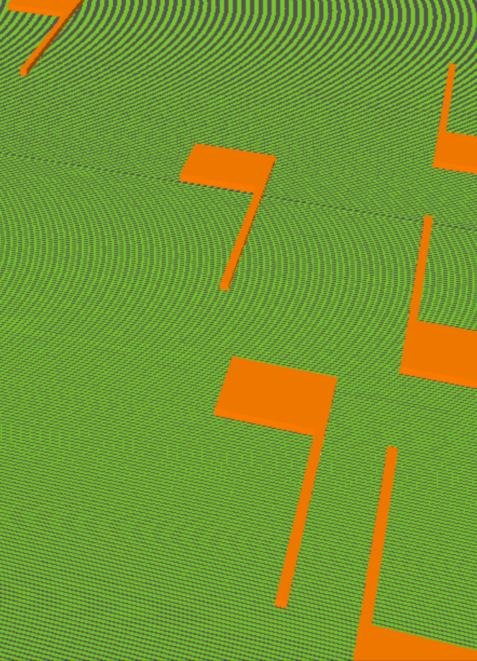
Structure Design –I: Lengths of Fingers
L₃
R
L₂
R_{terminal}
L
L₁

Slide 6
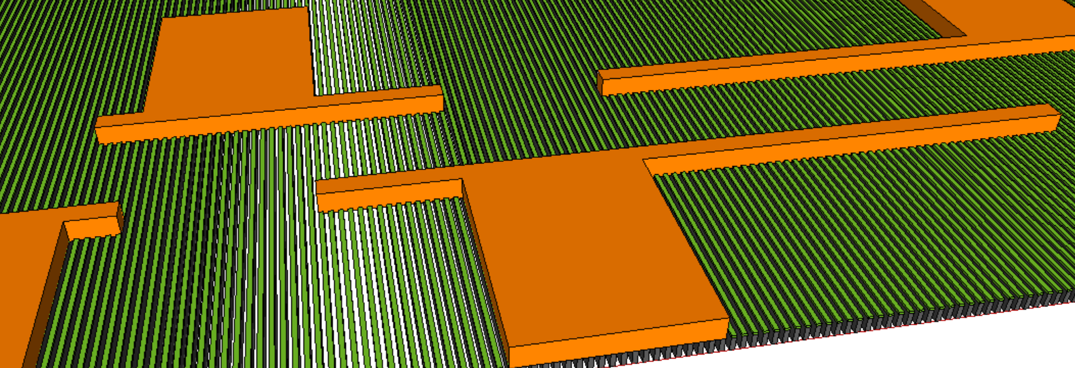
Structure Design–II: Number of Fingers
N₃
N₁
N₁
R
R_{terminal}
N

Slide 7
Critical Path and Help needed
Goal: to intercept S26A Pitch Quad W only L1D capability at best forecast capability @ WW43
Layout – 3 man∙day, need resources
Tapeout – x day, need to be prioritized
Process Development – 1 man∙week, need module allocation
Resistivity Eval – 1 man∙week, need etest bench support

