Slide 1
14nm BL/WL Resistivity using Pitch Quad S26A Mask
Steve, Kolya, Tony, Shafqat and DerChang, WW41/2017
Value Proposition
S26A Pitch Quad L1D current Status
Proposal on resistance evaluation with single damascene copper layer
Critical path and help needed for WW49 R_{BL/WL} risk mitigation

Slide 2
Why 14nm W resistivity validation is Critical
S37 scaling doubles density/bandwidth while maintaining die size and power of S26. The key assumptions for scaling working are array voltages equal to or lower then S26, including selection and read/write operation.
Therefore, the following voltages need to be validated at priority.
  Write Operation: R_{parasitics} ∙ I_{program} + Von, and
  Read/Select Operation: Selection/Inhibiting voltages and Window budge
DTS risk assessment of high risk items
  WL/BL resistance (1.6X)
  Vt distribution, particularly on Vt sigma (= to S26), and
  Thermal disturb if PM thickness cannot be scaled
  (simulation shows only 20% write count).
This proposal provides an alternative to pull in WL/BL resistance assessment.

Slide 3
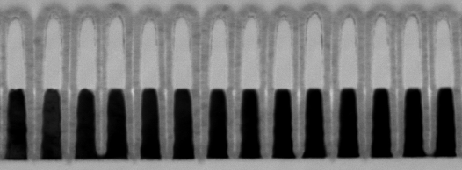
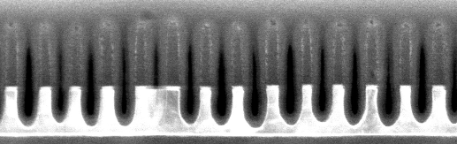
W only L1D Status, WW41
2nd cut like:
  55nm W;
  after WMMP etch:
  HM has to be adjusted (down);
  Over-etch increased.
1st cut like:
  37nm W + 25A WSiN;
  after 20s W1 etch only:
  CDs are too low; HM might need to be adjusted (down)
  Need to balance the over-etch vs undercut
  Some local blocked W etch.

Slide 4
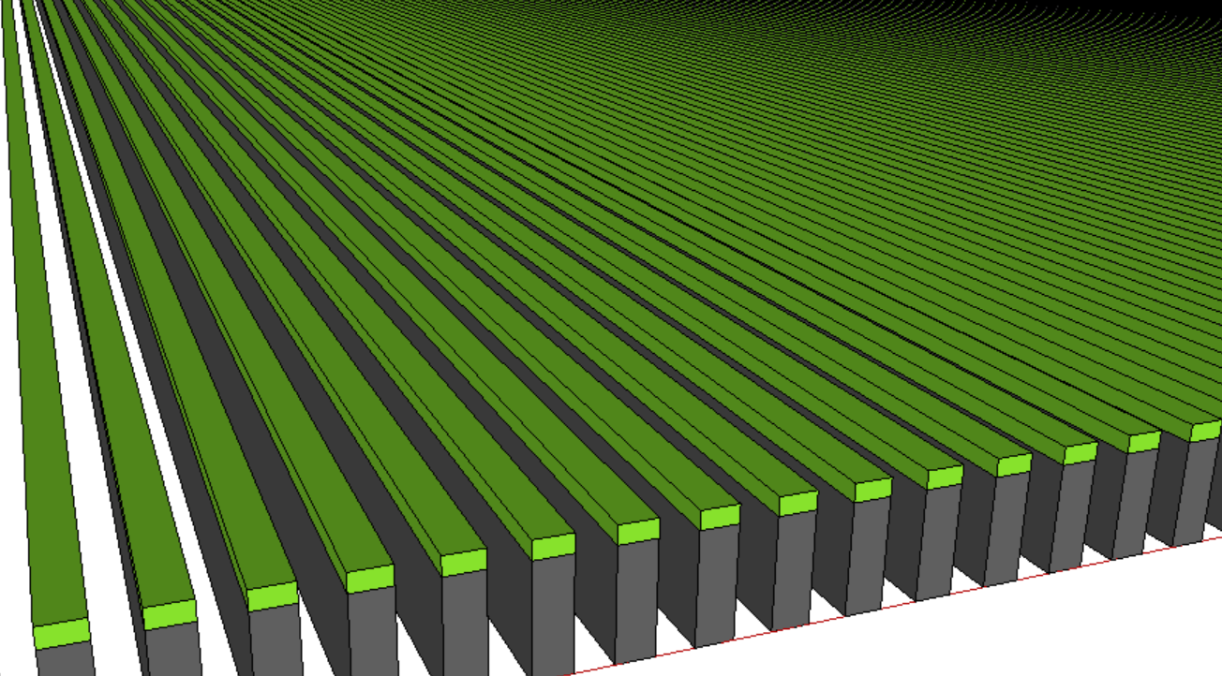
W only L1D Expectation
1st Cut equivalent for R_{WL}: 37nm W / CD: 12 to 16nm
2st Cut equivalent for R_{BL} : 55nm W / CD: 10 to 14nm
Nitride

Slide 5
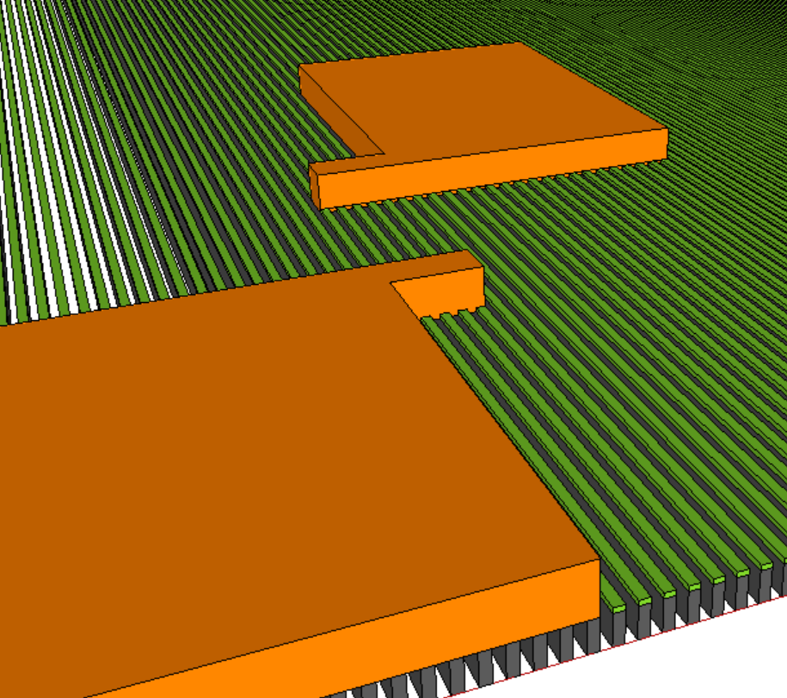
Single Damascene Copper Layer
Probe Pad - 2
Length of fingers
Number of fingers
Probe Pad - 1

Slide 6
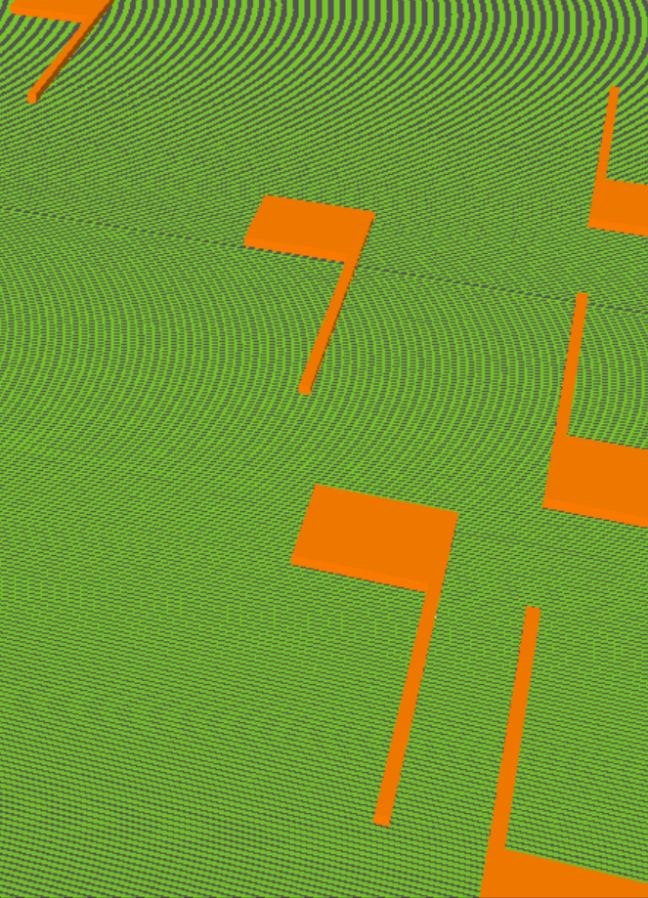
Structure Design –I: Lengths of Fingers
L₃
R
L₂
R_{terminal}
L
L₁

Slide 7
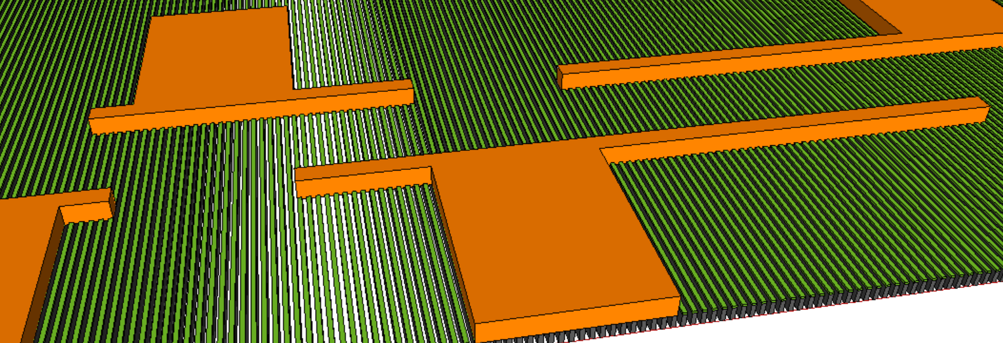
Structure Design–II: Number of Fingers
N₃
N₂
N₁
R
R_{terminal}
N

Slide 8
Critical Path and Help Needed
High Level Scope, gap fill/planar, single damascene for copper fill and cmp then bench char
Technical expertise besides Single layer Layout (3 head∙day)
  1 dielectric cmp resource for post W planarization
  1 photo resource (new mask)
  1 damascene etch resource with copper landing at W
  Small amount of Cu dep/plating resource in setup
  1 damascene polish resource (relatively small amount of work I think)
Schedule assessment
  1 = 1 or 2 rounds of targeting at cmp, ~1 week turnaround including x-sections
  2 = 1 day setup, 1 day metro (assumes high priority for the latter)
  3 = 2-3 rounds targeting, ~1 week turnaround including x-sections
  4 = negligible
  5 = 1 or 2 rounds of targeting at cmp, ~ 0.5 weeks
Probably about 2.5-3 weeks of effort
  Roughly gated by getting the mask (all items ex. 1)
  Need to scope/get buy-off from process guys & JDP managerial body

