Slide 1
14nm BL/WL Resistivity using Pitch Quad S26A Mask
Steve, Kolya, Tony, Khaled, Shafqat and DerChang, WW42/2017
Value Proposition
S26A Pitch Quad L1D current Status
Proposal on resistance evaluation with single damascene copper layer
Critical path and help needed
Supplementary materials, including
Process Flow consideration
Design of test structure and DOE

Slide 2
Why 14nm W resistivity validation is Critical
S37 scaling doubles density/bandwidth while maintaining die size and power of S26. The key assumptions for scaling working are array voltages equal to or lower then S26, including selection and read/write operation. Therefore, the following voltages need to be validated at priority.
Write Operation: R_{parasitics} ∙ I_{program} + Von, and
Read/Select Operation: Selection/Inhibiting voltages and Window budge
DTS risk assessment of high risk items
WL/BL resistance (1.6X)
Vt distribution, particularly on Vt sigma (= to S26), and
Thermal disturb if PM thickness cannot be scaled (simulation shows only 20% write count).
This proposal provides an alternative to pull in WL/BL resistance assessment.

Slide 3
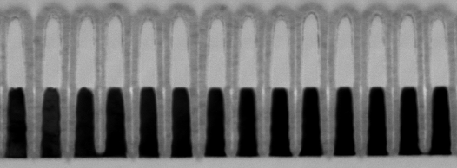
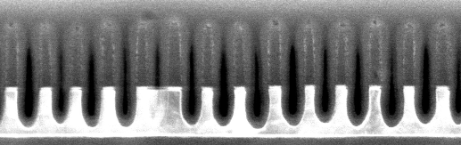
W only L1D Status, WW41
2nd cut like:
55nm W;
after WMMP etch:
HM has to be adjusted (down);
Over-etch increased.
1st cut like:
37nm W + 25A WSiN;
after 20s W1 etch only:
CDs are too low; HM might need to be adjusted (down)
Need to balance the over-etch vs undercut
Some local blocked W etch.

Slide 4
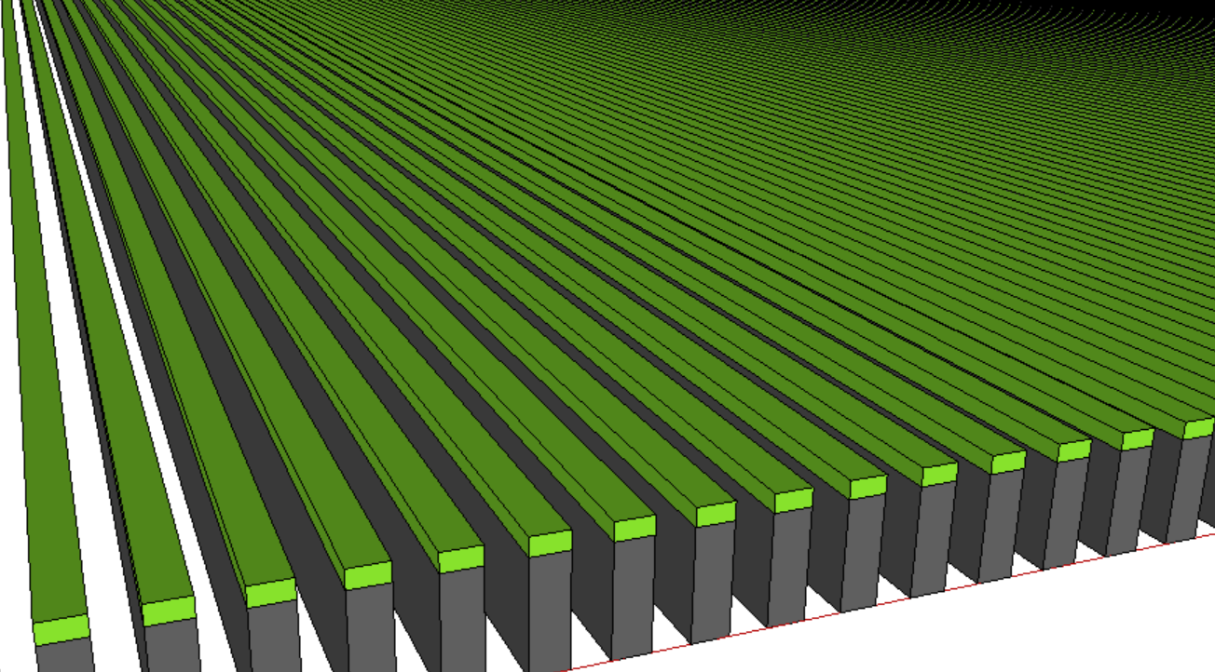
W only L1D Expectation
1st Cut equivalent for R_{WL}: 37nm W / CD: 12 to 16nm
2st Cut equivalent for R_{BL} : 55nm W / CD: 10 to 14nm
Nitride

Slide 5
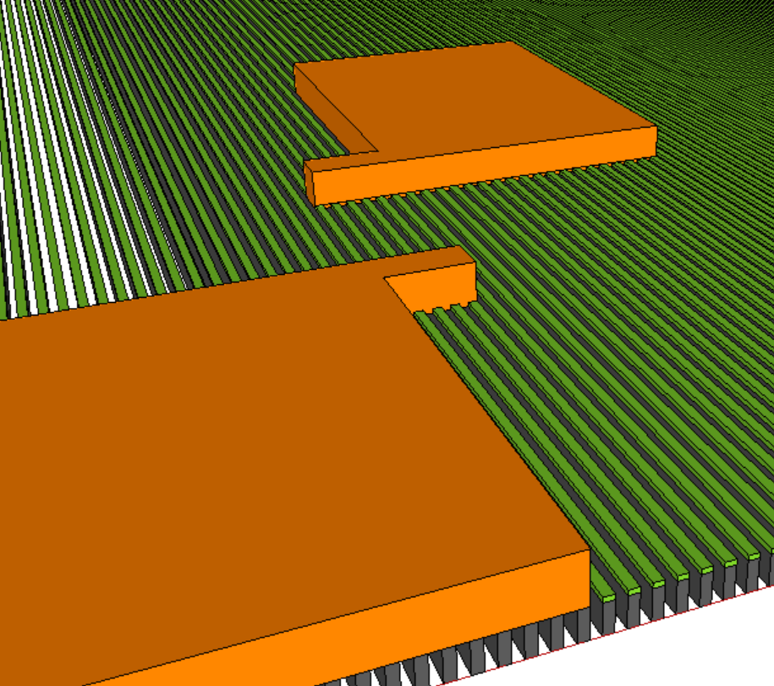
Single Damascene Copper Layer
Probe Pad - 2
Length of fingers
Number of fingers
Probe Pad - 1

Slide 6
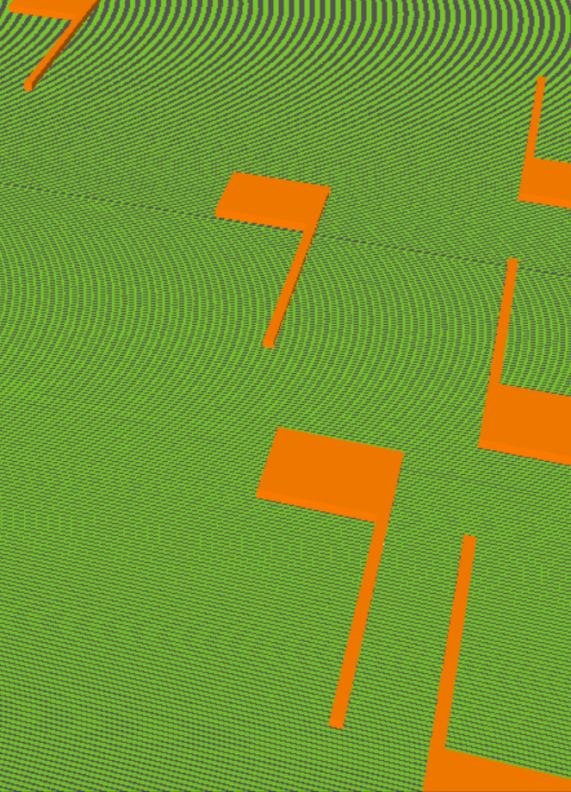
Structure Design –I: Lengths of Fingers
L₃
R
L₂
R_{terminal}
L
L₁

Slide 7
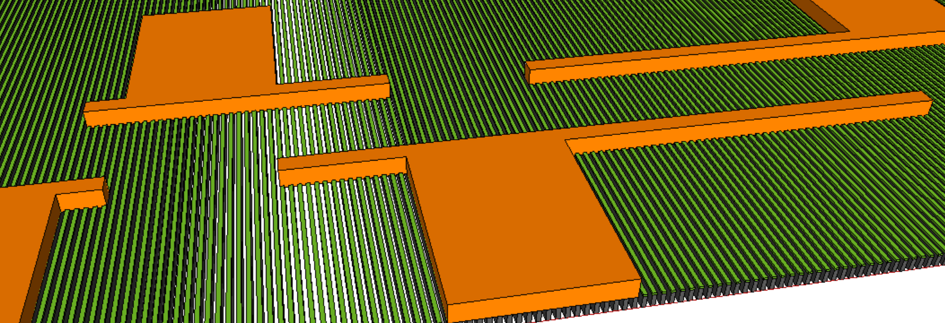
Structure Design–II: Number of Fingers
N₃
N₂
N₁
R
R_{terminal}
N

Slide 8
Critical Path and Help Needed High Level Scope, gap fill/planar, single damascene for copper fill and cmp then bench char
Technical expertise besides Single layer Layout (3 head∙day)
1 dielectric cmp resource for post W planarization
1 photo resource (new mask)
1 damascene etch resource with copper landing at W
Small amount of Cu dep/plating resource in setup
1 damascene polish resource (relatively small amount of work I think)
Schedule assessment
1 = 1 or 2 rounds of targeting at cmp, ~1 week turnaround including x-sections
2 = 1 day setup, 1 day metro (assumes high priority for the latter)
3 = 2-3 rounds targeting, ~1 week turnaround including x-sections
4 = negligible
5 = 1 or 2 rounds of targeting at cmp, ~ 0.5 weeks
Probably about 2.5-3 weeks of effort
Roughly gated by getting the mask (all items ex. 1)
Need to scope/get buy-off from process guys & JDP managerial body

Slide 9
Supplementary Materials

Slide 10

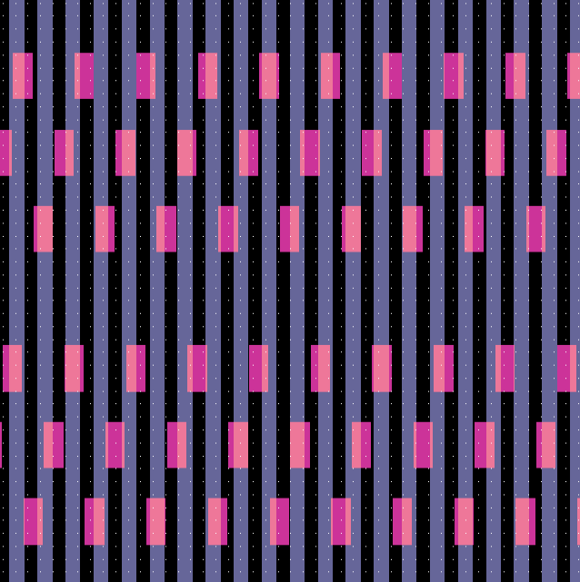


Pitch Quad Mask Process Integration Consideration
Electrical evaluation wafers should use oxide wafer
Overlay of 64 and 51 data is shown right. Each 51 line turns into 2 loops after PQ. Multiple-row 64 vias is to short all the 51 horizontally.
Starting with 94/64 results in unintended shorts convoluting with R_{WL}/_{BL} evaluation.
No Chop is required for loop End
Any parallel conduction paths through the loop ends should be so much more resistive and render their effect negligible.
Without Chop With Cop

Slide 11
Damascene Mask Design
Resistance to be explored ➔ R_{min} = R_{BL}= 10.8 Ω/b; R_{max} = R_{WL}= 56.5Ω/b.
Resistivity: ± 50% of 1.7X of S26 BL
R_{WL}: 37nm W / CD: 12 to 16nm; R_{BL} : 55nm W / CD: 10 to 14nm
Structure design to cover ~1 tile dimensions: ~4500 fingers and ~120𝛍m
Detectable at @ 1uA or higher, max sourcing less than 100mA at 1mV to 50V.
Current Range explored: 1 to 100uA/finger
Background leakage tolerance calibration structure will be included.
DUT Resistance @ min R_{BL}, 10.8 Ω/b
DUT Resistance @ max R_{wL}, 56.5 Ω/b
 |  | N: Number of fingers / width in μm]
 |  | 10 | 30 | 50 | 100 | 300 | 500 | 1000 | 3000
 |  | 0.28 | 0.84 | 1.4 | 2.8 | 8.4 | 14 | 28 | 84
Finger Length | 10 | 0.39 | 0.13 | 0.08 | 0.04 | 0.01 | 0.01 | 0.00 | 0.00
 | 20 | 0.78 | 0.26 | 0.16 | 0.08 | 0.03 | 0.02 | 0.01 | 0.00
 | 30 | 1.16 | 0.39 | 0.23 | 0.12 | 0.04 | 0.02 | 0.01 | 0.00
 | 50 | 1.94 | 0.65 | 0.39 | 0.19 | 0.06 | 0.04 | 0.02 | 0.01
 | 75 | 2.91 | 0.97 | 0.58 | 0.29 | 0.10 | 0.06 | 0.03 | 0.01
 | 100 | 3.88 | 1.29 | 0.78 | 0.39 | 0.13 | 0.08 | 0.04 | 0.01
 | 150 | 5.82 | 1.94 | 1.16 | 0.58 | 0.19 | 0.12 | 0.06 | 0.02
 | 200 | 7.76 | 2.59 | 1.55 | 0.78 | 0.26 | 0.16 | 0.08 | 0.03
 | 300 | 11.64 | 3.88 | 2.33 | 1.16 | 0.39 | 0.23 | 0.12 | 0.04
 |  | N: Number of fingers / width in μm]
 |  | 10 | 30 | 50 | 100 | 300 | 500 | 1000 | 3000
 |  | 0.28 | 0.84 | 1.4 | 2.8 | 8.4 | 14 | 28 | 84
Finger Length | 10 | 2.02 | 0.67 | 0.40 | 0.20 | 0.07 | 0.04 | 0.02 | 0.01
 | 20 | 4.04 | 1.35 | 0.81 | 0.40 | 0.13 | 0.08 | 0.04 | 0.01
 | 30 | 6.06 | 2.02 | 1.21 | 0.61 | 0.20 | 0.12 | 0.06 | 0.02
 | 50 | 10.09 | 3.36 | 2.02 | 1.01 | 0.34 | 0.20 | 0.10 | 0.03
 | 75 | 15.14 | 5.05 | 3.03 | 1.51 | 0.50 | 0.30 | 0.15 | 0.05
 | 100 | 20.18 | 6.73 | 4.04 | 2.02 | 0.67 | 0.40 | 0.20 | 0.07
 | 150 | 30.28 | 10.09 | 6.06 | 3.03 | 1.01 | 0.61 | 0.30 | 0.10
 | 200 | 40.37 | 13.46 | 8.07 | 4.04 | 1.35 | 0.81 | 0.40 | 0.13
 | 300 | 60.55 | 20.18 | 12.11 | 6.06 | 2.02 | 1.21 | 0.61 | 0.20

