Slide 1
Multi-Ported Memories
DerChang Kau, Mar 21, 2023
Multi-Ported SRAM
  Cells
  N6 Standard offering and N3 Custom Cells
  Application
Array :
  Building a memory array
  Array Implementation with single- and multi-ported Cells
  Multiport array using single port cell
The basic: Memory cell = Storage Element(s) + Access Device(s)

Slide 2
Multi-Ported Cells

Slide 3
SRAM Cells
1:1:1
U
V_{cc}
U
6T symmetry for 1RW SNM
  Strong Pull down for R/W Speed
  Lower Pass Gate Vt W yield
8T for Dual-ported access
W
W
B
G
D
V_{ss}
D
G
B
1:2:2
U
V_{cc}
U
W
W
B
G
D
V_{ss}
D
G
B
2RW
1R1W
B₁
W₁
B₁
W₁
U
V_{cc}
U
WB
WW
WB
U
V_{cc}
U
W₁
WW
WW
B₁
G₁
V_{ss}
G₁
B₁
WB
G
D
V_{ss}
D
G
WB
B₂
G₂
D
D
G₂
B₂
RD
RG
RB
B₂
W₂
B₂
W₂
W₂
RW
RW
RB

Slide 4
Multi-ported SRAM Symmetry
1R1W – P
RB
RW
V_{cc}
WB
WW
WB
1R1W – N
U
RG
RU
U
U
D
D
U
WB
WW
WB
D
G
G
D
RG
G
G
RU
2R1W
RW
RB
WB
WW
WB
U
U
RD
D
U
U
D
G
D
D
G
RD
RG
RG
G
G
RW₁
RB₂
RW₂
RB₁
U
U
RD
D
U
U
D
RD
G
D
D
G
RG
RD
RD
RG
RG
G
G
RG

Slide 5
N6 SRAM Cell PDK 1.0 (March/20/’20)
Cell Type | Cell Name | X'tor | Fin | Wdrawn | Ldrawn
6T Cell 1RW | HD | Nch, Pass Gate | 1 | 0.008 | 0.011
 |  | Nch, Pull Down | 1 | 0.008 | 0.011
 |  | Pch, Pull Up | 1 | 0.008 | 0.011
 | HC | Nch, Pass Gate | 2 | 0.038 | 0.011
 |  | Nch, Pull Down | 2 | 0.038 | 0.011
 |  | Pch, Pull Up | 1 | 0.008 | 0.011
8T Cell 1R1W | 8T (RP:LVT) | Nch, Pass Gate | 2 | 0.038 | 0.011
 |  | Nch, Pull Down | 2 | 0.038 | 0.011
 |  | Pch, Pull Up | 1 | 0.008 | 0.011
 |  | Nch, Read Pass Gate | 2 | 0.038 | 0.011
 |  | Nch, Read Pull Down | 2 | 0.038 | 0.011
 | HC8T (RP: LVT) | Nch, Pass Gate | 2 | 0.038 | 0.011
 |  | Nch, Pull Down | 2 | 0.038 | 0.011
 |  | Pch, Pull Up | 1 | 0.008 | 0.011
 |  | Nch, Read Pass Gate | 3 | 0.068 | 0.011
 |  | Nch, Read Pull Down | 3 | 0.068 | 0.011
8T Cell 2RW | DP | Nch, Pass Gate | 2 | 0.038 | 0.011
 |  | Nch, Pull Down | 4 | 0.098 | 0.011
 |  | Pch, Pull Up | 1 | 0.008 | 0.011

Slide 6
Intel-TSMC N3 Custom Cell
Bitcell Name | Bitcell type | Marker Layer | Pattern
ctmmm011p2c16v02x5 | 1r1w | SRM_1R1W | 1N-4P-2N (part 1/2)
 |  | SRM_1R1W_2ROW | 2N - 2N (part 2/2)
ctmmc021p4c06o02m5 | 2r1w | SRM_2R1W | 2N-1P
ctmmc022p4c16d02a5 (b5) | 2r2w | SRM_1RST2R1W | 3N-1P
ctmmc02208c16o02m5 | 2r2w | SRM_2R2W_T2 | 2N-1P
ctmma12108b36d04x5 | 1rst2r1w | SRM_2R2W_T2 | 3N-1P
ctmmc04118c16e04m5 | 4r1w | SRM_4R1W_2W | 4N-1P
ctmmc04218c16e04m5 | 4r2w | SRM_4R1W_2W | 4N -1P
ctmma0060cd16t04m5 | 12r6w | SRM_12R6W | 4N-2P
ctmma0070ed16t04m5 | 12r7w | SRM_12R6W | 4N-2P

Slide 7
Why “Multi-Port Memories”
﻿Multi-Port Memories have all the features of single-port memories
Used for multi-tasking
Parallel Processing – increase bandwidth without cycle time compressing
“Simultaneously” read and write data or read-while-write
Examples
  Dedicated Memory – In a branch-target-buffer memory to keep track branch prediction and decision
  Shared Memory – multiple requests for data from multi-cores or networked processors
Analysis and Synthesis
  Multi-port (MP) SRAM is a commonly used for cache design as it allows simultaneous R/W accesses.
  For CISC CPUs, such as the X86 architecture, MP cache such as mRnW configuration is used
  For RISC CPUs, such as the ARM architecture, SP cache such as 1RW with multi-bank (MB) configuration is used.
  Overall, the choice of cache memory organization and multiport SRAM configuration depends on the specific design goals, performance requirements, and trade-offs between cost, power consumption, and performance.

Slide 8
Cache Implementation Examples
 | L1 cache |  | L2 cache |  | L3 cache
 | Itanium-2 | Snapdragon 768G | Itanium-2 | Snapdragon 768G | Itanium-2
Size | 16-KB Harvard | 192KB (2:1/I:D) | 256-KB unified | 512KB | 3-MB unified
Associativity | 4-way assoc. | 2-way set assoc. | 8-way assoc. | 8-way assoc. | 24-way assoc.
Cache line size | 64 bytes | 64 bytes | 128 bytes | 128 bytes | 128 bytes
Write policy | Write-through | Write-Back | Write-back | Write-back | Write-back
Replacement policy | LRU | LRU | NRU | LRU or pLRU | NRU
Error correction | ECC 2 | N/A | ECC | ECC | ECC
No. of ports | 2R2W | 1RW or 2R1W | 4R4W | not public | 1 RW
Location | On-chip | On-chip | On-chip | On-chip | On-chip

Slide 9
Memory Subsystem
 |  | Cascade Lake | ADL P-core | ADL E-core | Zen 2 | Zen 3 | M1 P-Core | M1 E-Core | M1x P-Core | M1x E-Core | IBM z15 | IBM z16 Telum
I-Cache | KB | 32 | 32 | 64 | 32 | 32 | 192 | 128 | 192 | 128 | 128
D-Cache | KB | 32 | 48 | 32 | 32 | 32 | 128 | 64 | 128 | 64 | 128
L2 Cache | MB | 1 | 1.25(clinet) 2(server) | 2 | 0.5 | 0.5 | 12/4c | 4/4c | 24/8c | 4/2c | 4(I$)/4(D$) | 32 semi-private
L3 Cache | MB | 38.5/28c | 30/(8p+8e) |  | 16/4c | 32 or 96 /8c | 24/(4p+4e) |  | 48/(8p+2e+16g), 48/(8p+2e+32g) |  | 256/12c | Virtual 256MB (32MB·8core)
 |  |  |  |  |  |  | apple 1 GPU core ≈ 16EU |  |  |  |  | 2 die per socket (512MB L4) 4 sockets per drawer, (2GB L5) 4 drawers per system (8GB L6)
Socket |  | CXL-SP | i9-12900K |  |  | Ryzen 9 5950X | Apple M1 |  | Apple M1x
DRAM | Phy | DDR4/2933 | DDR5/4800 |  |  | DDR4/3200 | LPDDR4X/4266 |  | LPDDR5/6400
DRAM | # of DQ | 384b | 128b |  |  | 128b | 128b |  | 56b(pro), 512b(max)

Slide 10
SRAM Array

Slide 11
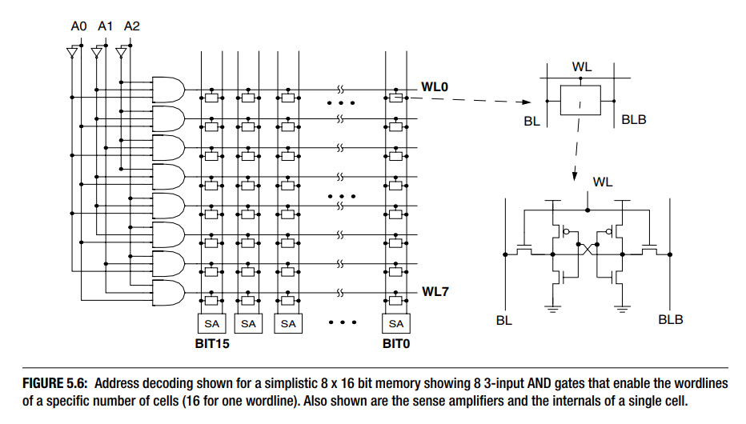
Simple SRAM Array Example
Bruce Jacobs, Spencer Ng & Davide Wang, Memory System: Cache, DRAM, Disk, p.262

Slide 12
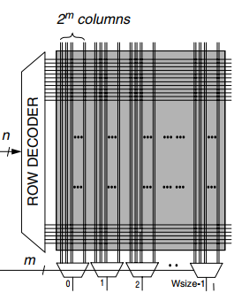

Array Capacity: $n$·$m\text{·}w$ bits with 1RW, 1R1W, 2R2W cells
Read D
Read C
m
0
1
2
W_{size}-1
m
0
1
2
W_{size}-1
12T cell
n·m·w b Bank
6T cell
1RW
8T cell
1R1W
16T cell
2R2W
Read
m
0
1
2
W_{size}-1
n
n
ROW DECODER – WWL-B
ROW DECODER – RWL-D
8T cell
n·m·w b Bank
n
n
ROW DECODER – WWL-A
ROW DECODER – RWL-C
n
n
ROW DECODER - WWL
ROW DECODER - RWL
m
m
0
1
2
W_{size}-1
m
0
1
2
W_{size}-1
0
1
2
W_{size}-1
Write A
Read/Write
Write
Bruce Jacob et.al, Memory System, p.265
Write B

Slide 13

$n$·$m$·$w$-bit array
4 RW ports vs. 2R2W ports
Read D
Read C
m
0
1
2
W_{size}-1
m
0
1
2
W_{size}-1
12T cell
n·m·w b Bank
6T cell
1 RW port
1Bank
6T cell
4 RW ports
4 banks
16T cell
2R2W ports
1Bank
6T Cell
¼·n·m·w b Bank
n
n
n/2
ROW DECODER – WWL-B
ROW DECODER – RWL-D
ROW DEC
n
n
ROW DECODER – WWL-A
ROW DECODER – RWL-C
m/2
0
1
2
W_{size}-1
0
1
2
W_{size}-1
Read/Write
Bank Logic: 4ports Cmd/Add + I/O
m
m
0
1
2
W_{size}-1
0
1
2
W_{size}-1
Read/Write
0
1
2
W_{size}-1
0
1
2
W_{size}-1
Write A
Bruce Jacob et.al, Memory System, p.265
Write B

Slide 14
Single Multiported Bank vs. Multibanked Channel
Multiported caches using multiported SRAM cells are custom designed to allow concurrent accesses to any location.
  Allows relatively simple control of the SRAM
  Significant increase in footprint due to the addition of multiple “access transistors” for each port
  It also incurs additional delay because of wire length increase within the memory array (R and C)
A “Bank” of memory is an independent operable unit of memory array
﻿An alternative to multiporting is deploying multiple independent banks
  each bank is implemented as a simple single-ported R/W ﻿cache.
  Multiple cache accesses (read and/or write) as long as the accesses are to different banks.
  The example in the previous slide can perform a maximum of four R/W accesses concurrently.
  Modularize the intelligence by a cache controller managing data flow instead overburdening CPU complexity.

Slide 15
Memory Cell

Slide 16
A memory cell consists one storage element and one or more access switch(es)
Storage Elements:
  Latch: Circuit based or Thyristor device
  Electrostatic memory switch: Two terminal capacitor, floating gate/plate, charge traps devices
  Atomic memory switch: Phase change, Magneto Tunnel Junction, Ferroelectric, Oxy-Vacancy (Filamentation)
Access Devices:
  3 terminal Transistor:
    Pass logic (1T) is typical used for read/write access.
    Gated common-source amp (2T) is used for read only access
    Biased Source-follower (1T) is used for read only access
  Two-terminal diodes: Thermionic (PN junction, Schottky barrier, DIAC & etc) , MIT, OTS MIEC, volatile filamentation and etc.
A₁
S
A₂
•••
•••
One or memory storage elements may also share one access device

Slide 17
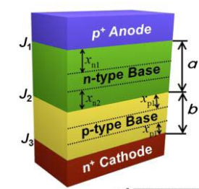
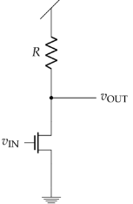
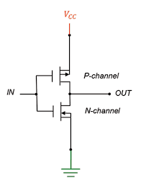
Latch
Latch
Inverter: 1R-1T (nMOS) vs. 2T (CMOS) Inverter
Q
Q

Slide 18
3-terminal Access Devices
WL
Pass Logic for R/W
Gated CS Amp for RO
Biased SF for RO
Q
Q
BL
RWL
Q
Q
RBL
RWL
Q
Q
RBL

Slide 19
Complementary Gain Memory Cell
Dual Ports
WBL
RBL
WWL
RWL
S. Shukuri et al., “Super-Low-Voltage Operation of a Semi-Static Complementary Gain RAM Memory Cell,” VLSI Tech. Symposium pp. 23-24 (1993);
N. Ikeda et al., “A novel logic compatible gain cell with two transistors,” Dig. Symp. VLSI Technology, 2002, pp. 168–169.
D. Somasekhar, et al. “2 GHz 2 Mb 2T gain cell memory macro with 128 GBytes/sec bandwidth in a 65 nm logic process technology,” IEEE J. Solid-State Circuits, vol. 44, no. 1, pp. 174–185, Jan. 2009.

Slide 20
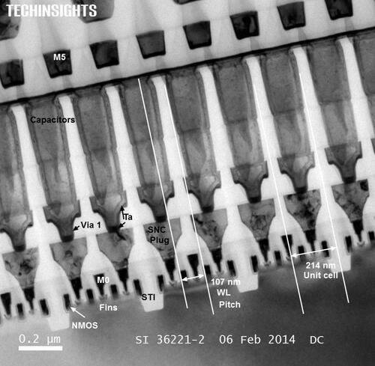






Emerging Memories for In Package Memory candidates
1T- 1X Array Architecture
Intel Gen 1 eDRAM [1T1C]
BL
SL
BL
SL
WL
WL
Y decoder
WL
Write Driver and Sense Amp
X –decoder and Multiplexer
Output driver and I/O
Access Transistor
Si channel planar / nonplanar XTOR
TFT channel planar / nonplanar XTOR
2T [independent read write] Option
High-k Capacitor
MRAM [STT/SOT]
Ferro-capacitor
Nano-structure change
Memory Element
Key Challenge: BW, Granularity
INTEL CONFIDENTIAL

Slide 21
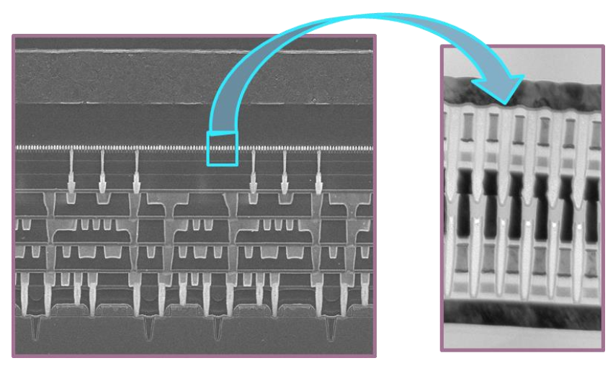
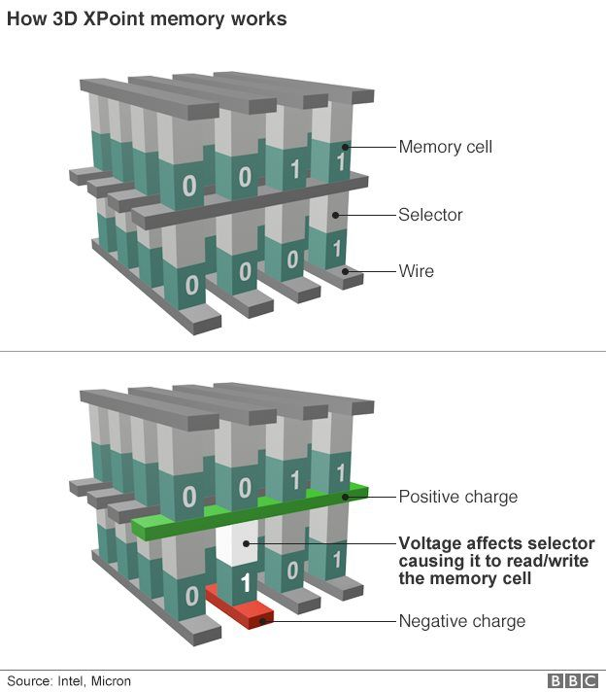
Emerging Memories for Persistent Memory in 3D Cross Point Architectures
Intel Gen 1 3D XPoint™
Access Diode
Thermionic
[diode, MIEC, ..]
Volatile filament
Metal-Insulator Transition
Ovonic Threshold
Magnetic
[MRAM, STT(SOT)MRAM]
Resistance Change ReRAM[1D, 2D], PCM [3D]
Ferroelectrics
Memory Element
Key Challenge: Matching Memory & Selector
INTEL CONFIDENTIAL

Slide 22
Scratchpad

Slide 23
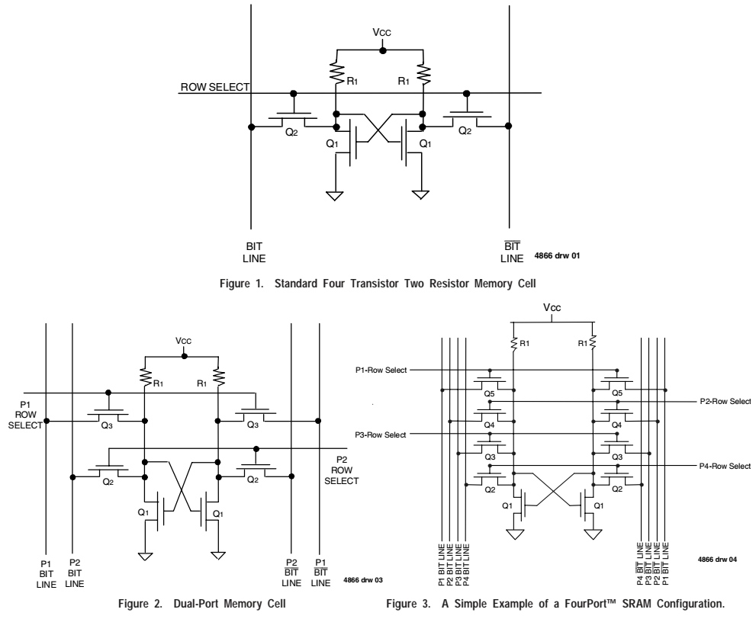
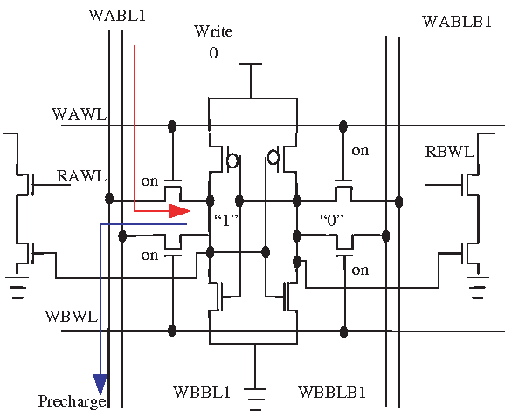
Renesas App Note AN-253

