Slide 1
TC DRAM Intel SK Hynix Collaboration
TCD team
09/02/2021
Data shared under CNDA 30991112 & CNDA 112784

Slide 2
Agenda
TCD Overview
Product Value Proposition
Data Center/AI/HPC
Client/Mobile
Graphics
TCD Macro details and perf/power/area summary
Proof –of-Concept & Test Chip Plans
Product Intercept Timeline
Manufacturing Details
Business Model
Next steps
Data shared under CNDA 30991112 & CNDA 112784

Slide 3
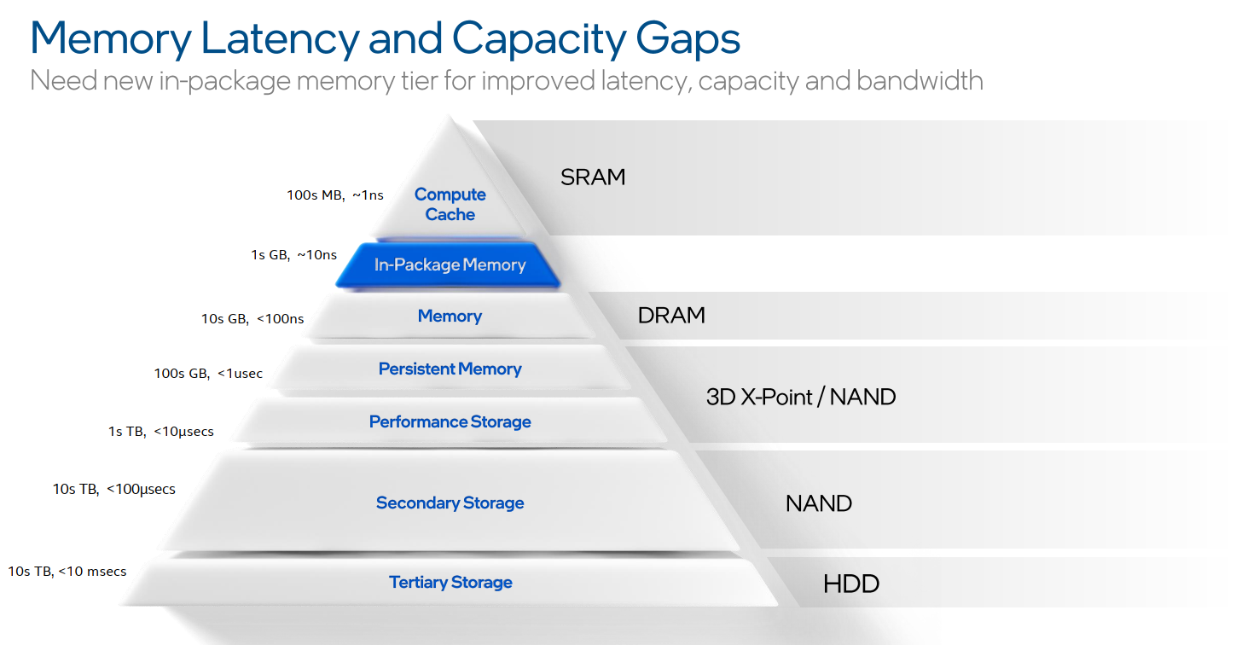
TCD Overview
Topic of discussion today
Data shared under CNDA 30991112 & CNDA 112784

Slide 4
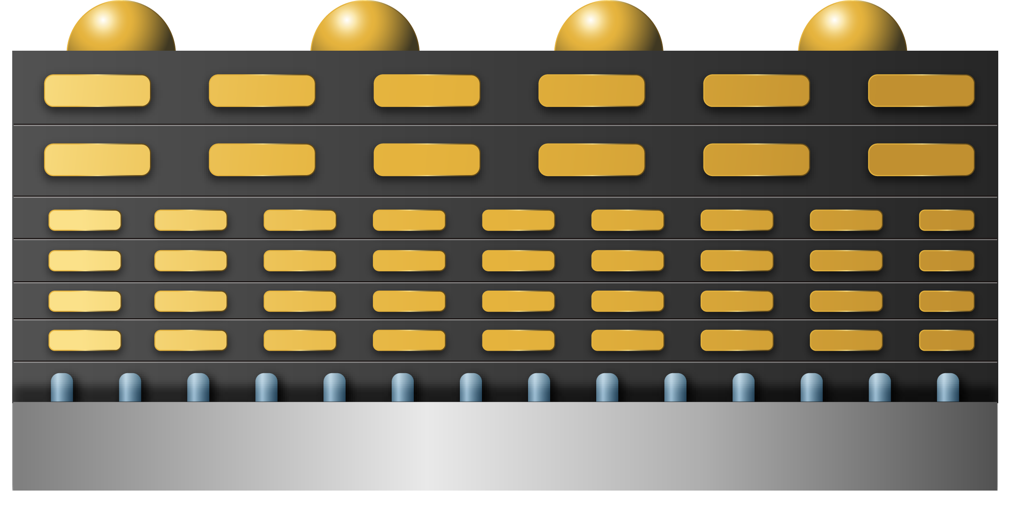
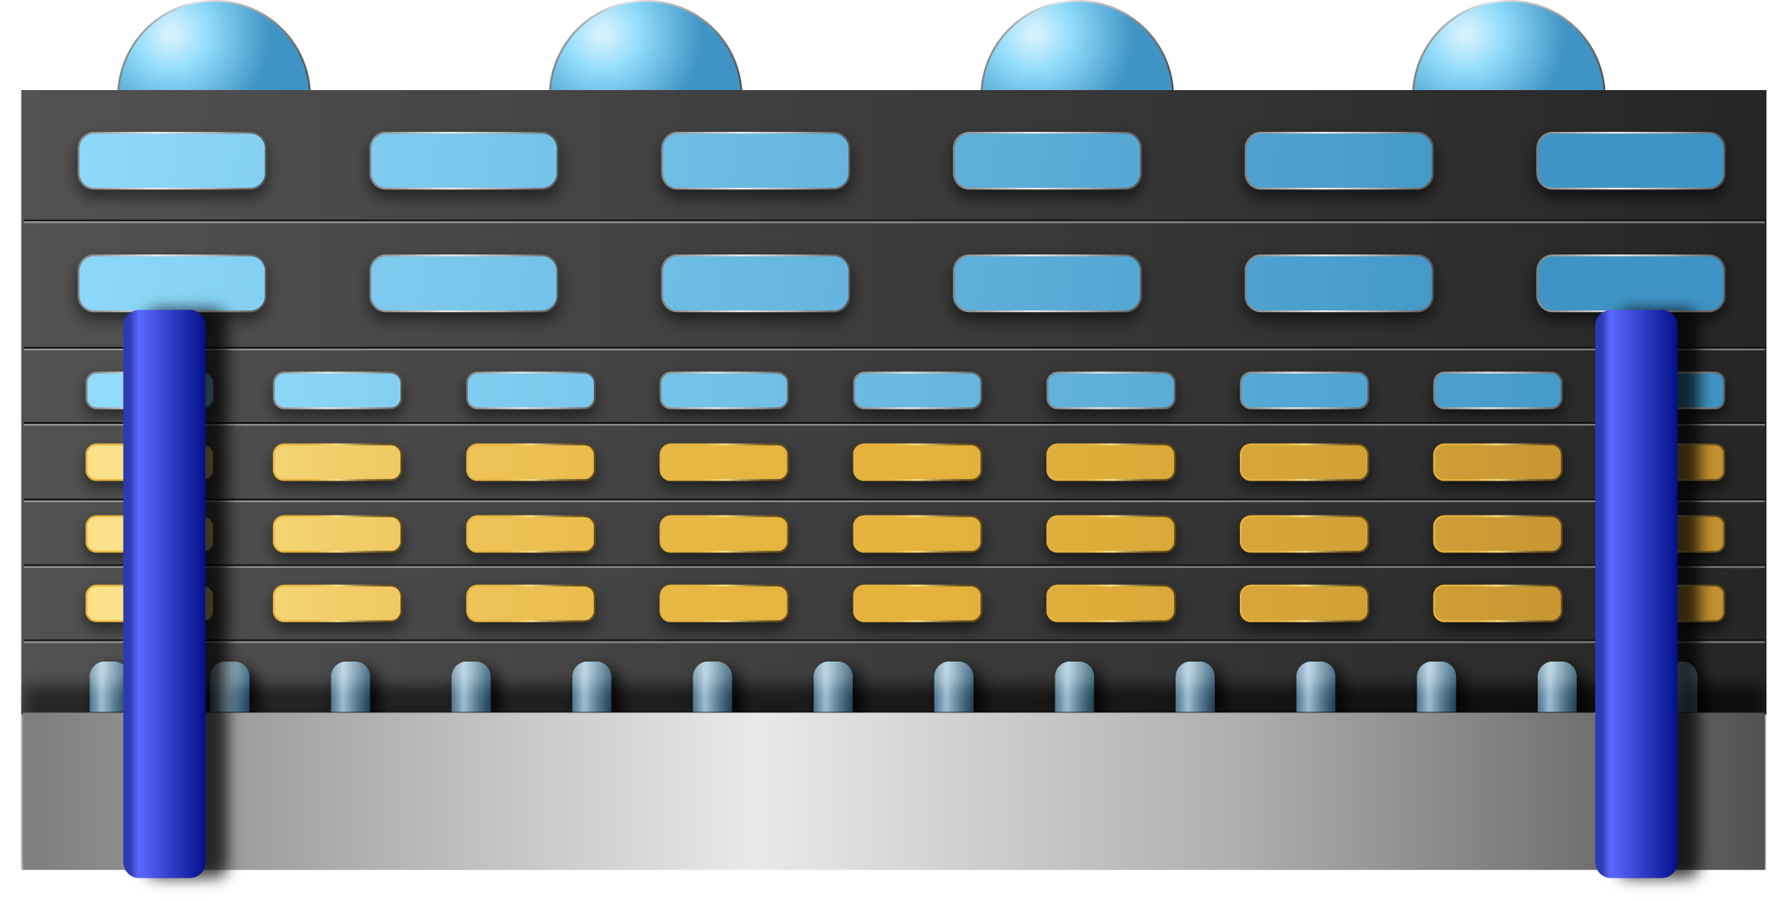
TCD Overview
Tightly Coupled DRAM (TCD) concept
Standard
Custom
SK Hynix makes full DRAM metal stack
SK Hynix makes DRAM wafers up to M3
Intel completes top metal layers
TSV processing can by SK or Intel (TBD)
SK Hynix Metal Stack
Intel Top metal layers, MIM & TSV
SK Hynix Si Transistors + M1/M2/M3
SK Hynix Si Transistors + M1/M2/M3
Silicon Substrate
Silicon Substrate
Goal → Develop custom DRAM interposers to enable tighter integration with logic.
TCD Benefit → Ability to specialize memory solutions for the specific bandwidth, capacity and integration requirements across Intel portfolios by leveraging a common DRAM macro.
Data shared under CNDA 30991112 & CNDA 112784

Slide 5
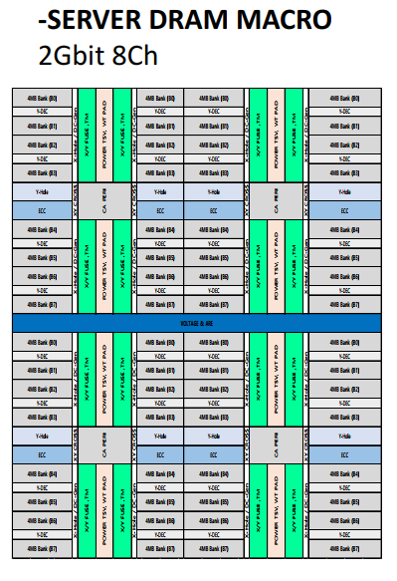
TCD macro key metrics (High Bandwidth)
Parameters \tech. | 2Gb Macro* (1znm) | 2Gb Macro* (1bnm) | 16Gb HBM2E (1ynm) | 16Gb HBM3 (1znm)
Density/mm2 | 16MB/mm² | 21.12MB/mm² | 19.66MB/mm² | 17.8MB/mm²
# Channel | 8 | ← | 8 | 16?
# pre-fetch/ch | 512b | ← | 1024b | ←
Page Size/ch | 0.5KB | ← | 1KB | TBD
# Bank/ch | 8 | ← | 32 | ←
tCCD target | 4ns | ← | 2.5ns | 1.25ns?
BW/ch | 16GB/s | ← | 51.2GB/s | 102.4GB/s
Total BW (per 1GB) | 512GB/s | ← | 51.2GB/s | 102.4GB/s
pj/bit ¹ | ~1.5 | ← | 5.2 | ~3-4?
LATENCY(Close) ² | 19.8ns | ← | 43.5ns | 48ns
LATENCY(Open) ³ | 15ns | ← | 28ns | 31ns
tRCR/tRCW | 30ns | ← | 60ns | 60ns
# DQ/Ch | 512b | ← | 128b | 64b?
In DRAM ECC | O | ← | X(Parity bit) | O(RS code)
BW/pin | 250Mbps | ← | 3.2Gbps | 6.4Gbps
High-Bandwidth Macro (2Gbit 8Ch)
1 pj/bit: Watt/Bandwidth
2 Latency (Close page): tRCD + tAA (ACT~RD + RD~ DATA)
3 Latency (Open page): tAA ( RD~ DATA)
*TSV overhead not included. No-SerDes circuit assumed
**pJ/bit and latency numbers above are at macro level and do not account for base die/3D stack costs
Data shared under CNDA 30991112 & CNDA 112784

Slide 6
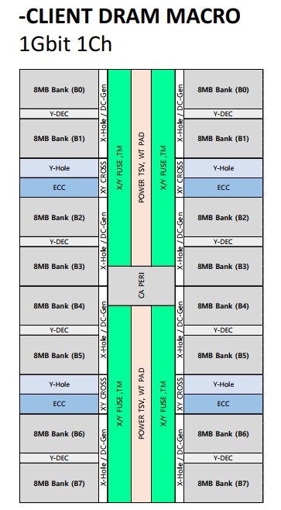
TCD macro key metrics (High Capacity)
Parameters \tech. | 1Gb Macro* (1znm) | 1Gb Macro* (1bm) | 16Gb LPDDR5 (1zm)
Density/mm2 | 19.17MB/mm2 | 25.56MB/mm2 | 33.73MB/mm2
# Channel | 1 | ← | 1
# pre-fetch/ch | 512b | ← | 128b
Page Size/ch | 1KB | ← | 2KB
# Bank/ch | 8 | ← | 16
tCCD target | 4ns | ← | 2.5ns
BW/ch | 16GB/s | ← | 12.8GB/s
Total BW (per 1GB) | 128GB/s | ← | 6.4GB/s
pj/bit ¹ | ~1.5 | ← | 3.5
LATENCY(Close) ² | ~25ns | ← | 40ns
LATENCY(Open) ³ | 15ns | ← | 25ns
tRCR/tRCW | 30ns | ← | 60ns
# DQ/Ch | 512b | ← | 16b
IDD6(4GB, mA) | 4.13 | ← | 1.28
In DRAM ECC | O | ← | O
BW/pin | 250Mbps | ← | 6.4Gbps
High-Capacity Macro (1Gbit 1Ch)
1 pj/bit: Watt/Bandwidth
2 Latency (Close page): tRCD + tAA (ACT~RD + RD~ DATA)
3 Latency (Open page): tAA ( RD~ DATA)
*TSV overhead not included. No-SerDes circuit assumed
**pJ/bit and latency numbers above are at macro level and do not account for base die/3D stack costs
Data shared under CNDA 30991112 & CNDA 112784

Slide 7
High Bandwidth Macro for Product - Cube
High-Bandwidth Macro (2Gbit 8Ch)
Single 256MB Macro with TSV @ ~15.5MB/mm²
3.72mm
4.745mm
2 GB, 1 TB/s
(2stack of ~70mm²)
4 GB, 2 TB/s
(2stack of ~140mm²)
8 GB, 4 TB/s
(2stack of ~280mm²)
Cube like implementation of the proposed high BW macro
Data shared under CNDA 30991112 & CNDA 112784

Slide 8
High Bandwidth Macro for Product - Interposer
High-Bandwidth Macro (2Gbit 8Ch)
Single 256MB Macro with TSV @ ~15.5MB/mm²
3.72mm
4.745mm
2 GB, 1 TB/s
(2stack of ~140mm²)
4 GB, 2 TB/s
(2stack of ~280mm²)
8 GB, 4 TB/s
(2stack of ~560mm²)
Interposer like implementation of the proposed high BW macro
Data shared under CNDA 30991112 & CNDA 112784

Slide 9
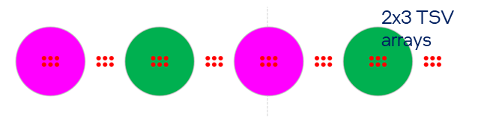
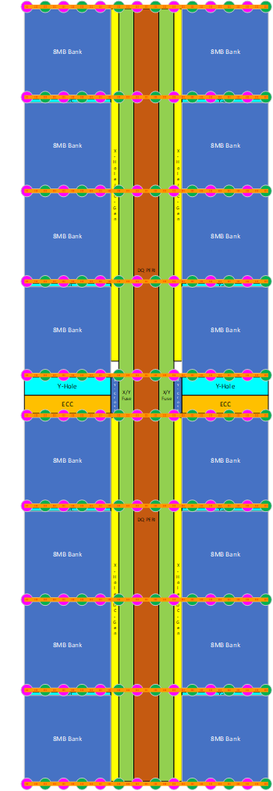
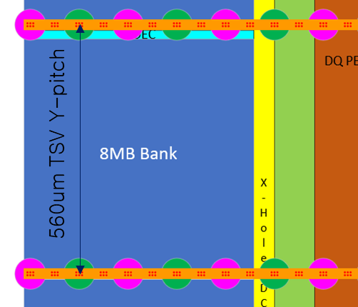
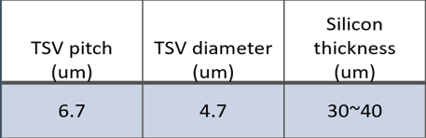
TSV and area overhead for Macros
High-BW
High-Capacity
High-BW
High-Capacity
High-BW
High-Capacity
TSV Assumptions
Sized for Data-Center/AI/HPC & Client/Mobile power delivery requirements.
High-Capacity macro sees ~11% area growth and the High-Bandwidth sees ~8% area growth.
Data shared under CNDA 30991112 & CNDA 112784

Slide 10
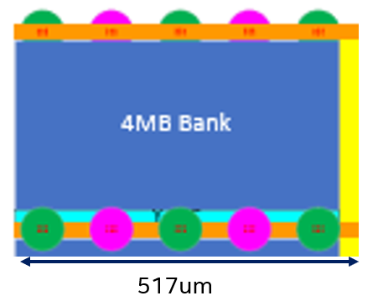
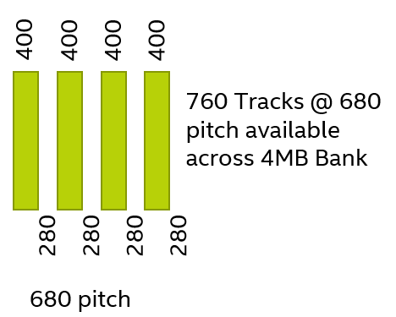
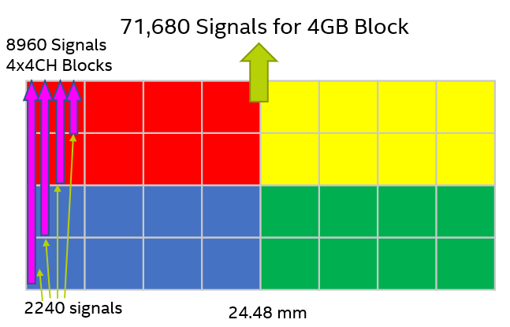
Power delivery and Die2die routing
Given the routing constraints Intel team is proposing only 1Ch per Macro, but eventually needs to be 2Ch/Macro.
Even for 1ch high-capacity macro at least 1 -2 additional metal layers are needed.
At least 2 additional metal layers needed for larger high-bandwidth macros.
Data shared under CNDA 30991112 & CNDA 112784

Slide 11
Process Construction /Hybrid Manufacturing
Standard
Custom
SK Hynix makes full DRAM metal stack
SK Hynix makes DRAM wafers up to M3
Intel completes top metal layers
TSV processing can by SK or Intel (TBD)
SK Hynix Metal Stack
Intel Top metal layers, MIM & TSV
SK Hynix Si Transistors + M1/M2/M3
SK Hynix Si Transistors + M1/M2/M3
Silicon Substrate
Silicon Substrate
Top three metal routing layers are Cu with a pitch and patterning scheme that is compatible with Intel processing.
No technical show-stoppers for custom metal layer addition or 3D integration.
Data shared under CNDA 30991112 & CNDA 112784

Slide 12
Yield and Recovery Model for large dies
Memory Cube like Usage Model (Client, D-GFx & GP Server): Small DRAM dies
SKH projects yield of 50-100mm2 DRAM die (like standard products) using existing modelling methodology (similar model as commodity HBM, with different die size)
DRAM as Interposer Usage Model (AI/HPC): Large DRAM dies
SKH to extend yield model of 50-100mm2 DRAM die to incorporate additional repair and redundant banks (small additional area overhead or small capacity reduction for same area) and project the die yield.
Intel then create a next-level model that puts together multiples 50-100 mm2 dies (that can defeature banks/channels) as a larger 700mm2 interposer.
Potential usage scenarios:
Interposer is just a larger dicing boundary – individual 50-100mm2 DRAM “dies” within the interposer are completely independent and defeatured, may need to support interconnect stitches crossing across scribe lines
Interposer is a larger dicing boundary, but all individual dies need to function – total yield will be composite yield of individual dies
Data shared under CNDA 30991112 & CNDA 112784

Slide 13
Test Issues
Array BIST at macro/die/stack level ownership and details of implementation
Need new test methodology between macro vs. full product
IP sharing concerns from SK Hynix
Need to build new controllers for cube or interposer options
Data shared under CNDA 30991112 & CNDA 112784

Slide 14
Summary table on DRAM Technology Node Choice
TCD Metric |  | 1z |  | 1a |  | 1b |  | SRAM
 |  | High-Capacity | High-Bandwidth | High-Capacity | High-Bandwidth | High-Capacity | High-Bandwidth
Density | MB/mm² | 19.2 | 16 | 21.4 | 17.71 | 25.6 | 21.12 | 3-4
BW/Ch | GB/s | 16 | 128 | 16 | 128 | 16 | 128 | 128
pJ/bit ¹ |  | ~1.5 | ~1.5 | ~1.5 | ~1.5 | ~1.5 | ~1.5 | ~0.2
Latency ² | ns | ~ 24 | ~19.8 | ~ 24 ns | ~19.8 | ~ 24 ns | ~19.8 | ~1-2
SRAM nos. based on 256Mb macro in N-1 or N node
1 pj/bit: Watt/Bandwidth
2 Latency (Close page): tRCD + tAA (ACT~RD + RD~ DATA)
Need competitive density for a given capacity and BW target in 2025.
DRAM node 1a nm is considered optimal in terms of cost effectiveness and longevity in supply.
Data shared under CNDA 30991112 & CNDA 112784

Slide 15
Proof-of-Concept Goals
Risk/Challenge | Objective/Goal of PoC Vehicle
Wafer Handling (Scribe, EDM, Fiducials) | Integration details to handle wafers across SK & Intel (alignment/metrology/wafer-health monitors etc)
Power Delivery/Thermals | Qualifying thermal solutions, TIM, backside metals, Tj-limits
Assembly | Die-wafer/hybrid-bonding 3D integration solution validation
Yield (Sort/Class) | Showing path to low-DD for overall concept
Test | Enable M-BIST engines in base-die with the 3D integration scheme (programmable micro-controller option makes test easier but at cost of area and complexity)
Bandwidth/Latency/Power | Process tuning to match macro spec for BW, latency and power
Reliability/ECC/DPM | Establish DPM targets/ECC bits/Row-hammer solution
Build simple test vehicle to test out integration with base die either from SKH or Intel.
Focus on manufacturing and test plans
Enable test/validation of more than one construction option.
Data shared under CNDA 30991112 & CNDA 112784

Slide 16
POC plan – Achieving Technology & Volume Goals
Team advocating a 3-step plan
Step1: Implement a PoC to prove out the basic concept and logistics
Step2: Bring to life an MVP product using the high-bandwidth macro
Step3: Scale out technology to high volume to enable a viable business model
Need to implement steps 2 and 3 in parallel and cannot be a serial implementation.

Slide 17
Value of doing PoC TC as Step1
Manufacturing, assembly, wafer-handling, TSV processing, thermals and test are the critical elements of the TCD product architecture plan.
Need early test vehicle to gain confidence before implementing an actual product. SK Hynix also recommending this as first step.
Exact macro construction, product spec closure and construction options need more in-depth technical study to close.

Slide 18
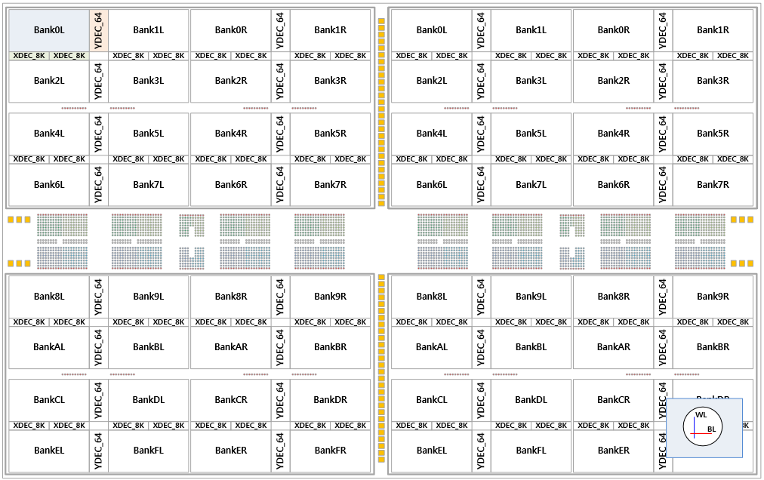
Step1 : Proof-of-Concept & Test Chip Plans – Option 1a & 1b
.
.
.
1 - N
DRAM
DRAM
Existing HBM Base die
Option 1a: Use SKH HBM2e base die
HBM2E core die, 2ch/16Gb
Use existing HBM2e macro from SK
Two options for base die: SKH HBM or Intel.
SKH team advocating using HBM2e base die (TBD).
Intel team sees value in integrating HBM2e macro with Intel/modern base die due to architecture and power needs.
.
.
.
1 - N
DRAM
DRAM
Intel Process Base die
Option 1b: Use SKH HBM2e core die with Intel base die
Data shared under CNDA 30991112 & CNDA 112784

Slide 19
Step1 : Proof-of-Concept & Test Chip Plans – Option2
High-Capacity Macro (1Gbit 1Ch)
High-Bandwidth Macro (2Gbit 8Ch)
Team is advocating macro to build capacity of 2, 4, 8 GB ( High-Bandwidth Macro)
Enable Cube and Interposer

Slide 20
Joint Recommendation : Option1b for PoC
PoC Goals | Option 1a (HBM2e Macro) | Option 1b (HBM2e Macro) | Option 2 ( High-BW Macro)
Wafer Handling | ✓ | ✓ | ✓
Power Delivery/Thermals | X | ✓ | ✓✓
Assembly | X | ✓ | ✓
Yield | ✓ | ✓ | ✓✓
Test | ✓ | ✓ | ✓
Bandwidth/Latency/Power | X | ✓ | ✓✓
Reliability/ECC/DPM | ✓ | ✓ | ✓
Execution Time | ✓✓ | ✓ | XX
New IP Dev Effort | ✓✓ | ✓ | XX
Matched to Final Product | XX | X | ✓
Team recommending Option1b as lead candidate for this engagement.
Data shared under CNDA 30991112 & CNDA 112784

Slide 21
Step2 : Enable High Bandwidth Macro
High-Bandwidth Macro (2Gbit 8Ch)
Single 256MB Macro with TSV @ ~15.5MB/mm²
3.72mm
4.745mm
2 GB, 1 TB/s
(2stack of ~70mm²)
4 GB, 2 TB/s
(2stack of ~140mm²)
8 GB, 4 TB/s
(2stack of ~280mm²)
Use step1 infrastructure for test and logistics
Data shared under CNDA 30991112 & CNDA 112784

Slide 22
Step3 : Scale out technology to high volume
High-Bandwidth Macro (2Gbit 8Ch)
High-Capacity Macro (1Gbit 1Ch)
Derive density optimized macros
Derive density optimized macros to cost optimized segments for high volume manufacturing
Data shared under CNDA 30991112 & CNDA 112784

Slide 23
Product Intercept Timeline
PoC
PC*
PoC
EC**
PoC
TC
D-GFx Product Def
GFx Product
Macro intercept
GFx Interposer based PoC/MVP
PRQ
Data-Center Product Def
Data-Center/AI/HPC Product Macro intercept
PRQ
Client/Mobile Product
Client/Mobile Product Macro intercept
PRQ
Earliest PoC TC has to be enabled by end of Q1 ‘22 for a 2H 24/1H 25 product intercept.
Use 2 Step plan to achieve technology and scale goals
* Product Concept
** Execution Commit
Data shared under CNDA 30991112 & CNDA 112784

Slide 24
Product Value Proposition
Product | Use Case | Usage Type | Capacity | BW | Performance/Power
Data-Center/ AI/HPC | GP Perf | Memory Side L4 Cache | 6-12 GB | 3 TB/s | ~20% IPC
 | AI/HPC | Tightly Coupled HBM | 16 GB | 4 - 8 TB/s | ~20% IPC
Client/Mobile | GP Client | DDR Supplement | ~2-8 GB | 0.2-0.8 TB/s | ~10-20% Power
 | iGFx | Mid-Large MSC | < 1 GB | 0.6 TB/s | ~30-40% Perf
Graphics | Discrete GFx | Large MSC | 1-2 GB | 2-4 TB/s | ~10% Perf
 |  | NUMA memory w/ page migration | 4-8 GB | 2-4 TB/s | ~15% Perf
TC-DRAM delivers ~4-7x capacity at iso-area compared to SRAM for potentially lower cost.
Assuming necessary BW and capacity is achieved, there is significant performance upside for all product segment use cases.
~4-7x @ iso-area
Data shared under CNDA 30991112 & CNDA 112784

Slide 25
TCD application to Intel Data-Center/AI/HPC Architecture
Use Case | Usage Type | Capacity | BW | Priority1
GP Perf | Memory Side L4 Cache | 6GB - 12GB | 3 TB/s | Latency
AI/HPC | Tightly Coupled HBM | 16GB | 4 - 8 TB/s | Power
Two use cases:
Mainstream/General Purpose Performance
AI/HPC Performance
~20% Server IPC Perf benefit with TCD
•8-16% higher performance vs. SRAM L3 (iso-area)
Looking for 2025 product intercept
Construction Options:
Compute
Compute
DRAM Interposer
Option 1: Interposer
DRAM
Compute
DRAM
Logic Interposer
Compute
Option 2: DRAM cube
With scalable height for capacity
Data shared under CNDA 30991112 & CNDA 112784

Slide 26
TCD application to Intel Client/Mobile
Use Case | Usage Type | Capacity | BW | Priority1
Client iGFx | Mid-Large MSC | 64MB – 1GB | 0.6 TB/s | Power
GP Client | DDR Supplement | ~ 2-8 GB | 0.2 – 0.8 TB/s | Power
Two use cases:
DRAM as Cache (iGFx)
DDR supplement
Looking for 2024 or early 2025 product intercept
Construction Options:
DRAM
Logic die + control
Option 1: Interposer with DRAM above/below
DRAM
Logic die
Control
Option 2: DRAM on side with control above/below
Data shared under CNDA 30991112 & CNDA 112784

Slide 27
TCD application to Intel GFx
Use Case | Usage Type | Capacity | BW | Priority1
GFx | Large MSC | 1-2 GB | 2-4 TB/s | Performance
GFx | NUMA memory w/ page migration | 4-8 GB | 2-4 TB/s | Performance
Two use cases:
DRAM as Cache
NUMA memory – if it can achieve sufficient cost-effective capacity
Looking for 2025 product intercept
Construction Options:
DRAM
Compute
DRAM
Compute
Compute
DRAM Interposer
Logic Interposer
Option 1: Interposer
Option 2a: small DRAM chiplets
DRAM
DRAM
Compute
DRAM
Compute
DRAM
Logic Interposer
Logic Interposer
Compute
Option 2b: small DRAM chiplets
Option 3: DRAM cube
With scalable height for capacity
Data shared under CNDA 30991112 & CNDA 112784

Slide 28
Business Engagement Details
Manufacturing Model using N-1 DRAM nodes
Joint partnership and JV possibilities and overall manufacturing strategy
Key partnerships in packaging, test, OSAT leveraging ……..
* Product Concept
** Execution Commit
Data shared under CNDA 30991112 & CNDA 112784

Slide 29
Cost vs. Volumes from SK Hynix
Need estimates of cost/GB vs. volume to make it a viable business engagement for both sides.
* Product Concept
** Execution Commit
Data shared under CNDA 30991112 & CNDA 112784

Slide 30
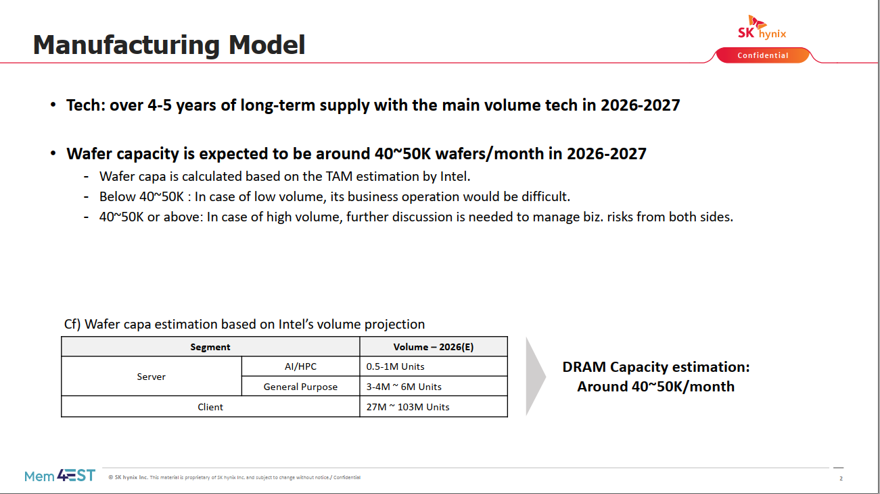
Manufacturing Details – Intel/SK
Data shared under CNDA 30991112 & CNDA 112784

Slide 31
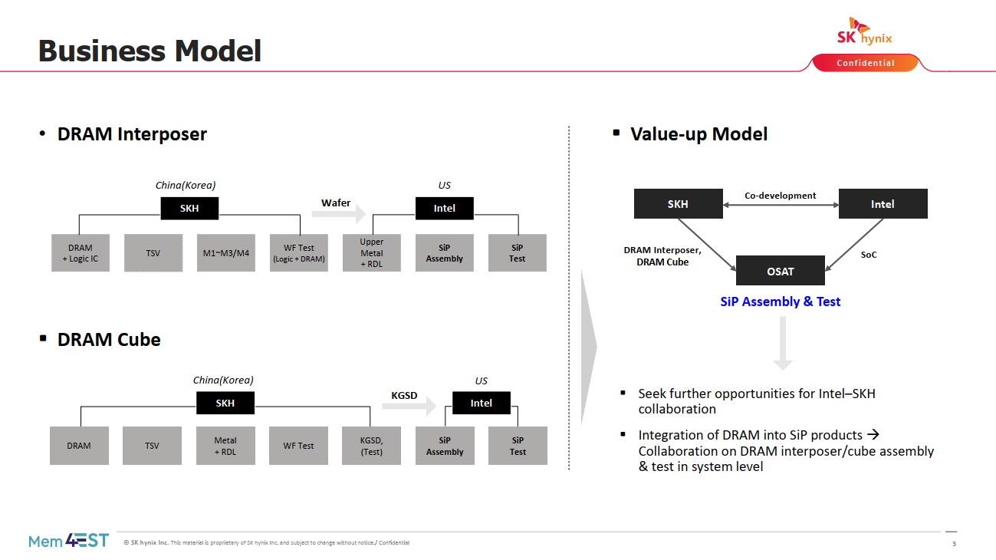
Business Model - SK
Data shared under CNDA 30991112 & CNDA 112784

Slide 32
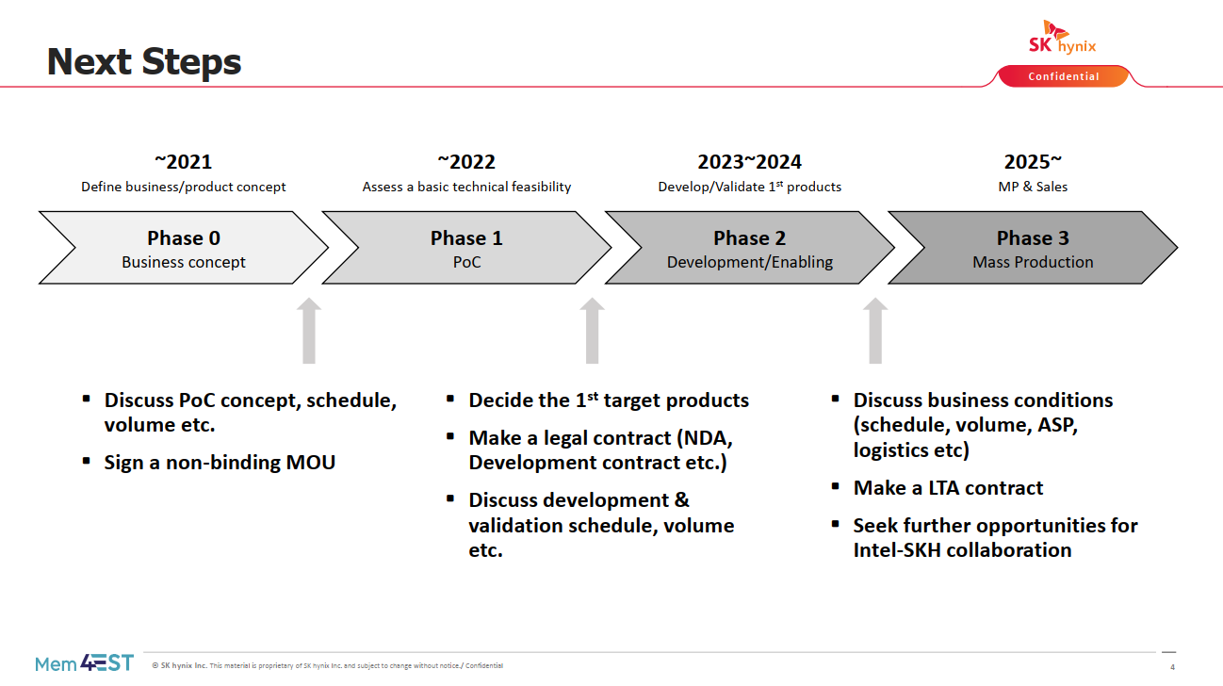
Next Steps
Data shared under CNDA 30991112 & CNDA 112784

Slide 33
Next Steps – Intel/SK Team Recommendation
…..
Data shared under CNDA 30991112 & CNDA 112784

Slide 34
Backup
Data shared under CNDA 30991112 & CNDA 112784

Slide 35
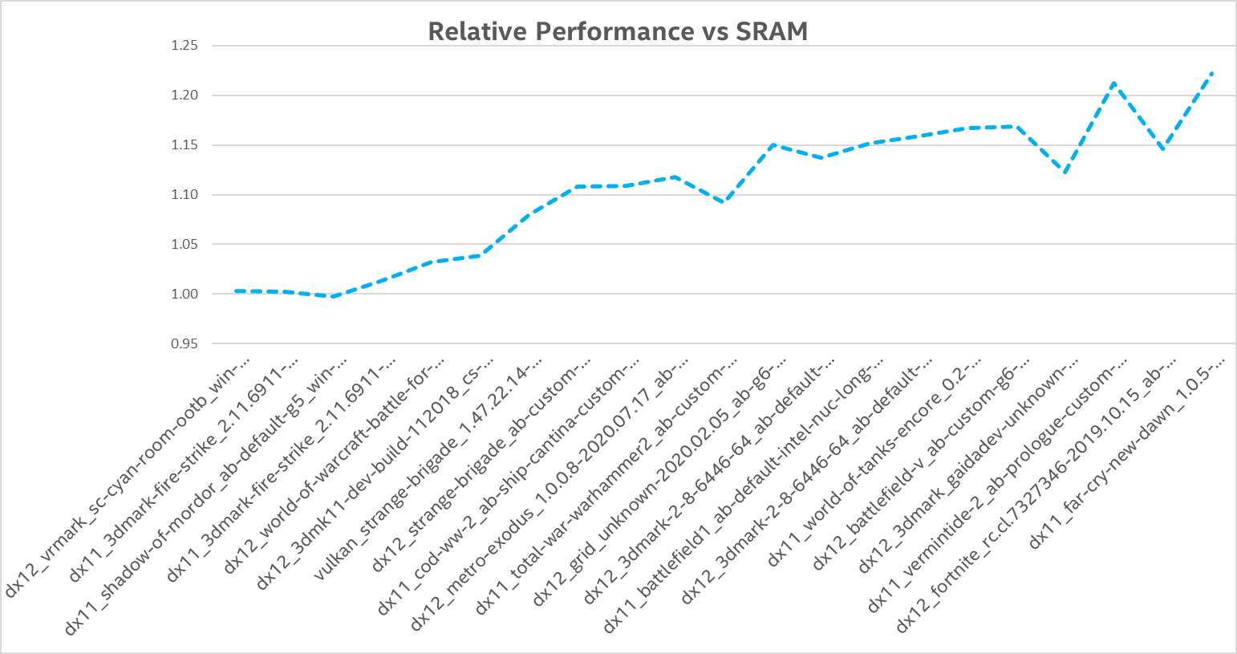
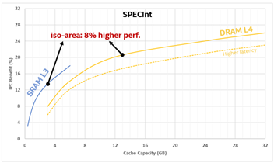
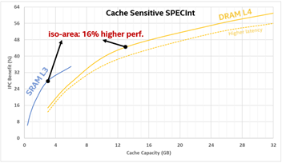
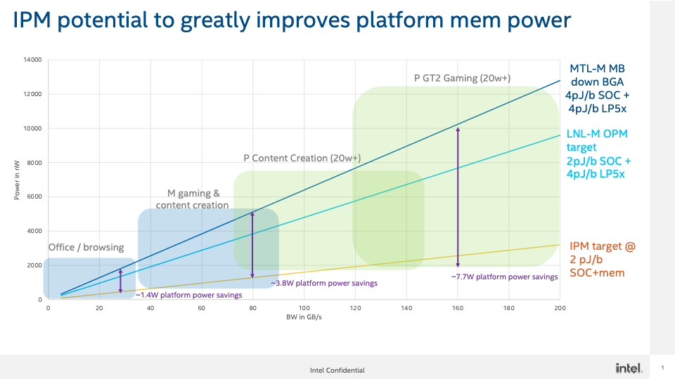
ROI Plots
Data shared under CNDA 30991112 & CNDA 112784

Slide 36
Step1 : Proof-of-Concept & Test Chip Plans
SK Advocacy (PoC TC )
Intel Advocacy (MVP)
PoC Goals | Option 1a (HBM2e Macro) | Option 1b (HBM2e Macro) | Option 2 ( High-BW Macro)
Wafer Handling | ✓ | ✓ | ✓
Power Delivery/Thermals | X | ✓ | ✓✓
Assembly | X | ✓ | ✓
Yield | ✓ | ✓ | ✓✓
Test | ✓ | ✓ | ✓
Bandwidth/Latency/Power | X | ✓ | ✓✓
Reliability/ECC/DPM | ✓ | ✓ | ✓
Execution Time | ✓✓ | ✓ | XX
New IP Dev Effort | ✓✓ | ✓ | XX
Matched to Final Product | XX | X | ✓
Two main options being proposed for the proof-of-concept vehicle plan.
Team recommending Option2 with a minimum viable product for initial POC
Data shared under CNDA 30991112 & CNDA 112784

