Slide 1
SRF Thermal Design Power (TDP) capping: Case study for system model
giri.venkata@intel.com

Slide 2
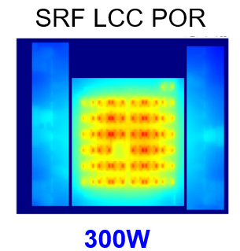
SRF TDP Capping to 300W – case study
SRF-SP LCC is thermally limited to 300W in BHS-SP vs competition able to support 350-400W
Cooling capability :
Ack: DCAI + ATTD Core competency
CMT Module
L2
c0
c1
Root cause : Back to back Floating Point (FP) units inside 4-core Crestmont module
FP
FP
BUS
c3
c2
FP
FP
Status Quo:
Other than PowerPoint presentations, very hard to get any solid data (split across multiple teams/orgs)
Barrier to simple what-ifs is high
Example what-if: What is the separation of FP units that will provide extra TDP head room?
Only option today : recreate the same virtual team that reached the conclusion above

Slide 3
Proof of concept goals for SRF-SP system model
Goal1: Create a single system model that demonstrates SRF-SP TDP capping of 300W
Goal2: Demonstrate what-if capability for following scenarios:
a) Floorplan movement of critical IPs
b) More expensive heatsink
Goal3: Can the punit firmware dynamically throttle adjacent cores to avoid FP unit hotspots?
=> Demonstrate modeling of firmware in the system model

Slide 4
Phase 0 : SRF-SP system model element gathering
LID
IO
SRF Cdie
IO
TIM
IO
SRF CDIE
IO
System Model Elements | Contact
SRF Cdie Floorplan with physical component detail (standard .def format) | Giri Venkata
SRF IO die Floorplan with physical component detail (standard .def format) | Kevin Kerr
OPT1 : TDP workload power component detail for SRF Cdie and IODie (.lib?) | Dan Tsunami
OPT2 : Leaf IP power component with simulation capability for any work load | Dan Tsunami
Power component to floorplan component mapping | Dan/Giri
SRF LCC Package floorplan (standard .def format) | Satish Surana?
Thermal model component details | Rajiv/Nick

