Slide 1
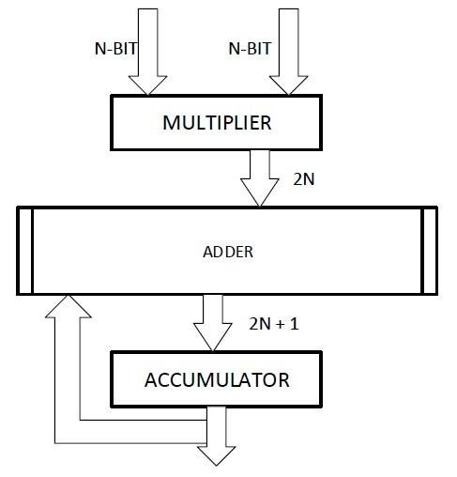
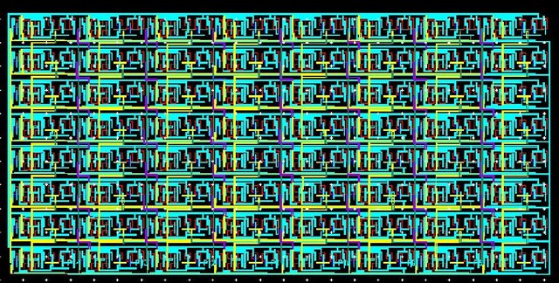
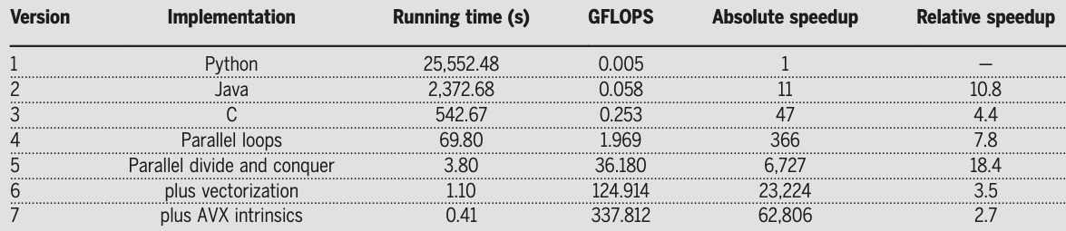
Matrix Multiply-Accumulate (MAC) or Multiply-Add (MAD) –
for i in xrange(4096):
for j in xrange(4096):
for k in xrange(4096):
C[i][j] += A[i][k] * B[k][j]
Multi-Core 7.8x
Coding Efficiency 47x
Upadhyay, et.al., Journal of Low Power Electronics, Volume 11, Number 1, March 2015, pp. 37-48(12)
18.4x
Memory Hierarchy
18.4x
Memory Hierarchy
3.5x
Vector Processing
2.7x
ISA Optimization
From “There’s plenty of room at the Top: What will drive computer performance after Moore’s law?”
Leiserson et.al. Science 368, eaam9744 (2020)
See also Dick Feynman’s “There’s plenty of room at the bottom” Eng. Sci.23,22–36 (1960)

Slide 2
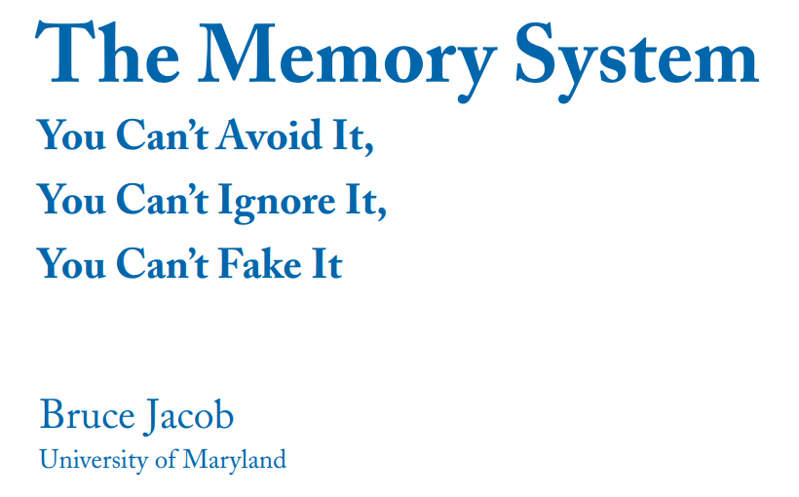
Publisher ‏ : ‎ Springer; 1st edition (June 19, 2009)
Language ‏ : ‎ English
Paperback ‏ : ‎ 77 pages
ISBN-10 ‏ : ‎ 3031005961
ISBN-13 ‏ : ‎ 978-3031005961

Slide 3
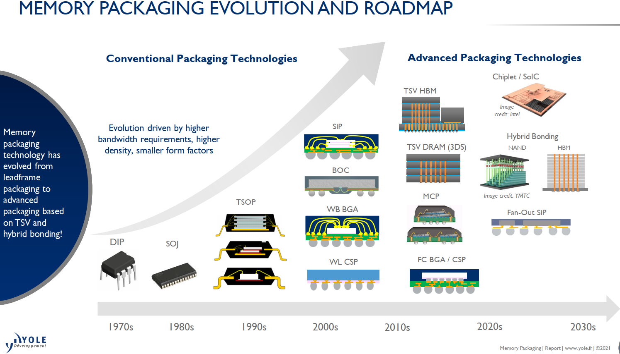

Slide 4
In Package Memory Technology
DerChang Kau, Nov. 27, ’23 @ FTiP Review Meeting
Memory Technology Construct in System hierarchy
IPM Benchmark
Edited Nov. 28, ‘23

Slide 5
Memory Technology Construct in System hierarchy
JEDEC Memory
Custom Memory

Slide 6
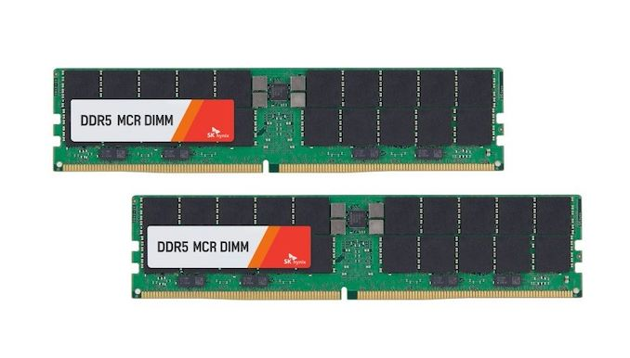
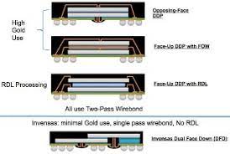
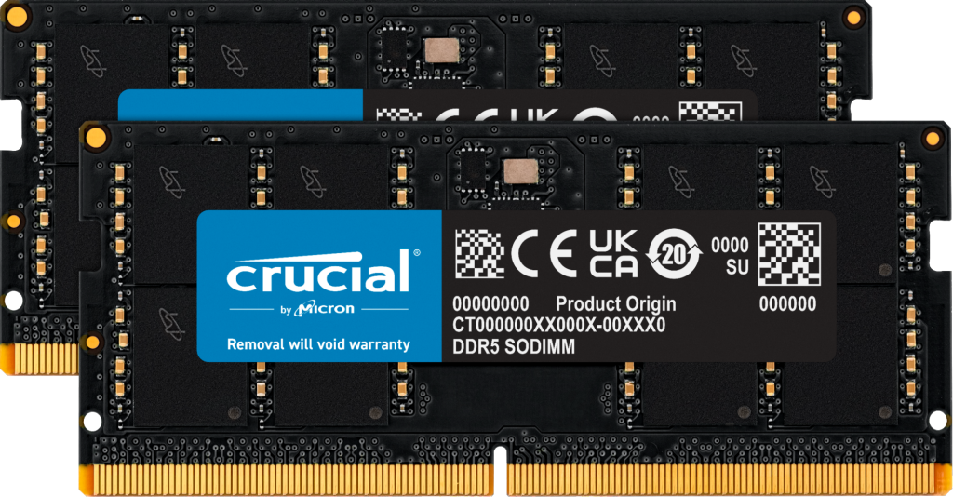
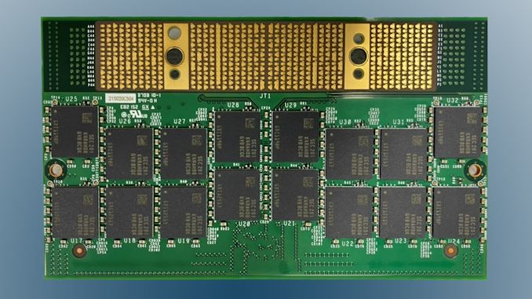
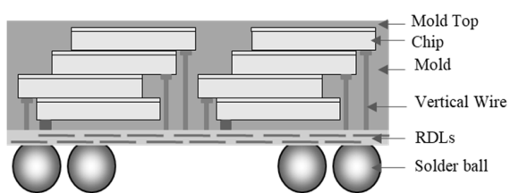
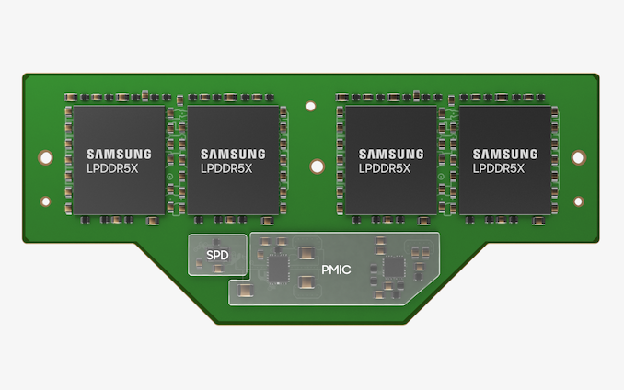
DDR is Memory Module Socketed on PCB
Ki-Jun Sung et.al., EDTM’23 DOI: 10.1109/EDTM55494.2023.10102966

Slide 7
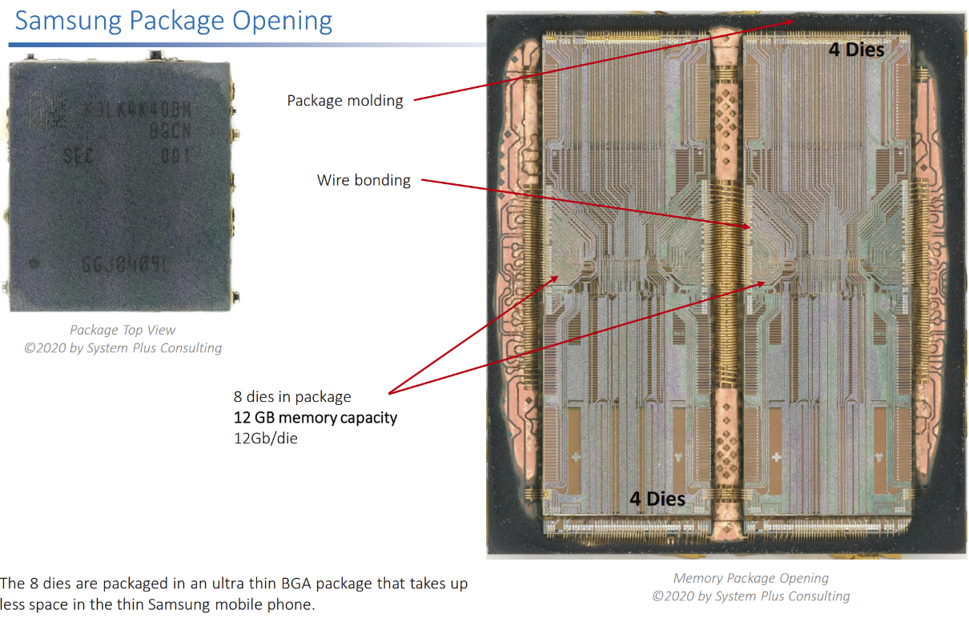
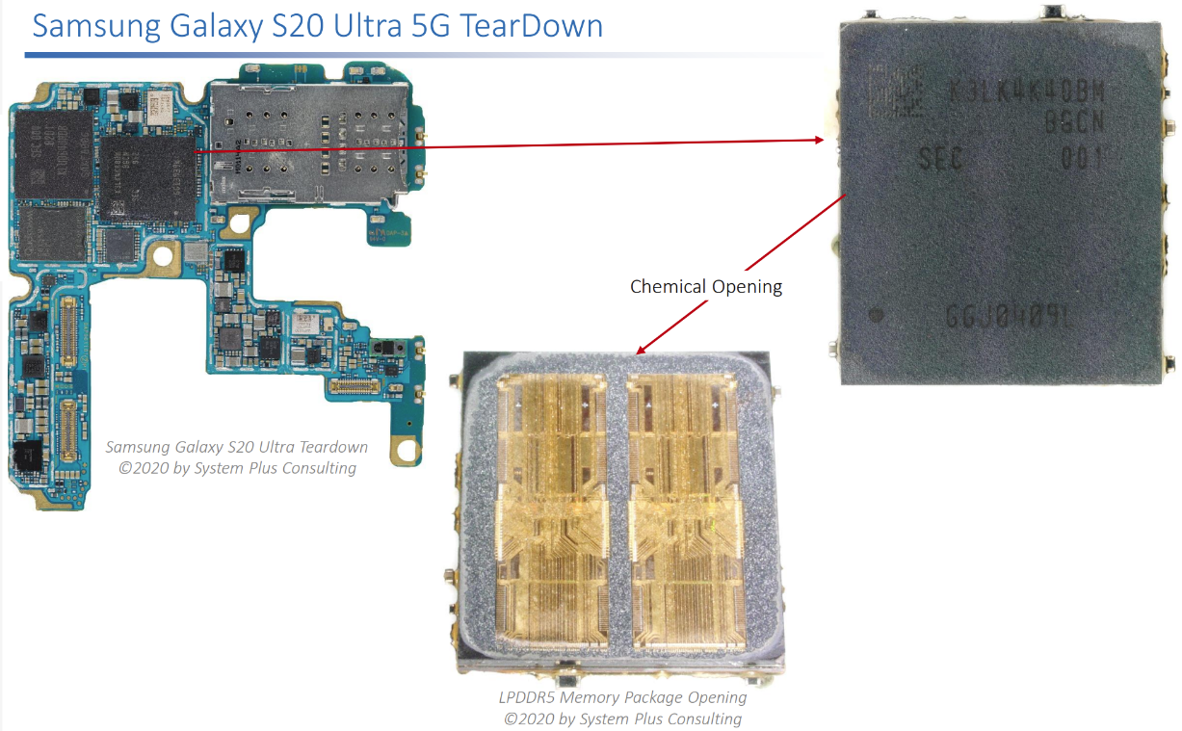
LPDDR5 in Phone Wire-bonded Package surface mounted on a PCB

Slide 8
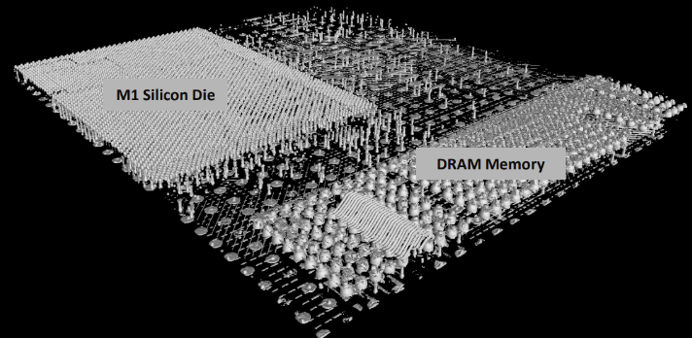
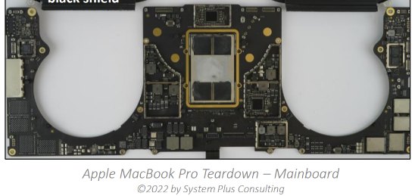
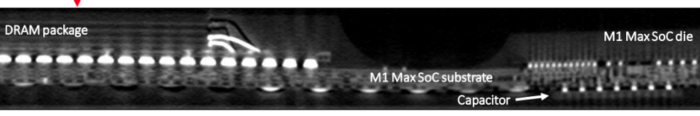
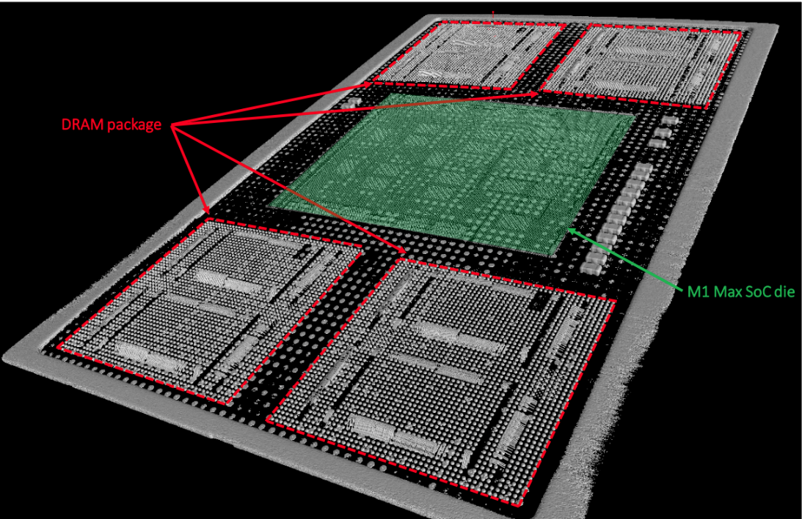
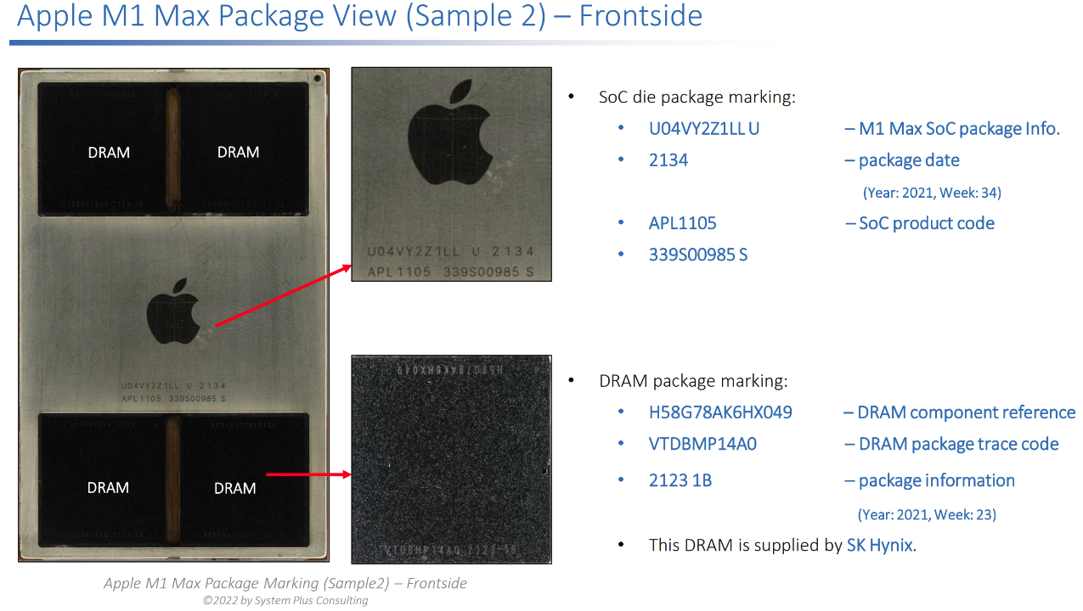
LPDDR5 in Client Compute System
Wire-bonded package micro bumped to an organic substrate surface mounted on PCB

Slide 9
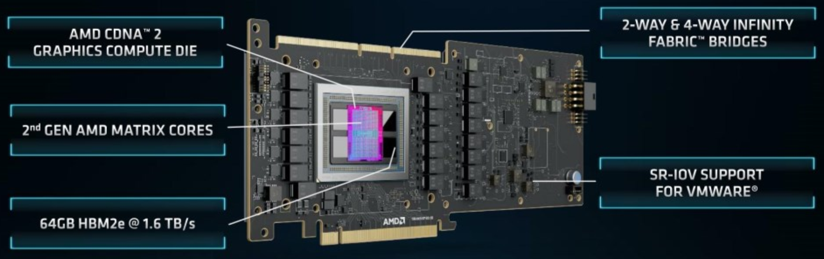
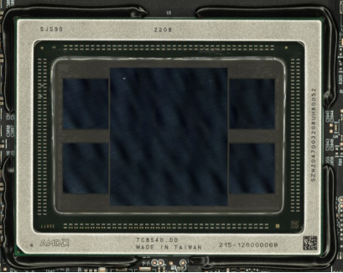
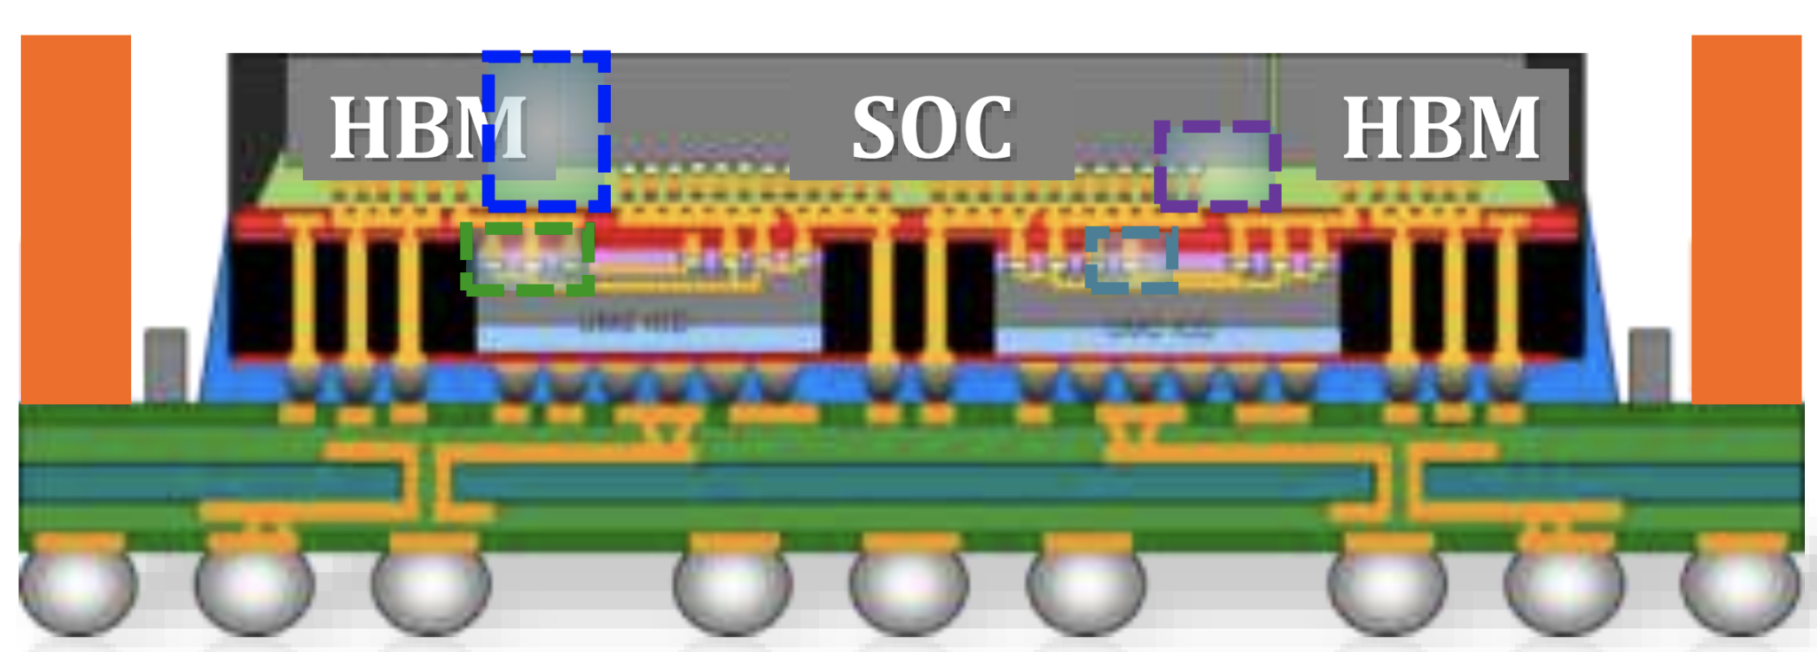
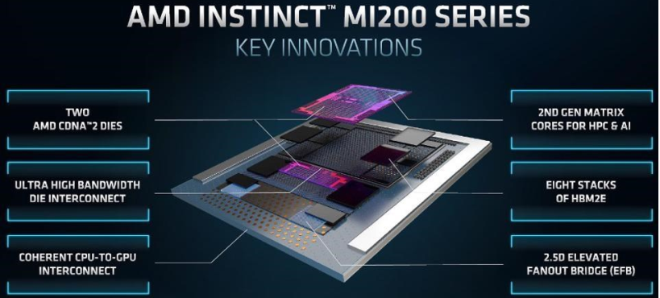
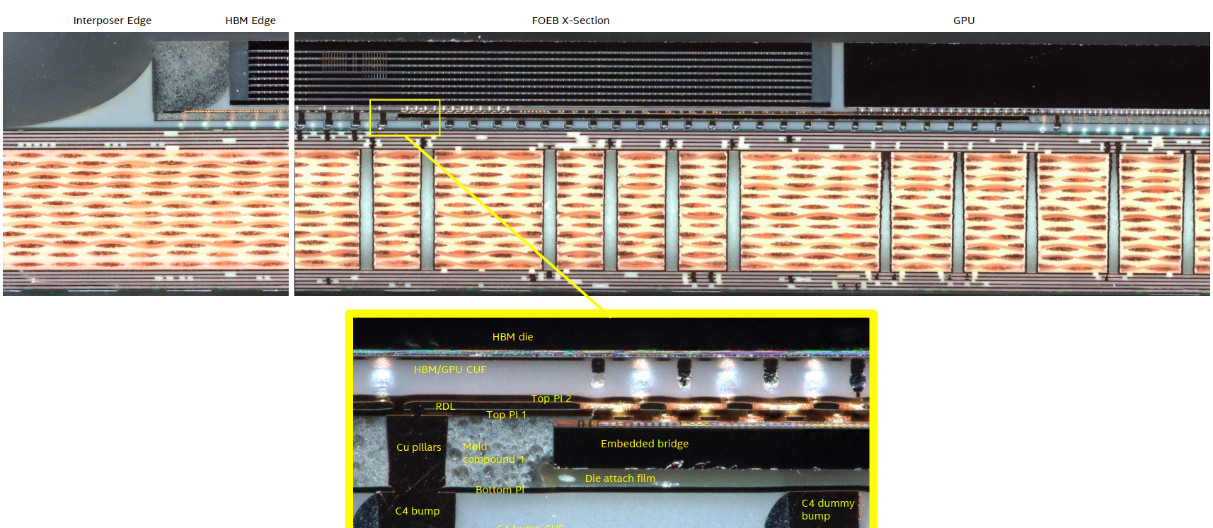
HBM in Accelerator
2.3D µB/TSV CoW Memory (8+1) chip stack in a 2.3D FO EB Module

Slide 10
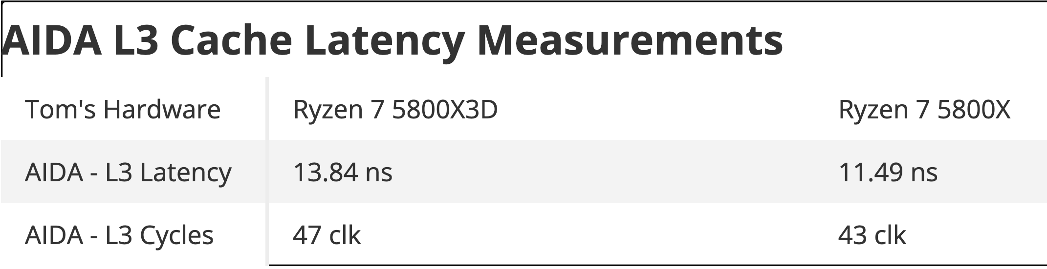
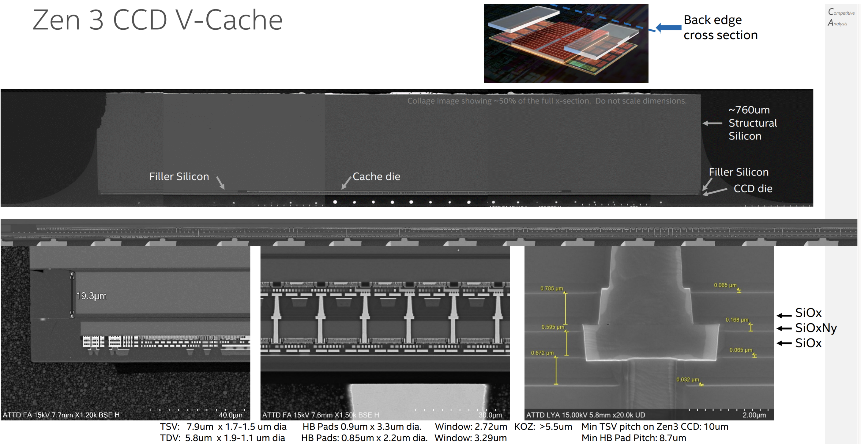
Disaggregated SRAM – AMD Zen 3 CCD V-Cache 7nm SRAM CoW F2B 9µm HBI to Logic Base die

Slide 11
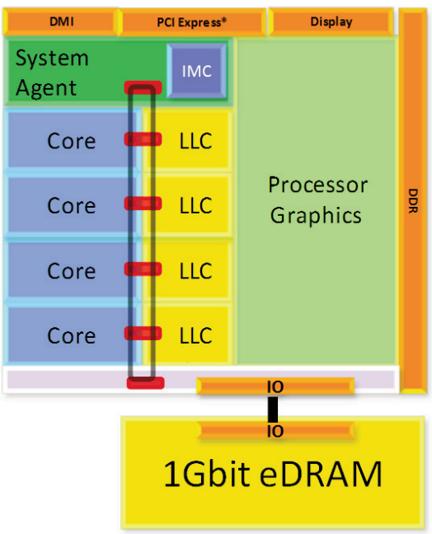
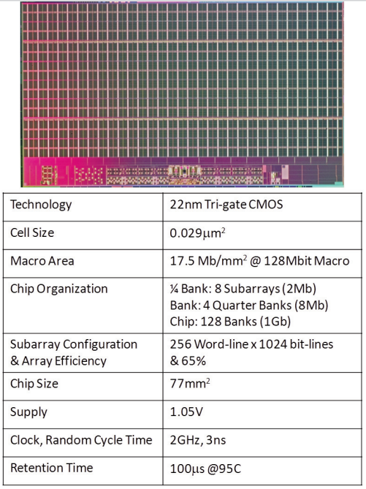
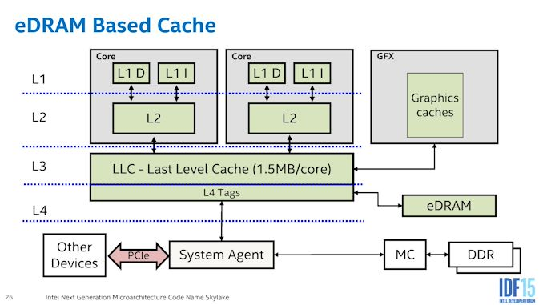
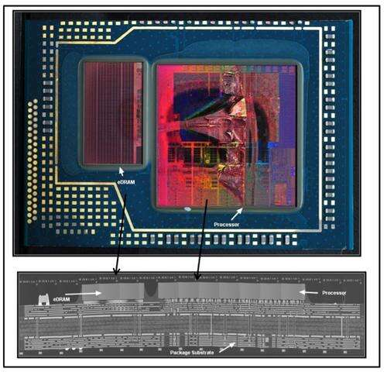
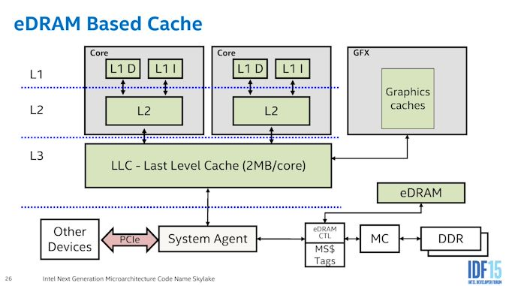
Custom DRAM (i) – MCP for Client Compute ~60nm 1T1C DRAM (~7nm 6T SRAM eq.) + 14nm Logic
Haswell/Broadwell eDRAM – L4 Cache
Skylake eDRAM – Memory Side Cache

Slide 12
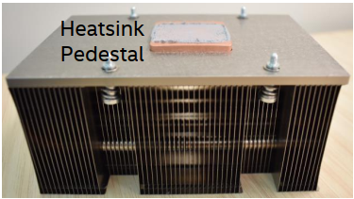
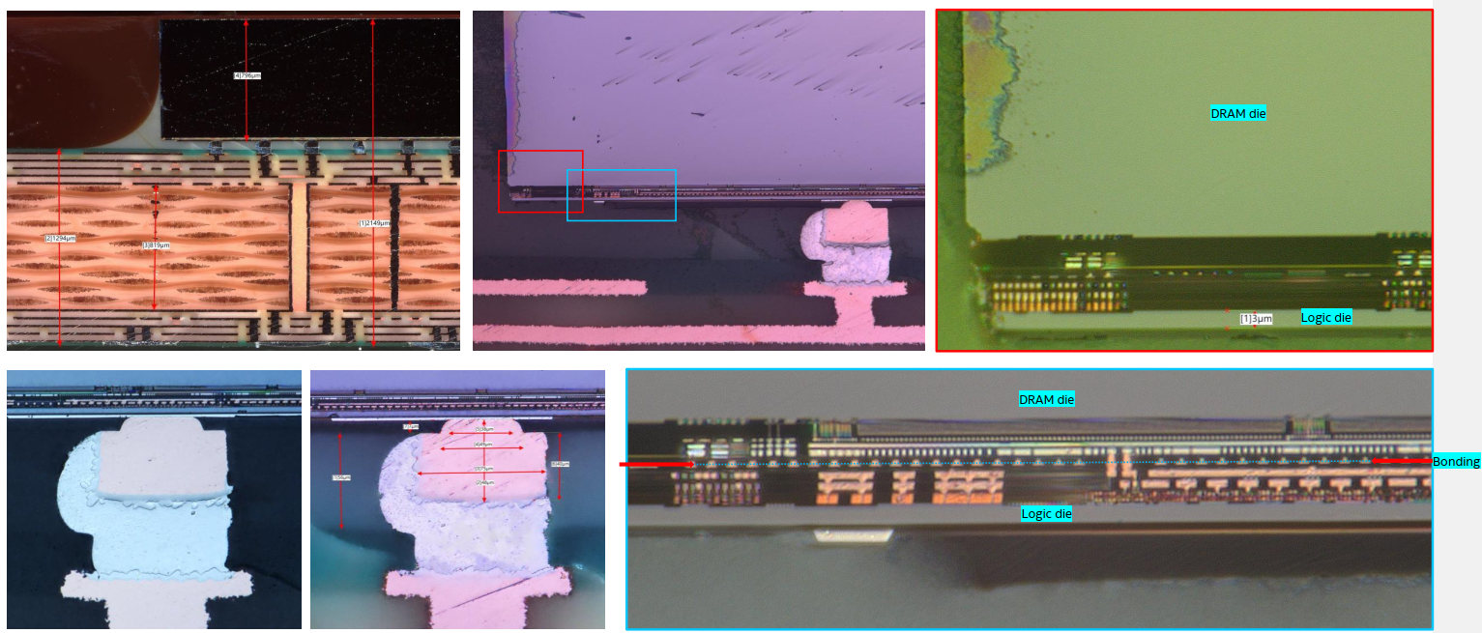
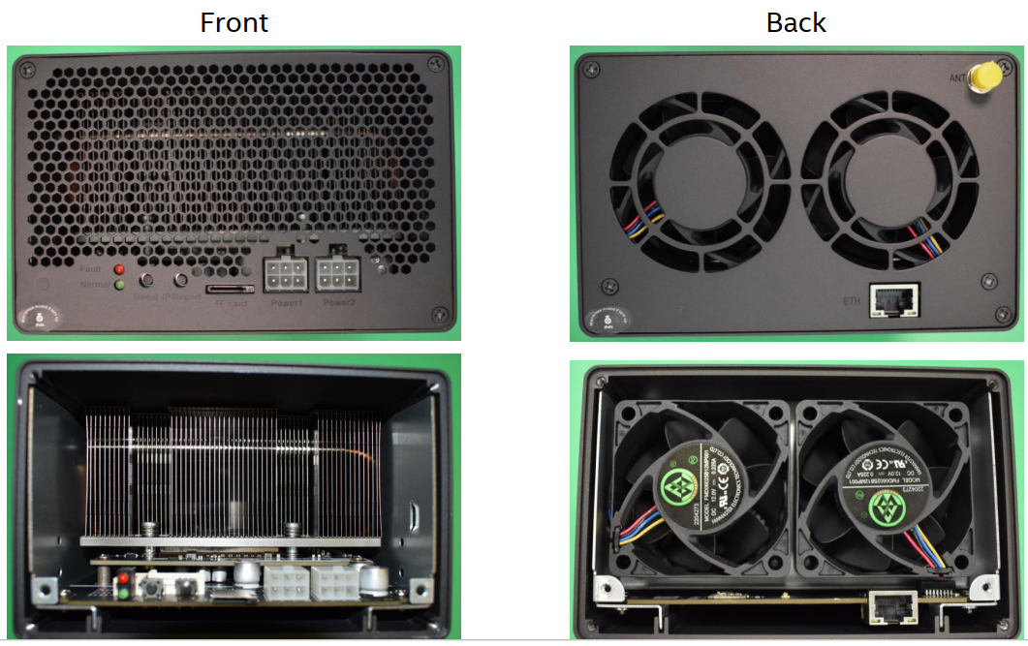
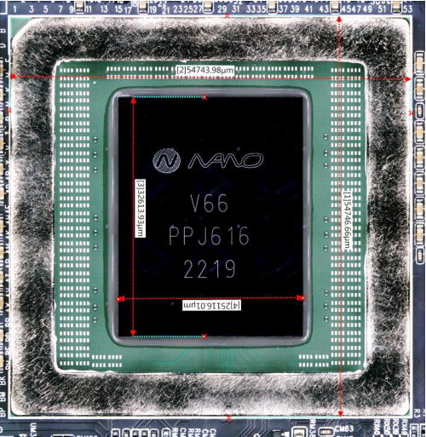
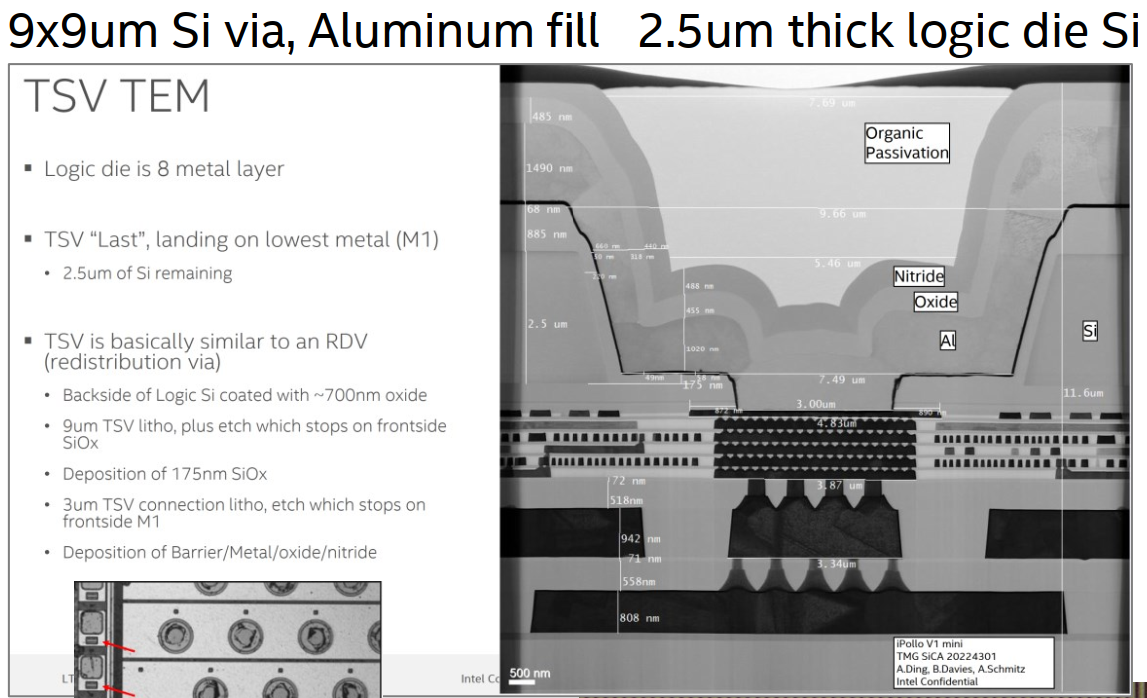
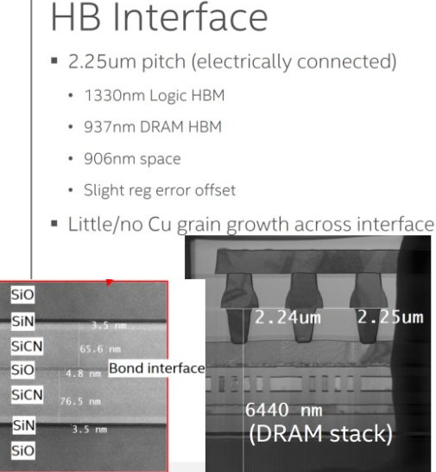
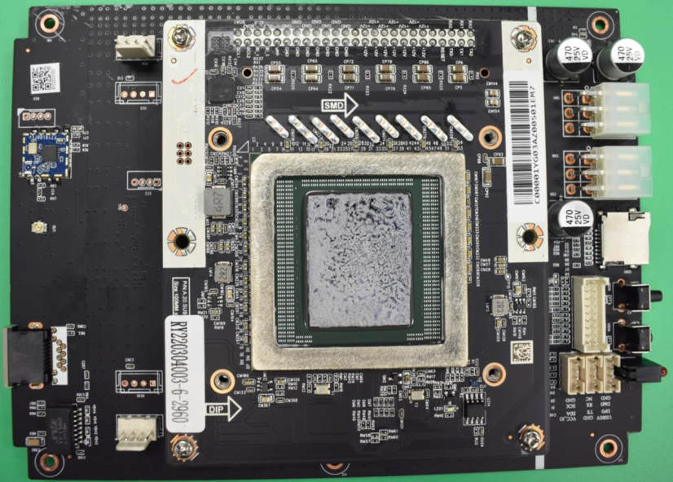
Custom DRAM (ii) – Cryptographic Hashing
Mixed SiFO/OSAT
PSMC 30nm DRAM | Logic: SMIC 40nm
3DIC: XMC WoW HBI2.25µm | C4 A/T: ASE

Slide 13
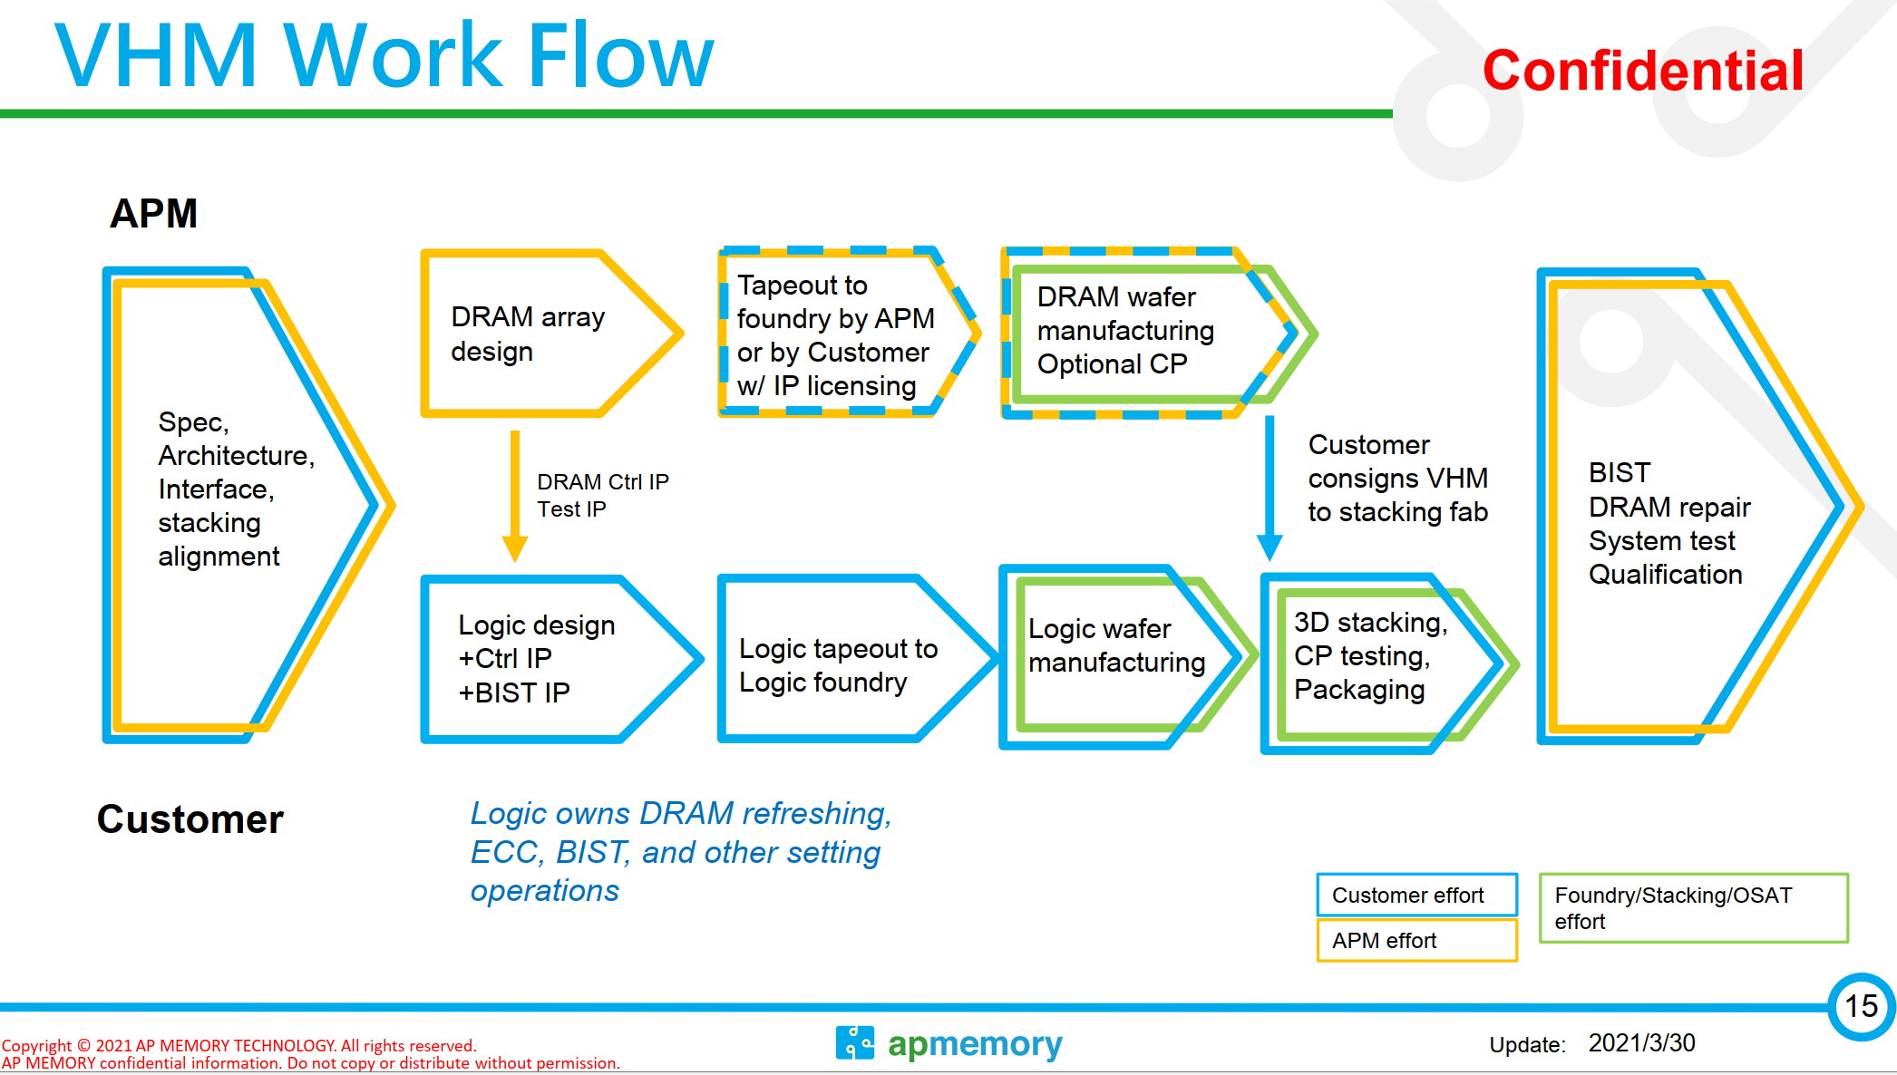

Slide 14
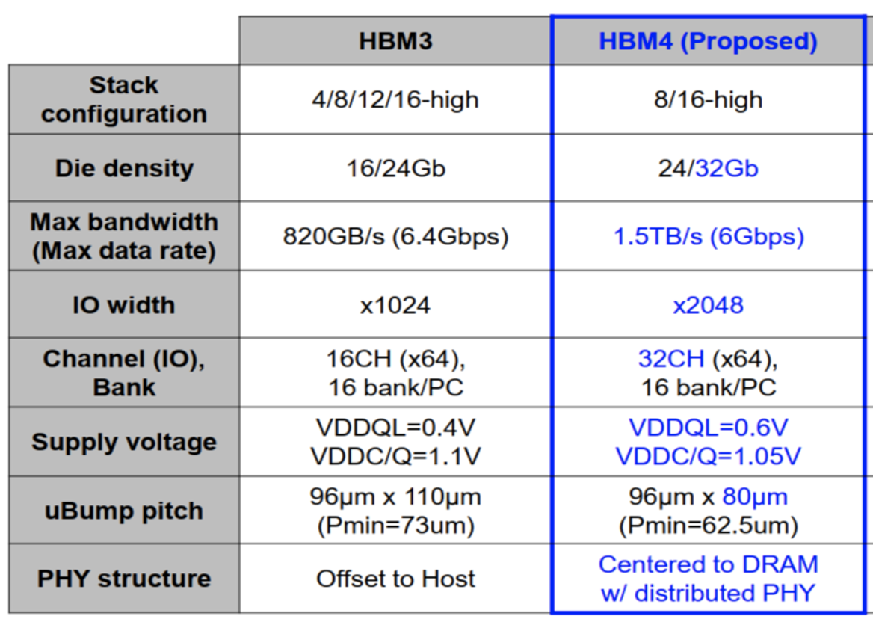
Beyond HBM3 – JEDEC In Package Memory

Slide 15
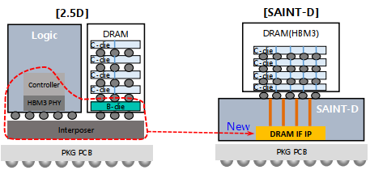
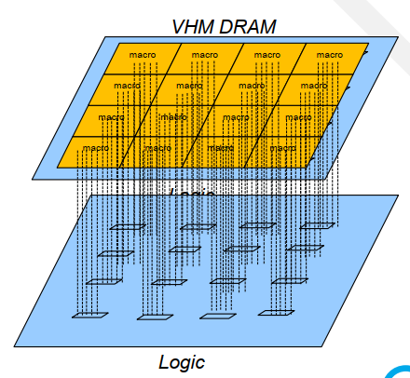
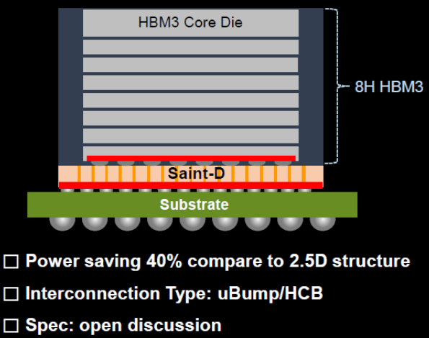
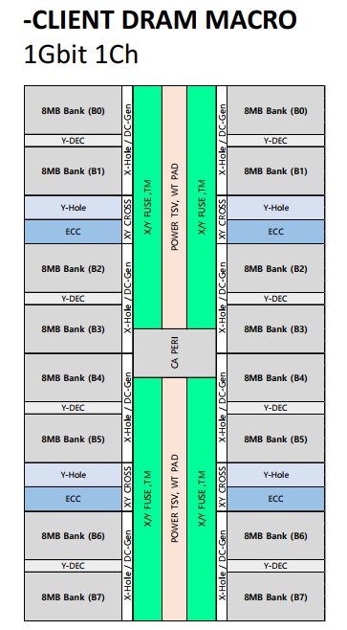
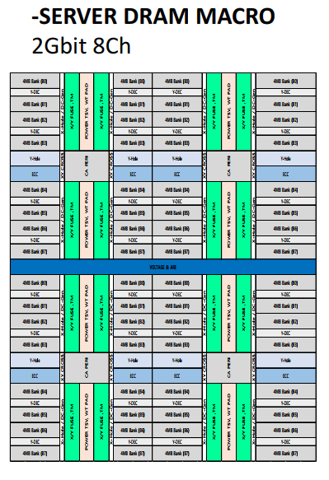
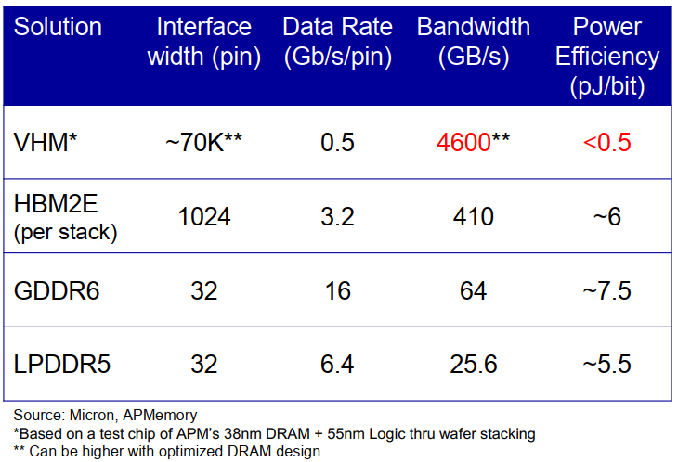
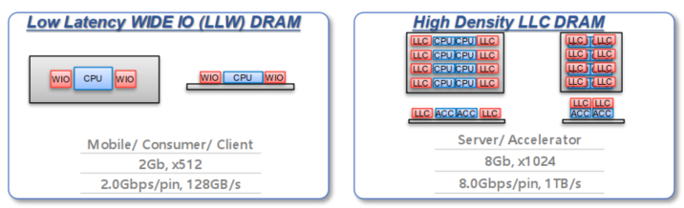
Beyond HBM3 – Custom In Package Memory
AP Memory
Intel-Hynix TCC-D
1 GB, 256GB/s 50mm²
1GB, 2TB/s
64mm²
2GB, 4TB/s
128mm²)
2 GB, 256GB/s 50mm²
High-Capacity Macro (128MB 1Ch)
21MB/mm2, 32GB/s/ch, 1.5pJ/b
High-Bandwidth Macro (16MB 1Ch)
16MB/mm², 32GB/s/Ch, 1.5pJ/b
Samsung LLW/LLC
a.k.a. DBM, SKH ULP

Slide 16
IPM Benchmark
What is the metric
Benchmark

Slide 17
Incumbent Technologies in Memory/Storage Hierarchy
“The Memory Organ – Ideally one would desire an indefinitely large memory capacity such that any particular … word would be immediately … available. … It does not seem possible physically to achieve such a capacity. …We are therefore forced to recognize the possibility of constructing a hierarchy of memories, each of which has greater capacity than the preceding but which is less quickly accessible.”
Preliminary Discussion of the Logical Design of an Electronic Computing Instrument
Arthur Burks, Herman Goldstine and John von Neumann, June/28/1946
SRAM
DRAM
HDD
SSD
Capacity, Latency
Bandwidth, Cost

Slide 18




Memory Hierarchy
~10sMB, ~100ps
HC, HS SRAM: Cell size and capacity, architecture and ip folding
~100sMB, ~1ns
~1sGB, ~10ns
Disagg. HD SRAM or Custom HBW DRAM: Chiplet in 3DIC
~10sGB, ~100ns
JEDEC DRAM Cell Size, 3D Topo
~100sGB, ~1µs
3D XPoint Adoption tipping point, “Crossing the chasm”
~1sTB, ~10µs
3D NAND HAR, Layer Transfer
~10sTB, ~100µs
Main Memory

Slide 19
Component (die) Attributes
 | JEDEC Memory |  |  |  | Custom In Package Memory
Tech Attributes | DDR5 | LPDDR5 | HBM3 | GDDR6 | P1271.3 | P1227.7 | Muddy Creek | APM VHM AI | APM VHM Blockchain | SKH TCCD | SEC LLW
Package Integration | FC | xDP WB | 2.xD | FC | MCP | 2.5D/3D | 2.xD/3D | 3D HBI | 3D HBI | 3D HBI | 3D HBI
Silicon Technology @ NPI | 1z | 1z | 1z | 1z | 22nm | 22nm | SF4X | 30nm | 30nm | 1z | 1z
Capacity (GB) | 4 | 2 | 2 | 2 | 0.125 | 1 | 0.25 | 0.59 | 4.39 | 4 | 1
Die Size (mm²) | 120 | 58 | 121 | 121 | 78 | 153 | 95 | 100 | 600 | 293 | 123
Protocol (Cmd/addr/DQ) | DDR | LPDDR | LP like | GDDR | F. Duplex | LP Like | F. Duplex | SDR | SDR | LP Like | LP Like
# of Channel per die | 1 | 2 | 4 | 16 | 128 | 32 | 32 | 300 | 1125 | 256 | 32
Max DQ width | 16 | 16 | 256 | 32 | 128 | 16384 | 16384 | 38400 | 72000 | 131072 | 4096
Max Data rate/pin (GT/s) | 8.4 | 6.4 | 8 | 24 | 6.4 | 1.6 | 1.6 | 0.5 | 0.5 | 0.25 | 2
Theoretical max BW (GB/s) | 16.8 | 12.8 | 256 | 96 | 102 | 3277 | 6554 | 2400 | 4500 | 4096 | 1024
DQ Density (DQ/mm²) | 0.1 | 0.3 | 8.5 | 0.3 | 1.6 | 107.2 | 344.9 | 384.0 | 120.0 | 448.0 | 33.3
Pin footprint (µm square/ pin) |  |  |  |  | .0108 | 68 | 44 | 36 | 65 | 33 | 122

Slide 20
Normalized Performance
 | JEDEC Memory |  |  |  | Custom In Package Memory
 | DDR5 | LPDDR5 | HBM3 | GDDR6 | P1271.3 | P1227.7 | Muddy Creek | APM VHM AI | APM VHM Blockchain | SKH TCCD | SEC LLW
Density (MB/mm²) | 34.1 | 35.3 | 16.9 | 16.9 | 1.6 | 6.7 | 2.7 | 6.0 | 7.5 | 14 | 8.3
BW/Capacity (BW/GB) | 4.2 | 6.4 | 128 | 48 | 819 | 3277 | 26214 | 4096 | 1024 | 1024 | 1024
BW/ Density ([GB/s]/mm²) | 0.140 | 0.221 | 2.12 | 0.79 | 1.31 | 21.4 | 69.0 | 24.0 | 7.5 | 14.0 | 8.3
Random Access Latency (ns) | 33 | 36 | 34 | 30 | 13 | 15 | 3 | 15 | 15 | 15 | 32
Access Energy (pJ/b) | 16 | 5 | 3.7 | 16 | 10 | 0.8 | 0.23 | 0.5 | 0.7 | 0.96 | 1.5
Power Density (mW/mm²) | 17.9 | 8.8 | 250.5 | 101.6 | 105.0 | 137.2 | 126.9 | 96.0 | 42.0 | 107.5 | 100.0
Performance of a 100mm² die
 | JEDEC Memory |  |  |  | Custom In Package Memory
 | DDR5 | LPDDR5 | HBM3 | GDDR6 | P1271.3 | P1227.7 | Muddy Creek | APM VHM AI | APM VHM Blockchain | SKH TCCD | SEC LLW
Capacity [GB] | 3.3 | 3.4 | 1.7 | 1.7 | 0.2 | 0.7 | 0.3 | 0.6 | 0.7 | 1.4 | 0.8
BW [TB/s] | 0.014 | 0.022 | 0.212 | 0.079 | 0.131 | 2.144 | 6.899 | 2.400 | 0.750 | 1.400 | 0.833
Power [W] | 1.8 | 0.9 | 25.0 | 10.2 | 10.5 | 13.7 | 12.7 | 9.6 | 4.2 | 10.8 | 10.0
Random Access Latency (ns) | 33 | 36 | 34 | 30 | 13 | 15 | 3 | 15 | 15 | 15 | 32
Access Energy (pJ/b) | 16 | 5 | 3.7 | 16 | 10 | 0.8 | 0.23 | 0.5 | 0.7 | 0.96 | 1.5

Slide 21
Performance Benchmark of a 100mm² die
 | JEDEC Memory |  |  |  | Custom In Package Memory
 | DDR5 | LPDDR5 | HBM3 (ref) | GDDR6 | P1271.3 | P1227.7 | Muddy Creek | APM VHM AI | APM VHM Blockchain | SKH TCCD | SEC LLW
Capacity [GB] | 3.3 | 3.4 | 1.7 | 1.7 | 0.2 | 0.7 | 0.3 | 0.6 | 0.7 | 1.4 | 0.8
(Large is better) | 2.02x | 2.09x |  | 1x | 0.1x | 0.4x | 0.16x | 0.35x | 0.44x | 0.83x | 0.49x
BW [TB/s] | 0.014 | 0.022 | 0.212 | 0.079 | 0.131 | 2.144 | 6.899 | 2.400 | 0.750 | 1.400 | 0.833
(Large is better) | 0.07x | 0.1x |  | 0.38x | 0.62x | 10.13x | 32.61x | 11.34x | 3.54x | 6.62x | 3.94x
Power [W] | 1.8 | 0.9 | 25.0 | 10.2 | 10.5 | 13.7 | 12.7 | 9.6 | 4.2 | 10.8 | 10.0
(Small is better) | 0.07x | 0.04x |  | 0.41x | 0.42x | 0.55x | 0.51x | 0.38x | 0.17x | 0.43x | 0.4x
Random Access Latency (ns) | 33 | 36 | 34 | 30 | 13 | 15 | 3 | 15 | 15 | 15 | 32
(Small is better) | 0.97x | 1.06x |  | 0.88x | 0.38x | 0.44x | 0.09x | 0.44x | 0.44x | 0.44x | 0.94x
Access Energy (pJ/b) | 16 | 5 | 3.7 | 16 | 10 | 0.8 | 0.23 | 0.5 | 0.7 | 0.96 | 1.5
(Small is better) | 4.32x | 1.35x |  | 4.32x | 2.7x | 0.22x | 0.06x | 0.14x | 0.19x | 0.26x | 0.41x

Slide 22
IPM Selection
~10sMB, ~100ps
HC, HS SRAM: Cell size and capacity, architecture and ip folding
IPM Tech | Latency [ns] | BW [TB/s] | Capacity [GB] | Power [W]
MDC | 3 | 6.899 | 0.3 | 12.7
APM VHM | 15 | 2.400 | 0.6 | 9.6
P1227.7 | 15 | 2.144 | 0.7 | 13.7
SKH TCCD | 15 | 1.400 | 1.4 | 10.8
SEC LLW | 32 | 0.833 | 0.8 | 10.0
HBM3 | 34 | 0.212 | 1.7 | 25.0
LPDDR5 | 36 | 0.022 | 3.4 | 0.9
~100sMB, ~1ns
~1sGB, ~10ns
Disagg. HD SRAM or Custom HBW DRAM: Chiplet in 3DIC
~10sGB, ~100ns
JEDEC DRAM Cell Size, 3D Topo
~100sGB, ~1µs
3D XPoint Adoption tipping point, “Crossing the chasm”
~1sTB, ~10µs
3D NAND HAR, Layer Transfer
~10sTB, ~100µs
Main Memory

Slide 23
Strategy for In Package Memory Exploration, Development and Deployment
Choosing Right Success Criteria – “pick on someone your own size”
Universal memory often sought, but hierarchy always existed and likely always will be
FoM must be benchmarked with respect to the corresponding hierarchy of memories of a computer architecture
In Package Memory Subsystem
Power/Thermal conscious: Energy of moving bits back and forth becoming limiting
Pair memory tech with compute architecture/hierarchy.
Modular, Modular, Modular

