Slide 1
IPM UPDATE
Kuljit Bains MIO
May 5, 2022

Slide 2
AGENDA
WHY IPM
TCCD- SK Hynix
TCM- Samsung
HBM4- JEDEC
Low latency Wide IO- Samsung

Slide 3
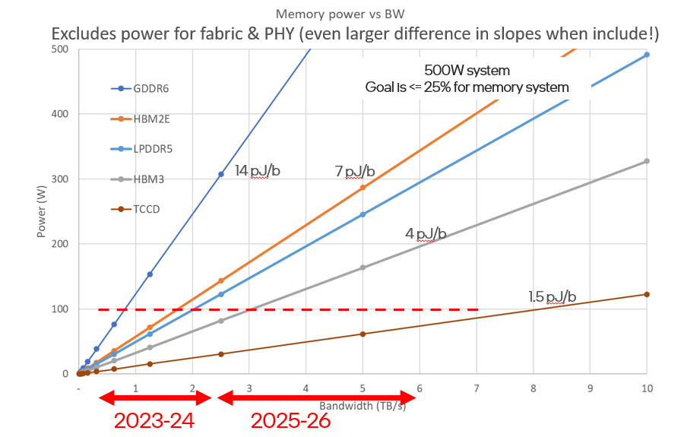
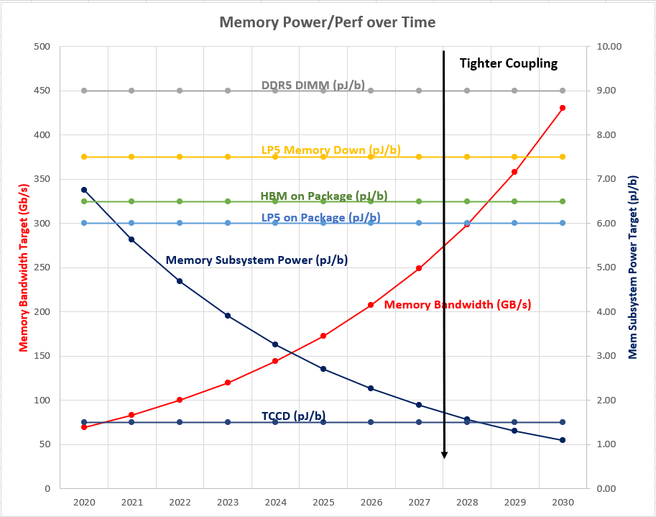
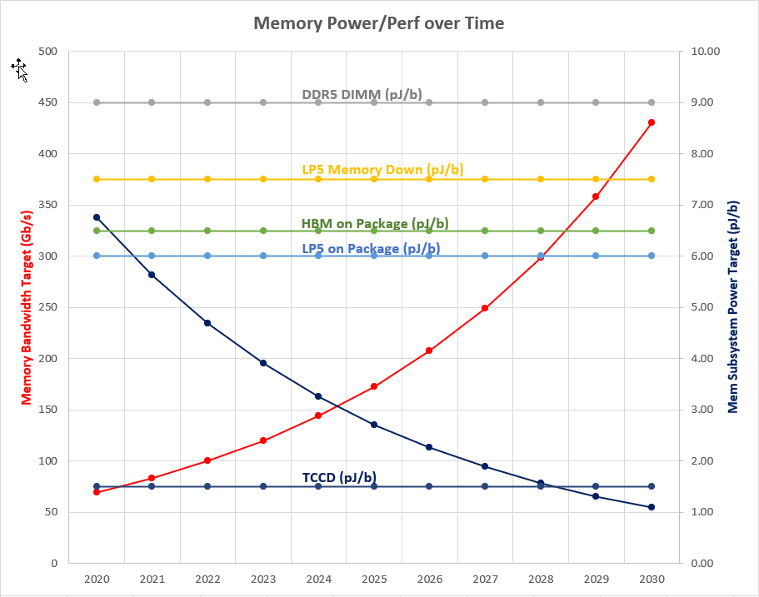
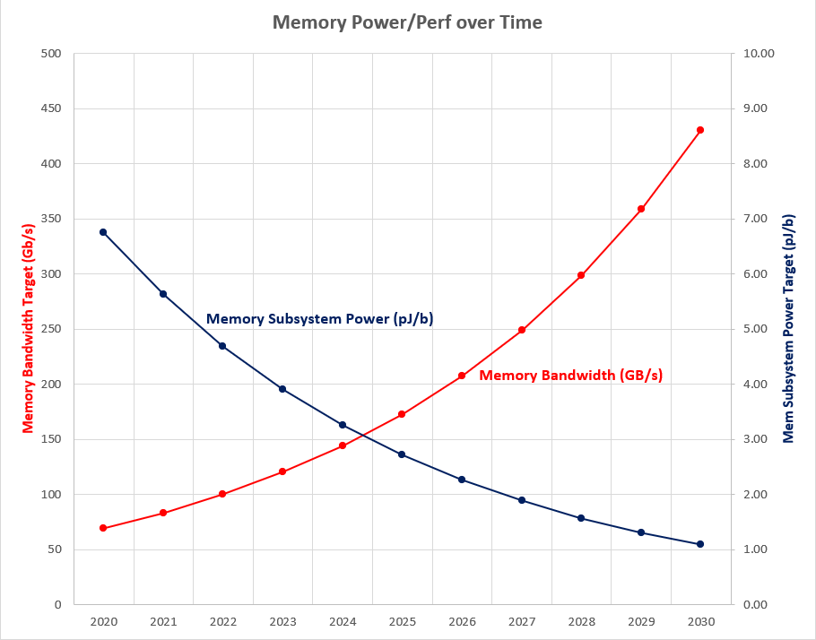
Memory Power Wall
Memory system power with existing technologies is not meeting budget.
Graphics Performance CAGR is 20%/year for Client and scales directly with memory BW.
Since memory power is fixed, pJ/b must scale by 20% per year.
Power within a given memory technology is relatively flat and needs a revolutionary technology solution like TCCD with tight 3D integration to address this.

Slide 4
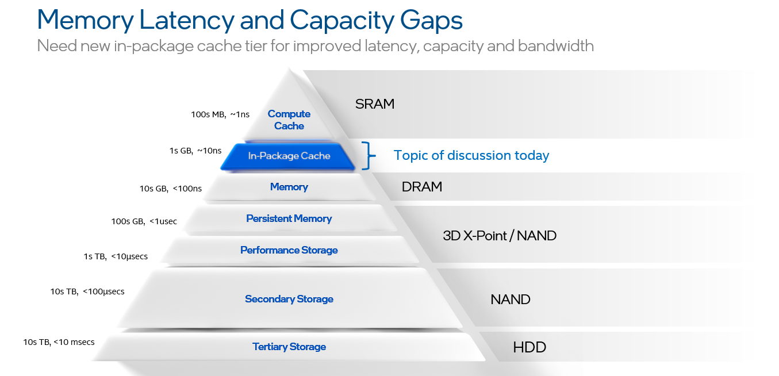
Memory hierarchy and need for IPM
( Not enough capacity )
Potential DRAM Growth tier with tight 3D integration
( Outside power budget and low BW)

Slide 5
Why an in-package Cache?
In package Cache is lower power, but only if we have sufficient cache capacity.
Otherwise, BW exceeds the cache and next level must solve BW problem.
BW
BW
BW
Baseline
power problem
Cache capacity too small;
still power problem
Cache big enough;
solved power problem
X
Y
Z
Capacity
Capacity
Capacity

Slide 6
Product Value Proposition
Product | Use Case | TCCD Capacity | TCCD BW | TCCD Performance | SRAM Stacking | HBM/xDDR Stacking | Comments
Data-Center/ AI/HPC | GP Compute (SIR) | 6-12 GB | 2 - 4 TB/s | 1x % IPC | Iso Perf | Iso Perf | Volume Segment/Cost Sensitive
 | GP Compute (SFR) | 6-12 GB |  | 1.5x % IPC | Half Perf | Half Perf | Volume Segment/Cost sensitive
 | AI Training/Inference | 16 GB | 4 - 8 TB/s | > 2x % IPC | No Solution | No Solution | Growth Segment
 | Cache Sensitive WLs | 16 GB |  |  | No Solution | No Solution | Growth Segment
Client/ Mobile | M (Ultra Mobile) | 2 GB | 0.25 TB/s | 5 TFlops | No Solution | No Solution | Volume Segment/Cost sensitive
 | P (Mobile) | 4 GB | 0.4 TB/s | 8 TFlops | No Solution | No Solution | Growth Segment/Cost sensitive
 | PX (Content Creation) | 8 GB | 0.85 TB/s | 17 TFlops | No Solution | No Solution | Growth Segment/Cost sensitive
Graphics/DC Accelerators | Discrete GFx | 8-16 GB | 4 - 8 TB/s | > 2x % IPC | No Solution | No Solution | Growth Segment
 | DC Accelerators | 8-16 GB |  |  | No Solution | No Solution | Growth Segment
Multitude of growth segments across data-center, client and discrete-GFx have no viable solution with existing SRAM or HBM/xDDR stacking technologies.
TCCD truly differentiates itself in these growth segments while delivering good-enough performance in the volume segments where alternate technology solutions exist.
TCCD is the technology of choice to pursue to enable new growth product segments across the board while meeting the needs of volume runners.
Notes:
Intel slide

Slide 7
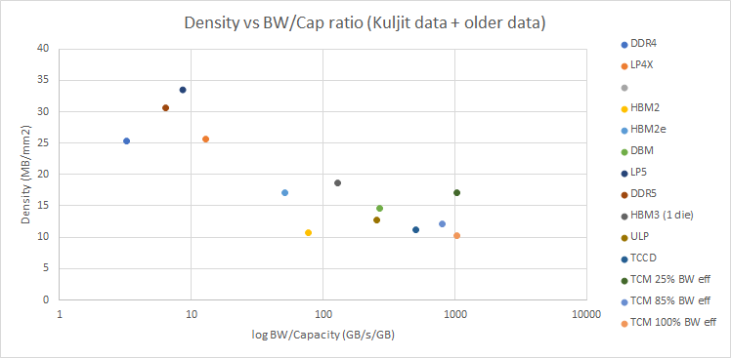
Density vs. BW/GB

Slide 8
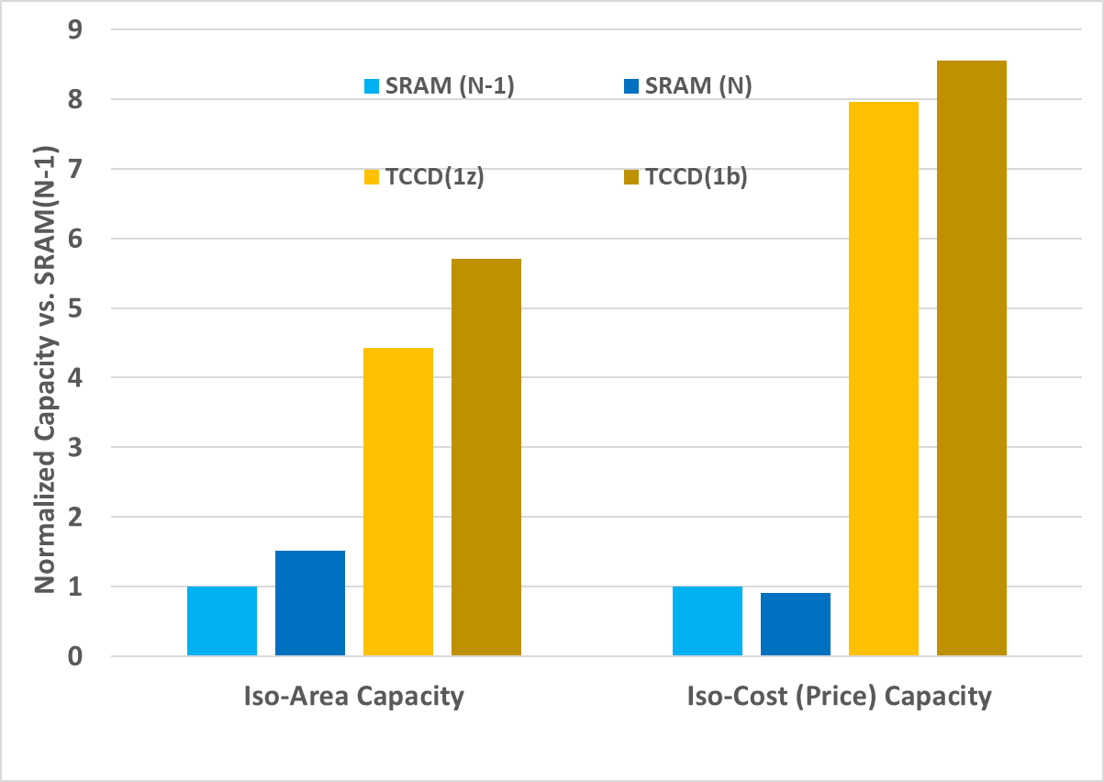
TCCD Technical Value Prop: Why not use SRAM?
General Purpose Workloads (Ex. SPECInt Rate)
  Low latency is more important than capacity
  For similar IPC improvement:
  4x TCCD:SRAM capacity needed to compensate for higher latency and TCCD has 2x cost advantage vs. SRAM
  SRAM solution approaching affordability limits, and not scalable to broader set of workloads
Cache Sensitive/AI Inference/Training Workloads
  Higher capacity (6-8GB) is essential to fit workload datasets
  Can result in 2-3x performance benefit over baseline GP workload improvement
SRAM solution simply not feasible at such capacity targets due to density, leakage and cost
  Doubles total CPU Si area required w/o concomitant performance improvement
~8x
~4x
Area projections include respective array efficiencies and TSV/IO overheads
Cost projections based on memory cost only.
With TCCD
With SRAM
Compute
Ack: Doug Josephson/Surhud Khare
Memory

Slide 9
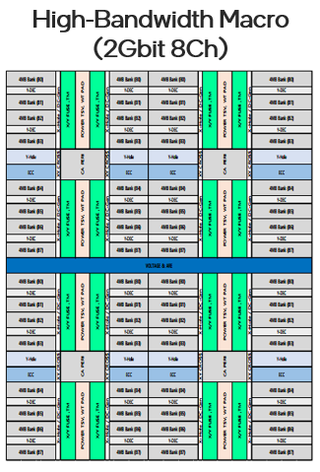
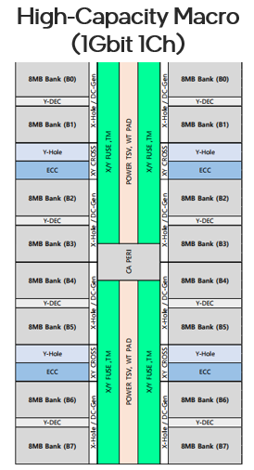
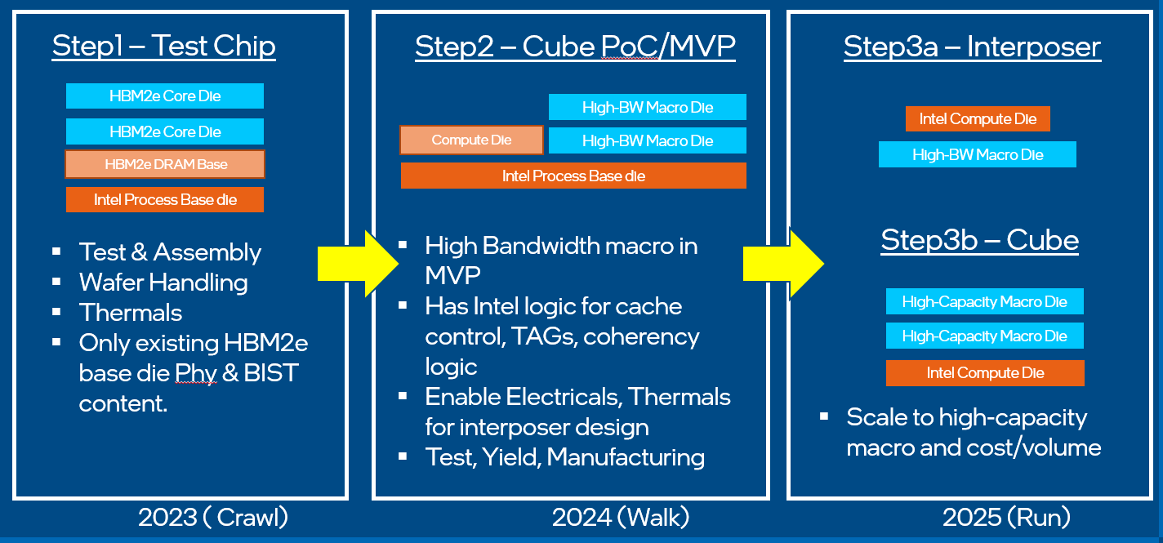
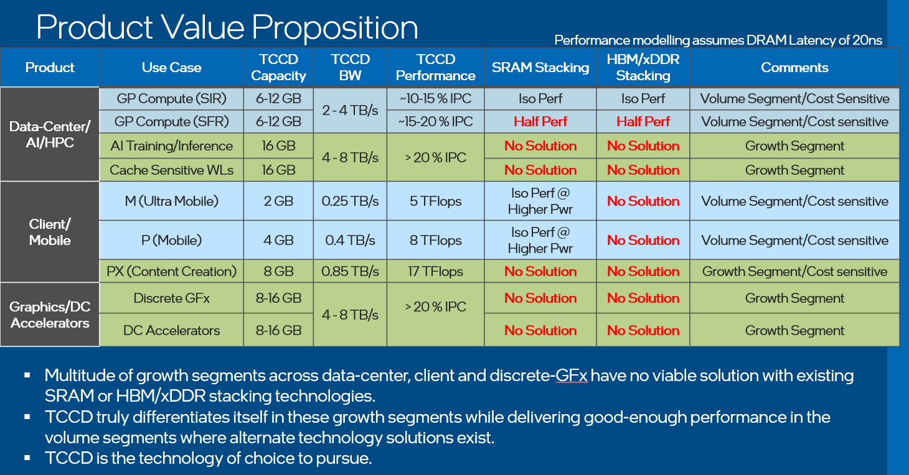
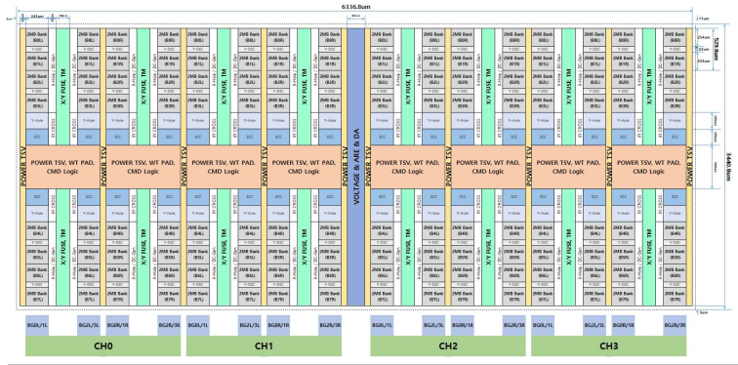
Technical Engagement Progression
Q2 ‘21
Q3 ‘21
Q4 ‘21
Q1 ‘22
Q2 ‘22
Q3 ‘22
Many parallel technical streams covering macro, yield, assembly and test
CEO level alignment on TCCD
TCCD Product Value prop vision requested by SK
First Technical Steering Committee Meeting
First Exec Sync
Early version of High-BW & High-Capacity Macros shared by SK
Crawl – Walk – Run approach proposed to enable TCCD across Intel product families
Focus shifted to MVP as HBM2e based POC does not add value
Leading MVP architecture based on Celestial+ Halo line reviewed by Intel
Product Value prop presented by Intel covering fundamental BW/capacity ratio and power wall issues.
SK shared initial yield model data, timing info and working on BW efficiency gaps raised by Intel
Data shared under CNDA 30991112 & CNDA 112784

Slide 10
TCCD Technical Viability – HB Macro
Priority | Metric Type | Parameter | Target (2Gb Macro) | Proposed @ 1α (2Gb Macro) | 16Gb HBM3 (1anm) | SRAM | Gaps
1 | BW Efficiency | Peak BW /GB (one way) | 1024 GB/s | 512 GB/s | 51.2 GB/s | >10 TB/s | 2x
 |  | Eff BW /GB | %of Peak?? | 50% of Peak | 75% of Peak @50% page hit rate |  | TBD
2 | Energy Efficiency | pj/bit | 1-1.5 | 2 | 5 | <0.5pJ/bit | ~1.5x
3 | Density | Density/mm2 | 16MB/mm² (> 13MB/mm²) | 11~12MB/mm² | >20MB/mm² | ~3MB/mm2 | ~ 30%
4 | Power Delivery | TCCD Load Line Contribution | 1x of no TCCD load line | ~1.5x | N/A | N/A | ~1.5x
 |  | Additional Metals | No RDL cost | 1-2 BE metals and 2-thick RDL layers | N/A | N/A
5 | Latency | Open Page | < 10ns | ~19ns | 32ns | <5ns | ~2x
 |  | Close Page | < 15ns | ~31ns | 50ns |  | ~2x
BW efficiency gaps of ~2x exist which are not fundamental. Current proposed solution for this is incurring too much of a DRAM density hit which needs to be addressed.
Top die power delivery requirements can be met with 2 thick RDL layers which add to overall cost.
No fundamental showstoppers to making TCCD technically viable.

Slide 11
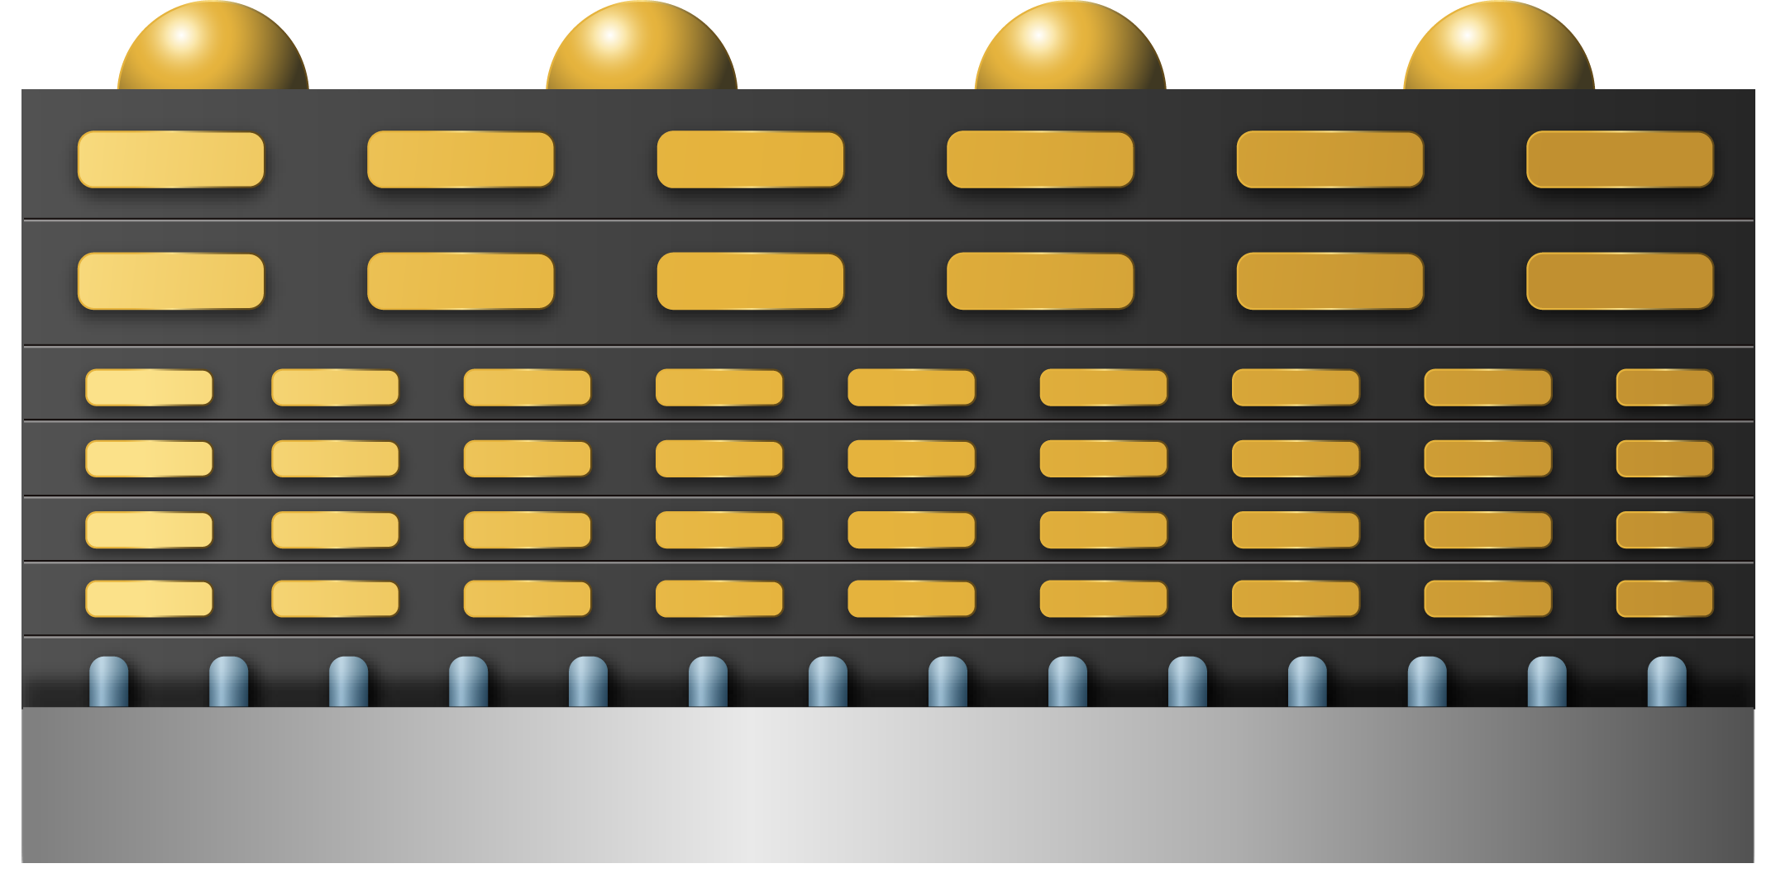
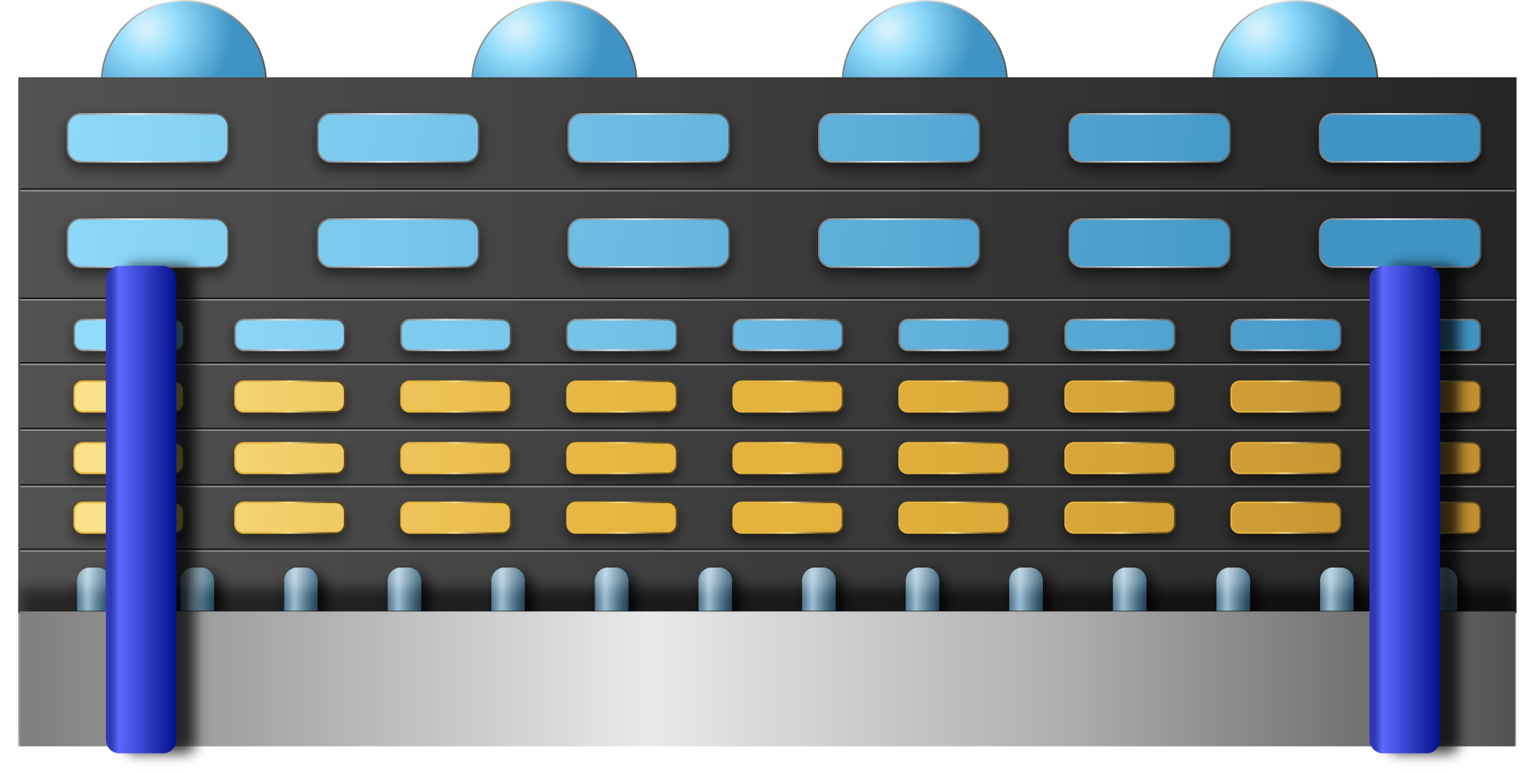
WHAT IS TCC-D?
Tightly Coupled Cache - DRAM (TCC-D) concept
Standard
Custom
SK Hynix makes full DRAM metal stack
SK Hynix makes DRAM wafers up to M3
Intel completes top metal layers
TSV processing can by SK or Intel (TBD)
SK Hynix
Metal Stack
Intel
Top metal layers, MIM & TSV
SK Hynix
Si Transistors
+ M1/M2/M3
SK Hynix
Si Transistors
+ M1/M2/M3
Silicon Substrate
Silicon Substrate
Goal → Develop custom DRAM interposers to enable tighter integration with logic.
TCC-D Benefit → Ability to create Tightly coupled custom memory + logic solutions for a large range of bandwidth, capacity and integration requirements across Intel product portfolio.

Slide 12
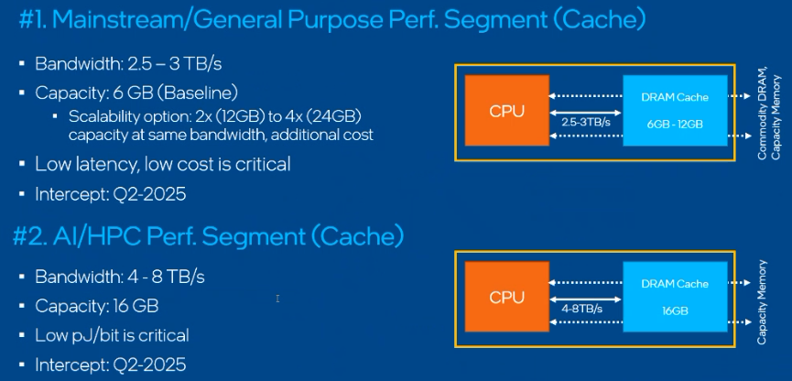
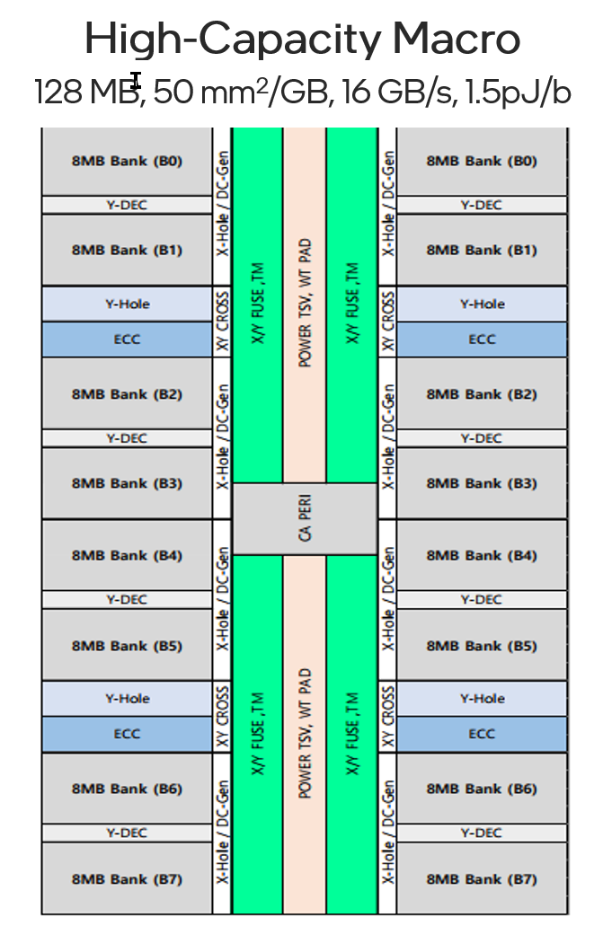
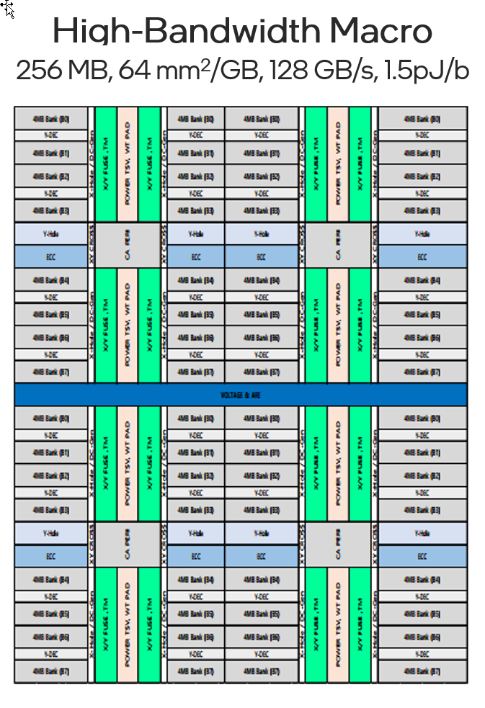
Where TCCD?
All Intel BUs are looking at this in 2025 timeframe
Client: Replace DRAM w/ Tiered Memory
  ~4GB of TCCD plus ≥ 8GB Far Memory (DRAM, NAND)
  Provide enough BW to satisfy up to GT3 requirements (ex: Avoid dedicated graphic cache)
  Priority Order is Cost, Power & BW. Latency same or better as LPDDR
Data Center: Large DRAM Cache
  Mainstream: 6GB with 3 TB/s, Priority is Latency, Cost & BW
  AI/HPC: 16 GB, 8 TB/s. Priority is Power
Graphics:
  GDDR hitting BW (30+ Gbps single ended) and Power (15 pJ/b) Wall
  Requires 1-4 GB with BW of 0.5 to 2 TBs
  Priority is Cost, Bandwidth
All requirements can be satisfied by 2 version of TCCD
  High Capacity and High Bandwidth Macros

Slide 13
TCC-D Construction Example
Many construction options with Memory on Bottom, Side or Top
  Use Foveros, ODI or Hybrid Bonding to connect memory to Compute
One possible example for Client (Top Picture)
  DRAM die is 1GB, 128GBs, 50mm² using High-Capacity Macro
  4 high stack (Wafer 2 Wafer bonding) to get 4 GB and 0.5 TB/s
Key Points:
  Stacking Memory for form factor will be common, especially in client
  DRAM process great for memory but not logic (4 Metal layers, Poor PnP)
  Memory controller, Home Agent, etc. all wants to sit on SOC or ODI die
    Cleaner Architecture, Easier Disaggregation, Better PnP, Better Memory Die reusability

Slide 14
Product Implementation: Near Term (MVP)
IO keep out (~4mm)
IO keep out (~2.5mm)
~7mm
IO keep out (~2.5mm)
TCCD signal gutter
IO keep out (~4mm)
TCCD MVP based on existing 2024 product line.
MVP now trending to be <= reticle size die (800mm2) for fabric and TCCD.
MVP will not be able to intercept the full long term scalable solution (carpet strategy) for products and needs an intermediate solution.
A partial carpet (reticle sized) with fixed I/O keepouts at the boundary can be explored for MVP in 2025 and Gen1 product intercept in 2026.
Thermal considerations for MVP and Gen1 TCCD products need to be closed (key engineering open).

Slide 15
Product Implementation: Long Term (Carpet Strategy)
Problem Statement1: De-couple DRAM macro needs from product construction needs as much as possible.
Problem Statement2: Enable a scalable solution for a given macro for multiple products/product segments to meet SK volume requirements.
Carper Strategy: Create a fixed modular building block for a given macro that is tiled in the entire wafer (assuming semi-processed wafers with known good die/macro map received) to shift complexity away from the TCCD DRAM die.
  This building block can be a single macro or an array of N macros (TBD).
  SK Hynix responsible for delivering this modular building block with high yield.
  The building block will have a scribe around it to enable singulation at Intel side depending on product need.
  Intel owns assembly and all product level construction requirements.
Data shared under CNDA 30991112 & CNDA 112784

Slide 16
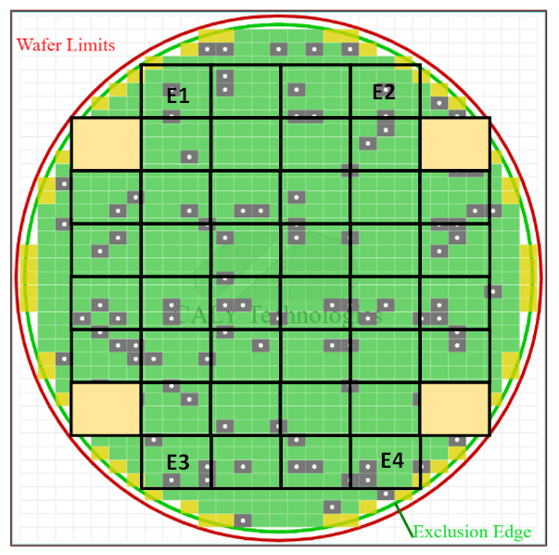
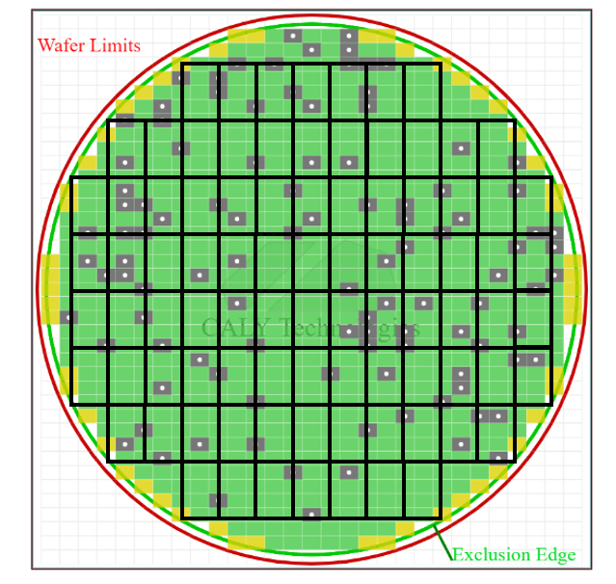
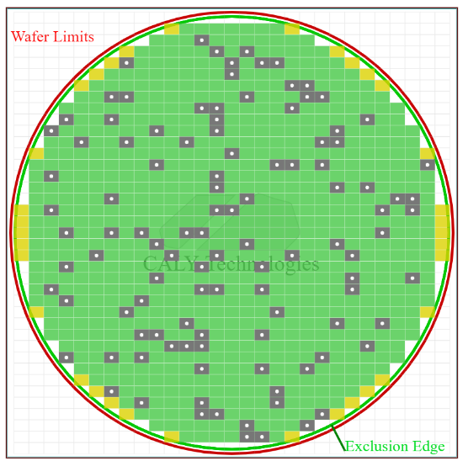
Product Implementation: Long Term (Carpet Strategy)
TCCD wafer made up of a modular macro array tiles for example ~75mm2.
Can singulate based on need to a 1200mm2, 600mm2, 300mm2 or smaller tiles.
The unused # of modular tiles for a given product due to the carpet strategy can be limited to <5%. With carpet strategy unused die can actually be used for different products.
Exploring different assembly technology solutions to enable this carpet strategy.

Slide 17
TCM

Slide 18
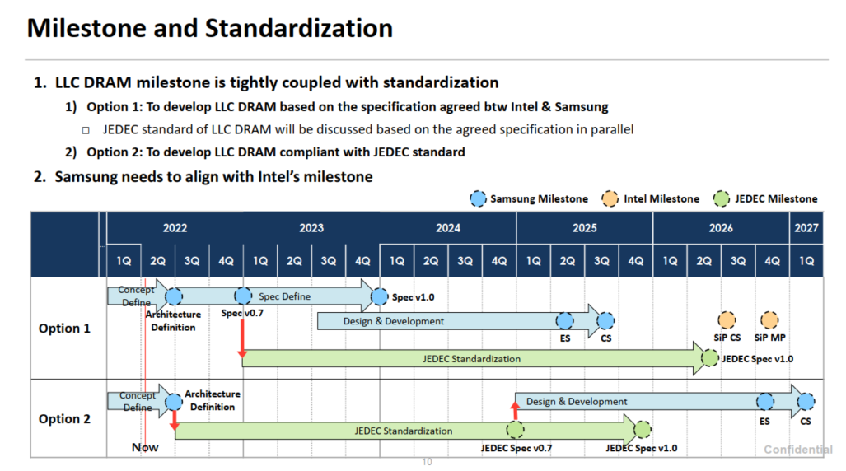

Slide 19
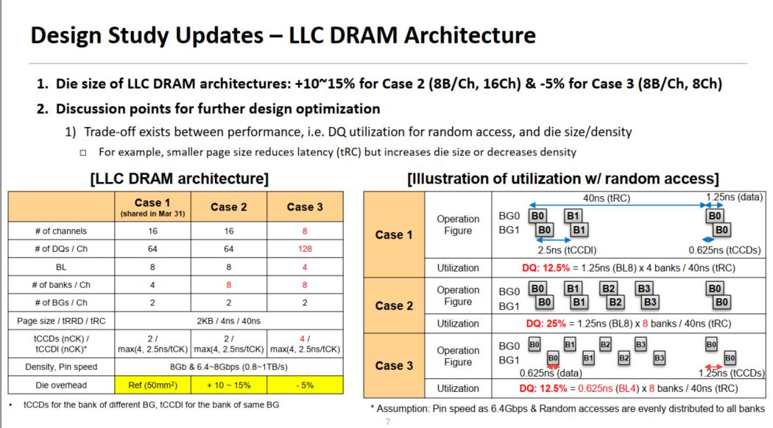
TCM Arch

Slide 20
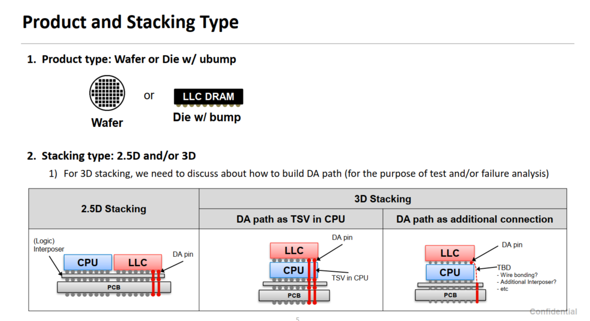
TCM

Slide 21
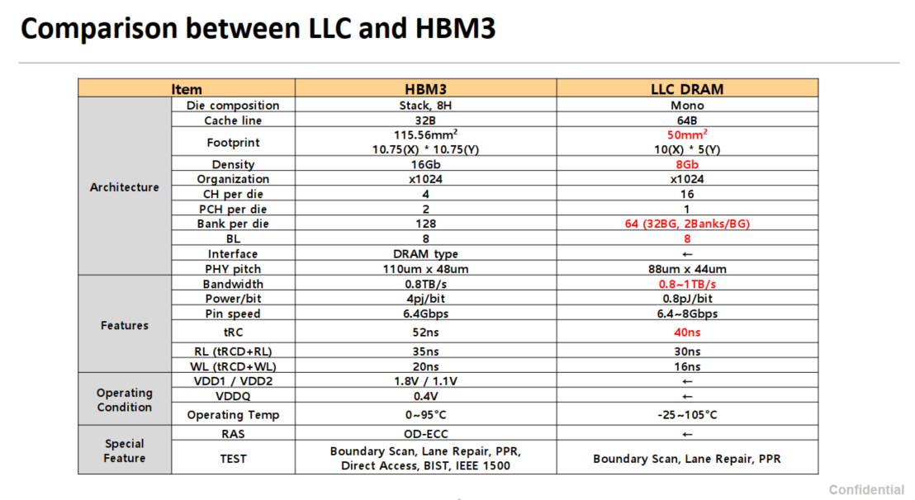

Slide 22
HBM4
JEDEC discussion started
2X the BW
Power is main concern as stack power ~45W
Power delivery with split PHY not practical with EMIB
Intel proposing base die on logic process. (Power ~30W)
Exploring direct attach to SOC without base die.

Slide 23
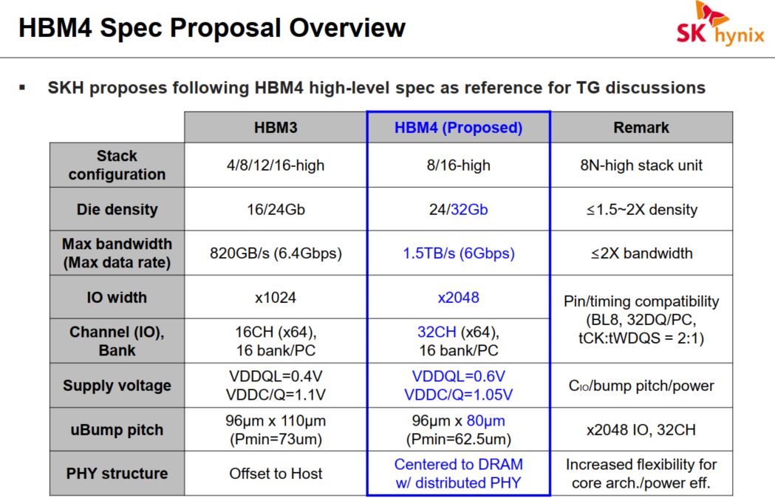

Slide 24
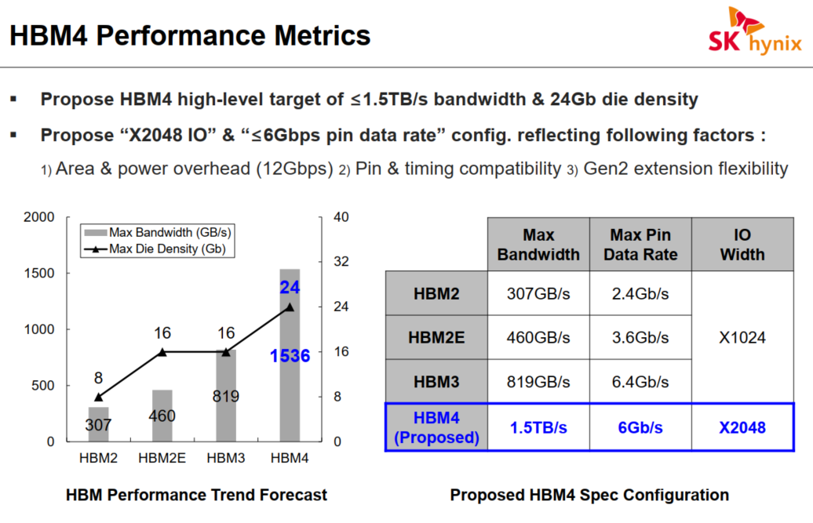

Slide 25
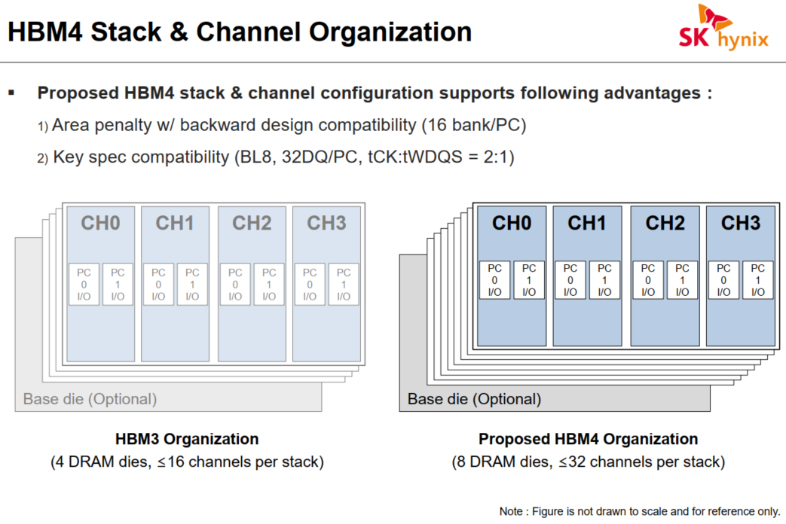

Slide 26
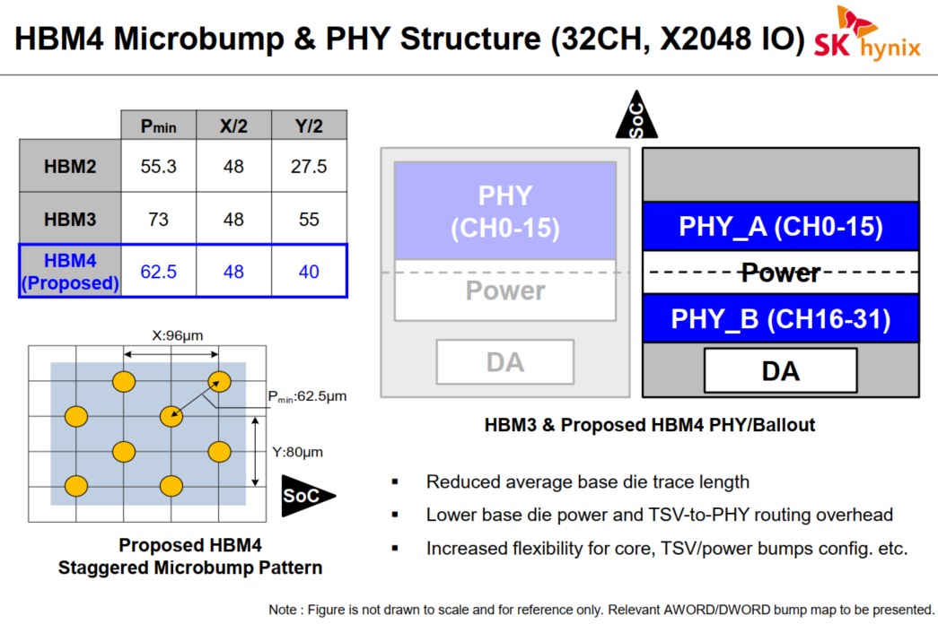

Slide 27
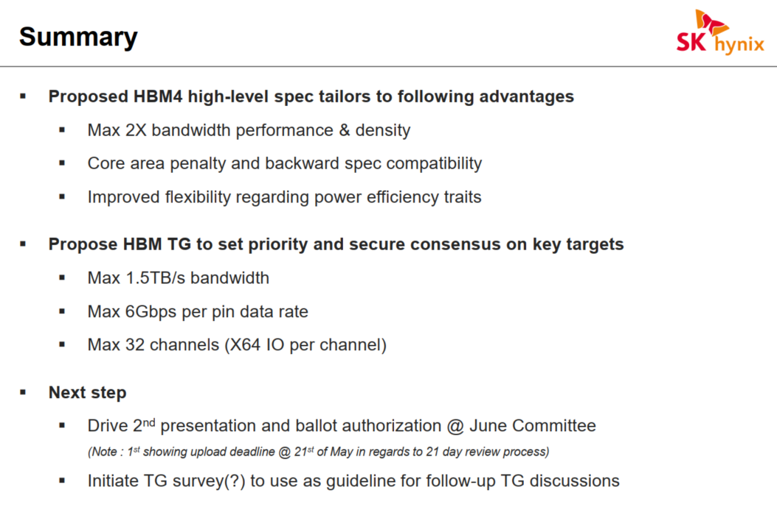

Slide 28
LLW (Low Latency Wide IO)
Previously DBM
SK Hynix has similar proposal (ULP) and JEDEC discussion started this Quarter

Slide 29
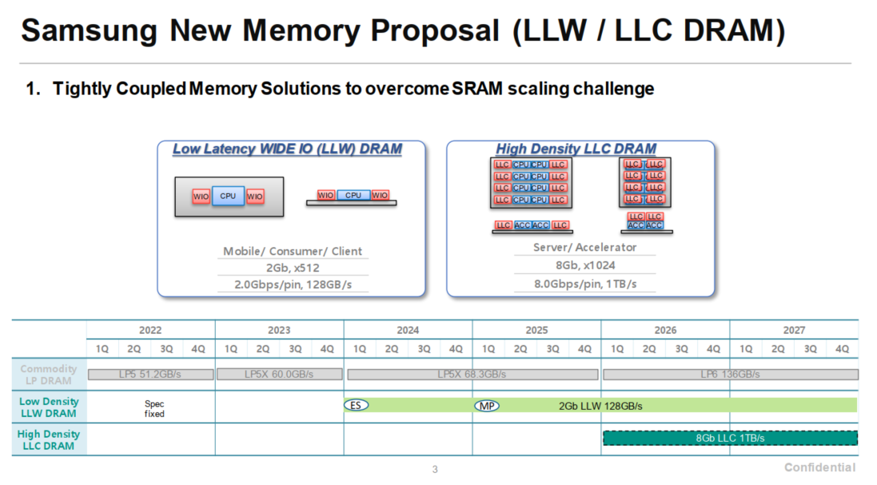

Slide 30
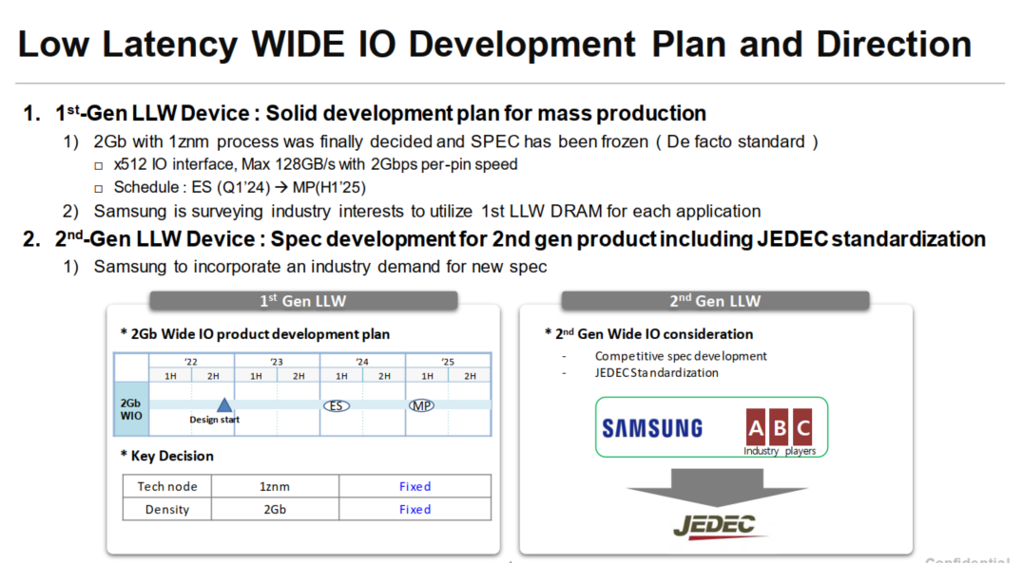

Slide 31
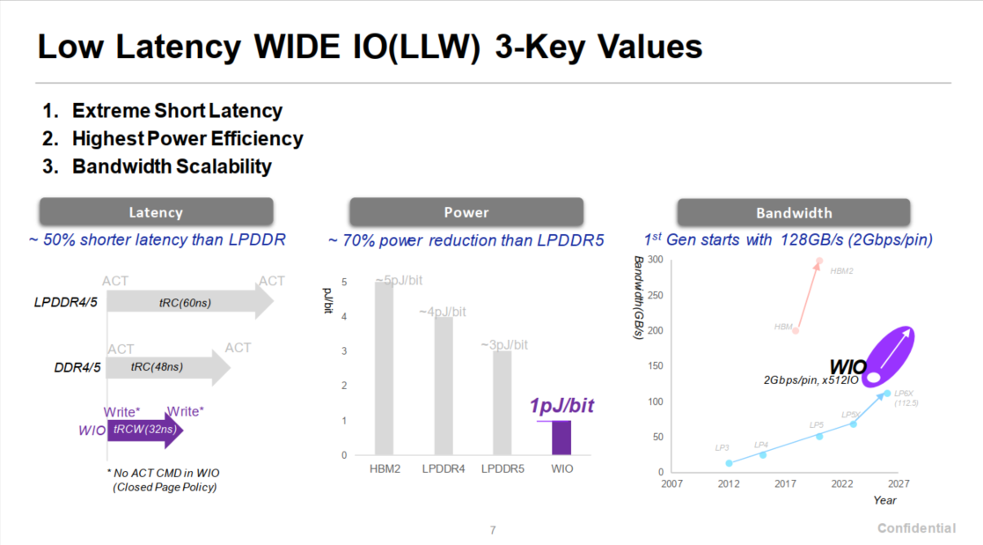

Slide 32
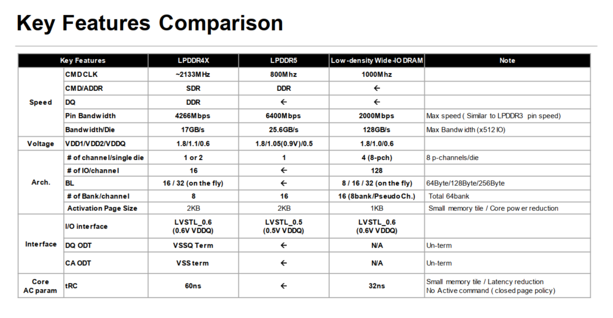

Slide 33
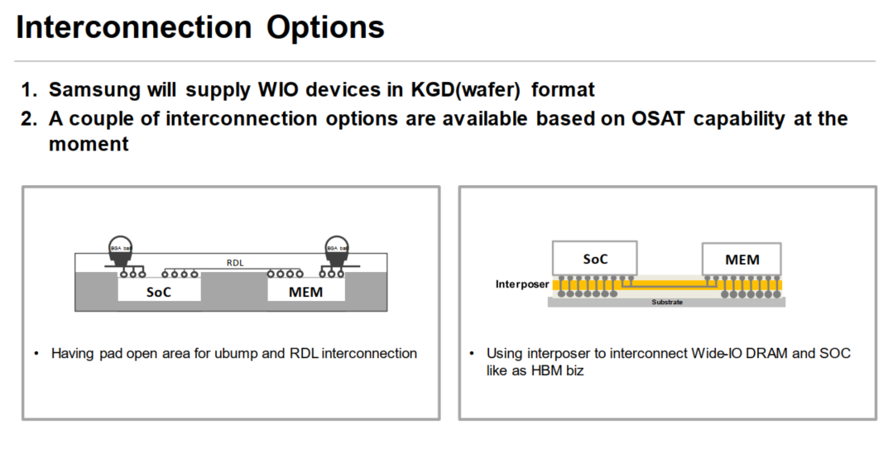

Slide 34
BACKUP

Slide 35
TCCD Macro Evolution Roadmap
Priority | Metric Type | Parameter | MVP (Q1 ‘25) | Gen1 Product (Q1 ‘26) | Gen2 Product (Q1 ‘27) | Gen3 Product (Q1 ‘28) | End of Life Target
 |  |  | TCCD Gen1 (1a) |  |  | TCCD Gen2 (1b)
1 | BW Efficiency | Peak BW /GB (one way) | 512 GB/s | 1.5x | ~2x | 1.5x | > 1 TB/s
2 | Energy Efficiency | pj/bit | ~2 | 2 | 2 | 1.5 | ~1-1.5
3 | Density | Density/mm2 | >11-12 MB/mm² | >13 MB/mm² | >13MB/mm² | +10% | 16 MB/mm²
Exact evolution roadmap of the TCCD Macro is still under discussion (Not yearly cadence of significant macro).
Peak BW evolution roadmap:
  MVP Macro to Gen1- BW improvement- of ~1.5x is key area of concern and topic of future discussions.
  Stacking of TCCD enables ~2x aggregate BW (orthogonal to macro improvements)
Energy Efficiency and Density evolution roadmap:
  Density and energy efficiency need to meet floor for Gen1 and Gen2 products
  Move to next DRAM process node (1b or 1c) and get 10% density and meet EOL energy efficiency targets
Data shared under CNDA 30991112 & CNDA 112784

Slide 36
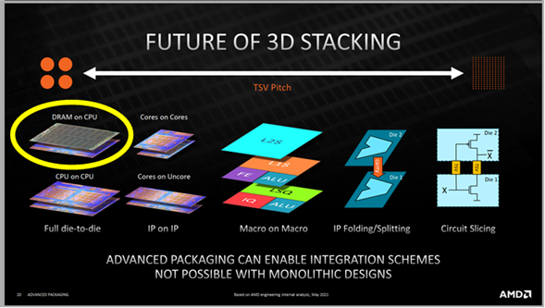
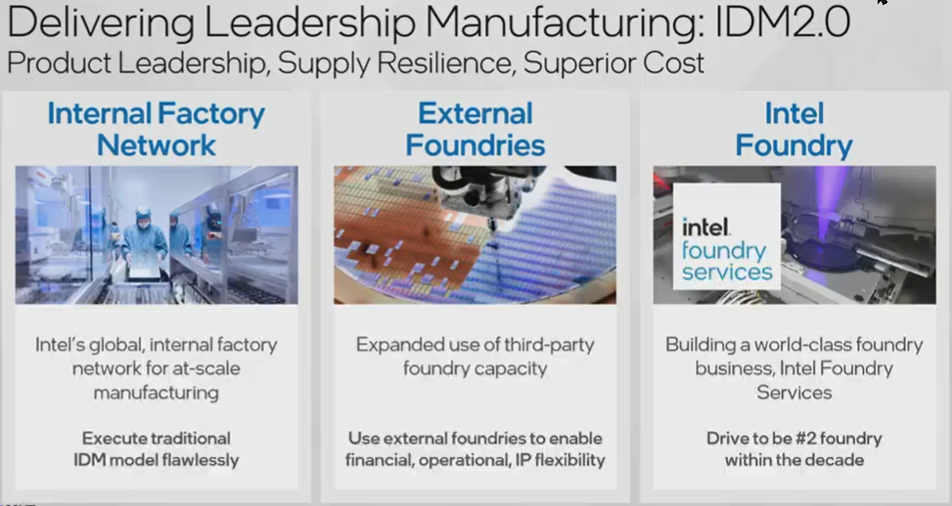
WHY TCCD?
SRAM
  Realistic Capacity < 64 MB vs. target of 1-16 GB
ADM
  Current Capacity < 1 GB. ADM is > 2X off industry DRAM on (mm²/GB) and ($/GB)
  CapX: Product roadmap can consume an entire fab, assuming ADM matches Industry’s (mm²/GB)
  If you don't have a competitive advantage, don't compete – Jack Welch (GE CEO)
TCCD Benefits
  Intel can optimally size capacity & BW to the market (Not true of DDR, LPDDR, HBM, …)
  Tight coupling provides major benefits: Power (6→3 pJ/b), Bandwidth (130→512 GBs), Latency (~5nS)
  New business model that shares NRE and offers significant value to both customer
Why Now?
  Dis-aggregation and 3D package integration are becoming mature, mainstream technologies
  Graphics and AI are driving significant increase in Memory BW requirements
    Ex: 16 channels of DDR in Server (3K Pins), Client/Graphic/DataCenter are all adding HBM or ADM to roadmap
    Power Wall: MTL LPDDR is (6 pJ/b * 130 GB/s) = 6W in a 15W TDP SKU !!!
  Competitive pressure is real and (AMD, Apple, Google & Likely others) are all looking at similar ideas
    Intel alone is having independent discussion w/ (Hynix, Samsung, Micron and Winbond). We know they aren’t just talking to us …

