Slide 1
DRAM L3 Cache Feasibility Update
Sandeep Guliani and Doug Josephson
Jan 26, 2023
Acknowledgement: Al Fazio, Prashant Majhi
Note: Portion of this presentation contains confidential information from AP Memory. Please do not share.
Intel Confidential

Slide 2
DRAM L3 Cache Feasibility
High Level Specs
Capacity = 1GB
Latency (activate row + read data) ~ 10ns (pin to pin i.e. from input to DRAM to output from DRAM)
Access Size = 64B
BW ~ 10 TB/s (closed page)
Page Size <= 2K Bytes
Intel Confidential

Slide 3
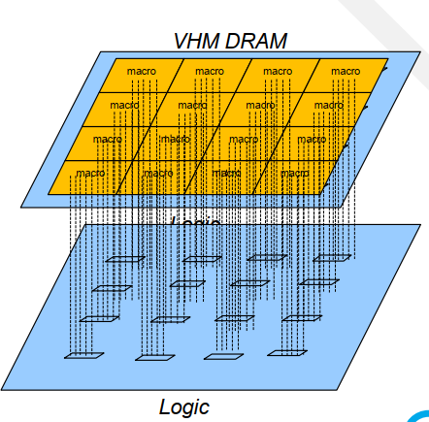
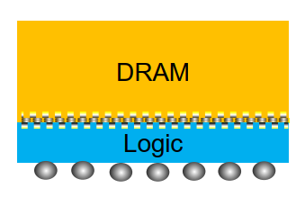
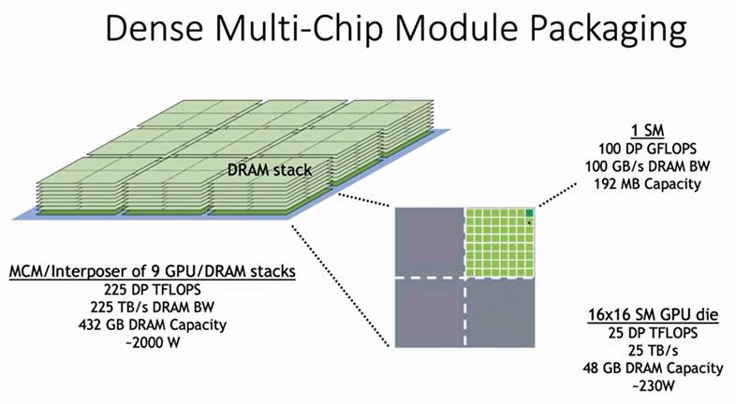

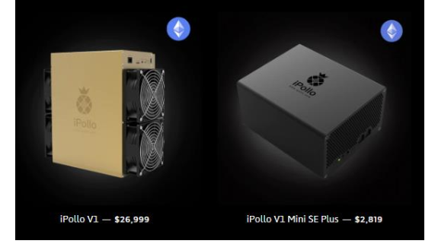
ABOUT AP Memory
A public fabless company out of Taiwan ~ 10 years old
Founded/led by an ex Intel Engineer/Manager
One of their offerings is 3-D stacking of Logic and DRAM through hybrid bonding called VHM (Virtual Embedded DRAM). They offer
Design services
Interface and test IP
Complete design and silicon manufacturing through various foundries
Idea is to stack high density DRAM and high performance logic to build a high bandwidth, low power memory
They have several products in the market
We tore down one of their products
From Bill Dally @ Nvidia conference; We believe they are working with AP Memory
Intel Confidential

Slide 4
DRAM Cache - VHM ( AP Memory)
DRAM vs Logic Die Partitioning
DRAM arrays and pitch cells are on the DRAM die
High frequency mux-demux logic is on the Logic die
Several partitioning options between DRAM die and Logic die for DRAM bank peripheral circuits
DRAM to Logic Die HBI interface
DRAM is divided into several data blocks of 1MB each
# of Data HBI IO pins are 512 per 1MB data block
(Pins are kept at 512 so there is no latency penalty due to serialization of cache line)
DRAM
Logic
bank_0
bank_1
bank_2
bank_3
Data Block
Intel Confidential

Slide 5
DRAM Cache Feasibility - VHM ( AP Memory)
DRAM Cache Spec Feasibility Results
BW = 10 TB/s (closed page)
Latency ~ 12ns (pin to pin i.e. from input to DRAM to output from DRAM)
Key enablers:
Hybrid bonding of DRAM and Logic Die (high BW is aggregated on the logic die)
Array customization/optimization for latency and bw (at the expense of die size)
Partitioning options | Description | Logic Die Area used for Cache | Die Size at 1x node | Die Size at 1b node
Option 1 | No DRAM periphery circuits on logic die | ~25% (rough estimate) | 200 sq mm | Array customization not available
Option 2 | Several DRAM periphery circuits on logic die | 100% | 110 sq mm | Array customization not available
Notes:
2u HBI pitch required for 1x node
There are other options between Option 1 and 2 which incrementally use up more logic die area and reduce DRAM die area
Intel Confidential

Slide 6
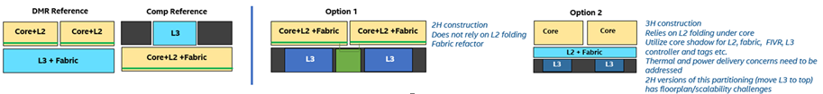
DRAM Cache – Construction Options
For above base construction options from Coral team, there are further 2 sub-options for AP Memory:
L3 die is replaced by DRAM die and supporting logic is on the die above
L3 die is replaced by DRAM+Logic die stack where logic die is on an older process node
Very rough cost analysis shows cost of DRAM cache to be comparable to ADM. This is cost not price.
Intel Confidential

Slide 7
DRAM Cache Feasibility VHM ( AP Memory)
Summary
Performance is close to what is required for L3
Key issues are
Lack of scalability (customization of array not allowed on advanced technology nodes)
Very fine HBI pitch requirement
Complex business model
Recommendation
Do not go for deeper engagement with AP Memory on L3 cache right now
Observe Intel/AP Memory working relationship on the Government project
Re-engage if their offering or our level of interest changes
Intel Confidential

