Slide 1
SRAM Array Hierarchy Definition
Cell size is defined by height x width in wl/bl orientation correspondingly.
Subarray is a matrix of cells enclosed by decoders and sense amplifier
Macro is an independent operable memory array, consists of a matrix of subarray, power rail, r/w control, address, and I/O.
Array is a matrix of macro with data path and control interface to compute unit
I/O

Slide 2
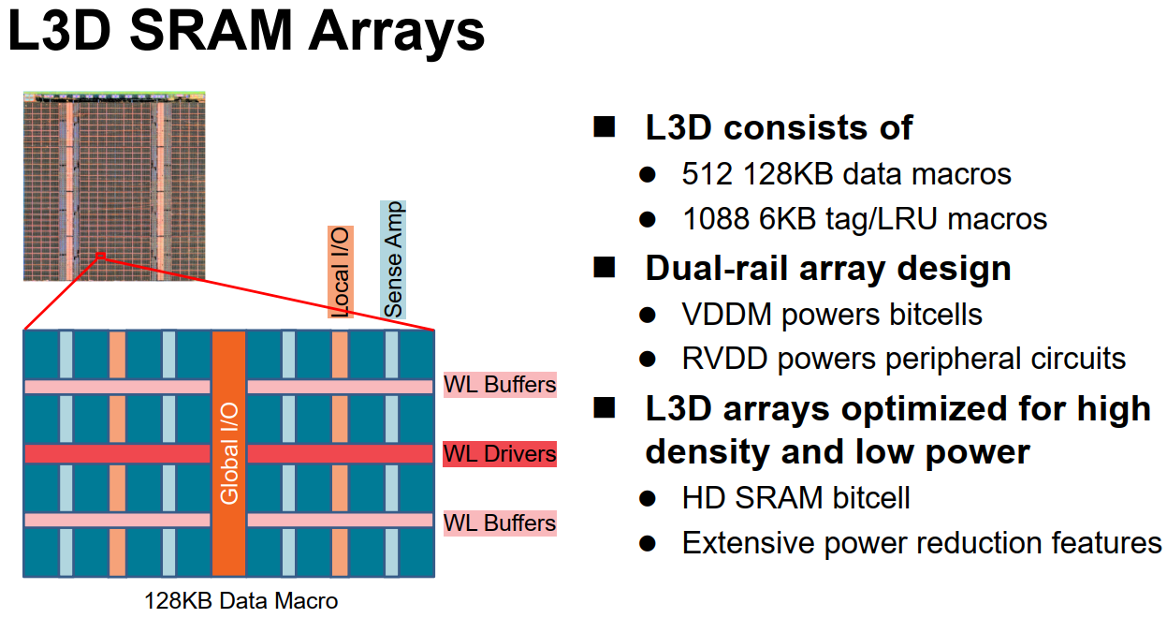
AMD L3D SRAM Array (V-Cache)

Slide 3
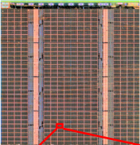
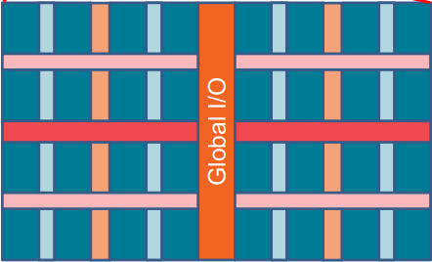
Die Size: 40.88 (6.51x6.28) mm² 2.77mm² on the top is unknown 7% Base uses 38.11mm² (L3 cache AE = 35.5%)
I/O: 1.415 (6.15x0.23) mm² (x2) 7.5%
256bFD/core x 8 core = 4K pads
Tag/LRU: 1.35(6.15x0.22) mm² (x4) 14.1%
1088/4 * 6KB = 1632KB 1.18MB/mm²
Array: 32MB/14.94(6.15x2.43)mm² (x2) 78.4%
2.14MB/mm² (Macro AE=48.5%)
8x32 128KB macro
Macro: 128KB/0.0416(0.16X0.26)mm²
3MB/mm² (Subarray AE=68% with I/O amortized)
4X4X2 4K
4K Subarray: 32 col X128 row(?)
Cell Size
0.027µm²
4.42MB/mm²

