Slide 1
Saint-D - Bufferless HBM

Slide 2
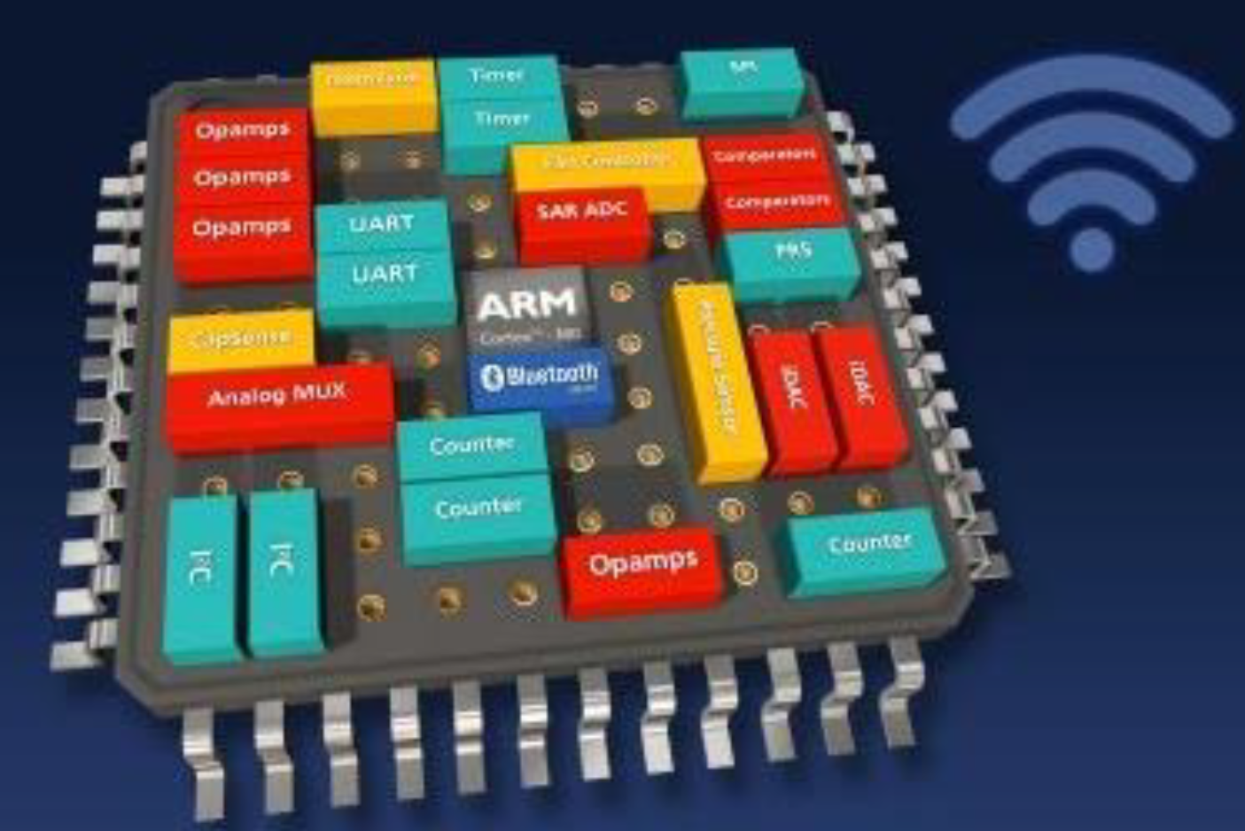

Motivation for Bufferless HBM
More number of HBMs, power/thermal problem should be matter in total system
Bufferless HBM can give
  1) Power can be reduced about 40% by excluding Buffer die
  2) Latency improvement through direct access C-die to Logic die
  3) Customer can flexibly configure Logic die regarding DRAM related IP
Power Improvement
Latency Improvement
Flexible Logic Configuration
48GB
<HBM 2.5D IC>
<Bufferless 3D IC>
24GB
2X
C-die
2.5D IC
3D IC
C-die
C-die
HBM
Capacity
C-die
C-die
3X
C-die
C-die
8GB
50W
B-die
Logic (MC/PHY)
C-die
HBM Density & Power
25W
Interposer
Logic + Interposer
(B-die + MC/PHY)
14W
30W
Substrate
Substrate
HBM Power
15W
Bufferless HBM Power
 | HBM 2.5D IC | Bufferless 3D IC
Latency (tRC) | 60ns | 55ns
※ Customer can configure Logic die without the
unnecessary functions in Buffer die.
HBM2
HBM3
HBM4
‘18
‘22
‘26
Time

Slide 3
Saint-D Architecture - Bufferless HBM
Open for customer’s feedback: IPs in Saint-D
1) Discussion slot is open until the end of this year
Saint-D Information
Concept of Saint-D IP
 | 2022 | 2023 | 2024
Overall Schedule
DRAM Interface IP in Logic Die
2Q
3Q
1Q
2Q
4Q
ASIC
HBM3
MTO
F/O
Dram Interface IP Transfer
Feedback Discussion
1st Vehicle
Veri.
2nd Vehicle
Veri.
HBM3
controller
HBM3PHY
B-die
C-DIE
HBM3 Core Die
(10.26mm x 9.875mm)
PHY
TSV
IO
HBM3 Core Die
DFI
JEDEC
TSV
HBM3
Saint-D
Saint-D(12.17mm x 10.39mm)
Interposer
Saint-D
(bottom die)
DRAM
(top die)
1st Vehicle Architecture
Saint-D + 4H HBM3 Core Die
uBump(TCB)
2nd Vehicle Architecture
3.5D : 1st Vehicle + HBM3
uBump(TCB)
HBM3
controller
DRAM interface IP
(0.75V)
C-DIE
(1.1V)
DFI
TSV IO
TSV

Slide 4
Bufferless HBM vs. HBM3(w Buffer die)
Main Diff. : # of DQ(x1024 → x4096), Operation speed(CA 3.2Gbps → 1.6Gbps, DQ 6.4Gbps → 1.6Gbps)
DBI, Jedec MRS and Test function(IEEE1500, DA, MBIST) are not supported
Category | Item | HBM3(w B-die) | Bufferless HBM(C-die) | Note
Mechanical | Die size | 11 x 11 (mm) | 10 x 10.4 (mm) | 16Gb die
 | Bump Pitch | 96 x 110 (um) | 28.5 x 27 (um) | C-die : TSV pitch
Core | Density | 16, 24, 32Gb | 16, 24, 32Gb
 | Stack height | 4, 8, 12, 16 | 4, 8, 12, 16
 | # of channel / # of p-channel | 16 ch/ 32 p-CH | 16 ch/ 32 p-CH
 | # of Bank | 16 ~ 64 bank/p-CH | 16 ~ 64 bank/p-CH
 | Bank group | Support | Support
 | Burst length | BL8 | BL2
 | # of DQ per 16 channel | x1024 | X4096 | DQ TSV Write Read common path
 | # of DQ per p-channel | x32 | x128 | DQ TSV per p-channel
 | Page size | 1KB / p-CH | 1KB / p-CH
 | Peak BW(Reference) | 819.2GBps(6.4Gbps) | 819.2GBps(6.4Gbps)
IO | VDD / VDDQ / VDDQL | 1.1 / 1.1 / 0.4V | 1.1 / 1.1 / 0.4V
 | CA / DQ data rate | DDR (3.2Gbps) / DDR (6.4Gbps) | DDR (1.6Gbps) / DDR (1.6Gbps) | CLK based operation
 | DQ / CA Tx | NMOS/NMOS un-term. (VDDQL swing) | CMOS/CMOS term. (VDD swing)
 | DQ Rx | DQ-DQS delay unmatched | DQ-CLK delay matched
 | DQS pair | 1 diff RDQS & WDQS per DWORD(32 DQ) | WCK & BRCK/CRCK per DWORD | BRCK : from B die to C die Read CLK CRCK : from C die to B die Read CLK
Function | Data masking | X | X
 | On-die ECC | O | O
 | External system ECC | X | X
 | DBI | O | X
 | MRS | O | X | Jedec
 | Test and Boundary Scan | O | X | IEEE1500, DA, MBIST

Slide 5
10x Bandwidth Memory

Slide 6
Ideation for 10x Bandwidth Memory
HBM Doubles Bandwidth with 4 years cadence
New technology will be needed to achieve more memory Bandwidth
1) Current Memory Pin speed is expected to be limited about 10Gbps with DRAM process (Many IO products)
2) Difficult to increase number of IOs a lot due to constraints as chip size and IO power
HBM expectation
IO and Pin speed for 10TB/s
Ideation for BW
1. Buffer die design by using Logic process
→ Pin speed improvement
2. Direct access to DRAM Core with HCB
→ Increase # of IOs
3. Co-Packaged Optic Link HBM
→ Expand capacity, Bandwidth
48GB
24GB
2TB/s
2X
DRAM
1TB/s
2X
Cu-Cu
8GB
Pin Speed [Gbps]
※ Reasonable IO and Pin speed
→ 6K ~ 12K for IO
→ 6Gbps ~ 13Gbps for Pin speed
CPU
HBM
Capacity
HBM Density & BW & Power
3.3X
50W
304GB/s
25W
HBM B/W
14W
16H
HBM Power
HBM
…
HBM
8H
12H
HBM2
HBM3
HBM4
Number of IOs [K ea]
EPIC
EPIC
Logic
‘18
‘22
‘26
‘30
Time

Slide 7
10x BW Memory Requirement for 10TB/s
Conventional DRAMs are difficult to achieve 10x Bandwidth. It is necessary to develop new technologies not only for memory but also for systems and packages
Case | IO | Pin SPEED (Gbps) | Bandwidth (TB/s) | How to | Requirements
1 | 1K | 80 | 10 | - | -. Memory Pin Speed limitation (up to 10Gbps with DRAM process)
2 | 2K | 40 | 10
3 | 4K | 20 | 10 | Pin speed | -. Need to improve Pin speed by applying logic process Buffer die
4 | 8K | 10 | 10 | IO density | -. Staking solution : 8H SID or More (HBM, LLC DRAM and etc.)
5 | 12K | 6.7 | 10
6 | 16K | 5 | 10 | New tech. | -. Need to find new solution such as CPO(pooled HBM), HCB(Direct access to core 3D)
7 | 20K | 4 | 10

Slide 9
Ideation for Bandwidth Increase
Samsung is considering and trying to improve memory performance. However, there will be a limit to Bandwidth increase only by Memory improvement
  Difficult to increase number of IOs a lot due to issues such as chip size and IO power
  Memory operation speed is expected to be limited to 9.6Gbps (Many IO products)
Industry should work together to find Bandwidth solutions in terms of Design/Package/System
DRAM
Case1 : HBM based
Case2 : LLC DRAM based
Case3 : New DRAM Concept
Cu-Cu
CPU
1. Current HBM structure
→ No further improvements other than Speed Scaling
1. LLC DRAM structure
→ Same Bandwidth with current HBM3 products
→ Improve Latency, Power Efficiency
※ Conventional DRAM
→ Common external WR/RD path
→ need serialize, de-serialize operation
HBM
Logic
HBM
LLC
LLC
WR
Interposer
Logic
2. Twin tower HBM (2 Core die cubes on Buffer die)
→ 2x Density, Bandwidth compared to normal HBM
Logic
Interposer
RD
2. LLC DRAM stacking type
→ Expand Capacity, Bandwidth by stacking
HBM
Logic
HBM
※ New DRAM using HCB
→ Direct access to DRAM Core (Increase # of IOs)
→ Separated WR/RD path for Full duplex
Twin Buffer
LLC
LLC
3. Pooled HBM Memory Module with CPO
→ Expand capacity, Bandwidth
LLC
LLC
LLC
LLC
WR
HBM
HBM
LLC
LLC
Logic
…
Logic
EPIC
EPIC
Interposer
RD
Logic

Slide 10
Expected Bandwidth of each Idea
Conventional DRAMs are difficult to achieve 10x Bandwidth. It is necessary to develop new technologies not only for memory but also for systems and packages
Case | Product | Concept | Stack | Density | IO | Operation Speed | Bandwidth | 10x BW Possibility | Note
Case 1-0 | HBM3 | Current HBM | 4H | 8GB | 1K | 6.4Gbps | 0.8TB/s | Low | -. B-die & C-die Design change not required -. No further improvements other than Speed Scaling
 |  |  |  |  |  | 8.0Gbps | 1TB/s
 |  |  |  |  |  | 9.6Gbps | 1.2TB/s
 |  |  |  |  |  | 80Gbps | 10TB/s
Case 1-1 |  | Twin Tower (2 C-dies on B-die) | 4H x2 | 16GB | 2K | 6.4Gbps | 1.6TB/s | Low | -. B-die Design change required -. HBM Cube size increase (X-axis double)
 |  |  |  |  |  | 8.0Gbps | 2TB/s
 |  |  |  |  |  | 9.6Gbps | 2.4TB/s
 |  |  |  |  |  | 40Gbps | 10TB/s
Case 1-2 |  | Optical HBM3 MM (Memory Module) | 4H x12 | 96GB | 12K | 6.4Gbps | 9.6TB/s | Mid | -. Improve to manage Power/Thermal away from XPU -. CPO Tech. required and Expensive System cost
 |  |  |  |  |  | 8.0Gbps | 12TB/s
 |  |  |  |  |  | 9.6Gbps | 14.4TB/s
Case 2-0 | LLC DRAM | LLC | - | 1GB | 1K | 6.4Gbps | 0.8TB/s | Low | -. Advantage of Latency, Power efficiency compared to HBM -. Low Density
 |  |  |  |  |  | 8.0Gbps | 1TB/s
 |  |  |  |  |  | 9.6Gbps | 1.2TB/s
 |  |  |  |  |  | 80Gbps | 10TB/s
Case 2-1 |  | Stacking Product | 4H | 4GB | 4K | 6.4Gbps | 3.2TB/s | Low | -. Improve Density/Bandwidth of LLC DRAM using TSV
 |  |  |  |  |  | 8.0Gbps | 4TB/s
 |  |  |  |  |  | 9.6Gbps | 4.8TB/s
 |  |  |  |  |  | 20Gbps | 10TB/s
Case 3-0 | Chiplet DRAM (New Memory) | Direct access from Logic to IOSA | - | 1GB | RD : 16K, WR : 16K (RD/WR 0.5K per CH) | 1.6Gbps | 3.2TB/s | Mid | -. Limitation of Speed scaling due to DRAM Core cycle
 |  |  |  |  |  | 4.8Gbps | 9.6TB/s
Case 3-1 |  | Stacking Product | 4H | 4GB | RD : 64K, WR : 64K (RD/WR 0.5K per CH) | 0.8Gps | 6.4TB/s | Mid | -. Improve Density/Bandwidth of Chiplet DRAM using TSV
 |  |  |  |  |  | 1.2Gbps | 9.6TB/s

