Slide 1
Eco System Competitive Capability for TCM/IPM

Slide 2
Agenda
Tightly coupled memory (TCM) options
Integration eco system capabilities
Memory eco system capabilities and Intel engagements
Other Considerations
Arch options (global vs distributed)
Power and thermals
Supply chain and business model
Next Steps

Slide 3
Tightly Couple Memory Options
Integration types and vendors
2.5D – memory (mono or 3D stacked) on the side – OSATs, TSMC, Samsung, Intel
3D stacked – memory (mono or 3D stacked) on the bottom or on the top – Tier 1 DRAM vendors, TSMC, Intel, XMC (memory wafer supply from non-domestic vendors are not likely), UMC
Memory types and vendor:
SRAM: Intel, TSMC, Global Foundries (GF), Samsung
DRAM:
Tier 1: Samsung, SK Hynix, Micron with active TCM programs
Tier 2: Winbond, Powerchip with active TCM programs, Nanya with likely active TCM programs
Tier 2(with Tier 1 potential): CXMT with no known TCM programs
ADM/eDRAM – Intel
eDRAM – IBM/GF – GF process RM limitation
STT/MRAM – TSMC, Samsung, GF – low density
Alternative technologies – Multiple in research/development phases
Memory usage model/architecture options
Centralized or distributed
Large possible # of combinations across architecture, integration, memory type and vendors
Well vetted goals and requirements can help to focus feasible combinations

Slide 4
Architecture Options

Slide 5
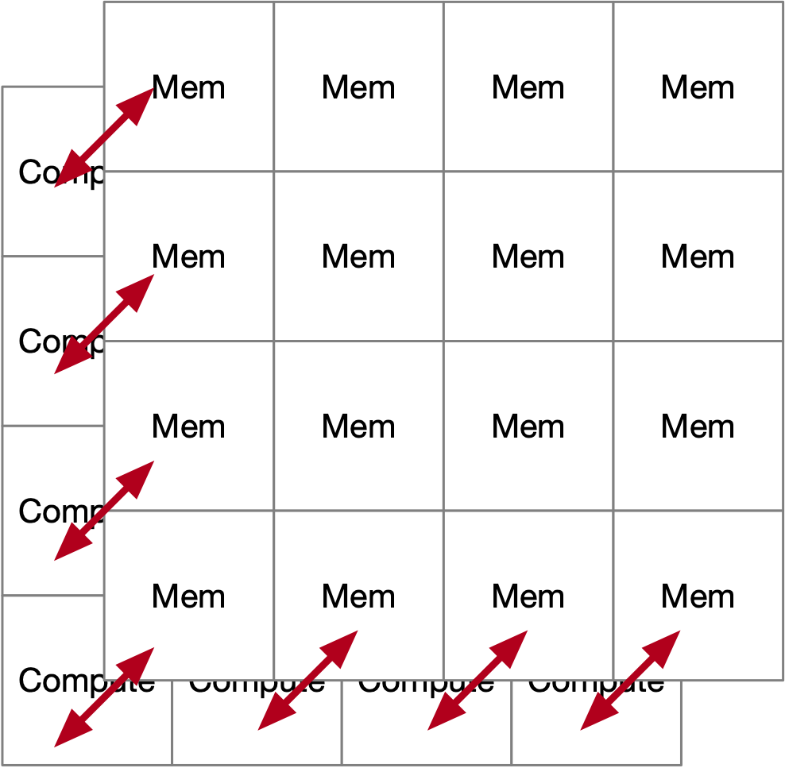
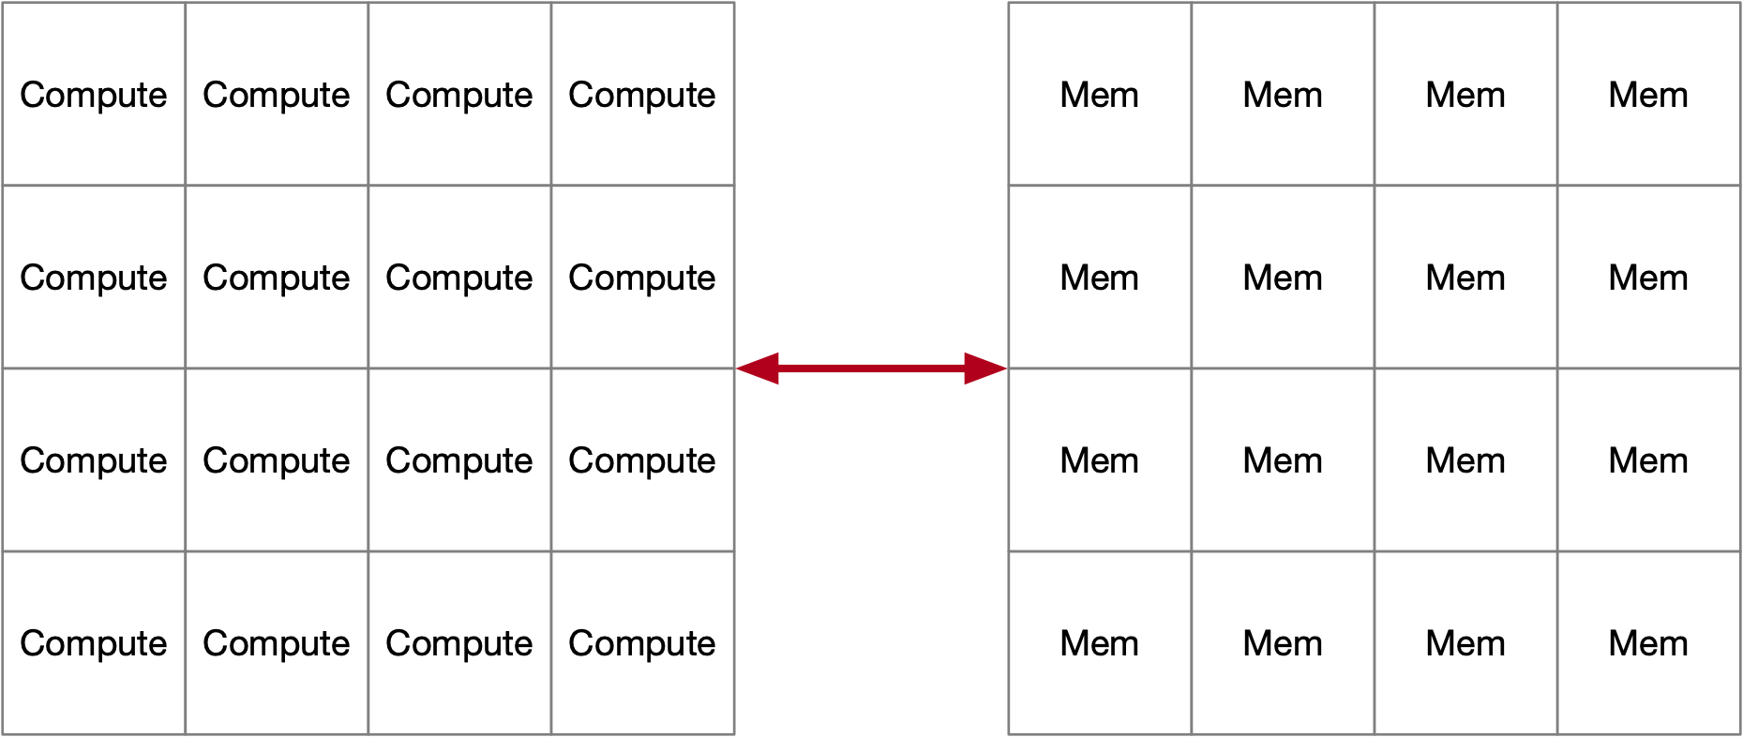
TCM Architecture Options
Centralized
Can be 2.5D or 3D integrated
No affinity between compute and memory partition
Examples:
Current ADM designs
Xeon LLC
PVC L3
BW limitation and significant data movement power
Distributed
Each compute partition has preferential access to memory that is closer
Examples:
Xeon L2 cache per core
AMD L3, local to each CCD (8 CCDs)
Nvidia A100: 8-way partition, in two halves of 4
Cerebras, 20PB/s BW to 40GB SRAM
Potential for higher total BW, lower power (less data movement power, better SI, …)
Performance (favors distributed arch), complexity (favors centralized) tradeoffs
Segment specific arch/SW studies needed to guide any pathfinding program

Slide 6
Integration Options

Slide 7
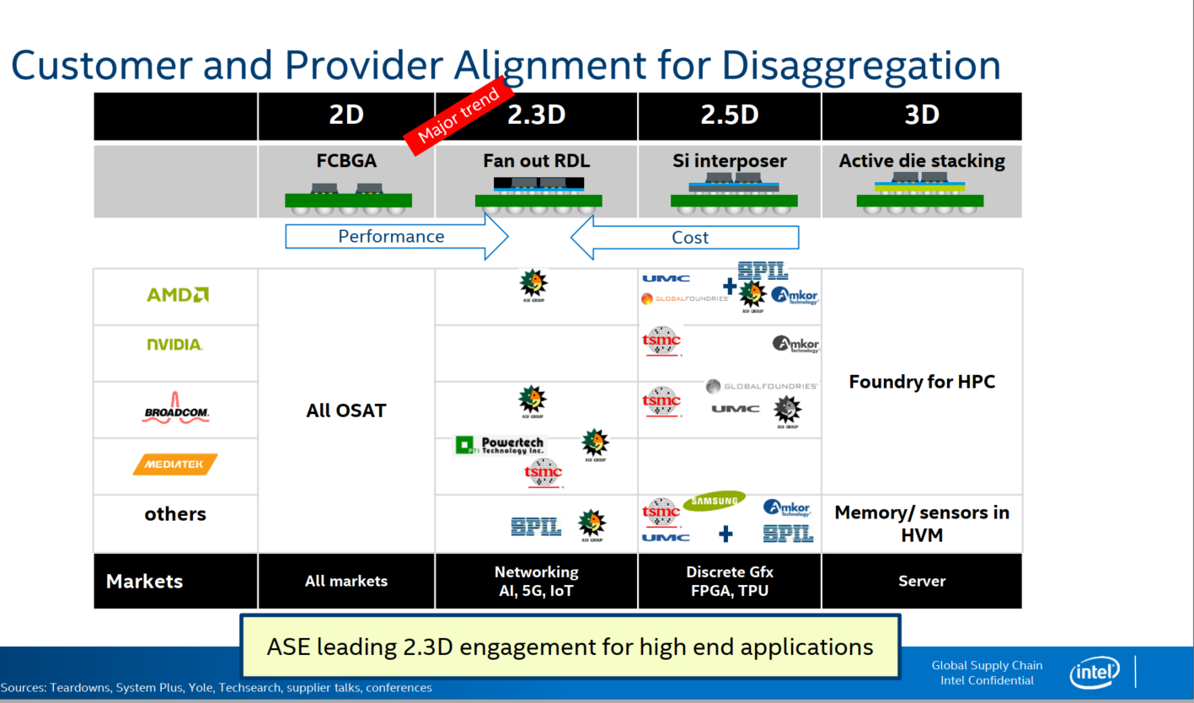
TSMC, Samsung
Intel, XMC, UMC
3D stacking capabilities consolidated and accessible to
all competition, volume/TTM will be favored by vendors

Slide 8
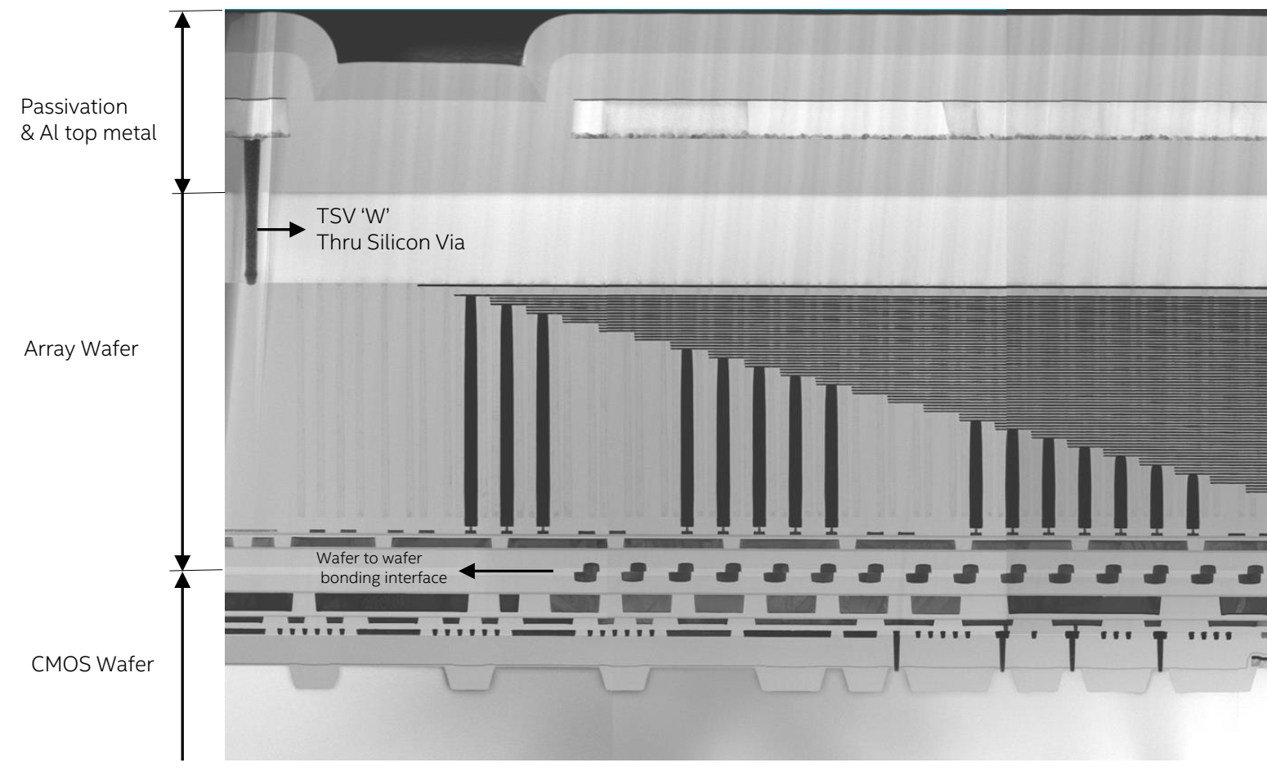
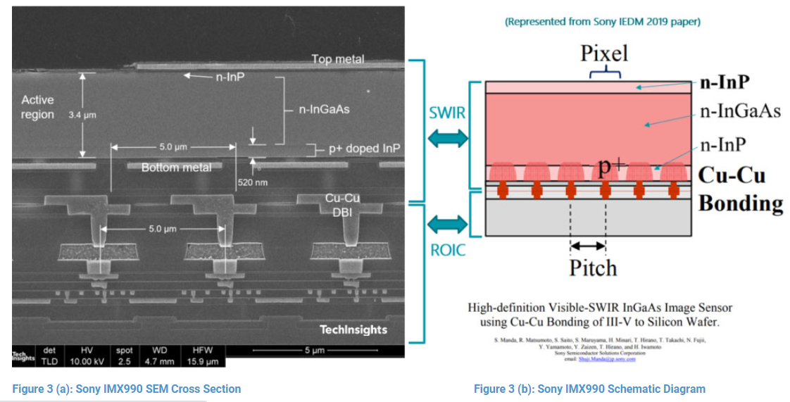
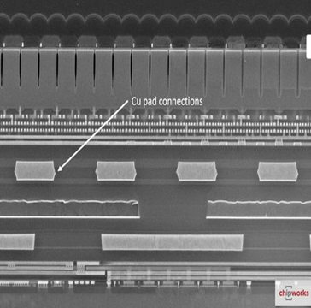
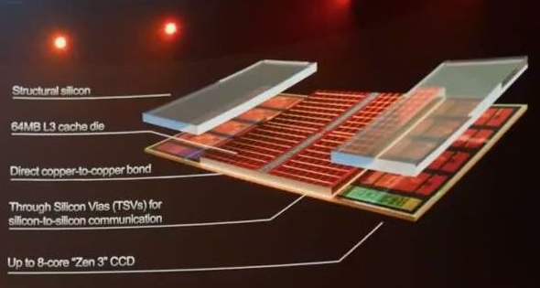
Bonding Landscape: R&D and HVM [Q2’2021]
C or W
C or W
Monolithic 3D
NMOS/PMOS
disagg
Hybrid Bonding HB [WoW]
Hybrid Bonding [CoW, CoC]
CMOS/Interconnect
disagg
SRAM or DRAM
Array/Peri Disagg
uBump [CoW]
Std Cell IP Disagg
CPU/Cache Disagg
YMTC 3DNAND
[WoW]
TSMC SOIC [CoW, WoW]
Hybrid Bonding (HB) in HVM
Global Foundry [WoW]
HB R&D [TD Path Validation]
Connections/mm²
CIS [WoW]
HB R&D [Concept/ Early Research]
SenSWIR Sensor Sony [CoW]
CIS [WoW]
DRAM HBM/3DS [CoC, WoW];
eFlash-Logic [WoW]
AMD V-Cache
SOIC [CoW]
Current 2.5D/3D products
Samsung claims competitive offering as other foundries
WoW Hybrid Bonding in Production for several yrs
Sony image sensors since 2016
YMTC 3D NAND since 2020
CoW Hybrid Bonding started Production
Sony SWIR Sensor, 2021
AMD V-Cache end of 2021
HB (WoW and CoW) mature for image sensors* and 3DNAND**, getting to MP for HPC at TSMC

Slide 9
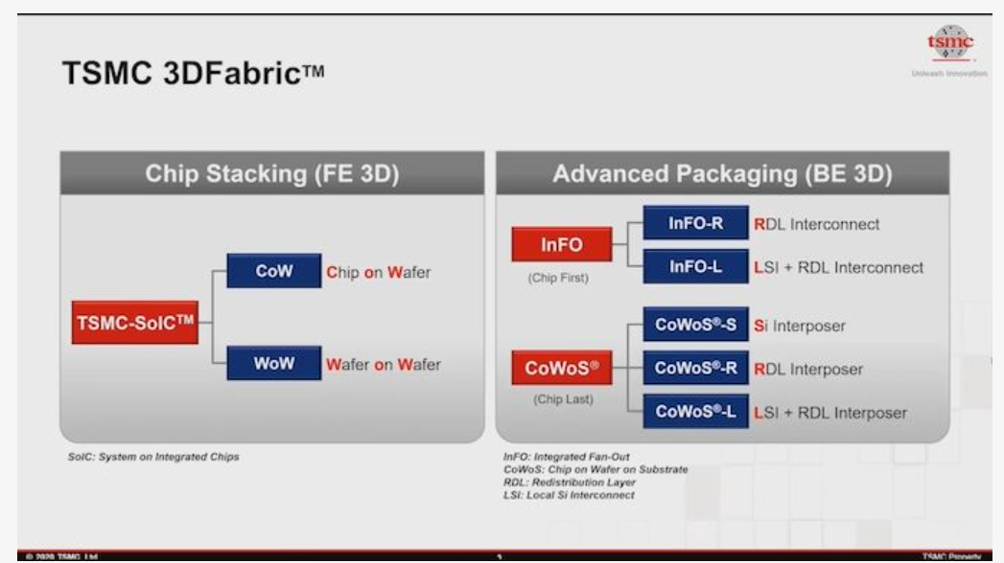
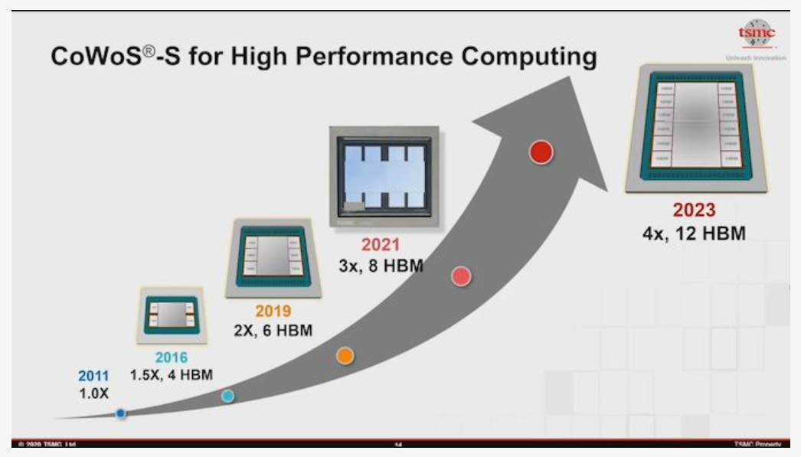
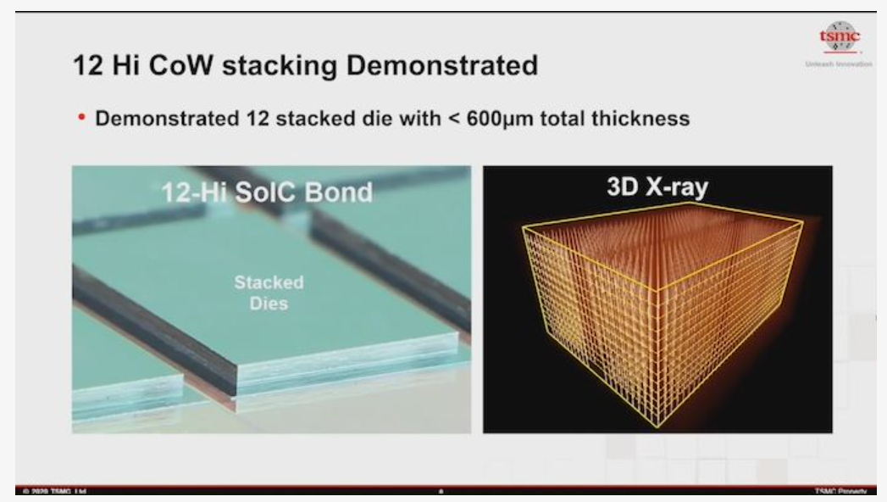
All competition has access to TSMC portfolio
though existing foundry relationships

Slide 10
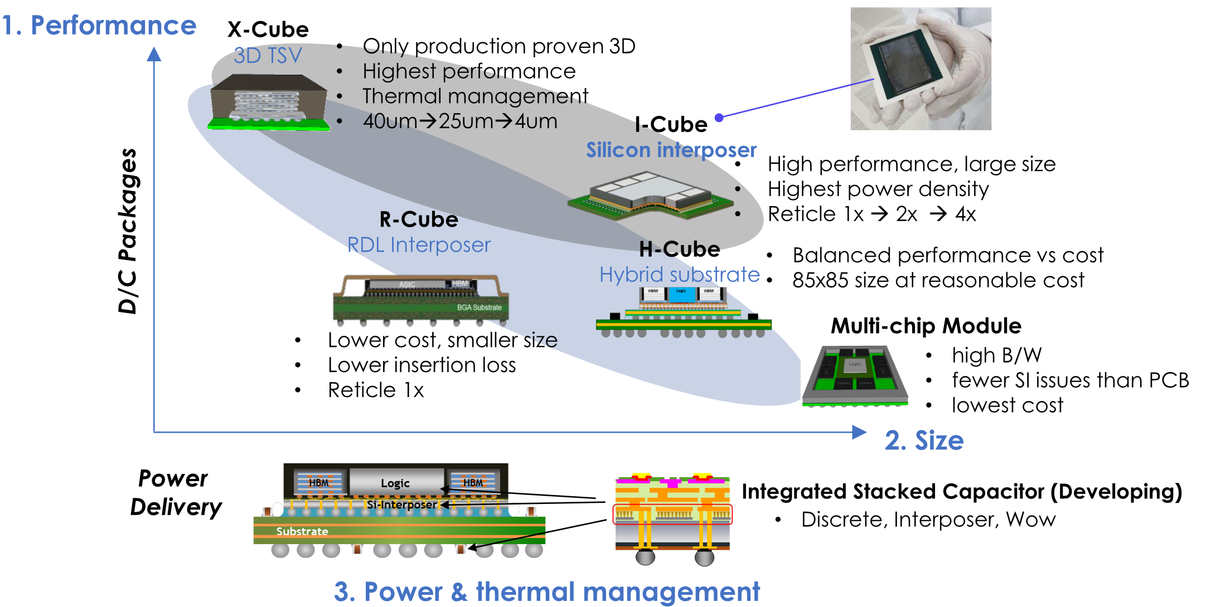
Samsung’s Cube Package Options for Foundry Customers
I-Cube (silicon interposer) offered with OSAT
X-Cube is developed internally
R-Cube will be developed with OSAT
E-Cube (embedded bridge) will be offered using the panel line for the embedding of bridge chip
X-cube SRAM stacking: TSV based MP ready, HB qual target EO ‘22 < 4nm (logic on top of SRAM)
Source: Samsung.

Slide 11
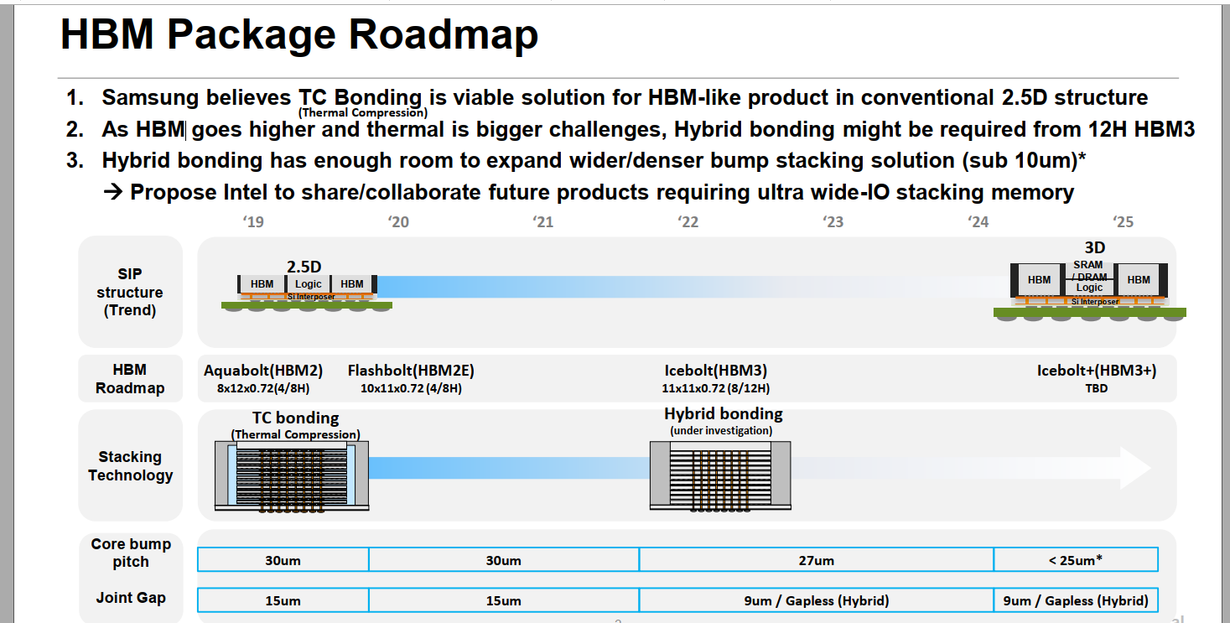
Samsung* and SKHynix targeting HB intercept with HBM within next 2-3** years
*Samsung demonstrated 3-stacked wafer bonding using hybrid bonding @ ECTC
** Need test methodology/tech for fine pitch HBI wafer for KGD

Slide 12

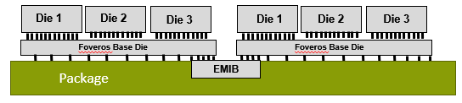
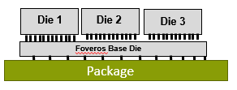
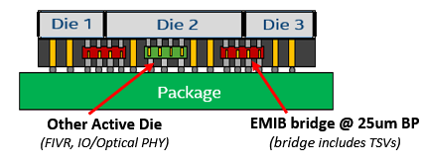
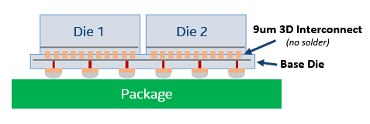
ATTD Advanced Packaging Architecture Portfolio
EMIB
Die to Die connection
on advanced package with EMIB
CoEMIB
Die to Die connection
With EMIB and Foveros
Foveros
Die to Die connection
On Active/Passive Silicon Base Die
Foveros Omni (ODI)
Die to Die connection via bridge in ODI complex.
Can also enable 3D Active Die connection
(Bridge can include TSV)
Foveros Ultra (HBI)
Die to Die solder less connection
On Silicon Base Die at <10um bump pitch

Slide 13
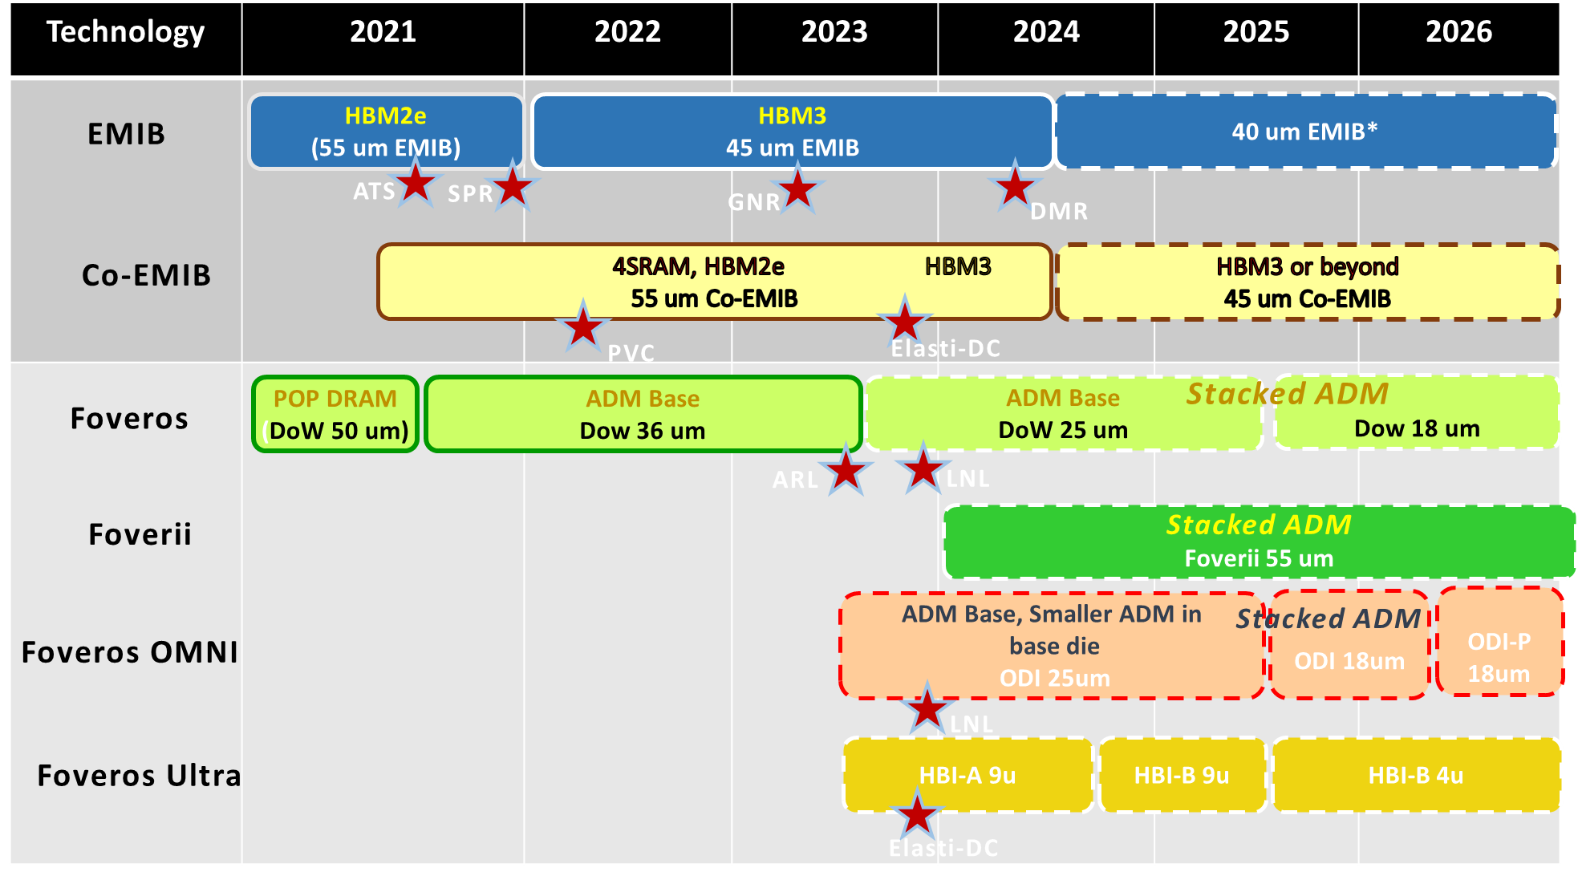
IPM Alignment with Packaging Architectures
ATTD POR
(Product Aligned)
Left Edge
HVM Ready
Directional Technology (No products Aligned))
No HBM on GNR, DMR schedule TBD
No ADM on LNL, OPM only
Product dates need update
No more DMR in 2024. DMR à CYR à HCR (2025)
For HCR TD in 2023, Multi memory die stacked test device project UBMC (previously, called HBI-C) is running now

Slide 14
DRAM Vendor Capabilities and Intel Engagements

Slide 15
DRAM vendor TCM engagements and scope
Company | Scope | Notes
Samsung | TCM for future products | 4/8GB, 2TB/s (HBM like 4/8 H stacks), ~50-100mm2 @ 2025-6, 1b/c, 1-2H vault type??
SK Hynix | Custom DRAM Si interposer and high BW DRAM | 6GB, 2.5-3TB/s ~480mm2 (stackable for capacity)
Micron | High BW stacked DRAM | 8GB, 1-1.28TB/s (8H HBM like w/o logic die) ~50mm2
Winbond | High BW stacked DRAM | 0.256GB
AP Mem* w/ Powerchip | cDRAM – Cache DRAM, low capacity, high BW VHM – Very high BW memory | 0.6-4.5GB, 2.4-4.5TB/s ~100-600mm2 @ 38nm Products going into production @ 25nm Same Powerchip process sold for commodity DDR3
*AP Memory is a design house using Powerchip as DRAM foundry
Variations due to differences in assumptions (mono vs stacked DRAM, …), BW vs density optimization and process nodes
WB, AP, SKH mono - S1, S3 4H - S2, M 8H
Clear separation of T1 vs T2
BW vs density optimization
TSV overhead
All DRAM companies can offer similar BW and capacity
@ die size dependent on process node capability
Common goals and requirements should guide these engagements
Includes 4/8H TSV overhead

Slide 16
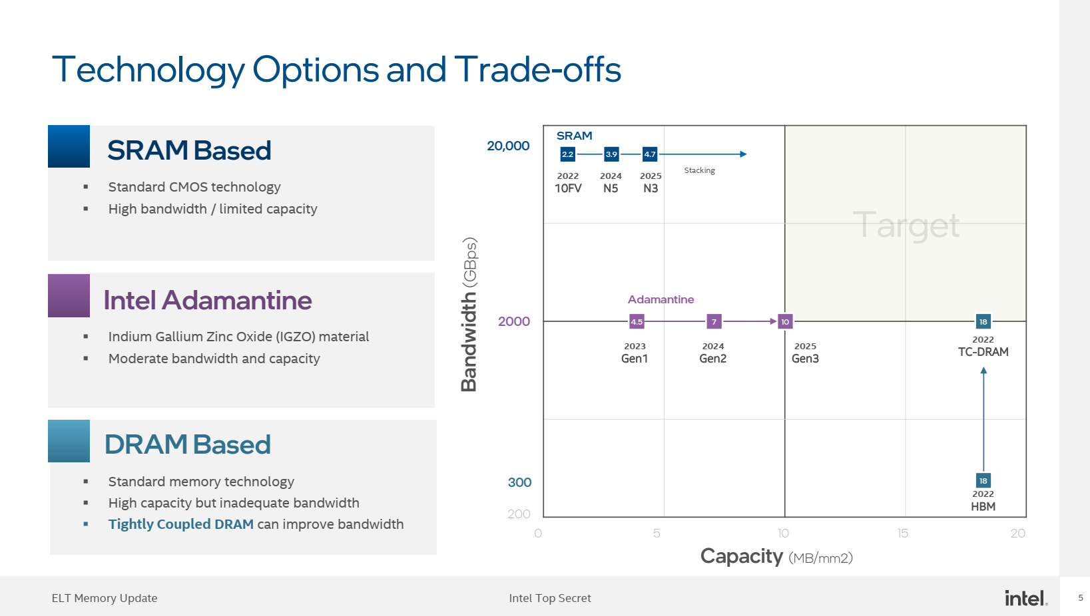
With NxSRAM Stacking
N7:2021;
N5:2022
Tier-1 3DIC [HB]
Tier-2 3DIC [HB]
Is the apples to apples comparison?

Slide 17
DRAM Vendor Considerations
Tier 1
IPM trend and mitigating scaling challenges motivates them for deeper pathfinding collaborations
Custom product commitments will require volume guarantees, NRE, and alignment any process customization
Existing close product collaborations with AMD/Nvidia on HBM
SKH collaborating with TSMC on logic-DRAM stacking
Existing close product collaboration with Apple on custom LPDDR packages
Apple may be collaborating with Micron on a custom HBM
Tier 2
Willingness and flexibility to collaborate. Lots of excitement in TWN around “AI memory” for a while now
Limited DRAM RM and capability
Nanya: 1Ynm (most adv in TWN). foundry Business with 2Znm.
Winbond: Main production is at ~2Ynm (2X/3Z tier 1 equivalent).
Both Nanya and Winbond required a lot of handholding to deliver spec compliant standard parts
PWC: DRAM foundry at 25nm, roadmap to 20nm.
PWC/AP memory –same DRAM process currently sold to Etron/ISSI/Others. (38nm or 25?)
CXMT: Currently at 19nm (40KW/m). 17nm ramp from Q4’21. Potential to join Tier 1 in a few years
Product commitment with Tier 2 partners will require heavy hand holding and risk management
Initial products must focus on performance value prop, chasing larger volume for cost reduction from get go not likely to succeed

Slide 18
Eco System Capabilities to Competition Mapping

Slide 19
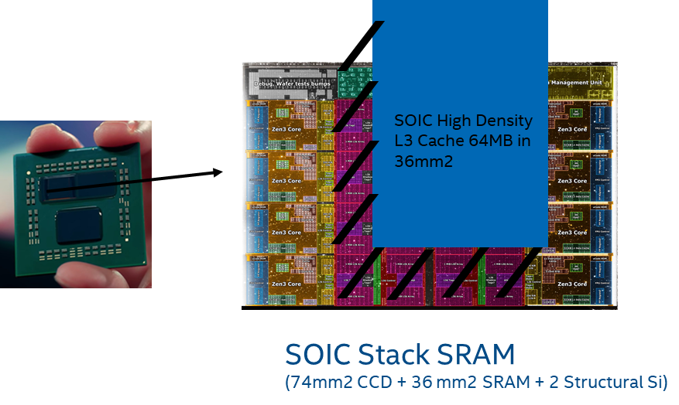
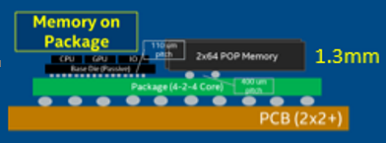
Client
APPLE
AMD
Tonga
(iGPU)
LP4 x64
2020
68GB/s
INTEL
LP4 x64
MTL-P halo/ARL
CPU
SoC
GPU
Jade
LP5 x128
2021
410GB/s
LP5 x128
Lifuca
(dGPU)
LP5 x128
I/O
LP5 x128
ADM
Stacked SRAM
SRAM process is cost reduced from logic process : metal layer count, vt’s , etc.
Very low risk:
Ship without cache die
Ship without working cache die due to HBI attach failure
LP5 x128
Rhode
LP5 x128
2022
820GB/s
LP5 x128
LP5 x128
LP5 x128
Lifuca
(dGPU)
LP5 x128
LP5 x128
LP5 x128
LNL w/ Memory on Package
wider LPDDR interface via custom packaging with commodity cost per bit
Additional SRAM layers
LP5X, custom HBM?
Stacked ADM/SRAM/DRAM

Slide 20
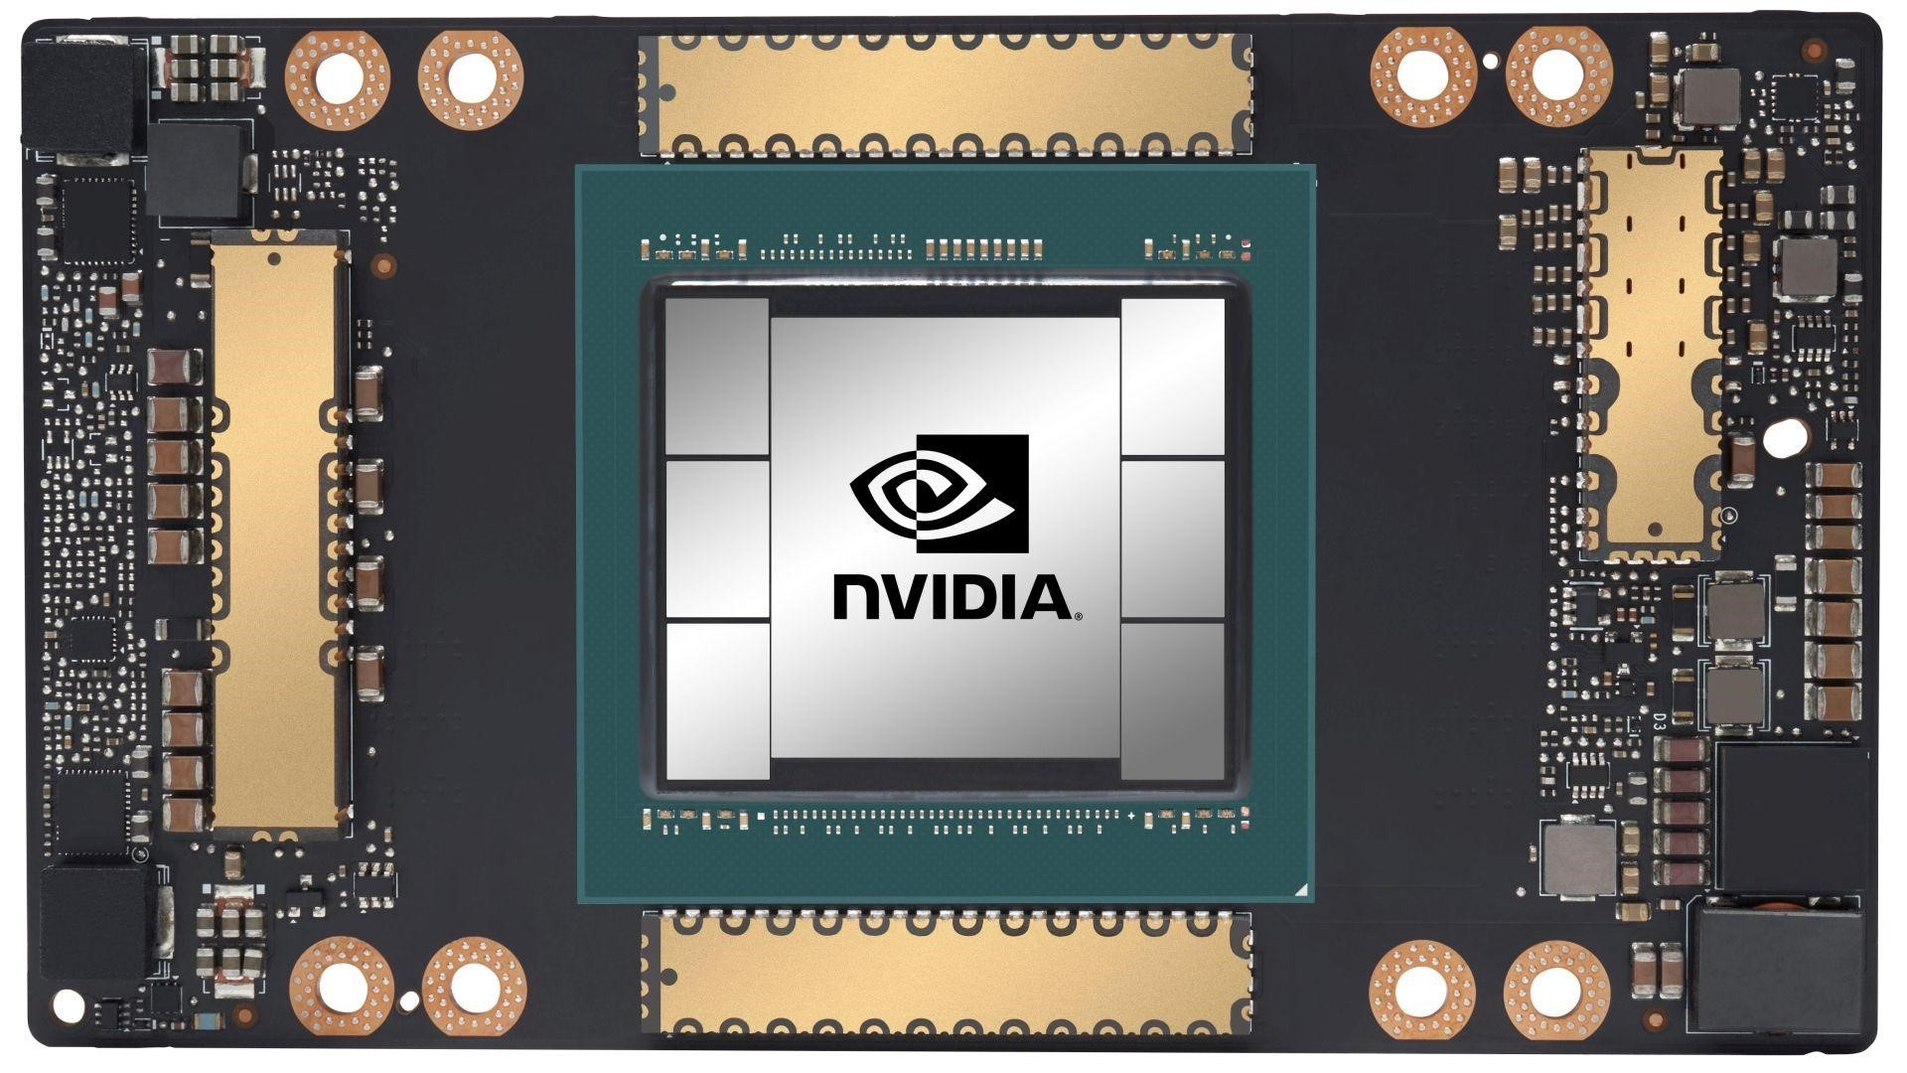
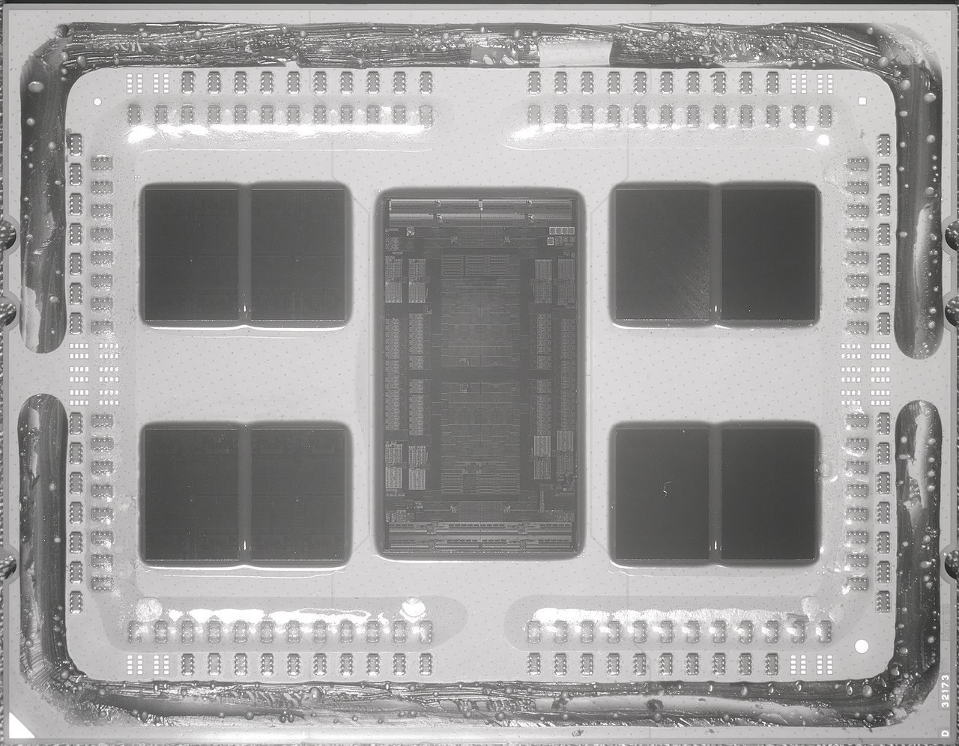
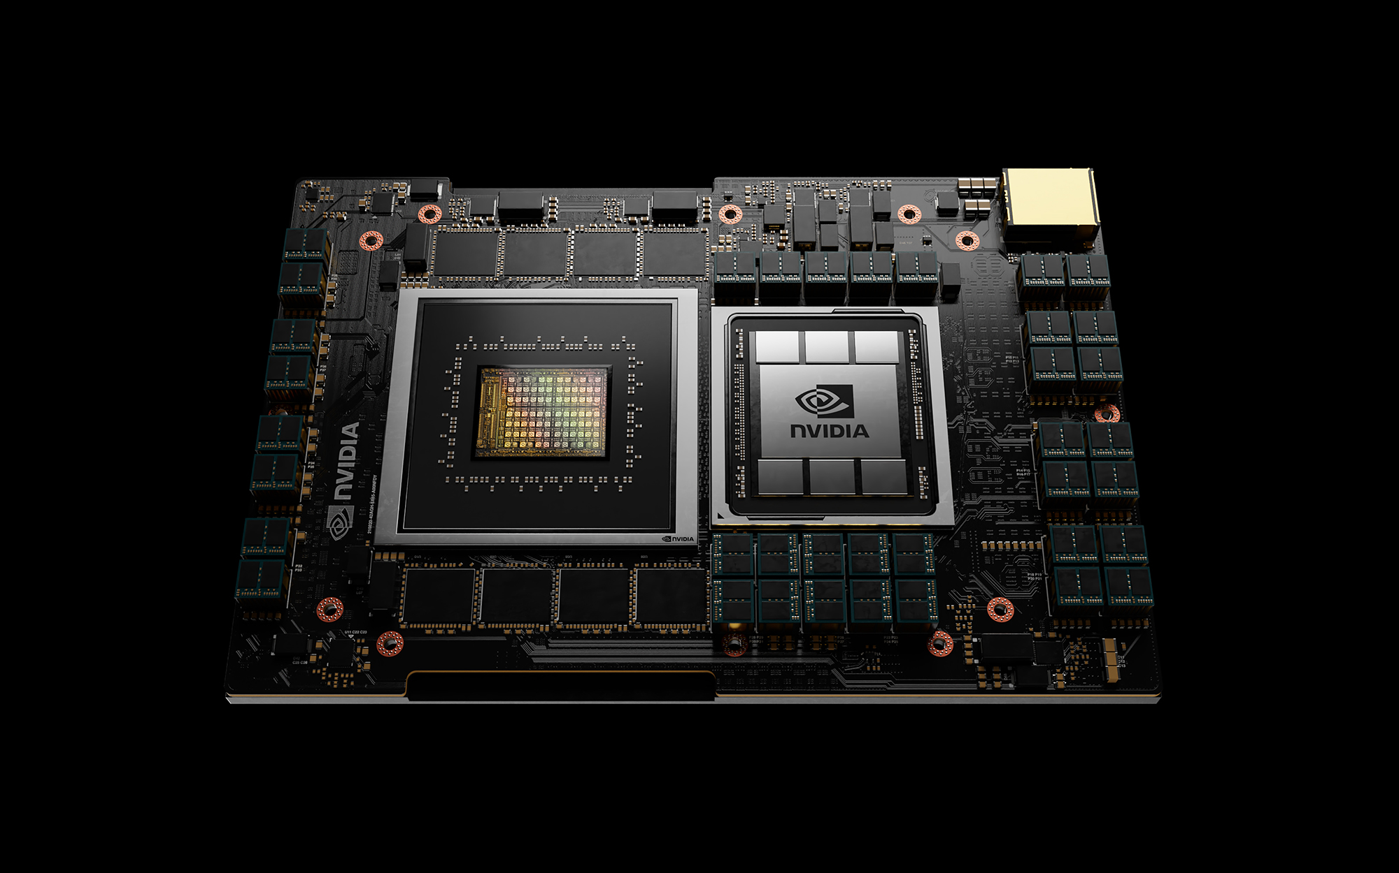
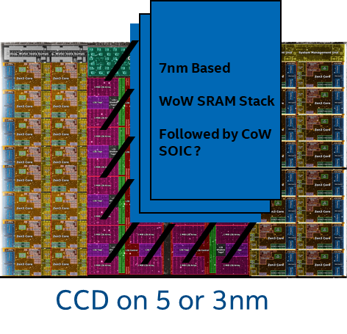
Server Product
INTEL
AMD
NVIDIA
Saphire Rapids + HBM
HBM Stack
HBM Stack
Cores, IO,
DDR Controllers,
HBM Controllers
DDR
DDR
HBM Stack
HBM Stack
SRAM on top of on-die SRAM
no power delivery or thermal degradation
Firmware support for 4 high – 2.3GB @ 16TB/s
More/higher BW HBMs
Interposer cost reduction
Opportunity for stacked SRAM/DRAMs
Higher stack count (12 high TSMC demo)
Lowest sram cost per bit, Low active power
Very low risk and incremental cost
More/higher BW HBMs on DMR
+
ADM/SRAM/DRAM cache on HCR
Nvidia have access to same TSMC tech for Grace CPU or follow-on

Slide 21
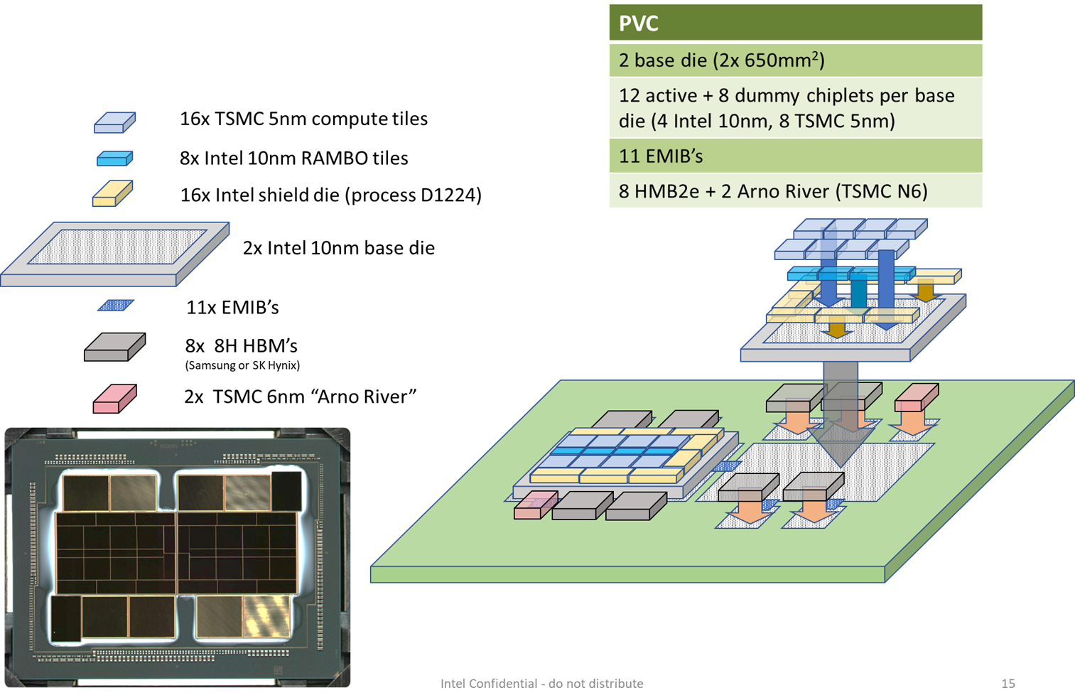
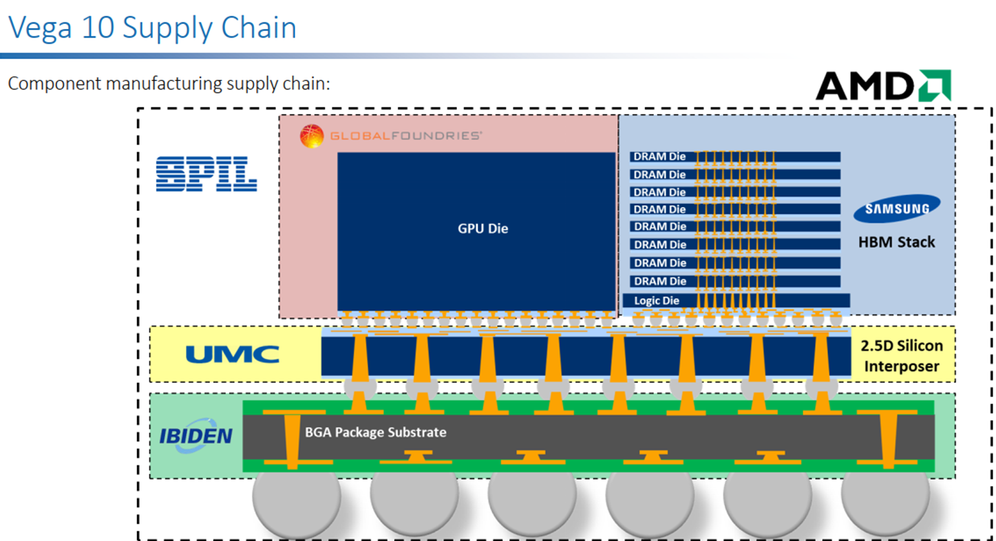
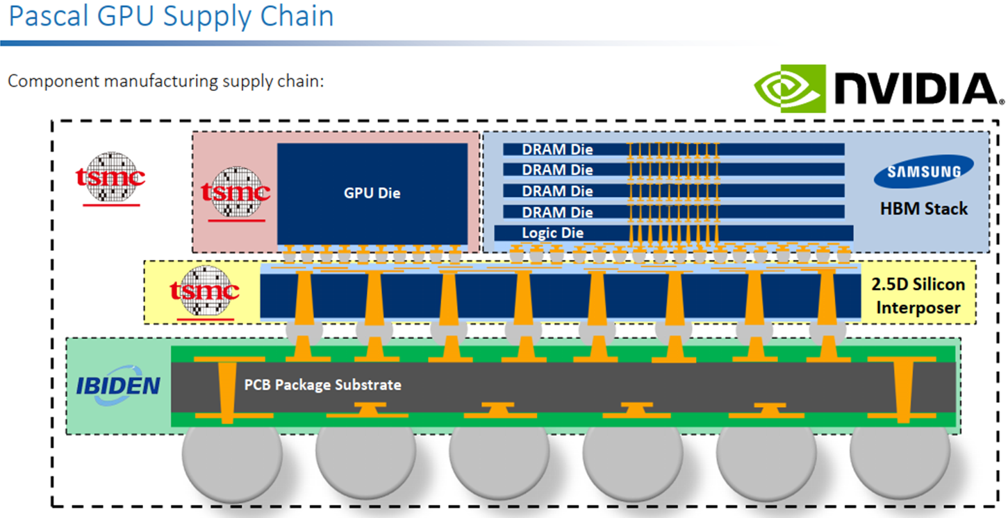
Discrete Graphics
INTEL
More/higher BW HBMs
Interposer cost reduction
Opportunity for stacked SRAM/DRAMs
More/higher BW HBMs
Interposer cost reduction
Opportunity for stacked SRAM/DRAMs
More/higher BW HBMs
+
ADM/SRAM/DRAM cache

Slide 22
Alternative Tech

Slide 23






Emerging Technology in Memory Pyramid
Access Device
Si channel planar / nonplanar XTOR
TFT channel planar / nonplanar XTOR
2T [independent read write] Option
High-k Capacitor
MRAM [STT/SOT]
Ferro-capacitor
Nanostructure change
Memory Element
In-Package Memory – Intel’s ADM is the leading low-latency alternative, but density is not competitive to bulk Si 1T1C solution
Samsung, Hynix and Micron have indications of monolithic 3DIC DRAM interest but no public disclosure.
low latency 1T-STTM technology requires large x’tor footprint or more advanced technology for high current bipolar operation.
1T-1FeCap, 1T-nFeCap, 1FeFET and 2T-0C gain-cell (IxZO class) in research stage. Long lead time is anticipated.
No near term alternatives to DRAM or ADM for TCM usage

Slide 24
Next Steps
Consistent with IDM 2.0 goals, take advantage of eco system capabilities where it offers advantages
Clearly document goal/requirements and realistic assumptions per segment vs time
Arch/SW studies to help guide integration direction
Better coordination of external engagements with common set of goal and requirements per segment
…

Slide 25
backup

Slide 26
Executive Summary
Embedded memory – 1T-STTM with low write cycle time and high endurances were demonstrated.
TSMC-16nm, Samsung-28nm, GF-22nm and IBM-14nm improves write speed (~10ns) and reliability (10⁶ to 10¹² cycles).
IBM-Samsung JDP demo write speed limit at 2nsec; Read disturb is problematic.
1T-STTM density is low; Samsung’s 28nm yields 12Mb/mm² (~Intel’s eDRAM circa ’12), shipping buffer memory in LCD display.
2T-SOT is still in deep research.
In-Package Memory – Intel’s ADM is the leading low-latency alternative, but density is not competitive to bulk Si 1T1C solution
Samsung, Hynix and Micron have indications of monolithic 3DIC DRAM interest but no public disclosure.
low latency 1T-STTM technology requires large x’tor footprint or more advanced technology for high current bipolar operation.
1T-1FeCap, 1T-nFeCap, 1FeFET and 2T-0C gain-cell (IxZO class) in research stage. Long lead time is anticipated.
3D XPoint – Intel is leading competitive landscape by 24~36 months (SLC, MLC and BiSM)
Hynix: Although several papers published in 2020~21, no new information disclosed since IEDM18 paper (a S15-like product).
Samsung remains silent; Macronix-IBM primarily worked on cell level research with limited array activities.
Micron ceased SXP & SSM TD on March 16, 2021, 2y8m after ending IM-JDP. Gen-2 production at Lehi, UT ends by the end of ’21.
Alternative technologies for PM / SCM are either in primitive research, missed product milestone or dropped out.
Fujitsu-Nantero’s 40nm selector-less NRAM: missed sampling milestone of low-latency product.
Sony’s 20nm OTS-select CBRAM: missed sampling milestone likely due to Cu-integration, sigma, drift & disturb.
Avalanche 1S-STTM demonstrated very high NL single cell data; still no array information; disturb, sigma are likely showstoppers.
Crossbar/SMIC FAAST-VO⁺ cell has been radio-silent since their new CEO visited Intel in 2019. Co-funder’s resume is on the street.
Bipolar RRAM, Unipolar CeRAM and FeFET (NAND string) are either dropped out or in early stage of research.
Flash Memory: SunRise 3D QVM (NOR flash), Macronix 3DANDFlash

Slide 27
Memory Architectures
Arch | Description | Companies
MRAM | Uses electron spin to store information; high-density, non-volatile, power efficient Challenges: Requires significant process integration to manufacture Status: Furthest along in development; Solutions already in the market (Everspin, Samsung, TSMC, GF) | Avalanche Escencia Everspin (IPOed) Spin Transfer Tech
RRAM | Changes the resistance across a dielectric solid-state material, non-volatile Challenges: Variability issues are proving to be difficult to overcome Status: Advertised as the ultimate scalable memory; Many RRAM companies trying to penetrate into the AI/ML market and worth with in-memory compute model | Crossbar Intrinsic NuMe ReBIT ReRAM Spin Memory
NRAM | Based on carbon nanotube technology for strong write-endurance, non-volatile Challenges: Have yet to deliver on promises Status: Have been around for 20+ years, Fujitsu announced to partner with Nantero to bring to market in 2019 | Nantero
FeRAM | Uses ferroelectric layer to achieve non-volatility, low power, fast write Challenges: Historically used materials that were difficult to integrate into FAB environment, lower storage densities than Flash Status: Advances made to use Hafnium Oxide to make more accessible for FAB environment | FerroElectric Memory
Other | SRAM NAND | Zeno (SRAM) Netlist Yangtze Memory Tech

Slide 28
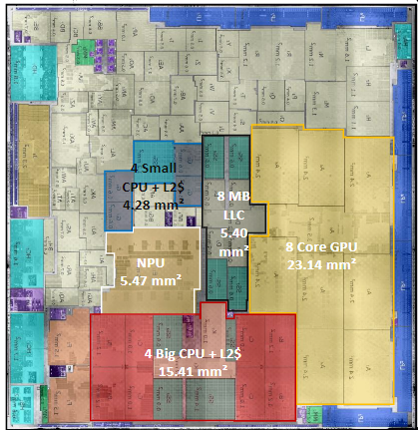
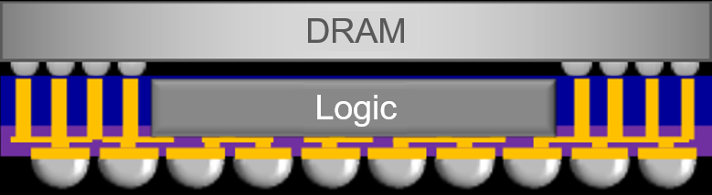
Client
CPU
SoC
GPU
I/O
ADM
MTL-P halo/ARL
INTEL
AMD
APPLE
 |  | Client Short/Med Term (2021-2023) |  |  |  |  |  |  |  |  | Client Long Term (2024-2026)
 |  | Intel |  |  | Competition 1 (Apple) |  |  | Competition 2 (AMD) |  |  | Intel |  |  | Competition 1 (Apple) |  |  | Competition 2 (AMD)
 |  | Low-Med Perf | Hi-Perf |  | Low-Med Perf | Hi-Perf |  | Low-Med Perf | Hi-Perf |  | Low-Med Perf | Hi-Perf |  | Low-Med Perf | Hi-Perf |  | Low-Med Perf | Hi-Perf
 | Likely Product Disagg/Config ==> | CPU,GPU, SoC, Base (P) | CPU,GPU, SoC, Base (A) |  | Monolithic XPU | Monolithic XPU |  | CCD, I/O | CCD, I/O |  | ? | ? |  | ? | ? |  | ? | ?
Memory Technology Option | Technology/Supplier Readiness
Traditional DDR | HVM Ready
On-Package (a.k.a LPDDRx); inc Info_B | HVM Ready |  |  |  | X (M1, 2) | M3: Info_B |  |  |  |  |  | X (LNL-M?) |  | M4: Info_B
In-Package 2.xD (a.k.a HBMx) | HVM since 2016; Adv HB enabled TBD |  |  |  |  | X (M2?) |  |  |  |  |  |  |  |  | M4?
In-Package 3D (in Interposer) | Intel ADM HVM ~ 2022+ |  | X (ARL) |  |  |  |  |  |  |  |  | ?
3D XPU/Memory (SRAM) HB enabled | HVM capable 2021+ (WoW); CoW TBD |  |  |  |  |  |  | CCD+SRAM (V-Cache) | CCD+SRAM (V-Cache:N) |  |  | ? |  |  |  |  | CCD+SRAM (V-Cache:N) | CCD+SRAM (V-Cache:N)
3D XPU/Memory (DRAM) HB enabled | HVM capable 2021+ (WoW); CoW TBD |  |  |  |  |  |  |  |  |  |  |  |  |  | M5? |  |  | SRAM/DRAM/CCD?
Disagg/Architecture & Memory: Inter-dependent
Apple → wider LPDDR interface to maintain BW growth

Slide 29
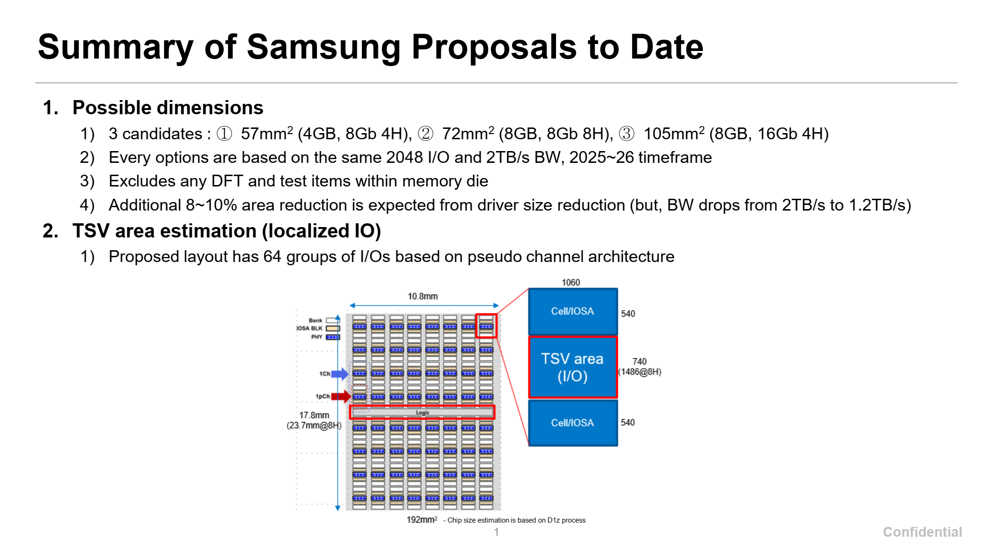

Slide 30
SK Hynix – DRAM interposer and HBW DRAM cube
#1. Mainstream/General Purpose Perf. Segment (Cache)
Bandwidth: 2.5 – 3 TB/s
Using SKH 128MB/128GB/s 9.9mm2 macro:
Need 24 macros for 3 TB/s
24 * 9.9 = ~240mm2
Capacity: 6 GB (Baseline)
Scalability option: 2x (12GB) to 4x (24GB) capacity at same bandwidth, additional cost
Using SKH 128MB/128GB/s 9.9mm2 macro:
Need 48 macros for 6GB →
Provide macro with different BW/capacity ratio. Ex. 256MB/128GB/s in 19.8mm2?
Construction Options
Compute area: ~1500mm2
Baseline 6GB DRAM area: ~480mm2
3x area delta , logic/DRAM will scale differently over time
Scalability option for 2x – 4x capacity?
Compute
Compute
Compute
Compute
DRAM Interposer
DRAM
DRAM
Option 1: Interposer
Use older/cheaper DRAM node?
Option 2: Intel ODI Packaging
Capacity | DRAM Area
6GB (1x) | ~480mm2
12GB (2x) | ~960mm2
24GB (4x) | ~1920mm2
DRAM
Compute
DRAM
Option 3: DRAM cube
With scalable height for capacity
Logic Interposer
Can we use the SK logic interposer without DRAM ?
Data shared under CNDA 30991112 & CNDA 112784

Slide 31
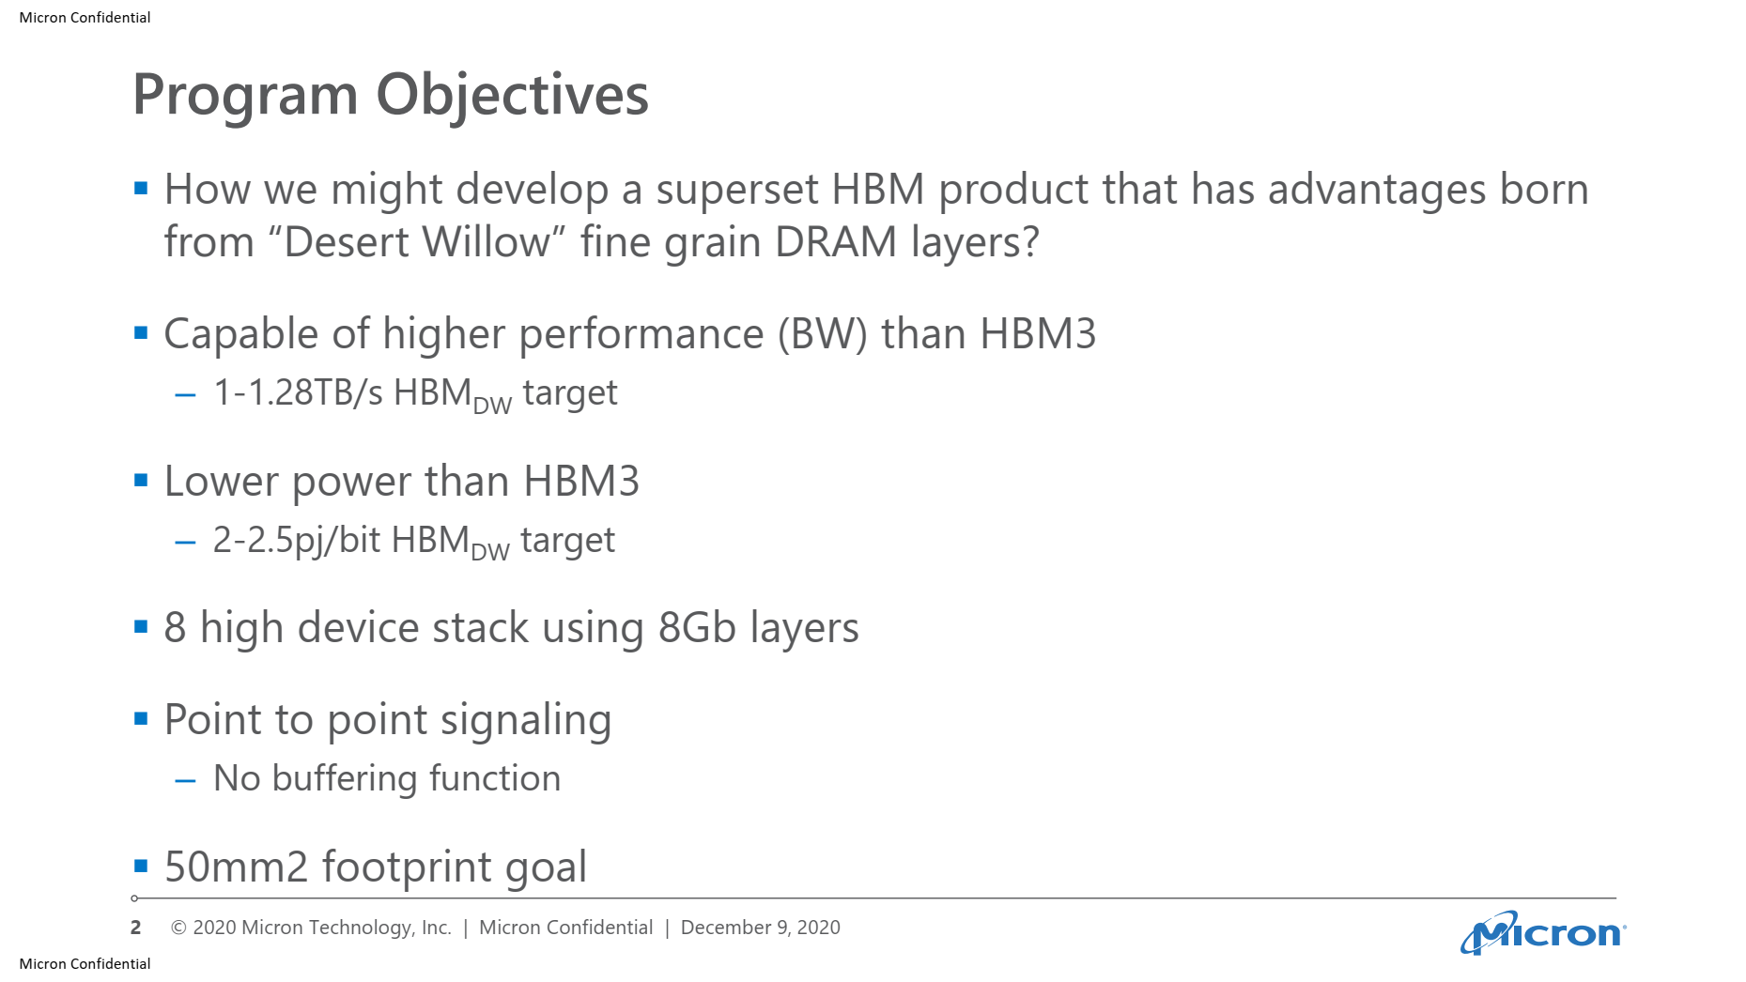
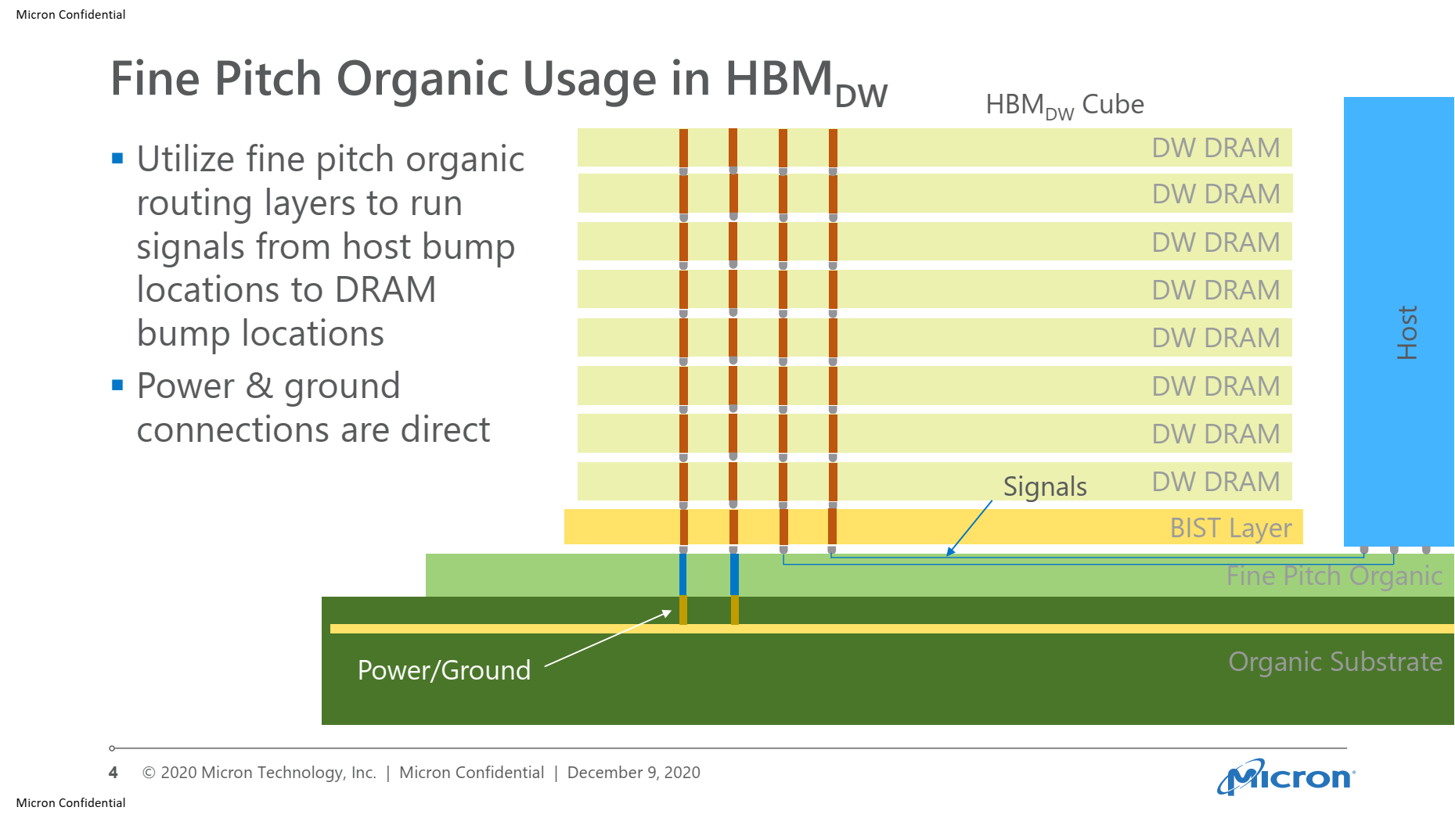
Micron Proposal

Slide 32
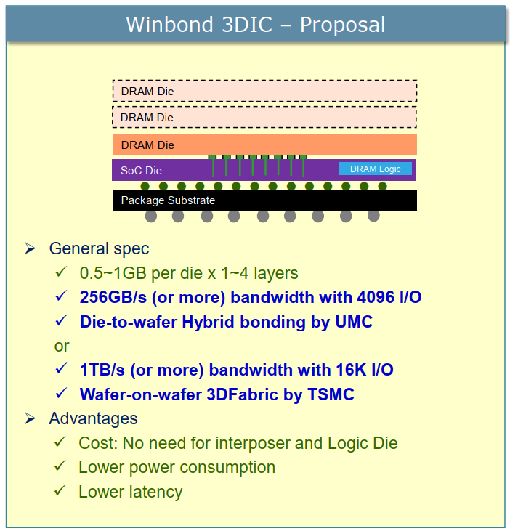
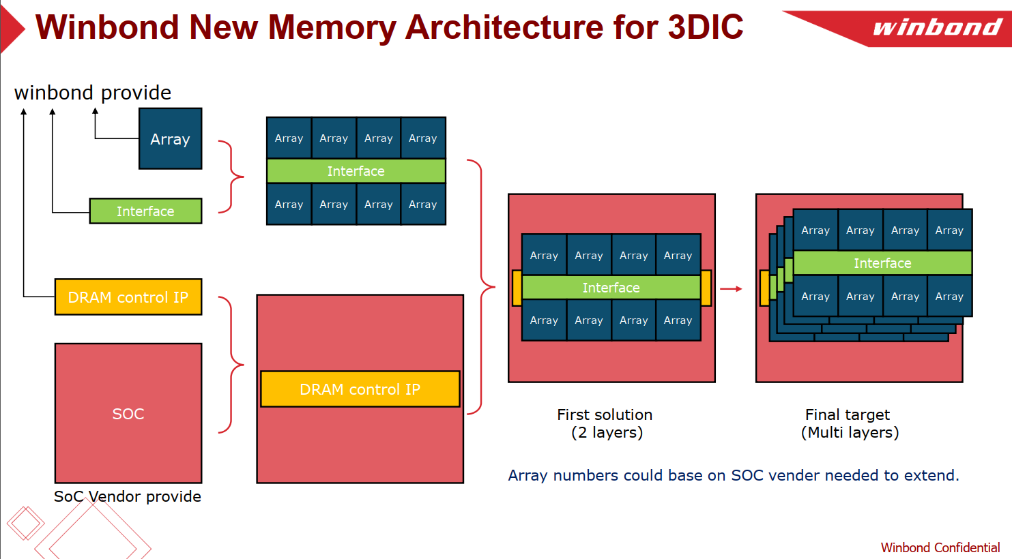
Parameter |  | unit | 3D DRAM 2Gb w/ ECC
 |  |  | Option 1 |  | Option 2 |  | Option 3 (Reference) |  | Option 3B
Process |  |  | D25s | D20 | D25s | D20 | D25s | D20 | D25s | D20
Size |  | mm^2 | 37.61 | 32.16 | 28.17 | 23.8 | 24.16 | 19.46 | 35.45 | 30.3
Size w/ bump pitch 25um |  | mm^2 |  |  |  |  |  |  | 33.93 | 28.83
Chip per wafers |  | est. | 1669 | 1952 | 2228 | 2637 | 2598 | 3225 | 1770 | 2071
Good Dies |  |  | 1418 | 1659 | 1894 | 2242 | 2208 | 2741 | 1505 | 1761
Stacked dies (layer) |  |  | 1 | 1 | 1 | 1 | 1 | 1 | 1 | 1
Channel (CH) # per Die |  |  | 16 | 16 | 8 | 8 | 8 | 8 | 4 | 4
Bank # per CH |  |  | 1 | 1 | 1 | 1 | 1 | 1 | 8 | 8
Memory per Die |  | MB | 256 | 256 | 256 | 256 | 256 | 256 | 256 | 256
Memory density |  | MB/mm^2 | 6.81 | 7.96 | 9.09 | 10.76 | 10.60 | 13.16 | 7.22 | 8.45
Memory per Channel |  | MB | 16 | 16 | 32 | 32 | 32 | 32 | 64 | 64
Peak Bandwidth* | per CH | Gbps | 256 | 256 | 256 | 256 | 128 | 128 | 256 | 256
 | per Die | Gbps | 4096 | 4096 | 2048 | 2048 | 1024 | 1024 | 1024 | 1024
 | per mm^2 | Gbps | 109 | 127 | 73 | 86 | 42 | 53 | 29 | 34
 | per 100 mm^2 | GB/s | 1361 | 1592 | 909 | 1076 | 530 | 658 | 361 | 422
Effective Bandwidth | per CH | GB/s | 2.8 | 2.8 | 2.8 | 2.8 | 1.4 | 1.4 | 22.8 | 22.8
 | per 1GB | GB/s | 182 | 182 | 91 | 91 | 46 | 46 | 364 | 364
 | per 100 mm^2 | GB/s | 121 | 142 | 81 | 96 | 47 | 58 | TBD | TBD
DQ I/O # | per CH |  | 512 | 512 | 512 | 512 | 64 | 64 | 128 | 128
 | per Die |  | 8192 | 8192 | 4096 | 4096 | 512 | 512 | 512 | 512
ECC IO # | per CH |  | 32 | 32 | 32 | 32 | 4 | 4 | 8 | 8
 | per Die |  | 512 | 512 | 256 | 256 | 32 | 32 | 32 | 32
Data Rate |  | Gbps | 0.5 | 0.5 | 0.5 | 0.5 | 2 | 2 | 2 | 2
Row Cycle time (tRC) |  | ns | 45 | 45 | 45 | 45 | 45 | 45 | 45 | 45
Memory core speed (tCCD) |  | ns | 4 | 4 | 4 | 4 | 4 | 4 | 4 | 4
Total Latency |  | ns | 21 | 21 | 21 | 21 | 21 | 21 | 21 | 21
Read Latency |  | nCK | 2 | 2 | 2 | 2 | 8 | 8 | 8 | 8
Access Time (RL + tAC) |  | ns | 9 | 9 | 9 | 9 | 9 | 9 | 9 | 9
* Under seamless read operation |  |  |  |  |  |  |  |  | * w/ Metal4

Slide 33
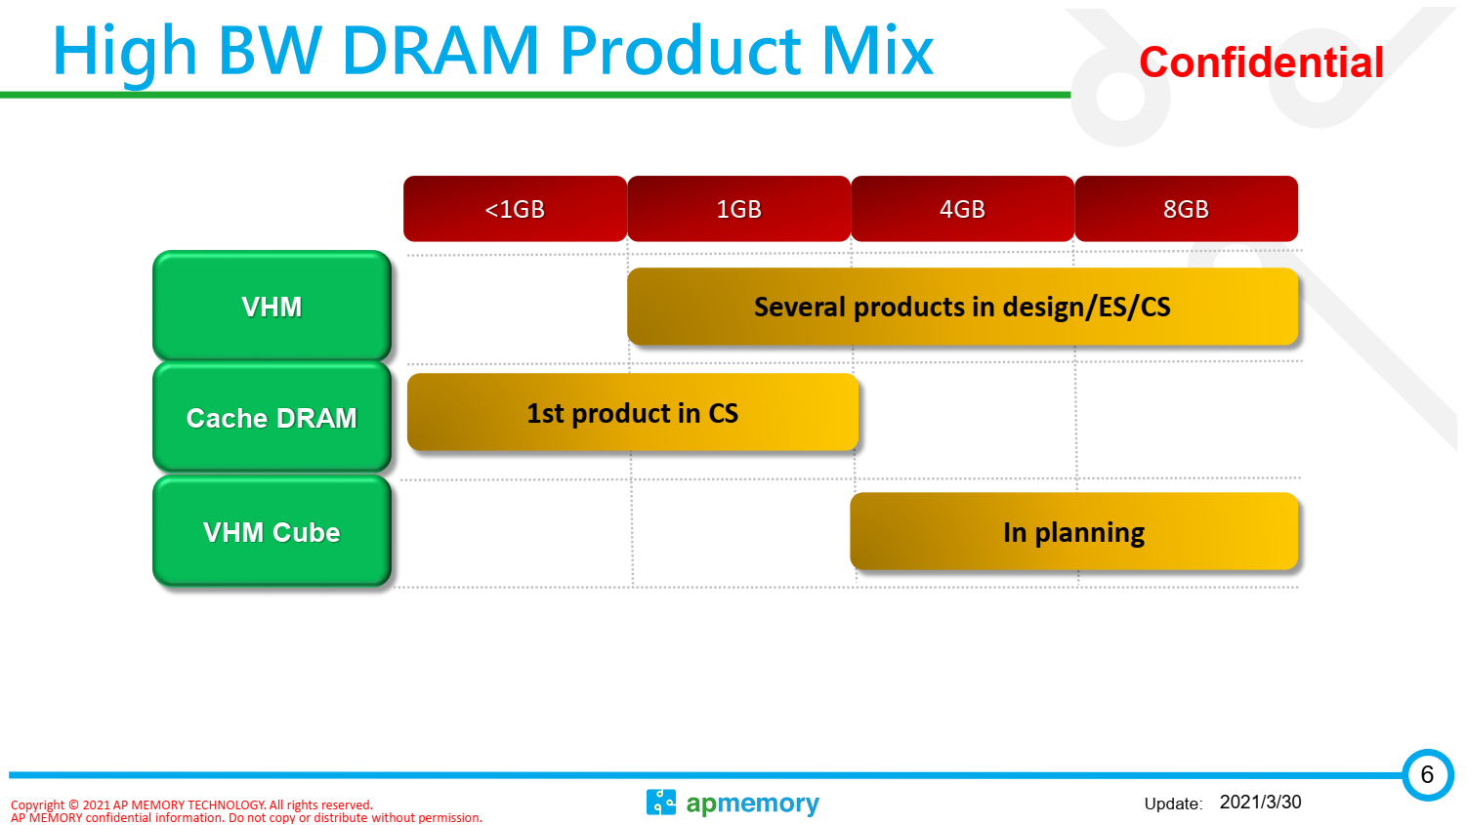
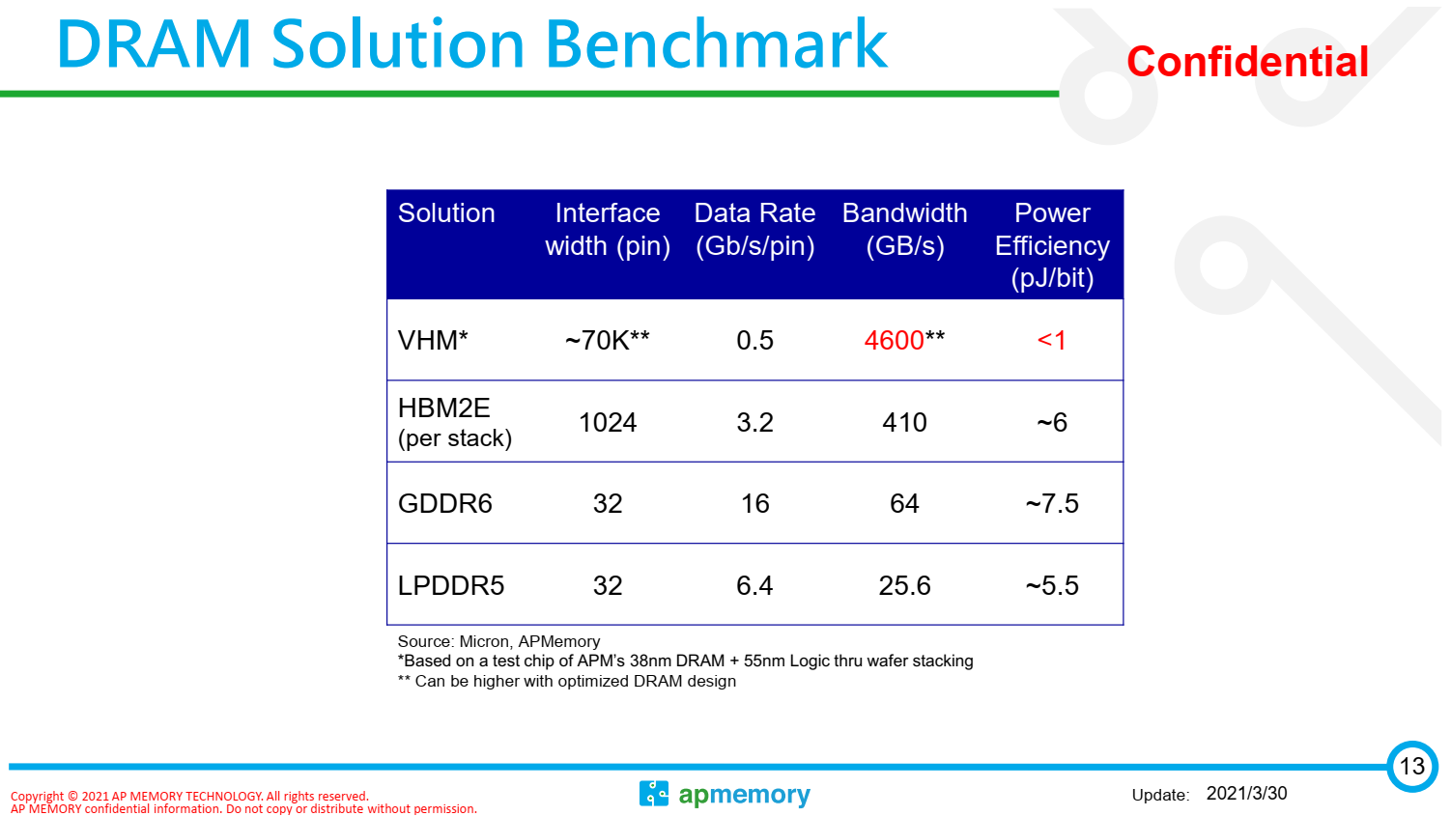
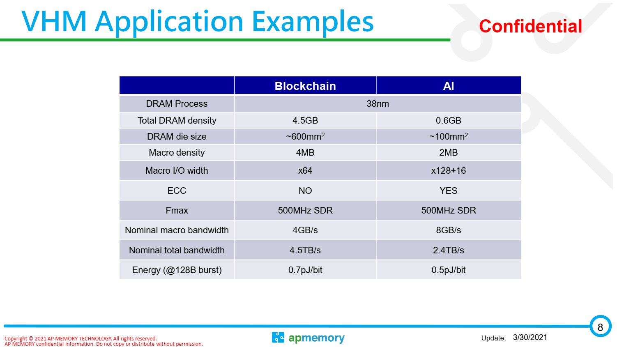
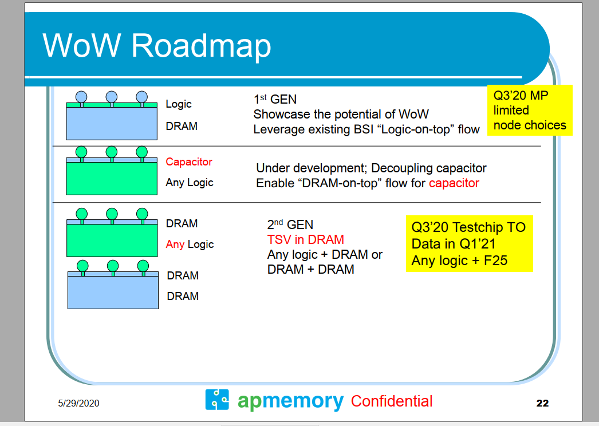
2020 Mar.: Hisilicion request the 600-700 uF capacitor and TSMC is working on Gen1 WoW solution, Gen1 DRAM also can replace by capacitor. Gen 1 now have two AI companys are working for that. Gen2 was request by a big design house and even Google intel also have highly interesting for that. Gen2 have better heating structure.
2021 Mar: 2-10 customer engagements

Slide 34
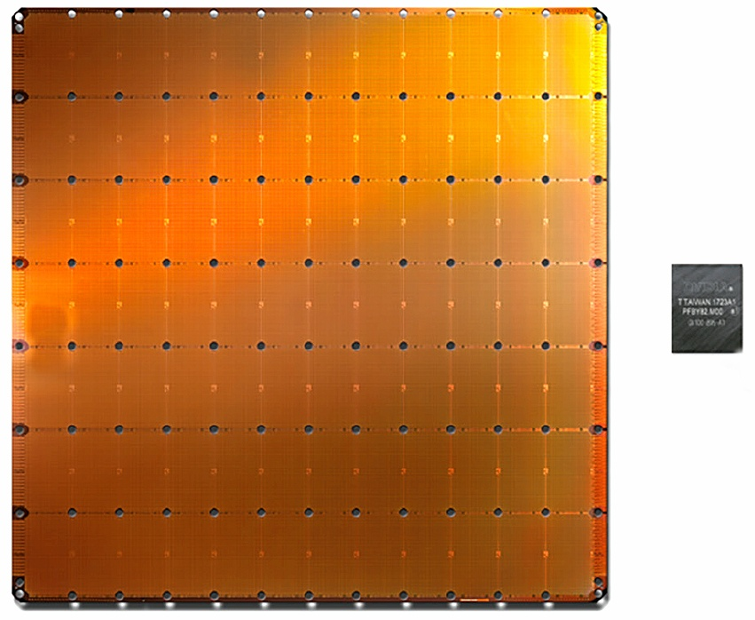
Cerebras Wafer Scale Engine for AI Compute
1.2 trillion transistors on single die (46,225mm²)
Packaged between heat spreader and power supply system
RDL used for interconnectivity within the wafer scale die and for power distribution

Slide 35
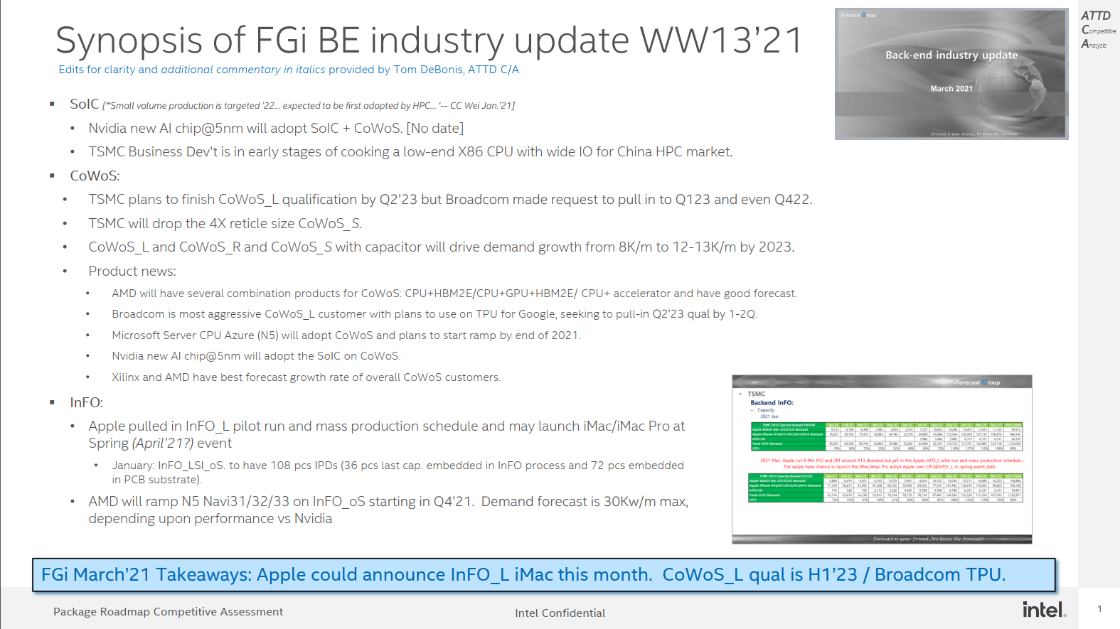

Slide 36
CoWoS • 2021 Mar.: Due to the CoWoS_L is getting more and more popular and will increase more flexibility for combination of different device and also can reduce the cost. So TSMC will drop the 4X reticle size CoWoS development. • 2021 Mar.: TSMC think the CoWoS_L and CoWoS_R and CoWoS with capacitor will let the CoWoS demand growth from 8k/M to 12-13K/m by 2023. • 2021 Mar.: The Broadcom is the most aggressive for CoWoS_L and plan to will use the TPU for Google to adopt the CoWoS_L,. TSMC plan to finish to finish qualification by Q223 and Broadcom request to pull in to Q123 and even Q422. • 2021 Mar. : The AMD will have several combination products for CoWoS CPU+HBM2E/CPU+GPU+HBM2E/ CPU+ accelerator and have good forecast in the coming. Now the AMD and Xilinix CoWoS have best forecast growth rate of overall customers. • 2021 Mar.: The Microsoft Server CPU for Azure@5nm will adopt CoWoS and plan to ramp up by end of 2021. • 2021 Mar.: The Nvidia new AI chip@5nm will adopt the SoIC on CoWoS

Slide 37
– InFO • 2021 Mar.: Apple cut 8-9M A12 and 2M around A13 demand but pill in the Apple InFO_L pilot run and mass production schedule…. • The Apple have chance to launch the iMac/iMac Pro adopt Apple own CPU@InFO _L in spring event date. • 2021 Mar.: AMD will ramp up the GPU@5nm Navu31/32/33 adopt the InFO_oS from Q421.Now total demand still forecast max is 30K/m but that will depe

Slide 38
y : – Backend 3D IC (WoW) : • 2021 Mar.: The TSMC BD (Business development) is cooking for low end X86 CPU with wide IO for high performance computing for China market due to China-USA trade conflict. But it’s in the early stage. – Backend InFO PTI • 2021 Mar.: The PTI have high possibility will give up the panel fan out due to PTI CTO was resign and now no specific owner to be in charge of the Panel fan out. But concentrate more resource for wafer base InFO and WoW. The PTI is working on the Sony CIS+ISP solution

Slide 39

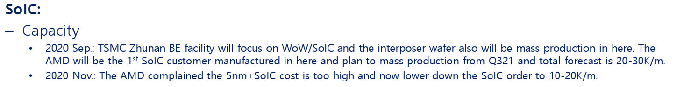

Slide 40
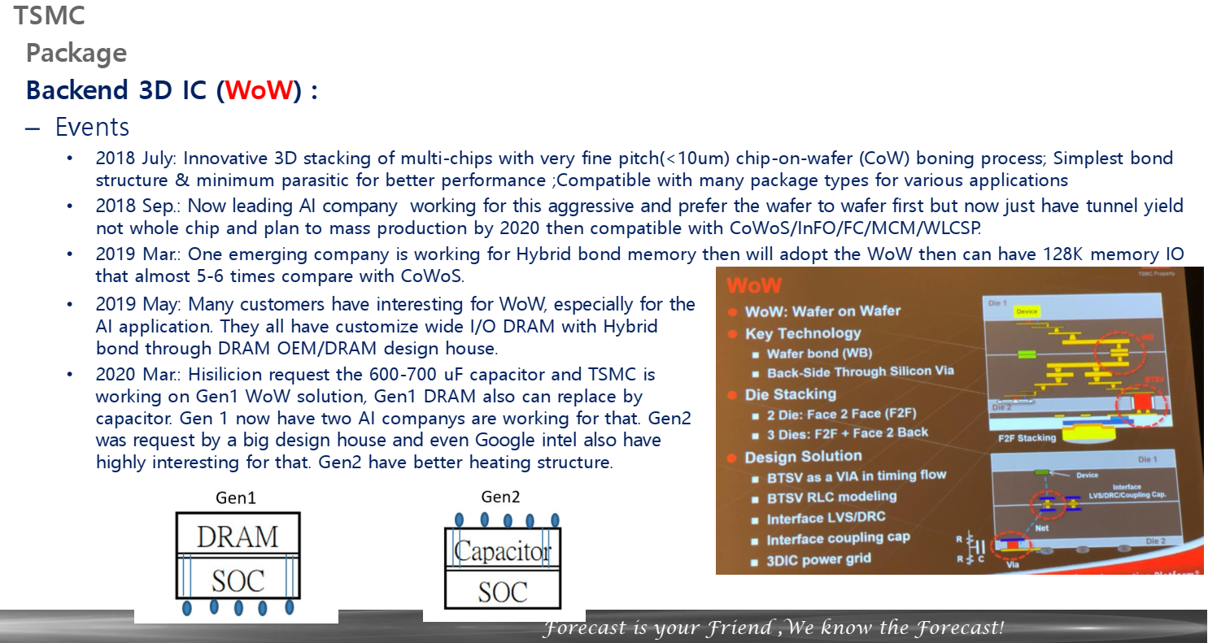
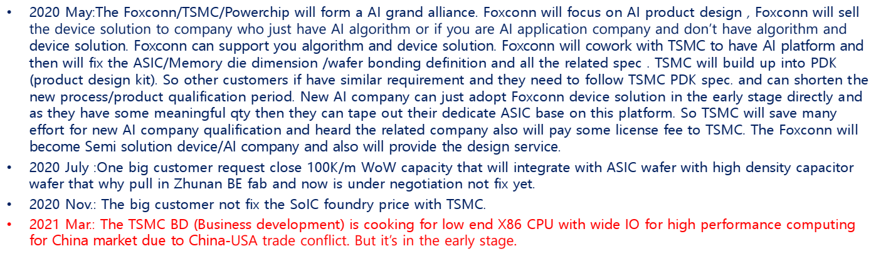

Slide 41
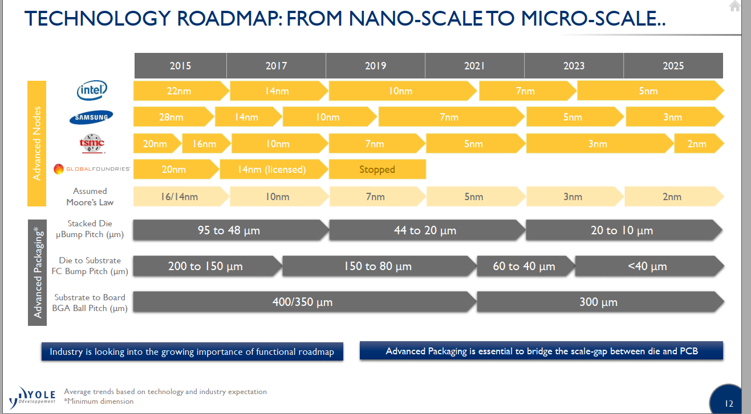

Slide 42
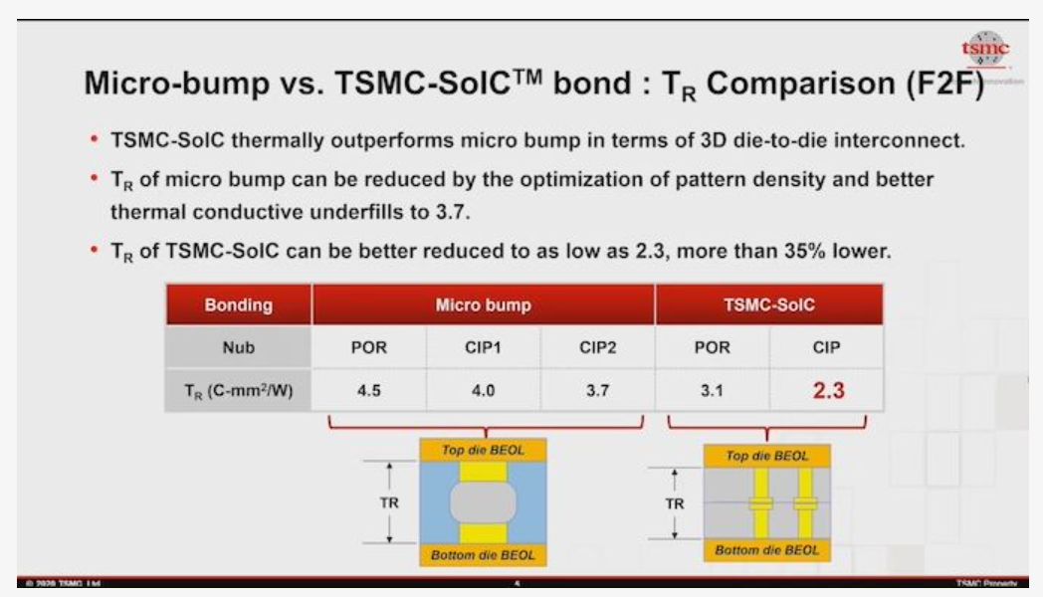
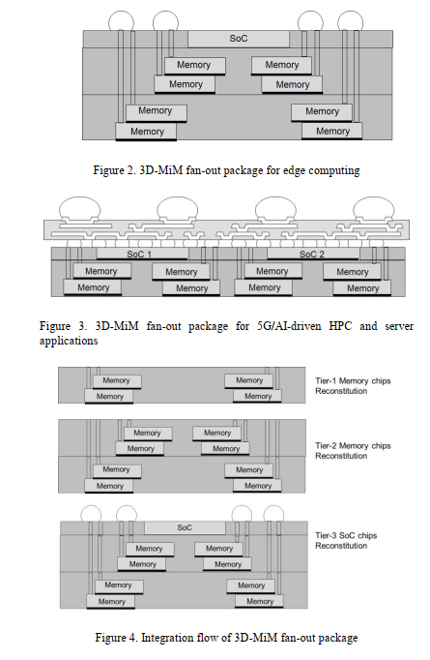

Slide 43
Mem On Top
Mem On Bottom
Adjacent
SRAM
ADM
DRAM
SRAM
ADM
DRAM
SRAM
ADM
DRAM
Intel
TSMC
Winbond
Samsung
SK
Samsung
AP Mem
Samsung
GF
New DRAM
AP Mem
Winbond
Micron
HBM
New DRAM
LP5
Custom GDDR
New DRAM
HBM
DRAM stacked on SRAM
7 permutations of DRAM adjacent to logic

Slide 44
Focus on taking advantage of each memory type with the best available interconnect tech.
Focus on TTM execution and quality
Per segment arch studies

Slide 45
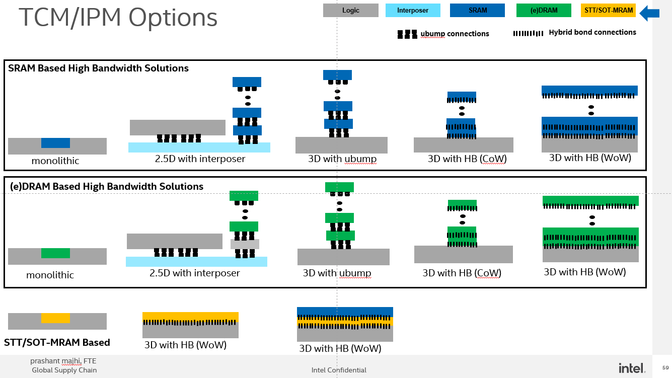
Samsung X-Cube
Samsung, GF
Samsung, GF
TSMC
TSMC
TSMC
IMEC, ARM
IMEC, ARM
Samsung, Micron, SKH
Samsung, Micron, SKH
Samsung, Micron, SKH
Winbond
Winbond
Winbond
AP Memory
AP Memory
AP Memory, Powerchip
TSMC
TSMC*
TSMC, Samsung, GF
TSMC
IMEC
Potential Foundry competitive offering
prashant majhi, FTE
* In pilot production status, unclear customer/node

Slide 46
Potential Foundry competitive offering
prashant majhi, FTE

Slide 47
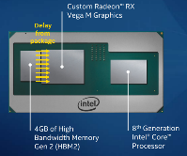
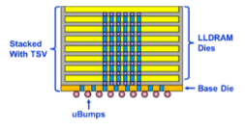


Performance Comparison of High Capacity Memories
SRAM
 | HBM3 (Samsung) | LL DRAM (Renesas) | ADM e-DRAM | SRAM
Bandwidth (GB/s) | 512 per 8GB | 288 per 4GB | >4000 per 1 GB | >8000 per 128 MB
Min capacity (GB) | 8 | 4 | 0.5 | <0.12
Density (GB/cm²) | 2 | 2 | 0.45 | ~0.29
Latency (ns) | 30 | 10 | 15 | 1.5
Energy (pJ/bit) | 4 | 3 | 0.4 (block-level) | 0.1 (block-level)
SRAM and e-DRAM need increased capacity while maintaining latency and BW to enable large model sizes (is it really doable)
Need to prepared to use each memory where it fits best instead of trying to come up with a “do it all” memory
(DDR, LPDDR, GDDR, RLDRAM, HBM, LLHBM, SRAM, eDRAM, ….)

Slide 48
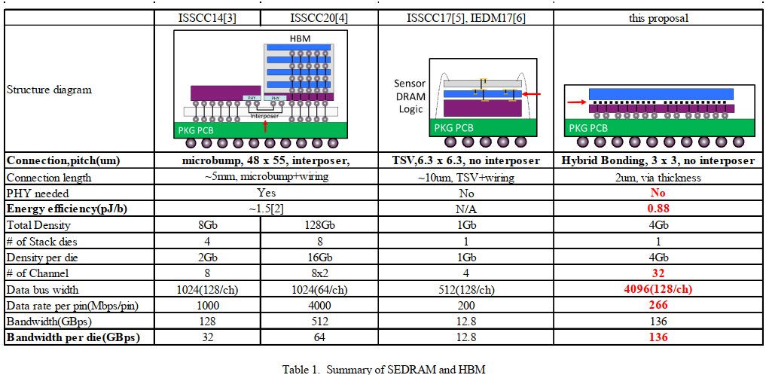


About C4 Bump
HBM1
HBM2E
SONY CMOS Imager
(IF Energy?)
475221
8Gb
(Interposer IF)
(HBI IF)
X-Sec Photo from the same paper
Die thickness is ~50um,
Easily to guess how much DRAM Stack uBump/TSV pitch would be?

Slide 49
Nvidia Grace CPU for AI and HPC
> 500 GB/s LPDDR5x
From EO’22

Slide 50


Slide 51
ECTC, vendors presented papers on the following technologies:
A*STAR devised a 10 x 10mm test chip with a 12µm pad pitch.
Fraunhofer demonstrated a 10μm hybrid bonding flow.
Imec devised a stacked face-to-face and back-to-back flow.
Intel taped out test chips, including a 10nm finFET.
Leti devised a path towards 5μm pitches with hybrid bonding.
Samsung demonstrated 3-stacked wafer bonding using hybrid bonding.
UMC showed a pre-bond qualification process for TSVs.
AMD is one of the early adopters here.
Starting in 2016, Sony began shipping CMOS image sensors using this technology
Hybrid bonding works the same way in packaging, but it’s more difficult. That’s why hybrid bonding for packaging has been stuck in R&D for years.
“The main challenges of this fine microbump interconnections come with bump coplanarity,” said Mu Hsuan Chan, a technical manager from Siliconware, part of ASE, in a presentation at ECTC. “Owing to finer solder volume on a much finer microbump pitch, solder is rapidly consumed after solder joint formation, and voids could form. The voids within the solder joint will deteriorate the solder joint reliability of the bumps.”

Slide 53
Key New Messages
Aggressive SRAM stacking and process optimization
Delivers highest performance at reasonable cost
AMD
Importance of distributed, not centralized memory
Tier 2/3 Taiwan dram foundry dram wafer available for WoW
Low wafer cost
High/very high bandwidth for architectures that can take advantage
Google AI, at least 2 more.
Aggressive packaging of commodity memory
Lowest cost per bit, adequate bandwidth

Slide 54
Summary of new memory technology
 | Density | Latency | Bandwidth | Cost | Source | Status | Scale req.
Stacked Sram | <20GB(16t) <5GB (4t) | Low | > PB/s | $20-$50/gb | Intel,tsmc,GF,UMC |  | low
Tier 1 stacked dram | <50GB | <Med | ? | > HBM | Micron, Samsung, skhyix |  | High
Foundry stacked dram | <10GB | Med | 1 to 10’s TB/s | $3 to $7 | Powerchip,Winbond, Nanya |  | Low
In package dram | >50GB | Med | <10TB/s | > HBM |  |  | High
On package dram | >100GB | Med | <10TB/s | commodity |  |  | Low to med
Edram (inc. ADM) | <5GB | Low |  | >>HBM |  |  | High*
STT/MRAM |  |  |  |  |  |  | Med
Research Level

Slide 55
Stacked SRAM
Cheapest cost per bit is in older nodes:
Intel 14nm
GF22nm
TSMC 6nm?
Stacking overcomes density limits and bitline length (latency/power)
Optimize process:
Limited metal layers (no global routing)
Limited transistor types (vt, voltage, etc.)
Remove unneeded masks
Hybrid of CoW and WoW minimize cost and gives integration flexibility
Mature and rapidly maturing process flow
Widely available foundry/tools/experience

Slide 56
Stacked Sram
Rough costs, green are estimates for sram optimized
Sram optimized: minimal metal layers, masks skipped
process | bitcell (u2) | wafer price | $/GB
"TSMC 5" | 0.021 | $ 14,000.00 | $ 53.45
TSMC 7 | 0.027 | $ 6,000.00 | $ 29.45
intel 14 | 0.05 | $ 2,000.00 | $ 18.18
GF28 | 0.11 | $ 1,000.00 | $ 20.00
GF14 | 0.064 | $ 4,000.00 | $ 46.54

Slide 57
Aggressive stacking
12 high and 22 high wafer stacks have been demonstrated
A process like 1272 can be thinned to under 1u per sram layer
5 metal layers + minimal silicon
WoW for yield and ability to aggressively thin
<$150 for wafer bonding, lower with optimization
(backup slide on cost, optimization, and design for yield)
 | 1272 | 1272 x4 | 1272 x8 | 1272 x16 | Samsung 1z DRAM
Bitcell u2 | 0.049 | 0.012 | 0.006 | 0.003 | 0.00197 u2
Density (chip) | 0.013 | 0.053 | 0.106 | 0.216 | 0.261 gb/mm

Slide 58

Aggressive stacking – WoW + CoW
AMD example
Theoretical Xeon example
WoW sram chiplet
CoW attach to back of CCD
1 cache chiplet stack per 4 xeon cores
L2 + L3 cache
16 cores (4 sram stacks) per chiplet
To handle HBI compound yield
Does not cover core – thermal/power

Slide 59


Slide 60
Distributed vs. Centralized
Centralized
Distributed
Location determined by address
Most accesses are distant
100W for 10TB/s global bw
Hard limit on global BW
Stacked Wafer can still be centralized if distribution by address
“affinity” between cache and data location
Cache can still be global/shared
Example policy
Data comes to cache segment closest to first requestor
100W -> 23W for same 10TB/s

Slide 61
Examples
Distributed
Centralized
AMD EPYC L3
With 4 high vchache:
288MB per 8 cores
250W (xeon like) -> 20W for 16 TB/s
Nvidia A100
8 way partitioned cache with affinity
Intel Xeon L2 cache
Cerebus
PVC
Xeon L3
All current AMD designs

Slide 62
Memory Roadmap for Apple M series
M1 Tonga Processor
LP4 4266 x64, 4ch, 877b(0.27bp)
Memory IO: LP4 x128 (2 * x64)
BW 68GB/s
Jade Processor, Lifuca dGPU
LP5 6400 x128, 8ch, 2406b(0.27bp)
ODP/16DP(8Gb), Mainly SK hynix
Memory IO: LP5 x512 (4 * 128)
Lifuca dGPU will use x256
BW 410GB/s
Rhode Processor, Lifuca dGPU
LP5 6400 x128, 8ch, 2406b(0.27bp)
ODP/16DP(8Gb)
Memory IO: LP5 x1024 (8 * 128)
Lifuca dGPU will use x512
BW 820GB/s
2020
2021
2022
2023+
M1
LP4 x64 4266
877b, 0.27bp
M2
LP5 x128 6400
2406b, 0.27bp
M3
LP5 x128 6400/7500?
2406b, 0.27bp
M4+
LP5x 0.25bp or less

