Slide 1
Eco System
Competitive Capability for TCM/IPM
Sponsor: Carolyn Duran
WG: Prashant Majhi, Stephen Morein, Tomishima Shigeki, Derchang Kau, Kuljit Bains, Melik Isbara

Slide 2
Agenda
Tightly coupled memory (TCM) options
Integration eco system capabilities
Memory eco system capabilities and Intel engagements
Eco system capabilities to competition mapping
Other Considerations
  Arch options (centralized vs distributed)
  Power and thermals
  Supply chain and business model
Next Steps

Slide 3
Tightly Couple Memory Options
Integration types and vendors
  2.5D – memory (mono or 3D stacked) on the side – OSATs, TSMC, Samsung, Intel
  3D stacked – memory (mono or 3D stacked) on the bottom or on the top – Tier 1 DRAM vendors, TSMC, Intel, XMC (memory wafer supply from non-domestic vendors are not likely), UMC
Memory types and vendor:
  SRAM: Intel, TSMC, Global Foundries (GF), Samsung
  DRAM:
    Tier 1: Samsung, SK Hynix, Micron with active TCM programs
    Tier 2: Winbond, Powerchip with active TCM programs, Nanya with likely active TCM programs
    Tier 2(with Tier 1 potential): CXMT with no known TCM programs
  ADM/eDRAM – Intel
  eDRAM – IBM/GF – GF process RM limitation
  STT/MRAM – TSMC, Samsung, GF
  Alternative technologies – Multiple in research/development phases
Memory usage model/architecture options
  Centralized or distributed
Large possible # of combinations across architecture, integration, memory type and vendors
Goals and requirements can narrow down feasible combinations

Slide 4
Integration Options

Slide 5
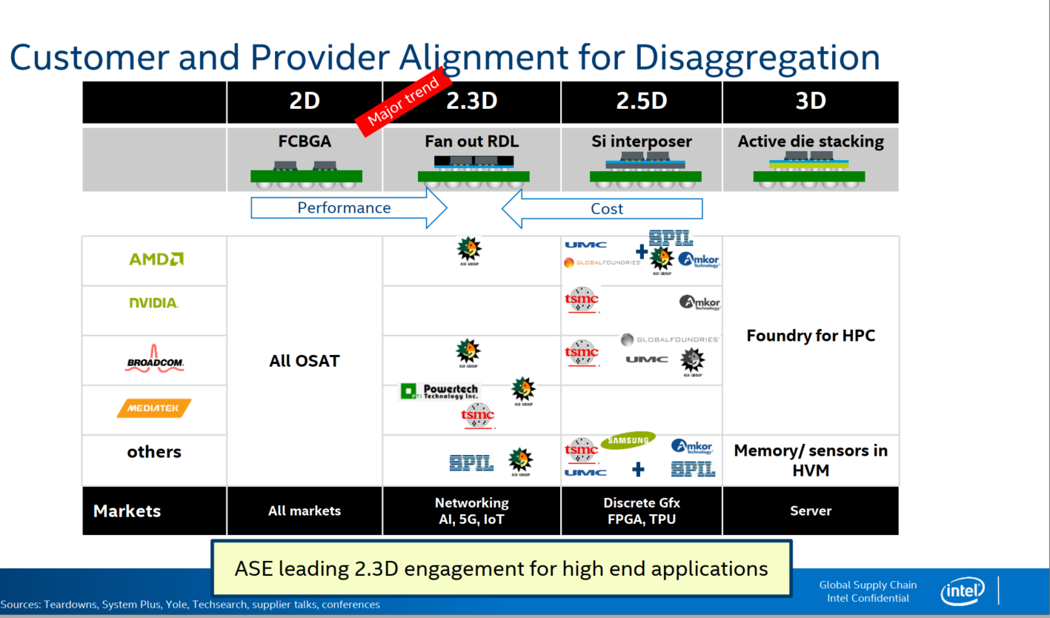
TSMC, Samsung
Intel, XMC, UMC
3D capabilities are consolidated and accessible to all competition,
volume/TTM will be favored by vendors

Slide 6
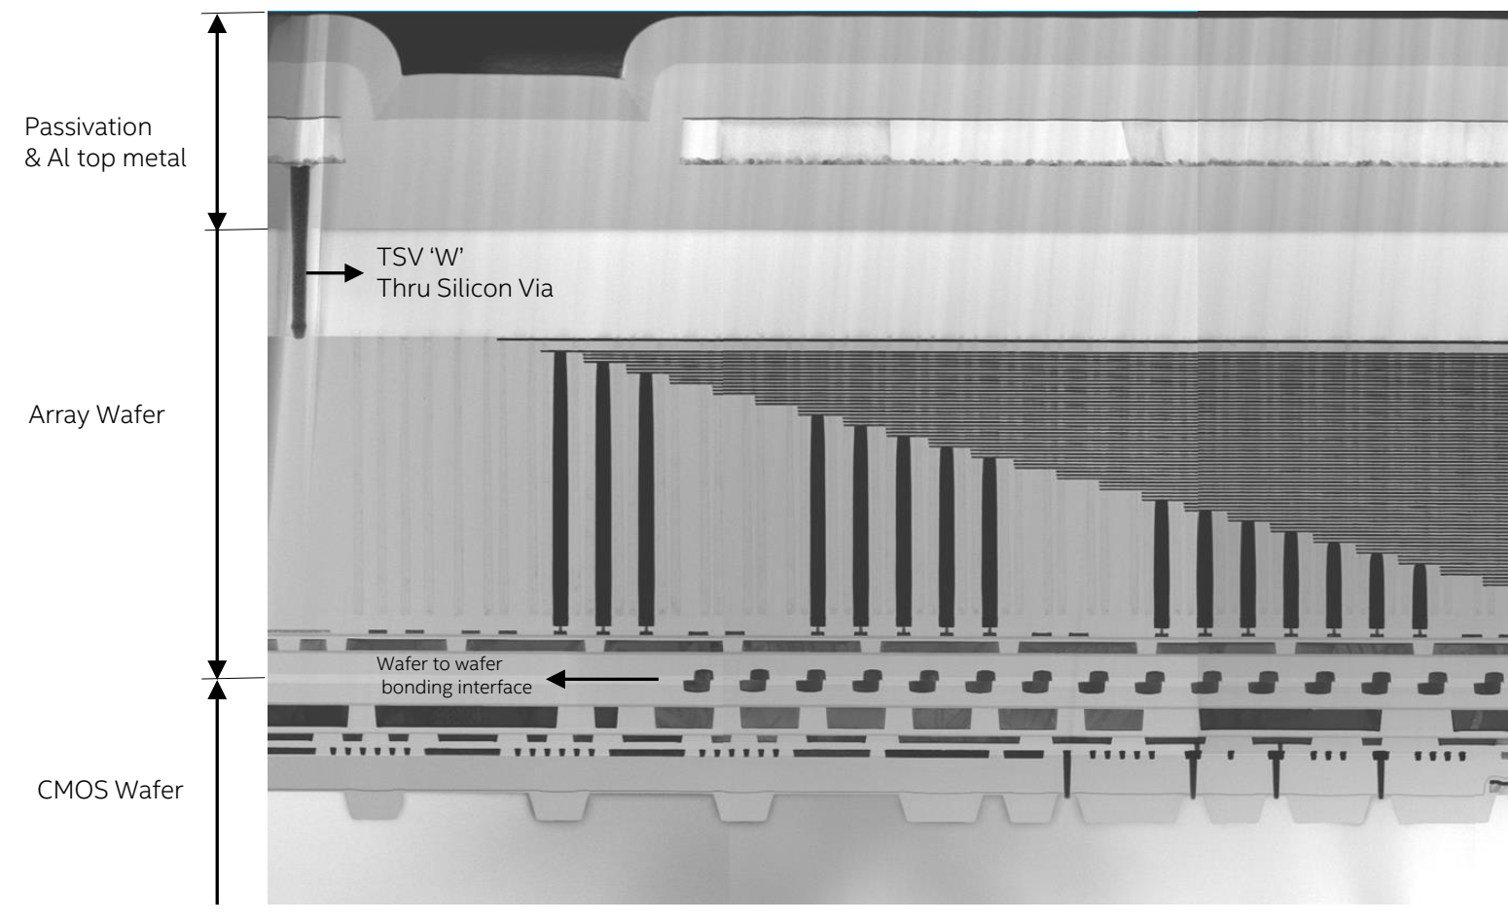
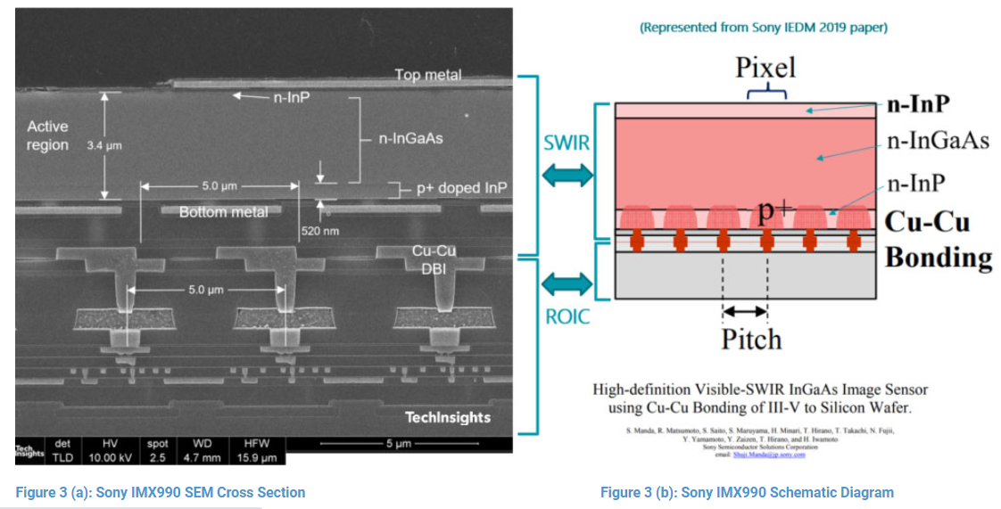
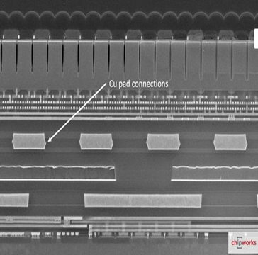
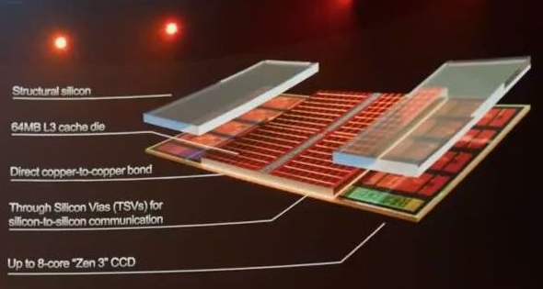
Bonding Landscape: R&D and HVM [Q2’2021]
C or W
Monolithic 3D
C or W
NMOS/PMOS
disagg
Hybrid Bonding HB [WoW]
Hybrid Bonding [CoW, CoC]
CMOS/Interconnect
disagg
SRAM or DRAM
Array/Peri Disagg
uBump [CoW]
Std Cell IP Disagg
CPU/Cache Disagg
Connections/mm²
YMTC 3DNAND
[WoW]
TSMC SOIC [CoW, WoW]
Hybrid Bonding (HB) in HVM
Global Foundry [WoW]
HB R&D [TD Path Validation]
CIS [WoW]
HB R&D [Concept/ Early Research]
SenSWIR Sensor Sony [CoW]
CIS [WoW]
DRAM HBM/3DS [CoC, WoW];
eFlash-Logic [WoW]
AMD V-Cache
SOIC [CoW]
Current 2.5D/3D products
Samsung claims competitive offering as other foundries
WoW HB in Production for several years
Sony image sensors since 2016
YMTC 3D NAND since 2020
CoW HB started Production
Sony SWIR Sensor, 2021
AMD V-Cache end of 2021
Pitch (um)
Hybrid Bonding (HB) in HVM for image sensors and 3DNAND
Getting to HVM for HPC at TSMC

Slide 7
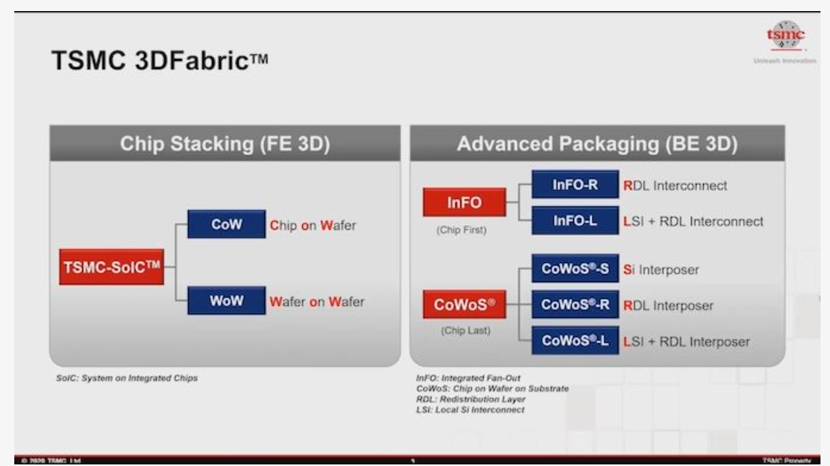
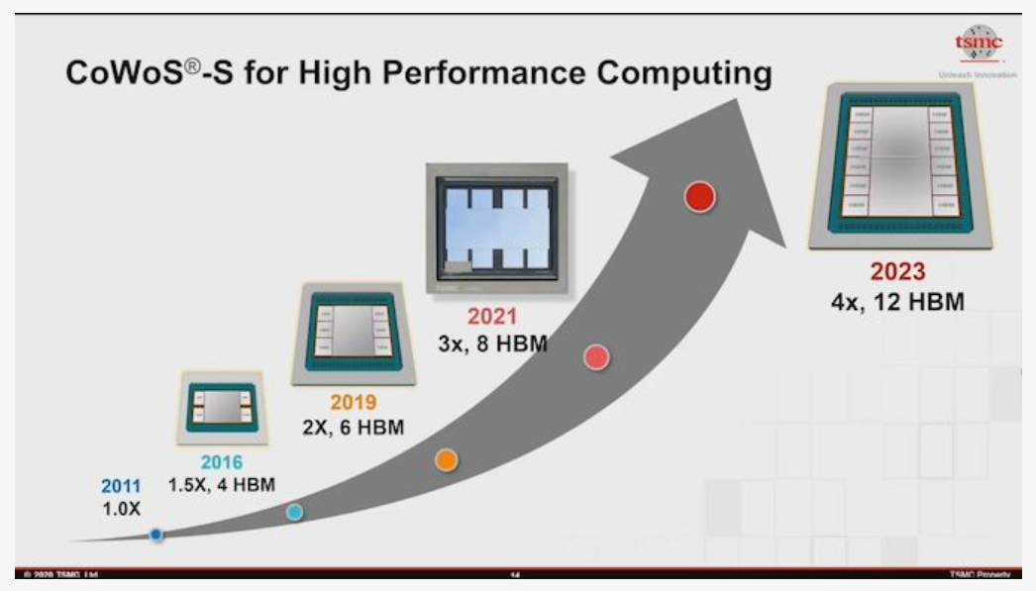
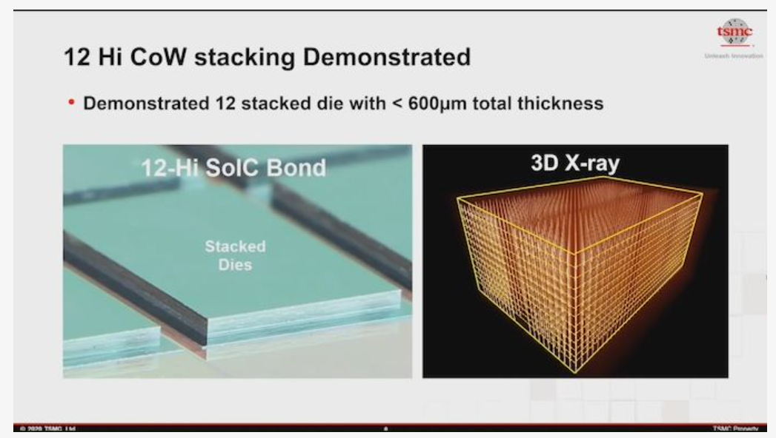
All competition have access to TSMC portfolio
though existing foundry relationships
Source: TSMC

Slide 8
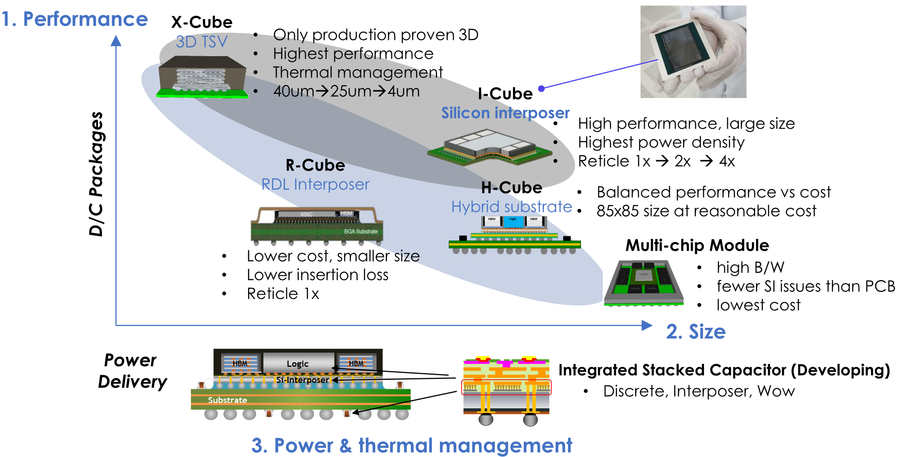
Samsung’s Cube Package Options for Foundry Customers
I-Cube (silicon interposer) offered with OSAT
X-Cube is developed internally
R-Cube will be developed with OSAT
E-Cube (embedded bridge) will be offered using the panel line for the embedding of bridge chip
X-cube SRAM stacking: TSV based HVM ready, HB qual target EO ‘22 < 4nm (logic on top of SRAM)
Source: Samsung

Slide 9
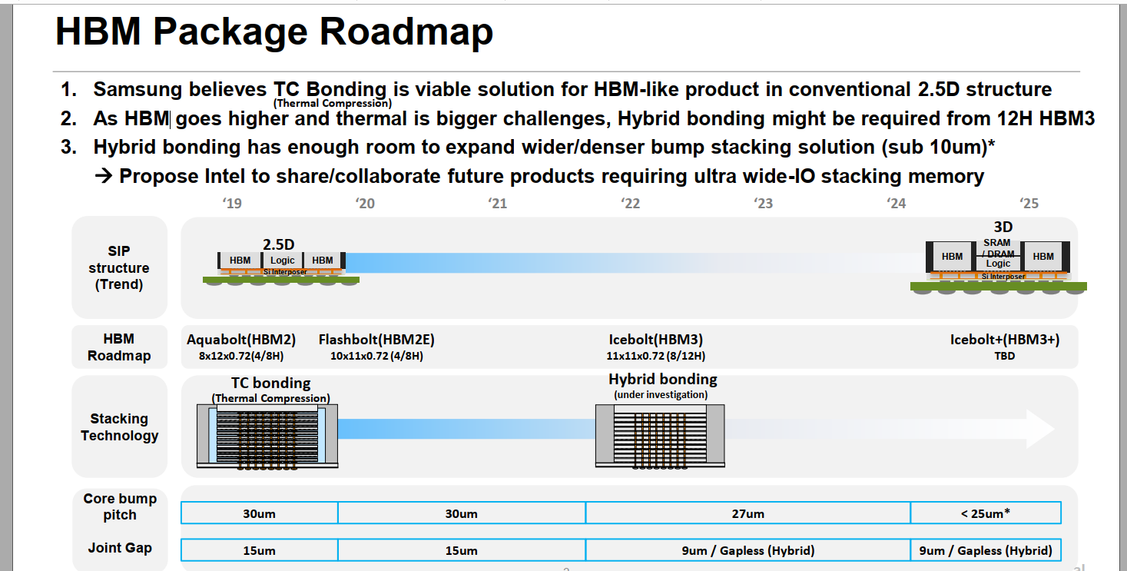
Samsung demo’ed 3H wafer bonding using HB @ ECTC
*Need test method/tech for fine pitch HB wafer for KGD
Samsung and SKHynix targeting HB intercept with HBM within next few years*
Source: Samsung

Slide 10

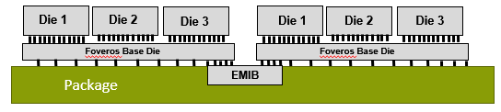
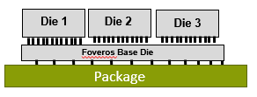
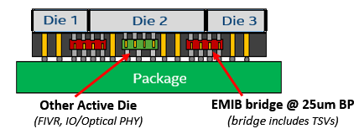
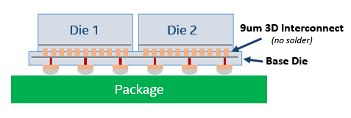
ATTD Advanced Packaging Architecture Portfolio
EMIB
Die to Die connection
on advanced package with EMIB
CoEMIB
Die to Die connection
With EMIB and Foveros
Foveros
Die to Die connection
On Active/Passive Silicon Base Die
Foveros Omni (ODI)
Die to Die connection via bridge in ODI complex.
Can also enable 3D Active Die connection
(Bridge can include TSV)
Foveros Ultra (HBI)
Die to Die solder less connection
On Silicon Base Die at <10um bump pitch

Slide 11
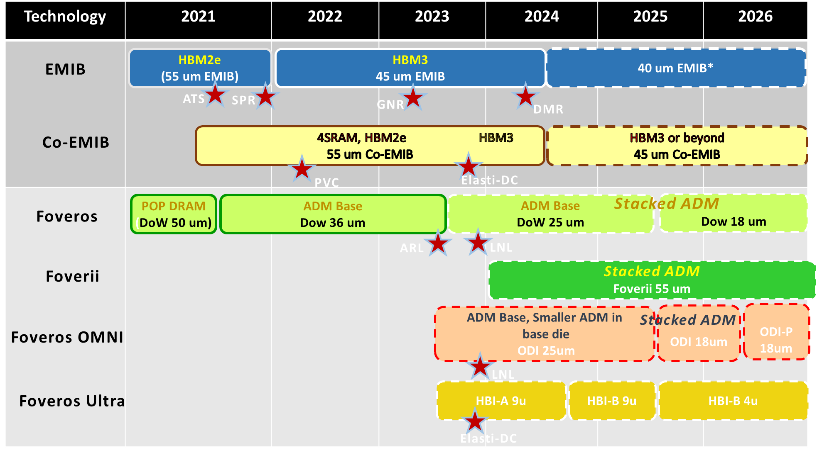
IPM Alignment with Packaging Architectures
ATTD POR
(Product Aligned)
Left Edge
HVM Ready
Directional Technology (No products Aligned))
No HBM on GNR,
DMR schedule TBD
Elasti schedule is not the latest
No ADM on LNL
No ADM on LNL
UBMC: Tech enabling test chip – WoW F2F HBI w/ 2H ADM on 1222 base die under development

Slide 12
DRAM Vendor Capabilities and Intel Engagements

Slide 13
DRAM vendor TCM engagements and scope
Company | Scope | Current supplier proposals
Samsung | TCM for future products | 4-8GB, 2TB/s (HBM like 4-8 H stacks), ~50-100mm2 @ 2025-6, 1b/c, or vault style arch where every ch is a die.
SK Hynix | Custom DRAM Si interposer and high BW DRAM | 6GB, 2.5-3TB/s (stackable for capacity) ~480mm2
Micron | High BW stacked DRAM | 8GB, 1-1.28TB/s (8H HBM like w/o logic die) ~50mm2
Winbond | High BW stacked DRAM | 0.256GB/die 128-512GB/s (stackable up to 4) ~20-30mm2/die
AP Mem w/ Powerchip | cDRAM – Cache DRAM, low capacity, high BW VHM – Very high BW memory | 0.6-4.5GB, 2.4-4.5TB/s ~100-600mm2 @ 38nm Products going into production @ ~25nm
Variations due to differences in assumptions (mono vs stacked DRAM, …), BW vs density optimization and process nodes
  Clear separation of T1 vs T2
  WB, AP, SKH mono - S1, S3 4H - S2, M 8H
  BW vs density optimization
  TSV overhead
All DRAM companies can offer similar BW and capacity
@ die size dependent on process node capability
Common goals and requirements should guide these engagements
Includes 4/8H TSV overhead

Slide 14
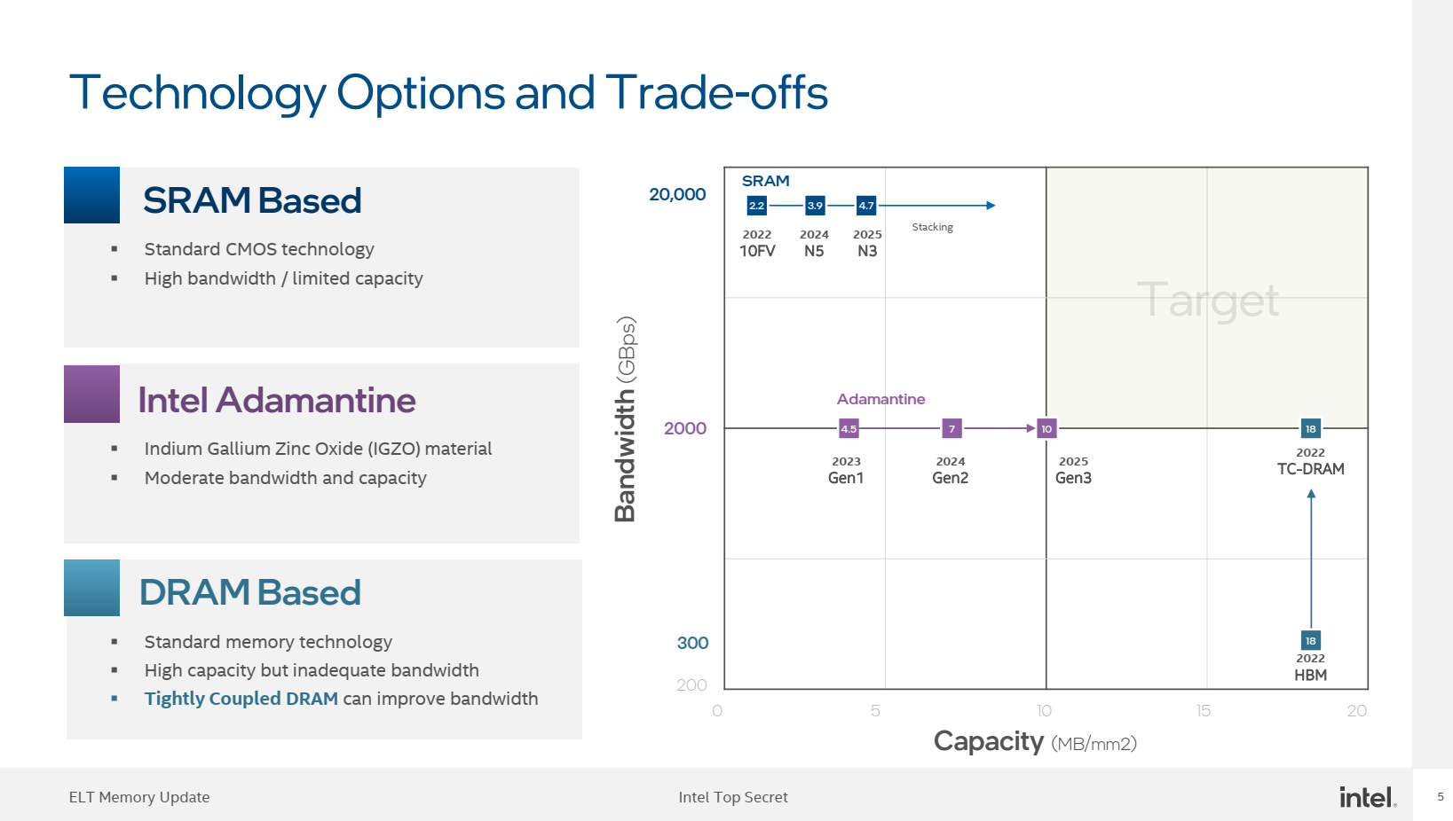
With NxSRAM Stacking
N7:2021;
N5:2022
Tier-1 3DIC [HB]
Tier-2 3DIC [HB]

Slide 15
DRAM Vendor Considerations
Tier 1
  IPM trend and mitigating scaling challenges motivates them for deeper pathfinding collaborations
  Custom product commitments will require volume guarantees, NRE, and alignment on any process customization
  Existing product collaborations with AMD/Nvidia on HBM (SKH collaborating with TSMC on logic-DRAM stacking)
  Existing product collaboration with Apple on custom LPDDR packages (Micron – Apple collab for a custom HBM?)
Tier 2
  Willingness and flexibility to collaborate. Lots of focus and excitement in TWN around “AI memory”
  Limited DRAM RM and capability
    Nanya: 1Ynm (most adv in TWN) foundry Business with 2Znm.
    Winbond: Main production is at ~2Ynm (2X/3Z tier 1 equivalent).
    Both Nanya and Winbond required a lot of handholding to deliver spec compliant standard parts
    PWC: DRAM foundry at 38/25nm, roadmap to 20nm.
    CXMT: Currently at 19nm (40KW/m). 17nm ramp from Q4’21. Potential to join Tier 1 in a few years
Product commitment with Tier 2 partners will require heavy hand holding and risk management

Slide 16
Architecture Options

Slide 17
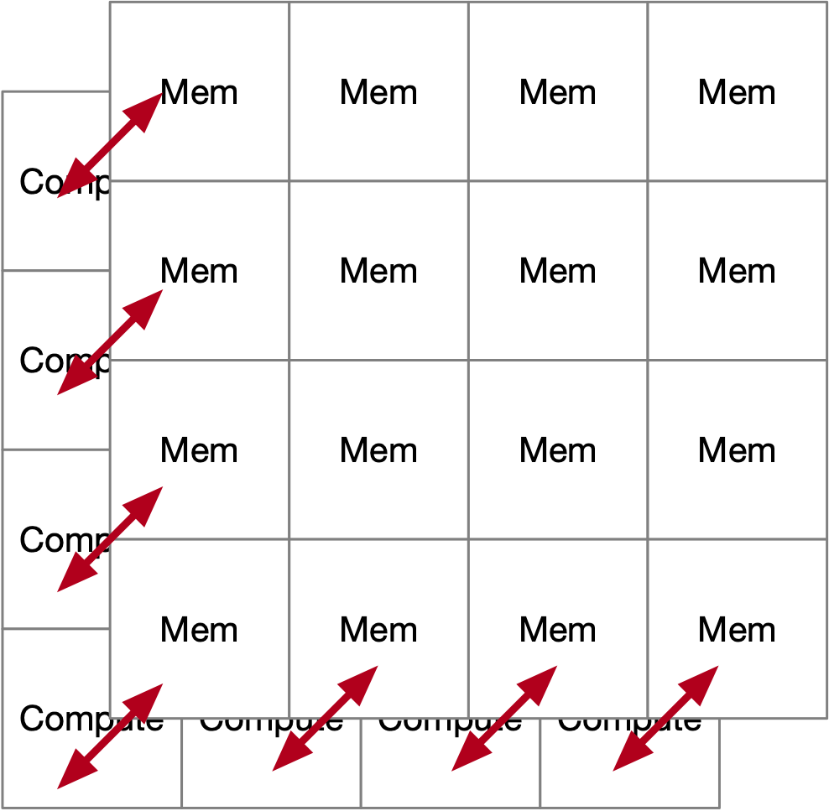
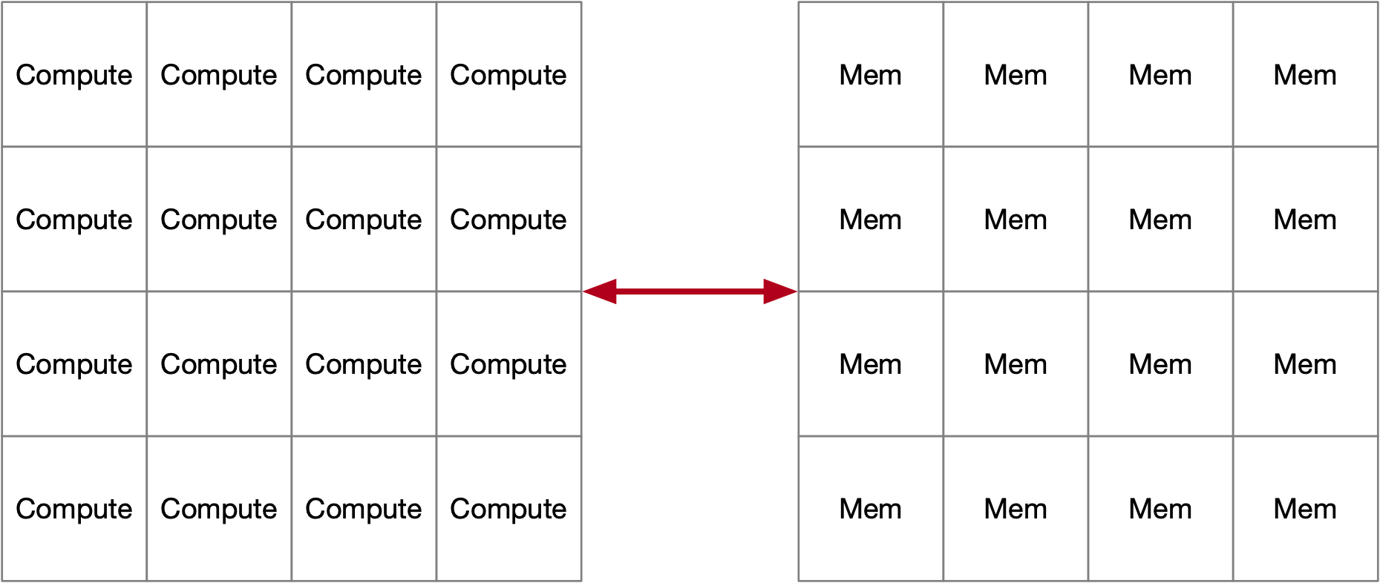
TCM Architecture Options
Centralized
Can be 2.5D or 3D integrated
No affinity between compute and memory partition
Examples:
  Current ADM designs
  Xeon LLC
  PVC L3
BW limitation and significant data movement power
Distributed
Each compute partition has preferential access to memory that is closer
Examples:
  Xeon L2 cache per core
  AMD L3, local to each CCD (8 CCDs)
  Nvidia A100: 8-way partition, in two halves of 4
  Cerebras, 20PB/s BW to 40GB SRAM
Potential for higher total BW, lower power (less data movement power, better SI, …)
Performance (favors distributed arch), complexity (favors centralized) tradeoffs
Segment specific arch/SW studies needed to guide any pathfinding program

Slide 18
Eco System Capabilities to Competition Mapping

Slide 19
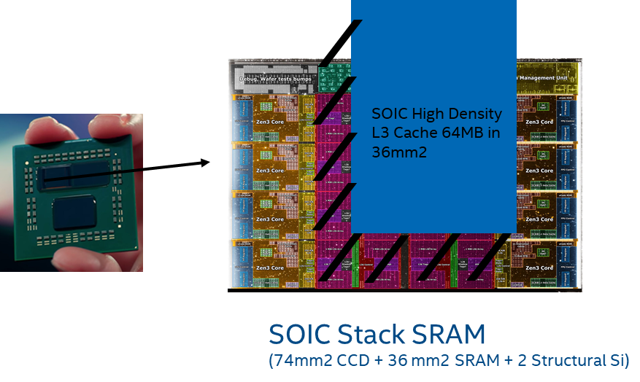
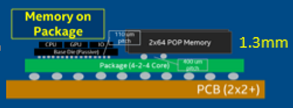
Client
APPLE
Tonga
(iGPU)
LP4 x64
2020
68GB/s
LP4 x64
Jade
LP5 x128
2021
410GB/s
INTEL
LP5 x128
ARL -P w/ADM 2023/4
Lifuca
(dGPU)
LP5 x128
LP5 x128
CPU
SoC
GPU
AMD
LP5 x128
Rhode
LP5 x128
2022
820GB/s
2022
LP5 x128
LP5 x128
I/O
LP5 x128
Lifuca
(dGPU)
LP5 x128
ADM
LP5 x128
LP5 x128
wider LPDDR interface via custom packaging with commodity cost per bit
LNL -M w/ OPM (on-pkg-mem) 2024
Stacked SRAM (SRAM process is cost reduced from logic process)
Low risk ( Can ship without cache die or w/o working cache die)
2023
x128 LP5X
On-going wide-IO explorations
Potential custom HBM w/ Micron
x64 4ch w/ rectangular pkg
PTL w/TBD 2025
OPM+CXL mem
Follow Apple’s lead with wider LPDDRx
Stacked ADM/SRAM/DRAM
Additional SRAM layers (2023+)
Firmware support for 4 high

Slide 20
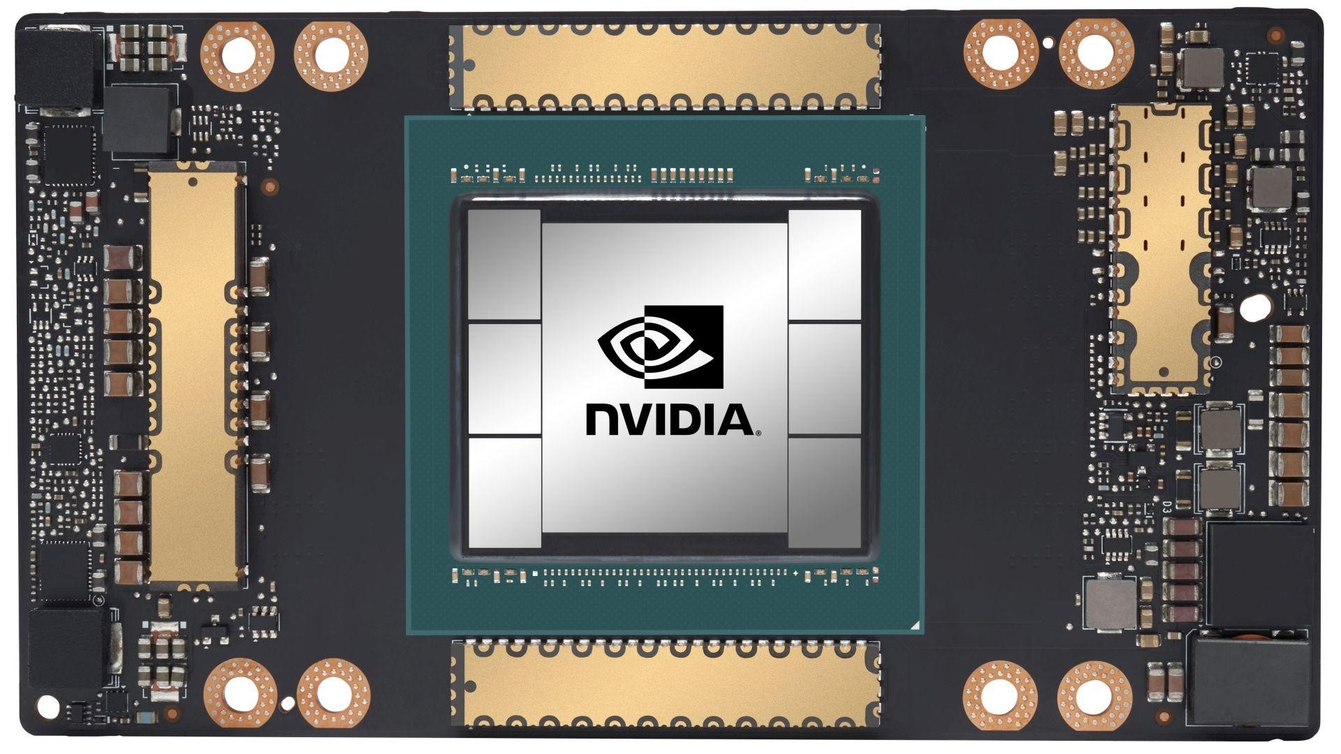
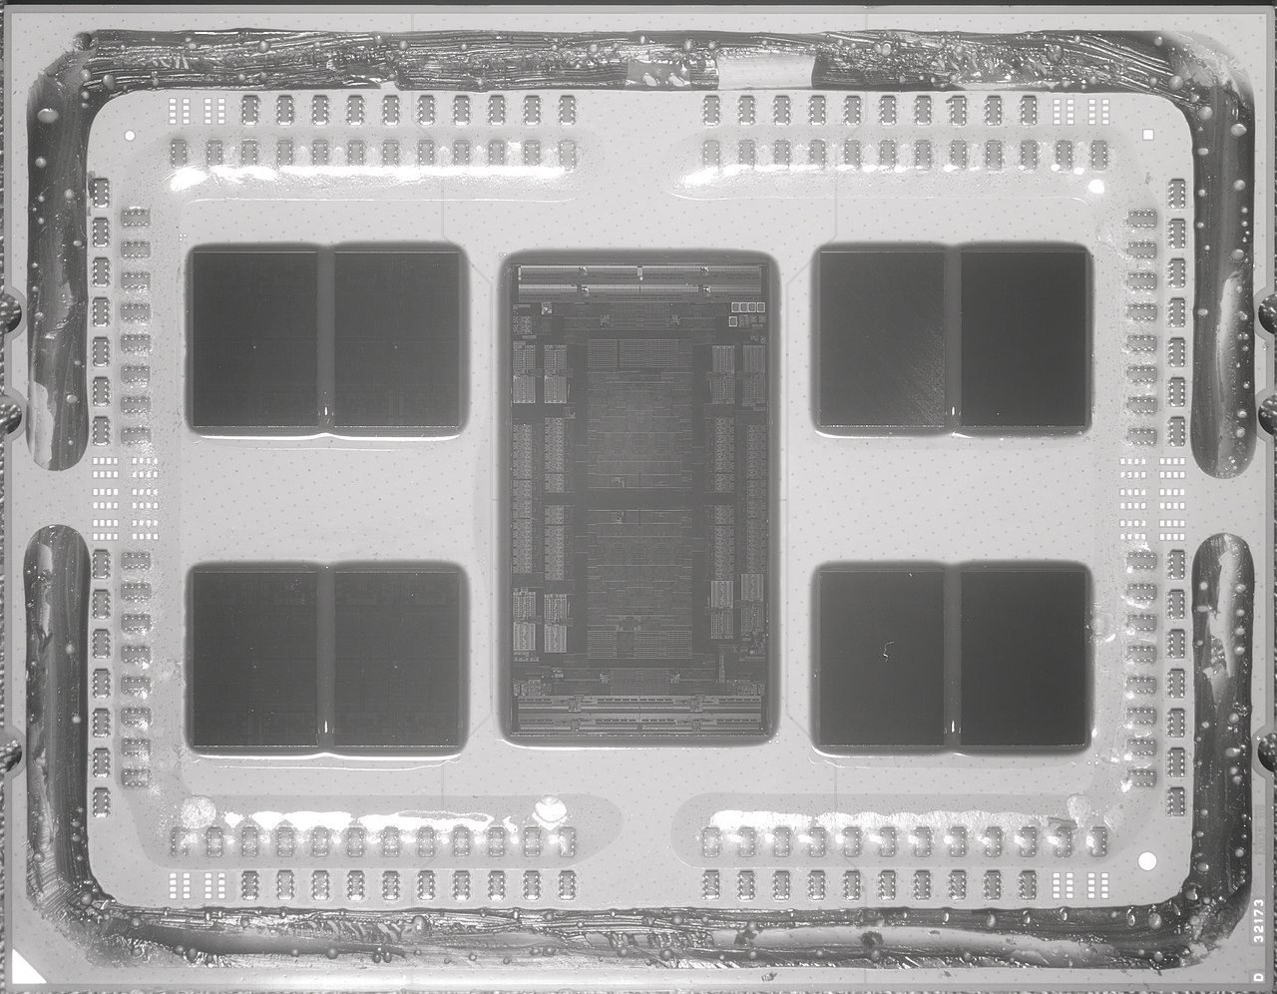
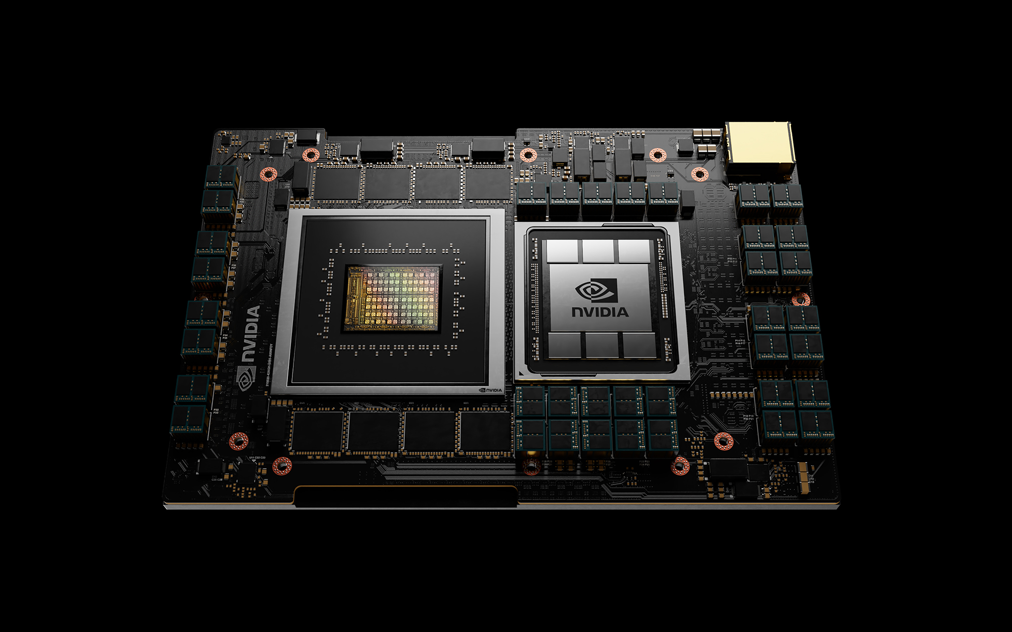
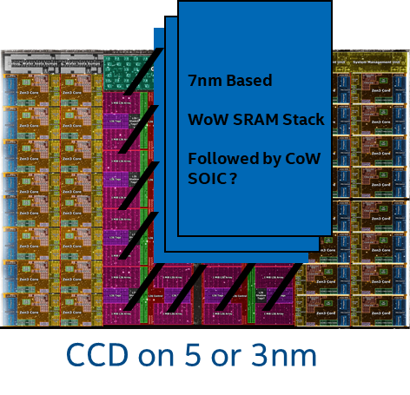
Server Product
INTEL
AMD
NVIDIA
Saphire Rapids + HBM
2022
GPU w/ GDDR or HBM
HBM Stack
HBM Stack
2022
2022
Cores, IO,
DDR Controllers,
HBM Controllers
DDR
DDR
HBM Stack
HBM Stack
SRAM on top of on-die SRAM
no power delivery or thermal degradation
Firmware support for 4 high – 2.3GB @ 16TB/s
More/higher BW HBMs
Interposer cost reduction
Opportunity for stacked SRAM/DRAMs
2022/3
Grace CPU w/
8 ch x512 LPDDR5
2023/4
Higher SRAM stack count
Low risk and incremental cost
More/higher BW HBMs on DMR
+
ADM/SRAM/DRAM cache on HCR
2023
2024/5
Nvidia have access to TSMC tech
for Grace CPU or follow-on

Slide 21
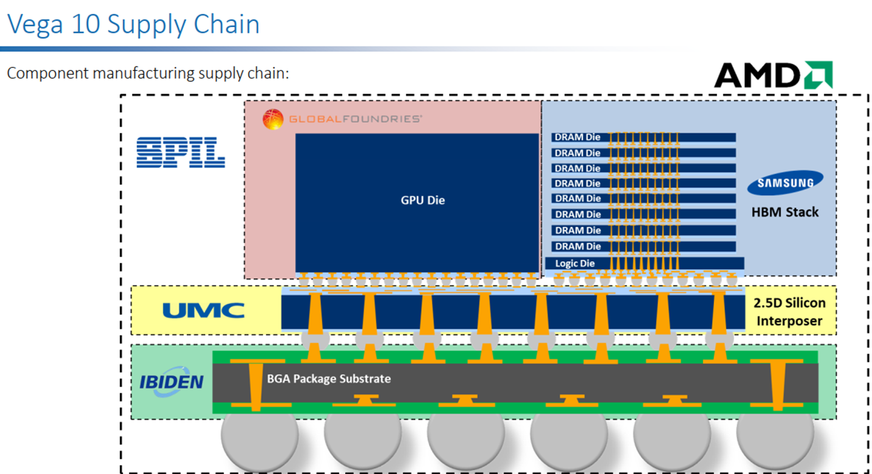
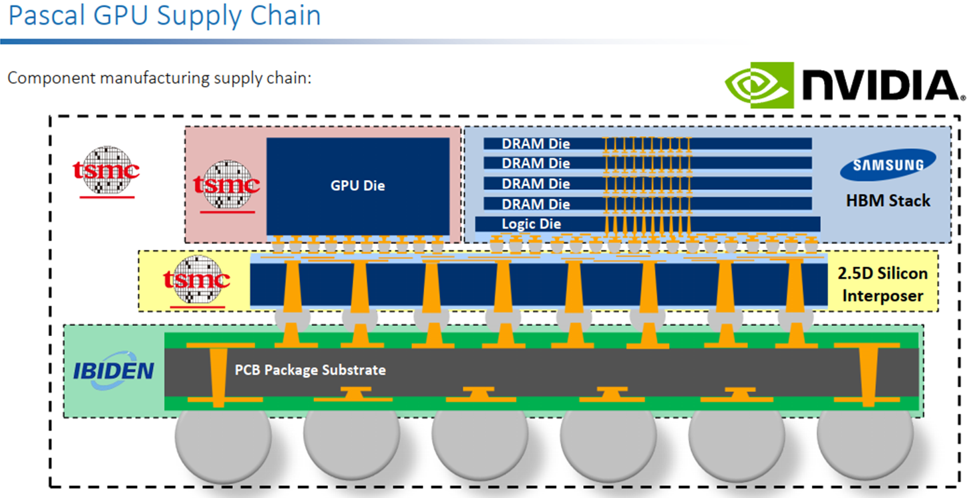
Discrete Graphics
INTEL
Data Center
Client
2022
PVC w/ HBM+SRAM
2023
Rialto Bridge
More/higher BW HBMs
+
ADM/SRAM/DRAM cache
2023
Elasti w/ GDDR6+ADM
More/higher BW HBMs/GDDRs
Interposer cost reduction
Opportunity for stacked SRAM (CPU influence) to cut back on HBM/GDDR channels
More/higher BW HBMs/GDDR
Interposer cost reduction
Opportunity for stacked SRAM/DRAMs for
DC GPUs
2024
Next Gen
ADM/SRAM/?

Slide 22
Alternative Tech

Slide 23






Emerging Technology in Memory Pyramid
Access Device
Si channel planar / nonplanar XTOR
TFT channel planar / nonplanar XTOR
2T [independent read write] Option
High-k Capacitor
MRAM [STT/SOT]
Ferro-capacitor
Nanostructure change
Memory Element
In-Package Memory – Intel’s ADM is the leading low-latency alternative, but density is not competitive to bulk Si 1T1C solution
  Samsung, Hynix and Micron have indications of monolithic 3DIC DRAM interest but no public disclosure.
  low latency 1T-STTM technology requires large x’tor footprint or more advanced technology for high current bipolar operation.
  1T-1FeCap, 1T-nFeCap, 1FeFET and 2T-0C gain-cell (IxZO class) in research stage. Long lead time is anticipated.
No near term alternatives to SRAM/DRAM or ADM for TCM usage

Slide 24
Next Steps
Guide/coordinate external engagements with common goals/requirements and realistic assumptions per segment vs time
Arch/SW studies for centralized vs distributed memory solutions to guide integration pathfinding
Develop a segment specific strategy or a plan for a strategy
  to leverage the eco system capabilities and differentiate with internal capabilities as they mature
…

Slide 25
backup

Slide 26
Executive Summary
Embedded memory – 1T-STTM with low write cycle time and high endurances were demonstrated.
  TSMC-16nm, Samsung-28nm, GF-22nm and IBM-14nm improves write speed (~10ns) and reliability (10⁶ to 10¹² cycles).
  IBM-Samsung JDP demo write speed limit at 2nsec; Read disturb is problematic.
  1T-STTM density is low; Samsung’s 28nm yields 12Mb/mm² (~Intel’s eDRAM circa ’12), shipping buffer memory in LCD display.
  2T-SOT is still in deep research.
In-Package Memory – Intel’s ADM is the leading low-latency alternative, but density is not competitive to bulk Si 1T1C solution
  Samsung, Hynix and Micron have indications of monolithic 3DIC DRAM interest but no public disclosure.
  low latency 1T-STTM technology requires large x’tor footprint or more advanced technology for high current bipolar operation.
  1T-1FeCap, 1T-nFeCap, 1FeFET and 2T-0C gain-cell (IxZO class) in research stage. Long lead time is anticipated.
3D XPoint – Intel is leading competitive landscape by 24~36 months (SLC, MLC and BiSM)
  Hynix: Although several papers published in 2020~21, no new information disclosed since IEDM18 paper (a S15-like product).
  Samsung remains silent; Macronix-IBM primarily worked on cell level research with limited array activities.
  Micron ceased SXP & SSM TD on March 16, 2021, 2y8m after ending IM-JDP. Gen-2 production at Lehi, UT ends by the end of ’21.
Alternative technologies for PM / SCM are either in primitive research, missed product milestone or dropped out.
  Fujitsu-Nantero’s 40nm selector-less NRAM: missed sampling milestone of low-latency product.
  Sony’s 20nm OTS-select CBRAM: missed sampling milestone likely due to Cu-integration, sigma, drift & disturb.
  Avalanche 1S-STTM demonstrated very high NL single cell data; still no array information; disturb, sigma are likely showstoppers.
  Crossbar/SMIC FAAST-VO⁺ cell has been radio-silent since their new CEO visited Intel in 2019. Co-funder’s resume is on the street.
  Bipolar RRAM, Unipolar CeRAM and FeFET (NAND string) are either dropped out or in early stage of research.
Flash Memory: SunRise 3D QVM (NOR flash), Macronix 3DANDFlash, …

Slide 27
Memory Architectures
Arch | Description | Companies
MRAM | Uses electron spin to store information; high-density, non-volatile, power efficient Challenges: Requires significant process integration to manufacture Status: Furthest along in development; Solutions already in the market (Everspin, Samsung, TSMC, GF) | Avalanche Escencia Everspin (IPOed) Spin Transfer Tech
RRAM | Changes the resistance across a dielectric solid-state material, non-volatile Challenges: Variability issues are proving to be difficult to overcome Status: Advertised as the ultimate scalable memory; Many RRAM companies trying to penetrate into the AI/ML market and worth with in-memory compute model | Crossbar Intrinsic NuMe ReBIT ReRAM Spin Memory
NRAM | Based on carbon nanotube technology for strong write-endurance, non-volatile Challenges: Have yet to deliver on promises Status: Have been around for 20+ years, Fujitsu announced to partner with Nantero to bring to market in 2019 | Nantero
FeRAM | Uses ferroelectric layer to achieve non-volatility, low power, fast write Challenges: Historically used materials that were difficult to integrate into FAB environment, lower storage densities than Flash Status: Advances made to use Hafnium Oxide to make more accessible for FAB environment | FerroElectric Memory
Other | SRAM NAND | Zeno (SRAM) Netlist Yangtze Memory Tech

Slide 28
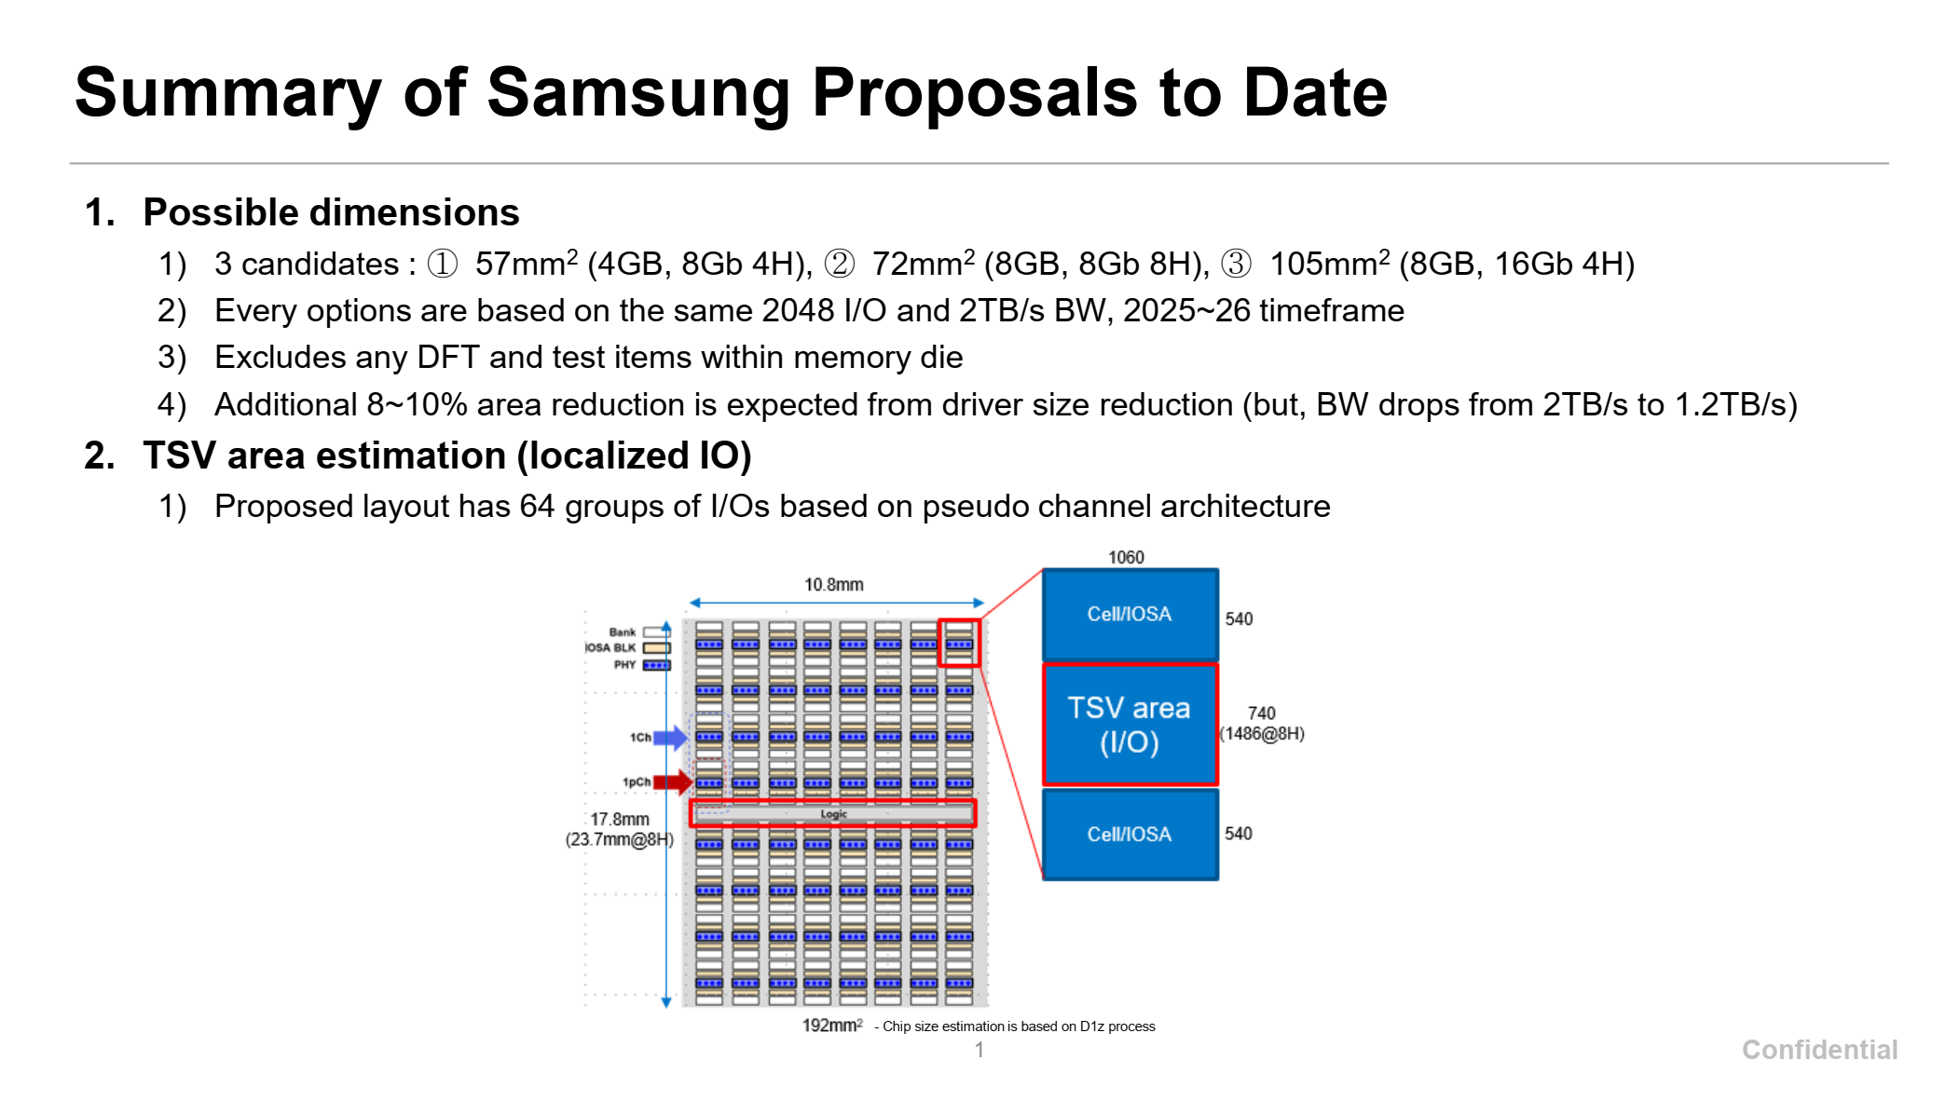

Slide 29
SK Hynix – DRAM interposer and HBW DRAM cube
#1. Mainstream/General Purpose Perf. Segment (Cache)
Bandwidth: 2.5 – 3 TB/s
  Using SKH 128MB/128GB/s 9.9mm2 macro:
  Need 24 macros for 3 TB/s
  24 * 9.9 = ~240mm2
Capacity: 6 GB (Baseline)
  Scalability option: 2x (12GB) to 4x (24GB) capacity at same bandwidth, additional cost
  Using SKH 128MB/128GB/s 9.9mm2 macro:
  Need 48 macros for 6GB →
  Provide macro with different BW/capacity ratio. Ex. 256MB/128GB/s in 19.8mm2?
Construction Options
  Compute area: ~1500mm2
  Baseline 6GB DRAM area: ~480mm2
  3x area delta , logic/DRAM will scale differently over time
  Scalability option for 2x – 4x capacity?
Compute
Compute
Compute
Compute
DRAM Interposer
DRAM
DRAM
Option 1: Interposer
Use older/cheaper DRAM node?
Option 2: Intel ODI Packaging
Capacity | DRAM Area
6GB (1x) | ~480mm2
12GB (2x) | ~960mm2
24GB (4x) | ~1920mm2
DRAM
Compute
DRAM
Option 3: DRAM cube
With scalable height for capacity
Logic Interposer
Can we use the SK logic interposer without DRAM ?
Data shared under CNDA 30991112 & CNDA 112784

Slide 30
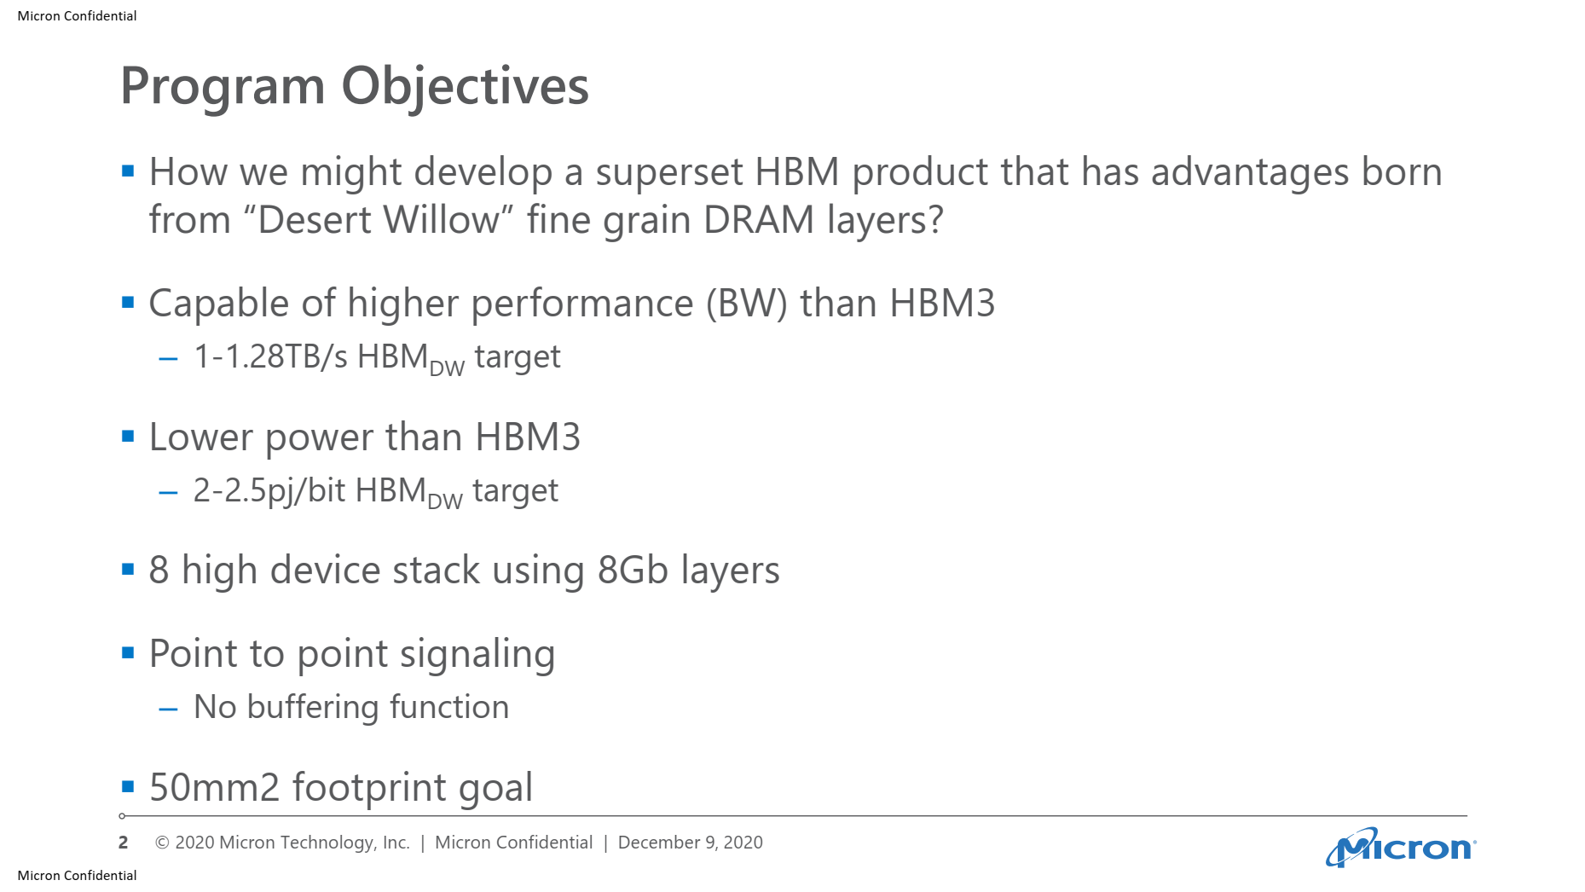
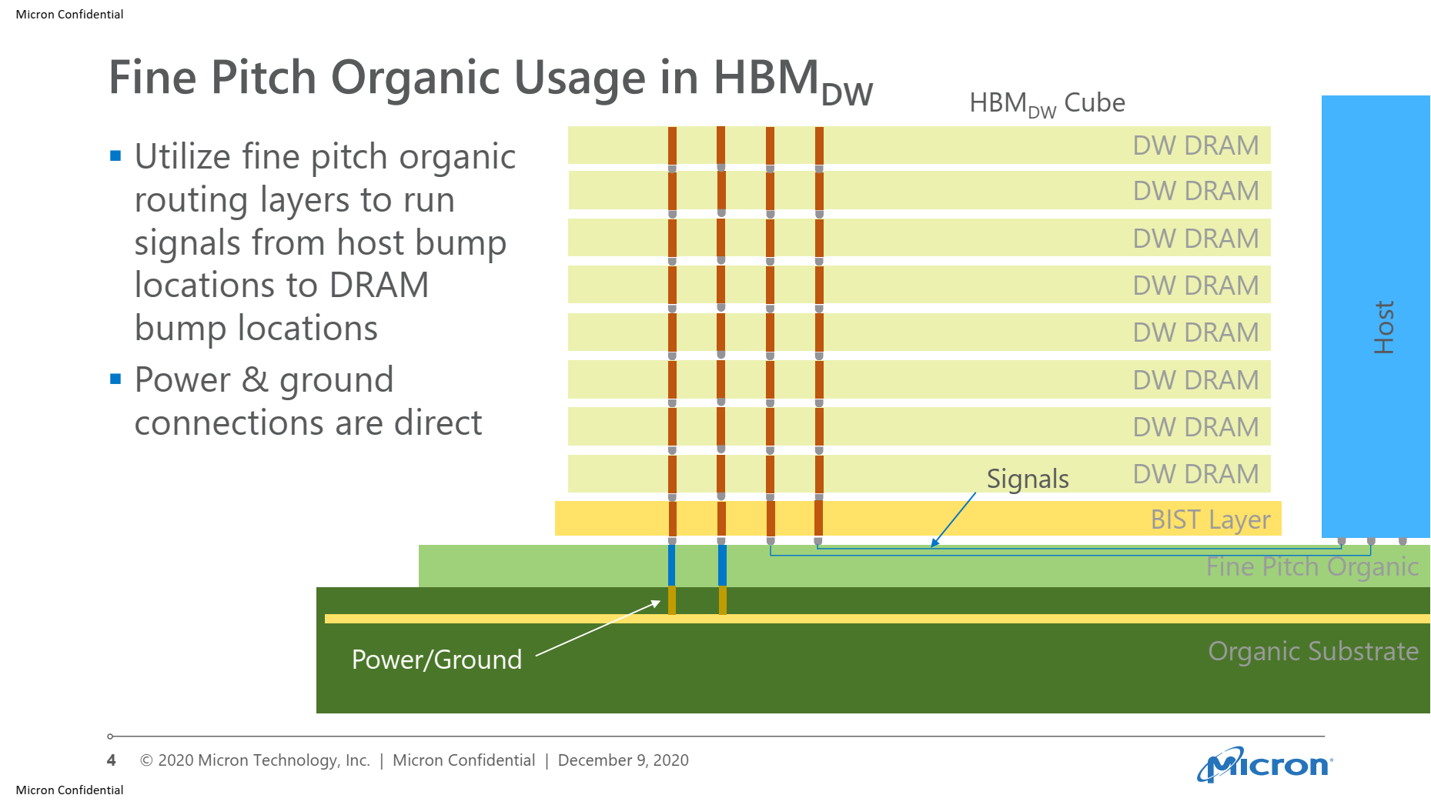
Micron Proposal

Slide 31
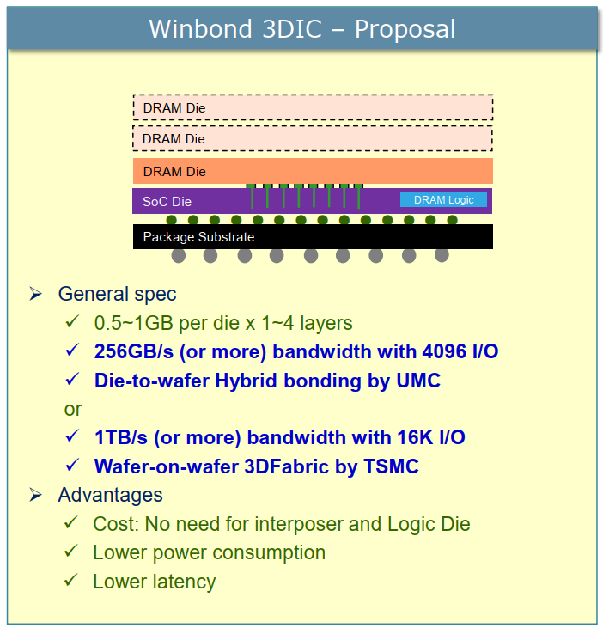
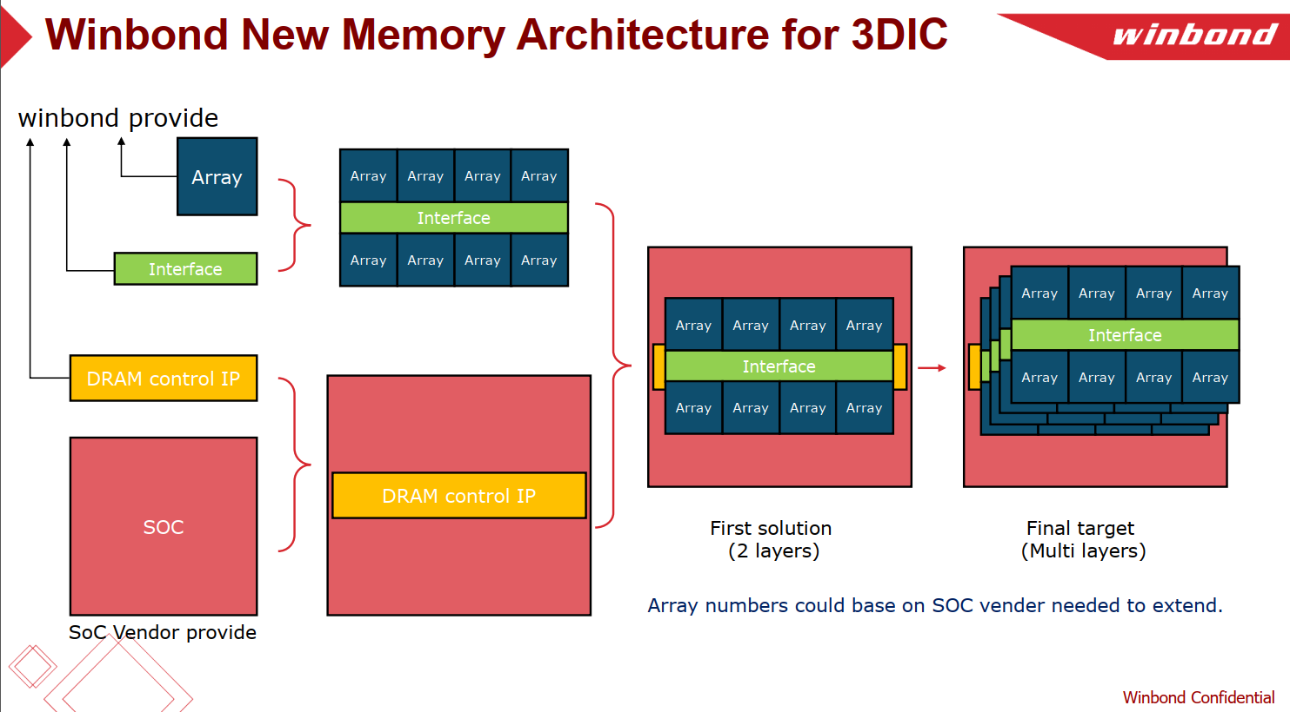
Parameter |  | unit | 3D DRAM 2Gb w/ ECC
 |  |  | Option 1 |  | Option 2 |  | Option 3 (Reference) |  | Option 3B
Process |  |  | D25s | D20 | D25s | D20 | D25s | D20 | D25s | D20
Size |  | mm^2 | 37.61 | 32.16 | 28.17 | 23.8 | 24.16 | 19.46 | 35.45 | 30.3
Size w/ bump pitch 25um |  | mm^2 |  |  |  |  |  |  | 33.93 | 28.83
Chip per wafers |  | est. | 1669 | 1952 | 2228 | 2637 | 2598 | 3225 | 1770 | 2071
Good Dies |  |  | 1418 | 1659 | 1894 | 2242 | 2208 | 2741 | 1505 | 1761
Stacked dies (layer) |  |  | 1 | 1 | 1 | 1 | 1 | 1 | 1 | 1
Channel (CH) # per Die |  |  | 16 | 16 | 8 | 8 | 8 | 8 | 4 | 4
Bank # per CH |  |  | 1 | 1 | 1 | 1 | 1 | 1 | 8 | 8
Memory per Die |  | MB | 256 | 256 | 256 | 256 | 256 | 256 | 256 | 256
Memory density |  | MB/mm^2 | 6.81 | 7.96 | 9.09 | 10.76 | 10.60 | 13.16 | 7.22 | 8.45
Memory per Channel |  | MB | 16 | 16 | 32 | 32 | 32 | 32 | 64 | 64
Peak Bandwidth* | per CH | Gbps | 256 | 256 | 256 | 256 | 128 | 128 | 256 | 256
 | per Die | Gbps | 4096 | 4096 | 2048 | 2048 | 1024 | 1024 | 1024 | 1024
 | per mm^2 | Gbps | 109 | 127 | 73 | 86 | 42 | 53 | 29 | 34
 | per 100 mm^2 | GB/s | 1361 | 1592 | 909 | 1076 | 530 | 658 | 361 | 422
Effective Bandwidth | per CH | GB/s | 2.8 | 2.8 | 2.8 | 2.8 | 1.4 | 1.4 | 22.8 | 22.8
 | per 1GB | GB/s | 182 | 182 | 91 | 91 | 46 | 46 | 364 | 364
 | per 100 mm^2 | GB/s | 121 | 142 | 81 | 96 | 47 | 58 | TBD | TBD
DQ I/O # | per CH |  | 512 | 512 | 512 | 512 | 64 | 64 | 128 | 128
 | per Die |  | 8192 | 8192 | 4096 | 4096 | 512 | 512 | 512 | 512
ECC IO # | per CH |  | 32 | 32 | 32 | 32 | 4 | 4 | 8 | 8
 | per Die |  | 512 | 512 | 256 | 256 | 32 | 32 | 32 | 32
Data Rate |  | Gbps | 0.5 | 0.5 | 0.5 | 0.5 | 2 | 2 | 2 | 2
Row Cycle time (tRC) |  | ns | 45 | 45 | 45 | 45 | 45 | 45 | 45 | 45
Memory core speed (tCCD) |  | ns | 4 | 4 | 4 | 4 | 4 | 4 | 4 | 4
Total Latency |  | ns | 21 | 21 | 21 | 21 | 21 | 21 | 21 | 21
Read Latency |  | nCK | 2 | 2 | 2 | 2 | 8 | 8 | 8 | 8
Access Time (RL + tAC) |  | ns | 9 | 9 | 9 | 9 | 9 | 9 | 9 | 9
* Under seamless read operation |  |  |  |  |  |  |  |  | * w/ Metal4

Slide 32
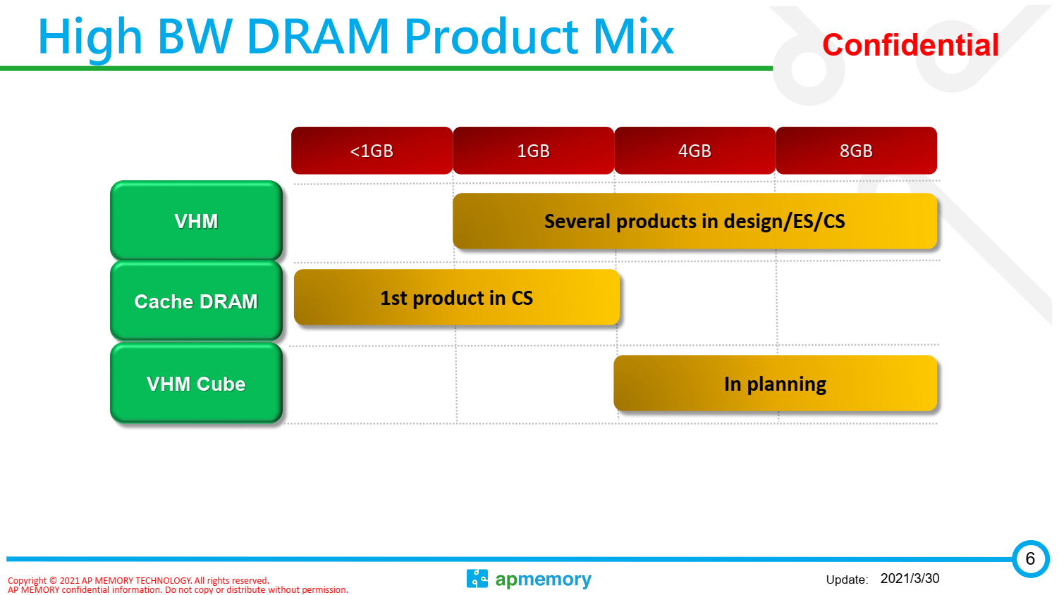
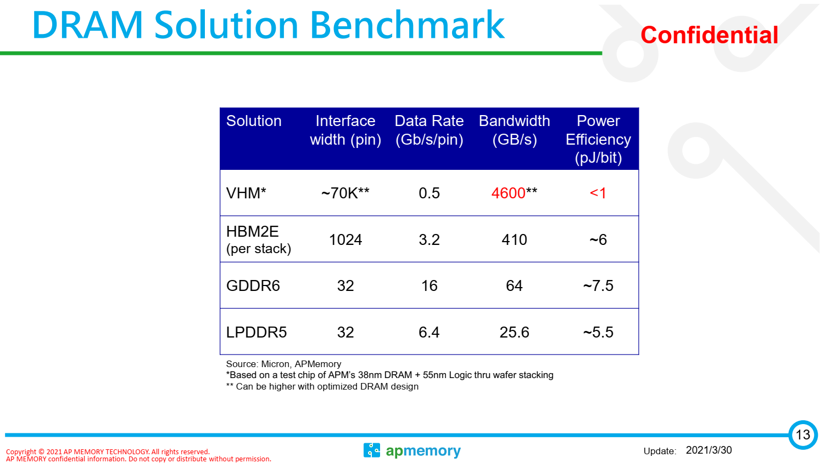
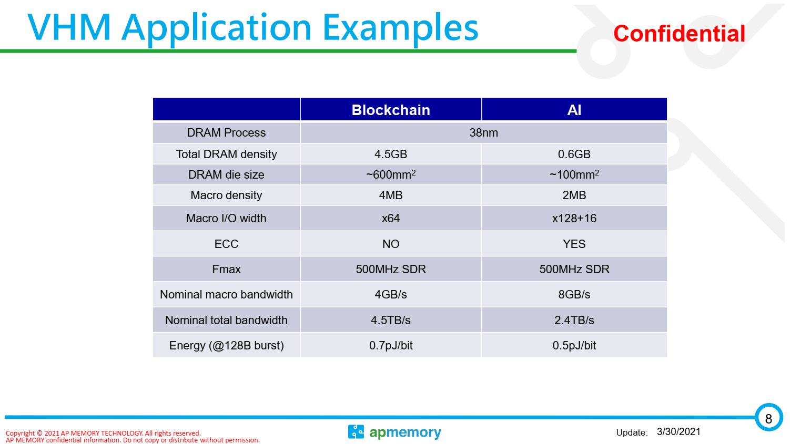
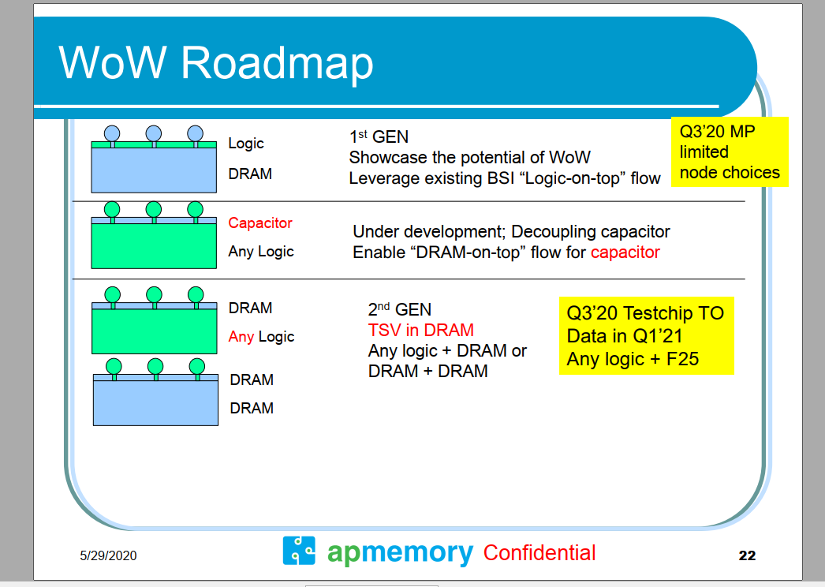
2020 Mar.: Hisilicion request the 600-700 uF capacitor and TSMC is
working on Gen1 WoW solution, Gen1 DRAM also can replace by
capacitor. Gen 1 now have two AI companys are working for that. Gen2 was request by a big design house and even Google intel also have highly interesting for that. Gen2 have better heating structure.
2021 Mar: 2-10 customer engagements

Slide 33
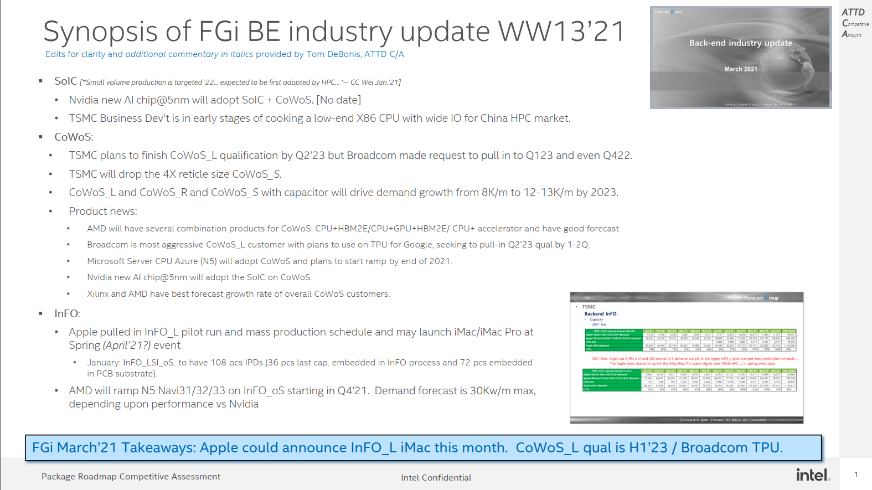

Slide 34
CoWoS
• 2021 Mar.: Due to the CoWoS_L is getting more and more popular and will increase more flexibility for combination of
different device and also can reduce the cost. So TSMC will drop the 4X reticle size CoWoS development.
• 2021 Mar.: TSMC think the CoWoS_L and CoWoS_R and CoWoS with capacitor will let the CoWoS demand growth from 8k/M
to 12-13K/m by 2023.
• 2021 Mar.: The Broadcom is the most aggressive for CoWoS_L and plan to will use the TPU for Google to adopt the CoWoS_L,.
TSMC plan to finish to finish qualification by Q223 and Broadcom request to pull in to Q123 and even Q422.
• 2021 Mar. : The AMD will have several combination products for CoWoS CPU+HBM2E/CPU+GPU+HBM2E/ CPU+ accelerator
and have good forecast in the coming. Now the AMD and Xilinix CoWoS have best forecast growth rate of overall customers.
• 2021 Mar.: The Microsoft Server CPU for Azure@5nm will adopt CoWoS and plan to ramp up by end of 2021.
• 2021 Mar.: The Nvidia new AI chip@5nm will adopt the SoIC on CoWoS

Slide 35
– InFO
• 2021 Mar.: Apple cut 8-9M A12 and 2M around A13 demand but pill in the Apple InFO_L pilot run and mass production
schedule….
• The Apple have chance to launch the iMac/iMac Pro adopt Apple own CPU@InFO _L in spring event date.
• 2021 Mar.: AMD will ramp up the GPU@5nm Navu31/32/33 adopt the InFO_oS from Q421.Now total demand still forecast
max is 30K/m but that will depe
y :
– Backend 3D IC (WoW) :
• 2021 Mar.: The TSMC BD (Business development) is cooking for low end X86 CPU with wide IO for high performance
computing for China market due to China-USA trade conflict. But it’s in the early stage.
– Backend InFO PTI
• 2021 Mar.: The PTI have high possibility will give up the panel fan out due to PTI CTO was resign and now no specific owner
to be in charge of the Panel fan out. But concentrate more resource for wafer base InFO and WoW. The PTI is working on the
Sony CIS+ISP solution

Slide 36

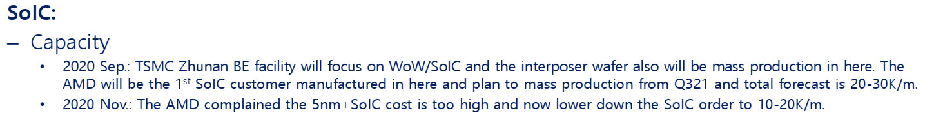

Slide 37
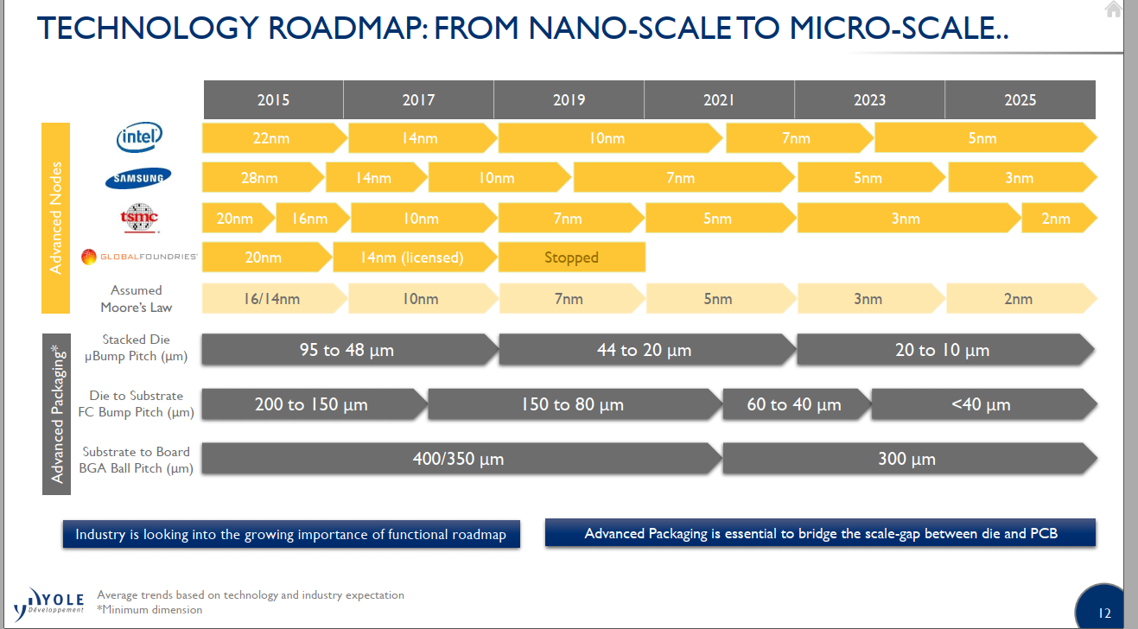

Slide 38
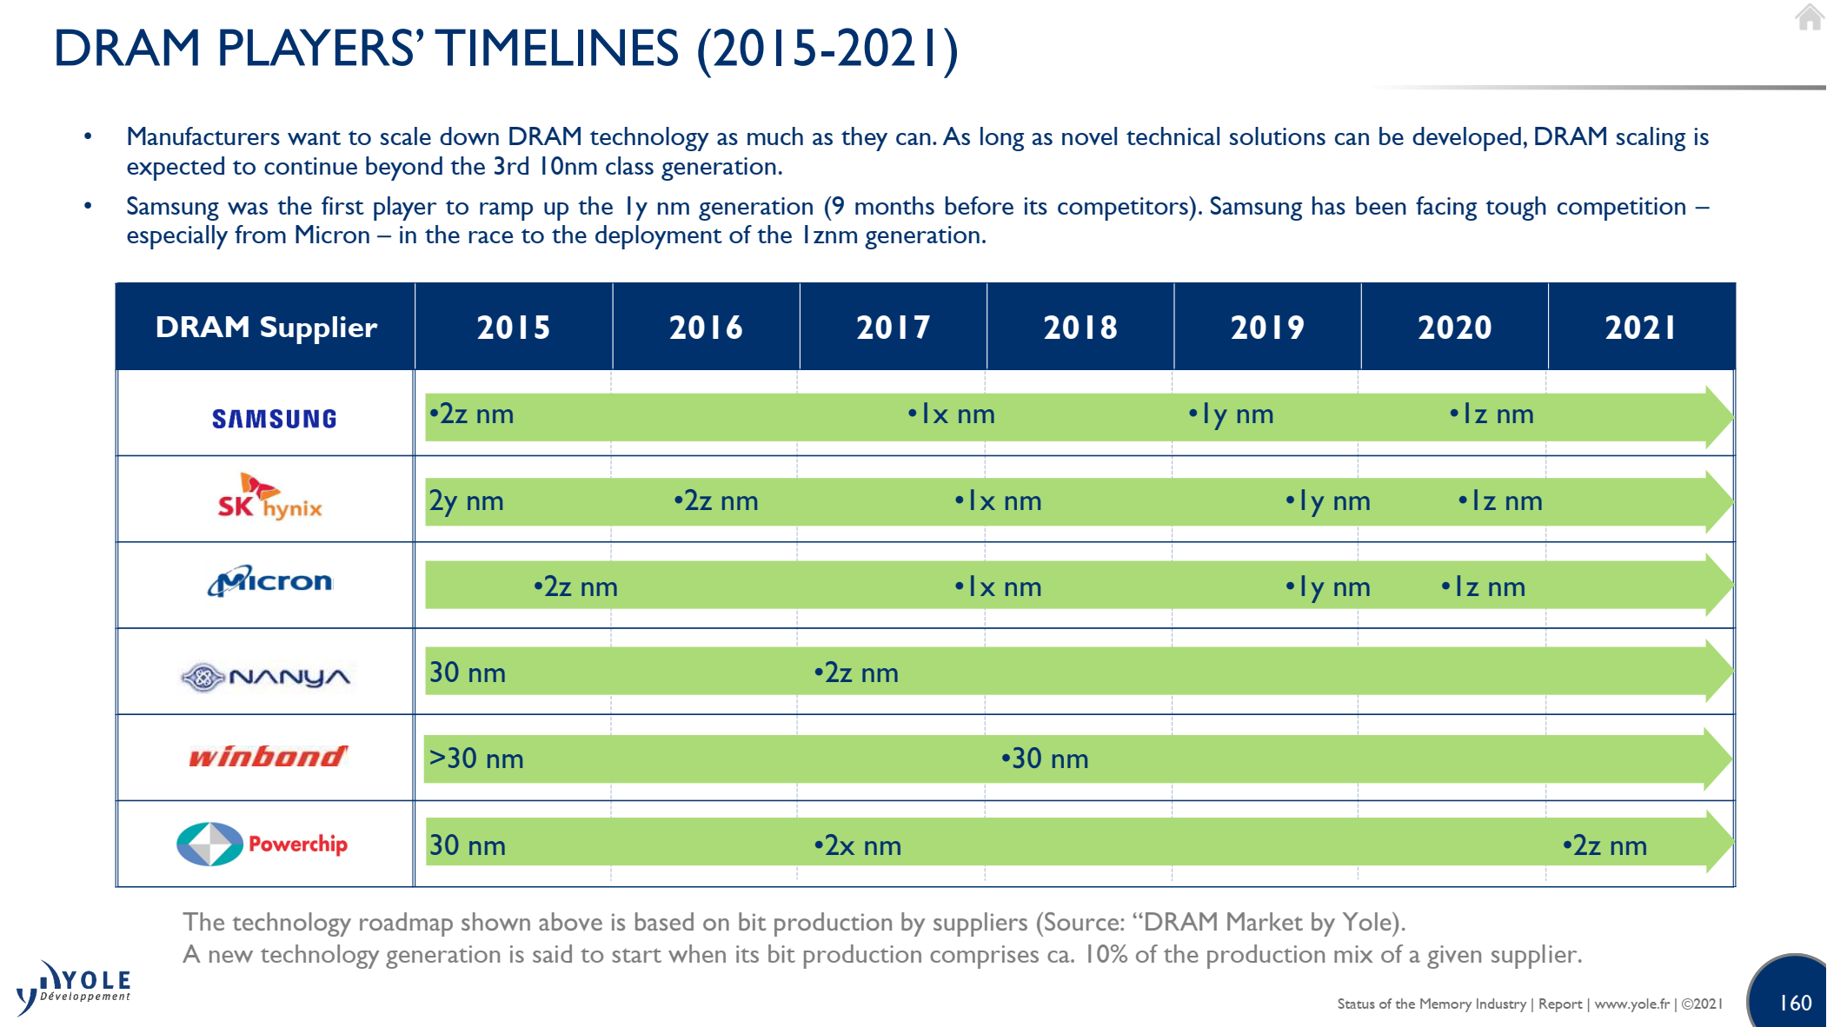
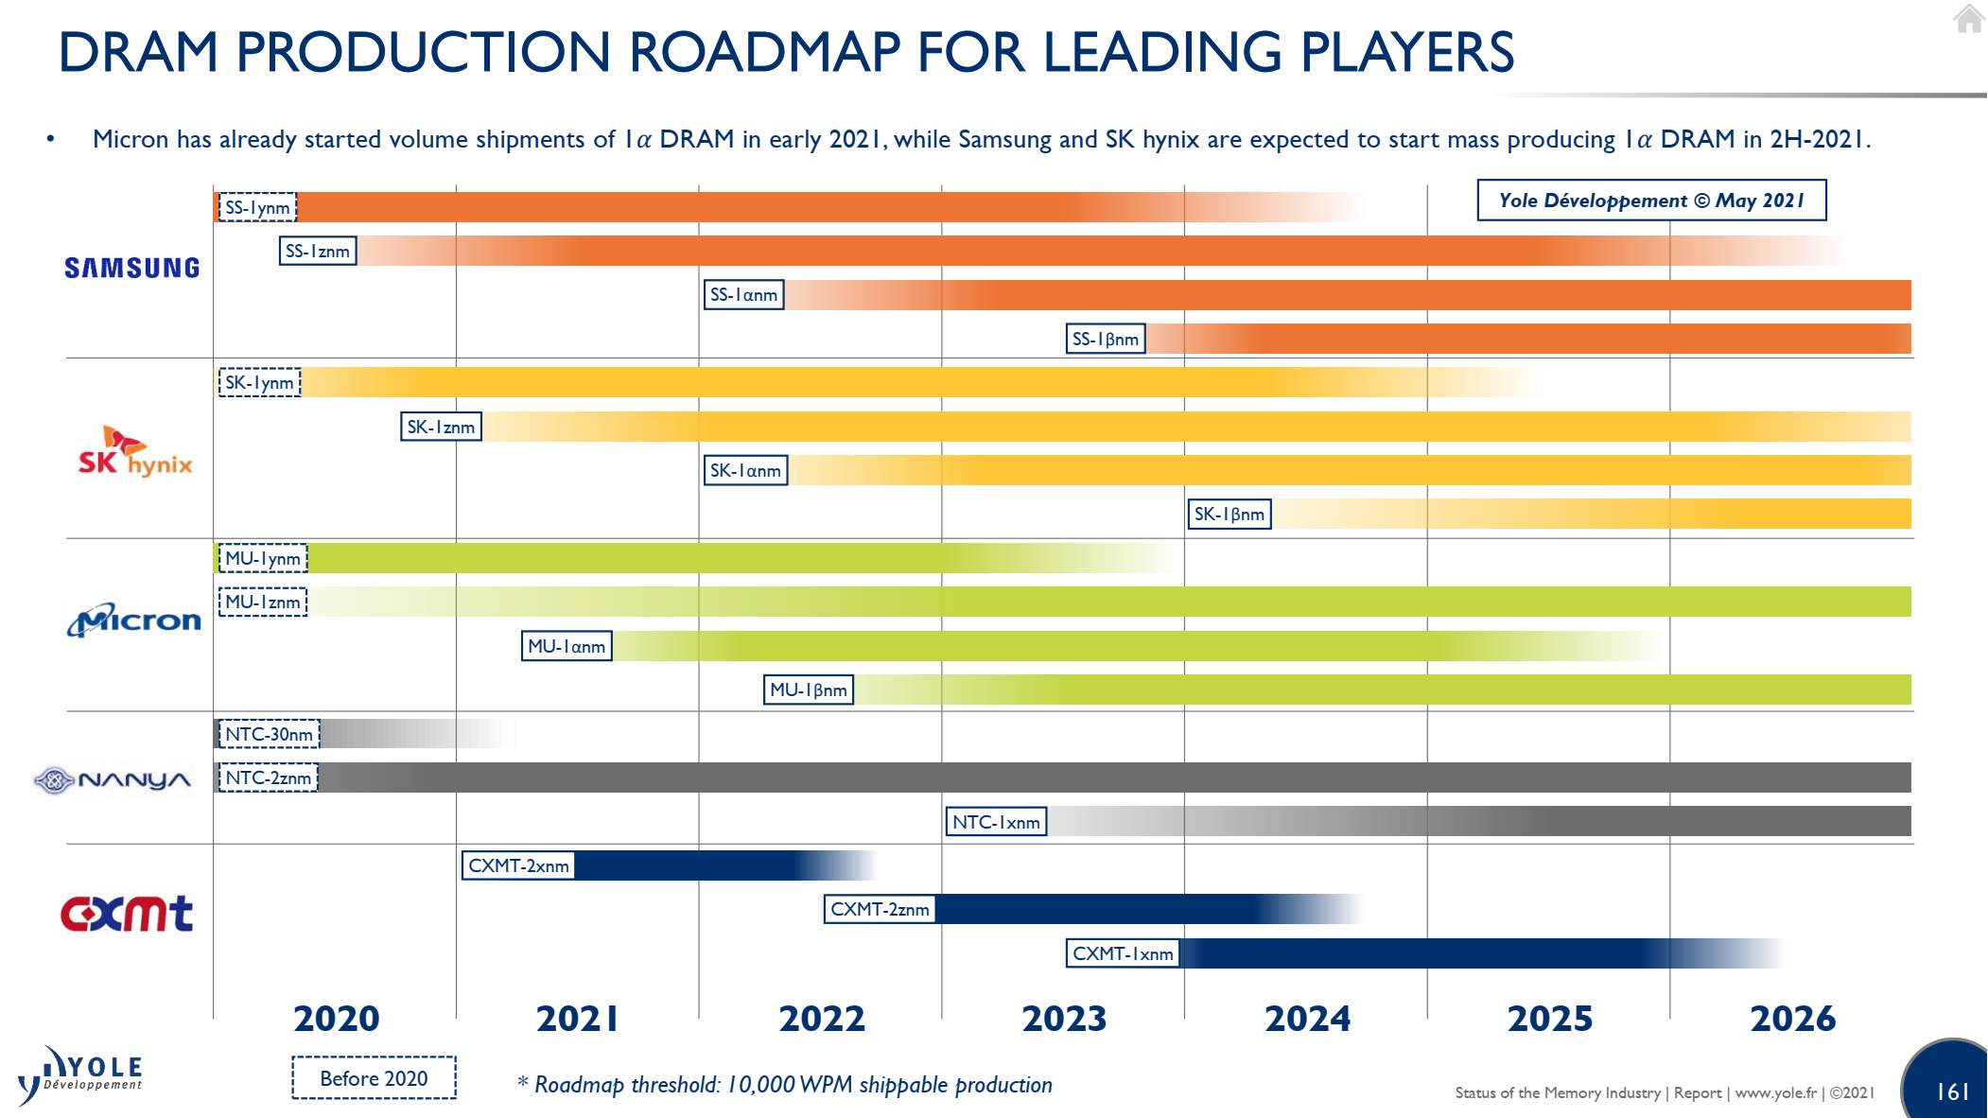

Slide 39
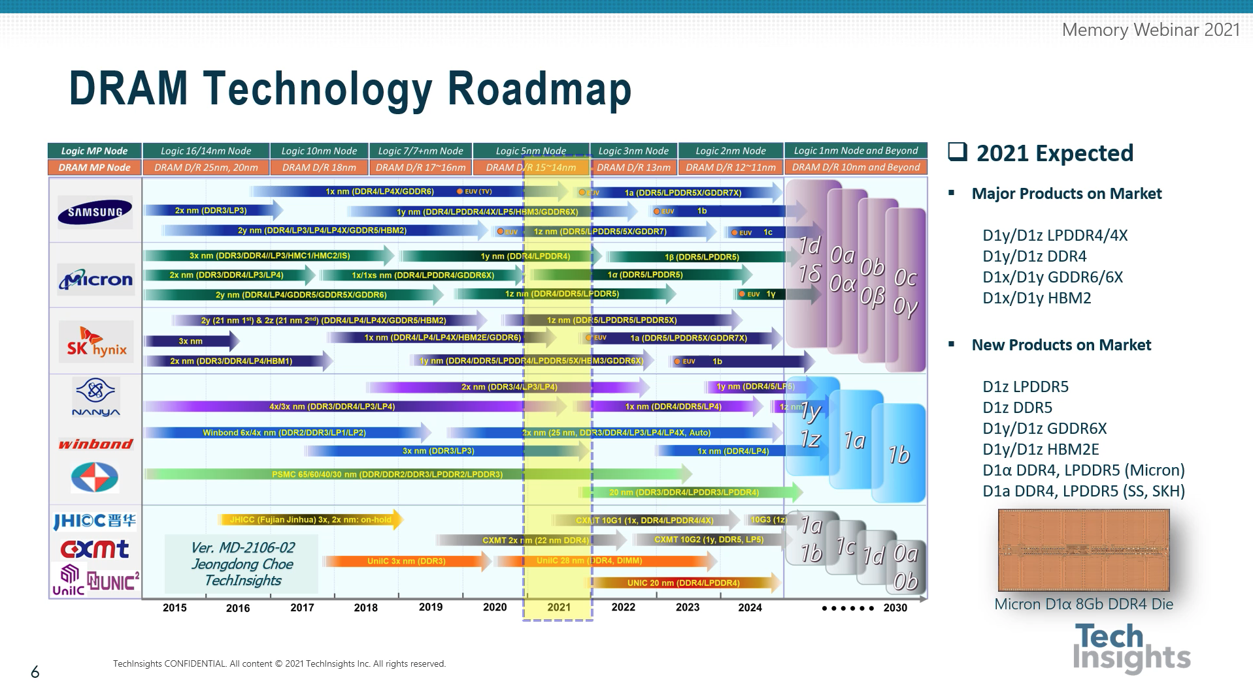

Slide 40
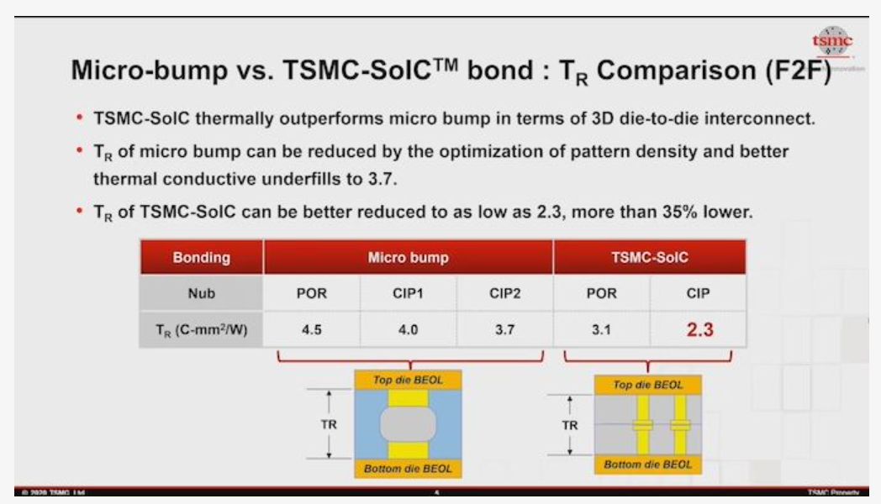
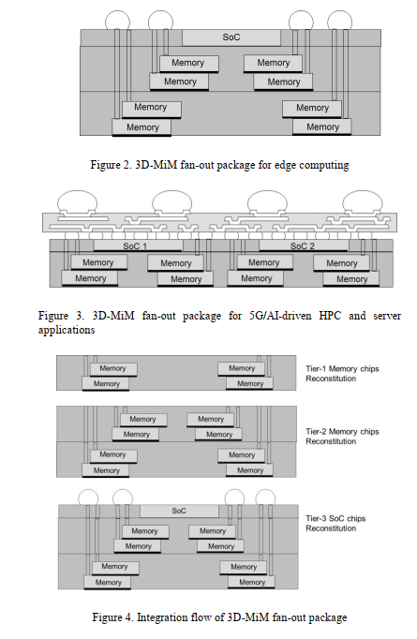

Slide 41
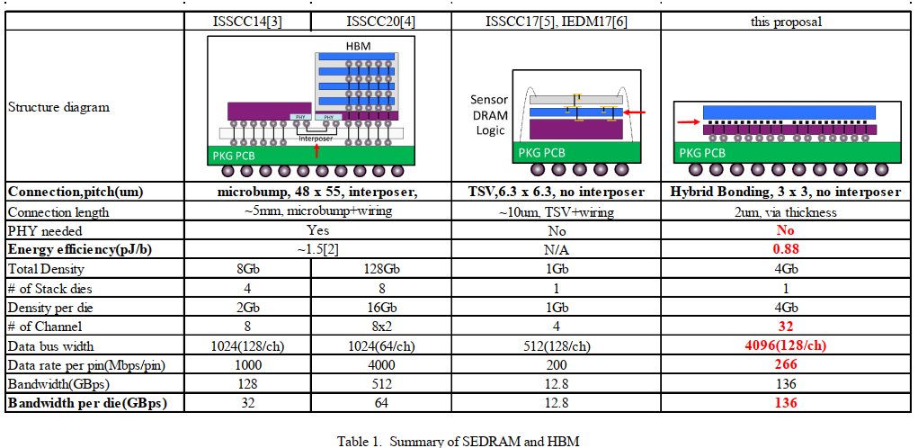
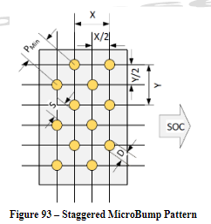
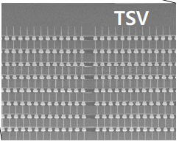
About C4 Bump
HBM1
HBM2E
SONY CMOS Imager
(IF Energy?)
475221
8Gb
(Interposer IF)
(HBI IF)
X-Sec Photo from the same paper
Die thickness is ~50um,
Easily to guess how much DRAM Stack uBump/TSV pitch would be?

Slide 42
ECTC, vendors presented papers on the following technologies:
  A*STAR devised a 10 x 10mm test chip with a 12µm pad pitch.
  Fraunhofer demonstrated a 10μm hybrid bonding flow.
  Imec devised a stacked face-to-face and back-to-back flow.
  Intel taped out test chips, including a 10nm finFET.
  Leti devised a path towards 5μm pitches with hybrid bonding.
  Samsung demonstrated 3-stacked wafer bonding using hybrid bonding.
  UMC showed a pre-bond qualification process for TSVs.
  AMD is one of the early adopters here.
Starting in 2016, Sony began shipping CMOS image sensors using this technology
Hybrid bonding works the same way in packaging, but it’s more difficult. That’s why hybrid bonding for packaging has been stuck in R&D for years.
“The main challenges of this fine microbump interconnections come with bump coplanarity,” said Mu Hsuan Chan, a technical manager from Siliconware, part of ASE, in a presentation at ECTC. “Owing to finer solder volume on a much finer microbump pitch, solder is rapidly consumed after solder joint formation, and voids could form. The voids within the solder joint will deteriorate the solder joint reliability of the bumps.”

Slide 43
Memory Roadmap for Apple M series
M1 Tonga Processor
  LP4 4266 x64, 4ch, 877b(0.27bp)
  Memory IO: LP4 x128 (2 * x64)
  BW 68GB/s
Jade Processor, Lifuca dGPU
  LP5 6400 x128, 8ch, 2406b(0.27bp)
  ODP/16DP(8Gb), Mainly SK hynix
  Memory IO: LP5 x512 (4 * 128)
  Lifuca dGPU will use x256
  BW 410GB/s
Rhode Processor, Lifuca dGPU
  LP5 6400 x128, 8ch, 2406b(0.27bp)
  ODP/16DP(8Gb)
  Memory IO: LP5 x1024 (8 * 128)
  Lifuca dGPU will use x512
  BW 820GB/s
2020
2021
2022
2023+
M1
LP4 x64 4266
877b, 0.27bp
M2
LP5 x128 6400
2406b, 0.27bp
M3
LP5 x128 6400/7500?
2406b, 0.27bp
M4+
LP5x 0.25bp or less

Slide 45
Key Specs for Optimization
Specification | Value range
Bandwidth (read/write combined) | 2 – 3 TB/s
Total stack power | 15 – 35 W
Total capacity | 8 – 16 GB
Schedule | Samples Q3’2023 Manufacturing ready Q1’2025
No priority implied in ordering
Specification priorities may vary based upon application
Desire to have parameterization to trade off specifications
At least 4X BW/mm² and 4X BW/W better than HBM3

Slide 46
Key Specs for Optimization
Specification | Value range
Bandwidth (read/write combined) | 2 – 3 TB/s
Total stack power | 15 – 35 W
Total capacity | 8 – 16 GB
Schedule | Samples Q3’2023 Manufacturing ready Q1’2025
No priority implied in ordering
Specification priorities may vary based upon application
Desire to have parameterization to trade off specifications
At least 4X BW/mm² and 4X BW/W better than HBM3

Slide 47
Key Specs for Optimization
Specification | Value range
Bandwidth (read/write combined) | 2 – 3 TB/s
Total stack power | 15 – 35 W
Total capacity | 8 – 16 GB
Schedule | Samples Q3’2023 Manufacturing ready Q1’2025
No priority implied in ordering
Specification priorities may vary based upon application
Desire to have parameterization to trade off specifications
At least 4X BW/mm² and 4X BW/W better than HBM3

Slide 48
Intel Server Architecture + DRAM Interposer
#1. Mainstream/General Purpose Perf. Segment (Cache)
Bandwidth: 2.5 – 3 TB/s
Capacity: 6 GB (Baseline)
  Scalability option: 2x (12GB) to 4x (24GB) capacity at same bandwidth, additional cost
Low latency, low cost is critical
Intercept: Q2-2025
CPU
DRAM Cache
6GB - 12GB
Commodity DRAM,
Capacity Memory
2.5-3TB/s
#2. AI/HPC Perf. Segment (Memory)
Bandwidth: 4 - 8 TB/s
Capacity: 16 GB
Low pJ/bit is critical
Intercept: Q2-2025
CPU
DRAM Memory
16GB
Capacity Memory
4-8TB/s
Data shared under CNDA 30991112 & CNDA 112784

Slide 49
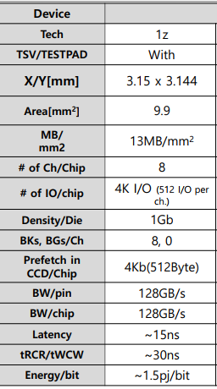
Intel Server Architecture + DRAM Interposer
#1. Mainstream/General Purpose Perf. Segment (Cache)
Bandwidth: 2.5 – 3 TB/s
  Using SKH 128MB/128GB/s 9.9mm2 macro:
  Need 24 macros for 3 TB/s
  24 * 9.9 = ~240mm2
Capacity: 6 GB (Baseline)
  Scalability option: 2x (12GB) to 4x (24GB) capacity at same bandwidth, additional cost
  Using SKH 128MB/128GB/s 9.9mm2 macro:
  Need 48 macros for 6GB →
  Provide macro with different BW/capacity ratio. Ex. 256MB/128GB/s in 19.8mm2?
Capacity | DRAM Area
6GB (1x) | ~480mm2
12GB (2x) | ~960mm2
24GB (4x) | ~1920mm2
SKH Proposal server Arch #1
SKH Confidential
Data shared under CNDA 30991112 & CNDA 112784

Slide 50
Intel Server Architecture + DRAM Interposer
#1. Mainstream/General Purpose Perf. Segment (Cache)
Bandwidth: 2.5 – 3 TB/s
  Using SKH 128MB/128GB/s 9.9mm2 macro:
  Need 24 macros for 3 TB/s
  24 * 9.9 = ~240mm2
Capacity: 6 GB (Baseline)
  Scalability option: 2x (12GB) to 4x (24GB) capacity at same bandwidth, additional cost
  Using SKH 128MB/128GB/s 9.9mm2 macro:
  Need 48 macros for 6GB →
  Provide macro with different BW/capacity ratio. Ex. 256MB/128GB/s in 19.8mm2?
Construction Options
  Compute area: ~1500mm2
  Baseline 6GB DRAM area: ~480mm2
  3x area delta , logic/DRAM will scale differently over time
  Scalability option for 2x – 4x capacity?
Compute
Compute
Compute
Compute
DRAM Interposer
DRAM
DRAM
Option 1: Interposer
Use older/cheaper DRAM node?
Option 2: Intel ODI Packaging
Capacity | DRAM Area
6GB (1x) | ~480mm2
12GB (2x) | ~960mm2
24GB (4x) | ~1920mm2
DRAM
Compute
DRAM
Option 3: DRAM cube
With scalable height for capacity
Logic Interposer
Can we use the SK logic interposer without DRAM ?
Data shared under CNDA 30991112 & CNDA 112784

Slide 51
Intel Server Architecture + DRAM Interposer
#2. AI/HPC Perf. Segment (Memory)
Bandwidth: 4 – 8 TB/s
  Using SKH 128MB/128GB/s 9.9mm2 macro:
  Need 64 macros for 8 TB/s
  64 * 9.9 = ~635mm2
Capacity: 16 GB
  Using SKH 128MB/128GB/s 9.9mm2 macro:
  Need 128 macros for 16GB →
  Provide macro with different BW/capacity ratio. Ex. 256MB/128GB/s in 19.8mm2?
Construction Options
  Compute area: ~1200mm2
  16GB DRAM area: ~1270mm2
  Compute/DRAM areas within ballpark
  Considering only 3D constructions (not 2.5D) due to very high bandwidth (at low energy) demands
Compute
Compute
DRAM Interposer
Capacity | DRAM Area
16GB | ~1270mm2
Option 1: Interposer
Data shared under CNDA 30991112 & CNDA 112784

