Slide 1
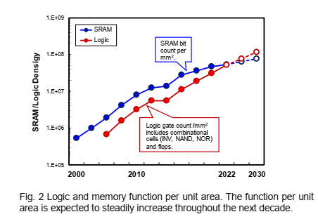
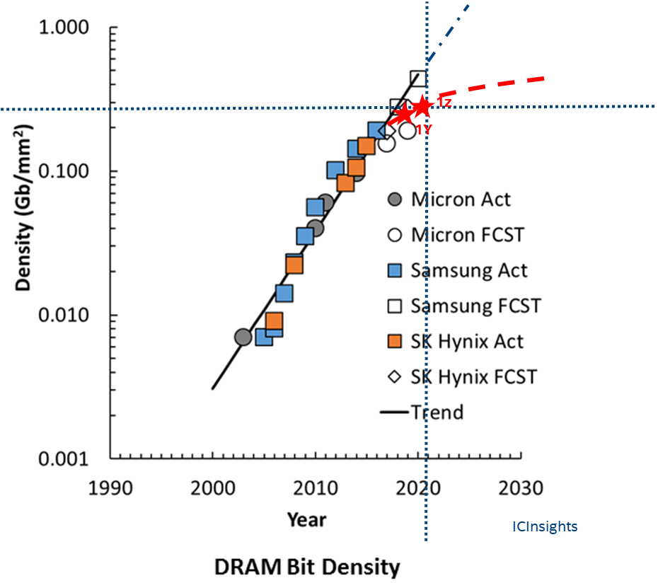
Logic & Memory Density Scaling
prashant majhi, FTE

Slide 2
DRAM Scaling: General Observations
Significantly reduced gen-2-gen array scaling since 2y nm node
Some additional periphery scaling to continue (with reduced) bit density scaling
Unclear pathway for significant dimensional scaling [limits to 2D scaling?]
3D DRAM (peri under array) may help with one time gain in bit density ..but cost?
Process simplification (including with EUV) may help reduce wafer cost?
prashant majhi, FTE

Slide 3
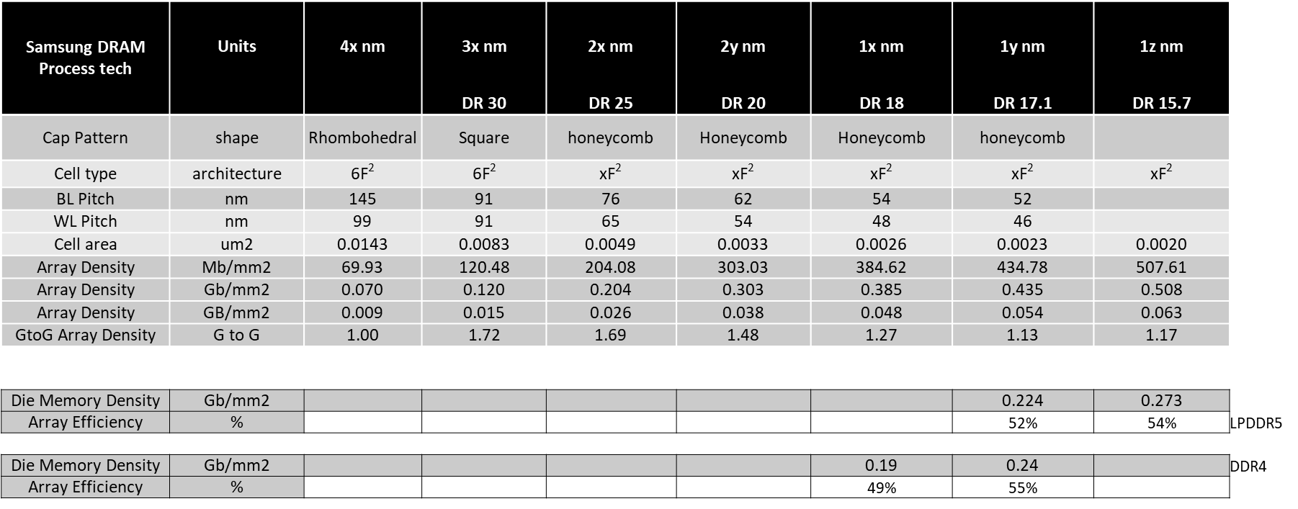
DRAM Scaling Trend to Date (1Z EUV):
Teardown
Product
prashant majhi, FTE

Slide 4
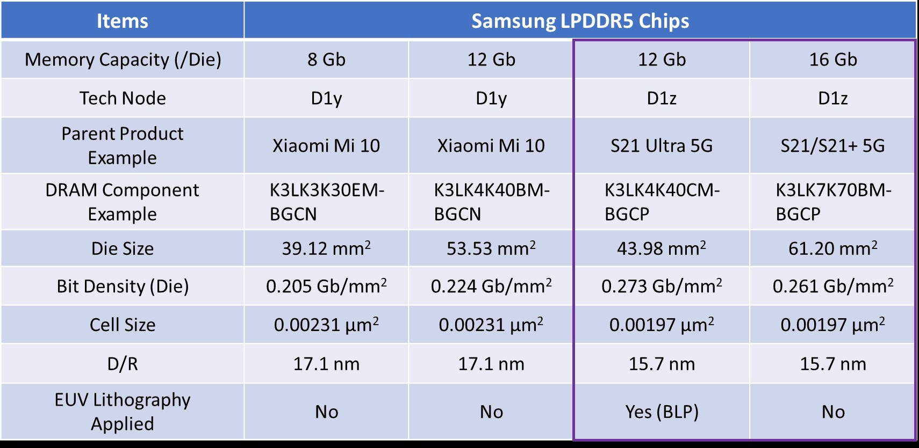
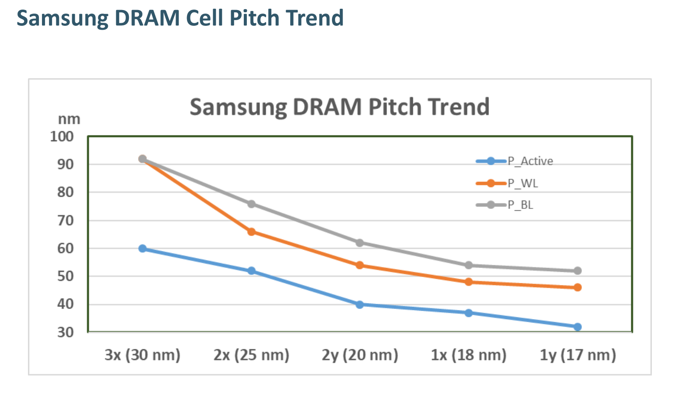
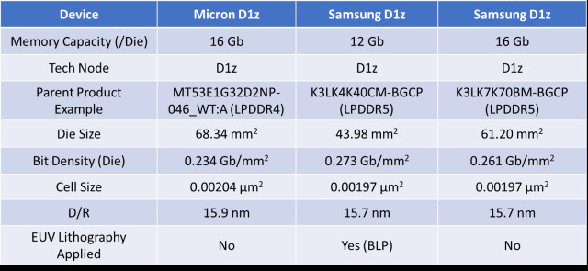
Samsung DRAM Feature Scaling
prashant majhi, FTE

Slide 5
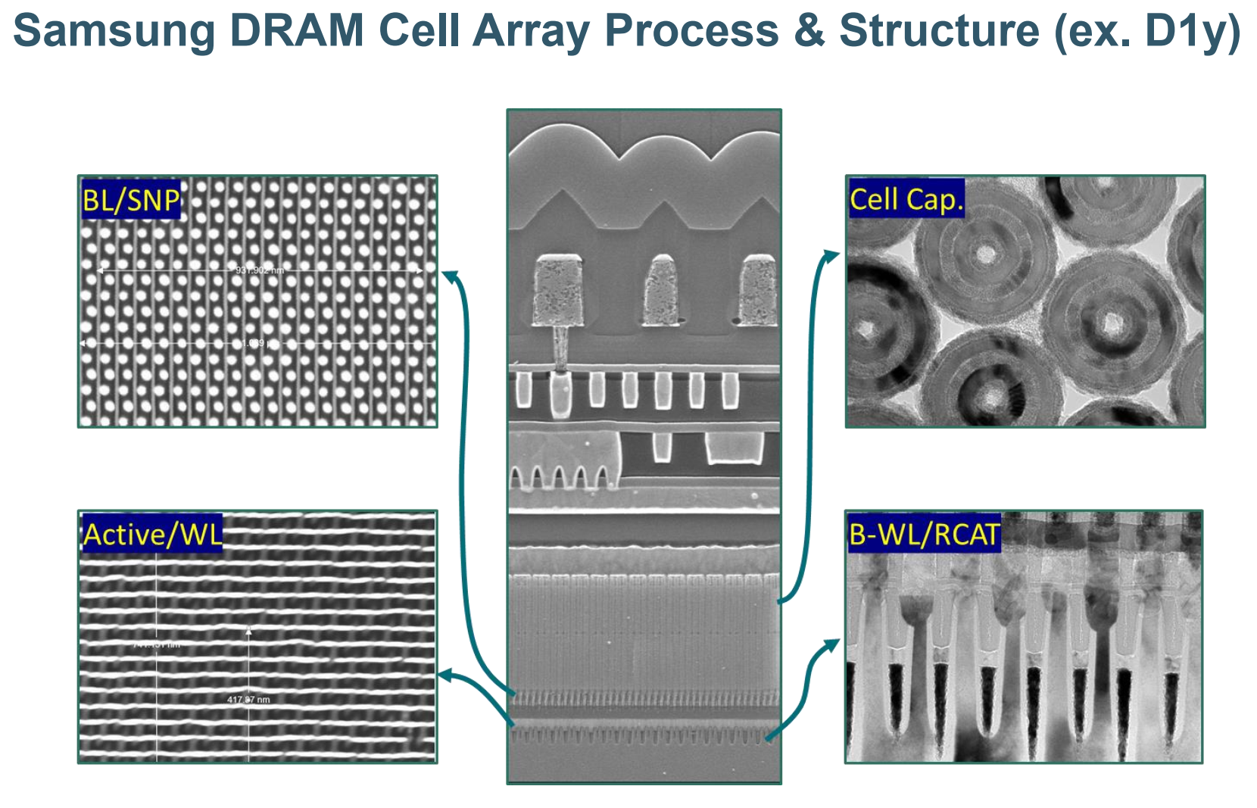
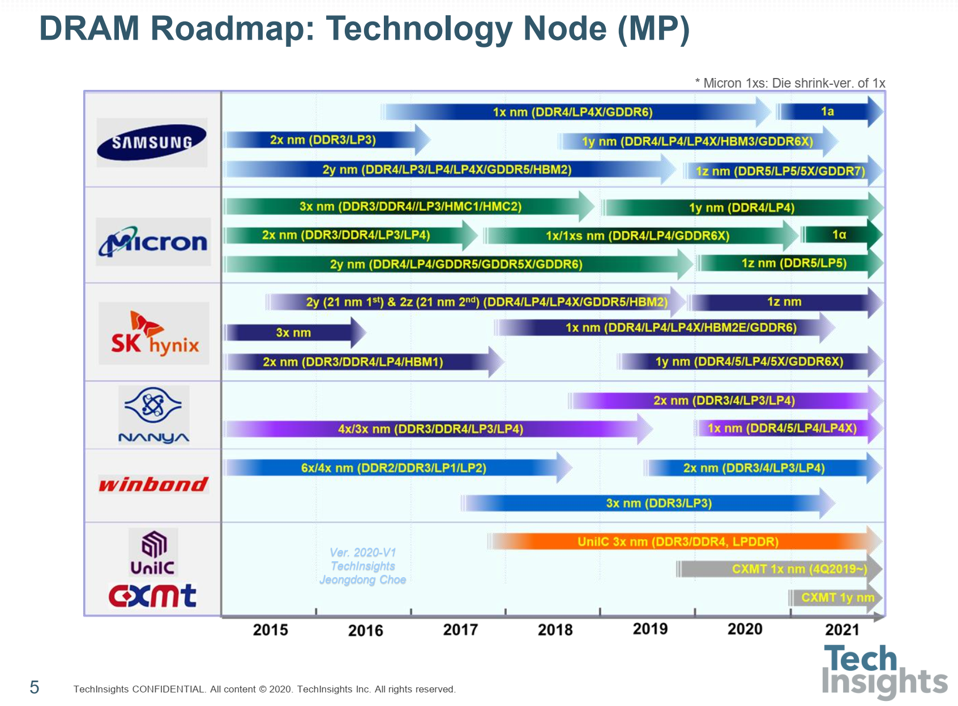
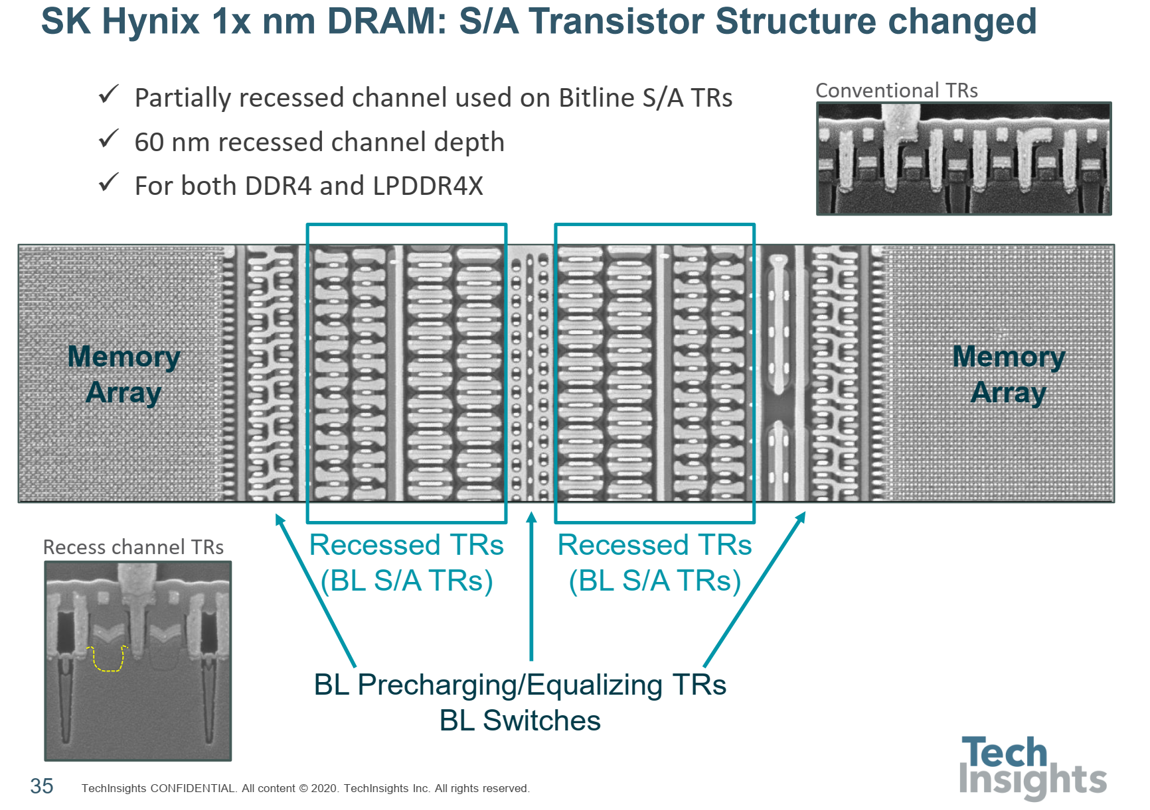
DRAM and CMOS Peri Roadmap
prashant majhi, FTE

Slide 6
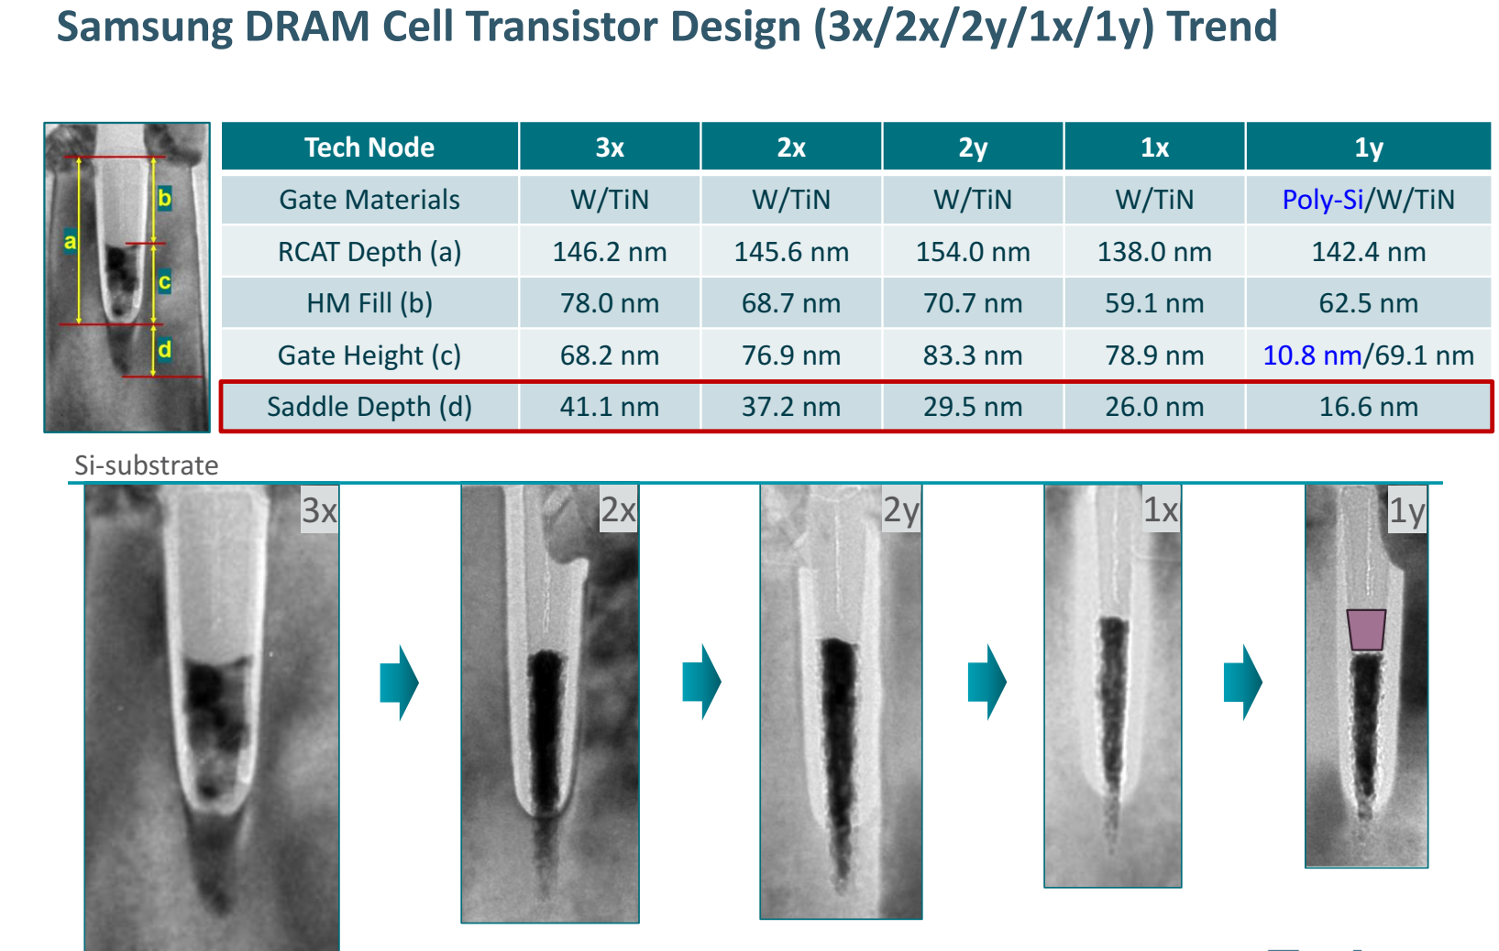
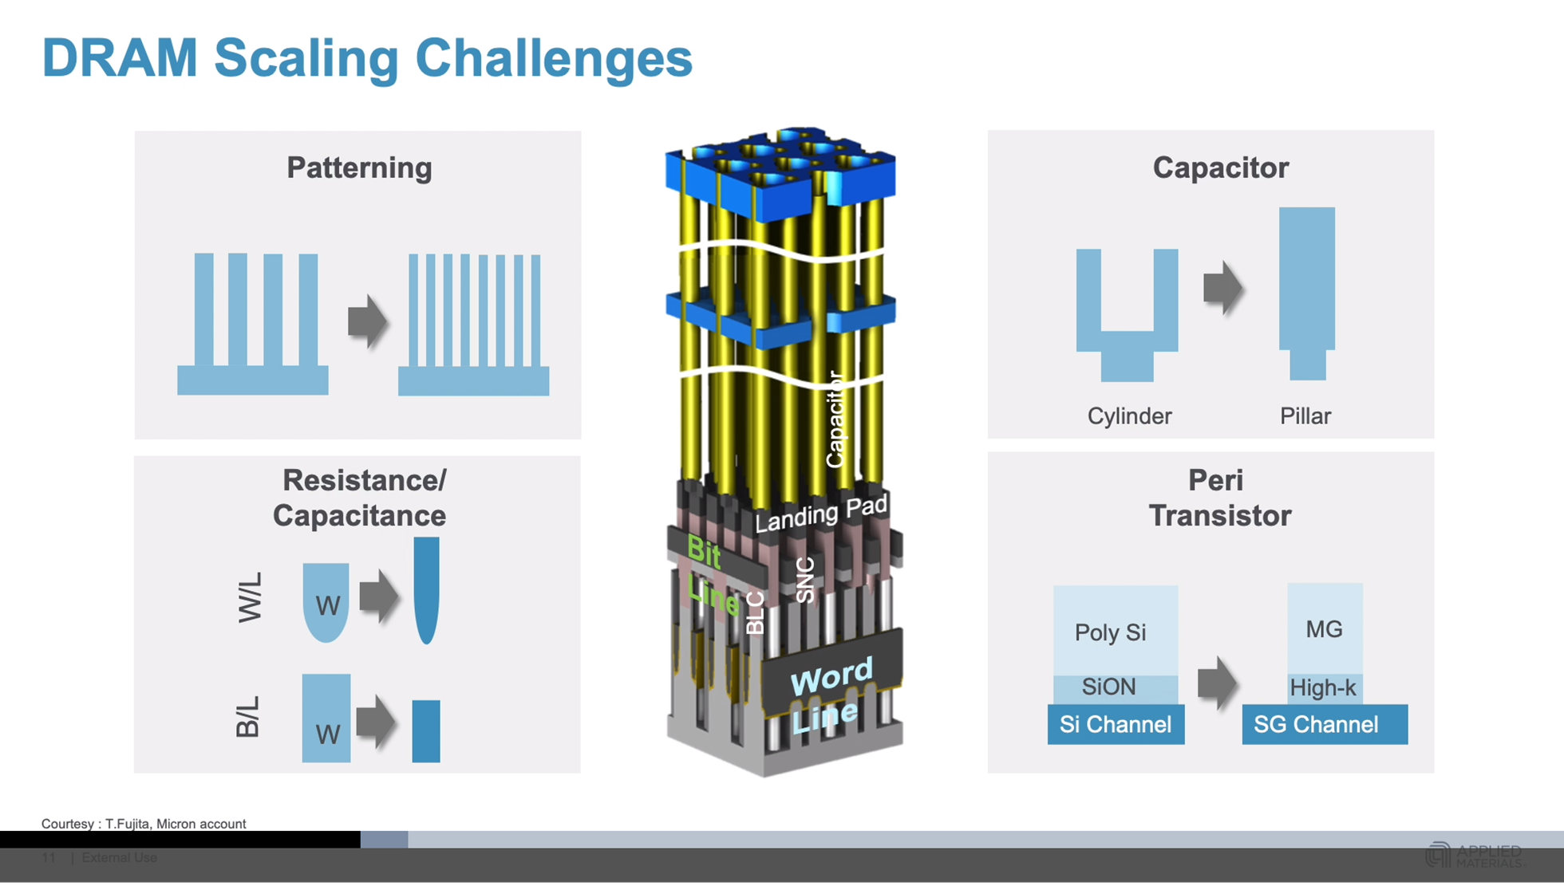
DRAM Scaling Challenges and Cell Transistor Trend
prashant majhi, FTE

Slide 7
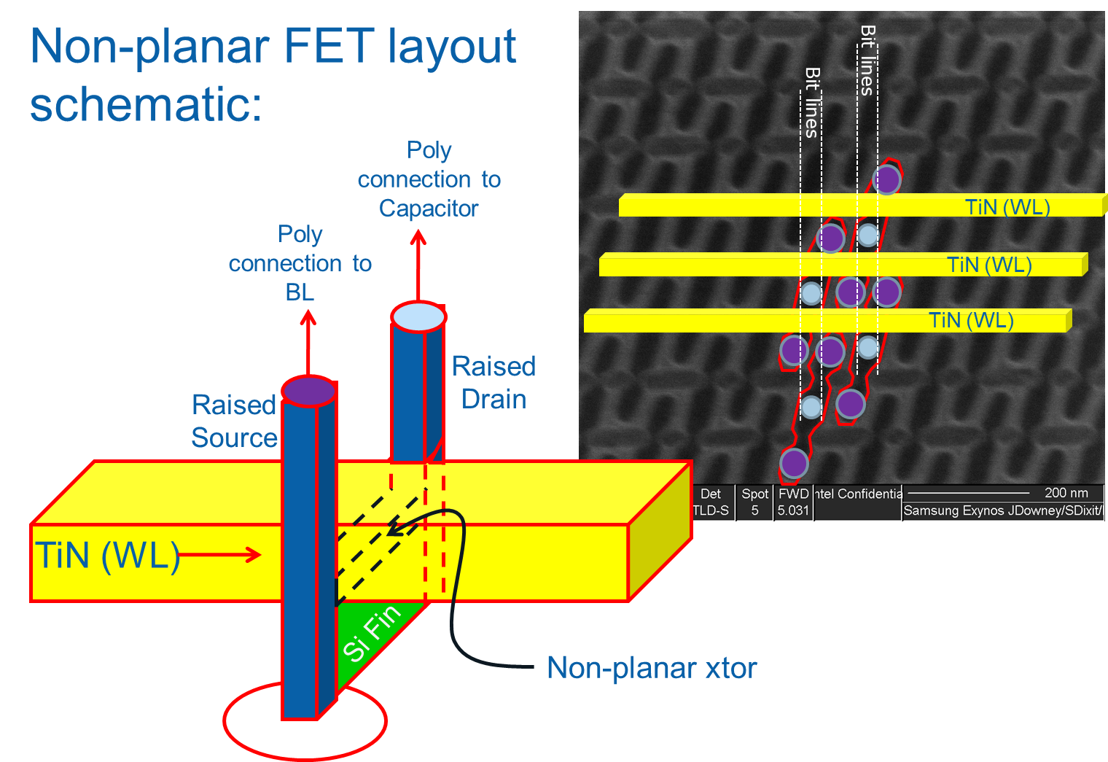
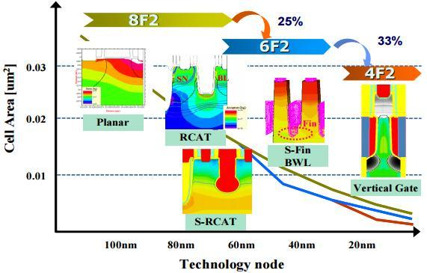
Can/Will 4F2 Cell Transistor Help?... Maybe Not
prashant majhi, FTE

Slide 8
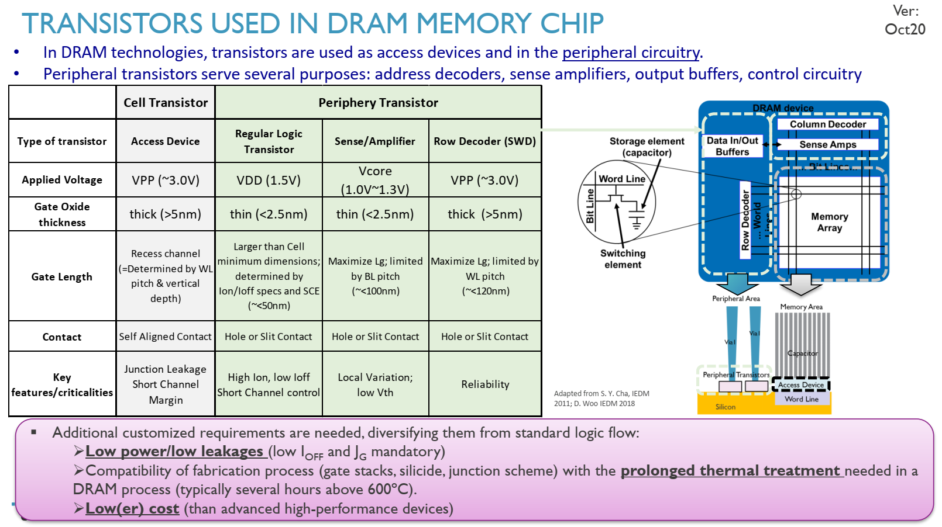
IMEC

Slide 9
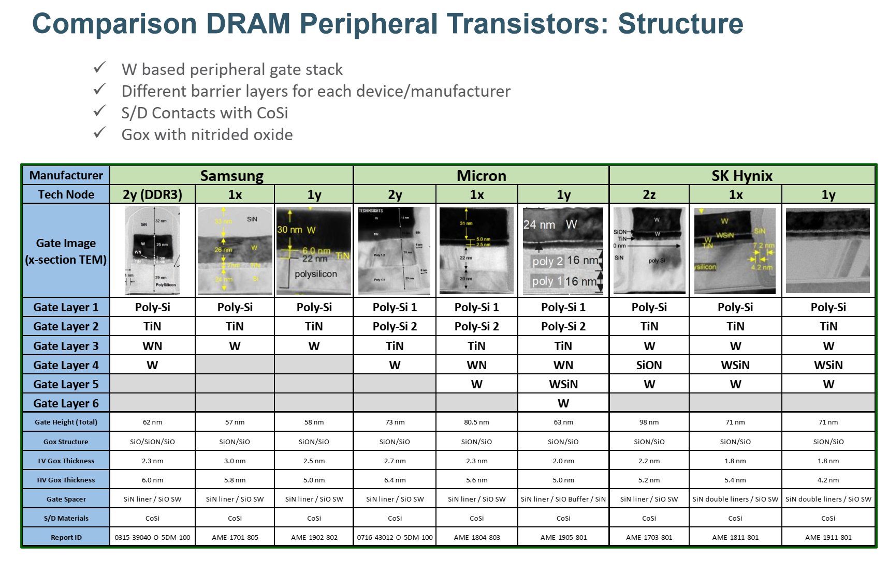

Slide 10
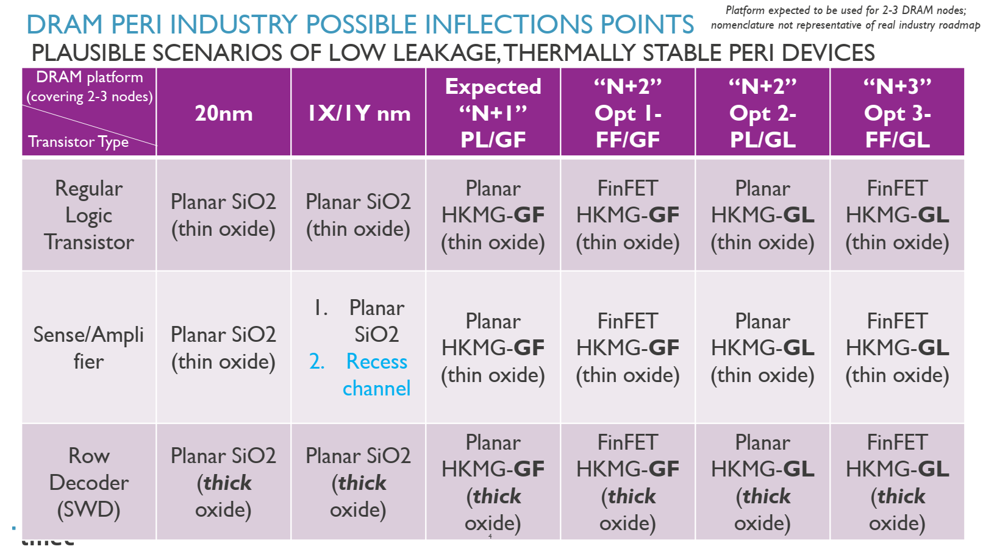
IMEC
IMEC DRAM Peri Focus
In production (Hynix)
Engineering Samples (Samsung GDDR6)?
prashant majhi, FTE

Slide 11
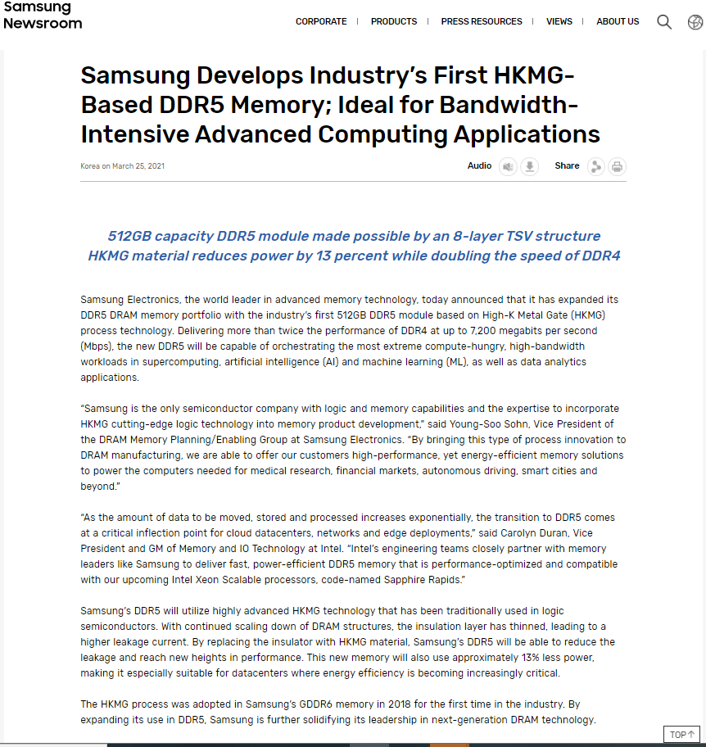
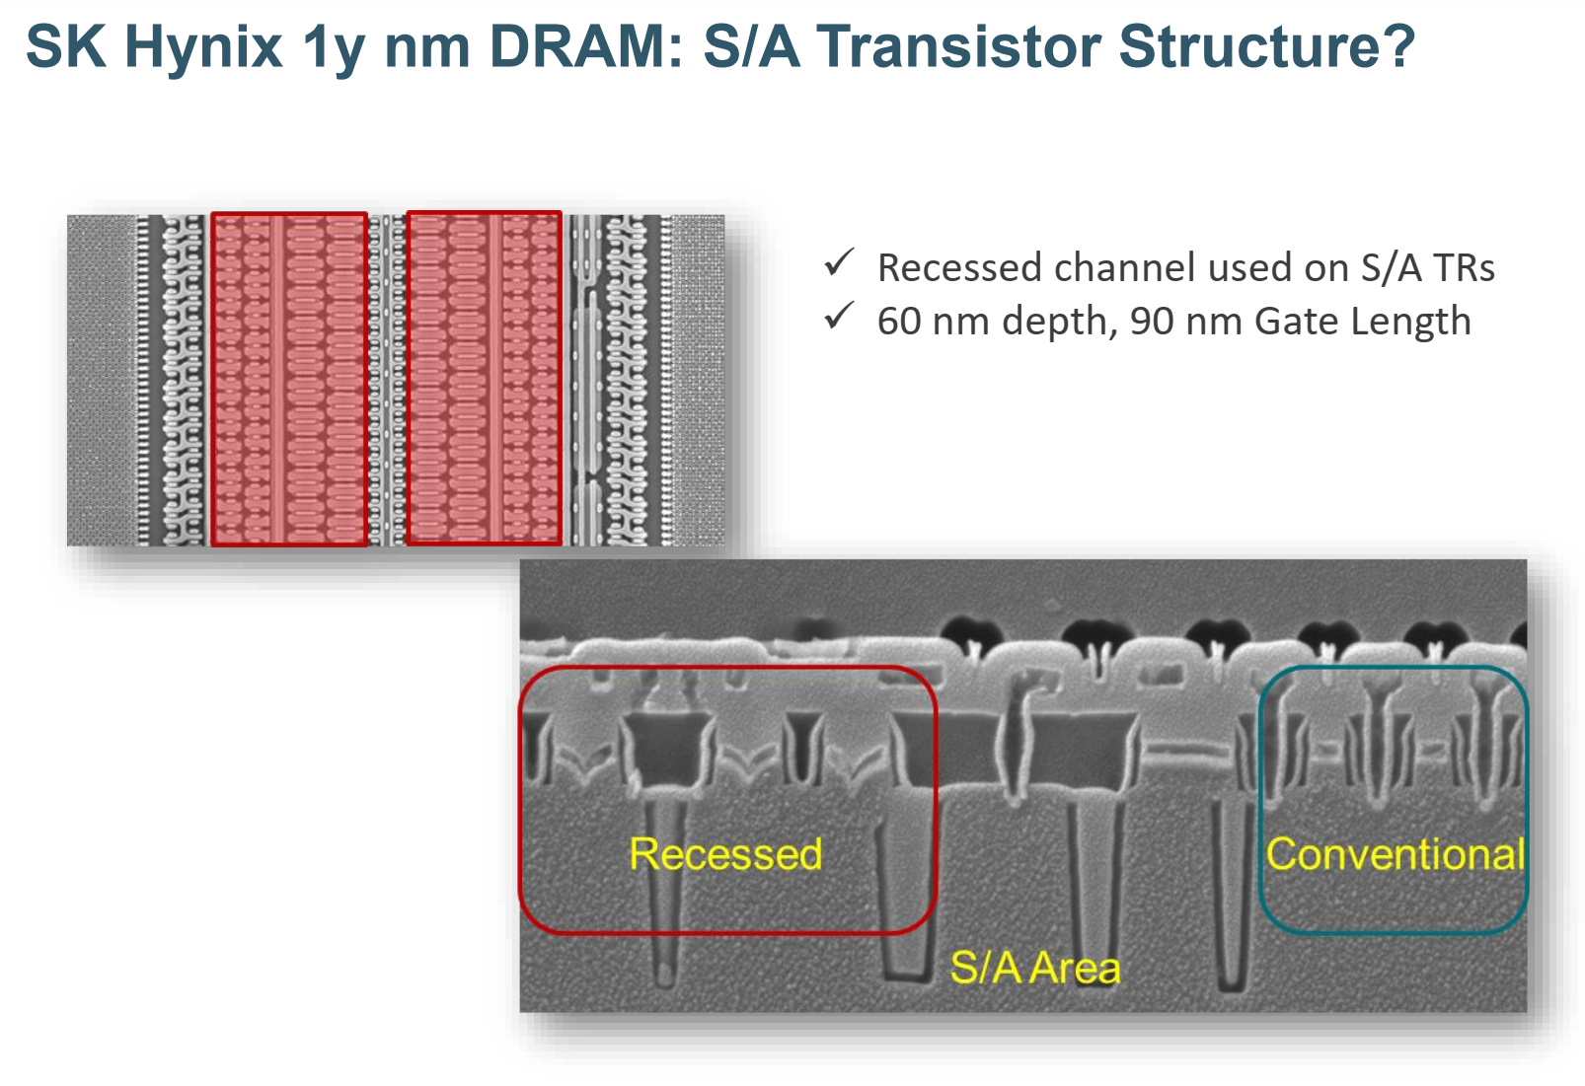
prashant majhi, FTE

