Slide 1
HBM3 Organization (JEDEC Spec R.95)
Bank is the lowest independently operable unit
DRAM core 250~400MHz (not scalable)
t_{CCD} (CAS2CAS delay, b2b same bank): 2.5~4ns
Hynix Spec: Open page latency (tAA) = 48ns
Close page latency (tRCD+tAA) = 31ns
Bank Group is supported for fast t_{CCDF})
Number of rows (pages) is part of HBM3 spec
52
HBM3
Channel₀
  Channel_{i}
…
…
Bank
Bank
Channel_{m}
….
Bank
120
RAS
SWD
Each stack of HBM die includes
(equivalent to 1 Rank of DDR DIMM)
Global command for the stack (52 µbumps)
Upto 16 channels / device (stack); upto 1K DQ
Double data rate @ 4.8~6.4GT/s (2.4~3.2GHz)
Max BW = 819.2GB/s/stack
I/O voltage 1.1 V, Tx driver voltage 0.4 V
DRAM core voltage 1.1 V
Unterminated data/add/cmd/clk interfaces
Unmatched data interfaces
2b encoded temp sensor
not prohibiting manufacturer specifics such as
an optional interface die in the stack
Signal redistribution and other functions
Bank
Bank
Memory Mat
….
Channels are full independent to each other
2~32Gb channel capacity [2^{31~35}b];
16, 32 or 48 banks per channel
64 DQ + ECC, SEV per channel. BL = 8
I/O (~90µbump) & ADD/CMD (~30µbmp)
2KB physical page [2¹⁴b]
1KB addressable [2¹³b], C[6:0]
BW = 38.4~51.2GB/s/Channel,
Max BW density = 205GB/s/GB
Bank grouping supported for short t_{CCD}
2 Pseudo Channel (PC) per Channel;
PCs share C/A RAS/CAS for finer granularity to lower cost to scheduler.
C/A
CSL
SA
CAS
Page
DQ + Metadata
52

Slide 2
TCM 2Gb Macro Organization
(Sep/2021 Rev 2)
Bank is the lowest independently operable unit
Bank Capacity 32Mb (2²⁸b); 8K WL; R[12:0]
DRAM core frequency 250MHz
t_{CCD} (CAS to CAS delay, b2b same bank): 4ns
Open page latency (tAA) = 15ns
Close page latency (tRCD+tAA) = 19.8ns
xx
2Gb Macro
Channel₀
  Channel_{i}
…
…
Bank₀
Bank₃
Channel₇
….
Bank
yyy
RAS
SWD
Each Macro includes
2Gb / Macro
8 channels / macro;
4K DQ
Double data rate @ 250MT/s (125MHz)
BW=128GB/s/macro,
Interface physical and electrical tbd
Hynix and Intel build based die separately with additional RDL
Bank₄
Bank₇
Memory Mat
….
Channels are full independent to each other
256Mb per channel capacity [2²⁸b]
8 banks per channel B[2:0]
DQ=512 [2⁹b] (HB required?)
½KB physical/addressable page [2¹²b] C[3:0]
BW = 16GB/s/Channel
BW density = 512GB/s/GB
Bank grouping ?
Pseudo Channel?
C/A
CSL
SA
CAS
Page
DQ + Metadata
52

Slide 3
High Level Spec Comparison
 |  |  | LPDDR5 | HBM3 |  | 2Gb Macro
 | Technology Node | nm | Hynix 1z | Hynix 1z | JEDEC R.95 | TCD 1z (512)
Die, including JEDEC device / stacked-die | Capacity | Gb | 16 | 16 | 2~512 | 2
 | Footprint | mm² | 60.72 | 115.06 | n/a | 16.07
 | Density | Mb/mm² | 270 | 142 | n/a | 127
 | # of DQ / die | pins | 16 | 256 (1K allocated) | uptp 1024 | 4096
 | # of Channel /Die | # | 1 | 4 | upto 16 | 8
 | Transfer Rate | GTpS | 6.40 | 6.40 | 4.8~6.4 | 0.25
 | Bandwidth Density | GB/s/GB | 6.4 | 102 | max. 205 | 512
 | Latency (Close page) | ns | 40.00 | 48.00 |  | 19.80
 | Latency (Open page) | ns | 25.00 | 31.00 |  | 15.00
 | access latency / t_{CCD} | ns | 2.50 | 2.50 | 2.5~4.0 | 4.00
Channel | Channel Capacity | Mb/Channel | 16384 | 4096 | 2K~32K | 256
 | DQ / Channel | pins | 16 | 64 | 64 | 512
 | # of Bank / Channel | Bank/Channel | 16 | 16 | 16, 32, 48 | 8
 | BW/Channel | GB/s/Channel | 12.8 | 51.2 | 38.4~51.2 | 16
Bank, Partition | Bank Capacity | Mb/Bank | 1024 | 256 | see spec | 32
 | # of col of Mat/Tile (GBL) | n | 16 | 16 | n/s | 8
 | # of Row of Mat/Tile (GWL) | n | 64 | 32 | n/s | 16
 | Physical Page Size | bits | 16384 | 16384 | 16384 | 4096
Mat, Tile | Array Capacity | Mb/Array | 1.00 | 1.00 | n/s | 0.250
 | # of BL | Col | 1024 | 1024 | n/s | 512
 | # of WL | row | 1024 | 1024 | n/s | 512

Slide 4
High Level Spec Comparison (2)
 |  |  | LPDDR5 |  | HBM2 | HBM3 |  | 2Gb Macro | AP HVM
 | Technology Node | nm | Hynix 1z | Apple M1 Pro | Hynix 1z | Hynix 1z | JEDEC R.95 | TCD 1z (512) | 2y
Die, including JEDEC device / stacked-die | Capacity | Gb | 16 | 64, 128 | 16 | 16 | 2~512 | 2 | 32
 | Footprint | mm² | 60.72 |  | 104.17 | 115.06 | n/a | 16.07 | 220-320
 | Density | Mb/mm² | 270 |  | 157 | 142 | n/a | 127 | 100~150
 | # of DQ / die | pins | 16 | 128 | 128 (1K/stack) | 256 (1K/stack) | uptp 1024 | 4096 | 10K
 | # of Channel /Die | # | 1 | 8 | 8 | 4 | upto 16 | 8
 | Transfer Rate | GTpS | 6.40 | 6.4 | 03.20 | 6.40 | 4.8~6.4 | 0.25 | 3.20
 | Bandwidth Density | GB/s/GB | 6.4 | 12.8~6.4 | 51.2 | 102 | max. 205 | 512 | 1024
 | Latency (Close page) | ns | 40.00 |  |  | 48.00 |  | 19.80
 | Latency (Open page) | ns | 25.00 |  |  | 31.00 |  | 15.00
 | access latency / t_{CCD} | ns | 2.50 |  |  | 2.50 | 2.5~4.0 | 4.00
Channel | Channel Capacity | Mb/Channel | 16384 | 8192,16384 |  | 4096 | 2K~32K | 256
 | DQ / Channel | pins | 16 | 16 |  | 64 | 64 | 512
 | # of Bank / Channel | Bank/Channel | 16 |  |  | 16 | 16, 32, 48 | 8
 | BW/Channel | GB/s/Channel | 12.8 |  |  | 51.2 | 38.4~51.2 | 16
Bank, Partition | Bank Capacity | Mb/Bank | 1024 |  |  | 256 | see spec | 32
 | # of col of Mat/Tile (GBL) | n | 16 |  |  | 16 | n/s | 8
 | # of Row of Mat/Tile (GWL) | n | 64 |  |  | 32 | n/s | 16
 | Physical Page Size | bits | 16384 |  |  | 16384 | 16384 | 4096
Mat, Tile | Array Capacity | Mb/Array | 1.00 |  |  | 1.00 | n/s | 0.250
 | # of BL | Col | 1024 |  |  | 1024 | n/s | 512
 | # of WL | row | 1024 |  |  | 1024 | n/s | 512

Slide 5
High Level Spec Comparison (2)
 |  | LPDDR5 |  | HBM2 | HBM3 | 2Gb Macro | AP HVM
Technology Node | nm | Hynix 1z | Apple M1x | Hynix 1z | Hynix 1z | TCD 1z (512) | 2y
Pricing estimate | $/Gb | .50 | .50 | 2.00 | 2.00
Component Unit |  | Die | Package | Package | Package | Macro | Macro
Capacity / Component | Gb | 16 | 64 | 64 | 64 | 2 | 32
Footprint | mm² | 60.72 |  | 104.17 | 115.06 | 16.07 | 220-320
Density | Mb/mm² | 270 |  | 157 | 142 | 127 | 100~150
# of DQ / component | pins | 16 | 128 | 1024 | 1024 | 4096 | 10K
# of Channel / component | # | 1 | 8 | 32 | 16 | 8
Transfer Rate | GTpS | 6.40 | 6.4 | 3.2 | 6.40 | 0.25 | 3.20
Bandwidth | GB/s | 12.8 | 102.2 | 409.6 | 819.2 | 128
Bandwidth Density | GB/s/GB | 6.4 | 12.8 | 51.2 | 102.4 | 512 | 1024
Normalized Bandwidth/$ | Ref. LPDDR5 | 1 | 2 | 2 | 4
Channel Capacity | Gb/Channel | 16 | 8 | 2 | 4 | 1/4
DQ / Channel | pins | 16 | 16 | 32 | 64 | 512

Slide 6
Compute Memory Disaggregation
Channel_{i}
Host
Memory Farm
Channel₀
Bank₀
Bank_{m-2}
….
Bank_{j}
…
…
Channel_{n-1}
RAS
SWD
Bank₁
Bank_{m-1}
….
Memory Mat
Logic
Logic
C/A
Access Device
CSL
Si channel planar / nonplanar XTOR
TFT channel planar / nonplanar XTOR
2T [independent read write] Option
Mat
SA
High-k Capacitor
MRAM [STT/SOT]
Ferro-capacitor
Nanostructure change
CAS
Decoder / Driver
Page
Memory Element
DQ + Metadata
Access Device
Thermionic
[diode, MIEC, ..]
Volatile filament
Metal-Insulator Transition
Ovonic Threshold
Logic and Mix Signal
Magnetic
[MRAM, STT(SOT)MRAM]
Resistance Change ReRAM[1D, 2D], PCM [3D]
Ferroelectrics
Memory Element
SA / Data Latch
Memory Specific
Mix Signal

Slide 7
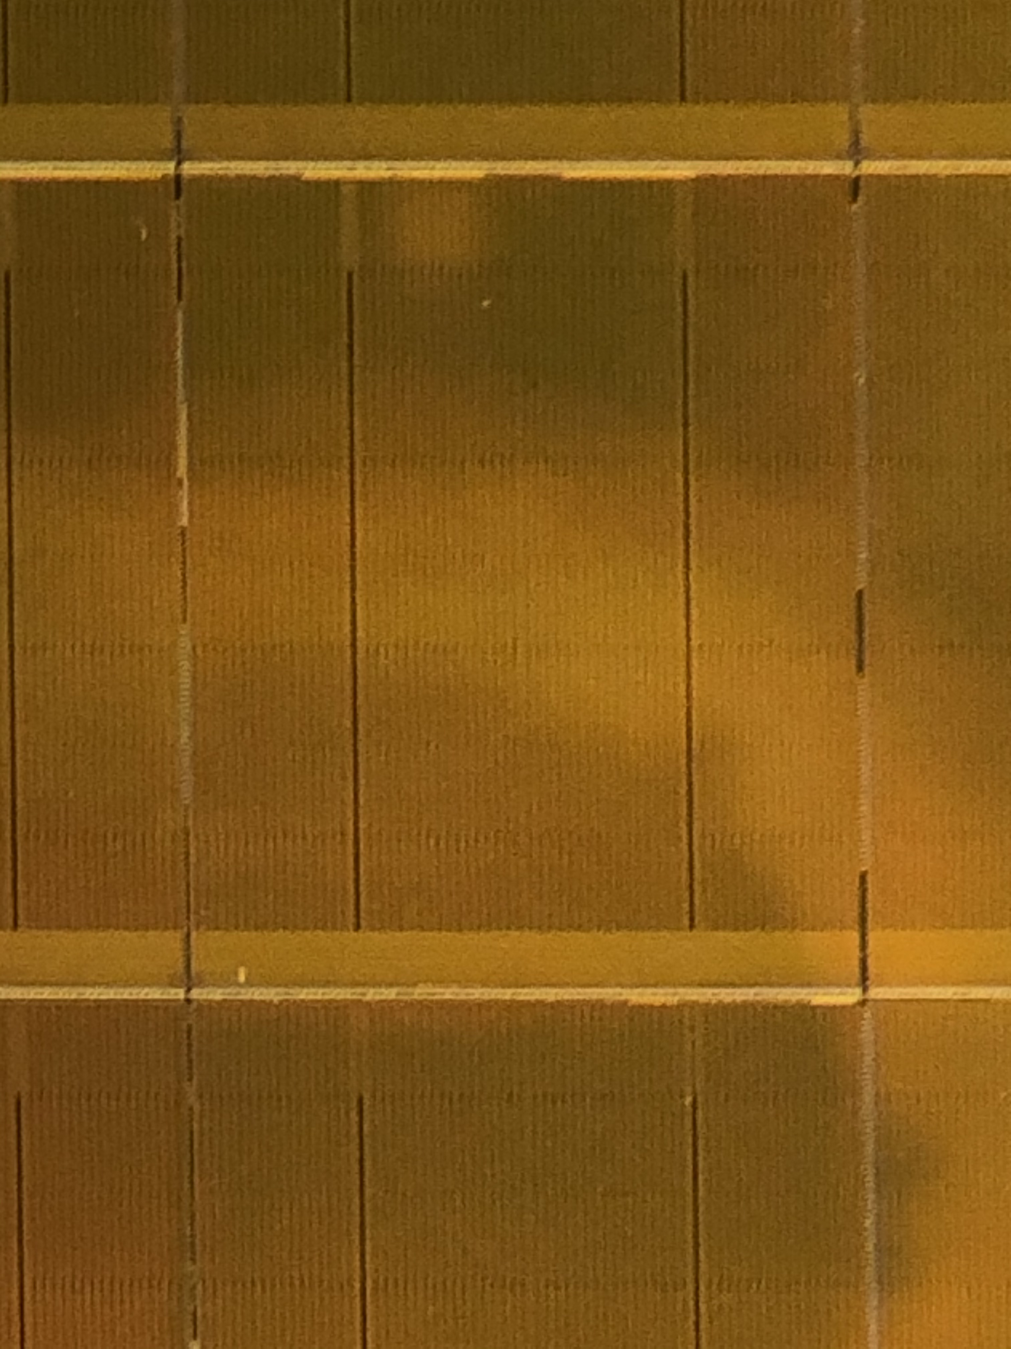
3DXP Component Organization
1/Tile
Array
64Mb/tile
4X4 Patches/Tile
Patch footprint is ~[50µm]²
@ 41P node
Data Buffer
Read / Write
64/Patch
Global MUX
Command /
Data
Interface
Address Tag
Analog / control
32/Patch
64/Patch
Local MUX
State Machine
(Instruction)
1K/Patch
On Pitch Via
HiZ Path
LoZ Path
LVT
Mixed
HVT
Die size = 200mm²
Shaded area is global ~ 17mm²
4KTiles (64K Patches) occupy ~155mm²
Routing takes ~20mm²

Slide 8
Memory and Array Core
Access Device
Control/decode
Decoder/ Driver
Mat
Si channel planar / nonplanar XTOR
TFT channel planar / nonplanar XTOR
2T [independent read write] Option
Memory Mat
X, X-Y or X-Y-Z
Termination and Socket included
Decoder / Driver
High-k Capacitor
MRAM [STT/SOT]
Ferro-capacitor
Nanostructure change
Memory Element
Access Device
SA/Latch
Thermionic
[diode, MIEC, ..]
Volatile filament
Metal-Insulator Transition
Ovonic Threshold
SA / Data Latch
Page Buffer
Magnetic
[MRAM, STT(SOT)MRAM]
Resistance Change ReRAM[1D, 2D], PCM [3D]
Ferroelectrics
DQ
Memory Element
Logic and Mix Signal
Mix Signal
Memory Specific

Slide 9
Compute Memory Disaggregation
Channel
Bank
Host
Memory Farm
Mat
Mat
Bank
Bank
Channel
….
….
…
…
…
…
Channel
Mat
Mat
Bank
Bank
….
….
Logic
Logic
Logic and Mix Signal

Slide 10
Mat

Slide 11
3DXP 3DIC Strategy
3DXP Team 3DIC
WW47.3

Slide 12
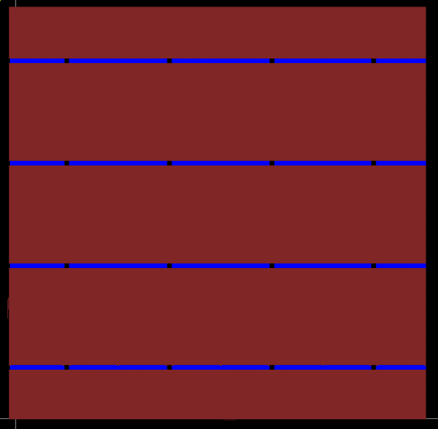
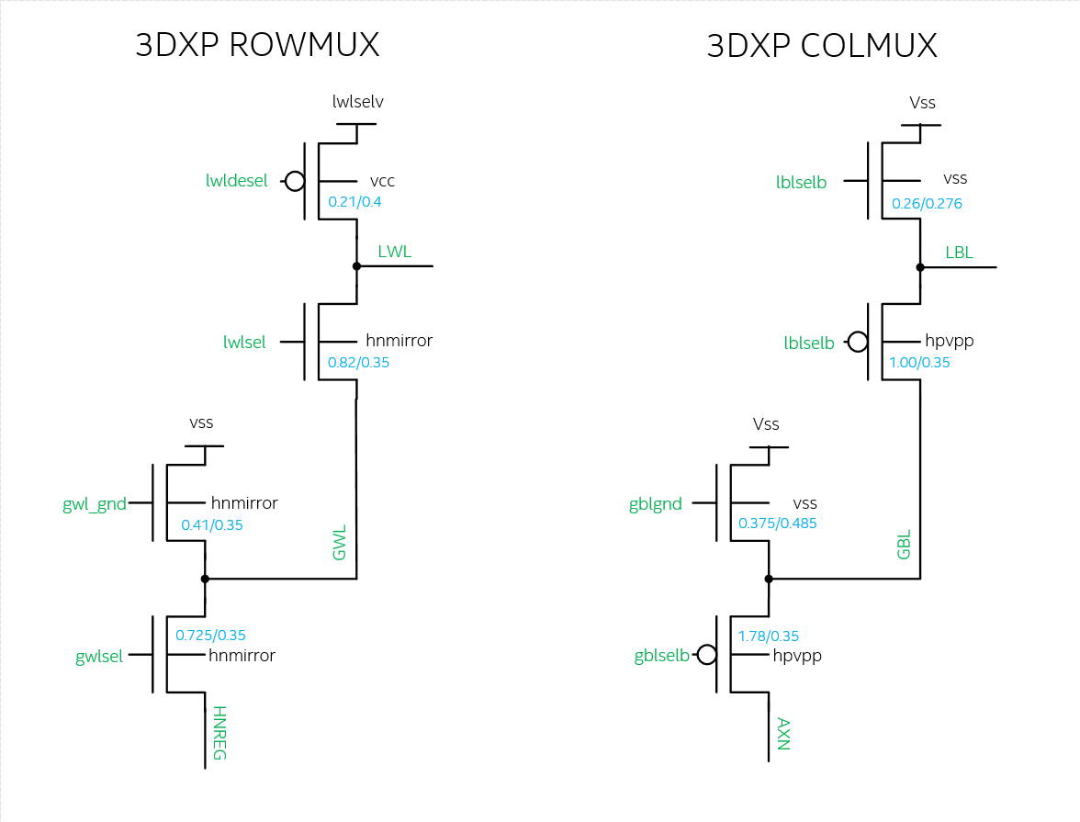
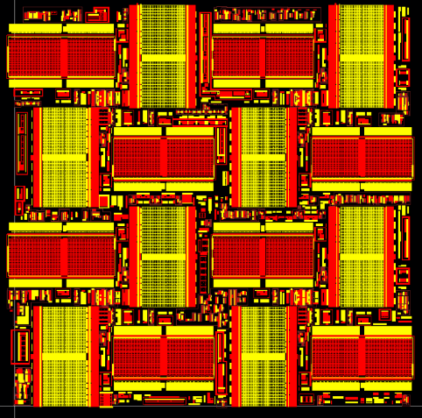
P1240/ALF32 Decoder
One Tile of 3DXP
16k Sel. + 16k Desel. Per tile
4096 tiles/die.
130mm² area for decoders
NDIFF & PDIFF

Slide 13
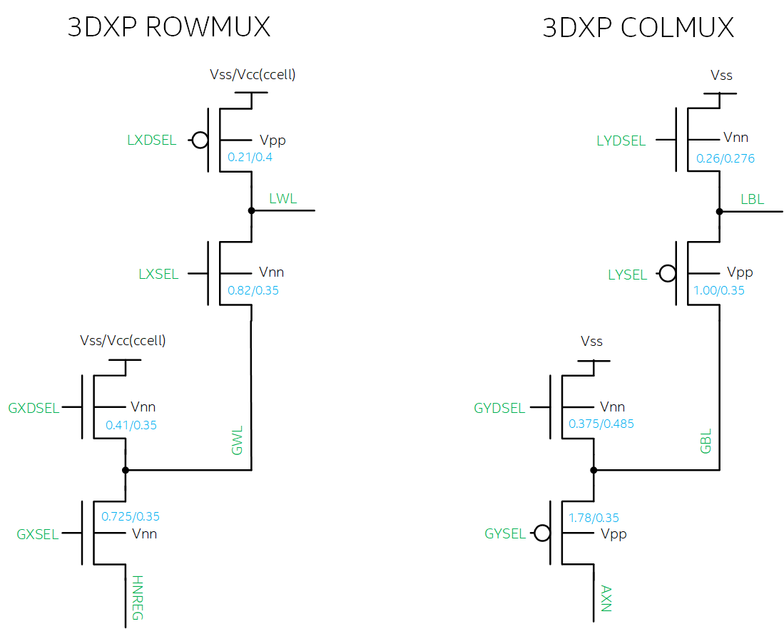

Slide 15
Problem Statement and Solution Space Scope
Decoder Scaling becomes cost inhibitive or performance inhibitive
Solution Spaces
  Si Bulk CMOS augmentation – Trench, FinFET, SOI
  3D Integrated circuits – monolithic 3D, stacked 3D, wide E_{G} FET
Key questions to guide 3DIC strategy development
  Which function block can be replaced by thin film transistor.
  What is circuit connectivity between bulk and thin-film devices.
  Seeking for modular strategy enabling density and performance scaling roadmap.

Slide 16

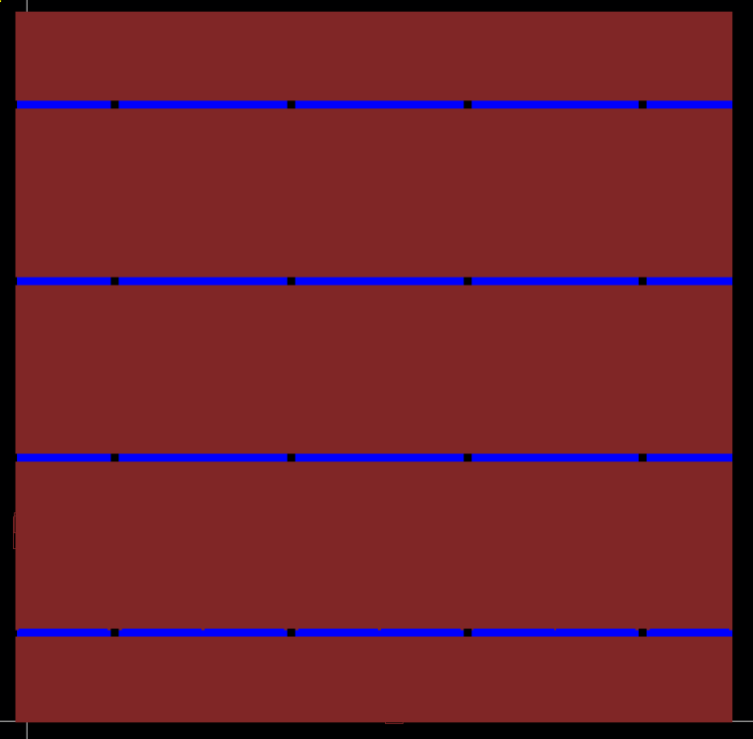
A_TILE
NDIFF & PDIFF
AM1 & AM23

Slide 17
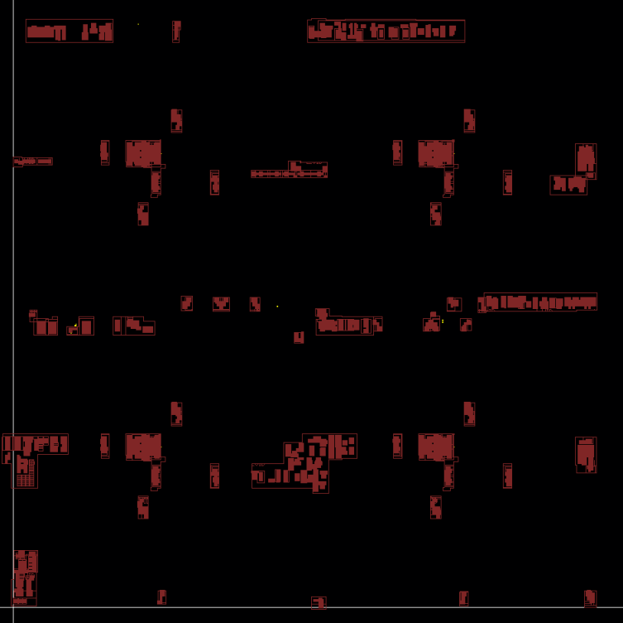
A_TILE
NDIFF & PDIFF
LVID

Slide 18
HVT Success Criteria
The goal is to meet or exceed ALF HVT device target spec
Electrical
  NMOS: Idsat ~500uA/um & Ioff ~10pA/um at L=350nm
  PMOS: Idsat ~ 300uA/um & Ioff ~ 1nA/um at L=350nm
Reliability (7-year AC lifetime)
  TDDB (5.3V stress): <100x increase in gate leakage at 5.57V
  BTI (5.3V stress): 10% Idsat degradation at Vd=Vg=5.1V
  CHC (WC stress): 10% Idsat degradation at Vd=Vg=5.1V

Slide 20
Modularity
3DIC
  Monolithic √
  Stacked
Monolithic
  Gate oxide division
  Function block division
  HVT Type √

Slide 21
Modularity for 3DIC
Array
64Mb/tile
4X4 Patches/Tile
Patch footprint is ~[50µm]²
@ 41P node
TM
Data Buffer
Read / Write
1/Tile
Array
64/Patch
Global MUX
M4
Command /
Data
Interface
Address Tag
M3
Analog / control
M2
32/Patch
M1
LV / HV MOS
64/Patch
Local MUX
State Machine
(Instruction)
1K/Patch
On Pitch Via
HiZ Path
LoZ Path
LVT
Mixed
HVT
TM
TM
Array
Array
Replacement strategy – Which potion of HVT can be replaced by thin film transistor: all, Mux only, or local Mux only
Vertical placement – What is connectivity from circuit in substrate to circuit in thin film: below M1 or below M4 or other multilevel interconnect scheme.
Modularity for scaling such as wafer stacking feasibility
M4
M4
M3
M?
M2
MUX
M1
M?
HVT
M2
LV
M1
LV / HV

Slide 22
ATF HIGH LEVEL FLOOR PLAN
Not all of this termination edge fits under the array
PART 31
GBLS DRVR/TERM ANALOG
Tile 127
GWLS DRVR/TERM CAPS
PCL/LBLS & LBLd DRVRS
Tile 0
LWLs/LWLd/PCL CTRL DRVRS
PART 0
PERIPHERY
IO
Tile Circuits: Decoders, VDM source followers, current mirrors, sense amp, mask logic, ..
Partition Circuits: Address drivers, PCL, VDM_DAC, iREF_DAC
PERIPHERY CIRCUITS: PL, Fuses, redundancy matching, HV regulators,..
IO CIRCUITS: PADS, Tx, Rx, DLL,..
Intel Confidential

Slide 23
A_TILE
NDIFF & PDIFF
LVID

Slide 24
BLOCK DIAGRAM
axn
32 Global Selects
1 Global deselect
Global Column mux
32 Local Selects
16 Local deselects
32 GBL’s
IO (PADs, Tx, Rx, DLL,..)
Local Column mux
Address Drivers
(GBL, LBL, GWL, LWL)
BL Tile Circuits
( BL Voltage mux, Mask Logic, Sense Amp)
1024 LBL’s
Periphery Logic
( Command processor, SIPO, PISO,.. )
Partition Control Logic
(Read/Write algo u-controller)
1024 LWL’s
WL Tile Circuits
( WL VDM, Mask Logic, Current Mirrors, Spike mit)
Local Row mux
Partition Analog
( VDM_DAC, iREF_DAC,…)
32 Local Selects
16 Local deselects
HV ( Fuses, redundancy matching, regulators )
32 GWL’s
Global Row mux
32 Global Selects
1 Global deselect
hnreg
IO/Periphery
Partition x32
Tile x128 per partition
Global/Local mux’s x8 per tile
LV + HV
LV + HV
LV + HV
HV

Slide 25
Monolithic thin film transistor topology
Front Gate
Back Gate
G
S
D
S
D
Flip Front Gate
Back Gate II
S
D
G
S
D
Hybrid
S
D
G

Slide 26
Modularity
3DIC
  Monolithic √
  Stacked
Monolithic
  Gate oxide division
  Function block division
  HVT Type √

Slide 27
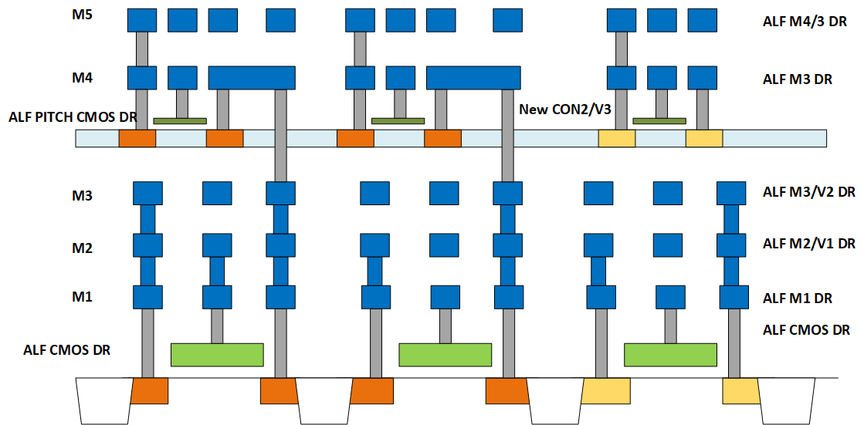
Design Rules for SXP 3DIC
Follow design rules for ALF CMOS for lower and upper deck CMOS.
  Upper deck HV only.
  Lower Deck HV + LV.
Map metal design rules as shown in the figure.
Introduce new con2/v3 rules
  Con2 => same rules as CON, except interacts with upper deck CMOS ONLY. Connects upper decks Diffusion/poly to M4.
  Via3 connect M3 directly to M4.
    Via3 Size: 2x2, Space 3.0
    M3 overlap of V3 1.0.
    M4 coverage of V3: 0.50
    Via3 Space to upper deck Diff/Poly 2.0.

Slide 28
Backup Materials

Slide 29
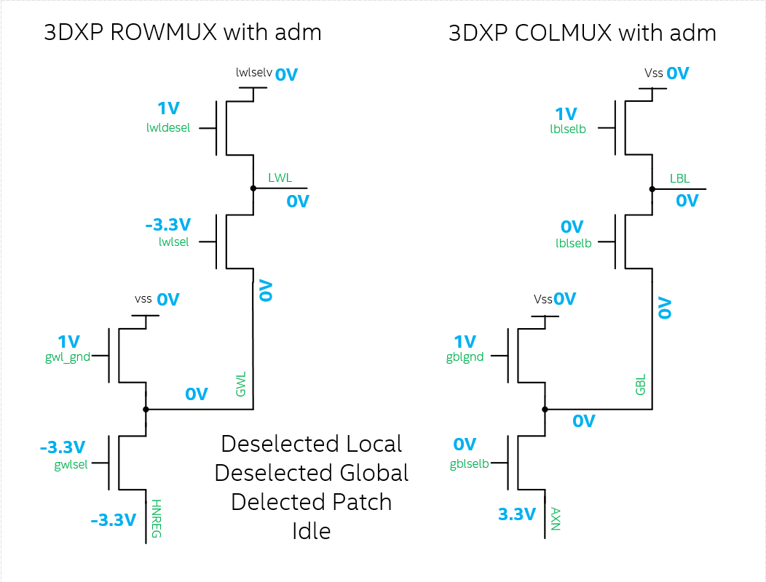
Idle

Slide 30
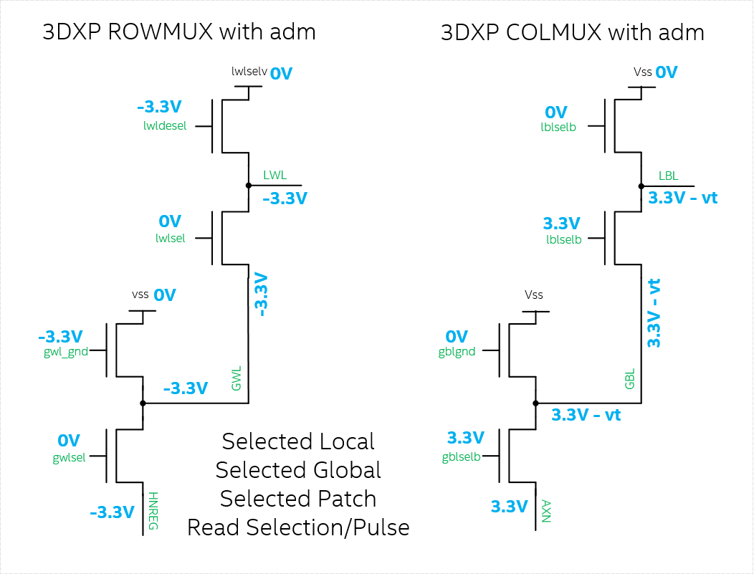
Read Algo SL SG SP
Does this
work?

