Slide 1
Chiplets –
Memory chiplet/placement/utilization
PHW

Slide 2
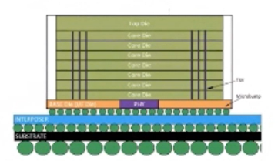
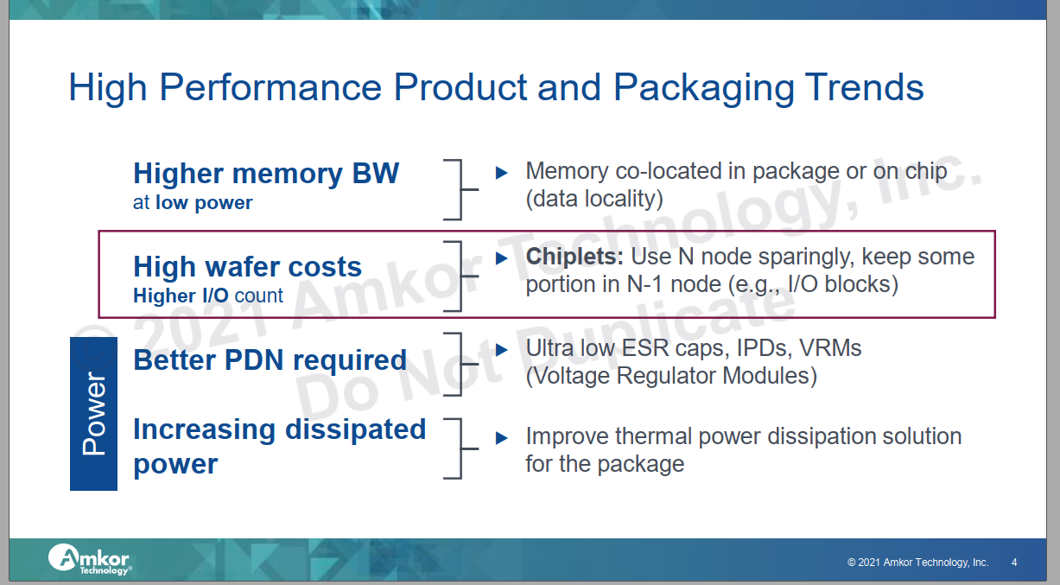
Why chiplets and how?
System level going chiplets disaggregation for various reasons.
Memory hierarchy allocation impacts performance (particularly BW)/power/cost
  HBM type DRAM 1st true commercial Known Good Stacking dies
  CoWoS biggest customer is to handle HBM/GPU or CPU connection today
Commodity HBM DRAM chiplet (KGSD-stacking die) achieved all aspects
Process (legacy DDR4/5 )
Additional DRAM memory controller/packaging re-design
Typical 3D packaging OH –TSV, extra MC/interface….
CoWoS-R roadmap is all for HBM integration w/ CPU/server (huge chip interposer size/reticle stitch)
DRAM Commodity price Reference
DDR5/6 ~$7/GB
HBM2 ~$11/GB
Notes:
Ira Feldman kicked off
Ravi, Jaspreet (Xilinx), and 2 independent people were the “program committee”
Ravi moderated day 1, Greg Taylor moderated day 2

Slide 3
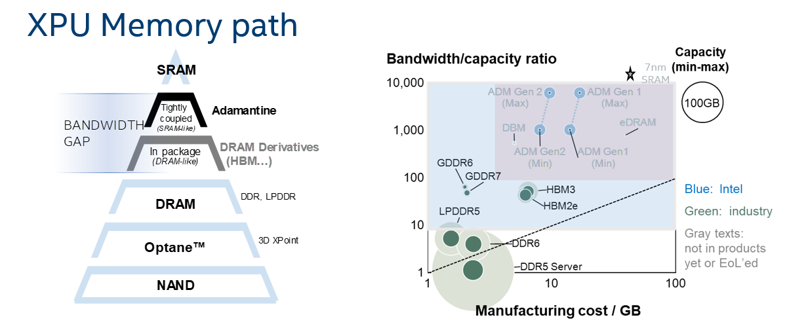
Memory CSD decision
Strengthen XPU product leadership by establishing a differentiated cache strategy
  Invest and deliver Adamantine technology roadmap for a differentiating 1s of Gigabytes cache
  Commit to employing that solution for AI/Graphics/Xeon products (Elasti G3/ARL-px)
Notes:
Main driver she noted was to economically address die size growth
While EMIB is the most famous embedded bridge, others also have embedded bridges

Slide 4
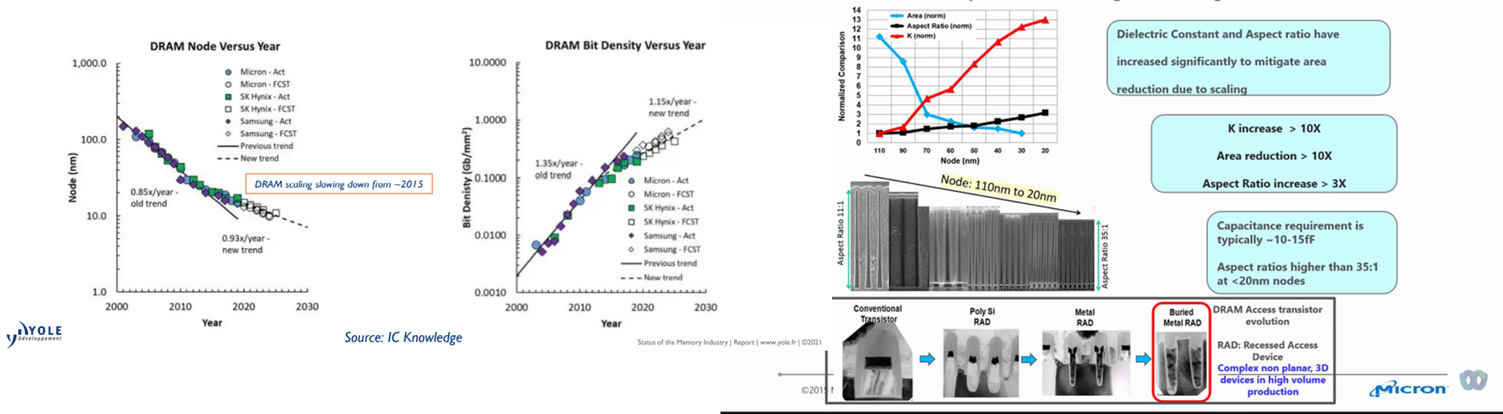
DRAM technology evolution slows down.
  Technology encountered both access transistor/capacitor limits
    1a eUV intro; 1x/1y/1z are not shrinking much
    Latest technology starts looking into peripheral improvement
Notes:
Main driver she noted was to economically address die size growth
While EMIB is the most famous embedded bridge, others also have embedded bridges

Slide 5
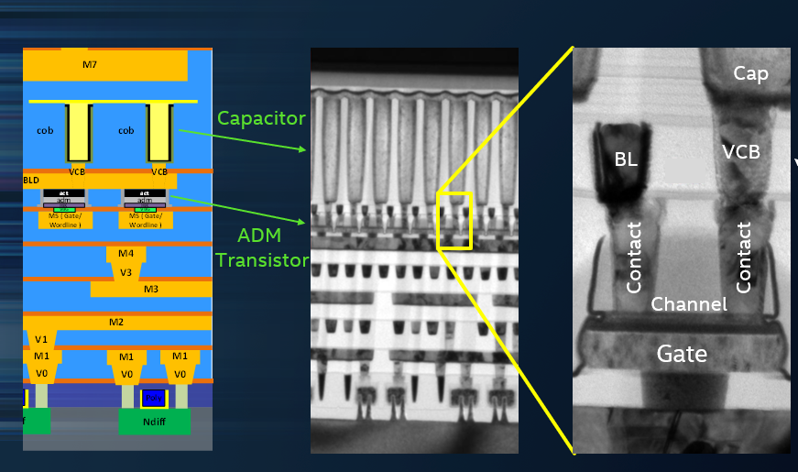
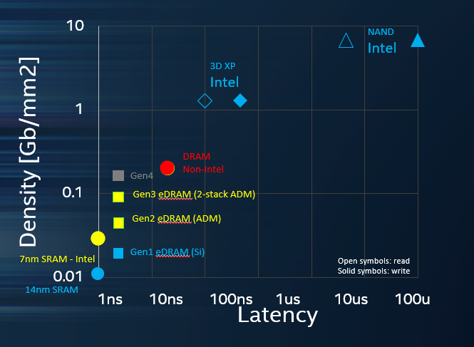
What is ADM? It is a new DRAM technology
DRAM cell (1T1C) shrinkage has been limited by Si transistor leakage for last 10 yrs; Capacitor optimization is approaching its limits.
ADM is to replace Si transistor w/ high bandgap semiconductor material; >3 order leakage difference.
  A buried DRAM bitcell array between MT5 to MT7
  Memory R/W controller circuits still using traditional Si logic technology; however, it can be buried underneath bitcell array
    Latency <5 ns, capacity >500MB/cm2
Notes:
Main driver she noted was to economically address die size growth
While EMIB is the most famous embedded bridge, others also have embedded bridges

Slide 6
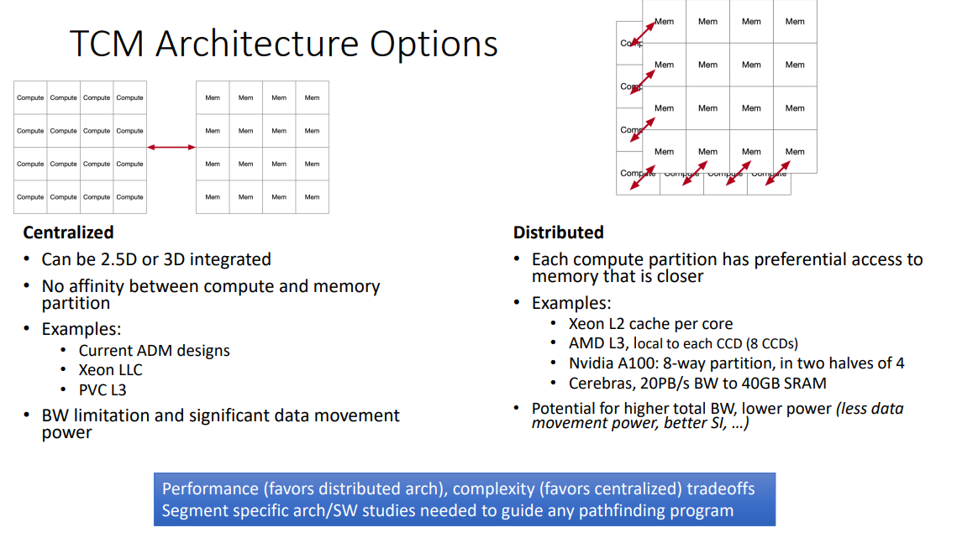
Tightly Coupled Memory - architecture choice
From CSD discussion
Notes:
Main driver she noted was to economically address die size growth
While EMIB is the most famous embedded bridge, others also have embedded bridges

Slide 7
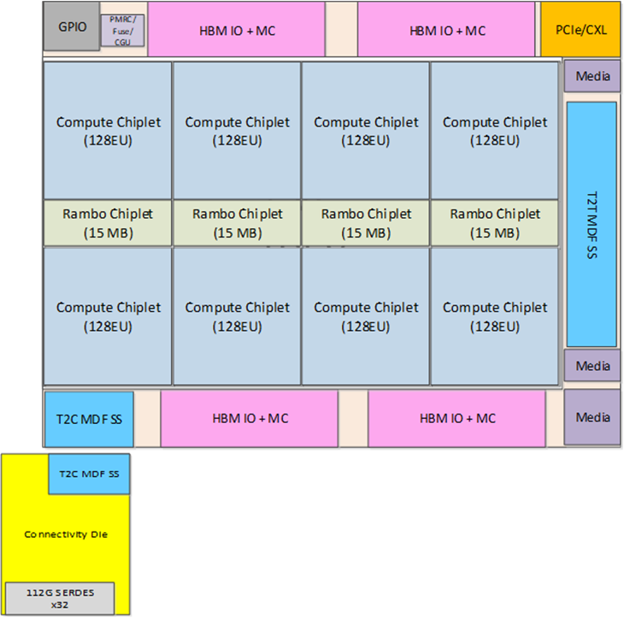
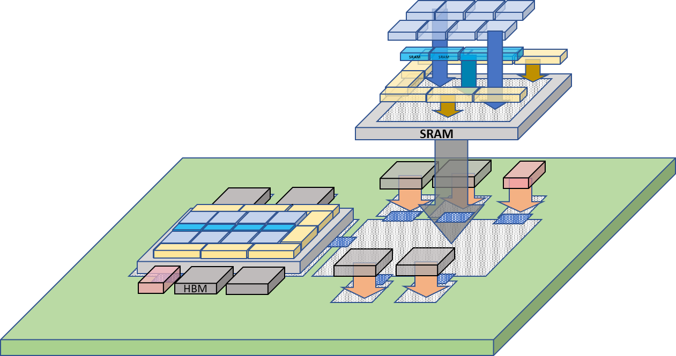
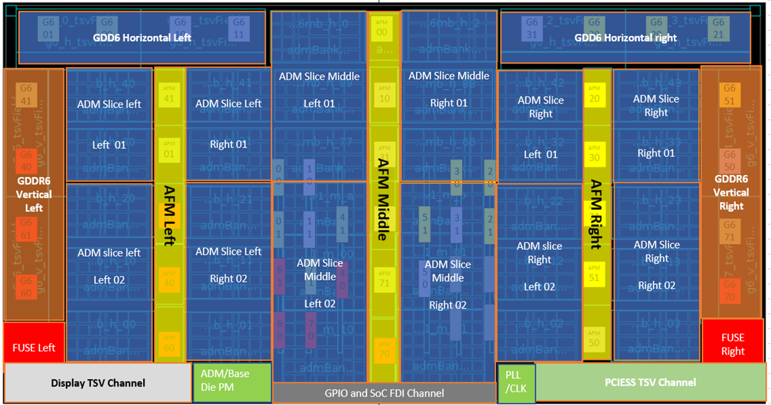
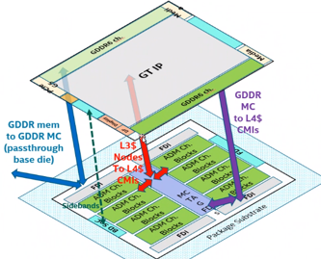
Two TCM utilization cases in near future products –
PVC – high end graphic product
ARL-px/Elasti-G3 family
All targeted for GFX memory accelerator
ADM function as L4 cache btw L3 and GDDR6
Chip | Node | Area | Functionality
Compute die | P1276 or TSMC n5p | ~40 mm2 | EU complex, L1 $
SRAM die | 10nm | ~15 mm2 | Some L3 $ banks (3.75MB*4)
Base Die | 10 FV | ~650 mm2 | L3 fabric, some L3 $ banks, misc globals (156MB SRAM)
Connectivity Die | TSMC N7 | ~75 mm2 | Scale-up serdes, Internal switch
Notes:
Main driver she noted was to economically address die size growth
While EMIB is the most famous embedded bridge, others also have embedded bridges

Slide 8
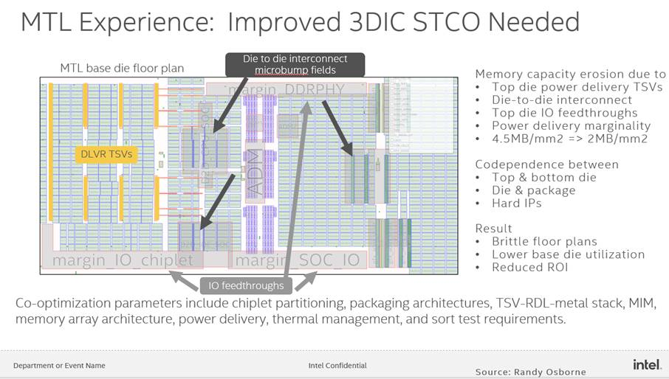
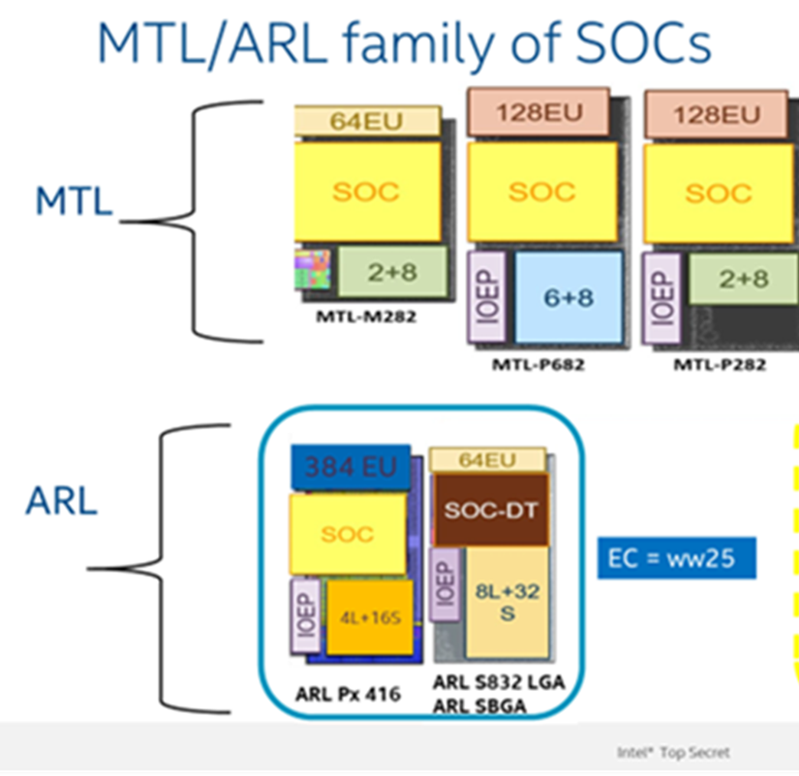
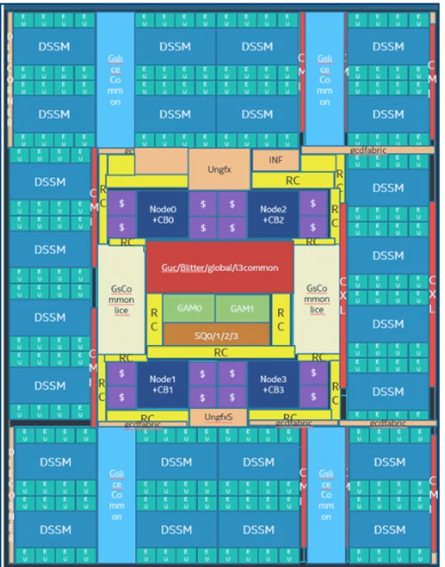
Memory utilization is extremely poor from 1st generation ADM product implementation – It is not just adding cache memory but also served as an active interposer to “connect” all chiplets
ADM is not like a typical DRAM IP, more like SRAM compiler – “soft” IP
  Semi-flexible, so it will not be perfect for area optimization like commodity DRAM
1st MTL implementation; Memory utilization <50% .
  One ADM bottom base die wafer price is 5-6x higher than typically Si passive interposer
  >50% area can be replaced by passive interposer to serve its 2.5D Si interposer purpose
ARL-PX-GFX -1st run of 384EU w/ 6x CXL interface
Notes:
Main driver she noted was to economically address die size growth
While EMIB is the most famous embedded bridge, others also have embedded bridges

Slide 9
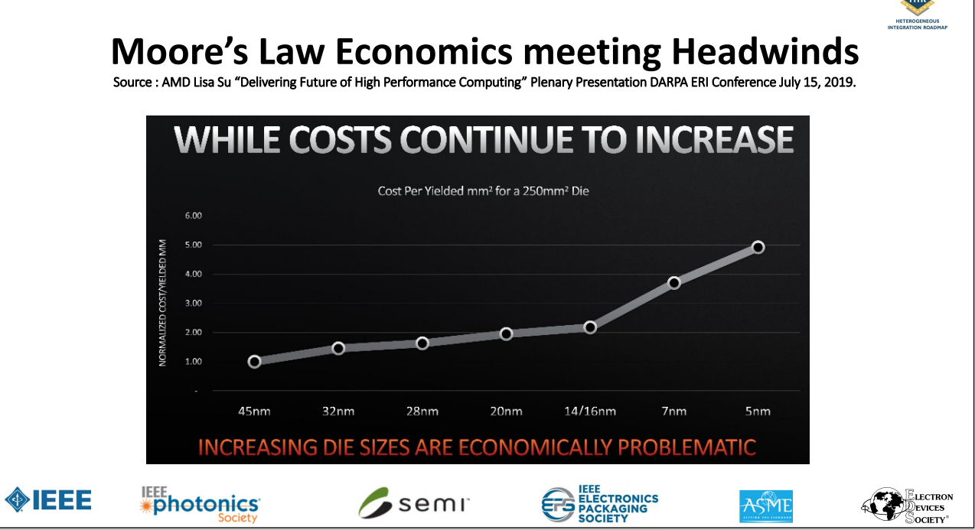
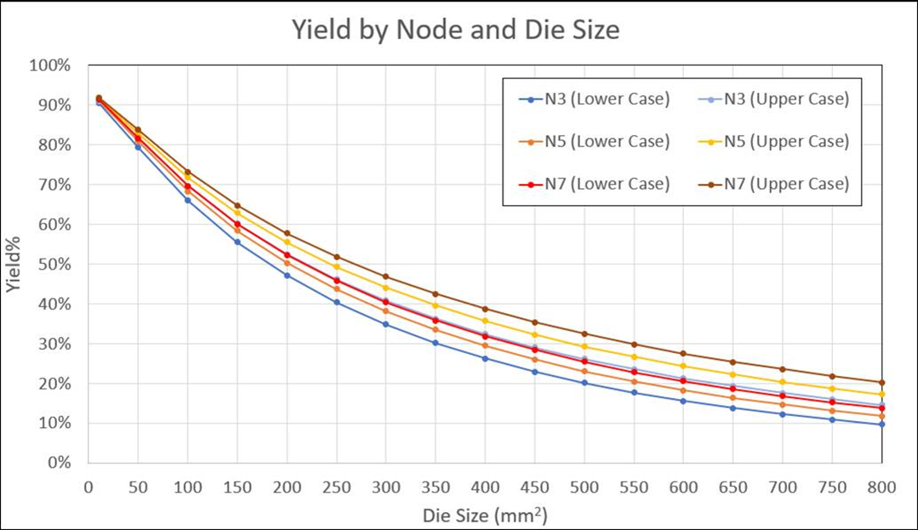
Memory implementation
PPA extreme case w/commodity cost boundary
Intel’s choice of TCM implementation- extremely expensive => niche/showcase
Even with 10% ECC(redundancy), cannot cover large die yield loss
>40x SRAM $MB/mm2 cost if we use N7
AMD 7nm die 36mm2
For 64MB SRAM
PVC 10+ die 650mm2 for 156MB SRAM
~$7000-8000/W SRAM (w/o TSV/CoWoS….)
How much more redundancy memory need to cover such big die yield impact?
HBM2 DRAM 20nm
single die (250MB)
71-82mm2
ADM 322mm2/640MB(ARL)
366mm2/374MB (Elasti)
Notes:
Main driver she noted was to economically address die size growth
While EMIB is the most famous embedded bridge, others also have embedded bridges

Slide 10
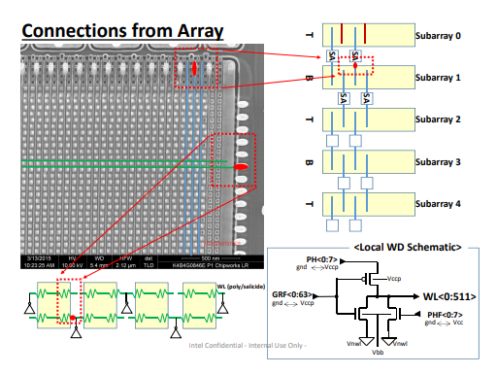
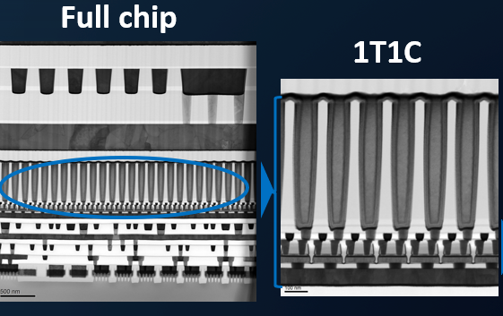
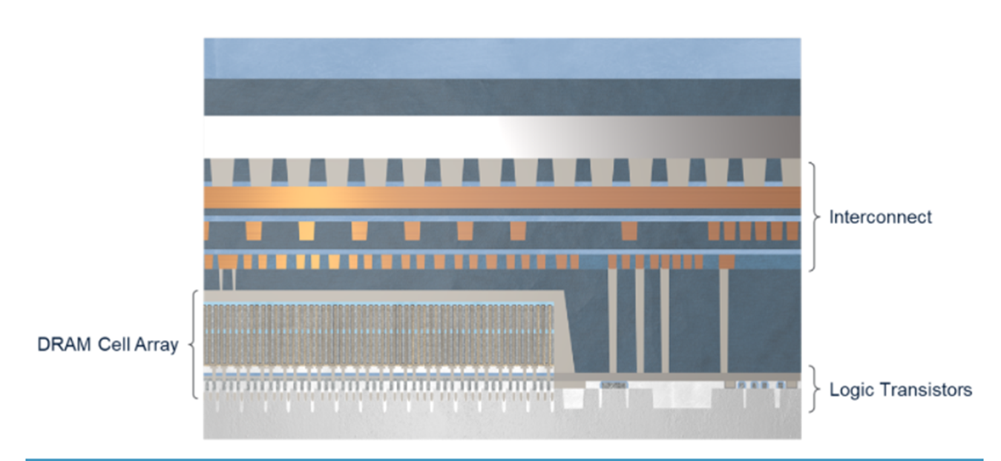
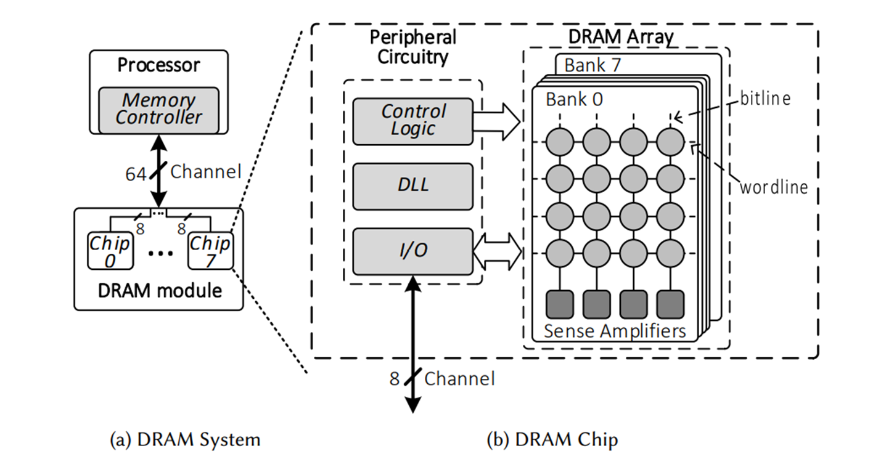
TCM – Tightly coupled DRAM for higher BW than HBM
Higher BW -100% achievable (already demonstrated on 1273.1 Intel’s 1st generation Si eDRAM)
    HBM by nature is HBW to start with; more Channels/Banks for parallel accesses
      Memory area efficiency/die will be reduced, so 10-20% increase in area/die is expected.
    Separate out MC/MI into a bottom die (like SOC IC die)
      DRAM logic processes is much cheaper; and shared w/ DRAM cell processes
        N7 vs DRAM logic
        Controller/IO area can be smaller (toggled underneath array); but can’t have TSV.
      Nothing can be cheaper than free DRAM logic/bitcell wafer; but how much area reduction?
    It will NOT be cheaper than commercial HBM type DRAM
    What is the right spec? one spec fit all for DRAM nature?
If commanding/IO logics separated into a different chip; TCDRAM is just like ADM DRAM. ADM starts with 1222 mainly because it is cheapest logic processes at Intel for a stand-alone eDRAM implementation.
1T1C
R/W/addressing Si circuits
R/W/addressing Si circuits
ADM DRAM
Traditional DRAM
Notes:
Main driver she noted was to economically address die size growth
While EMIB is the most famous embedded bridge, others also have embedded bridges

Slide 11
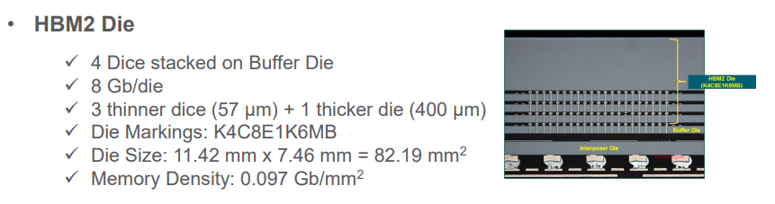
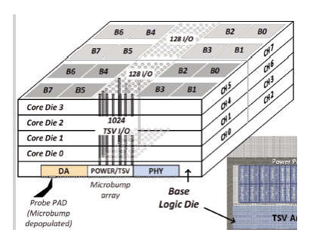
What is high bandwidth DRAM -HBM2 type DRAM
HBM – world’s first 3D TSV active dies product
  Parallel accessing thru TSV I/O (BW > 10 GBps)
  Lower pJ/bit as compared to its DDR version
    Lower Vdd-Vpp/clock frequency to achieve similar BW
    Power management thru various channels/banks
Capacity – stacking using smaller footprint to start with.
  Increase peripheral area/die, lower memory utilization (-)
    More Controller circuits
    TSV OH
  But peripheral circuits can be stacked (+).
Total chip area ->4*(1GB/die)> 4GB/die (current estimate >20%)
HBM Industry standard
  HCM->HBM1->HBM2->HBM2E->HBM3

Slide 12
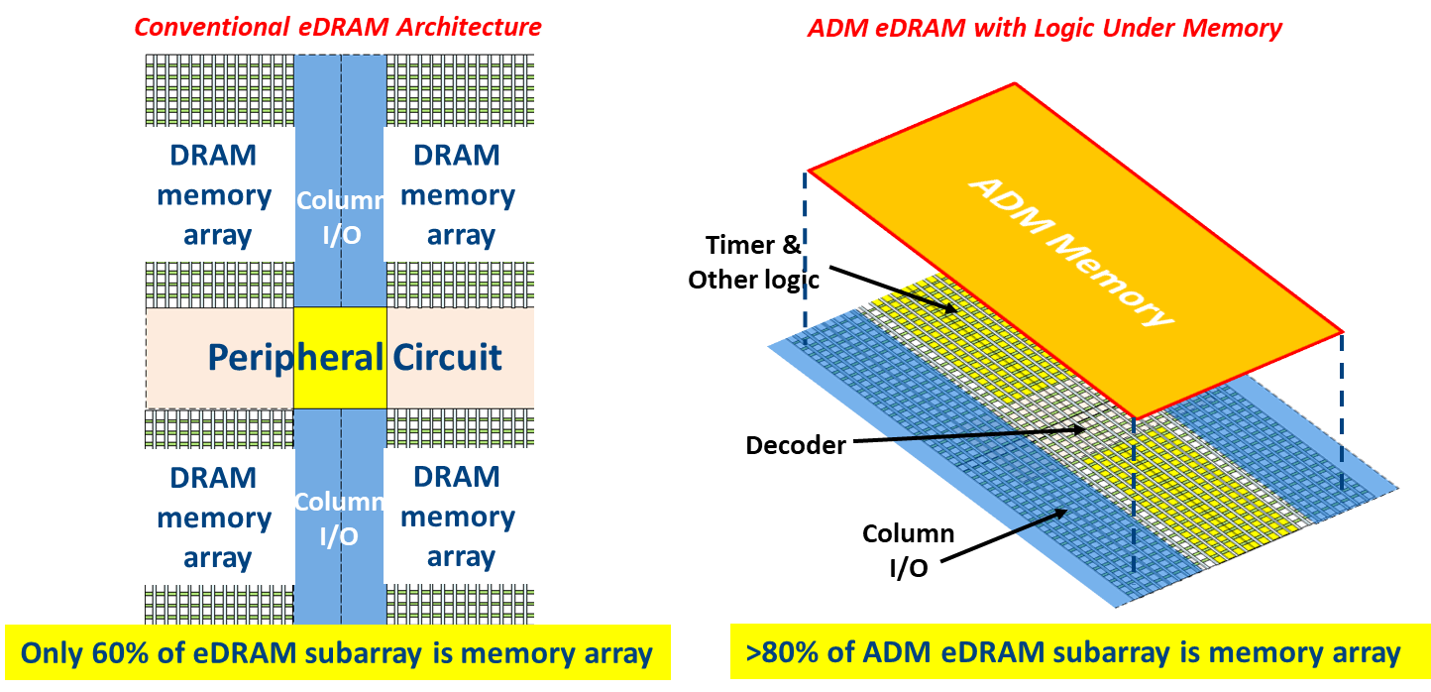
ADM DRAM vs. traditional DRAM
Free ADM memory from logic technology and connected (bond) together w/o losing bitcell’s tight pitch
  BEOL TF transistor process flow – so cheap/fast compared to FEOL Si transistor flow.
  Stacking (20% additional cost) for 40% area reduction (Concept already proven on Si)
  Bitline pitch <108nm (too big already)
Will tightly coupled DRAM chiplet (IPM) disaggregation eventually make DRAM more like ADM approach?
  GDDR6/GDDR5 performance trend
  Multi-die memory controller and communication interface like PCIe/
    Bitcell area still > peripheral area
    What can extra bottom “active” space be used for? Any idea?
      SRAM? (any other choice w/ less overhead?) MRAM/RRAM?
      Memory controller hub for all chiplets (SOC IC)
      PM/clock IC for all chiplets (SOC IC)
Notes:
Main driver she noted was to economically address die size growth
While EMIB is the most famous embedded bridge, others also have embedded bridges

Slide 13
TCM choices - two kinds of memories SRAM or DRAM
TCM/IPM DRAM – hard to believe it will be cheaper than HBM commodity offering. However, better peak BW can be expected
  Need a clear success/selection criteria even for POC projects
Cost per bit >15x delta, not even counting pJ/bit benefit for DRAM
CPU clock freq~ 3-4.2 GHz
ADM Clock freq~1.6 GHz
8x bitcell area delta
2-3x wafer cost delta
>3x wafer cost delta
No KGD if decouple
Notes:
Main driver she noted was to economically address die size growth
While EMIB is the most famous embedded bridge, others also have embedded bridges

Slide 14
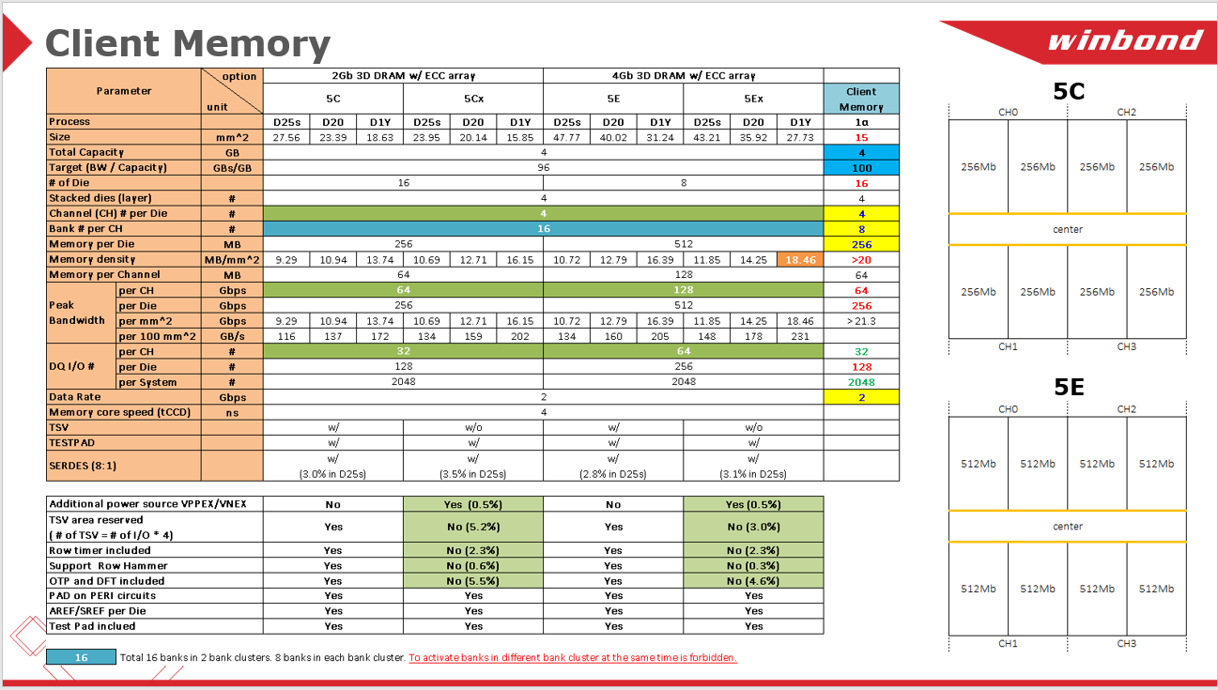
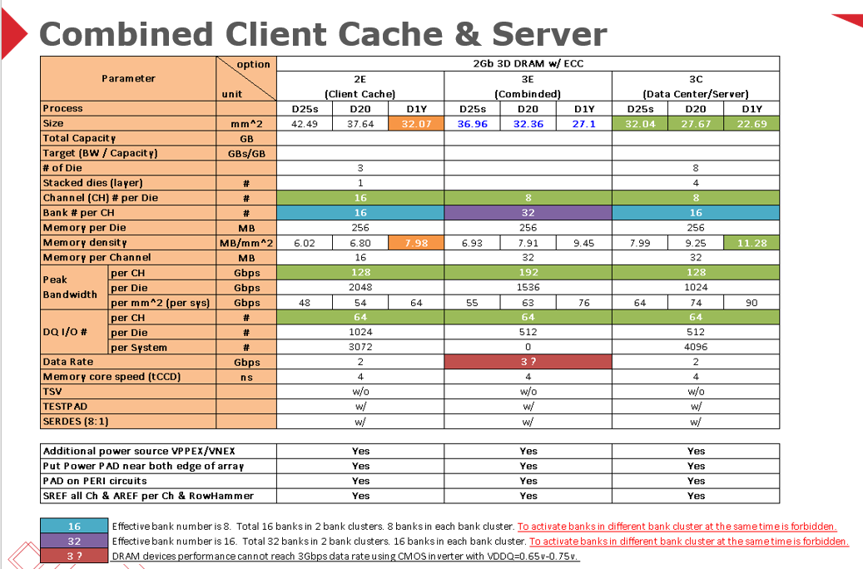
TCM – Tightly coupled DRAM approaches
Poof of concept - 2nd tier DRAM foundries like Winbond – proactive response
  Each individual DRAM die/wafer still a functional DRAM die/wafer; re-partitioning Channel/Bank for BW requirement and further CMD/RMS details for area saving.
    IO counts still < ~1000/mm2 (using CoWoS 40um bump pitch), tough to push HB. Intel’s team has requested supplier to consider Hybrid-bond in last meeting.
  A good learning - detail area partition for BW gain/TSV OH/Interface –SERDES/PHY area impact.
  No true multi-die product experience.
  What right specs/success criteria for Intel’s special need? Still 2.5D/HBM approach product integration?
    HBM3 (nVidia/Samsung) definition is on-going, most likely it will be cheaper to drive future HBM3 “sub”-commodity products to meet our internal special need.
1st tier DRAM house SKH – still negotiation (Sept/E, CEO meetings)
Notes:
Main driver she noted was to economically address die size growth
While EMIB is the most famous embedded bridge, others also have embedded bridges

Slide 15
What future technology implications for memory solution
Hybrid-bonding for ADM to de-couple memory peripheral circuits w/ memory array
  Hybrid-bonding for stacking GEN3 ADM (2 ADM layers) w/ other chiplets – always the example for HB future roadmap
    GEN II (1st generation of ADM) - 3 layers (2 minimum metal pitch layers)
    GEN III (Stacking ADMs) -6 layers of metals (4 minimum metal pitch in each technology node) to relax to right metal bonding pitch
Backside power rail implication for memory
    Power coming from Si chip bottom
      Hub for all chiplets PMIC/CLK?
    BL/WL metal connection splits (one go up, one go down)? Stacking ADM not processing ADM sequentially
Centralized memory hub
  Please DO NOT use any large “active” die as interposer
    Learning from HBM, die size needs to be <100mm2 for long-term meaningful volume production even for memory. Si Interposer – by default, yield needs to be >95%.
    Memory is not exactly flexible enough for floorplan adjustment
      Companion chips connection flexibility?
      Best performance for hub concept?
  What’s right balance? Any input? Should be determined by true latency along memory pipeline.
Notes:
Main driver she noted was to economically address die size growth
While EMIB is the most famous embedded bridge, others also have embedded bridges

Slide 17
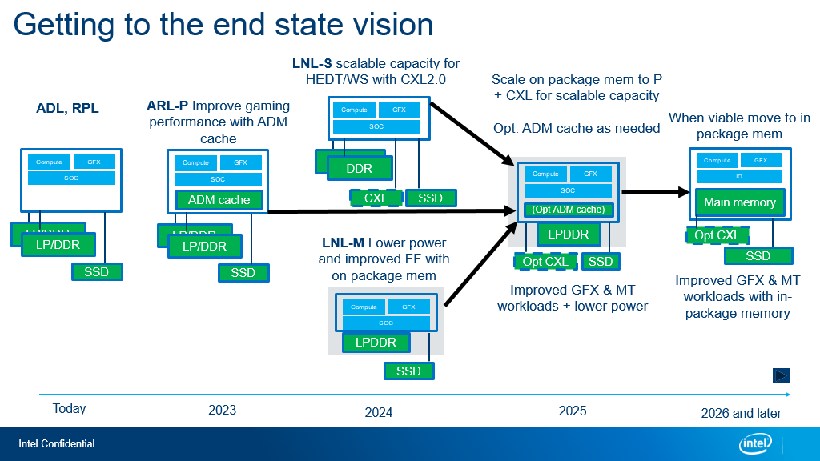
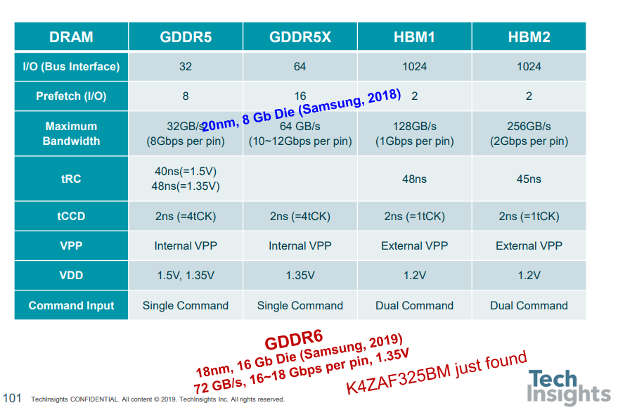

Slide 18
