Slide 1
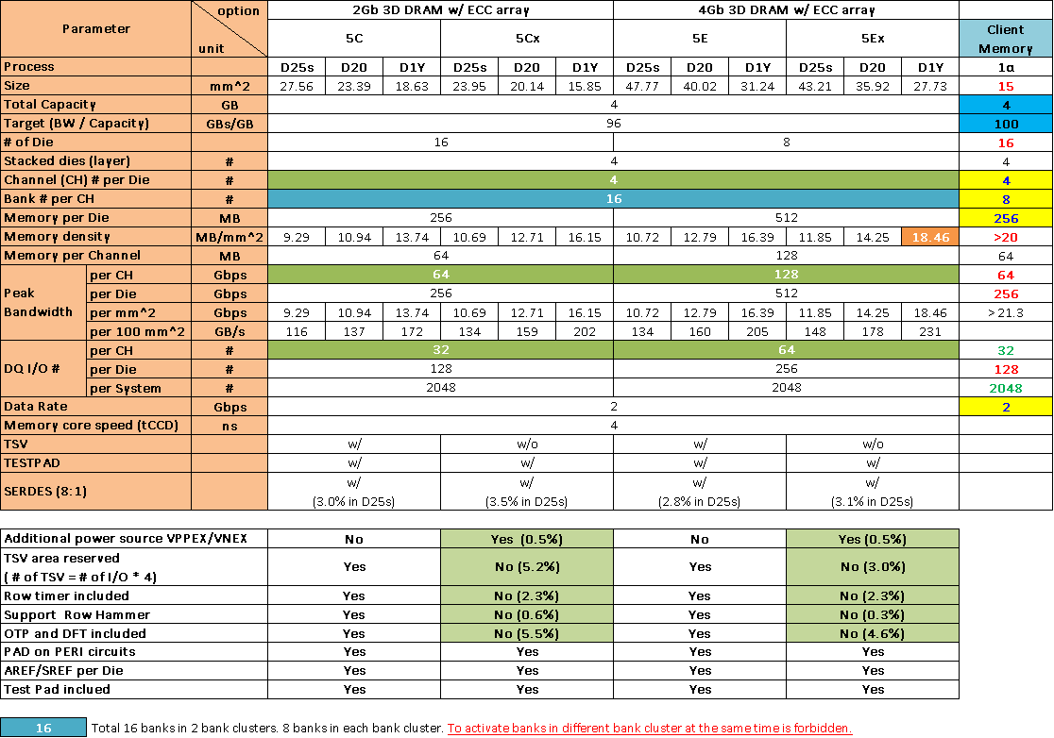
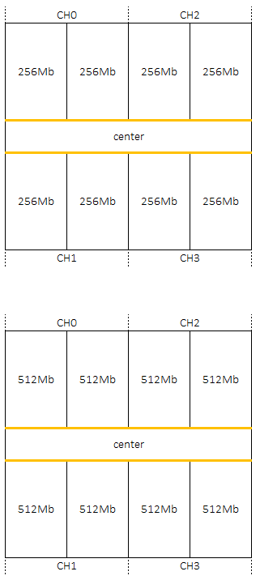
Client Memory
5C
5E

Slide 2
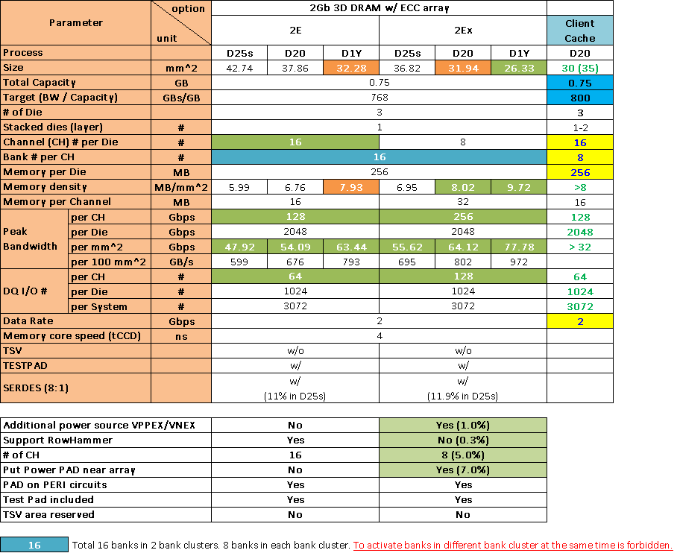
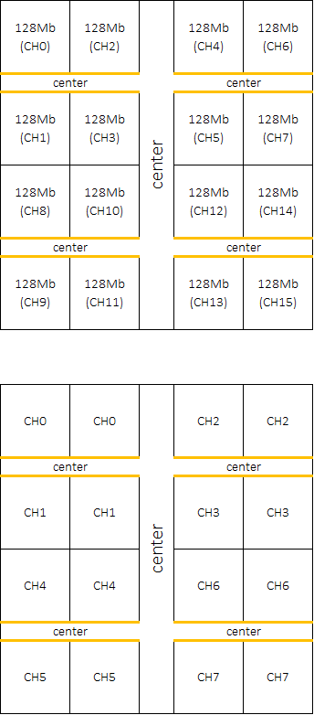
Client Cache
2E
2Ex

Slide 3
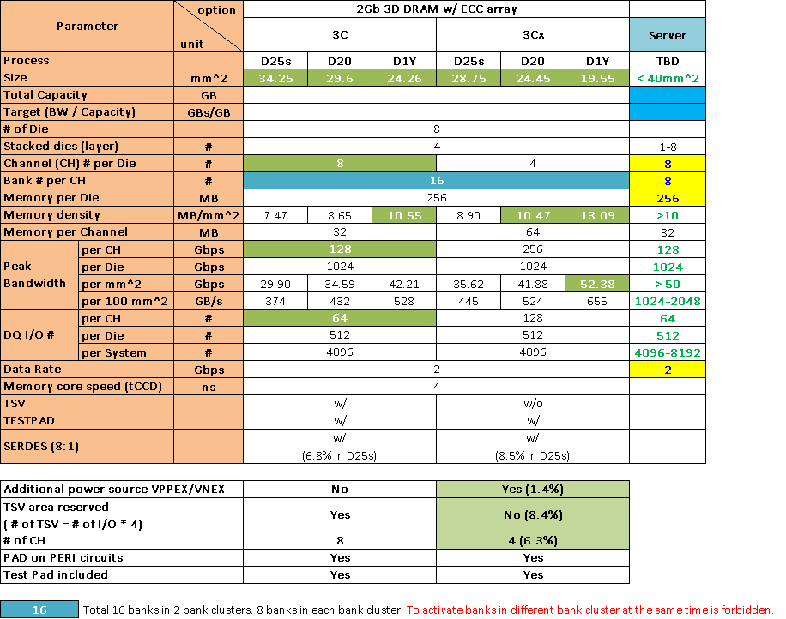
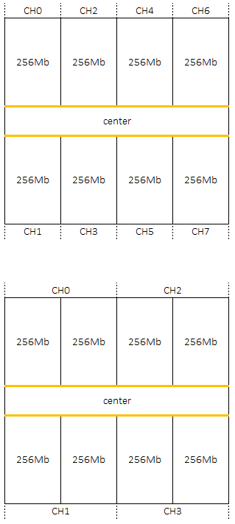
Server
3C
3Cx

Slide 4
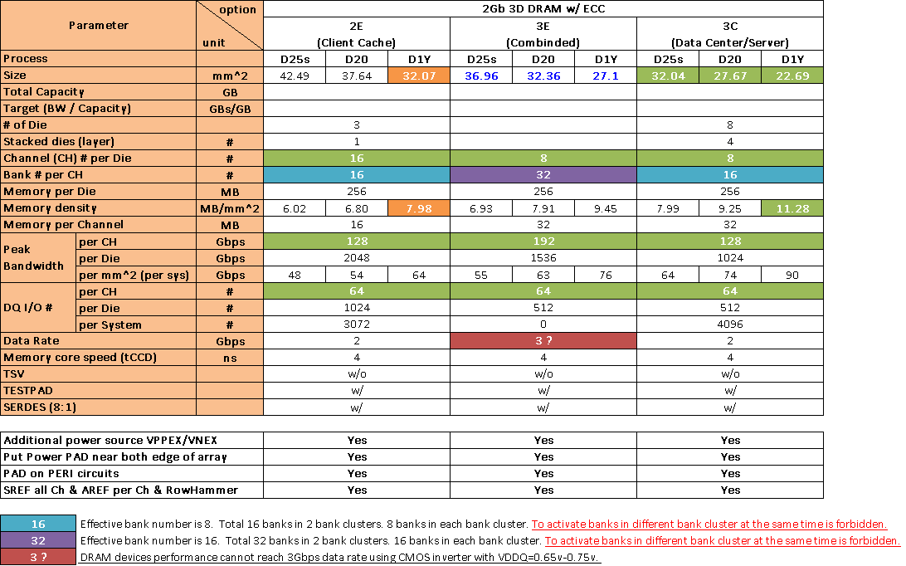
Combined Client Cache & Server

Slide 5
Q&A
Okay with “master channel” for SRE/SRX commands to all channels in parallel.
Must have Per Channel Refresh. Okay with no per bank refresh.
Temperature compensation is required for both regular and self-refresh operation.
Based on items above, Winbond would like to confirm below items.
1. For SREF, can all channels use the same refresh rate?
2. To support temperature compensation for AREF, does DDR4 TCR meet Intel’s needs?

Slide 6
Q&A
Must have BC4 (ex: 32B transactions). Need to understand how ECC will be handled for 32B transfers.
As previously discussed, Winbond provide ECC array only. No calculation/correction in DRAM.
When we planed mapping for DQ to ECC bits as below, BC4 of ECC will be the same as DQ.
Okay to drop critical 32B first to save die area. That said, how different is critical 32B first vs. supporting BC4/32B transfers?
What does it mean “to drop critical 32B first” ?
Does it means BC4 without additional address to indicate which half to be transferred?
DQ | Burst | DQ bits | ECC | Burst | ECC bits
[63:32] | [7:4] | 128b | [3:2] | [7:4] | 8b
 | [3:0] | 128b |  | [3:0] | 8b
[31:0] | [7:4] | 128b | [1:0] | [7:4] | 8b
 | [3:0] | 128b |  | [3:0] | 8b

Slide 7
Q&A
Thermal sensor granularity is negotiable. Intel can use a combination of DRAM thermal sensors as well as compute die power state and thermal sensors to create a more complete picture of die temperature. However, this approach requires Intel to know the mapping for temperature to refresh rate.
[Q to Intel]. How is the density of temperature sensor Winbond need to place?
Winbond can provide mapping for temperature to refresh rate as below.
Okay with different IDD2 power numbers for 1 channel power down vs. All channel power down.
Winbond is working on IDD2P difference between 1 Ch vs. All Ch power down.
Temp. | Refresh Rate
T.B.D. | 4x
T.B.D. | 2x
85C | 1x
T.B.D. | 0.5x
T.B.D. | 0.25x

Slide 8
Q&A
Intel requests we eliminate any “training” for this interface such as write leveling. Can all the training requirements be achieved by using first order delay matching?
What does it mean “1st order delay matching” ?
Does it mean Intel will provide small pin-to-pin skew so Winbond can just use delay matching
for input timing path?
How about read training?

Slide 9
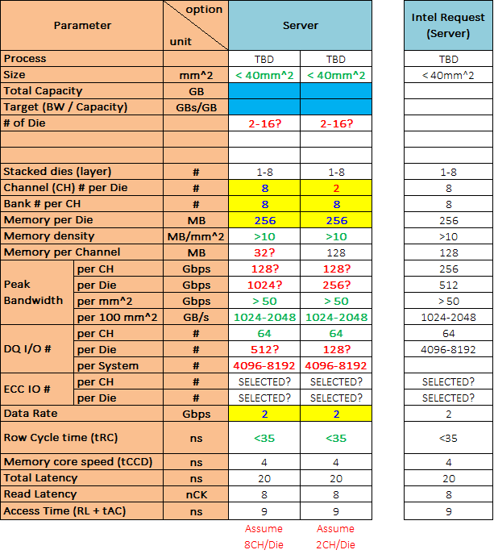
Parameters of Server
Q1. Parameters of Server
Some parameters are not clear.
Could Intel confirm those numbers in red?

Slide 10
PAD open
Array
Q2. Power PAD placement
Will DRAM power pad connect to package ball?
If so, what’s SIP ESD spec?
Q3. C/A & I/O PAD placement
Do we have to reserve empty area for C/A & I/O PAD?
Or they can be placed on PERI circuits?
PERI
PAD on PERI circuits
P
P
P
P
P
P
P
P
P
P
P
P
P
P
P
P
PAD on empty area

Slide 11
TSV
Separated I/O
DRAM #4
Q4. About die stacking, is left illustration correct?
If not, could Intel provide correct one?
Q5. For separated I/O case, does it mean
4 different RDL masks are required?
DRAM #3
DRAM #2
DRAM #1
SoC/Interposer
Shared I/O
DRAM #4
DRAM #3
DRAM #2
DRAM #1
SoC/Interposer
RDL
PAD
uBump

Slide 12
TSV
Array
Q6. TSV area (Related to Q4)
For separated I/O of die stacking, is left
illustration practical?
Solution I: RDL
Solution II: Fuse to control MUX @ PAD
If not, could Intel suggest practical TSV plan
for each application?
PERI
Solution II
P
P
P
P
P
P
P
P
DRAM #4 (Pass thru.)
DRAM #3 (Pass thru.)
DRAM #2 (Pass thru.)
DRAM #1
T
T
T
T
T
T
T
T
T
T
T
T
T
T
T
T
T
T
T
T
T
T
T
T
T
T
T
T
T
T
T
T
Solution I
P
T
P
PAD
TSV
PAD
w/ MUX
RDL
Metal
In DRAM

Slide 13
backup

Slide 14
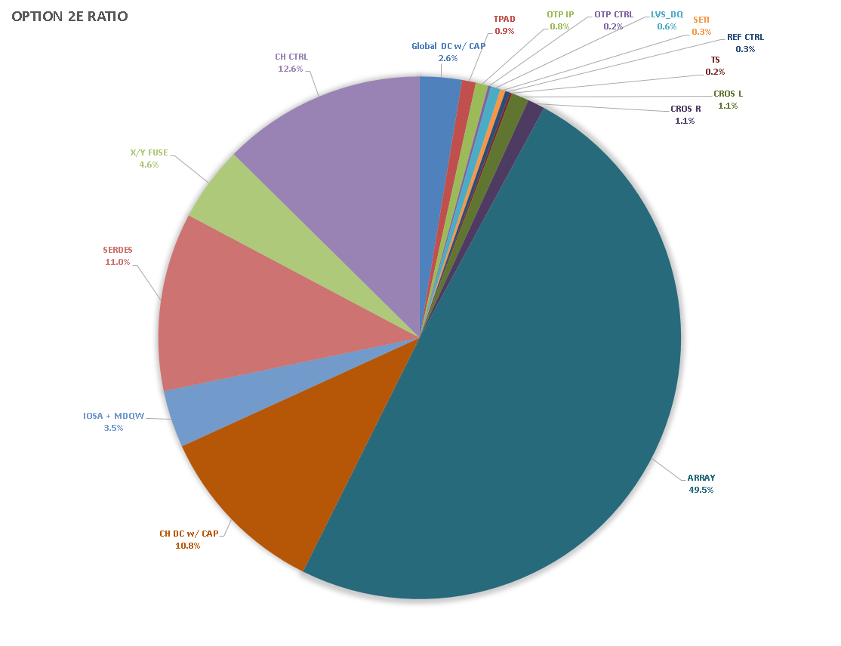

Slide 15
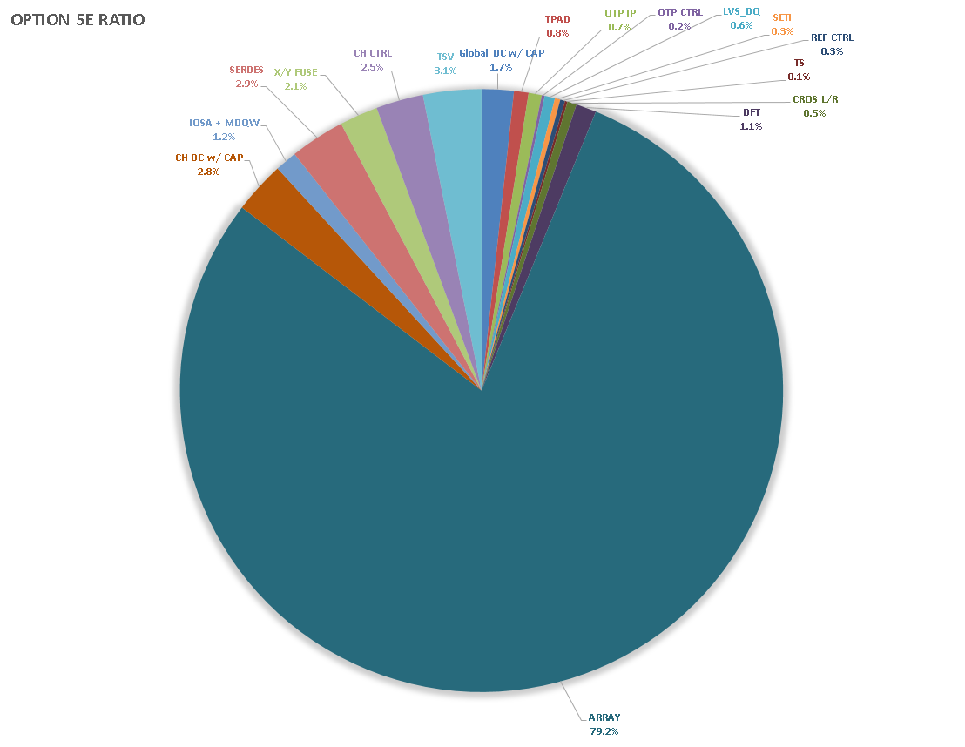

Slide 16
