Slide 1
TCM/IPM Landscape of High Bandwidth Options for System Performance
*DB level comparisons, 100mm2 die
Technology (Foundry Options) |  | Density (Gb/mm²) | Capacity (GB/die) | Bandwidth density (TB/s/GB) |  | Latency (ns) |  | Masks (#) |  | Array Energy (pJ/bit) |  |  | Process Tech Readiness | Limitations | Ex-Industry Engagements
 |  |  |  | R | W | R | W | M | C | Read | Write | IdleP/GB
eDRAM | ADM | 0.16 | 2 | 16/4 | “ | 15 | 15 | 23 | 60 | 0.6 | 0.6 | 70m | Medium | Slow cap access, high tRC | ADM 90x60 bitcell, 2L
 | Si | 0.16 | 2 | 16/4 | “ | 10 | 10 | 100+ | 100+ | 0.6 | 0.6 | >100m
SRAM | 6T | 0.025 | 0.3 | 30/8 | “ | 2 | 2 | 100+ | 100+ | 1.1 | 1.2 | >100m | High | Low density | SAINT-S, Intel-RAMBO
 | 3T | 0.05 | 0.6 | 30/8 | “ | 2 | 2 | 100+ | 100+ | 1 | 1.1 | >100m |  | Moderate density
DRAM | HBM | 0.3 | 3.75 | 0.2 | “ | 32 | 32 | 20 | 20 | 1.2 | 1.2 | 22m | High |  | Samsung, Hynix, Micron, Renesas 1z HBM3
 | DBM | ? |  |  |  | 12 | 12 | 20 |  | 1.2 | 1.2 | ? | High
 | LL-DRAM | 0.18 | 2 | 4 | 4 | 14 | 14 | 20 |  | 1.2 | 1.2 | ? | High
STT/SOT-MRAM | Classic STTM
 | SOT
Notes:
Command/Data Energy
Up to 10 Gb
L1 KB
L2 100 KB
L3 10 MB
Per core? E.g. 8 core system
ADM → div between llc type perf-centric ipm; vs high cap
Energy/bit dependence on arch (MUX/data width/page size)

Slide 2
SRAM Reference
RAMBO and SAINT-S
Parameters | Samsung SAINT-S | Intel - RAMBO | Intel - RAMBO normalized
Process | 7nm | 10nm+++ | 10nm+++
Die size (mm2) | 81 | 14.73 | 81
Capacity (MB) | 256 (estimated) | 15 | 82.48472505
Vdd (V) | 0.85/1.0/1.8 | 0.65-0.85 | 0.65-0.85
Freq (MHz) | 760 | 2000 | 2000
#Chan | 128bit/2ch*mult factor | 512bit/4ch | 512bit/4ch
Power (W) SRAM/TSVIO | 0.156 | ? | ?
Bandwidth (GB/s) | 1555.2 | 429.15 | 429.15
Latency (ns) | 7.2/RD; 2.6/WR | 2.00 | 2.00
Mb/mm2 | 25 | 8.15 | 8.15
mm2/GB | 324 | 1005.57 | 1005.57
GB/s/GB | 6220.8 | 29296.88 | 5327.69
pJ/b (1R/1W) | 3.21 | 0.28 DB only | 0.28 DB only
pJ/b (TSV/link) | 0.1 | 0.12 | 0.12
Mult factor | 32
PVC BGEMM Kernel based data | Value
L3 RD BW | 34.60%
L3 WR BW | 2.23%
Rambo total cdyn with kernel BW above [pF] | 2910.90
Rambo total cdyn with 100% BW ( one RD transaction ) [pF] | 7903.60
Rambo total cdyn with 100% BW ( one WR transaction ) [pF] | 8006.52
Rambo Bank Energy per bit [pJ] for one RD @ TR=36.58% | 0.408
Rambo Bank Energy per bit [pJ] for one WR @ TR=36.58% | 0.413

Slide 3
 | Data Owner | Stage | Industry Players | Volume Est (YR) | Capacity (GB) | Peak BW (GB/s) | Data Rate (GT/s) | BW/Cap (GB/s/GB) | Latency (ns) | Power (pJ/b) | Standby Power (mw) | Vol/NV | Endurance? | BER | Die Size (mm2) | Manuf. Cost ($/GB) | Price $/GB (60% GM)
Industry Standard (Volume) | The expectation is that we'll have the most complete picture on these technologies and they're likely useful as a baseline. Don't go too detailed such that it slows us down
DDR5 | Kuljit's xls | Development | Samsung,Hynix, Micron | 2021 | 16-32Gb die -512 GB/DIMM | 67.2 (x64 DIMM) | 4.8 to 8.4GT/s |  | 33 (tRCD+tAA) | 28pj/b (x4 DIMM) | 704mW (2Rx8) 44mW / die | Vol | >1E15 |  | 16Gb, 1Znm 60mm^2 | $1.38 | $3.45
LPDDR5 | Kuljit's xls | Production | Samsung,Hynix, Micron | 2020 | 16Gb die - 32GB pkg | 67.2 (x64 ch) | 3.2 to 8 GT/s |  | 36 | 5 | 12 | Vol | >1E15 |  | 12Gb, 1Znm 43mm^2 | $1.54 | $3.85
HBM2E | Kuljit's xls | Production | Samsung,Hynix, Micron | 2020 | 16Gb die - 16GB pkg | 460 | 2.8-3.6GT/s |  | 34 | 7 | 1040mW (8H) | Vol | >1E15 |  | 16Gb, 1Ynm 110mm^2 | $6.13 | $15.33
HBM3 | Kuljit's xls | Development | Samsung,Hynix, Micron | 2022 | 32Gb die -64GB(16 Hi) | 921 | 4.8-7.2 GT/s |  | 34 | 4 | 1400mW (8H) | Vol | >1E15 |  | 16Gb, 1Znm 121mm^2 | $6.44 | $16.10
GDDR6 | Kuljit's xls | Production | Samsung,Hynix, Micron | 2019 | -16Gb 8GB/ch | 192 (x64) | 8-24 GT/s |  | 30 | 16 | 81 | Vol | >1E15 |  | 8Gb, 1Znm 66mm^2 | $1.99 | $4.98
Intel Roadmap Products | Again, we'll likely have the most detail here. Its value is as an internal baseline unless we think there are things on the roadmap that shouldn't be.
eDRAM (22nm) | Fatih | Production | IBM | 2013-2019 | 128MB | design was 100GB/s but could have been designed for 8TB/s/GB | 8Gt/s | 0.8TB/s/GB | ~12ns | ~4pJ/b w/ OPIO at 78mm2 die level | 200mW/128MB @50C | Vol | 1E14+ | Median die 1E-07 | 78mm2 | 32
SRAM (on die) | Fatih | Production
RAMBO SRAM (in package) | Wilfred | Production
S15 3DXP (Gen 1) | Derchang | Production | Micron, Hynix, IBM/Macronix in pathfinding | 2017 | 16 | 1.6/.55 | 1.6 | 0.1/.034 | 110/465 | 73/168 |  | NVM | 4M | 2.00E-04 | 208
S26 3DXP (Gen 2) | Derchang | Development | Micron | 2020 | 32 | 1.6/.8 | 1.6 | 0.05/0.025 | 105/465 | 54/118 |  | NVM | 4M | 2.00E-04 | 199 | 0.3
A-Falls 3DXP (Gen 3) | Derchang | Development |  | 2022 | 32 | 3.2/1.1 drive to 3.2/1.6 | 3.2 | 0.1/.05 | 100/465 Drive-to 100/320 | 47/86 |  | NVM | 4M | 2.00E-04 | 135 | 0.22
eDRAM (ADM Gen 1) | Fatih | Development | unknown | 2H'22 |  |  |  | up to 6TB/s/GB | 5ns @1MB Macro | 0.6pJ/b @1MB Macro | <100mW/GB @50C | Vol | 1.00E+13 | <=1E-06 @Time0 | 0.22mm2 @1MB Macro | $12-$14
eDRAM (ADM Gen 2) | Fatih | Development | unknown | 2H'23 |  |  |  | up to 6TB/s/GB | 6ns @2MB Macro | 0.7pJ/b @2MB Macro | <75mW/GB @50C | Vol | 1.00E+13 | <=1E-06 @Time0 | 0.26mm2 @2MB Macro | $7.5-$9

Slide 4
TCM/IPM Landscape of High Bandwidth Options for System Performance
Technology (Foundry Options) |  | Density | Scalability | Bandwidth | Masks | Energy |  |  | Process Tech Ready? | Eco-System Readiness | 3D integration limitations | Ex-Industry Engagements
 |  |  |  |  |  | Macro | PHY | I/O
SRAM | Mono |  |  | 4+TB/s |  | 0.2 | 0.3 | 0.1 |  |  |  | TSMC, Samsung
 | WoW |  |  | 4+TB/s |  | 0.2 | 0.3 | 0.1
 | DoW |  |  | 4+TB/s |  | 0.2 | 0.3 | 0.2
 | Bumps |  |  | 2 TB/s |  | 0.2 | 0.3 | 2.2
eDRAM | Mono |  |  | 1-4 TB/s |  | 0.5 | 0.67 | 0.1 |  |  |  | IBM, TSMC (sunset), Samsung DBM, Micron
 | WoW |  |  | 4+ TB/s |  | 0.5 | 0.67 | 0.1
 | DoW |  |  | 4+ TB/s |  | 0.5 | 0.67 | 0.2
 | Bumps |  |  | 1.5 TB/s |  | 0.5 | 0.67 | 2.6
DRAM | Mono |  |  |  |  | 1 | 0.65 | 0.1 |  |  |  | Samsung, Hynix, Micron,
 | WoW |  |  |  |  | 1 | 0.65 | 0.1
 | DoW |  |  |  |  | 1 | 0.65 | 0.2
 | Bumps |  |  | 1.2 TB/s |  | 1 | 0.65 | 2.6
STT/SOT-MRAM | Mono |  |  |  |  |  |  |  |  |  |  | SAMSUNG, TSMC
 | WoW
 | DoW
 | Bumps
prashant majhi, FTE
Notes:
Monolithic – 100nm via-via bond @100nm pitch
WoW – 500nm pitch,

Slide 5
Power Components
ADM layer1
ADM layer0
CMOS Peripherals
ML
Substrate
Col_IO
Substrate
SOC
GFX
ADM layer
HVCC
Substrate
CMOS Peripherals
ML
Charge Pump + LDO (7%)
Charge Pump + LDO (7%)
Charge Pump + LDO (7%)
Timer
1MB ADM DB
1MB ADM DB
1MB ADM DB
FDI and other cross die TSV power
DB to TSV Routing channel power
Datablock power
Charge Pump power
Within datablock routing power
Array power
622.08 µm
622.08 µm
622.08 µm
WL0, WL1
357.84 µm
357.84 µm
357.84 µm
Timer
HVCC

Slide 6
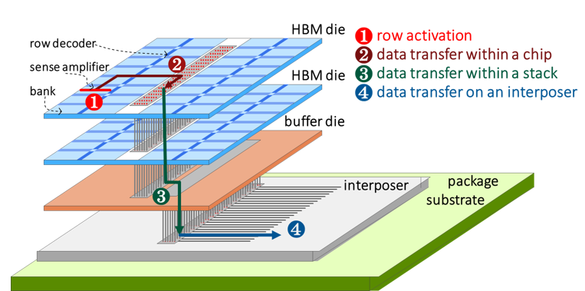
HBM vs Teleios
Energy (pJ/bit) | Bank/DB | Logic PHY | TSV/Stacking | External Routes (2.5D) | Total
HBM2E | 1.20 | 0.95 | 2.15 | 2.40 | 6.700
HBM2E LV/7nm | 0.47 | 0.37 | 0.84 | 2.40 | 4.080
TSMC | 1.20 | 0.95 | 0.42 | 2.40 | 4.970
ADM 0.8V | 0.64 | 0.64 | 0.72 | 0.00 | 2.000
ADM 0.7V | 0.50 | 0.50 | 0.57 | 0.00 | 1.570
ADM 0.6V | 0.26 | 0.37 | 0.35 | 0.00 | 0.975
Bank/DB:
1.2 pJ/bit → 0.47 pJ/bit
TSV/External Route:
~0.72 pJ/bit → 0.35 pJ/bit
Substrate
PHY:
0.64 pJ/bit → 0.37 pJ/bit
Almost entirely metal8/9 inter-db
Controller
GFX
TSV:
2.15 pJ/bit → 0.84 pJ/bit
PHY:
0.95 pJ/bit → 0.37 pJ/bit
ADM layer
ADM layer
Substrate
CMOS Peripherals
ML
ADM layer
Bank:
0.64 pJ/bit → 0.26 pJ/bit
0.15 @WL
0.25 @BL
Remaining M8 intra-db
ADM layer
Substrate
CMOS Peripherals
ML
External Route:
~2.4 pJ/bit
Teleios ensures tightly coupled memory-compute with <1pJ/bit enabled by shorter routes, lower voltages, scaled PHY
Can ensure Intel lead over HBM

Slide 7
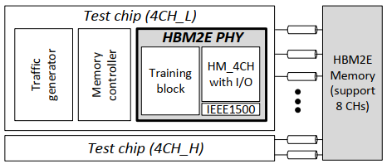
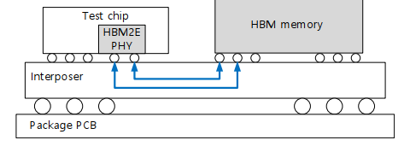
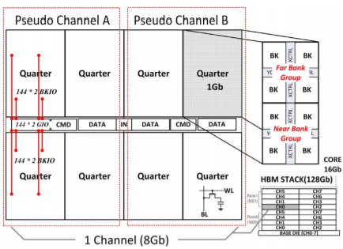
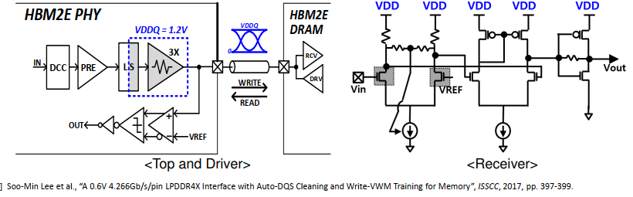
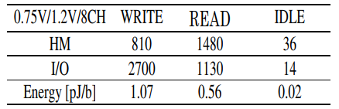
Samsung HBM2E Modifications @HotChips 2020
1.2V → 0.75V with 7nm tech @Bank and @TSV
ADM layer
Substrate
CMOS Peripherals
ML
2.6x lower energy from V_{DD} reduction shown at HotChips 2020
ADM layer
Substrate
CMOS Peripherals
ML
D. U. Lee et al., "22.3 A 128Gb 8-High 512GB/s HBM2E DRAM with a Pseudo Quarter Bank Structure, Power Dispersion and an Instruction-Based At-Speed PMBIST," 2020 IEEE International Solid- State Circuits Conference - (ISSCC), San Francisco, CA, USA, 2020, pp. 334-336, doi: 10.1109/ISSCC19947.2020.9062977.

Slide 8
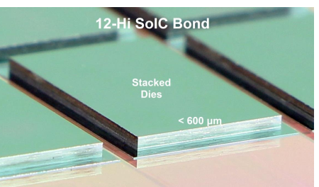
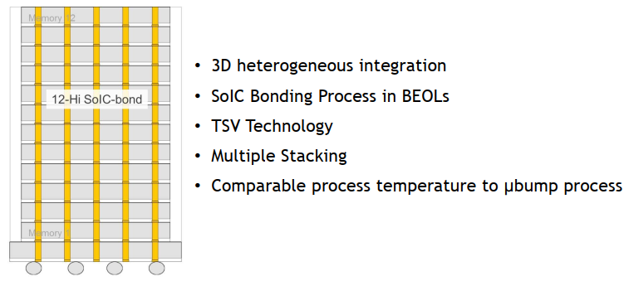
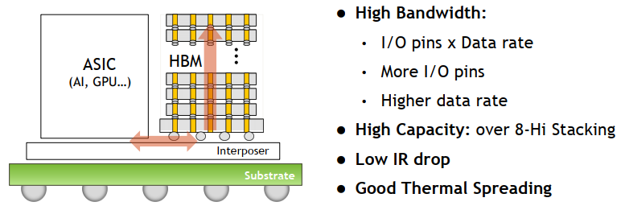
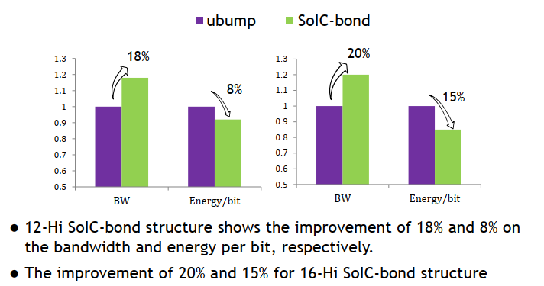
TSMC HBM Modification
Mostly focus on reducing PHY and TSV energy
Associated BW increase

Slide 9
Can the pJ/bit be lowered? (0.85/0.75 voltages?)
ADM layer2
ADM layer1
ADM layer0
CMOS Peripherals
ML
Substrate
Monolithic Stacking
Energy (pJ/bit)
ADM layer
Substrate
CMOS Peripherals
ML
ADM layer
Substrate
CMOS Peripherals
ML
Die Stacking (bumps)
DRAM options
ADM layer
Substrate
CMOS Peripherals
ML
ADM layer
Substrate
CMOS Peripherals
ML
Thin Die Stacking (bumps)

Slide 10
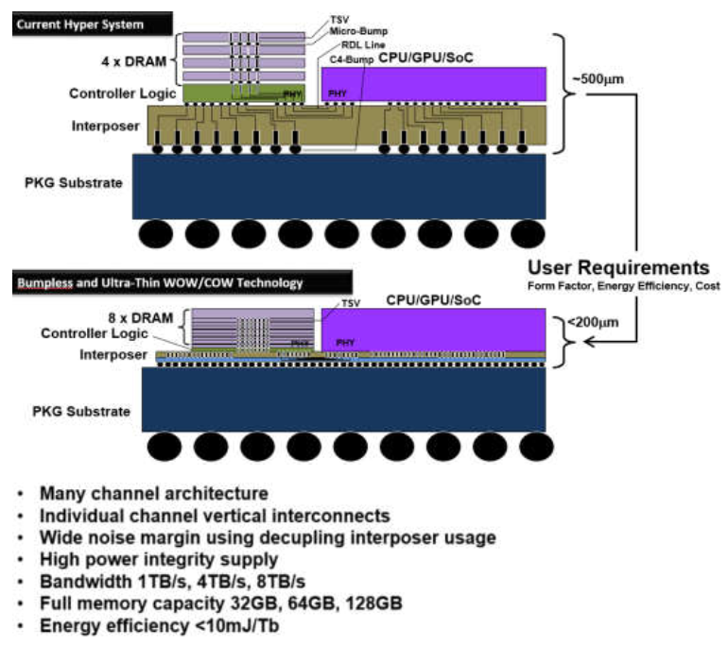
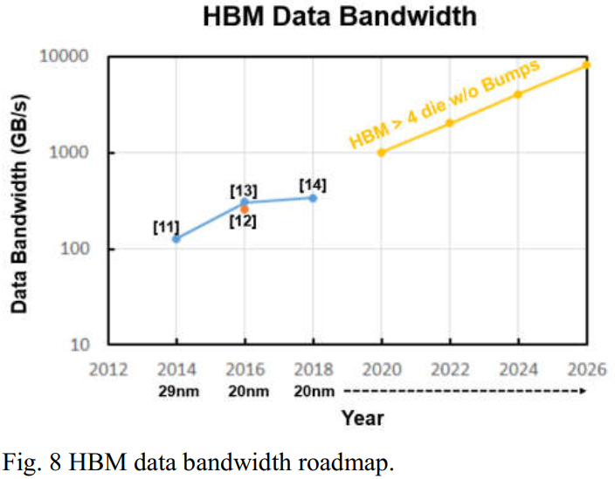
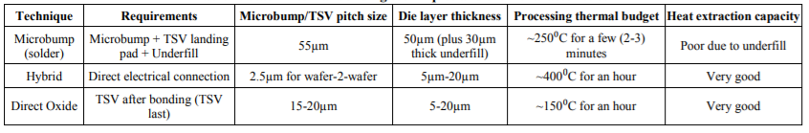
Trends on Memory Stacking
HBM roadmap includes bumpless stacking with TSVs or with Hybrid Bonding

Slide 11
Power within ADM IP
Die size reduction ~2.5x
Energy (pJ/bit)
AG 40% lower C
Lower AR for 2x better C, higher cond by 2x

Slide 12
Can the pJ/bit be lowered? (0.85/0.75 voltages?)
ADM layer2
ADM layer1
ADM layer0
CMOS Peripherals
ML
Substrate
Monolithic Stacking
ADM layer
Substrate
Energy (pJ/bit)
CMOS Peripherals
ML
ADM layer
Substrate
CMOS Peripherals
ML
Die Stacking (bumps)
DRAM options
Break down into steps
Roadmap – voltage and area shrink show separately (what gets us to voltage and die size shrink separately)
What are the gaps? Targets, enablers; add-in 1207 etc
How can HBM be made into the same
ADM layer
Substrate
CMOS Peripherals
ML
ADM layer
Substrate
CMOS Peripherals
ML
Thin Die Stacking (bumps)

Slide 13
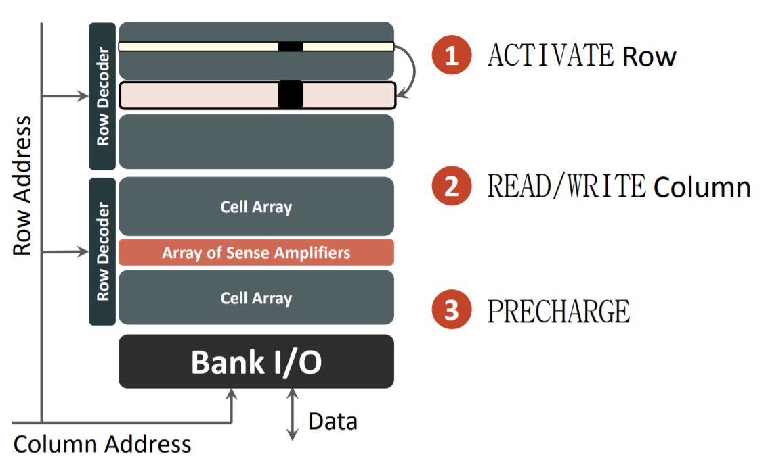
Timing Analysis of eDRAM
V_{WL}
WL rise
Writeback
BL dev
Voltage (V)
V_{SN}
V_{BL}
t_{WB}
V_{SAEN}
t_{RCD}
t_{RC}
time (s)
Three key sections of DRAM timing determine latency, row cycle time and hence BW

Slide 14
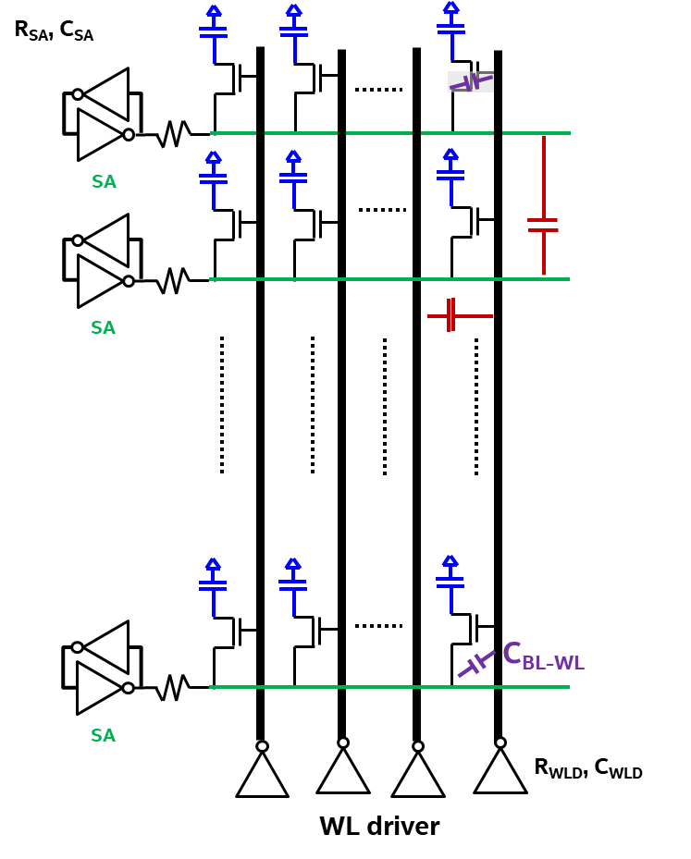
Timing Analysis of eDRAM
V_{SN}
V_{BL}
V_{WL}
WL rise
Writeback
BL dev
V_{SN}
V_{WL}
Voltage (V)
V_{BL}
t_{WB}
V_{SAEN}
t_{RCD}
t_{RC}
time (s)
Three key sections of DRAM timing determine latency, row cycle time and hence BW

Slide 15
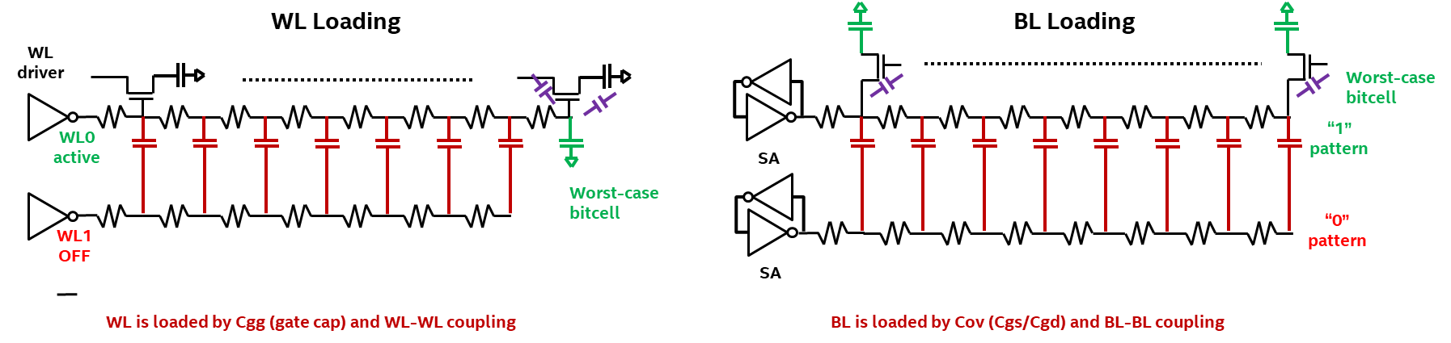
Performance Limiters in eDRAM
C_{OV}
Array limiters to performance
Metal lines (BL/WL), capacitance etc
SA
C_{BL-BL}
Bitcell limiters to performance
Transistor resistance, capacitance, COB etc
Additionally organizational limiters to performance → not covered in this talk
SA
C_{WL-WL}
RC delays impact the timing
C_{BL-WL}
SA
CMOS limiters of performance
R_{WLD}, C_{WLD}
WL driver

Slide 16
Timing Analysis of eDRAM
V_{SN}
V_{BL}
V_{WL}
WL rise
Writeback
BL dev
V_{SN}
V_{WL}
Voltage (V)
V_{BL}
t_{WB}
V_{SAEN}
t_{RCD}
t_{RC}
time (s)
Three key sections of DRAM timing determine latency, row cycle time and hence BW

Slide 17
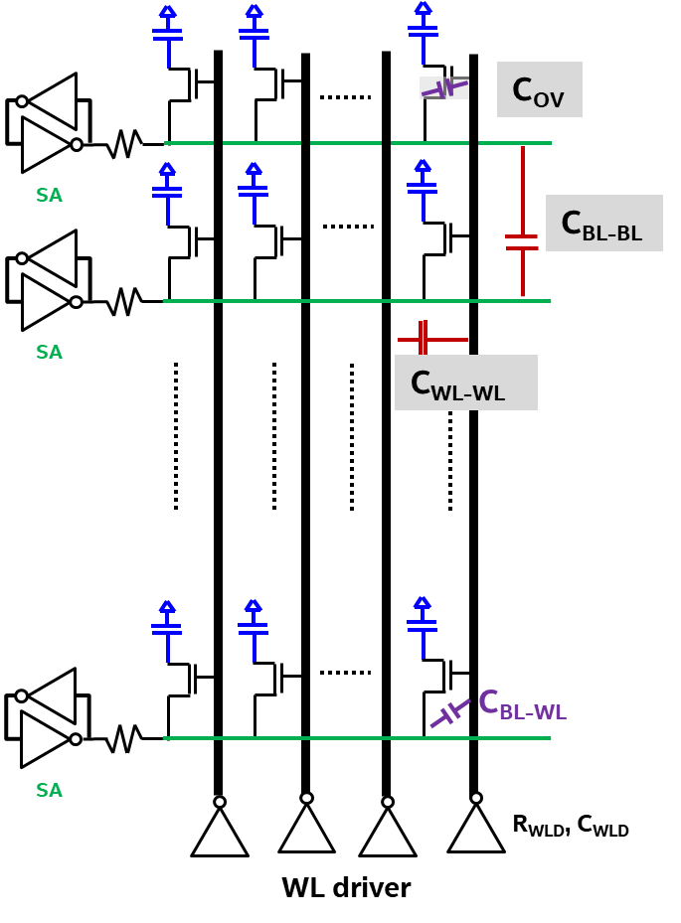
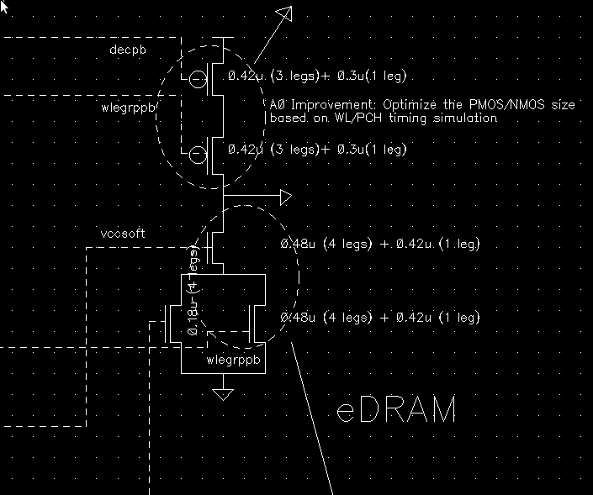
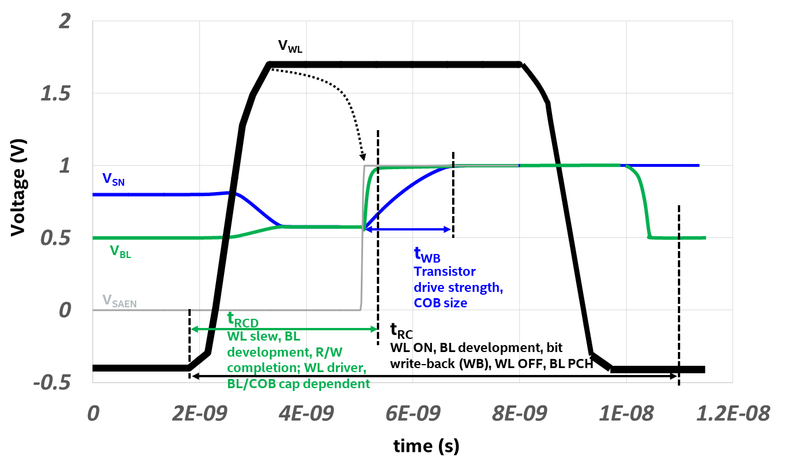
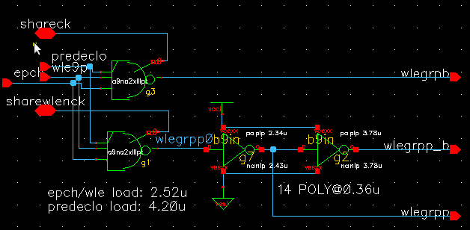
Timing Analysis of eDRAM: WL Rise/Fall
1222.6
τ_{WL} = R_{WL_dr}*(C_{WL_dr} + C_{WL}*(n-1) + C_{WL}*(1))
+ R_{WL}*(n-1)*(C_{WL}*(n-1) + C_{WL}*(1)) + R_{WL}*C_{WL}
τ_{WLem} = 1300*(3f +250f) + 2k*(250f/2) + 4*0.24f; τ_{WL}= 1.5ns
Equally WL RC and driver
Transistors used for driver:
108nm pitch
72nm Lg
120nm Z per leg
High voltage peak 1.8V
Transistors used for group driver:
90nm pitch
40nm Lg
120nm Z per leg
High voltage peak 1.1V
50x50 FinFET
τ_{WL} = R_{WL_dr}*(C_{WL_dr} + C_{WL}*(n-1) + C_{WL}*(1))
+ R_{WL}*(n-1)*(C_{WL}*(n-1) + C_{WL}*(1)) + R_{WL}*C_{WL}
τ_{WL} = 1300*(3f +152f) + 7.8k*(152f/2) + 4.3*0.14f = 2.38ns
Mostly WL RC dominated
Need Cu WL or

Slide 18
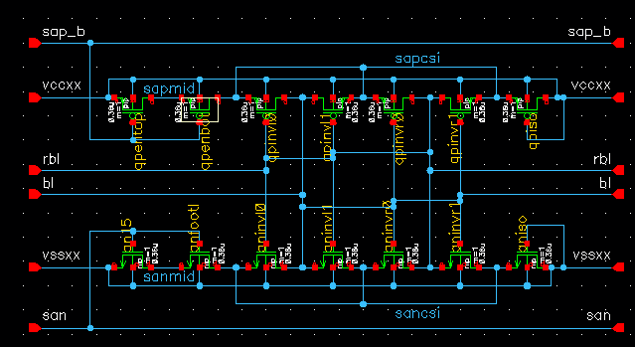
Timing Analysis of eDRAM: BL development
1222.6
τ_{WL} = R_{ADM}*(C_{BL}*(1)+ C_{BL}*(n-1) + C_{SA})
+ R_{BL}*(n-1)*(C_{BL}*(n-1) + C_{SA}) + R_{BL}*(1)*C_{SA}
τ_{WB} = 1e5*(12f +5f) + 700*(12f/2 + 5f) + 5*5f = 1.7ns
Transistors used for group driver:
90nm pitch
40nm Lg
120nm Z per leg
High voltage peak 1.1V
50x50 FinFET
τ_{WB} = R_{ADM}*(C_{BL}*(1)+ C_{BL}*(n-1) + C_{SA})
+ R_{BL}*(n-1)*(C_{BL}*(n-1) + C_{SA}) + R_{BL}*(1)*C_{SA}
τ_{WBprecorrection} = 1e5*(14.6f +5f) + 7.8k*(14.6f/2 + 5f) + 5*5f
τ_{WB} = 5.5ns
Mostly AT resistance dominated

