Slide 1
1222.6 Stack
C4B (110.3 um)
C4T needed, too
GM1 (4000 nm)
GM0 (1080 nm)
Metal 8 (360 nm)
Metal 7 (360 nm)
PGD cut
OGD cut
ADM section
Metal 6 (90 nm)
Metal 5 (90 nm)
Metal 4 (90 nm)
Metal 3 (90 nm)
Metal 2 (90 nm)
Metal 1 (90 nm)
CE! 1222.2 Front end

Slide 2
P1222 M5/VA4 POR processing
M5
Ta
M5
V4
ES
CDO
V4
Si sub
Logic
Memory Array
Notes:
2

Slide 3
VBG patt
Logic
ADM Array
5)130nm PR
4)26nm SiARC
3)170nm CHM
No TiN
2)+42nm Copulean VBG ES
CVD (SiC) double dep 10 and 32nm
1)1.3nm HALO
M5
Ta
V4
ES
halo
Si sub

Slide 4
VBG dry etch (TAO)
Logic
ADM Array
TAO does TriLayer and Cop
Stops on halo (strong ES)
170nm CHM
+42nm Copulean
1.3nm HALO

Slide 5
VBG ash/cleans
RCL ASH removes CHM
CAT BLU wet cleans removes HALO
Logic
ADM Array
+42nm Copulean
1.3nm HALO

Slide 6
CSB VBG metal fill and overburden
Logic
ADM Array
+ 35nm Ta (top)
35nm TaN
+42nm Copulean
1.3nm HALO

Slide 7
VBG polish (CE! NVM VJB polish)
1)Optically endpointed on TaN/Copulean reflectivity difference outside array
Logic
ADM Array
~20nm Cop/TaN
+42nm Copulean
20nm TaN
1.3nm HALO

Slide 8
Bottom electrode dep/polish
35nm TiN dep “Bottom Electrode”
Hanging polish; timed. 20-25nm TiN left
Logic
ADM Array
20-25nm TiN gate electrode
20nm TaN
+42nm Copulean
1.3nm HALO

Slide 9
ADB trilayer litho stack/SED
Frame-only topographical alignment feature
Aligns to MT5 (VBG)
**Frame only**
ADB spin/expose/develop; align to MT5
Logic
MT5
MT4
137.5nm PR
26nm SiARC
160nm CHM
20-25nm TiN gate electrode
20nm TaN
+42nm Copulean
1.3nm HALO

Slide 10
ADB dry etch (TAO/GTA)
Etch touched down into V4 etchstop
**Frame only** -> need to have keep away distance from MT5
Logic
Etch down to V4 ES/halo
CHM
20-25nm TiN gate electrode
20nm TaN
+42nm Copulean
1.3nm HALO

Slide 11
ADB ash/cleans
Ash RCL H2/He removes CHM; DHF cleans preserves BE
**Frame only**
Logic
20-25nm TiN gate electrode
20nm TaN
+42nm Copulean
1.3nm HALO

Slide 12
ADM stack dep
Too thick for downstream optical alignment
6nm HfOx
7nm ADM
Top seal 1nm AlOx
N implant
**Frame only**
Needed for ADO/ADP litho to align
Full adm stack (ignore color)
20-25nm TiN gate electrode
20nm TaN
20nm Copulean
1.3nm HALO
Logic
Array

Slide 13
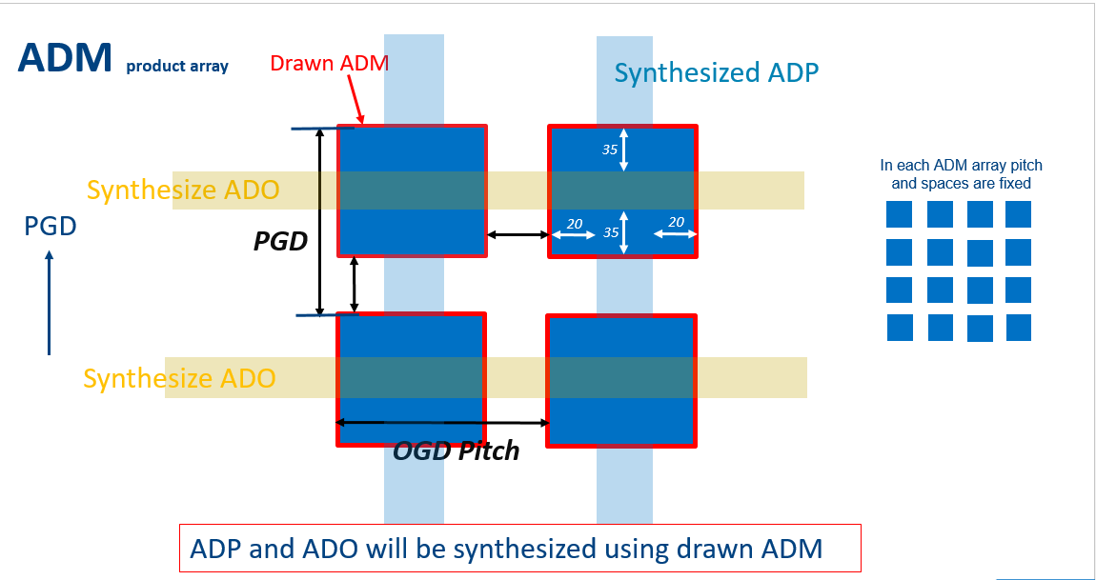
ADO vert
ADP horiz

Slide 14
ADM/HiK/TiOx Film Stack
TiN 25nm bot gate
HfO gate ox
ADM 10nm channel
AlO 3nm protection
PVD SiN – ILD for contact
Spu a-Si BB (BE material, sacr)
CVD SiN HM (sacr)
HM 30nm
Si 40nm
Fox NSA-PSA,
  PVD SiN 50nm
AlOx 3nm
ADM 20nm
160nm-180nm
HfOx 6nm
TiN 25 nm
50nm SiN
3nm AlO
20nm ADM
6nm HfO
25nm TiN
20nm TaN
M5
Ta
M5
ES
V4
ES
CDO
V4
Si sub
Logic
Memory Array

Slide 15
HM 30nm
Litho ADO: Define OGD pat
resist
Si 40nm
Resist
Si ARC
ILD/SiN 50nm
CHM
AlOx 3nm
SiN
ADM 20nm
HfOx 5nm
TiN 25nm
50nm SiN
3nm AlO
20nm ADM
6nm HfO
25nm TiN
20nm TaN
M5
Ta
M5
ES
V4
ES
CDO
V4
Si sub
Logic
Memory Array /PGD

Slide 16
ICE patt Siarc/CHM
Dep 32nm(?) fox to make narrower
FOX on CHM to get right etch bias
HM 30nm
Spacer : low temp FOX
Si 40nm
PVD SiN 50nm
AlOx 3nm
ADM 20nm
HfOx 6nm
TiN 25nm
50nm SiN
3nm AlO
20nm ADM
6nm HfO
25nm TiN
20nm TaN
M5
Ta
M5
ES
V4
ES
CDO
V4
Si sub
Logic
Memory Array PGD

Slide 17
Spacer ETCH and Si etch to form Lg+S-D
HM 30nm
ICE patt Siarc/CHM
Dep 32nm(?) fox to make narrower
ICE etches CVD SiN and Si BB
Si 40nm
PVD SiN 50nm
AlOx 3nm
ADM 20nm
Si
Si
HfOx 6nm
TiN 25nm
50nm SiN
1nm AlO
7nm ADM
6nm HfO
25nm TiN
20nm TaN
M5
Ta
M5
ES
V4
ES
CDO
V4
Si sub
Logic
Memory Array -PGD

Slide 18
SiN 30nm
CHM and FOX SPCR removal with
insitu ICE + RCL for CHM
DHF clean for FOX
Si 50nm
ILD/SiN 50nm
AlOx 3nm
ADM 20nm
Si
Si
HfOx 5nm
TiN 25nm
50nm SiN
3nm AlO
20nm ADM
6nm HfO
25nm TiN
20nm TaN
M5
Ta
M5
ES
V4
ES
CDO
V4
Si sub
Logic
Memory Array -PGD

Slide 19

HM 30nm
ADP patterning: Define transistor isolation in OGD
Si 40nm
resist
resist
resist
PVD SiN 50nm
Resist
CHM
AlOx 3nm
ADM 20nm
HfOx 5nm
TiN 25nm
Si
50nm SiN
3nm AlO
20nm ADM
6nm HfO
25nm TiN
20nm TaN
M5
Ta
M5
ES
V4
ES
CDO
V4
Memory array/ OGD
Memory array/ PGD

Slide 20
ADP patterning: fox spacer dep on resist
ADO/ADP same trilayer?
ADP is thicker to fill ADO topo
HM 30nm
Si 40nm
resist
resist
resist
PVD SiN 50nm
Resist
AlOx 3nm
ADM 20nm
HfOx 6nm
TiN 25nm
50nm SiN
3nm AlO
20nm ADM
6nm HfO
25nm TiN
20nm TaN
M5
Ta
M5
ES
V4
ES
CDO
V4
Memory array OGD
Memory arreay/ PGD

Slide 21
ADP patterning: ICE: Spacer etch, Si
resist
resist
resist
Resist
HM 30nm
Si 40nm
PVD SiN 50nm
AlOx 3nm
ADM 20nm
HfOx 5nm
50nm SiN
TiN 25nm
3nm AlO
20nm ADM
6nm HfO
25nm TiN
20nm TaN
M5
Ta
M5
ES
V4
ES
CDO
V4
Memory arreay OGD
Memory arreay PGD

Slide 22
HM 30nm
PR consumed but fox remains
Si 40nm
PVD SiN 50nm
Resist
AlOx 3nm
ADM 20nm
HfOx 5nm
TiN 25nm
M5
Ta
M5
ES
V4
ES
CDO
V4
Memory array OGD
Memory array PGD

Slide 23
SiN 30nm
ADP spacer removal DHF
Si 40nm
ILD/SiN 50nm
Resist
AlOx 3nm
ADM 20nm
HfOx 5nm
TiN 25nm
M5
Ta
M5
ES
V4
ES
CDO
V4
Memory array OGD
Memory array PGD

Slide 24
hm 30nm
ICE etches CVD SiN and SI BB
Si 40nm
25nm in 2X cell
PVD SiN 50nm
30nm in 2X cell
AlOx 3nm
ADM 20nm
HfOx 6nm
TiN 25nm
50nm SiN
3nm AlO
20nm ADM
6nm HfO
25nm TiN
20nm TaN
M5
Ta
M5
ES
V4
ES
CDO
V4
Memory array OGD
Memory array PGD

Slide 25
CHM ashed with RCL O2/N2
CVD SiN
50nm
Si 40nm
PVD SiN
50nm
AlOx 3nm
ADM 20nm
25nm
30nm
HfOx 6nm
TiN 25nm
50nm SiN
3nm AlO
20nm ADM
6nm HfO
25nm TiN
20nm TaN
M5
Ta
M5
ES
V4
ES
CDO
V4
Memory array OGD
Memory array PGD

Slide 26
ANT etch dual step all the way thru TiN
HM 30nm
Si 40nm
ILD/Oxide 50nm
AlOx 3nm
ADM 20nm
HfOx 6nm
TiN 25nm
25nm
30nm
50nm SiN
3nm AlO
7nm ADM
6nm HfO
25nm TiN
20nm TaN
M5
Ta
M5
ES
V4
ES
CDO
V4
Memory arreay OGD
Memory arreay PGD

Slide 27
Side sealing layer of HfOx (3nm)
For wet etch selectivity
HM 30nm
Si 40nm
PVD SiN 50nm
3nm AlOx
ADM 20nm
HfOx 6nm
TiN 25nm
HfOx
25nm
30nm
50nm SiN
3nm AlO
20nm ADM
6nm HfO
25nm TiN
20nm TaN
M5
Ta
M5
ES
V4
ES
CDO
V4
Memory array OGD
Memory array PGD

Slide 28
30nm AlO dep’d fills in gap between transistors
With little divots
HM 30nm
Si 40nm
ILD/Oxide 50nm
AlOx 3nm
ADM 20nm
HfOx 6nm
TiN 25nm
AlOx
HfOx
25nm
30nm
50nm SiN
3nm AlO
20nm ADM
6nm HfO
25nm TiN
20nm TaN
M5
Ta
M5
ES
V4
ES
CDO
V4
Memory array OGD
Memory array OGD
Memory array PGD
Memory array PGD

Slide 29
Logic-Transition Vs. Array X section
AlO removed by DHF
HfO implanted by TIM
Implanted HfO rem’d by DHF
HM 30nm
Si 40nm
PVD SiN 50nm
AlOx 3nm
ADM 20nm
HfOx 5nm
TiN 25nm
AlOx
HfOx
50nm SiN
3nm AlO
20nm ADM
6nm HfO
25nm TiN
20nm TaN
M5
Ta
M5
ES
V4
ES
CDO
V4
Logic PGD

Slide 30
Logic-Transition Vs. Array X section
300nm CDO film depostition
HM 30nm
Si 40nm
PVD SiN 50nm
AlOx 3nm
ADM 20nm
HfOx 5nm
TiN 25nm
AlOx
HfOx
50nm SiN
3nm AlO
20nm ADM
6nm HfO
25nm TiN
20nm TaN
M5
Ta
M5
ES
V4
ES
CDO
V4
Logic PGD

Slide 31
Logic-Transition Vs. Array X section
PLM – polish down to 140nm
DROC (TAO) – remove ~20nm
HM 30nm
Si 40nm
PVD SiN 50nm
AlOx 3nm
ADM 20nm
HfOx 5nm
TiN 25nm
20nm
AlOx
HfOx
120nm
50nm SiN
3nm AlO
20nm ADM
6nm HfO
25nm TiN
20nm TaN
M5
Ta
M5
ES
V4
ES
CDO
V4
Logic PGD

Slide 32
ACG+ACP patterning to define SD
resist
resist
CVD Oxide
TiN HM
10nm
CDO
AlOx
25nm
30nm
HfOx
50nm SiN
3nm AlO
20nm ADM
6nm HfO
25nm TiN
20nm TaN
M5
Ta
M5
ES
V4
ES
CDO
V4
Memory array OGD
Memory array OGD
Memory array PGD
Memory array PGD

Slide 33
CAT THF to de-cap FOX
TAO removes CHM
BB
CM
CVD Oxide
TiN HM
10nm
CDO
AlOx
25nm
30nm
HfOx
50nm SiN
3nm AlO
20nm ADM
6nm HfO
25nm TiN
20nm TaN
M5
Ta
M5
ES
V4
ES
CDO
V4
Memory array OGD
Memory array OGD
Memory array PGD
Memory array PGD

Slide 34
CVD OX HM etch, consumes FOX, Siarc
CVD Oxide
TiN HM
10nm
CDO
AlOx
25nm
30nm
HfOx
50nm SiN
3nm AlO
20nm ADM
6nm HfO
25nm TiN
20nm TaN
M5
Ta
M5
ES
V4
ES
CDO
V4
Memory array OGD
Memory array OGD
Memory array PGD
Memory array PGD

Slide 35
ACP patterning
resist
resist
resist
resist
CVD Oxide
TiN HM
10nm
CDO
AlOx
25nm
30nm
HfOx
50nm SiN
3nm AlO
20nm ADM
6nm HfO
25nm TiN
20nm TaN
M5
Ta
M5
ES
V4
ES
CDO
V4
Memory array OGD
Memory array OGD
Memory array PGD
Memory array PGD

Slide 36
ADP etch (ICE)
And CHM clean (TGR)
CVD Oxide
TiN HM
10nm
CDO
AlOx
25nm
30nm
HfOx
50nm SiN
3nm AlO
20nm ADM
6nm HfO
25nm TiN
20nm TaN
M5
Ta
M5
ES
V4
ES
CDO
V4
Memory array OGD
Memory array OGD
Memory array PGD
Memory array PGD

Slide 37
ACP HM etch to transfer pattern to TiN HM (ICE)
ACP HM clean to remove remaing oxide (TGR)
TiN HM
10nm
CDO
AlOx
25nm
30nm
HfOx
50nm SiN
3nm AlO
20nm ADM
6nm HfO
25nm TiN
20nm TaN
M5
Ta
M5
ES
V4
ES
CDO
V4
Memory array OGD
Memory array OGD
Memory array PGD
Memory array PGD

Slide 38
ACT etch (ICE, etch TiN and CDO/SiN, stop on ADM)
BLU clean off remaining TiN
AA to reset ADM interface
10nm CDO
AlOx
25nm
30nm
50nm
SiN
HfOx
20nm ADM
6nm HfO
25nm TiN
20nm TaN
M5
Ta
M5
ES
V4
ES
CDO
V4
Memory array OGD
Memory array OGD
Memory array PGD
Memory array PGD

Slide 39
1nm HfOx (MIS)
CSB Cu seed
Cu EPN
CON hole W:40nm/H:70nm
CuBS+EPN
1nm HfOx
10nm CDO
AlOx
25nm
30nm
50nm
SiN
HfOx
3nm AlO
20nm ADM
6nm HfO
25nm TiN
20nm TaN
M5
Ta
M5
ES
V4
ES
CDO
V4
Memory array OGD
Memory array OGD
Memory array PGD
Memory array PGD

Slide 40
CON Cu polish
Removes Cu/HfOx/some CDO on top
CON hole W:40nm/H:70nm
10nm CDO
AlOx
25nm
30nm
50nm
SiN
HfOx
3nm AlO
20nm ADM
6nm HfO
25nm TiN
20nm TaN
M5
Ta
M5
ES
V4
ES
CDO
V4
Memory array OGD
Memory array OGD
Memory array PGD
Memory array PGD

Slide 41
ES Film Dep
End of Transition
1 micron from array
AD1
750 nm
ES
M5
M5
M5
M5
WL
WL
WL
WL
3.5nm Si3N4 (DE)
2nm HALO (WE)
V4 ILD
CDO
Logic
eDRAM Array

Slide 42
AD1 litho
End of Transition
1 micron from array
AD1
750 nm
Resist
BARC
ES
M5
M5
M5
M5
WL
WL
WL
WL
3.5nm Si3N4 (DE)
2nm HALO (WE)
V4 ILD
CDO
Logic
eDRAM Array

Slide 43
AD1 Etch
End of Transition
1 micron from array
ICE
AD1
750 nm
Resist
BARC
ES
M5
M5
M5
M5
WL
WL
WL
WL
3.5nm Si3N4 (DE)
2nm HALO (WE)
V4 ILD
CDO
Logic
eDRAM Array

Slide 44
AD1 ASH and Clean
End of Transition
1 micron from array
RCL O2/N2
and BLU 120s (doesn’t blow CD)
AD1
750 nm
ES
M5
M5
M5
M5
WL
WL
WL
WL
10nm Si3N4 (DE)
2nm HALO (WE)
V4 ILD
CDO
Logic
eDRAM Array

Slide 45
HM DEP
5nm of Ti
30nm of TiN
35nm TiN HM
ES
100nm
180nm
M5
M5
M5
M5
WL
WL
WL
WL
V4 ILD
CDO
Logic
eDRAM Array

Slide 46
CHM/SiARC DEP
SiARC
CHM
Currently 2000 A, but can make thinner
35nm TiN HM
ES
100nm
180nm
M5
M5
M5
M5
WL
WL
WL
WL
V4 ILD
CDO
Logic
eDRAM Array

Slide 47
BLD SED
PR
SiARC
CHM
Currently 2000 A, but can make thinner
35nm TiN HM
ES
100nm
180nm
M5
M5
M5
M5
WL
WL
WL
WL
V4 ILD
CDO
Logic
eDRAM Array

Slide 48
BLD SED
PR
SiARC
CHM
35nm TiN HM
ES
100nm
180nm
M5
M5
M5
M5
WL
WL
WL
WL
V4 ILD
CDO
Logic
eDRAM Array

Slide 49
BLD HM ETCH
ICE
CHM
35nm TiN HM
ES
100nm
180nm
M5
M5
M5
M5
WL
WL
WL
WL
V4 ILD
CDO
Logic
eDRAM Array

Slide 50
BLD in situ ASH ICE
Clean XM
35nm TiN HM
ES
100nm
180nm
M5
M5
M5
M5
WL
WL
WL
WL
V4 ILD
CDO
Logic
eDRAM Array

Slide 51
MT6 CHM/SiARC/SED
PR
SiARC
CHM
Currently 1600 A, but can make thinner
35nm TiN HM
ES
100nm
180nm
M5
M5
M5
M5
WL
WL
WL
WL
V4 ILD
CDO
Logic
eDRAM Array

Slide 52
MT6 HM ETCH
HME
CHM
35nm TiN HM
ES
100nm
180nm
M5
M5
M5
M5
WL
WL
WL
WL
V4 ILD
CDO
Logic
eDRAM Array

Slide 53
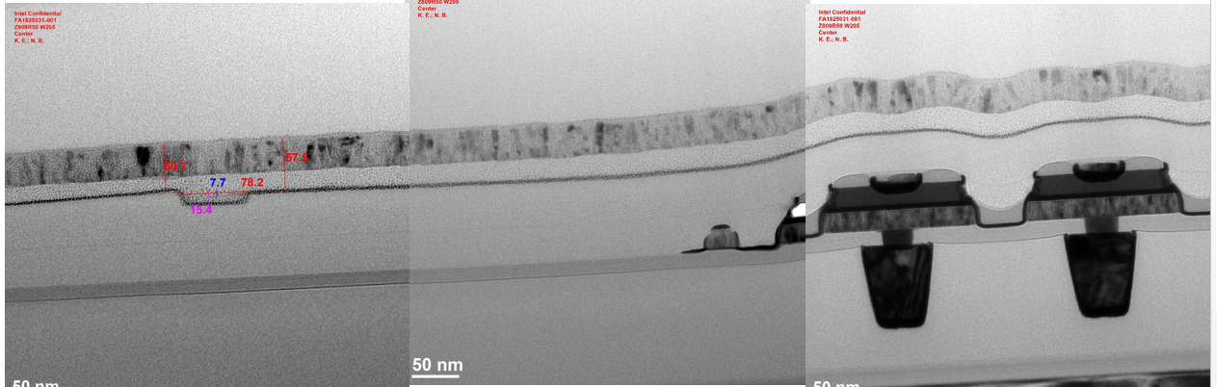
MT6 In Situ ASH
HME ASH
XM clean
35nm TiN HM
ES
100nm
180nm
M5
M5
M5
M5
WL
WL
WL
WL
V4 ILD
CDO
Logic
eDRAM Array

Slide 54
VA5 CHM/SiARC/SED
PR
SiARC
CHM
35nm TiN HM
ES
100nm
180nm
M5
M5
M5
M5
WL
WL
WL
WL
V4 ILD
CDO
Logic
eDRAM Array

Slide 55
VA5 Etch
TAO
CHM
35nm TiN HM
ES
100nm
180nm
M5
M5
M5
M5
WL
WL
WL
WL
V4 ILD
CDO
Logic
eDRAM Array

Slide 56
VA5 ASH+Clean
RCL ASH O2N2 v H2He
CLN XM
*This is the ASH step that we are skewing for
V5 ASH O2N2 v H2He
35nm TiN HM
ES
100nm
180nm
M5
M5
M5
M5
WL
WL
WL
WL
V4 ILD
CDO
Logic
eDRAM Array

Slide 57
M6+BLD BT
HME (may change back to CAR or ICE)
35nm TiN HM
ES
100nm
180nm
M5
M5
M5
M5
WL
WL
WL
WL
V4 ILD
CDO
Logic
eDRAM Array

Slide 58
M6 HMR
CAT BLU 120s
ES
100nm
180nm
M5
M5
M5
M5
WL
WL
WL
WL
V4 ILD
CDO
Logic
eDRAM Array

Slide 59
M6 CSB+EPN
ES
100nm
180nm
M5
M5
M5
M5
WL
WL
WL
WL
V4 ILD
CDO
Logic
eDRAM Array

Slide 60
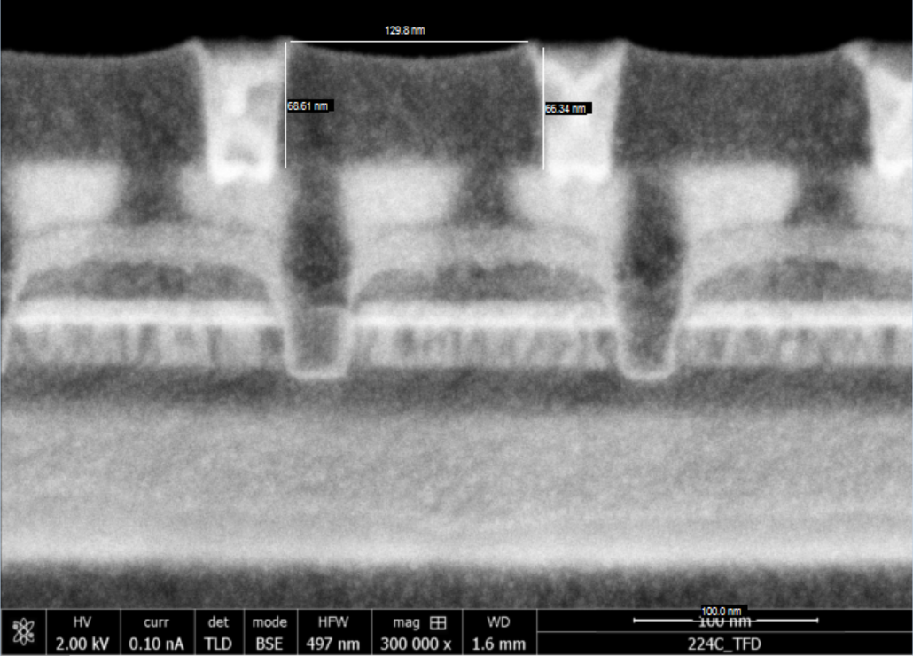
M6 Polish
BLD PGD Cut landing on ACT
M5
M5
M5
M5
WL
WL
WL
WL
V4 ILD
CDO
Logic
eDRAM Array

Slide 61
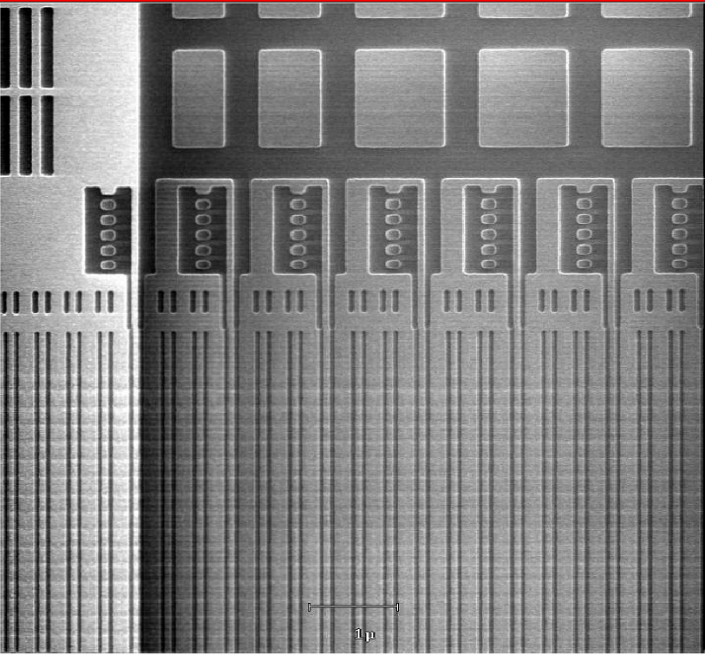
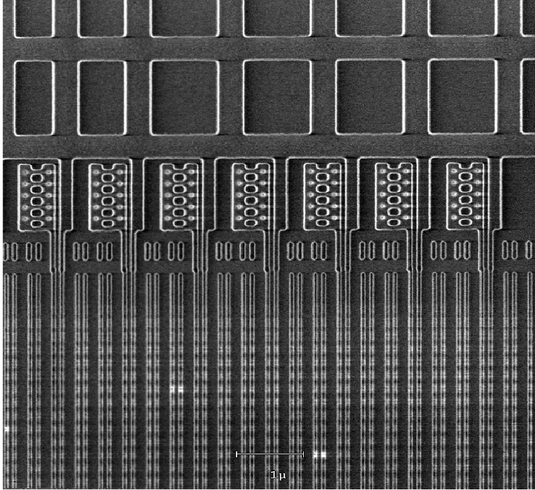
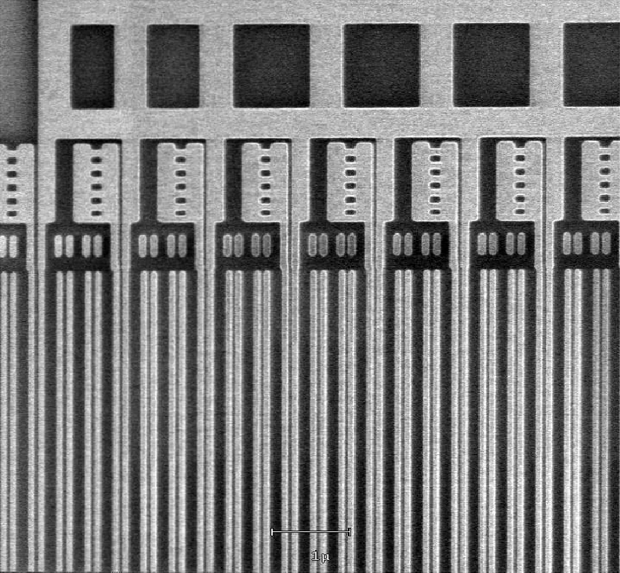
Post M6 HM Etch
Post BT Etch
Post Polish
M6 on top, BLD on bottom (of image)

Slide 62
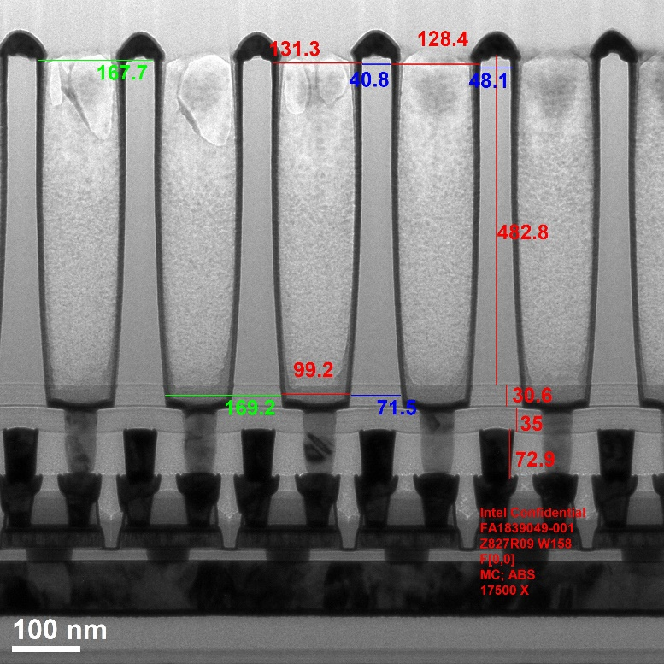
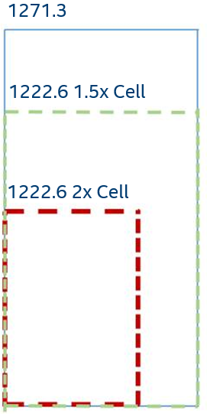
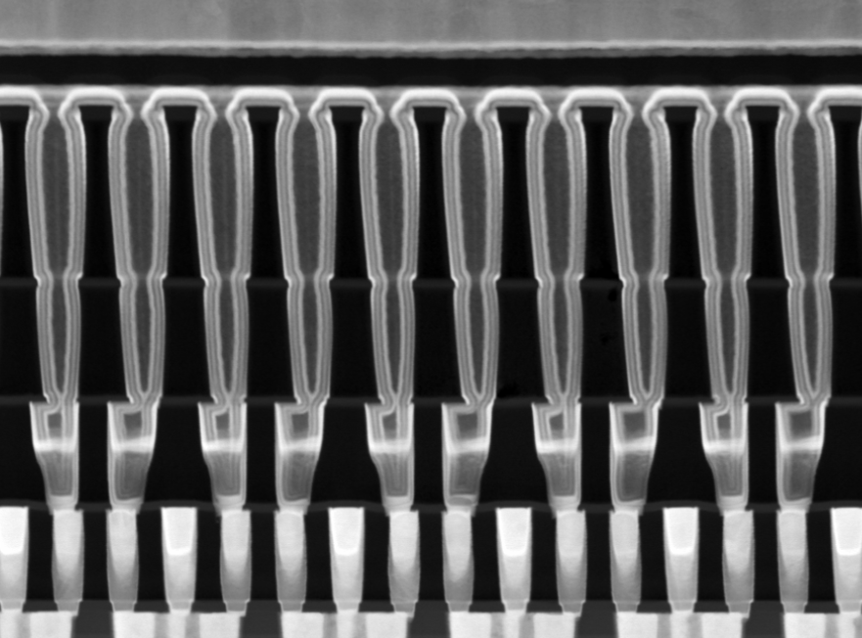
COB Differences
ADM COB
ADM COB is in one large SiOx dielectric layer
Capacitance comes from COB only (no need to etch out bottom interconnect)
COB Size is about 170x89 in 1271.3 and it is 62x89 for X22MA
1271 REF
Edram | Size | Scaled area
1271.3 | 170 x 89 | 1
ADM 1.5x | 134 x 89 | 0.78
ADM 2x | 89 x 64 | 0.37

Slide 63
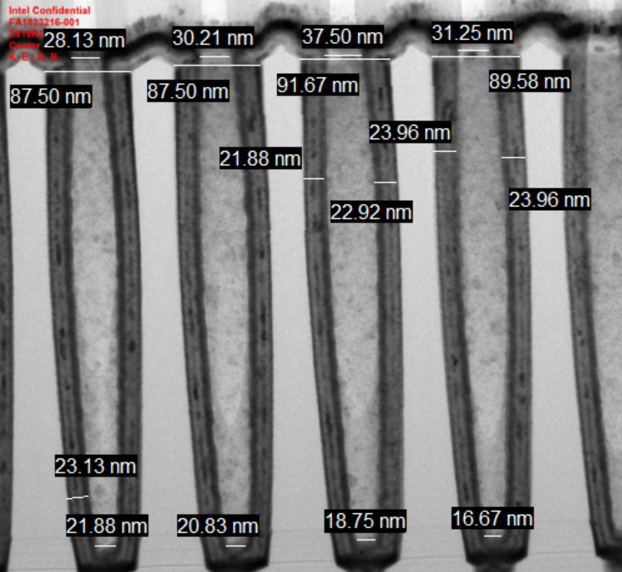
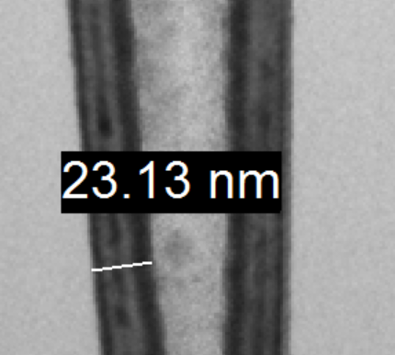
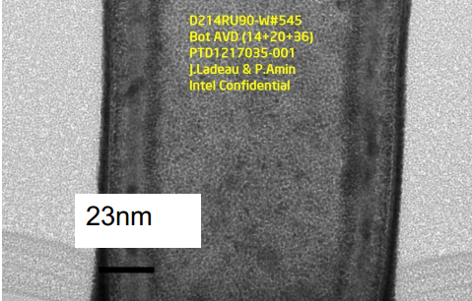
Goal is to match TZT Dielectric as close as possible
ADM COB
1271 REF

Slide 64
CAP VIA (VCB) dielectric and litho stack dep and SED
End of Transition
1 micron from array
Etch this one first. So we do not expose Cu to CHM on the bridge via. If we etch the other one first then we have risk on wafer for corrosion and risk in FAB for Cu contamination
Resist
SIARC
CHM
20nm SiOx
35nm CDN ES
VCB ILD
60nm
P3T
V6 ES
V6 ES 35nm CDN
M6
M6
M6
BLD
V5 ILD
BLD
BLD
BLD
ES
V5
Array
M5
M5
M5
M5
WL
WL
WL
WL
V4 ILD
CDO
OGD Cut
PGD Cut
Logic
eDRAM Array

Slide 65
VCB Etch - TAO
End of Transition
1 micron from array
Resist
SIARC
CHM
20nm SiOx
35nm CDN
VCB ILD
60nm
P3T
V6 ES
V6 ES 35nm CDN
M6
M6
M6
BLD
BLD
BLD
BLD
V5 ILD
ES
V5
Array
M5
M5
M5
M5
WL
WL
WL
WL
V4 ILD
CDO
OGD Cut
PGD Cut
Logic
eDRAM Array

Slide 66
CAP VIA RCL H2/H2 ASH and BLUE 120s clean
End of Transition
1 micron from array
20nm SiOx
35nm CDN
VCB ILD
60nm
P3T
V6 ES
M6
M6
M6
BLD
V5 ILD
BLD
BLD
BLD
ES
V5
Array
M5
M5
M5
M5
WL
WL
WL
WL
V4 ILD
CDO
OGD Cut
PGD Cut
Logic
eDRAM Array

Slide 67
CAP VIA fill
CSB BS
EPN
End of Transition
1 micron from array
20nm SiOx
VCB ES
35nm CDN
V6 ES
VCB
VCB
VCB
M6
M6
M6
BLD
60nm
P3T
BLD
BLD
BLD
V5 ILD
ES
V5
M5
M5
M5
M5
WL
WL
WL
WL
V4 ILD
CDO
Array
OGD Cut
PGD Cut
Logic
eDRAM Array

Slide 68
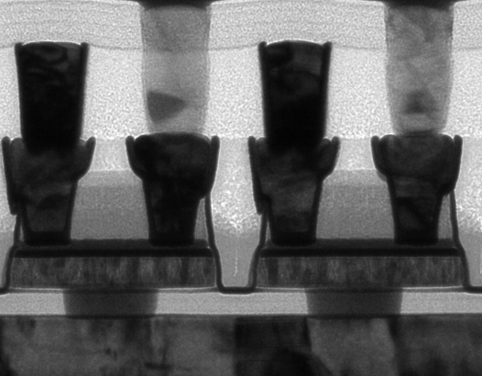
CAP VIA polish
End of Transition
1 micron from array
VCB ES
35nm CDN
V6 ES
VCB
VCB
VCB
M6
M6
M6
BLD
40nm
P3T
BLD
BLD
BLD
V5 ILD
ES
V5
10nm HALO
M5
M5
M5
M5
WL
WL
WL
WL
V4 ILD
CDO
Array
OGD Cut
PGD Cut
Logic
eDRAM Array

Slide 69
V6 ES dep – AVD AlOx and CVD CDN
End of Transition
1 micron from array
35nm CDN
2nm HALO
VCB ES
35nm CDN
V6 ES
VCB
VCB
VCB
M6
M6
M6
BLD
40nm
P3T
V5 ILD
BLD
BLD
BLD
ES
V5
10nm HALO
M5
M5
M5
M5
WL
WL
WL
WL
V4 ILD
CDO
Array
OGD Cut
PGD Cut
Logic
eDRAM Array

Slide 70
Deposit V6ES and COB ILD and TiN HM+HALO
COB ES/HM
Matching 1271.3 will use TiN HM and HALO.
Current COB height is set at 520nm for BLD height of 60
COB/V6 ILD
VCB ES
35nm TiN
V6 ES
VCB
VCB
VCB
6nm HALO for etch
M6
M6
M6
BLD
520nm SiOx CVD
BLD
BLD
BLD
V5 ILD
ES
V5
M5
M5
M5
M5
WL
WL
WL
WL
35nm CDN
V4 ILD
CDO
2nm HALO
OGD Cut
PGD Cut
35nm CDN
Array
Logic
eDRAM Array

Slide 71
Deposit COB litho stack and SED (CBG+CBP)
Resist
SiARC
CHM
CHM needs to be thick to withstand the etch. Patterning will be grating/plug matching 1271.3
COB/V6 ILD
35nm TiN
V6 ES
VCB
VCB
VCB
6nm HALO
M6
M6
M6
BLD
520nm SiOx
BLD
BLD
BLD
V5 ILD
ES
V5
M5
M5
M5
M5
WL
WL
WL
WL
35nm CDN
V4 ILD
CDO
2nm HALO
OGD Cut
PGD Cut
35nm CDN
Array
Logic
eDRAM Array

Slide 72
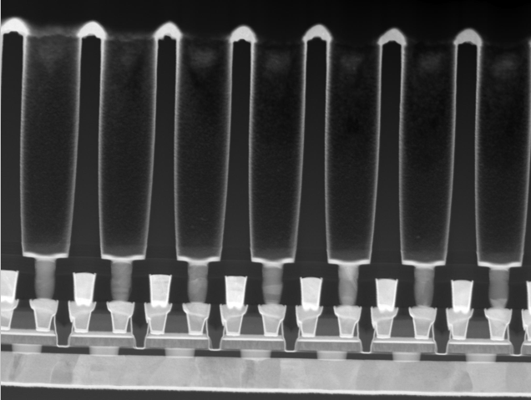
ICE trilayer
OXT ILD
RCL ASH
CAT DHF/SRO3B clean
CAR BT (ES)
BLU HM 270s
Halo still there
COB Etch and Wet clean
COB
COB/V6 ILD
VCB ES
V6 ES
VCB
VCB
VCB
BLD ES
M6
M6
M6
BLD
BLD
BLD
BLD
6nm HALO
V5 ILD
ES
520nm SiOx
V5
M5
M5
M5
M5
WL
WL
WL
WL
V4 ILD
CDO
35nm CDN
OGD Cut
PGD Cut
2nm HALO
35nm CDN
Logic
eDRAM Array
Array

Slide 73
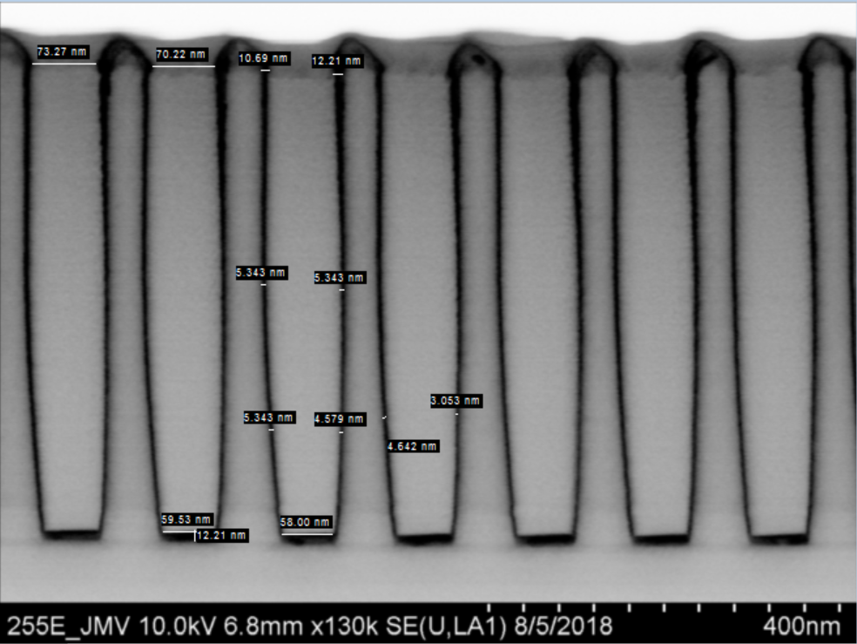
Dep Ta/TaN bottom electrode
COB
COB/V6 ILD
V6 ES
VCB
VCB
VCB
M6
M6
M6
BLD
30nm Ta/TaN
BLD
BLD
BLD
V5 ILD
ES
520nm SiOx
V5
M5
M5
M5
M5
WL
WL
WL
WL
V4 ILD
CDO
35nm CDN
OGD Cut
PGD Cut
2nm HALO
35nm CDN
Logic
eDRAM Array
Array

Slide 74
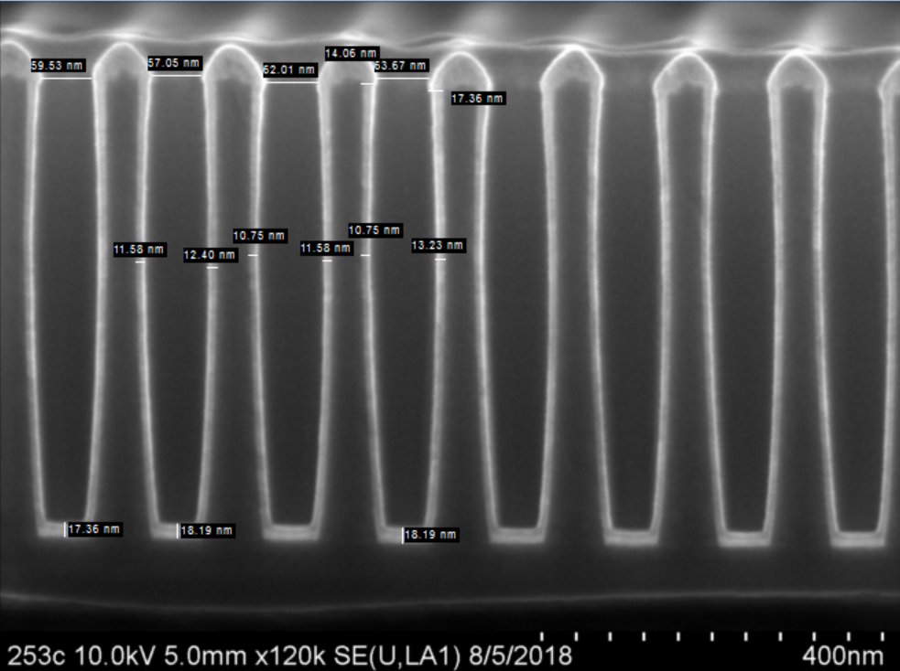
Dep AMBER+SAB Film
2 AVD steps
TiN (AMBER) bottom electrode
TiO (SAB) first layer of hiK
AMBER is the conducting TiN film. SAB is TiO2
COB
COB/V6 ILD
1.5nm SAB
VCB ES
V6 ES
VCB
VCB
VCB
4.4nm AMBER
M6
M6
M6
BLD
30nm Ta/TaN
BLD
BLD
BLD
V5 ILD
ES
520nm SiOx
V5
M5
M5
M5
M5
WL
WL
WL
WL
V4 ILD
CDO
35nm CDN
OGD Cut
PGD Cut
2nm HALO
35nm CDN
Logic
eDRAM Array
Array

Slide 75
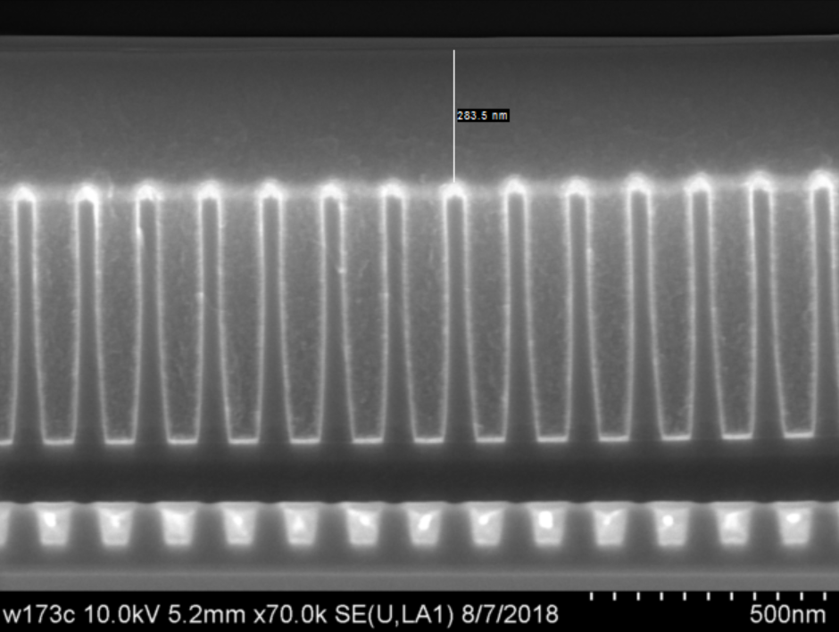
Double SLM dep
SLAM Dep
COB
375nm SLAM
COB/V6 ILD
1.5 nm SAB
V6 ES
VCB
VCB
VCB
4.4 nm AMBER
M6
M6
M6
BLD
30nm Ta/TaN
BLD
BLD
BLD
V5 ILD
ES
520nm SiOx
V5
M5
M5
M5
M5
WL
WL
WL
WL
V4 ILD
CDO
35nm CDN
OGD Cut
PGD Cut
2nm HALO
35nm CDN
Logic
eDRAM Array
Array

Slide 76
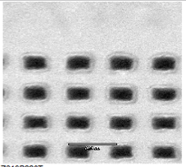
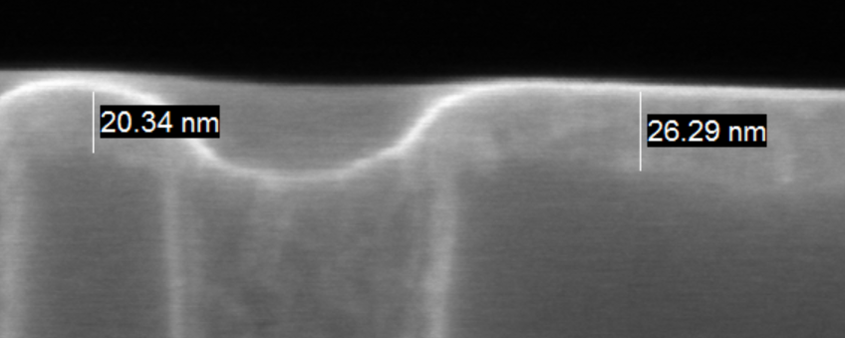
Polish for Metal recess etch
COB
COB/V6 ILD
1.5 nm SAB
V6 ES
VCB
VCB
VCB
4.4 nm AMBER
M6
M6
M6
BLD
30nm Ta/TaN
BLD
BLD
BLD
V5 ILD
ES
520nm SiOx
V5
M5
M5
M5
M5
WL
WL
WL
WL
V4 ILD
CDO
35nm CDN
OGD Cut
PGD Cut
2nm HALO
35nm CDN
Logic
eDRAM Array
Array

Slide 77
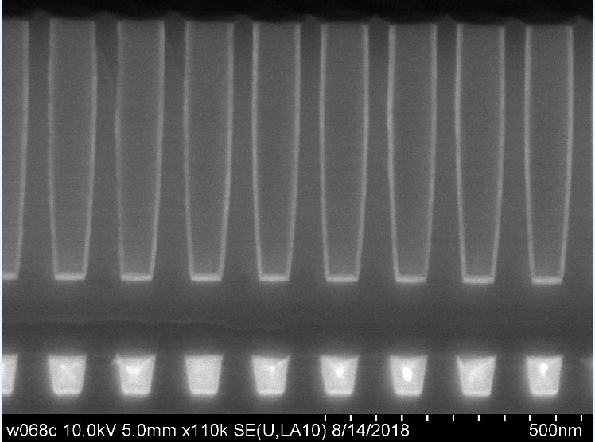
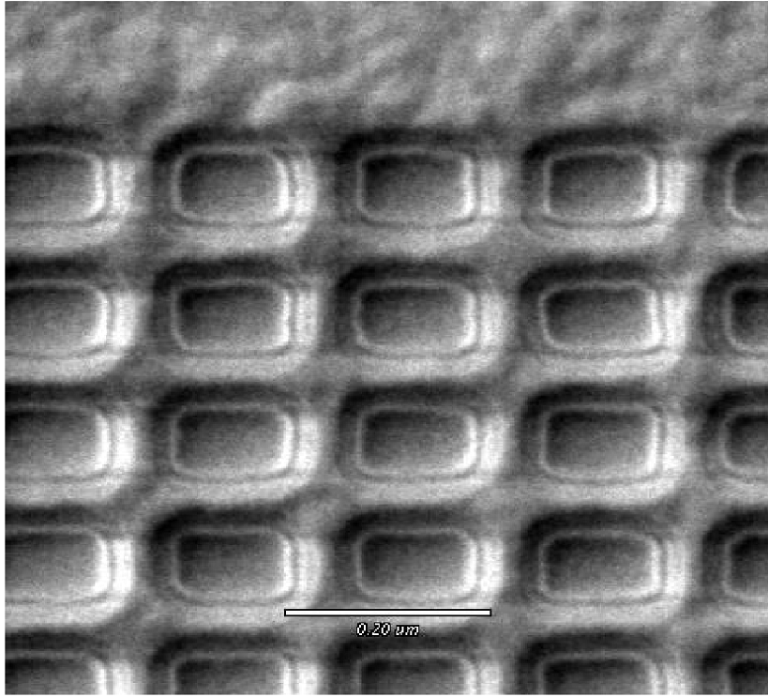
HME Metal Recess Etch
HME etch
SLM
COB
COB/V6 ILD
1.5nm SAB
VCB ES
V6 ES
VCB
VCB
VCB
4.4nm AMBER
M6
M6
M6
BLD
30nm Ta/TaN
BLD
BLD
BLD
V5 ILD
ES
520nm SiOx
V5
M5
M5
M5
M5
WL
WL
WL
WL
V4 ILD
CDO
35nm CDN
OGD Cut
PGD Cut
2nm HALO
35nm CDN
Logic
eDRAM Array
Array

Slide 78
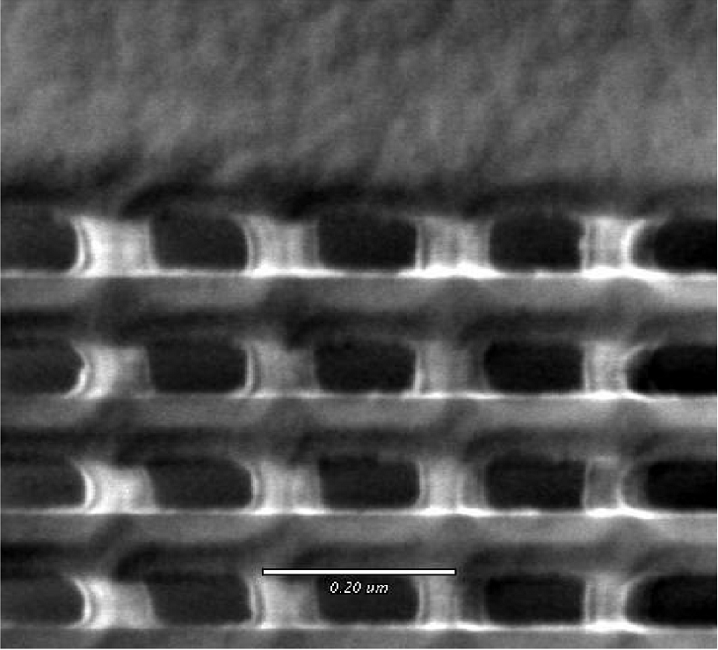
SLAM Clean
SR03B Cleans. Two cleans 360s each
COB
COB/V6 ILD
1.5nm SAB
VCB ES
V6 ES
VCB
VCB
VCB
4.4nm AMBER
M6
M6
M6
BLD
30nm Ta/TaN
BLD
BLD
BLD
V5 ILD
ES
520nm SiOx
V5
M5
M5
M5
M5
WL
WL
WL
WL
V4 ILD
CDO
35nm CDN
OGD Cut
PGD Cut
2nm HALO
35nm CDN
Logic
eDRAM Array
Array

Slide 79
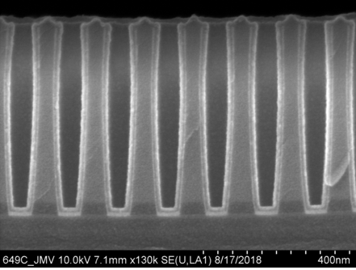
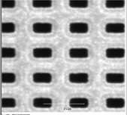
Deposit HiK Dielectric
Deposit top HiK film. ZrOx and TiOx
Will want to tune ZrOx THX for CAP. May need to decrease.
COB
1.5nm SAB
COB/V6 ILD
5.4nm SID
1.5nm SAB
VCB ES
V6 ES
VCB
VCB
VCB
4.4nm AMBER
M6
M6
M6
BLD
30nm Ta/TaN
V5 ILD
BLD
BLD
BLD
520nm SiOx
V5
M5
M5
M5
M5
WL
WL
WL
WL
V4 ILD
CDO
35nm CDN
OGD Cut
PGD Cut
2nm HALO
35nm CDN
Logic
eDRAM Array
Array

Slide 80
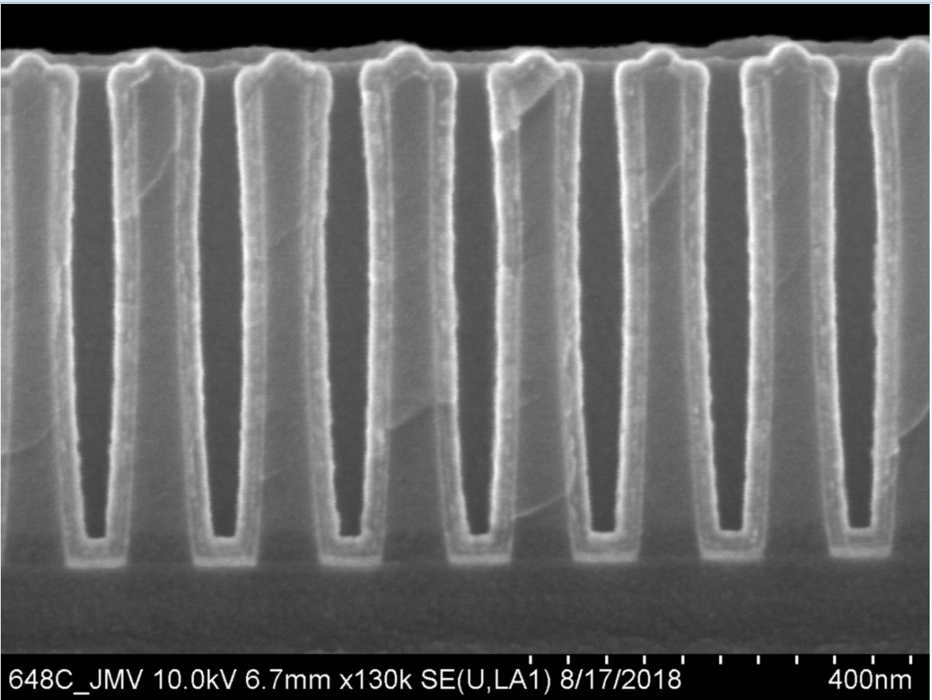
Deposit Top electrode
Dep AMBER (conductive TiN), ESM (protective film for AMBER) and TaN (copy from 1271.3)
Top will be close to pinching off. Okay if pinches off with thick dep.
2 steps
AMBER+ESM (TaAl)
1 CSB Ta
10nm Ta
7.2nm ESM
2.2nm AMBER
COB
1.5nm SAB
COB/V6 ILD
5.4nm SID
1.5nm SAB
VCB ES
V6 ES
VCB
VCB
VCB
4.4nm AMBER
M6
M6
M6
BLD
30nm Ta/TaN
V5 ILD
BLD
BLD
BLD
520nm SiOx
V5
M5
M5
M5
M5
WL
WL
WL
WL
V4 ILD
CDO
35nm CDN
OGD Cut
PGD Cut
2nm HALO
35nm CDN
Logic
eDRAM Array
Array

Slide 81
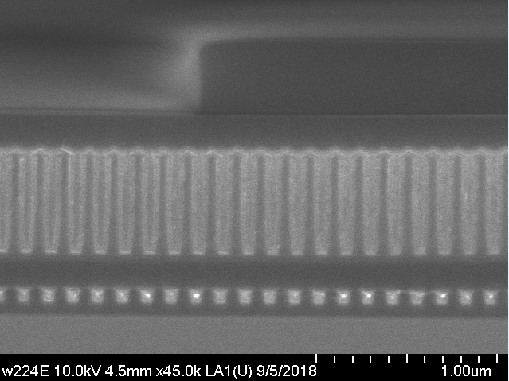
Actually using CHM+Barc+PR
Deposit CTP HM and CTP litho patterning
Resist
CHM+BARC
15nm TiN
COB
10nm Ta
COB/V6 ILD
7.2nm ESM
2.2nm AMBER
VCB ES
V6 ES
VCB
VCB
VCB
1.5nm SAB
M6
M6
M6
BLD
5.4nm SID
BLD
BLD
BLD
V5 ILD
ES
520nm SiOx
V5
M5
M5
M5
M5
WL
WL
WL
WL
V4 ILD
CDO
35nm CDN
OGD Cut
PGD Cut
2nm HALO
35nm CDN
Logic
eDRAM Array
Array

Slide 82
CTP HME Etch, ASH, and Clean
ICE instead of HME, etches all stack
RCL O2N2
CLEAN DHF
BLU (TiN)
DIW
Etch away blanket TE, leaving MIM like structure floating in V6 ILD
COB
10nm Ta
COB/V6 ILD
7.2nm ESM
2.2nm AMBER
VCB ES
V6 ES
VCB
VCB
VCB
1.5nm SAB
VCB
M6
M6
M6
BLD
5.4nm SID
BLD
BLD
BLD
V5 ILD
ES
520nm SiOx
V5
M5
M5
M5
M5
WL
WL
WL
WL
V4 ILD
CDO
35nm CDN
OGD Cut
PGD Cut
2nm HALO
35nm CDN
Logic
eDRAM Array
Array

Slide 83
V6 ILD Dep
Dep rest of V6 ILD. 430nm
COB
10nm Ta
COB/V6 ILD
7.2nm ESM
2.2nm AMBER
VCB ES
V6 ES
VCB
VCB
VCB
1.5nm SAB
VCB
M6
M6
M6
BLD
5.4nm SID
BLD
BLD
BLD
V5 ILD
ES
520nm SiOx
V5
M5
M5
M5
M5
WL
WL
WL
WL
V4 ILD
CDO
35nm CDN
OGD Cut
PGD Cut
2nm HALO
35nm CDN
Logic
eDRAM Array
Array

Slide 84
V6 ILD Polish
Do oxide polish for rest of V6 ILD and continue V6 pattern as if there were MIM (but this will be Top COB Electrode). Total oxide heght is now 800nm above top ES
~280+nm SiOx
COB
10nm Ta
COB/V6 ILD
7.2nm ESM
2.2nm AMBER
VCB ES
V6 ES
VCB
VCB
VCB
1.5nm SAB
VCB
M6
M6
M6
BLD
5.4nm SID
BLD
BLD
BLD
V5 ILD
ES
520nm SiOx
V5
M5
M5
M5
M5
WL
WL
WL
WL
V4 ILD
CDO
35nm CDN
OGD Cut
PGD Cut
2nm HALO
35nm CDN
Logic
eDRAM Array
Array

Slide 85
Finish V6 processing and connection
V6 will land on M6 and go through the TE like MIM and land on Dummy M6 (or connected). V6 OXS etch will end on HALO and the subsequent clean will take care of HALO. CAR BT will happen as normal. V6 will have to have new etch to clear metals for some V6 but not on others. HALO+COPULEAN will help stop etch for naked Via6.
V6
Resist
V6
COB
10nm Ta
COB/V6 ILD
7.2nm ESM
2.2nm AMBER
VCB ES
V6 ES
VCB
VCB
VCB
1.5nm SAB
VCB
M6
M6
M6
BLD
5.4nm SID
BLD
BLD
BLD
V5 ILD
ES
520nm SiOx
V5
M5
M5
M5
M5
WL
WL
WL
WL
V4 ILD
CDO
35nm CDN
OGD Cut
PGD Cut
2nm HALO
35nm CDN
Logic
eDRAM Array
Array

Slide 86
OXS
Finish V6 processing and connection
V6
V6
COB
10nm Ta
COB/V6 ILD
7.2nm ESM
2.2nm AMBER
VCB ES
V6 ES
VCB
VCB
VCB
1.5nm SAB
VCB
M6
M6
M6
BLD
5.4nm SID
BLD
BLD
BLD
V5 ILD
ES
520nm SiOx
V5
M5
M5
M5
M5
WL
WL
WL
WL
V4 ILD
CDO
35nm CDN
OGD Cut
PGD Cut
2nm HALO
35nm CDN
Logic
eDRAM Array
Array

Slide 87
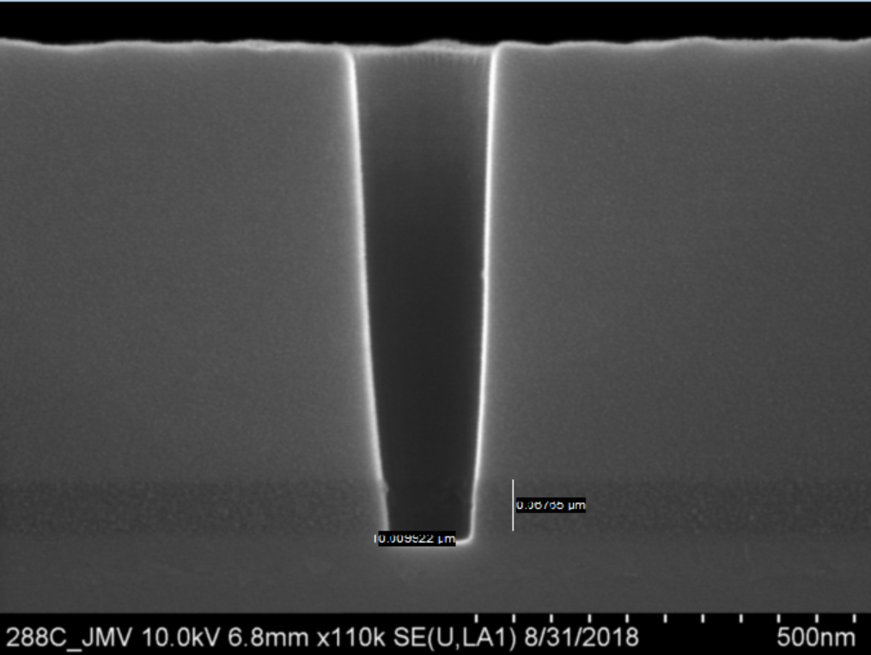
Finish V6 processing and connection
CAR
Second Car BT Etch will land on MT6
V6
V6
COB
10nm Ta
COB/V6 ILD
7.2nm ESM
2.2nm AMBER
VCB ES
V6 ES
VCB
VCB
VCB
1.5nm SAB
VCB
M6
M6
M6
BLD
5.4nm SID
BLD
BLD
BLD
V5 ILD
ES
520nm SiOx
V5
M5
M5
M5
M5
WL
WL
WL
WL
V4 ILD
CDO
35nm CDN
OGD Cut
PGD Cut
2nm HALO
35nm CDN
Logic
eDRAM Array
Array

Slide 88
CSB
EPN
Finish V6 processing and connection
Complete Connection. V6 connecting through CTP may only hang partway through the ILD, but that is okay for connection for CTP To MT7
V6
V6
COB
10nm Ta
COB/V6 ILD
7.2nm ESM
2.2nm AMBER
VCB ES
V6 ES
VCB
VCB
VCB
1.5nm SAB
VCB
M6
M6
M6
BLD
5.4nm SID
BLD
BLD
BLD
V5 ILD
ES
520nm SiOx
V5
M5
M5
M5
M5
WL
WL
WL
WL
V4 ILD
CDO
35nm CDN
OGD Cut
PGD Cut
2nm HALO
35nm CDN
Logic
eDRAM Array
Array

Slide 90
Incoming stack: 2 types
TiN/HZO/TiN
TiN/HZO only
**note that HZO/TiN thicknesses may be modulated +/- 50%
TiN-4 nm (stack #1, remove TiN if stack #2)
HZO-6 nm
20-25nm TiN gate electrode
TiN 20 nm
20nm TaN
+42nm Copulean
Cu
1.3nm HALO
oxide
Cu
Silicon Oxide on Si Substrate (HiRES)-P823-3030-38
Request to strip 5 nm of TiN
Request to clean TiN electrode before HZO deposition

Slide 91
Incoming to ZDE X22S wafer:
Program- Agni
Purpose- qualify X22S for Agni Ferroelectric work
Request-
N2 plasma nitridation on TiN electrode
Constraints-
Need to not etch TiN, cause issues in frame (exposed Copulean and SiO2 ILD; 1.3 nm HALO)
**Frame only**
Logic region
Memory region
20-25nm TiN gate electrode
20nm TaN
+42nm Copulean
M5
1.3nm HALO
Via 4
Cu (M4)

