Slide 1
ADM Scaling Value Proposition
Abhishek A. Sharma, Sarah Atanasov, Noriyuki Sato, Van Le

Slide 2
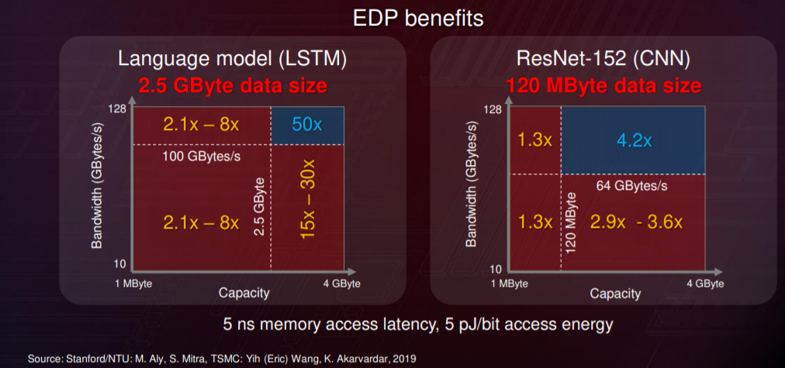
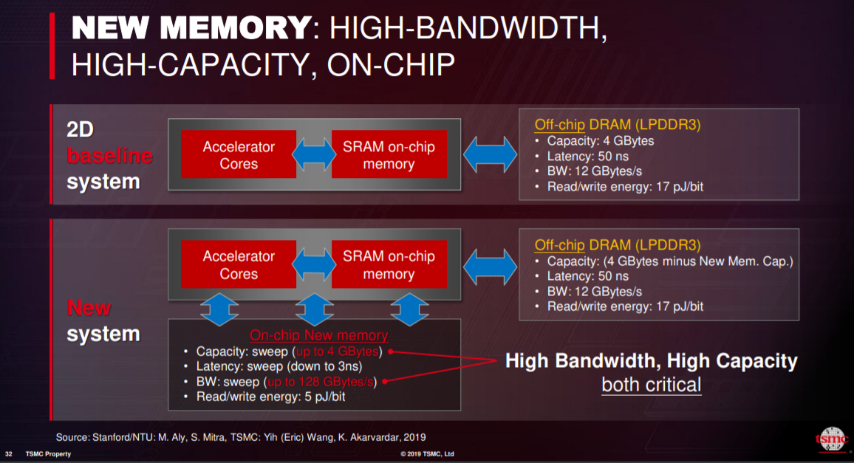
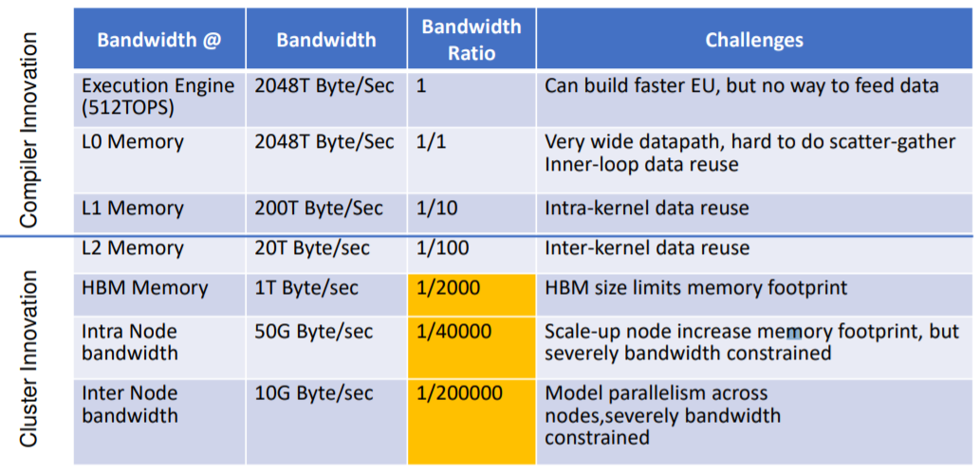
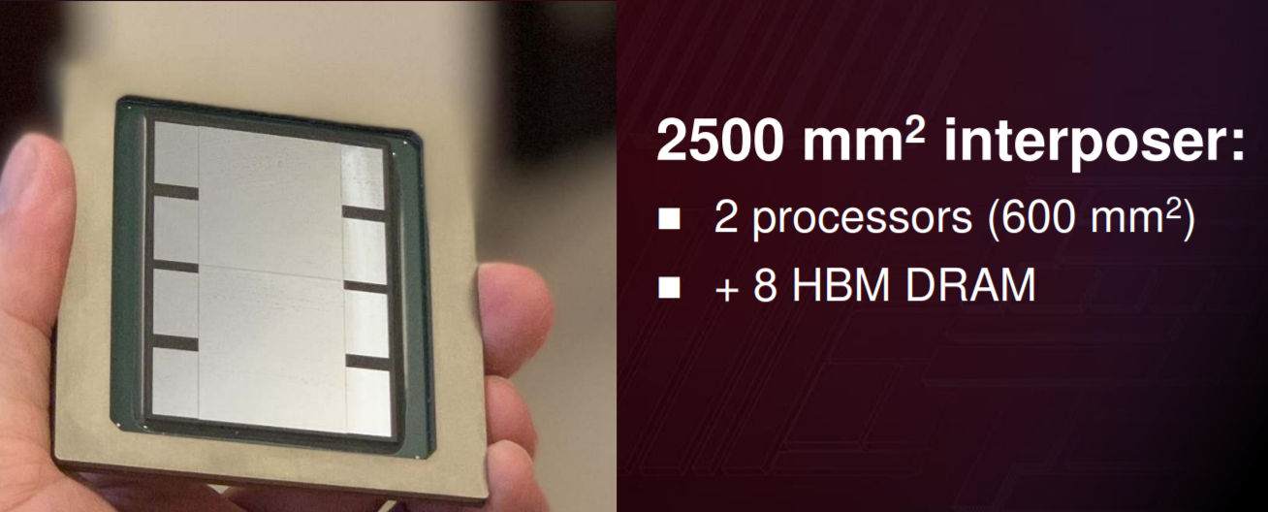
Need for in-package Memory
TSMC, Hot Chips ‘19
No current TD thrust
Real need for high bandwidth AND high capacity in-package memory
Defines 2 clear distinctions in requirements
Intel’s current ADM thrust
→ Enabled with IPM/custom design
Huawei, Hot Chips ‘19

Slide 3
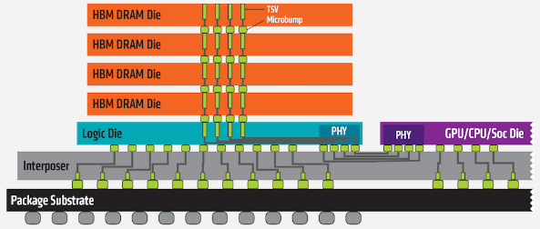
DRAM Design and Application Space
Meteor Lake PRQ ‘22
PCH
GFX
CPU
P1222 ADM base die
Parameter | eDRAM (ADM) | DRAM (from datasheet)
Transistor type | Fin/BG | RCAT/Fin
Density (Gb/mm²) | 0.04 | 0.241 (1y)
Bandwidth Density (GB/s/mm²) | 42.667 | 2.107
Cell size (μm²) | 0.01458 | 0.002244
Cell dim (nm x nm) | 108 x 135 | 44 x 51 (1y)
Latency @ array edge (ns) | 2-5 | 12-15
Product Latency (ns) | 15-20 ns | 20-35 ns
tRC (ns) – row cycle time | 7-15ns | 50-55 ns
eDRAM is geared towards low latency and High Random Bandwidth applications
Scaled DRAM is >6x smaller cell size than eDRAM → geared towards high capacity segment

Slide 4
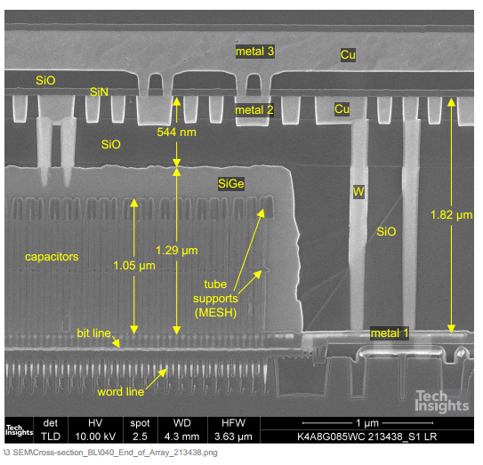
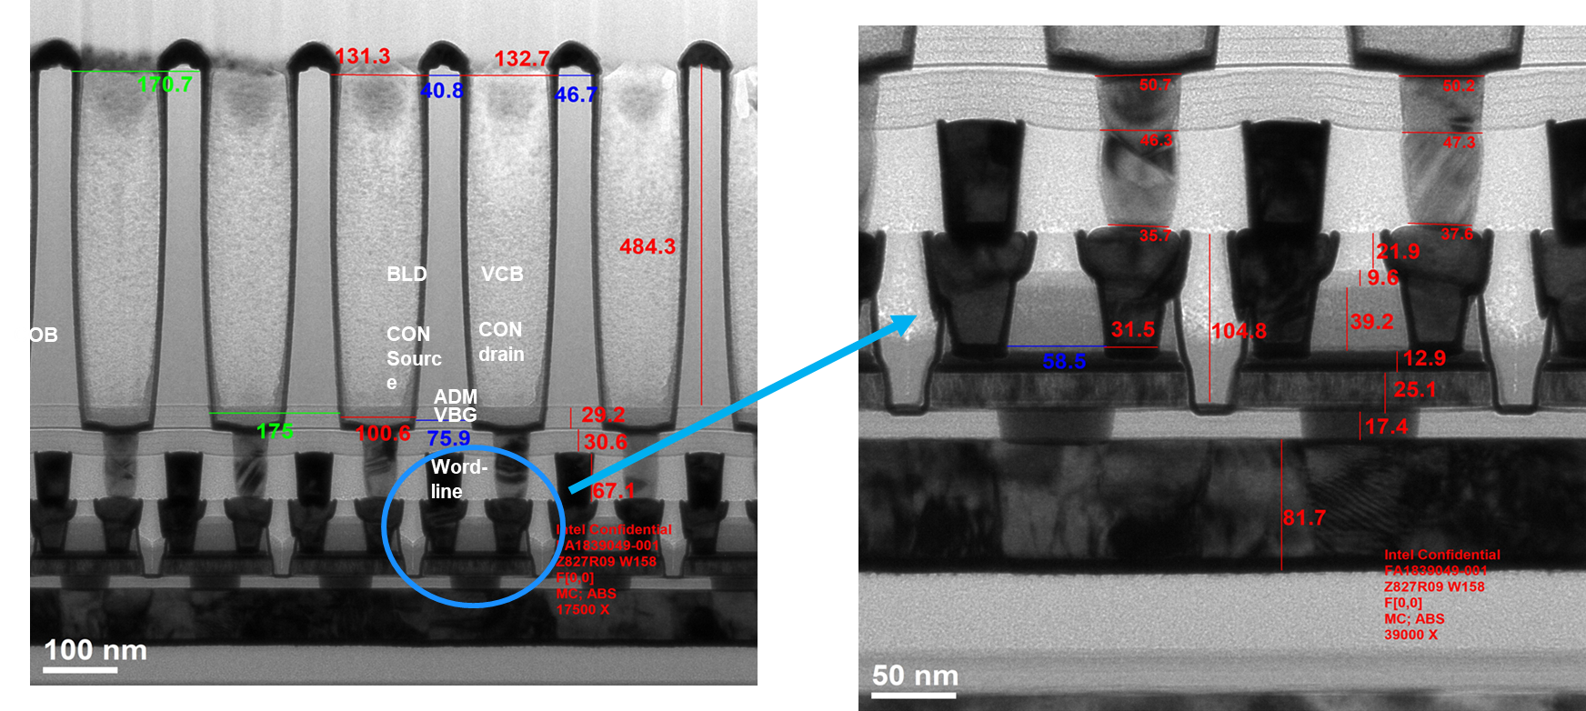
DRAM Design and Application Space
Parameter | eDRAM | DRAM
Transistor type | Fin/BG | RCAT/Fin
WL slew (ns) | 1.5ns (low R) | 3ns (low C)
Access Transistor Resistance (Ω) | 10k-30k | 30k-50k
Storage Capacitance (fF) | 8-15 fF | 15-20 fF
Cov (aF/cell) | 25 (→ fewer bits/BL) | 6
DRAM achieves similar read latency performance by optimizing WL capacitance (low C) despite high R
DRAM bottleneck is in the write through the array transistor when writing 1 onto 0 (high V_{ds} condition)

Slide 5
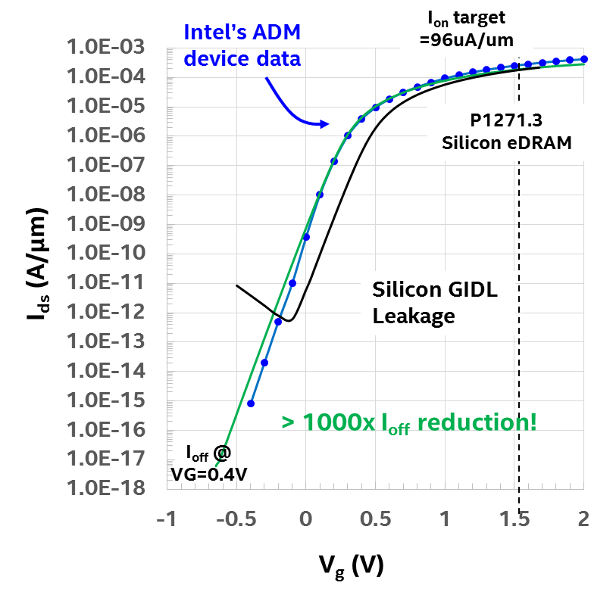
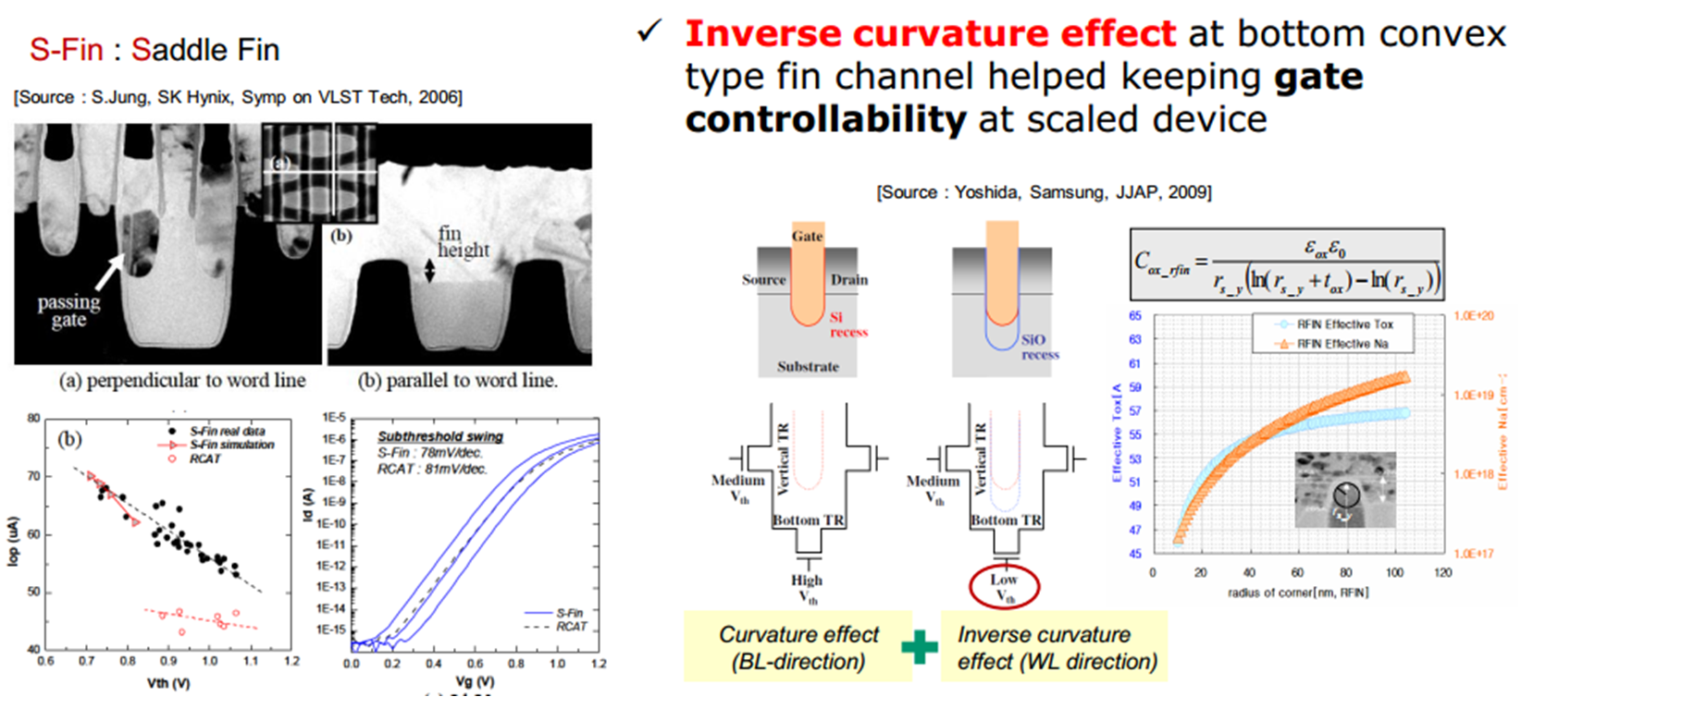
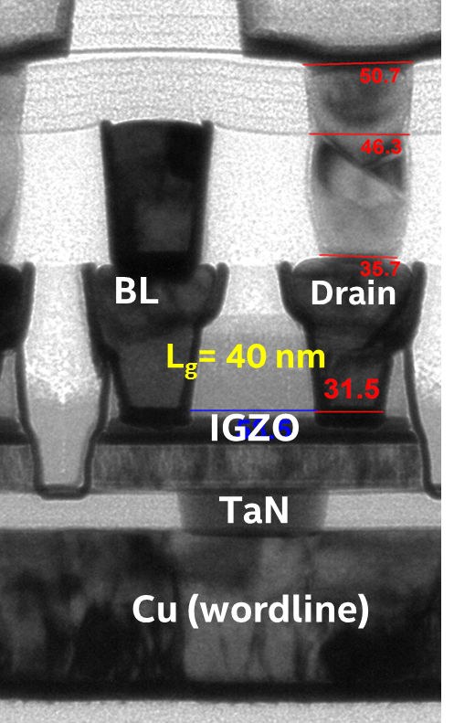
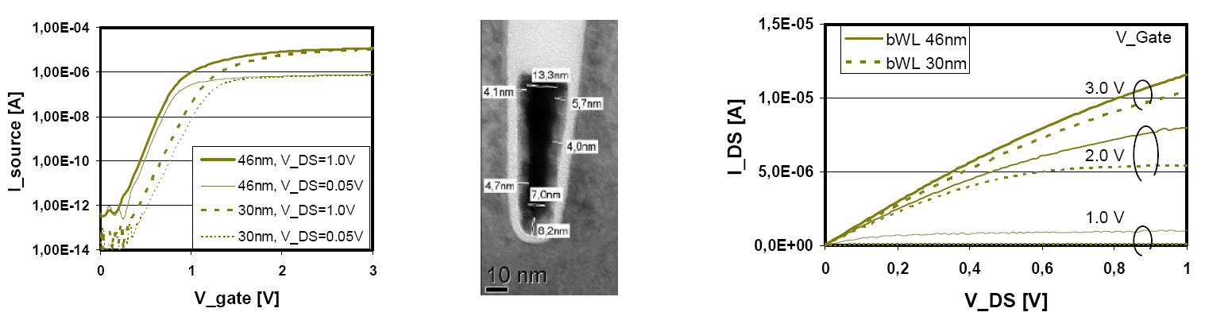
ADM Provides ~I_{ON} @ >10x lower I_{OFF}
Hynix 2006
Z ~100/70 nm
DRAM uses long channel devices with pulled-back tips to achieve RCAT configuration with low Ioff
Suffers from low drive current due to poor Rc and long Lg; HBM @ 5pJ/bit @ mem
ADM is scaled in Lg and has better contact resistance to achieve high drive currents
Because of being wide bandgap, there is no junction/tunneling leakage – <50mW idle power target @100C; peak BW power ~2-3 W; 3 pJ/bit @subarray; SRAM @~100-300fJ/bit
DRAM
ADM

Slide 8
Timing Analysis of eDRAM
R_{SA}, C_{SA}
C_{OV}
SA
C_{BL-BL}
V_{WL}
SA
V_{SN} post retention depends on leakage;
Disturbs associated with unintentional body biasing
C_{WL-WL}
t_{BL} depends on SA strength, BL RC including C_{OV}
Voltage (V)
V_{SN}
V_{BL}
t_{WB}
Transistor drive strength, COB size
C_{BL-WL}
V_{SAEN}
t_{RCD}
WL slew, BL development, R/W completion; WL driver, BL/COB cap dependent
t_{RC}
WL ON, BL development, bit write-back (WB), WL OFF, BL PCH
SA
R_{WLD}, C_{WLD}
WL driver
time (s)
Notes:
1. Complete array schematics and all 6 algo
2. Detailing one algo with all DTS numbers and analytical function
3. calibrating the DTS calculator by comparing P1271.3 and P1222.6
Read 0, Read 1; Write 0 to 0; Write 0 to 1; Write 1 to 0; Write 1 to 1

Slide 9
WL and BL design
WL Loading
BL Loading
WL
driver
Worst-case bitcell
WL0
active
“1” pattern
SA
Worst-case bitcell
WL1
OFF
“0” pattern
SA
WL is loaded by Cgg (gate cap) and WL-WL coupling
BL is loaded by Cov (Cgs/Cgd) and BL-BL coupling
Longer WL important for high BW/vector math, but comes at cost of wire RC
WL C further increases noise → detrimental for high random BW
Ratio of CBL to Cstorage determines sensing margin
CBL scales with #bits
More #bits/BL preferred due to lower transition area
Very important to control WL delay (mostly C) by limiting gate capacitance
Transistor Cov helps in improving sensing margin (indirectly area), and helps reduce the need for large storage cap

Slide 10
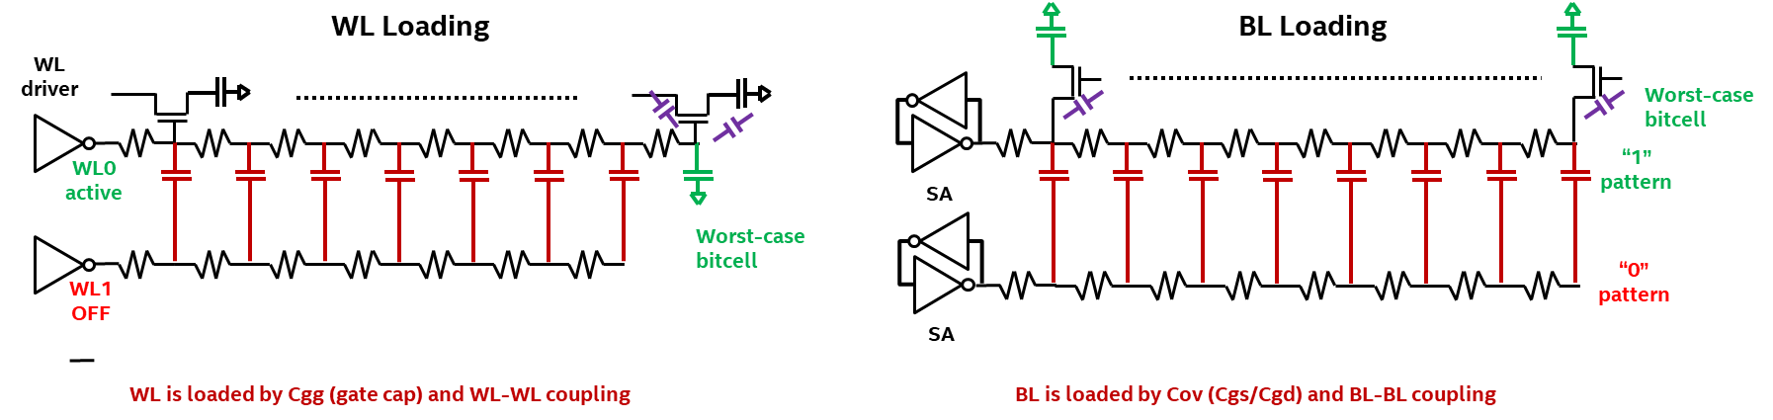
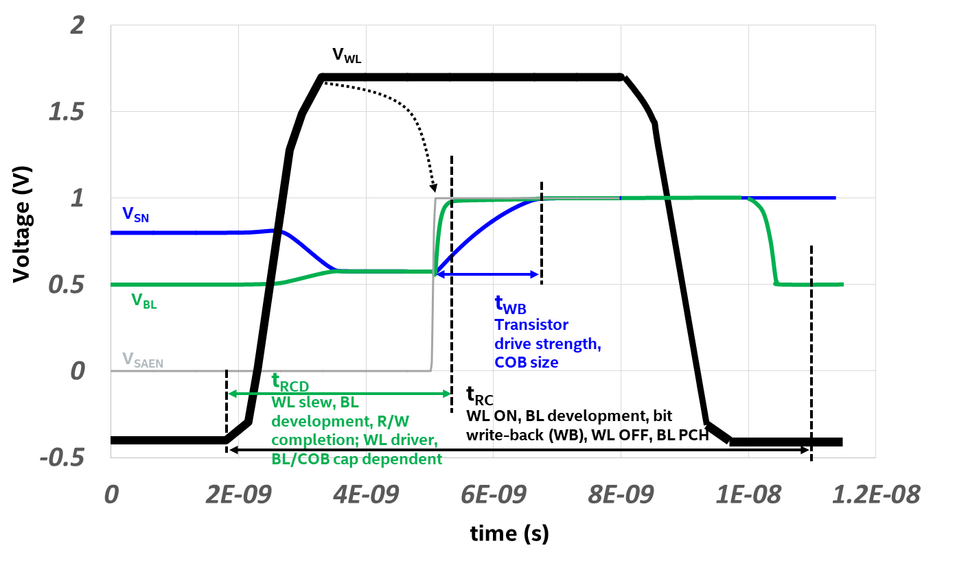
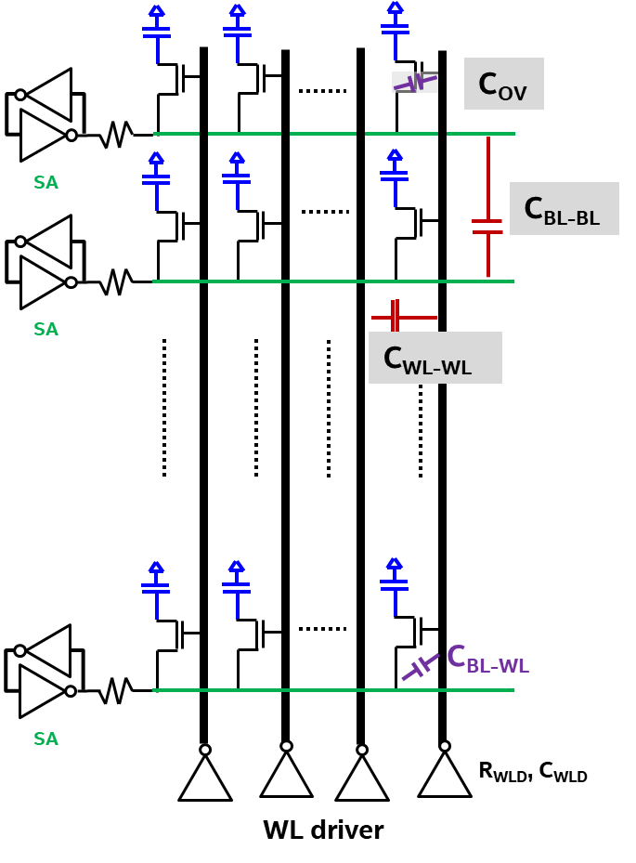
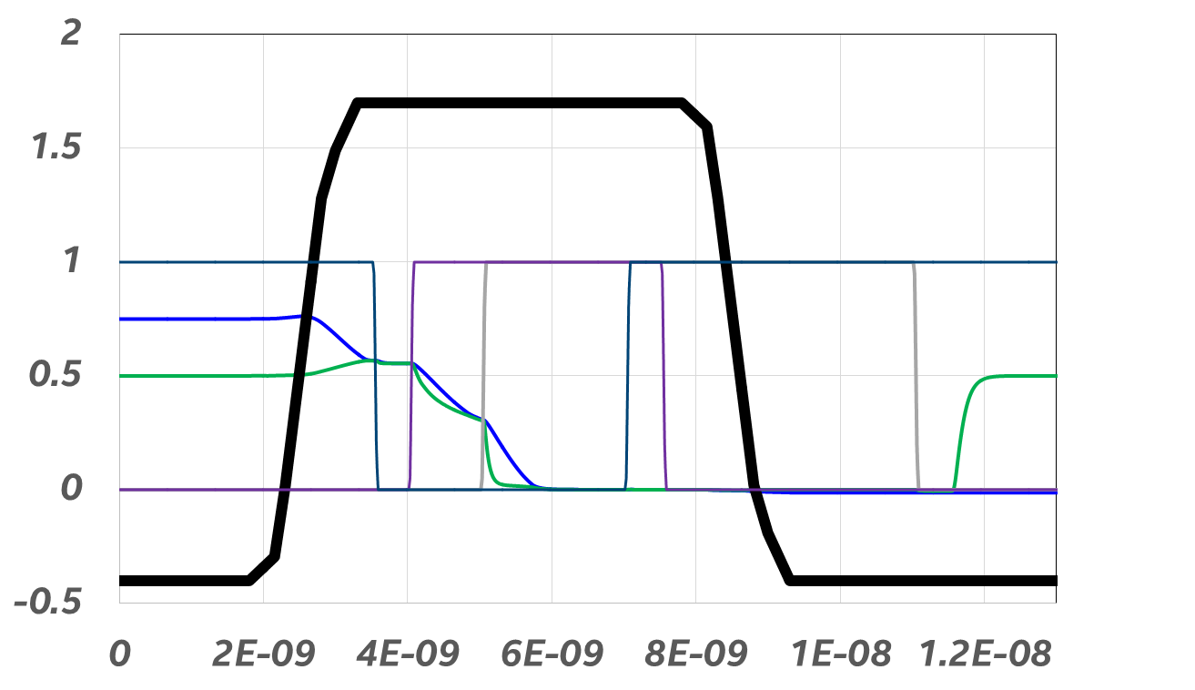
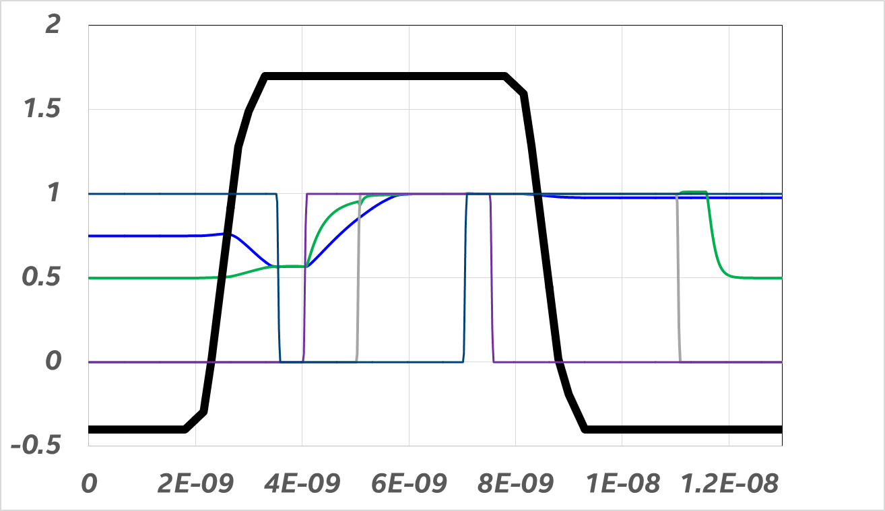
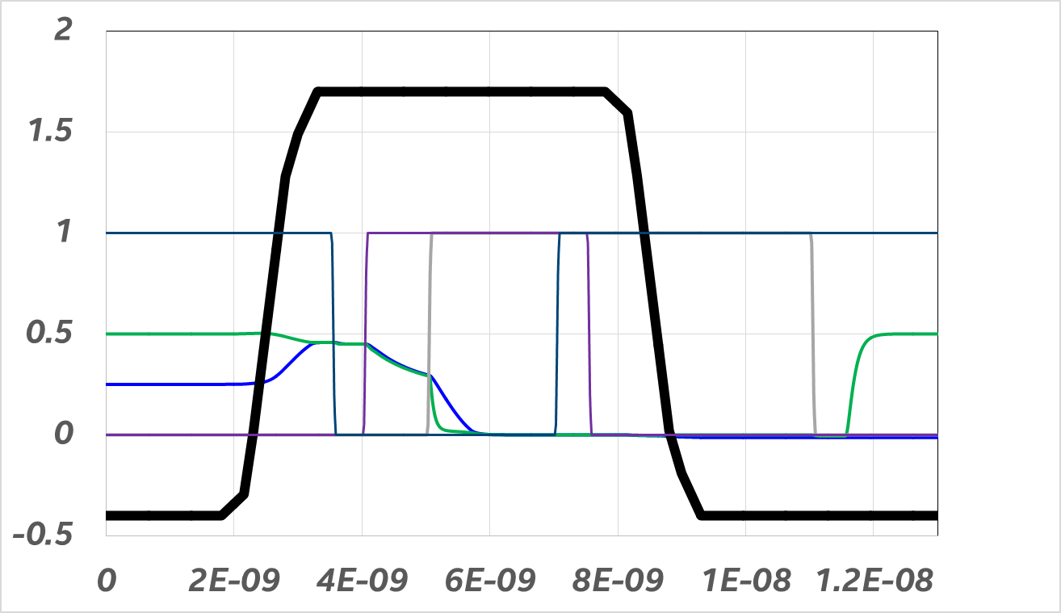
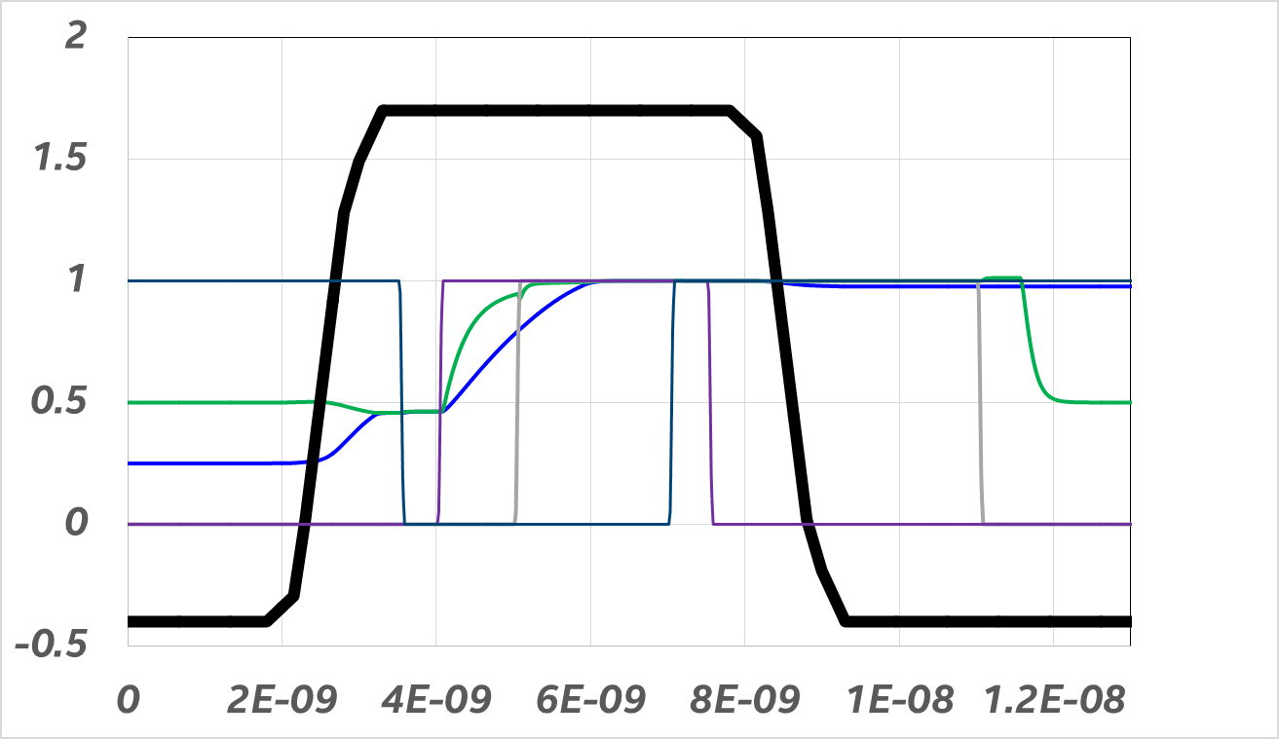
Timing Analysis of eDRAM
RD 0
WR 0 onto 1
WR 1 onto 1
WR 0 onto 0
WR 1 onto 0

Slide 11
Timing Analysis of eDRAM
WL rise
Writeback
BL dev
Three key sections of DRAM timing
Access transistor is the limiter for all BL operations
WL RS is the limiter in the WL operations

Slide 12
Timing Analysis of eDRAM
C_{OV}
SA
C_{BL-BL}
SA
C_{WL-WL}
C_{BL-WL}
SA
R_{WLD}, C_{WLD}
WL driver

Slide 13
Timing Analysis of eDRAM: WL Rise/Fall
WL
Driver
R_{WL_dr}, C_{WL_dr}
WL Rise and Fall
C_{gg}
WL0
active
C_{WL-WL}
Worst-case bitcell
WL1
OFF
WL is loaded by Cgg (gate cap) and WL-WL coupling
1222.6
τ_{WL} = R_{WL_dr}*(C_{WL_dr} + C_{WL}*(n-1) + C_{WL}*(1))
+ R_{WL}*(n-1)*(C_{WL}*(n-1) + C_{WL}*(1)) + R_{WL}*C_{WL}
τ_{WL} = 500*(4f +250f) + 4k*(250f) + 4*0.24f = 1.127ns
Word-line delay has the following components:
WL driver resistance and capacitance
WL wire resistance and WL wire capacitance → consists of WL-WL coupling (C_{WL-WL}) and WL-active coupling (C_{gg}); minor components are WL-BL metal coupling and WL coupling to layers underneath
Load capacitance is the farthest bit with C_{gg}+C_{WL-WL} of one bit as the load
1271.3:
τ_{WL} = R_{WL_dr}*(C_{WL_dr} + C_{WL}*(n-1) + C_{WL}*(1))
+ R_{WL}*(n-1)*(C_{WL}*(n-1) + C_{WL}*(1)) + R_{WL}*C_{WL}
τ_{WL} = 400*(4f +130f) + 4k*(130f) + 4*0.24f = 0.573ns
Mostly WL RC dominated

Slide 14
Timing Analysis of eDRAM: BL development
R_{SA}, C_{SA}
BL development
C_{ov}
Worst-case bitcell
“1” pattern
SA
C_{BL-BL}
“0” pattern
SA
BL is loaded by Cov (Cgs/Cgd) and BL-BL coupling
1222.6
τ_{WL} = R_{ADM}*(C_{BL}*(1)+ C_{BL}*(n-1) + C_{SA})
+ R_{BL}*(n-1)*(C_{BL}*(n-1) + C_{SA}) + R_{BL}*(1)*C_{SA}
τ_{WL} = 1e5*(12f +5f) + 500*(12f + 5f) + 5*5f = 1.7ns
Bitline delay has the following components:
Access transistor is the driver; driver resistance and capacitance
BL wire resistance and BL wire capacitance → consists of BL-BL coupling (C_{BL-BL}) and C_{ov} capacitance; minor components are WL-BL metal coupling
Load capacitance is the SA C_{SA}
1271.3
τ_{WL} = R_{ADM}*(C_{BL}*(1)+ C_{BL}*(n-1) + C_{SA})
+ R_{BL}*(n-1)*(C_{BL}*(n-1) + C_{SA}) + R_{BL}*(1)*C_{SA}
τ_{WL} = 6e4*(10f +5f) + 500*(10f + 5f) + 5*5f = 0.907ns
Mostly AT resistance dominated

Slide 15
Timing Analysis of eDRAM: BL/SN Writeback
R_{SA}, C_{SA}
BL and storage node write-back
C_{ov}
Worst-case bitcell
“1” pattern
SA
C_{BL-BL}
“0” pattern
SA
BL is loaded by Cov (Cgs/Cgd) and BL-BL coupling
1222.6
τ_{WL} = R_{SA}*(C_{SA} + C_{BL}*(1)+ C_{BL}*(n-1) + C_{SN})
+ R_{BL}*(n)*(C_{BL}*(n) + C_{SN}) + R_{ADM}*(1)*C_{SN}
τ_{WL} = 1000*(5f + 12f +8f) + 500*(12f + 8f) + 1e5*8f = 0.83ns
Bitline delay has the following components:
SA is the driver; driver resistance and capacitance
BL wire resistance and BL wire capacitance → consists of BL-BL coupling (C_{BL-BL}) and C_{ov} capacitance; minor components are WL-BL metal coupling
Load transistor is access transistor and load capacitance is the C_{COB}
1222.6
τ_{WL} = R_{SA}*(C_{SA} + C_{BL}*(1)+ C_{BL}*(n-1) + C_{SN})
+ R_{BL}*(n)*(C_{BL}*(n) + C_{SN}) + R_{ADM}*(1)*C_{SN}
τ_{WL} = 1200*(5f + 10f +13f) + 500*(10f + 13f) + 6e4*13f = 0.825ns
Mostly AT resistance dominated
AT resistance is a key enabler that needs to be maintained across generations

Slide 16
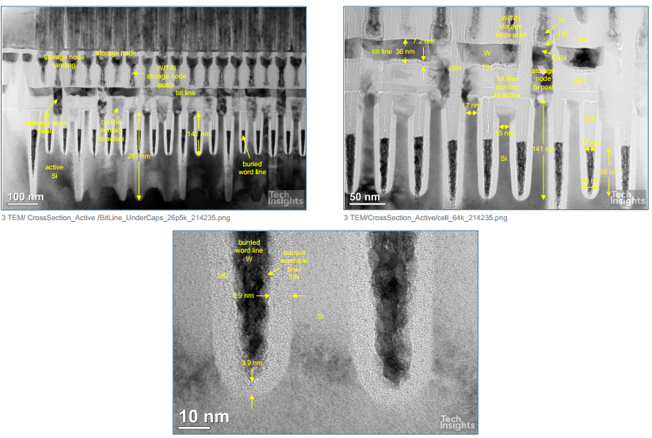
DRAM Saddle-type FinFET/ RCAT
S
D
SiGe80
SiGe80
Si
SiN
W-MG

Slide 17
DRAM Saddle-type FinFET/ RCAT: Gate Loop, WL
Uses FinFET technology with special gate recess technology followed by high quality thermal oxidation
Uses partial 111 surface post etch for high quality GOX formation using up 3.2nm Si (i.e. initial trench = 28nm + thermal oxidation to give 17nm space for W) → most likely @950C
Followed up with W recess and CVD-SiN fill
toxe = 7nm
Gate line resistance = 10-20kΩ
WL capacitance = 21 fF with 85-90% contrib from Cgg (no signs of strapping); 0.021 fF /cell
WL→ WL noise inhibited due to angled fin
WL slew = 5-10ns
Parameter | DRAM (1x) | Gen1 eDRAM | ADM
t_{oxe} (A) | 70 | 14 | 11
WL Resistance (Ω) | 10k-20k | 4k | 1.3k
WL capacitance (fF) | 21 | 130 | 300
WL slew (ns) | 5/10 | <1 | 1.5/2.5

Slide 18
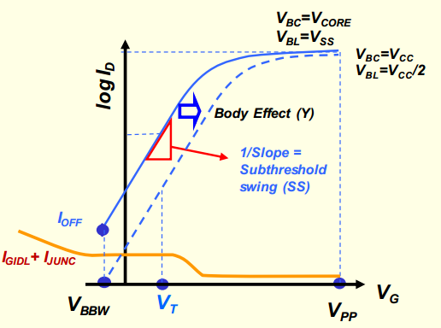
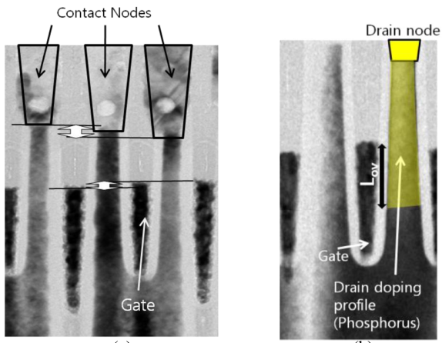
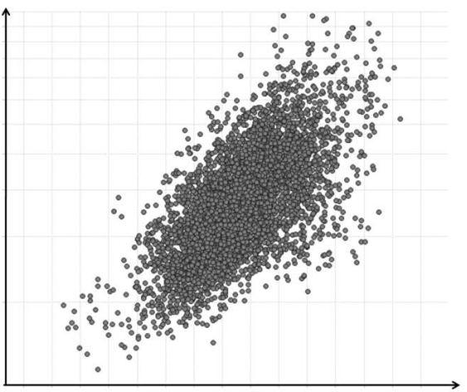
RCAT: Contact Loop, BL, n0
Resistance:
Two sources of leakage:
Junction leakage
GIDL (mostly dominant) (0.1 fA – 100’s fA for tail bits)
Contact resistivity ~ 1e-8 Ω-cm2 across 17*26 nm2 area
Total contact resistance = Rc = 2.2 kΩ (x2 for 2 CON)
Doping @SiGe80,top = 1e20 /cm3 (peak)
BL resistance = 840 cells * 35 uohm-cm*50nm/(16*40nm2) = 4.6 kΩ
Capacitance:
BL-n0 cap = C_metal-metal + C_SiGe-SiGe
BL-n0 cap = 5.7 aF + 5.5 aF (/cell)
BL-WL cap = 5.79 aF (/cell) → ~half of Cgg
Total BL loading cap = 15 aF/cell
Net BL parasitics = 12.6 fF
Column IO ~ 2-5 fF
Net BL loading = 19 fF
Net RC, Sensing:
BL charge/disch = 2ns
Sense margin = 120 mV approx
DRAM loads >840 cells on the BL to get array efficiency
DRAM target
10⁻¹⁴
10⁻¹⁶
GIDL (A)/bit vs Lov (nm)
0 25 50

Slide 19
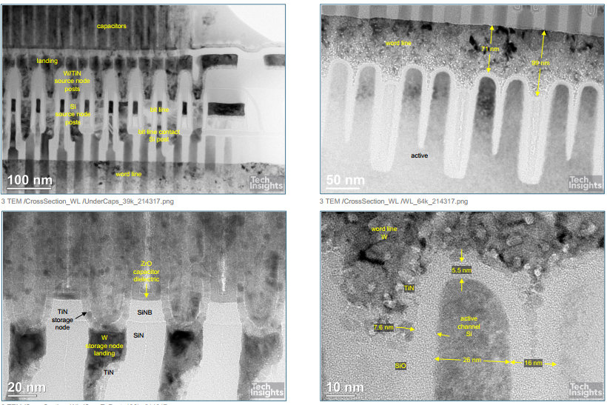
RCAT: Channel, Overall transistor performance
Transistor parameters:
Lg = 20nm fin-type + 40*2 nm gated planar
Z = 20nm + 90nm
toxe = 7nm
I_{dsat} = 217 uA/um @ Vds = 1V; Vgs-Vt = 3V
I_{off,GIDL} = 1e-13 to 1e-15 A/um @ Vgs = -0.3V
Refresh parameters:
Refresh time = 32/16ms @100C
Refresh power ~ 5fF * 1 * 1 * 5e8 Hz = 2.5e-6
DRAM has matched drive current for the same charge (i. e. (V_{GS}-V_{t}) ) compared to ADM
Long channel
Poor Rext
Thick EOT/t_{oxe}
ADM main advantage is fundamentally low leakage at better drive current

Slide 20
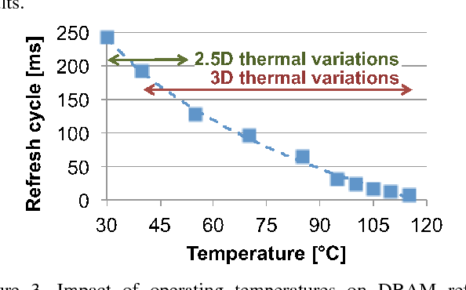
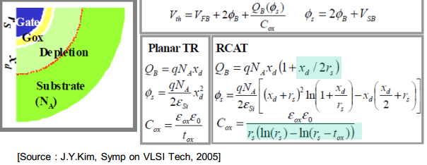
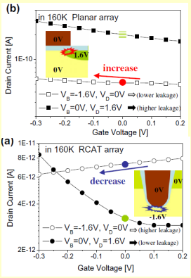
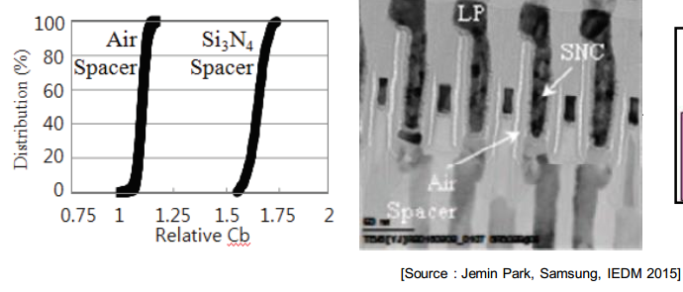
DRAM Unique Aspects
Benefit in Ioff due to high curvature channel
Air-gaps between BLs
High Vt device with BODY BIAS to improve leakage
GIJL issues @tip

Slide 21
Parameters I
Parameter | DRAM (1x) | Gen1 eDRAM | ADM
Cell size (nm x nm) | 48 x 54 | 108 x 270 | 108 x 135
L_{g} (nm) | 100 | 40 | 40
Z (nm) | 210 | 60 | 73
Cov capacitance (aF) | 6 | 38 | 25
BL Resistance (Ω) | 3k-4k | 0.5k | 1k-2k
I_{dsat} (uA/um) @ Vds = 1V | 217 (Vov = 3V) | 315 (Vov = 0.65V) | 300 (Vov = 1.2V)
I_{off} (pA/um) @ Vds = 1V | <0.01 | 0.1 | 0.1 to 0.0001
V_WL (V) | -0.4 to 3.5 | -0.4 to 1.8 | -1 to 1.8
t_{ref} (ms) | 16 @45C/ 8 @100C | 0.5 @ 100C | >8 @100C
R_{C} + R_{ext} (kΩ-um) | 2.2 | 0.8 | ~0.5
Fundamental transistor matches or surpasses eDRAM/ADM in leakage → but can ADM’s lower leakage matter for tref >16ms @100C/120C?

Slide 22
Parameters II
Parameter | DRAM (1x) | Gen1 eDRAM | ADM
WL capacitance (fF) | 21 | 130 | 300
WL slew (ns) | 3-5 | 1.2 | 1.5
BL Resistance (Ω) | 3k-4k | 0.5k | 1k-2k
WL Resistance (Ω) | 10k-20k | 4k | 1.3k
WL capacitance (fF) | 21 | 60 | 80-100
WL slew (ns) | 5/10 | 1.2 | 1.5/2.5
BL Resistance (Ω) | 3k-4k | 1.1k | 1k-2k
BL capacitance (fF) | 19 | 21 | 16
Storage capacitance (fF) | 11-16 | 13-16 | 7
Sense time (ns) | 3 | 1.1 | 1.3
Latency (ns) | 30-70 | 5 | <8.5
Power @ BW (W/GBps) | 50/100 | ? | ?
ADM uses thin EOT devices
ADM uses Cu lines
ADM uses Cu lines
Notes:
Optimistic next gen
PLANAR

Slide 23
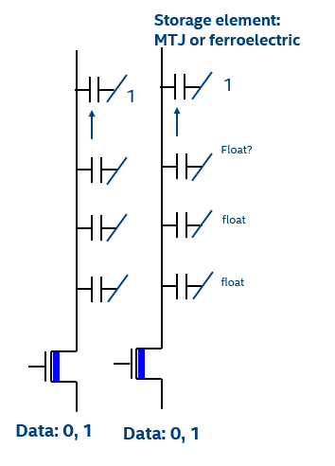
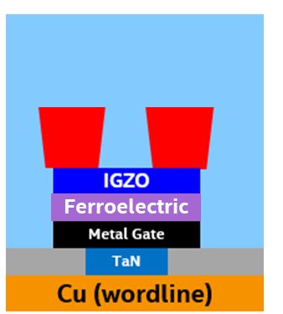
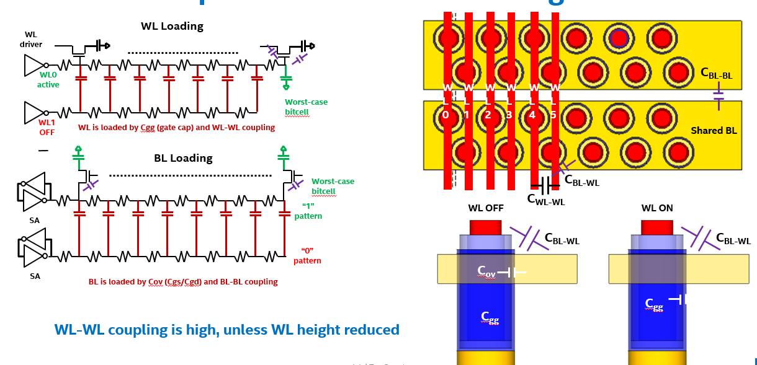
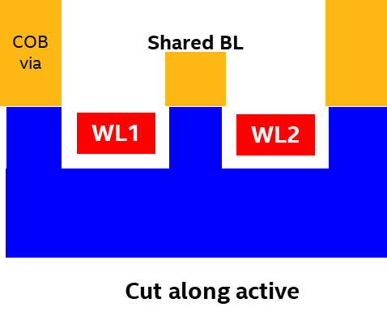
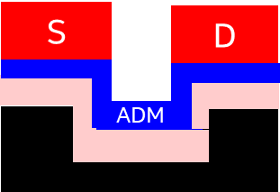
Gen5 Scaling Options
Recess Channel Topology
1T Memory:
Leakage needs alleviated
Needs precise Vt targeting to maintain sense margin across lifetime
Assists vertical AR in stacking
Gated by Ferroelectric technology + disturb
1T-nF:
Bitcell scaling without change in transistor dimensions
Leakage needs alleviated
Capacitor can be vertically integrated like NAND
Susceptible to noise
Gated by Ferroelectric technology + disturb
BG topo:
Offers advantage if COB and BL on opposite sides
Shared S/D and reduces Cov
Choice between RCAT and true fin
Lots inline; ECD 11/20
FinFET topo:
Offers advantage if COB and BL on opposite sides
Shared S/D and reduces Cov
Choice between RCAT and true fin
Lots inline; ECD 11/20
Vertical topo:
Offers advantage as COB may be completed before ADM processing
Gated contacts like backgate
Large Z despite scaling
Lot debug ongoing
How do we define the success criteria for each of these technologies?
How do we differentiate between results on large CR vehicle vs scaled implementations?

Slide 25
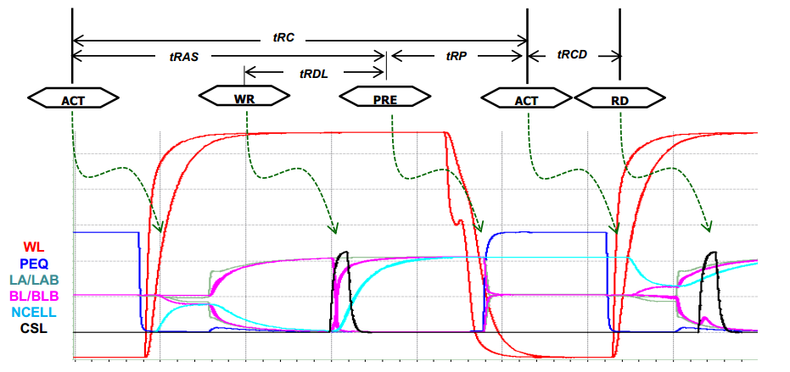
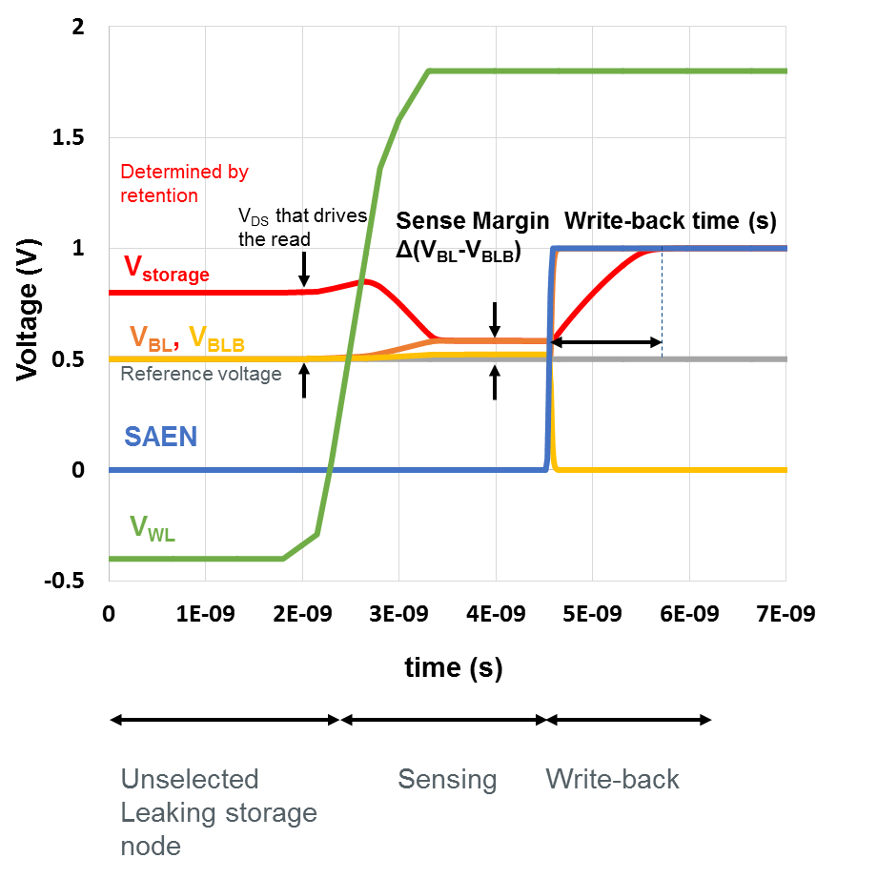
DRAM vs eDRAM Timings: Rate Limiting Metrics
tRC = 45ns to 48ns
tRC = 2ns to 5ns
tRAS = 35ns
Short write-back
i.e. low transistor resistance
Long write-back
i.e. high transistor resistance
0 10ns 20ns 30ns 40ns 50ns 60ns 70ns
eDRAM tRC is lower than DRAM/HBM due to the following:
1.2-1.5x Slow Transistor in DRAM vs eDRAM/ADM and 2x worse COB (50%)
WL/BL rise/fall is 1.5x lower in eDRAM due to Cu lines (30%)
Major difference is also SA speeds causing another 2x difference (20%)
Related to scaling bitcell
Most different comes from array transistor resistance @cost of IOFF

Slide 26
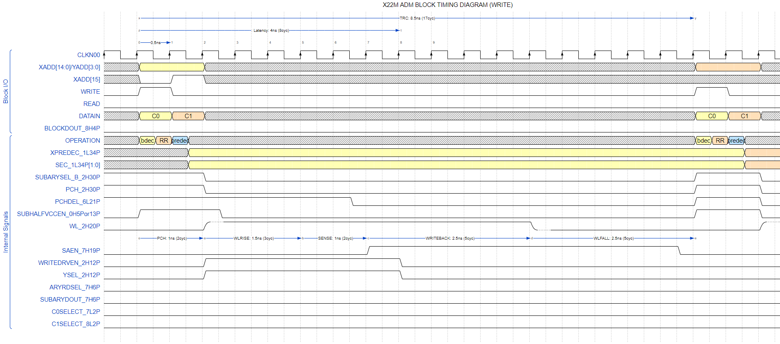
X22M Block Timing (Write)
Umut Arslan, AD

Slide 27
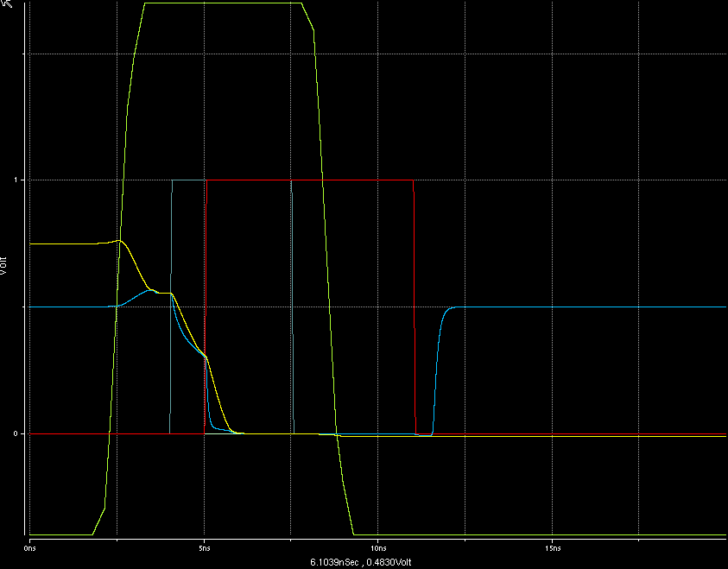
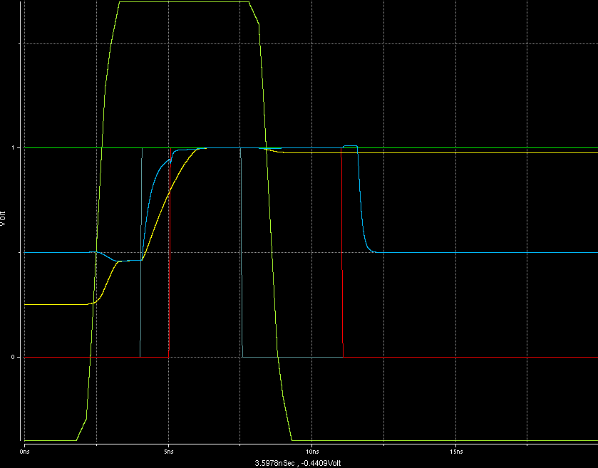

Slide 29
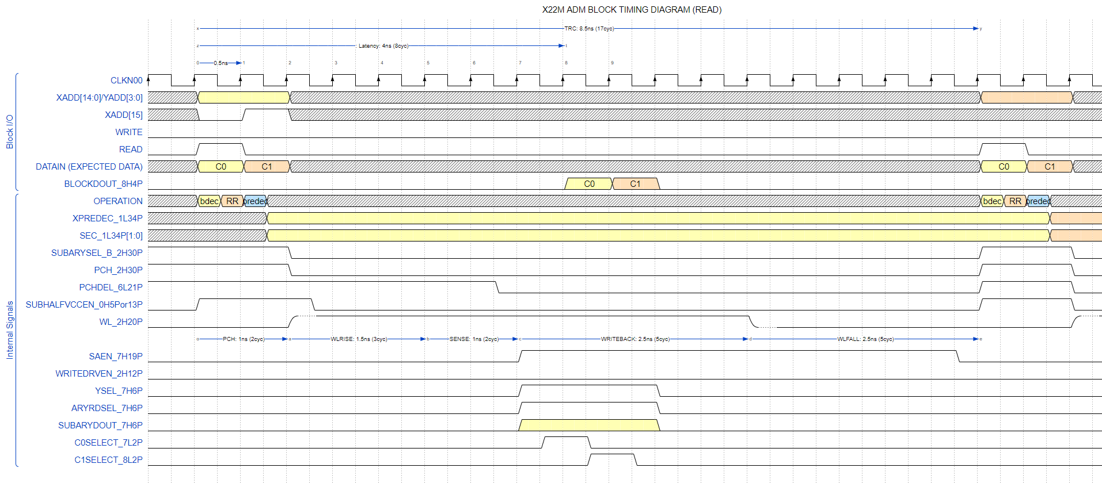
X22M Block Timing (Read)
Umut Arslan, AD

Slide 30
Retention – Median Bit - 25C
Assume 250 mV lost in storage node voltage → Another 250 mV used for sensing margin
COB = 5 fF, parasitic capacitances = 20 fF
AD team
 | Store 0 |  | Store 1
Self-refresh
 | Target (5σ bit + 110C) | ~ ms | Target (5σ bit + 110C) | ~ ms
 | Median Bit – Current UPF | 11 s | Median Bit – Current UPF | >> 100 s
Active Bitline
 | Target (5σ bit + 110C) | ~ 200-300 µs | Target (5σ bit + 110C) | ~ 200-300 µs
 | Median Bit – Current UPF | 1.6 s | Median Bit – Current UPF | 29 ms
-0.4V
-0.4V
0.5V
0V
0.5V
1V
-0.4V
-0.4V
1V
0V
0V
1V
Intel Top Secret

Slide 31
Retention – Median Bit - 110C
Assume 250 mV lost in storage node voltage → Another 250 mV used for sensing margin
COB = 5 fF, parasitic capacitances = 20 fF
AD team
 | Store 0 |  | Store 1
Self-refresh
 | Target (5σ bit + 110C) | ~ ms | Target (5σ bit + 110C) | ~ ms
 | Median Bit – Current UPF | 340 ms | Median Bit – Current UPF | 200 s
Active Bitline
 | Target (5σ bit + 110C) | ~ 200-300 µs | Target (5σ bit + 110C) | ~ 200-300 µs
 | Median Bit – Current UPF | 75 ms | Median Bit – Current UPF | 3.8 ms
-0.4V
-0.4V
0.5V
0V
0.5V
1V
-0.4V
-0.4V
1V
0V
0V
1V
Intel Top Secret

Slide 32
Read and Write – Median Bit - 25C
Read: Includes WL slope, measured time until equalization (10 mV difference)
Write: 99% charge or discharge, median bit does not reach WL slope turning off
AD team
 | ‘0’ |  | ‘1’
Read
 | Target (5σ bit) | 2.5 ns (including WL slope) | Target (5σ bit) | 2.5 ns (including WL slope)
 | Median Bit – Current UPF | 1.2 ns | Median Bit – Current UPF | 1.5 ns
Write
 | Target (5σ bit) | 2.5 ns + WL slope | Target (5σ bit) | 2.5 ns + WL slope
 | Median Bit – Current UPF | 1.2 ns | Median Bit – Current UPF | 1.8 ns
1.7V
1.7V
0.5V
0V
0.5V
1V
1.7V
1.7V
0V
1V → 0V
1V
0V → 1V
Intel Top Secret

Slide 33
Read and Write – Median Bit - 110C
Read: Includes WL slope, measured time until equalization (10 mV difference)
Write: 99% charge or discharge, median bit does not reach WL slope turning off
AD team
 | ‘0’ |  | ‘1’
Read
 | Target (5σ bit) | 2.5 ns (including WL slope) | Target (5σ bit) | 2.5 ns (including WL slope)
 | Median Bit – Current UPF | 1.4 ns | Median Bit – Current UPF | 1.9 ns
Write
 | Target (5σ bit) | 2.5 ns + WL slope | Target (5σ bit) | 2.5 ns + WL slope
 | Median Bit – Current UPF | 1.5 ns | Median Bit – Current UPF | 2.4 ns
1.7V
1.7V
0.5V
0V
0.5V
1V
1.7V
1.7V
0V
1V → 0V
1V
0V → 1V
Intel Top Secret

Slide 34
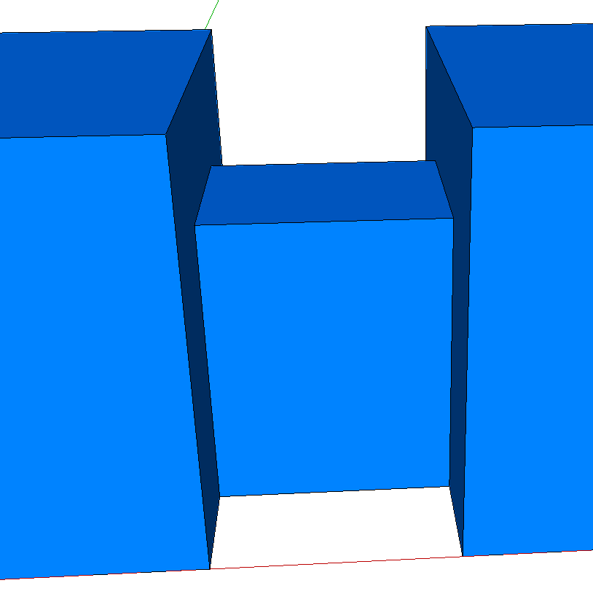
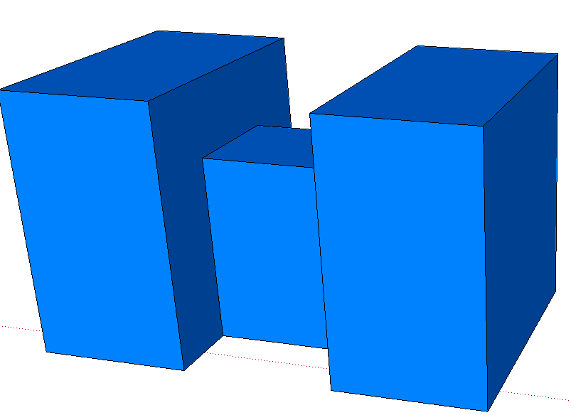
FinFET: Z, L Design Strategy
Fin height for on-state resistance to optimize t_{sense}
Recess Fin to increase Chanel length to reduce leakage for retention time
S_{Z}
L₁ + 2 · L₂ ≈ L_{min} ;
Z_{2,H} = Z_{1,H} + L₂ ;
Z_{2,W} = Z_{1,W} + 2 · L₂ ;
R_{Ch1}⁻¹ = qµC_{ox}V_{on} · (2 · Z_{2,H} + Z_{2,W} – 4 · L₂) / L₁ ;
R_{Ch2}⁻¹ = qµC_{ox}V_{on} · (2 · Z_{2,H} + Z_{2,w} – 2 · L₂) / L₂ ;
where
V_{on} = V_{P} – V_{T} ;
R_{Ch} = R_{Ch1} + 2· R_{Ch2} ;
Active Design Rule (2 Cells)
Cell Active Pitch = Z_{2W}+ S_{Z} ;
Cell Active Pitch = 3 · L_{SD} + 2 · L₁ + S_{L}
Z_{2,W}
Z_{1,W}
L₁
L₂
Z_{1,H}
Z_{2,H}
L_{SD}
S_{L}
R_{Ch1} = (qµC_{ox}V_{on})⁻¹ · L/W
R_{Ch1}⁻¹ = qµC_{ox}V_{on}· (2·Z_{1,H}+ Z_{1,W})/L_{G1}
R_{Ch2} = (qµC_{ox}V_{on})⁻¹ · L₂/[ ½ ·(Z₁+Z₂)]
R_{Ch2}⁻¹ = qµC_{ox}V_{on}· [Z_{1,H}+ Z_{2,H}+ ½(Z_{1,w}+Z_{2,w})]/L₂

Slide 35
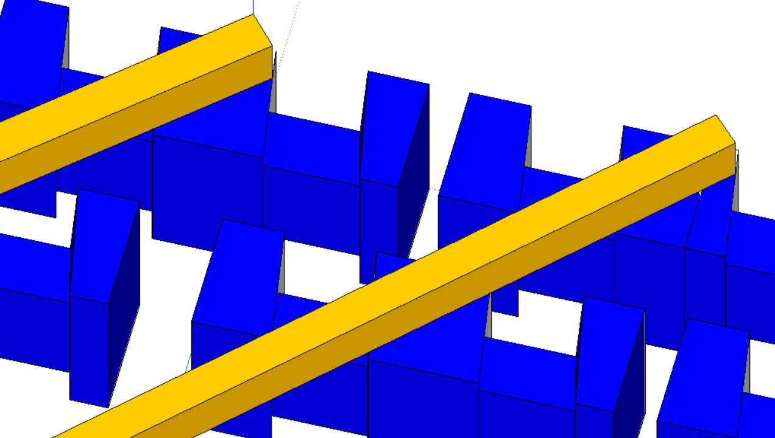
Layout for Shared Contact FinFET
COB via
Shared BL
COB via
Shared S/D
WL1
WL2
BL
WL1
COB via
COB via
Shared S/D
Cut along active
WL0
BL
COB via
COB via
Shared S/D
WL2
COB via
COB via

Slide 36
COB via
Shared BL
WL1
WL2
Cut along active

Slide 37
FinFET: WL and BL design
WL Loading
WL
driver
WL0
active
COB via
C_{BL-CV}
Shared BL
Worst-case bitcell
WL1
OFF
WL is loaded by Cgg (gate cap) and WL-WL coupling
C_{BL-WL}
BL Loading
WL1
OFF
WL2
ON
Worst-case bitcell
C_{ov}
C_{WL-WL}
C_{gg}
“1” pattern
SA
“0” pattern
Cut along active
SA
BL is loaded by Cov (Cgs/Cgd) and BL-BL coupling
Key bottleneck is BL parasitics to COB-via and WL

Slide 38
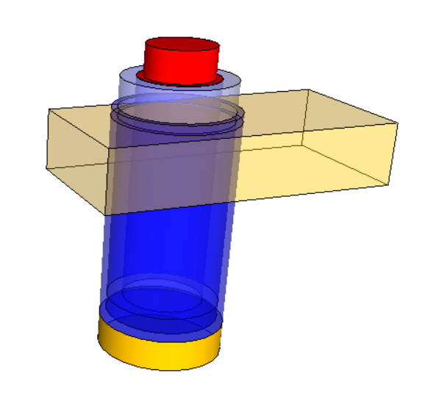
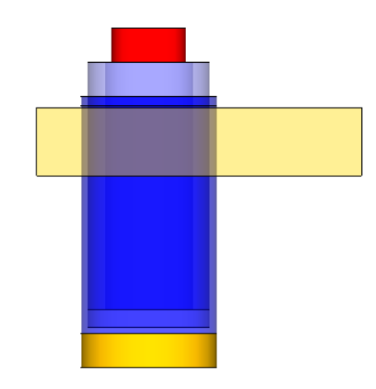
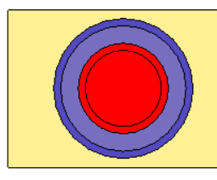
Channel WA: Z, L Design Strategy
Cylinder circumference for on-state resistance to optimize t_{sense}
Cylinder height to increase Chanel length to reduce leakage for retention time
S_{BL}
t_hik
t_ADM + t_hik + L_{e,min} ≈ L_{g} ;
Z_{ch} = π ·( D_{con,b} – 2 · t_ADM) ≈ π · D_{con,b} ;
D_{con,b} = 2 · (t_ADM + t_hik ) + t_MG
R_{con,b} = ρ_{con} · π · D_{con,b}²/4 ;
R_{con,t} = ρ_{con} · π · D_{con,t} · L_{con,t} ;
R_{Ch} = (qµC_{ox}V_{on})⁻¹ · L_{g} / (π ·( D_{con,b} – 2 · t_ADM)) ;
R_{Ch} = (qµC_{ox}V_{on})⁻¹ · L_{g} / (π ·( 2 · t_hik + t_MG)) ;
where
V_{on} = V_{P} – V_{T} ;
R_{total} = R_{Ch} + R_{con,b} + R_{con,t};
Active Design Rule
Cell Active Pitch = D_{con,b}+ S_{WL} + 2 · m_{WL} ;
Cell Active Pitch = D_{con,b}+ S_{BL}
S_{WL}
t_ADM
L_{con,t}
Z_{ch} = pi*D_{con,t}
t_MG
L_{e,min}
L_{g}
m_{WL}
D_{con,b}

Slide 39
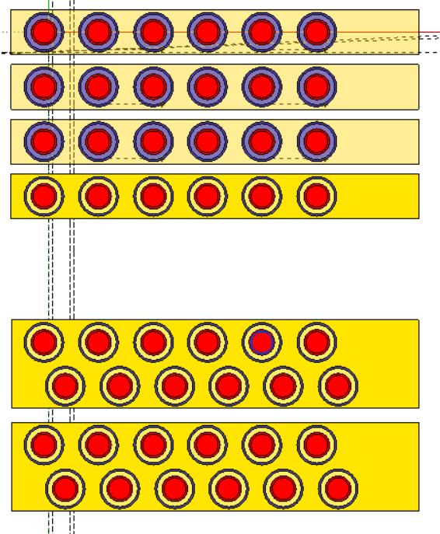
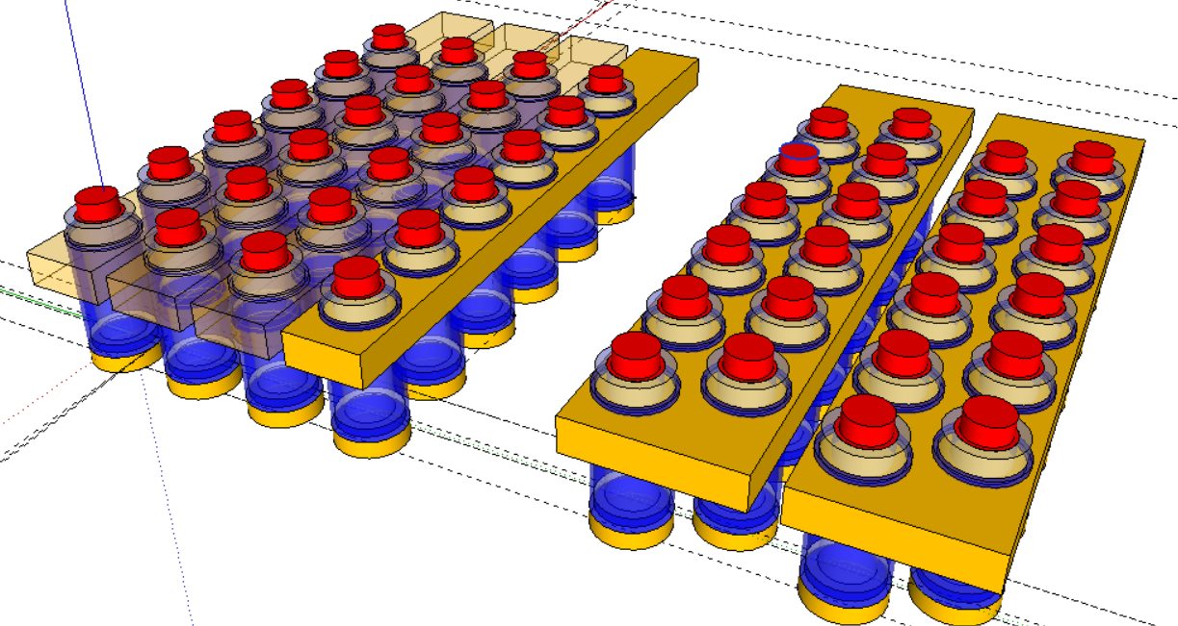
Layout of Channel Wrap-around Topology
WL0
WL1
WL2
Manhattan Geometry
WL0
WL1
WL2
WL3
WL4
WL5
Staggered Geometry
Manhattan Geometry
Staggered Geometry

Slide 40
Channel wrap-around: WL and BL design
WL Loading
WL0
WL1
WL2
WL3
WL4
WL5
WL
driver
WL0
active
C_{BL-BL}
Worst-case bitcell
WL1
OFF
WL is loaded by Cgg (gate cap) and WL-WL coupling
Shared BL
BL Loading
Worst-case bitcell
C_{BL-WL}
C_{WL-WL}
“1” pattern
WL OFF
WL ON
SA
C_{BL-WL}
C_{BL-WL}
“0” pattern
SA
C_{ov}
BL is loaded by Cov (Cgs/Cgd) and BL-BL coupling
C_{gg}
C_{gg}
WL-WL coupling is high, unless WL height reduced
Cut along active

Slide 41
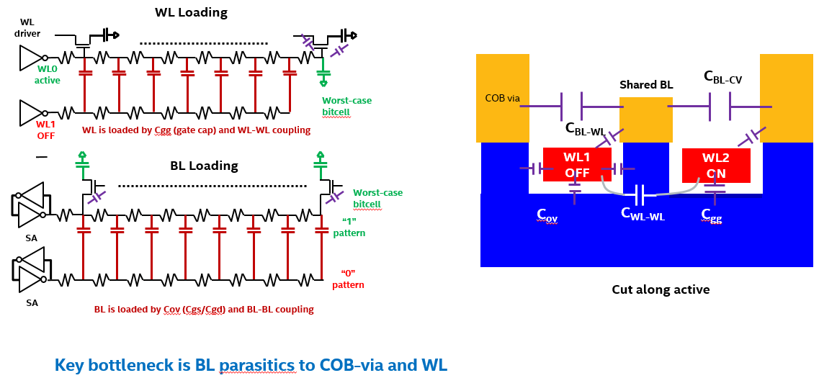
Comparison between Fin and Vertical
Type | resitivity (uohm.cm) | BL CD (nm) | BL space (nm) | height of BL (nm) | resistance/bit (ohms) | Cov (F) | BL-BL coupling (F) | BL-WL Coupling | Total BL cap/bit (F) | BL driver resistance (ohms) | BL driver capcitance (F) | bits/BL (#) | WB delay (s) | BL delay (s)
FinFET | 350 | 30 | 20 | 30 | 273.99 | 5.56E-19 | 3.74E-18 | 5.782E-19 | 4.88E-18 | 1500 | 1.39025E-15 | 1024 | 5.01E-08 | 1.07E-09
Channel WA | 350 | 10 | 10 | 10 | 1168.46 | 3.77E-17 | 2.22E-18 | 4.779E-20 | 4.00E-17 | 1500 | 1.39025E-15 | 128 | 6.33E-09 | 5.99E-10
Type | resitivity (uohm.cm) | height of WL | resistance/bit (ohms) | Cgg (F) | WL-WL coupling (F) | BL-WL Coupling | Total WL cap/bit (F) | WL driver resistance (ohms) | WL driver capcitance (F) | bits/WL (#) | WL delay (s)
FinFET | 30 | 30 | 10.21 | 1.36E-17 | 7.84932E-17 | 2.36E-19 | 9.24E-17 | 1500 | 1.39025E-15 | 1024 | 1.32E-09
Channel WA | 30 | 30 | 4.94 | 1.84E-16 | 7.2321E-18 | 4.248E-20 | 1.92E-16 | 1500 | 1.39025E-15 | 1024 | 2.15E-09

Slide 42
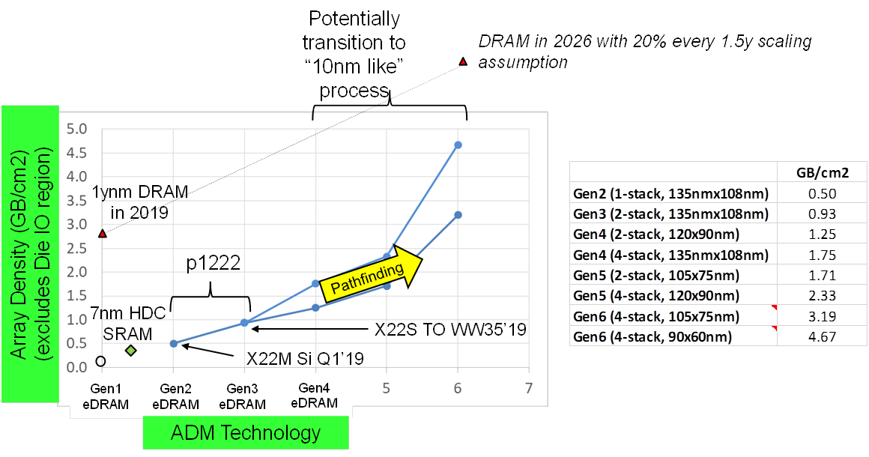
TD Roadmap
Channel
Raised S/D already assumed to increase Lg by ~7-10nm
Final scaling with current doping with planar geometry
For planar, need to reduce doping
Lg = 30nm
Lcon = 17.5nm
Z = 45nm
Lg = 40nm
Lcon = 20nm
Z = 70nm
Lg = 35nm
Lcon = 17.5nm
Z = 60nm
Fatih H.

Slide 43
CR Research Direction
90 x 60
Backgate
X22M
FinFET
BIG Question @Conclusion:
When should we jump from back-gate to a different topology?
Vertical
Alternate contact
Lateral scaling limits
Cell size (μm²)
Figure out the limitations for BG scaling (TCAD + data)
Define smallest DR’s possible for each topo
Establish pit-stops to assess scaling
Need help to define mask-set for intermediate steps

Slide 44
CR ADM WG Goals
Setup a clear parametric window for High Density Memory
Architecture → latency, BW, specs
Identify array-level pinch-points with scaling and disturb mechanisms
Determine BG topology challenges and scaling roadmap
Work with TD to define layout and device techniques that scale eDRAM (integrity of BG)
Work with TCAD to understand limits of scaling and potential solutions
Ascertain the scalable topology for eDRAM scaling
Define DTS and MTS for each topology
Identify break-points with scaling (Electrical + Integration)
Define DRs based on critical parameters (CRs, performance etc)
Define a framework for final mask-set needed for ‘fast-fail’ eDRAM transistor screening

Slide 45
CR Mask Timeline
Understand challenges of scaling BG flow
Establish deliverables on existing CR masks & identify shortcomings
Create integration options + design space
PHASE I
Define different topos and their features
Spider Flow with X22S/MA
Decide on DRs for different topos
Define test flow
PHASE II
Define immediate intercept for new CR mask-sets

Slide 46
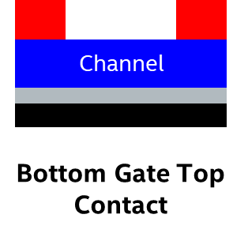

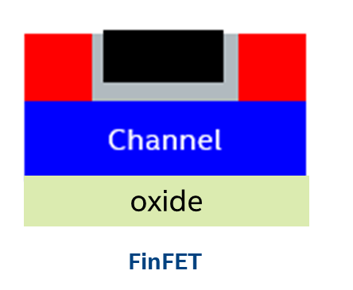

Timeline of Milestones
Demonstrate paired configuration with TD – implants, ozone treatment
ALD IGZO/In2O3, Raised S/D
CDO+CDN on top
C and other contact metals
No progress here
Demonstrate top gate on 1x35AA @ Lg <30nm
Scale GOX (<20A toxe), then stabilize cont/Rext (<2kohm-um)
Backend CDO/CDN stability
S/D regrowth, In2O3 channel
Follow TG:
FinFET on 1x35 @Lg<30nm; Z>100nm
GOX (<20A toxe), Rext (<2kohm-um)
Backend stability; S/D regrowth, In2O3 channel
Gain cell structures
Demo. Rext, ueff, Lg –ready device with vertical topology
Scale GOX, ALD MG, In2O3 channel
Impact of integration schemes and scaling limits
CON experiments
Q3’19
Q4’19
Q1’20
Q2’20
Vertical

Slide 47
Timeline of Milestones
Tentative cell size to Abhishek ww42.4
Establish DTS and process flow ww43 (rev1)
Finalize DTS and cell topo selection ww44
Discuss process flow with NSG stakeholders ww45
Peer review with TD+NSG ww46
Engage with Derchang ww41+
Engage with Elliot+Kim+Nikhil ww43+
Engage with Travis ww44+
Engage with NSG ww45+
Vertical
Starting next week – we will start a meeting with Elliot+Kim+Nikhil and use it as a discussion forum
Q3’19
Q4’19
Q1’20
Q2’20

Slide 48
CR New Mask Objectives
Must be easily transferable
Should learn at relevant pitches
Should answer fast-fail questions (what fundamentally fails upon scaling)
What is a Spider Flow?
Advantages of Spider Flow
CR builds upon existing TD infrastructure at scaled pitches – changes ONLY:
Array
Socket
Old array
New Product Flow (CR – RECL/FL)
New array
CMOS + 3-4 metal layers (TD start)
Advantages: @pitch, fast transfer to TD, aggressive topology skew
Disadvantages: Slow to NPI/develop/implement? Slow to SORT, need design alignment
May not be able to test each row
Reuses X22 infra
Fast cycle time and sturdy vehicle

Slide 49

ADM eDRAM Array Design
L_{g} = 40nm
CON = 27.5nm
BL
COB
WL0
8F² cell
2F
COB
WL1
COB
4F
Targeted cell:
108 x 135 nm²
2x cell area scaling wrt 22nm eDRAM
ADM is back-gated transistor

Slide 50



Depletion Depth in TFT-ADM
ADM
ADM
ADM
CB
CB
CB
TiN
TiN
TiN
E_{F}
E_{F}
E_{F}
HfO₂
HfO₂
HfO₂
Full Depletion
Limited Depletion
<1nm Depletion
Doping ~6e17 /cm3
CR-Coupon
Doping ~6e18 /cm3
CR 300mm
Doping ~6e19 /cm3
TD 300mm (X22M)
Increased doping from contacts and channel prevents gate field from fully depleting ADM → SS/Vt degradation → Poor I_{LEAK}

Slide 51

Model parameters that were optimized
Contact resistivity
DRAIN
SOURCE
PASSIVATION FILM
RAISED CONTACT
Constant electron mobility
RAISED CONTACT
ADM CHANNEL
HIGH-K DIELECTRIC
GATE METAL
Metal work function
TCAD team

Slide 52




Contact Improvement with R_{SD}
Channel cut line
Contact cut line
CHANNEL CUT LINE
CONTACT CUT LINE
M6
M6
1T1C
CURRENT DENSITY
1T1C
Current crowds at bottom surface when device is on.
V_{D}=1.0
V_{D}=1.0
*ADM top surface references to ADM/passivation interface
DISTANCE FROM ADM TOP SURFACE (nm)
DISTANCE FROM ADM TOP SURFACE (nm)
TCAD team

Slide 53






Off current (V_{G}=-0.8V)
Channel cut line
Contact cut line
CHANNEL CUT LINE
CONTACT CUT LINE
1T1C
1T1C
M6
M6
CURRENT DENSITY
V_{D}=0.05
V_{D}=0.05
1T1C
1T1C
M6
CURRENT DENSITY
M6
V_{D}=1.0
V_{D}=1.0
Leakage current crowds at top surface
*ADM top surface references to ADM/passivation interface
DISTANCE FROM ADM TOP SURFACE (nm)
DISTANCE FROM ADM TOP SURFACE (nm)
TCAD team

Slide 54




Device structure
PTD1930196 Summary
Simulated geometry: InOx → ADM
002 - W368(0,0) - 300C 5nm InOx RSD w/W/TaN BLD liner at M7
DRAIN
SOURCE
PASSIVATION
INOX
ADM
INOX
HIGH K DIELECTRIC
GATE

Slide 55

Scaling skews and metrics
BL
L_{g}
Drain
COB
COB
WL0
8F² cell
2F
COB
WL1
COB
Z
4F
LCON
LG
Doping skews:
0.1X, 0.5X, 1X (Fit = 1e19), 2X, 10X
Bias Conditions
 | VG | VS | VD
ION, CON | 1.7 | 0.5 | 0.7
 |  | 0 | 1
IOFF,COFF | -0.4 | 0 | 1
 | -0.8 | 0 | 1

Slide 56

Calibration with non-RSD contact
Dit + Uniform bulk density model
Vo, No as Dit at passivation interface
Parameters applied to RSD scaling study
Parameter | Value
Mobility | 15.9
Contact Resistivity | 1.097e-7
Bulk Doping (Ho) | 1e19
Bulk Vo | 1e16
Interface Vo | 1e13
Bulk No | 1e10
Interface No | 1e8
Gate Work Function | -0.256 eV
DRAIN
SOURCE
PASSIVATION
Constant mobility
ADM
HIGH K DIELECTRIC
Uniform bulk doping (Ho) and traps (Vo, No)
GATE
Lot Z917R52
Ho = Hydrogen on Oxygen site
Vo = Vacancy on Ox
No = Nitrogen on Ox

Slide 57




ID-VG vs doping (nominal roadmap)
IDLIN
IDSAT
LOWER DOPING
LOWER DOPING

Slide 58



Impact of doping on ION and IOFF
*Corrected for VT shift
IDLIN vs. NOMINAL IOFF
IDSAT vs. NOMINAL IOFF
LOWER DOPING
LOWER DOPING
POR in BOLD BLUE
Target space is GREEN BOX

Slide 59


Impact of doping on ION and IOFF
*Corrected for VT shift
IDLIN vs. UNDERDRIVE IOFF
IDSAT vs. UNDERDRIVE IOFF
LOWER DOPING
LOWER DOPING
POR in BOLD BLUE
Target space is GREEN BOX

Slide 60

6F² cell architecture - M5, VBG, New mask and ADM level
M5 WL at ½ of OGD pitch
Requires new mask to cut TiN before ADM HiK (use ADB?)
VBG needs:
Enclosed by ADM and/or TiN
Enough overlap to proper WL
Enough separation to adjacent WL
Ideas and concerns:
WL at different levels using deep via?
Coupling of unselected WL to selected BL in the same ADM island?
PGD cut 1
PGD cut 2
PGD cut 1
PGD cut 2

Slide 61
6F² cell architecture - ACT, BLD and VCB level
BLD pitch relaxed
BLD to VCB vs VCB to COB coverage trade-off
Ideas and concerns:
BLD overlapping two xtors?
BLD pitch division landing islands below VCB for shorting margin/ VCB centered on COB?
PGD cut 1
PGD cut 2
PGD cut 1
PGD cut 2

Slide 62
6F² cell architecture - COB level
COB square
BLD to VCB vs VCB to COB coverage trade-off
Ideas and concerns:
Double wall COB. Impact on layout?
If BLD landing pads, then VCB could be centered
PGD cut 1
PGD cut 2
PGD cut 1
PGD cut 2

Slide 63
COB
COB
PGD cut
PGD cut
ES
VCB
BLD
VCB
ACT
ACT
ACT
ADM
HiK
TiN
VBG
ES
VBG
WL

Slide 64
Height must be short enough to reduce CAP
Space needs to be large enough to limit CAP/crosstalk
ACT needs to be large enough that it does not walk off of TiN/ADM Island
Looks like Center ACT will always need to be bigger
PGD cut
PGD cut
How will we define these cuts? Bottom cut not “necessary” but may make tessellating easier
Lg still defined by ACT space, so L/R Lg always are the same
ACT
ACT
ACT
ADM
HiK
TiN
VBG
ES
VBG
WL

Slide 65
TCAD Request (2019/10/11)
COB
COB
BL
In₂O₃ contacts 3nm, 5nm
“Lcon”
ADM
ADM
For ADM thickness 5nm, 6nm, 7nm
“x”
Questions (assuming doping skew between 0.5X POR to 5x POR; 120x90 cell component dimensions):
How much does Rext change vs Vg?
How much does Ioff change when ‘x’ is an underlap?
What is it’s impact on Cov and WL-WL coupling (vs TiN MG thickness 5, 10, 20 nm)?
Does an underlap in the COB side matter equally?
What is the sensitivity to misalignment (range +/- 20nm) given x = Lcon, 0.5*Lcon, 2*Lcon ?
What is the breakdown of RextBL, RextCOB, Rchannel?

Slide 66
Solutions for BG ADM Scaling
What limits S/D spacing/Lg/AR of trench?
Max impact
L_{g} = 30nm
BL
CON = 15nm
COB
S
D
WL0
Recessed Channel
ADM
COB
COB
WL1
S
S
D
D
Raised S/D
Scaled cell:
60 x 90 nm²
Lg = 40nm; Lcon = 15nm; Z = 40nm
ADM
Recessed Channel for Lg increase
Raised S/D for Rc improvement
Z-scaling still fundamentally limited
What is the correct topo for scaling?
Notes:
Topos for Lg increase
Lcon increase
Z-scaling
Summarize into Lg, Lcon,

Slide 67
Scaling Challenges/Paths
ADM Scaling
XTOR scaling
Ion + Ioff in voltage range
Contact length scaling
Parasitic capacitance scaling
Angled ADM?
COB scaling
Double-walled capacitor to reduce noise/increase cap
Ferroelectric to increase retention – decouple Ioff
Pillar type?
Parasitic Scaling
Introduce air-gaps BL→n0
Reduce Cov with scaling or S/D regrowth
Angled ADM?

Slide 68
Scaling Challenges/Paths
ADM Scaling
XTOR scaling
Ion + Ioff in voltage range
Contact length scaling
Lg scaling
New topologies
Materials
Scalable and tunable ADM to enable multi-Vt EOL
CON stability, EOL stability
MG WF engineering
GOX engineering
Implantation, treatments etc
Vertical ADM
Demonstrate scaling limit of vertical ADM
Rc and Rext
Shared gating
FinFET ADM
Demonstrate scaling limit of FinFET ADM
RCAT
Rc and Rext
C_overlap
Planar ADM
Demonstrate scaling limit of planar ADM at high doping
Recess Channel/Z
S/D Regrowth

Slide 69
Topologies with TFTs
D
MG
4F2
8F2 – 6F2
6F2 – 5F2
S
CAA
Channel
Channel
Channel
Channel
S
Bottom Gate Top Contact
Top Gate Top Contact
Top Gate Bottom Contact
Top Gate Alternate Contact
D
GAA
Key advantages:
Ease of integration
Key advantages:
Fin → better gate control, better subthreshold swing, better leakage, more Z → more current @Ion
Key advantages:
Fin → better gate control, better subthreshold swing, better leakage, more Z → more current @Ion
Gate to contact overlap → better contact resistance while having low Cov @BL side for good SM
Cov at CUB-side is miller → does not affect active device
No need for angling
Key advantages:
Better electrostatics
Lg independent of scaling cell
Large contact areas
Fewer masks

Slide 70
Changes with ADM Scaling
L_{g} = 30nm
BL
CON = 15nm
L_{g} = 30nm
BL
CON = 15nm
COB
COB
WL0
COB
WL0
WL0
WL0
COB
COB
WL1
COB
COB
COB
WL1
Scaled cell:
40 x 50 nm²
WL_p = 40nm; BL_p = 100nm; Active_p = 40 x 100
Lg = 20nm; Lcon = 15nm; Z = 100nm
Optimal angle = 76 deg for OGD = 40nm
Scaled cell:
40 x 50 nm²
WL_p = 40nm; BL_p = 50nm; Active_p = 40 x 50
Lg = 20nm; Lcon = 35nm; Z = 100nm
Scaled cell:
60 x 90 nm²
WL_p = 50nm; BL_p = 90nm; Active_p = 50 x 90
Lg = 40nm; Lcon = 15nm; Z = 40nm
50 x 67.5 nm²
WL_p = 60nm; BL_p = 135nm; Active_p = 50 x 135
Lg = 30nm; Lcon = 15nm; Z = 35nm
Back-gated device suffers from Lg scaling due to SCE @high doping
Lcon and Z scaling further reduces the performance
Fin height → wide Z
Better gate control
Angled for 6F2
GAA/2-sided → wide Z
Long Lg
Contact area = active pitch

Slide 71
FinFET: Z, L Design Strategy
Fin height for on-state resistance to optimize t_{sense}
Recess Fin to increase Chanel length to reduce leakage for retention time
S_{Z}
L₁ + 2 · L₂ ≈ L_{min} ;
Z_{2,H} = Z_{1,H} + L₂ ;
Z_{2,W} = Z_{1,W} + 2 · L₂ ;
R_{Ch1}⁻¹ = qµC_{ox}V_{on} · (2 · Z_{2,H} + Z_{2,W} – 4 · L₂) / L₁ ;
R_{Ch2}⁻¹ = qµC_{ox}V_{on} · (2 · Z_{2,H} + Z_{2,w} – 2 · L₂) / L₂ ;
where
V_{on} = V_{P} – V_{T} ;
R_{Ch} = R_{Ch1} + 2· R_{Ch2} ;
Active Design Rule (2 Cells)
Cell Active Pitch = Z_{2W}+ S_{Z} ;
Cell Active Pitch = 3 · L_{SD} + 2 · L₁ + S_{L}
Z_{2,W}
Z_{1,W}
L₁
L₂
Z_{1,H}
Z_{2,H}
L_{SD}
S_{L}
R_{Ch1} = (qµC_{ox}V_{on})⁻¹ · L/W
R_{Ch1}⁻¹ = qµC_{ox}V_{on}· (2·Z_{1,H}+ Z_{1,W})/L_{G1}
R_{Ch2} = (qµC_{ox}V_{on})⁻¹ · L₂/[ ½ ·(Z₁+Z₂)]
R_{Ch2}⁻¹ = qµC_{ox}V_{on}· [Z_{1,H}+ Z_{2,H}+ ½(Z_{1,w}+Z_{2,w})]/L₂

Slide 72
Layout for Shared Contact FinFET
COB via
Shared BL
COB via
Shared S/D
WL1
WL2
BL
WL1
COB via
COB via
Shared S/D
Cut along active
WL0
BL
COB via
COB via
Shared S/D
WL2
COB via
COB via

Slide 73
COB via
Shared BL
WL1
WL2
Cut along active

Slide 74
FinFET: WL and BL design
WL Loading
WL
driver
WL0
active
COB via
C_{BL-CV}
Shared BL
Worst-case bitcell
WL1
OFF
WL is loaded by Cgg (gate cap) and WL-WL coupling
C_{BL-WL}
BL Loading
WL1
OFF
WL2
ON
Worst-case bitcell
C_{ov}
C_{WL-WL}
C_{gg}
“1” pattern
SA
“0” pattern
Cut along active
SA
BL is loaded by Cov (Cgs/Cgd) and BL-BL coupling
Key bottleneck is BL parasitics to COB-via and WL

Slide 75
Channel WA: Z, L Design Strategy
Cylinder circumference for on-state resistance to optimize t_{sense}
Cylinder height to increase Chanel length to reduce leakage for retention time
S_{BL}
t_hik
t_ADM + t_hik + L_{e,min} ≈ L_{g} ;
Z_{ch} = π ·( D_{con,b} – 2 · t_ADM) ≈ π · D_{con,b} ;
D_{con,b} = 2 · (t_ADM + t_hik ) + t_MG
R_{con,b} = ρ_{con} · π · D_{con,b}²/4 ;
R_{con,t} = ρ_{con} · π · D_{con,t} · L_{con,t} ;
R_{Ch} = (qµC_{ox}V_{on})⁻¹ · L_{g} / (π ·( D_{con,b} – 2 · t_ADM)) ;
R_{Ch} = (qµC_{ox}V_{on})⁻¹ · L_{g} / (π ·( 2 · t_hik + t_MG)) ;
where
V_{on} = V_{P} – V_{T} ;
R_{total} = R_{Ch} + R_{con,b} + R_{con,t};
Active Design Rule
Cell Active Pitch = D_{con,b}+ S_{WL} + 2 · m_{WL} ;
Cell Active Pitch = D_{con,b}+ S_{BL}
S_{WL}
t_ADM
L_{con,t}
Z_{ch} = pi*D_{con,t}
t_MG
L_{e,min}
L_{g}
m_{WL}
D_{con,b}

Slide 76
Layout of Channel Wrap-around Topology
WL0
WL1
WL2
Manhattan Geometry
WL0
WL1
WL2
WL3
WL4
WL5
Staggered Geometry
Manhattan Geometry
Staggered Geometry

Slide 77
Channel wrap-around: WL and BL design
WL Loading
WL0
WL1
WL2
WL3
WL4
WL5
WL
driver
WL0
active
C_{BL-BL}
Worst-case bitcell
WL1
OFF
WL is loaded by Cgg (gate cap) and WL-WL coupling
Shared BL
BL Loading
Worst-case bitcell
C_{BL-WL}
C_{WL-WL}
“1” pattern
WL OFF
WL ON
SA
C_{BL-WL}
C_{BL-WL}
“0” pattern
SA
C_{ov}
BL is loaded by Cov (Cgs/Cgd) and BL-BL coupling
C_{gg}
C_{gg}
WL-WL coupling is high, unless WL height reduced
Cut along active

Slide 80



Gate WA: Z, L Design Strategy
Cylinder circumference for on-state resistance to optimize t_{sense}
Cylinder height to increase Chanel length to reduce leakage for retention time
S_{WL}
2 · LgCON_{UL} + L_{e,min} ≈ L_{g} ;
Z_{ch} = π · D_{con} ;
R_{con} = ρ_{con} · π · D_{con}²/4 + R_{LgCONUL} ;
R_{Ch} = (qµC_{ox}V_{on})⁻¹ · L_{g} / (π · D_{con}) ;
where
V_{on} = V_{P} – V_{T} ;
R_{total} = R_{Ch} + 2 · R_{con};
Active Design Rule
Cell Active Pitch = 2 · t_hik + D_{con} + S_{WL} + 2 · m_{WL} ;
Cell Active Pitch = 2 · t_hik + D_{con} + S_{BL}
S_{BL}
t_hik
Z_{ch} = pi*D_{con}
D_{con}
L_{e,min}
L_{g}
LgCON_{UL}
m_{WL}
t_ADM
D_{con}

Slide 81
Changes with ADM Scaling
BL
L_{g} = 40nm
L_{g} = 30nm
CON = 27.5nm
BL
CON = 15nm
COB
COB
WL0
WL0
COB
COB
WL1
2F
COB
WL1
COB
4F
Today’s cell:
108 x 135 nm²
WL_p = 108nm; BL_p = 135nm; Active_p = 108 x 135
Lg = 40nm; Lcon = 27.5nm; Z = 73nm
Scaled cell:
60 x 90 nm²
WL_p = 60nm; BL_p = 90nm; Active_p = 60 x 90
Lg = 30nm; Lcon = 15nm; Z = 45nm
Back-gated device suffers from Lg scaling due to SCE @high doping
Lcon and Z scaling further reduces the performance

Slide 82


Accumulation-mode Band Diagram in ADM
SiO₂
SiO₂
CNT
CNT
Passivation
Passivation
ADM
HfO2 10 nm
TiN 100 nm
ADM gate modulates both R_{channel} and R_{contact} → together they result in low I_{OFF}

Slide 83


Short Channel Effects Improve with Adamantine Body Scaling of Doping Reduction
Experimental Data
SiO₂
SiO₂
CNT
CNT
Passivation
ADM Scaling
Passivation
ADM
1e20 /cm3
HfO2 6 nm
TiN 100 nm
1e19 /cm3
1e18 /cm3
TCAD: Sean Ma
TCAD Simulations predicts that thin body will enable SS target
High doping results in Poor Gate Control
Intel Top Secret
Notes:
ION Ioff vs Lg min Z possible

Slide 84
CR Memory Research Density vs. Latency Benchmark
In Production (Intel, Samsung)
Intel
NAND
PTD – 1222 Dev’t
CR Research
OPTANE
X-Point
NAND 1T-1C or NAND FerroFET with Word Access
Vertical ADM or FeFET
HBM
DRAM
ORION + ADM x 2
ORION or ADM x 2
ADM
1274
SRAM
1271.3
e-DRAM
e-NVM
MRAM
RRAM
Intel Confidential
Notes:
Add another column showing Q2/Q3 progress

Slide 85
Topology Assumed for simulations
5nm ADM; 5nm HfO2; 10nm space; 20nm MG
D
MG
15nm
15nm
S
11nm
11nm
Wrap-around Channel
S
S
S
20nm
Leff = 40nm
D
S
D
20nm
D
20nm
D
20nm
5nm
TiN 5nm
10nm
5nm ADM; 5nm HfO2; 10nm space; 20nm ADM
ADM 5nm
Leff = 30 + 20 + 30
TiN 5nm
S
HfO2 5nm
50nm tall
D
GAA

Slide 86
Topology Assumed for simulations
5nm ADM; 5nm HfO2; 10nm space; 20nm MG
D
MG
15nm
15nm
S
11nm
11nm
Wrap-around Channel
S
S
S
40+nm
D
S
D
20nm
D
20nm
D
20nm
5nm
ADM 5nm
2nm
TiN 5nm
HfO2 5nm
5nm ADM; 5nm HfO2; 10nm space; 20nm ADM
TiN 5nm
Leff = 20 + 20 + 20
S
50nm tall
D
D
redep
250C
GAA
S
x
ADM 5nm
orig
180C
HfO2 5nm
D
TiN 5nm

Slide 87
Changes with ADM Scaling
L_{g} = 30nm
BL
CON = 15nm
L_{g} = 30nm
BL
CON = 15nm
COB
COB
WL0
COB
WL0
WL0
WL0
COB
COB
WL1
COB
COB
COB
WL1
Scaled cell:
40 x 50 nm²
WL_p = 40nm; BL_p = 100nm; Active_p = 40 x 100
Lg = 20nm; Lcon = 15nm; Z = 100nm
Optimal angle = 76 deg for OGD = 40nm
Scaled cell:
40 x 50 nm²
WL_p = 40nm; BL_p = 50nm; Active_p = 40 x 50
Lg = 20nm; Lcon = 35nm; Z = 100nm
Scaled cell:
50 x 90 nm²
WL_p = 50nm; BL_p = 90nm; Active_p = 50 x 90
Lg = 30nm; Lcon = 15nm; Z = 35nm
50 x 67.5 nm²
WL_p = 60nm; BL_p = 135nm; Active_p = 50 x 135
Lg = 30nm; Lcon = 15nm; Z = 35nm
Back-gated device suffers from Lg scaling due to SCE @high doping
Lcon and Z scaling further reduces the performance
Fin height → wide Z
Better gate control
Angled for 6F2
GAA/2-sided → wide Z
Long Lg
Contact area = active pitch

Slide 88


Slide 89

ADM eDRAM offers stackable arrays
Row decoder area grows by 2.2x every stack
Gate
Gate
Monolithic Stacking
Gate
Caveats with vertical stacking:
Beyond 2 layers, peripherals will exceed array every additional layer @7-10% /layer Xdec for every layer
Unless ADM Xdec used → latency +1.5ns
If ADM high performance, it can be used as row Xdec too
Gate

Slide 90
CR New Mask Objectives
Demonstrate scaling limits (Lg, Lcon) of ADM topologies
Array + etest vehicles using ADM only and ADM+Si_nmos demonstrations
Etestable at fast speeds including charge pumping
<10 masks
3 masks < 70nm pitch
What is a Spider Flow?
New Target Definition
CR builds upon existing TD infrastructure at scaled pitches – changes ONLY:
Array
Socket
CR build NEW VEHICLE:
Array
Socket
New Product Flow (CR – RECL/FL)
New Product Flow (CR – RECL etest)
CMOS + 3-4 metal layers (TD start)
Advantages: @pitch, fast transfer to TD, aggressive topology skew
Disadvantages: Slow to NPI/develop/implement? Slow to SORT, need design alignment
Advantages: @pitch fast prototyping, aggressive topology skew and flexibility, device fundamentals
Disadvantages: slow transfer to TD, ltd in transferability due to change in tools, pitches, array size etc

Slide 91

1T-1X vs 1T vs 1S-1X
Storage element
BL
BL
SL
Source
Gate
Drain
Source
Gate
Drain
HfO2 4 nm
Storage element
Semiconductor
Semiconductor
Modes: 1T-1C, 1T-1F, 1T-1M
Advantages:
Known physics for 1T-1C, 1T-1M
Word access – high BW; unselected bits consume 0 power
2-5 pJ/bit R/W energy
Low latency 1T-1C; ~4-9ns R/W
Disadvantages:
8F2 to 6F2 orientation when planar; 4F2 vertical
Best scaling EOL roadmap ~45x45 nm2 (DRAM)
More mask steps w/o self-alignment
Modes: 1T ferroelectric
Advantages:
Fewer mask steps, no need for tall COB or complicated MTJ etch
Similar BW and latency (~20% lower)
2-10 pJ/bit R/W energy
Disadvantages:
Ferroelectric physics new; endurance <1e9 cycles; research work in progress
8F2 to 6F2 orientation when planar; 4F2 vertical
Best scaling EOL roadmap ~45x45 nm2 (DRAM)
Modes: 1S-1PCM, 1S-1M
Advantages:
Ultra dense; EOL roadmap 10x10nm (>15x better than DRAM)
MRAM + selector may be better performance than PCM
Disadvantages:
Bitwise R/W → lower BW
Best case latency limited by parasitics @~200ns
Unselected bits burn half-select power
50 pJ RD and 0.5-2 nJ/bit WR energy (parasitics)
Endurance < 1e9 cycles (selector limited)

Slide 92
ADM eDRAM Array Design
L_{g} = 40nm
CON = 27.5nm
BL
COB
WL0
8F² cell
2F
COB
WL1
COB
4F
Targeted cell:
108 x 135 nm²
2x cell area scaling wrt 22nm eDRAM
WL in different plane than COB and BL
➔ No angled fins needed

Slide 93

Tyche – II eDRAM Array (Teleios)
OGD
L_{g} = 14nm?
COB
COB
Optional WL strap
BL
BL
PGD
WL →
WL0
WL1
2F
COB
COB
>1µm
COB
6F² cell
6F/2cells
Power for hvcc, PLL etc (optional – can be Tyche)
BL routing to SA
COB in different plane than WL and BL
➔ No angled fins needed
WL driver
SA, PLL, HVCC gen

Slide 94
Topologies with TFTs
Channel
Channel
Channel
Channel
Bottom Gate Top Contact
Top Gate Top Contact
Top Gate Bottom Contact
Top Gate Alternate Contact
Key advantages:
Fin → better gate control, better subthreshold swing, better leakage, more Z → more current @Ion
Gate to contact overlap → better contact resistance while having low Cov @BL side for good SM
Cov at CUB-side is miller → does not affect active device
No need for angling

Slide 95


Alternate Contact 1T-1C
1T – 1C
Channel
Channel
SiN ES
Key advantages:
Fin → better gate control, better subthreshold swing, better leakage, more Z → more current @Ion
Gate to contact overlap → better contact resistance while having low Cov @BL side for good SM
No need for angling

Slide 96

Bottom gate bottom contact
Simulated Id-Vg
Bottom gate top contact
Current (A/um)
Top gate top contact

Slide 97

Commodity DRAM Array
TEM XS
(along the diffusion)
Samsung 3Xnm 2Gb DDR3 DRAM
<Samsung DRAM>
(Row, Column)
Bit lines
Bit lines
WL0
WL1
WL2
WL3
(1, 0)
(3, 0)
wordline
BL0
(0, 0)
(2, 0)
(0, 1)
(2, 1)
61nm
BL1
(1, 1)
(3, 1)
(1, 2)
(3, 2)
BL2
(0, 2)
(2, 2)
(0, 3)
(2, 3)
BL3
COB, WL, BL in same plane
➔ Angled fins needed
(1, 3)
(3, 3)
Courtesy: Tomishima, Shigeki, IL

Slide 98




Advantage of Angled Fins: ~25% area reduction
$$HCP:Manhattan Layout:$$
$$Area shrink=\frac{\sin{2θ}}{4}$$
$θ$ = 30
BL
L_{g}
Drain
COB
COB
WL0
8F² cell
Manhattan Layout:
$$WL Pitch=2r$$
$$BL Pitch=2r$$
$$CAP Pitch=r$$
$$xTOR Pitch=2r$$
$$Bitcell Area=4r^{2}$$
2F
COB
WL1
COB
4F
Because we share BL, we eliminate 1 isolation per 2 cells
This results in ~25% reduction in area going to angled fins
It also enables densest possible configuration of capacitors @hcp → assumes double-walled capacitor
HCP Layout:
$$WL Pitch=r\sin{θ}$$
$$BL Pitch=4r\cos{θ}$$
$$CAP Pitch=r$$
$$xTOR Pitch=2r/2$$
$$Bitcell Area=4r^{2}\sin{θ}\cos{θ}$$

Slide 99
Timeline of Milestones
Demonstrate paired configuration with TD – implants, ozone treatment
ALD IGZO/In2O3, Raised S/D
CDO+CDN on top
C and other contact metals
Add a slide for doping control → impact of flows etc
Demonstrate top gate on 1x35AA @ Lg <30nm
Scale GOX (<20A toxe), then stabilize cont/Rext (<2kohm-um)
Backend CDO/CDN stability
S/D regrowth, In2O3 channel
Follow TG:
FinFET on 1x35 @Lg<30nm; Z>100nm
GOX (<20A toxe), Rext (<2kohm-um)
Backend stability; S/D regrowth, In2O3 channel
Gain cell structures
Demo. Rext, ueff, Lg –ready device with vertical topology
Scale GOX, ALD MG, In2O3 channel
Impact of integration schemes and scaling limits
CON experiments
Q3’19
Q4’19
Q1’20
Q2’20
Vertical

Slide 100
Tools Used
Fundamental Studies:
C-V dot – GOX scaling, ADM scaling, CON reactivity
Long Lg Xtors – GOX, scaling, Channel Mobility, CON reactivity, Passivation
Integrated Studies:
300mm 1x35
X22M vehicle (<15 mask RECL)

Slide 101
CR New Mask Objectives
Demonstrate scaling limits (Lg, Lcon) of ADM topologies
Array + etest vehicles using ADM only and ADM+Si_nmos demonstrations
Etestable at fast speeds including charge pumping
<10 masks
3 masks < 70nm pitch
What is a Spider Flow?
New Target Definition
CR builds upon existing TD infrastructure at scaled pitches – changes ONLY:
Array
Socket
CR build NEW VEHICLE:
Array
Socket
New Product Flow (CR – RECL/FL)
New Product Flow (CR – RECL etest)
CMOS + 3-4 metal layers (TD start)
Advantages: @pitch, fast transfer to TD, aggressive topology skew
Disadvantages: Slow to NPI/develop/implement? Slow to SORT, need design alignment
Advantages: @pitch fast prototyping, aggressive topology skew and flexibility, device fundamentals
Disadvantages: slow transfer to TD, ltd in transferability due to change in tools, pitches, array size etc

Slide 102
CR Mask Timeline
Learn existing X22M flow
Establish deliverables on existing mask-set & identify shortcomings
Create Flows for new topologies
PHASE I
Get DRs from existing X22M flow and their purpose
Spider Flow with X22S/MA
Decide on DRs for new Product
Define full-flow scope, SORT, design needs
PHASE II
New Mask Definition

Slide 105
Topology Assumed for simulations
5nm ADM; 5nm HfO2; 10nm space; 20nm MG
D
MG
15nm
15nm
S
11nm
11nm
Wrap-around Channel
S
S
S
20nm
Leff = 40nm
D
S
D
20nm
D
20nm
D
20nm
5nm
TiN 5nm
10nm
5nm ADM; 5nm HfO2; 10nm space; 20nm ADM
ADM 5nm
Leff = 20 + 20 + 20
TiN 5nm
S
HfO2 5nm
50nm tall
D
GAA

Slide 106


sp_ADM_BL,min = 10nm
BLcn_area,min = pi*cbcn_dia,min x h_BL
BLcn_area,min =
H_BL = Lcon_BL > 20nm
Lgmin = 47nm
Lgnom = 70nm
Le,min = 40nm
Lg > t_ADM + t_hik + Le,min
t_ADM,min = 2nm
t_ADM,max = 5nm
t_hik,min = 5nm
Z = pi*(cbcn_dia-t_ADM*2) = 109 nm
cbcn_dia,min = 39nm
cbcn_dia = 2*t_ADM + 2*t_hik + t_MG,min
t_MG,min = 25nm
Min cell size = 49 (WL) x 53 (BL)

Slide 107


sp_ADM_WL,min = 10nm
Z = pi*BLcn_dia = 47nm
Lgmin = 40nm
Lgnom = 70nm
h_WL <= Lgmin = 40nm
BLcn_dia,min = 15nm = t_ADM
BLcn_dia = doping electrostatics
t_hik,min = 5nm (leakage)
BLcn_area,min = pi*(BLcn_dia,min/2)^2 = 176 nm2
Min cell size = 35 (BL) x 39 (WL)

Slide 108


T_con = 5nm
10nm
T_fin
25nm
Lgdrw
25nm
Zcon
t_hik = 5nm
t_ADM = 2nm
H_fin = 40nm
Lgv,min = Lgh,min = 7.5*2 + Lg,drw – 2*t_hik = 30nm
Z = (h_fin + t_hik)*2 + t_fin + 2*t_hik = 120nm
Min cell size = 49 (BL) x 55 (WL)

Slide 110
SiO₂
SiO₂
CNT
CNT
Passivation
Passivation
ADM
High doping:
Controlled doping ~5e18 /cm3
Gate induced electrostatic doping
HfO2 10 nm
TiN 100 nm
Small SBH: ~0.4 eV
Contact
ADAMANTINE
ADM
Gox
Gox
Gate
Low doping:
Controlled doping <5e17 /cm3
Controls Lg scaling
Gate

Slide 111
Subtractive BG CV dot flow
Metal (0.5nm TiN/50nm Pd)
Metal
ADM (10nm, 40nm)
ADM
Suggestions:
2 ADM thicknesses – 10, 40 nm
Different metal layer deps (C, TiN, ALD metal etc)
GOX Y; POR = 10, 5nm HfO₂
HfO₂
POR TiN
TiN
P++ Si
Si
Blanket layer dep
PR + develop + F22 etch

Slide 112
Subtractive TG CV dot flow
Metal X
POR TiN
Suggestions:
Metal X can be differently deposited metals (ALD PVD etc), and different materials (TiN, W, Co etc)
Gate oxide can be any material or temperature that we want to try (SiO2, HfO2, SIN, Al2O3 important)
GOX Y
5nm HfO₂
ADM (10nm, 40nm)
ADM (10nm, 40nm)
TiN, W, InOx, ITO, IrOx etc
Metal (0.5nm TiN/50nm Pd)
P++ Si
P++ Si
Blanket layer dep
PR + develop + F22 etch

Slide 113

C-V Vehicle: Method + assumptions
With thick ADM, depletion depth is less than ADM thickness, so ADM doping is calculated
Xdep=159nm
Doping = 2.5e16
Metal
Doped layer X
ADM
HfO₂
TiN
1/e depletion layer width
C_{depl} (F/cm²)
35nm ADM
ADM thickness (nm)
95nm ADM
C-V assumes effective box-type doping profile and gives us an interaction distance from contact metal
If Cdepl changes → contact doping
If additionally Vfb & dC/dV change → doping difference
195nm ADM

Slide 114
CR Mask Timeline
Learn existing X22M flow
Establish deliverables on existing mask-set & identify shortcomings
Create Flows for new topologies
PHASE I
Get DRs from existing X22M flow and their purpose
Spider Flow with X22S/MA
Decide on DRs for new Product
Define full-flow scope, SORT, design needs
PHASE II
New Mask Definition

Slide 115
1T-1X vs 1T vs 1S-1X
Storage element
BL
BL
SL
Source
Gate
Drain
Source
Gate
Drain
HfO2 4 nm
Storage element
Semiconductor
Semiconductor
Modes: 1T-1C, 1T-1F, 1T-1M
Advantages:
Known physics for 1T-1C, 1T-1M
Word access – high BW; unselected bits consume 0 power
2-5 pJ/bit R/W energy
Low latency 1T-1C; ~4-9ns R/W
Disadvantages:
8F2 to 6F2 orientation when planar; 4F2 vertical
Best scaling EOL roadmap ~45x45 nm2 (DRAM)
More mask steps w/o self-alignment
Modes: 1T ferroelectric
Advantages:
Fewer mask steps, no need for tall COB or complicated MTJ etch
Similar BW and latency (~20% lower)
2-10 pJ/bit R/W energy
Disadvantages:
Ferroelectric physics new; endurance <1e9 cycles; research work in progress
8F2 to 6F2 orientation when planar; 4F2 vertical
Best scaling EOL roadmap ~45x45 nm2 (DRAM)
Modes: 1S-1PCM, 1S-1M
Advantages:
Ultra dense; EOL roadmap 10x10nm (>15x better than DRAM)
MRAM + selector may be better performance than PCM
Disadvantages:
Bitwise R/W → lower BW
Best case latency limited by parasitics @~200ns
Unselected bits burn half-select power
50 pJ RD and 0.5-2 nJ/bit WR energy (parasitics)
Endurance < 1e9 cycles (selector limited)

Slide 116
ADM eDRAM Array Design
L_{g} = 40nm
CON = 27.5nm
BL
COB
WL0
8F² cell
2F
COB
WL1
COB
4F
Targeted cell:
108 x 135 nm²
2x cell area scaling wrt 22nm eDRAM
WL in different plane than COB and BL
➔ No angled fins needed

Slide 117
Tyche – II eDRAM Array (Teleios)
OGD
L_{g} = 14nm?
COB
COB
Optional WL strap
BL
BL
PGD
WL →
WL0
WL1
2F
COB
COB
>1µm
COB
6F² cell
6F/2cells
Power for hvcc, PLL etc (optional – can be Tyche)
BL routing to SA
COB in different plane than WL and BL
➔ No angled fins needed
WL driver
SA, PLL, HVCC gen

Slide 118
Commodity DRAM Array
TEM XS
(along the diffusion)
Samsung 3Xnm 2Gb DDR3 DRAM
<Samsung DRAM>
(Row, Column)
Bit lines
Bit lines
WL0
WL1
WL2
WL3
(1, 0)
(3, 0)
wordline
BL0
(0, 0)
(2, 0)
(0, 1)
(2, 1)
61nm
BL1
(1, 1)
(3, 1)
(1, 2)
(3, 2)
BL2
(0, 2)
(2, 2)
(0, 3)
(2, 3)
BL3
COB, WL, BL in same plane
➔ Angled fins needed
(1, 3)
(3, 3)
Courtesy: Tomishima, Shigeki, IL

Slide 119

Channel
Raised S/D already assumed to increase Lg by ~7-10nm
Final scaling with current doping with planar geometry
For planar, need to reduce doping
Lg = 30nm
Lcon = 17.5nm
Z = 45nm
Lg = 35nm
Lcon = 17.5nm
Z = 60nm
Lg = 40nm
Lcon = 20nm
Z = 70nm
Fatih H.

Slide 120
ADM eDRAM offers stackable arrays
Row decoder area grows by 2.2x every stack
Gate
Gate
Monolithic Stacking
Gate
Gate
Beyond 2 layers, peripherals will exceed array every additional layer @7-10% /layer Xdec for every layer
Unless ADM Xdec used → latency +1.5ns
If ADM high performance, it can be used as row Xdec too

Slide 121
Scaling Challenges/Paths
ADM Scaling
XTOR scaling
Ion + Ioff in voltage range
Contact length scaling
Parasitic capacitance scaling
Angled ADM?
COB scaling
Double-walled capacitor to reduce noise/increase cap
Ferroelectric to increase retention – decouple Ioff
Pillar type?
Parasitic Scaling
Introduce air-gaps BL→n0
Reduce Cov with scaling or S/D regrowth
Angled ADM?

Slide 122
Advantage of Angled Fins: ~50% area reduction
$$HCP:Manhattan Layout:$$
$$Area shrink=\frac{\sin{2θ}}{4}$$
$θ$ = 30
BL
L_{g}
Drain
COB
COB
WL0
8F² cell
Manhattan Layout:
$$WL Pitch=2r$$
$$BL Pitch=2r$$
$$CAP Pitch=r$$
$$xTOR Pitch=2r$$
$$Bitcell Area=4r^{2}$$
2F
COB
WL1
COB
4F
Because we share BL, we eliminate 1 isolation per 2 cells
This results in ~50% reduction in area going to angled fins
It also enables densest possible configuration of capacitors @hcp → assumes double-walled capacitor
HCP Layout:
$$WL Pitch=r\sin{θ}$$
$$BL Pitch=4r\cos{θ}$$
$$CAP Pitch=r$$
$$xTOR Pitch=2r/2$$
$$Bitcell Area=4r^{2}\sin{θ}\cos{θ}$$

Slide 123

Gain Cell – 2T and 2T-1C configuration
Optional WL strap
>1µm
COB
WL driver
Read Xtor
BL routing to SA
Capacitor size (fF) | Random->Access latency (ns) | Read time (ns) | Refresh time (ms) | Write latency (ns)
5fF | 3ns | 200ps | 100ms | 8ns
3fF (limit) | 2.5ns | 200ps | 60ms | 8ns
Gain cell – with and without peripherals underneath

Slide 124
POR eDRAM
Gain-Cell eDRAM
tRCD/tRC = 3ns/9ns
tRCD/tRC = 1ns/9ns
Short write-back
i.e. low transistor resistance
Read 0
Read 1
Challenges in Current Art:
Long raw access/read time makes it unattractive for SRAM replacements
SRAM scaling is progressing @30% every generation

Slide 125


Nano Pillar Transistor with Shared Gate 1T-1X

Slide 126

Data on ADM Double-Gate to demonstrate shared=gating
SiO₂
Cu
PVD
SiO₂
Cu
PVD
TaN
PVD
I_{d}-V_{g}
Lg = 40nm
Z = 80nm
TiN
SiN
halide
ADM 20 nm
HfO2 10 nm
TiN 100 nm
~2V delta in Vt when both gates are ON vs one ON
SS is degraded with single gating due to charge sharing

Slide 127



ADM cell architectures (up to opt 5)
Broadly – Surround Gate vs Surround Channel
 | Back-gate Planar | Vertical ALD ADM | Vertical NW ADM with GAA | Vertical NW with SPG
Min cell size (um²) | 90 x 60 w/ Agni/Orion | 50 x 50 | 50 x 50 | 50 x 50
Cell Aspect ratio | 6F2 | 4F2 | 4F2 | 4F2
L_{g,typ} (nm) | 35 | 50 | 50 | 50
Masks till VCB | 6 | 6 | 5 | 5/6
Contact area (um²) | 27.5 x 73 | 40 x 40 | 40 x 40 | 40 x 40
Advantages | X22M | Ultra-thin body Fully gated contact | Ultra-thin body DRAM roadmap No passivation needed Akin to BG | Gate self-aligned to channel
Disadvantages | ALD essential Lg scaling-SCE Contact scaling Passivation needed Sealants challenging | ALD essential Contact scaling Fewer sealant locations Contact below ADM | Ungated contacts Channel CD needs ctrl Need WL→ ADM alignment Contact below ADM | Etch on ADM surface Ungated contacts Channel CD needs ctrl Cov↑, Vbd↓ Contact below ADM

Slide 128


Details: TFT offers Versatile Device Topology
Metal gate
Gate oxide
Channel
Contacts
Planar structures:
Channel
Channel
Channel
Channel
Bottom Gate Bottom Contact
Bottom Gate Top Contact
Top Gate Top Contact
Top Gate Bottom Contact
FinFET structures:
oxide
Fin-cut View
Gate Cut View

Slide 129

TFT offers Versatile Device Topology
Metal gate
Gate oxide
Channel
D
Contacts
MG
S
S
MG
D
ALD TFT enables Vertical Devices
S
D
ADM
S
D

Slide 130

ADM Planar Scaling Challenges & Roadmap
ILD
SiO₂
Source
Drain
ILD
Source
Drain
ILD
S
D
35nm
40nm
35nm
18nm
35nm
18nm
10nm
20nm
10nm
ADM
ADM
ADM
HfO₂
HfO₂
HfO₂
TiN
TiN
TiN
Requires S/D doping
Metrics | X22MR: ADM | ADM+ | ADM++ | Remarks
Cell dimension | 108 x 135 | 60 x 90 | 60 x 67.5 | 2x scaling every generation
SS (mV/dec) | 83 | 96 | >100 | Short-channel effects
I_{dsat} (A/um) | 100 uA/um | 40 uA/um | <5 uA/um | SCE, Rc dominated
I_{off} (A/um) | 0.01 pA/um | 0.01 pA/um | >1nA/um | SCE
C_{OV} (aF/cell) | 31 | 15 | 8 | SCE; will need to scale down to reduce power
Need an architectural change to enable ADM scaling only beyond 90 x 60 cell

Slide 131


Metal to Metal Lg=25nm
Pd
HfO2
Al S/D
SS=77mV/dec DIBL=26mV/V
25nm Lg
IGZO
HfO2
TiN
Top metal gate does not reach bottom of gate trench, so gating is by back gate
SS of 77mV/dec with ~25mV/V DIBL achieved on a 25nm single gated device!!!!!

Slide 132


CR-QTM vs X22MR
MIM Capacitor
ILD
Cu
TaN
TaN
Passivation
electrode
ADM
HfO₂
1T, 1C testable separately
TiN 100 nm
S/D Contact
Bitline
Key transistor enablements in X22M are:
Short L_{g,} self-alignment, integrated BE learning vehicle
Enables capacitor, transistor and 1T-1C learning with focus on transistor performance under backend conditions
ADM
Gate dielectric
Structural
Metal Gate
TaN
Cu (wordline)

Slide 133
X22MR single PFT transistor enablement
Parameter | Existing CR-QTM | New CR-QTM | X22M (ADM option masks) | Process learning/ Targets
L_{g} | 60+ | 40+ | 30+ | Short channel effects/ leakage
Small contacts | 100+ | 30+ | 30+ | Contact resistance
Self-aligned contacts | Yes* (topo-only) | Yes* (topo-only) | Yes
Hermeticity | Yes (loose pitch) | Yes (loose pitch) | Yes | O-vacancy formation
BE dT | Yes | Yes | Yes | ADM stability against BE temp
Key transistor enablements in X22M are:
Short L_{g}
Hermeticity learning at tighter pitches
Option for self-aligned contacts

Slide 134
X22MR eDRAM test-structure enablement
Parameter | Existing CR-QTM | New CR-QTM | X22M (ADM option masks) | Process learning/ Targets
Transistor | Yes | Yes | Yes | Full stack
Capacitor learning | No | No | Yes | Cap leakage vs ADM Xtor
1T-1C cell | No | No | Yes | Retention, performance learning
Array learning | No | No | Yes | Sense margin/loading
Key eDRAM enablements in X22M are:
Capacitor learning (can we limit leakage of capacitor vs low-leakage ADM)
1T-1C cell and array learning

