Slide 1
ADM Scaling Roadmap
Value in Memory PF team to evaluate & validate Gen4 topology
Decision on Gen4 topology in 2022 is KEY to deliver cadence
Enabler for Scaling
PDK0.1
Prod A-0 TI
Prod PRQ
Gen1 eDRAM (1st ADM)
Dev on Test Chip
Dev on Prod
Production
PDK0.1
Prod A-0 TI
Prod PRQ
Gen2 eDRAM (Stacked ADM)
Dev on Test Chip
Dev on Prod
Production
Stacking 2 ADM layers
FL option masks for X22S taped in
PDK0.1
Prod A-0 TI
Prod PRQ
Gen3 eDRAM (In Development)
Def. + SL TC
Dev on Test Chip
Dev on Prod
Production
Lateral Scaling
RECL test chip taped in
PDK0.1
Decide on Topology
Prod A-0 TI
Prod PRQ
Gen4 eDRAM (12-18m cadence)
Use Hacked X22G Process
Dev on Test Chip
Dev on Prod
Production
Lateral Scaling /
New ADM topology?
Need to have Si validation of right topology for Gen4
Note this is extended for new topology
2019
2020
2021
2022
2023
2024
2025
2026
2027
Definition for each generation will be re-evaluated / closed for PDK0.1
Courtesy: PTD/Travis L.

Slide 2
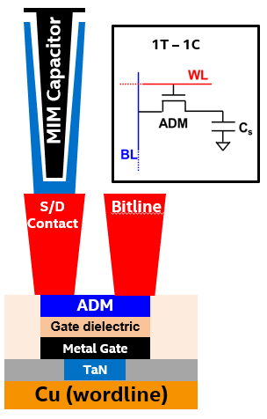
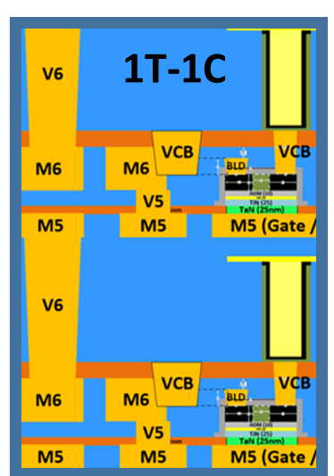
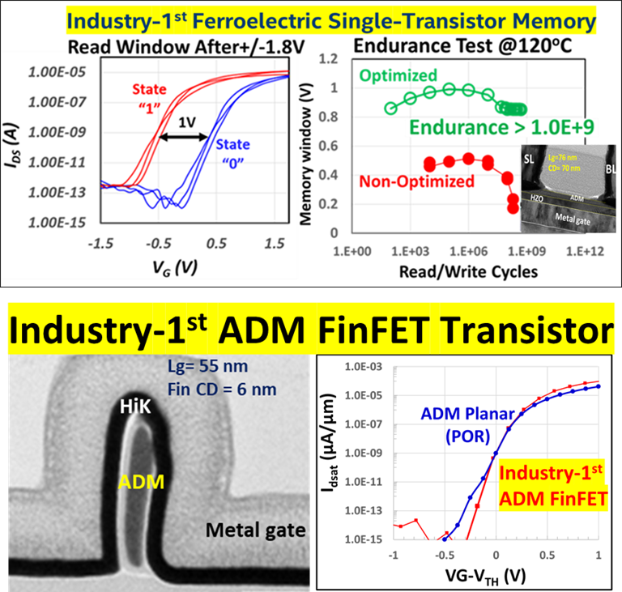
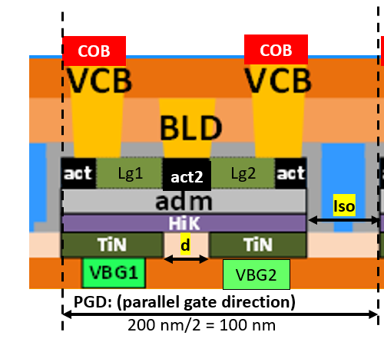
ADM Cell Scaling Options:
Stars are projections, not official TD roadmap
High Bandwidth/capacity 1TB/sec/GB; <20 ns
ADM FinFET (2H)
Capacity (GB/mm ²)
ADM FinFET (2H)
ADM Gen4
Topology?
ADM
‘Simplest’ FinFET 107 X 75 nm (2H)
ADM Gen 3
120x90nm (2H)
ADM 6F2: 95 x 85nm (2H)
ADM Gen 1
108x135 (1H)
ADM Gen 2
108X135nm (2H)
Production Year

Slide 3
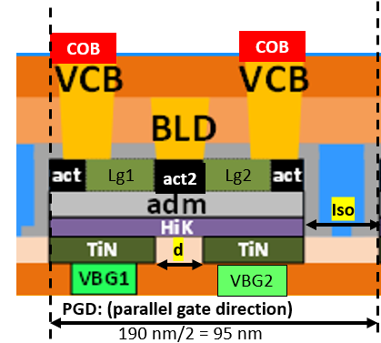
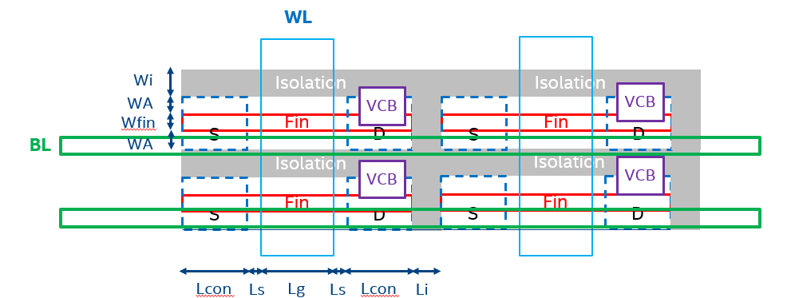
Memory PF team to validate Gen4 topology : 6F2 BG or Top gate FinFET?
6F2 Backgate (95x85nm2)
Simple FinFET Layout (107x75nm2)
No shared contacts, no angling required
Gen
Assumptions: (OGD = 110 nm)
Lcon=26.5 nm
Lg= 30 nm
Ls= 6 nm
Li = 15 nm
Wfin=10 nm
FinFET- validate scalability of Lcon, Lg with BEOL stability; reliability.
Use: 1X35SA mask
Need to validate 6F2 (120x90nm) with shared contacts.
Use: Gen3 X22GR RECL w/ADG mask

Slide 4
Backup slides

Slide 5
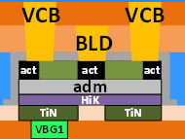
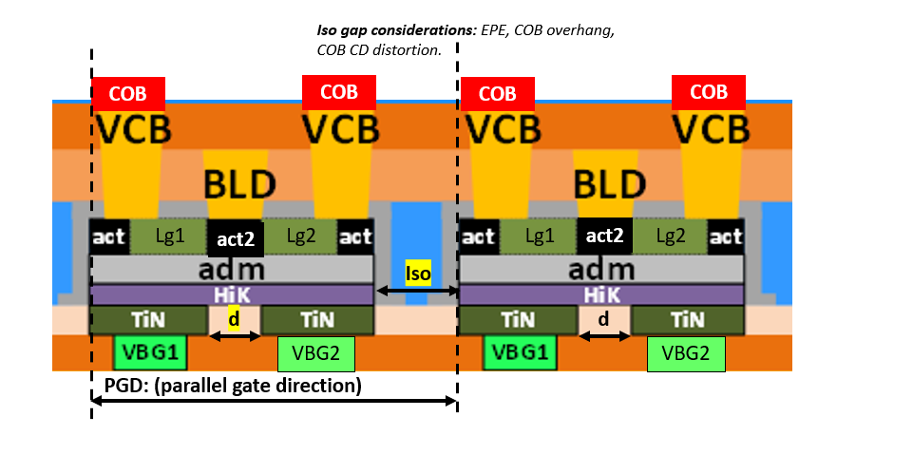
6F2 Backgate Cell Topology
Assume 95x85nm2
Iso gap considerations: EPE, COB overhang, COB profile
Risk items:
Shared drain- Ioff leakage issues? Need to simulate
Rext due to underlap contact to back gate (region d)
Need to see if enough drive current if we scale down to Z= 70 nm (15 nm space, total 85 nm= OGD)
Need to calculate if COB dimensions are good for acceptable sense margin
Smaller Lg- is Ion/Ioff on target still?
COB
COB
COB
COB
Lg1
act2
Lg2
Lg1
act2
Lg2
Iso
d
d
d
d
VBG2
VBG2
PGD: (parallel gate direction)
190 nm/2 = 95 nm
6F2 cell @ 95 (PGD) X 85 (OGD) nm2: (assumptions)
Lg1=Lg2=30 nm (shrink Lg from 40 (Gen1,2) to 30 nm)
act=act2=d=26.5 nm
COB (80x70xZ nm3)-assume Double wall capacitor
Iso= 50 nm (EPE= 10-15 nm, COB overhang=25 nm, 10 nm space)
act patterned separately from act2 (extra mask)

Slide 6
Transistor ‘Design Rules’ (≤ 90x90 nm² cell)
Parameters | 8F2 | 8F2 | 6F2 | 6F2
Cell Sizes (nm2) | 135X108 | 120x90 | 95x85 | 80X70
Lg (nm) | 40 | 35 | 30 | 22.5
Act (nm) | 27.5 | 25 | 26.5 | 22.5
Act2 (nm) | 0 | 0 | 26.5 | 22.5
Iso (nm) | 40 | 35 | 50 | 45
d (nm) | 0 | 0 | 26.5 | 22.5
Act (nm) | 27.5 | 25 | 26.5 | 22.5
PGD direction (nm) | 135 | 120 | 93 | 78.75
OGD (nm) | 108 | 90 | 85 | 70
Z (nm) | 73 | 73 | 70 | 55
COB (top dim)-nm | 89x65x500 | 75x65x500 | 80x70xZ | 65x58xZ
scaling factor | 1 | 1.35 | 1.805572755 | 2.603571429
Notes:
6F2 is a back-gate topology with shared drain to enable further back-gate scaling but needs to be validated
Initial design parameters in table are based on integration but need device simulations to understand the performance tradeoffs
Sensitivity of design parameters→ Lg and Lcon tradeoff (impacts Ioff and Ion), and iso values impact density/yield, d-parameter is going to be set by litho (will need 2 litho passes)
6F2 is introducing at least 3 more masks (2x cut gate; and 1x act2)
Scaling 6F2 cell to 80x70 nm2 is high performance risk

Slide 7
Parameters | 8F2 (Gen1) | 8F2 | 8F2 | 8F2 | 6F2 | 6F2
Cell Sizes | 135X108 | 120x90 | 95x85 | 95x85 | 95x85 | 80X70
Lg | 40 | 35 | 26 | 20 | 30 | 24
act | 27.5 | 25 | 22 | 20 | 26.5 | 22.5
act2 | 0 | 0 | 0 | 0 | 26.5 | 22.5
iso | 40 | 35 | 25 (EPE risk) | 35 (at EPE margin) | 50 | 45
d | 0 | 0 | 0 | 0 | 26.5 | 22.5
act | 27.5 | 25 | 22 | 20 | 26.5 | 22.5
PGD direction | 135 | 120 | 95 | 95 | 94.75 | 80.25
OGD | 108 | 90 | 85 | 85 | 85 | 70
Z | 73 | 73 | 70 | 70 | 70 | 55
COB (top dim) | 89x65x500 | 75x65x500 | 75x65x500 | 75x65x500 | 75x65x500 | 65x55x680
scaling factor | 1 | 1.35 | 1.3374613 | 1.3374613 | 1.3374613 | 1.441964286
scaling wrt to Gen1 | NA | 1.35 | 1.805572755 | 1.805572755 | 1.805572755 | 2.603571429
Backgate (no sharing) 8F2 at 95x85 nm2 is at risk for electrostatics and Ion not meeting target-would like to see calibrated simulations based on R96 (on TD’s line)
Sharing contacts at 95x85 nm2 (6F2) enables 50% longer Lg; 33% longer Lcon compared to 8F2 @ 95x85 nm2 but WL pitch is tighter!
Need to evaluate angling with shared contacts to see ROI of 6F2 cell. Currently 80x70 nm2 @6F2 manhattan is risky for not meeting total drive current

Slide 8
BL
BL
8F2 Top Down View: (95x85 nm2)
WL
WL
WL
WL
BLD
BLD
BLD
BLD
COB
COB
COB
COB
BL
OGD
BLD
BLD
BLD
BLD
BL pitch=85 nm
COB
COB
COB
COB
BL
Unit cell
PGD
WL pitch=95 nm

Slide 9
BL
BL
6F2 Top Down View: 95x85 nm2)
WL
WL
Dummy WL
WL
WL
BLD
BLD
COB
COB
COB
COB
BL
BL pitch = 85 nm
OGD
BLD
COB
COB
COB
COB
BL
Unit cell
PGD: (parallel gate direction)
WL pitch =26.5 nm + 30 nm=56.5 nm

Slide 10
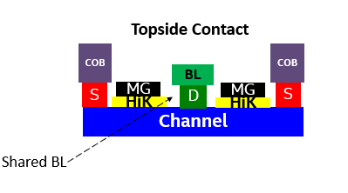
Simplest FinFET-1st Gen FinFET
3) S/D engineering
Metals
doping
stability
2) Top gate
Gate oxide
Metal gate (ALD)
ADM
1) ALD spacer fin profile
Simplest FinFET focus on topology ONLY
No shared contacts, no angling and no backside contacts FinFET
@ 107x75 nm2 (meets Gen4 scaling target)

Slide 11
Simplest FinFET Layout
Simplest FinFET focus on topology ONLY. No shared contacts, no angling and no backside contacts
Cell Design considers BL, VCB, WL placement +EPE
WL
TOP-DOWN VIEW
Wi
Isolation
Isolation
WA
VCB
VCB
Risk Items:
Top gate reliability unknown
S
D
S
D
Wfin
Fin
Fin
BL
WA
Isolation
Isolation
VCB
VCB
S
D
S
D
Fin
Fin
Lcon
Ls
Lg
Ls
Lcon
Li
Assumptions: (OGD = 107 nm)
Lcon=25 nm
Lg= 30 nm
Ls= 6 nm
Li = 15 nm
Assumptions: (PGD = 75 nm)
Wi= 15 nm
2*WA= 20 nm
Wfin= 10 nm
+ 30 nm BL/VCB shorting margin (due to all topside routing)
Cell length = 2*Lcon + 2*Ls + Lg + Li
Cell width = Wi + 2*WA + Wfin
OGD= cell length direction
PGD = cell width direction

