Slide 1
ADM Scaling Roadmap
Enabler for Scaling
PDK0.1
Prod A-0 TI
Prod PRQ
Gen1 eDRAM (1st ADM)
Dev on Test Chip
Dev on Prod
Production
PDK0.1
Prod A-0 TI
Prod PRQ
Gen2 eDRAM (Stacked ADM)
Dev on Test Chip
Dev on Prod
Production
Stacking 2 ADM layers
FL option masks for X22S taped in
PDK0.1
Prod A-0 TI
Prod PRQ
Gen3 eDRAM (In Development)
Def. + SL TC
Dev on Test Chip
Dev on Prod
Production
Lateral Scaling
RECL test chip taped in
PDK0.1
Decide on Topology
Prod A-0 TI
Prod PRQ
Gen4 eDRAM (12-18m cadence)
Use Hacked X22G Process
Dev on Test Chip
Dev on Prod
Production
Lateral Scaling /
New ADM topology?
Need to have Si validation of right topology for Gen4
Note this is extended for new topology
2019
2020
2021
2022
2023
2024
2025
2026
2027
Definition for each generation will be re-evaluated / closed for PDK0.1
Courtesy: PTD/Travis L.

Slide 2
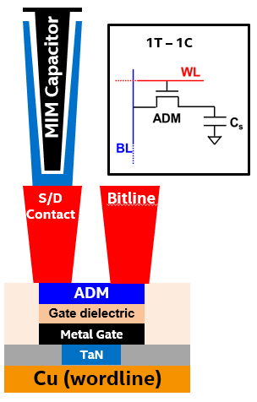
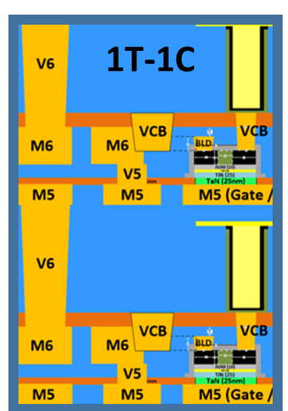
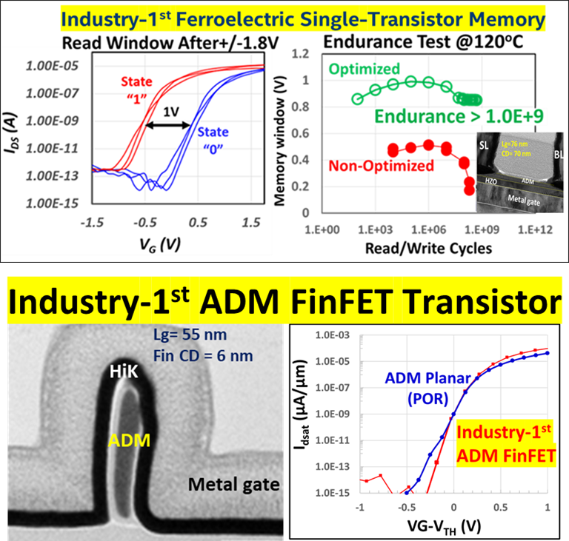
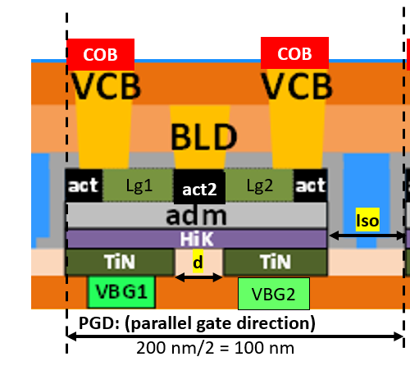
ADM Cell Scaling Options:
Stars are projections, not official TD roadmap
High Bandwidth/capacity 1TB/sec/GB; <20 ns
ADM FinFET (2H)
Capacity (GB/mm ²)
ADM FinFET (2H)
ADM
ADM Gen4
‘Simplest’ FinFET 107 X 75 nm (2H)
ADM Gen 3
120x90nm (2H)
ADM 6F2: 95 x 85nm (2H)
ADM Gen 1
108x135 (1H)
ADM Gen 2
108X135nm (2H)
Production Year

Slide 3
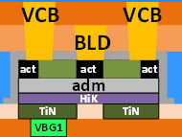
6F2 Backgate Cell Topology
Assume 95x85nm2
Iso gap considerations: EPE, COB overhang, COB CD distortion.
Risk items:
Shared drain- Ioff leakage issues? Need to simulate
Rext due to underlap contact to back gate (region d)
Need to see if enough drive current if we scale down to Z= 70 nm (15 nm space, total 85 nm= OGD)
Need to calculate if COB dimensions are good for acceptable sense margin
Smaller Lg- is Ion/Ioff on target still?
COB
COB
COB
COB
Lg1
act2
Lg2
Lg1
act2
Lg2
Iso
d
d
VBG2
VBG2
PGD: (parallel gate direction)
190 nm/2 = 95 nm
6F2 cell @ 95 (PGD) X 85 (OGD) nm2: (assumptions)
Lg1=Lg2=30 nm (shrink Lg from 40 (Gen1,2) to 30 nm)
act=act2=d=26.5 nm (matched to Gen1,2)
COB (80x70xZ nm3) w/ 5 nm CD distortion
Iso= 50 nm (EPE= 10 nm, COB overhang=25 nm, 5 nm CD distortion + 10 nm space)
act patterned separately from act2 (extra mask)

Slide 4
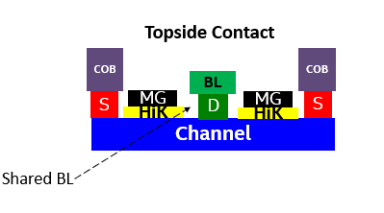
Simplest FinFET-1st Gen FinFET
3) S/D engineering
Metals
doping
stability
2) Top gate
Gate oxide
Metal gate (ALD)
ADM
1) ALD spacer fin profile
Simplest FinFET focus on topology ONLY
No shared contacts, no angling and no backside contacts

Slide 5
Simplest FinFET Layout
Simplest FinFET focus on topology ONLY. No shared contacts, no angling and no backside contacts
Cell Design considers BL, VCB, WL placement +EPE
BL pitch is the tighter direction; ideally want square unit cell for design
WL
TOP-DOWN VIEW
Wi
Isolation
Isolation
WA
VCB
VCB
Risk Items:
Top gate reliability unknown
S
D
S
D
Wfin
Fin
Fin
BL
WA
Isolation
Isolation
VCB
VCB
S
D
S
D
Fin
Fin
Lcon
Ls
Lg
Ls
Lcon
Li
Assumptions: (OGD = 107 nm)
Lcon=25 nm
Lg= 30 nm
Ls= 6 nm
Li = 15 nm
Assumptions: (PGD = 75 nm)
Wi= 15 nm
2*WA= 20 nm
Wfin= 10 nm
+ 30 nm BL/VCB shorting margin (due to all topside routing)
Cell length = 2*Lcon + 2*Ls + Lg + Li
Cell width = Wi + 2*WA + Wfin
OGD= cell length direction
PGD = cell width direction

Slide 6
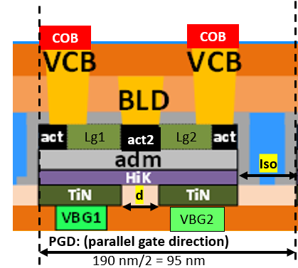
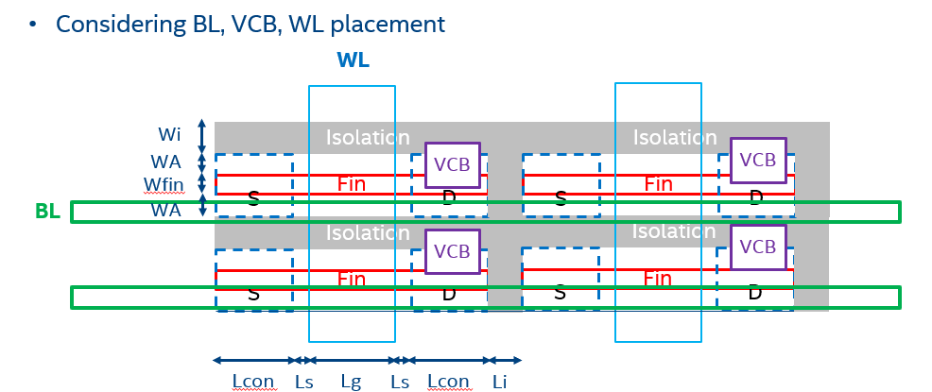
Need experimental validation of Gen4 topology : 6F2 BG or Top gate FinFET?
6F2 Backgate
Simple FinFET Layout
Gen
Assumptions: (OGD = 110 nm)
Lcon=26.5 nm
Lg= 30 nm
Ls= 6 nm
Li = 15 nm
Wfin=10 nm
FinFET- need to show scalability of Lcon, Lg with BEOL stability; reliability—1X35SA mask
6F2 (120x90nm) need to be NPI on Gen3 RECL w/ADG mask—X22GR mask

Slide 7
Decision Tree with Metrics To be constructed later…..

Slide 8
Backup/Extra

Slide 9
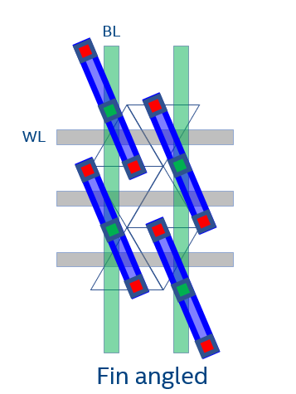
Design Options for FinFETs & Tradeoffs
Features | Most innovative | Topside contacts
Angled Fin | Yes | Yes
Shared BLC | Yes | Yes
B/S contact | Yes | No
Lg @90x60 nm² | 56 | 48
Lg @50x50 nm² | 30 | 22
B/S contact enables scaling below 50x50nm²
Lg and Lcon can be traded with each other to meet target
L con= 15 nm; Rc= 1e-7 Ω-cm²
Most innovative
Topside Contact
COB
COB
COB
COB
BL
S
MG
MG
S
S
MG
D
MG
S
HiK
HiK
HiK
HiK
Channel
Channel
D
Angled Fins
Backside contacts
BL
Shared BL

Slide 10
Features for ADM FinFET on RECL 2021 NPI
Features | CR 1X35QA (2020) | 85x85 nm2 Mask-(2021)
Angled Fin | no | Yes
Shared BLC | yes | Yes
Backside contacts | no | Yes
Fin CD (nm) | 10 | 10
Fin height (nm) | 60 | 60
Fin length (nm) | 70 | 55
Contact-Lcon (nm) | 30 | 20-30*
Lg (nm) | 56 | 43-53*
Mini array | no | Yes (1024x1024 bits)
Disturb structures | No | yes
COB
COB
S
MG
MG
S
HiK
HiK
Channel
D
BL
Shared Backside contact
Test vehicle (@ 85x85 nm2) is a good proxy for 90x60 nm2 target
4 new masks NPI starts Q2 2021 with support of TD litho
Demonstrate ADM finfet (85x85 nm2) devices (>99.7%) at product dimensions passing BEOL stability & reliability
*skew to understand sensitivities to e-test

Slide 11
Different Product Segments & Requirements
Client-1TB/sec and 4GB-L4 cache (0.5TB/sec, small form factor, 1GB), DRAMless (200GB/sec, 4-8GB)
Server-low latency (<25ns), 4-8 GB, diamond rapids, trc=?
GFXs: 2-4TB/s with 1 GB, BW/watt (total banks/trc), trc<20ns
AI accelerators: 8-32 GB, 16TB/sec (<2pJ/bit—controller, memory stack to I/O)
Memory bit cell technology that has the following properties
Density >= 4X SRAM in leading node
Power < 2pJ/b for 1GB (not yet for ADM)
Cost < $10/GB (not yet for ADM)
cycle time 10ns (yes for ADM)
endurance 1E14 (not yet for ADM)
retention time > 1ms at 85C (not yet for ADM)
standby power of 20mW for 1GB (not yet for ADM)

