Slide 1
FTE Pathfinding Meeting (WW12)
DCAI/DPEA/MIO
Tomi

Slide 2
Outline
JEDEC Memory Summary
DDRx
HBMx
AI-PC

Slide 3
Outline
JEDEC Memory Summary
DDRx
HBMx
AI-PC

Slide 4
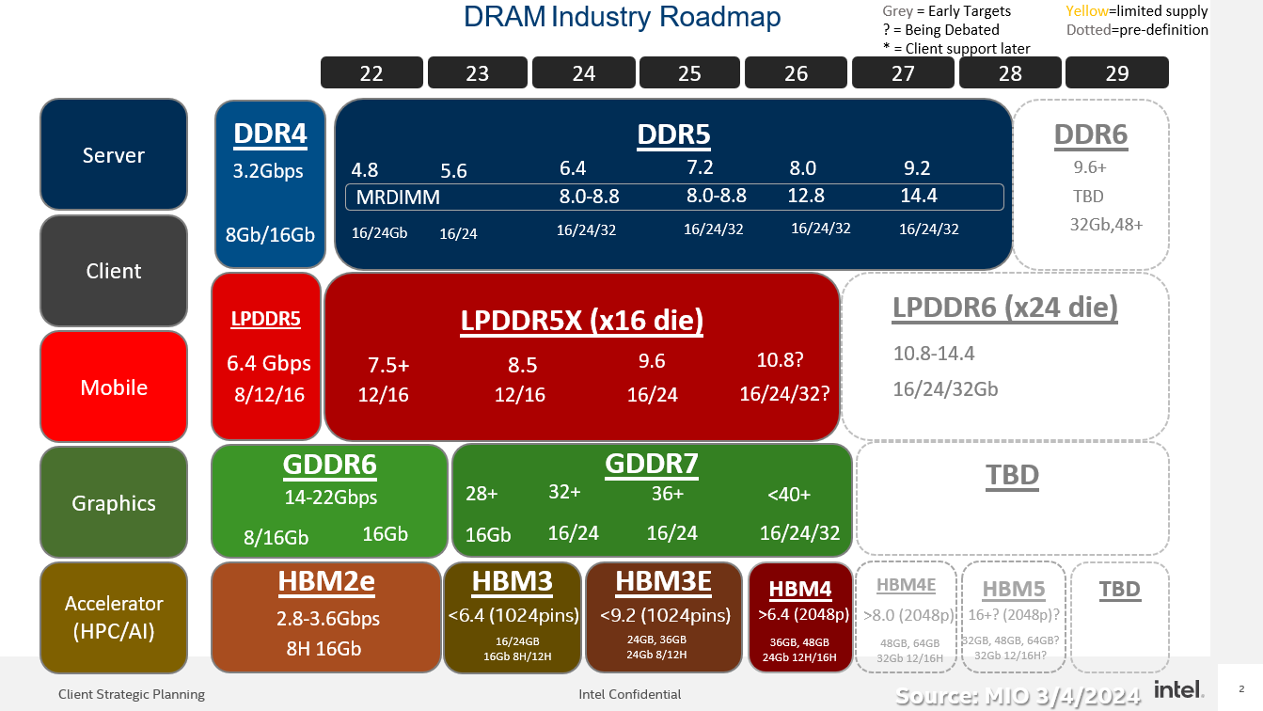

Slide 5
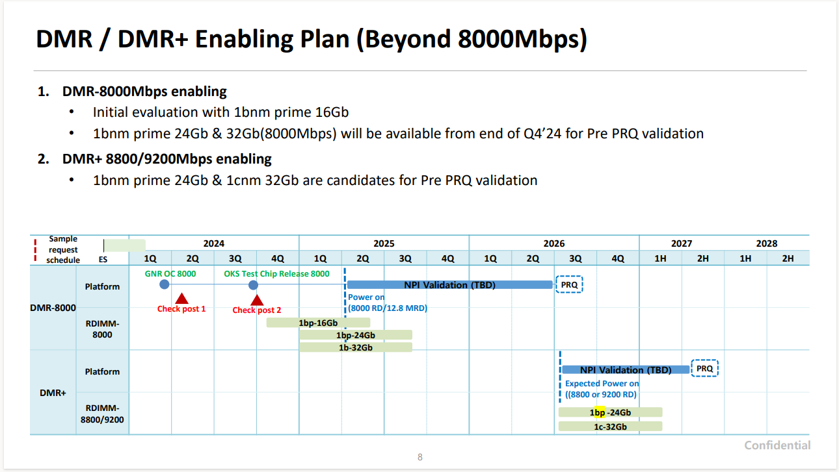

Slide 6
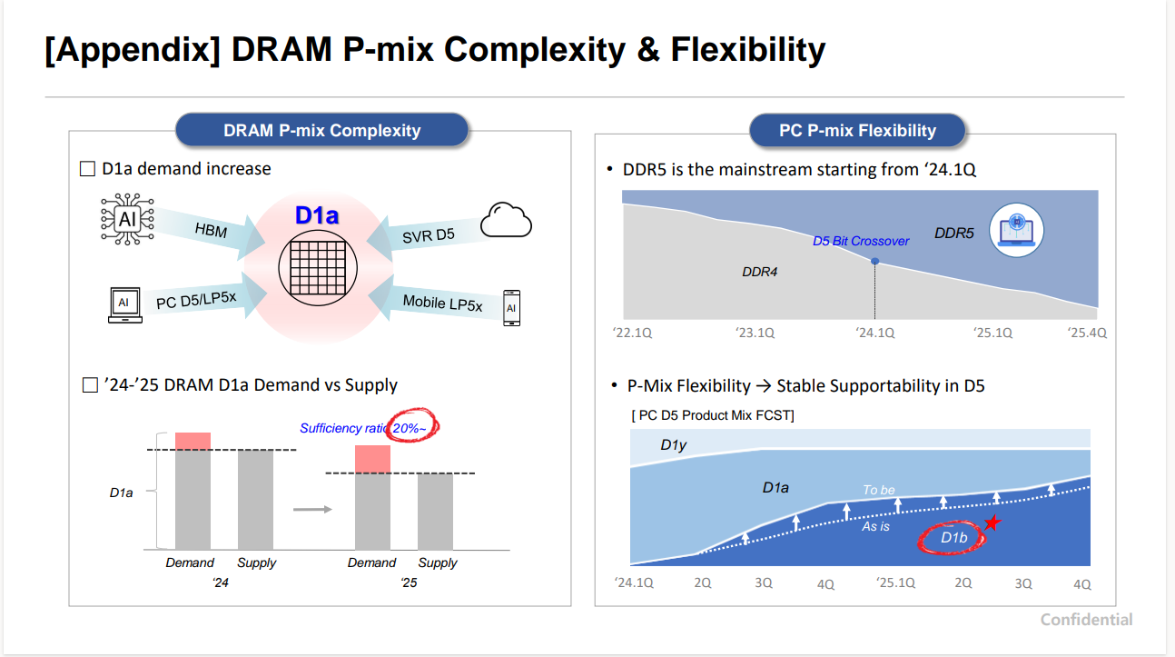

Slide 7
Outline
JEDEC Memory Summary
DDRx
HBMx
AI-PC

Slide 8
DDRx Summary
DDR5:
Speed Bin was extended to 9200.
RFMs, PRAC (only Micron) were introduced.
Modules are expanding to MR-DIMM, Tall DIMM etc.
JEDEC Standardization is almost closed.
DDR6:
Stepped into Big Discussion for Intel’s Revolutionary Proposal.
Still before Rev. 0.3
Industry started worrying about Schedule Delay.

Slide 9
Intel’s DDR6 Architecture Proposal
Package(s)
DDR5 DIMM(s)
LP5 Die
LP5 Die
LP5 Die
LP5 Die
Host
…
Host
LPDDR5:
Narrow & efficient sub-channels
1x Cache line from 1x device
Low power optimized
Short trace length
Basic RAS capability
DDR5:
Field replaceable modules
1x Cache line from many devices
Dense server optimized
Long trace length
SDDC capability
DDR6:
Power efficient architecture
Flexible RAS modes for High BW and High RAS
Server optimized

Slide 10
DDR6 Ecosystem Enablement
Intel’s Projection – Subject to change
2024
2025
2026
2027
2028
Q1
Q2
Q3
Q4
Q1
Q2
Q3
Q4
Q1
Q2
Q3
Q4
Q1
Q2
Q3
Q4
Q1
Q2
Q3
Q4
DDR6 Architecture Requirements & IO
Commands/Features, Component Definition and Ball-out
Signaling, DIMM Definition, Support Components, Raw Cards
Memory
Spec Dev
Proto Module Development
Early Modules
Initial Modules
Volume Modules
DRAM Spec
Milestones
0.1
0.3
0.5
0.7
0.9
1.x
Focus Areas:
Spec: Internal/vendor-based spec, defined by trend/consensus at TG level, expect JEDEC to lag 1-2 Qtrs
Test Vehicle Definition: A test platform must be provided 2Q before CPU PO to screen volume modules.

Slide 11
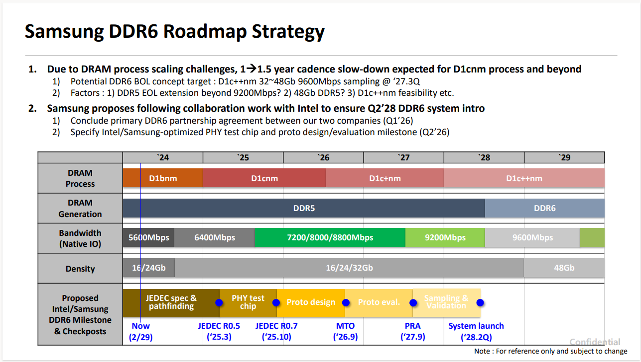

Slide 12
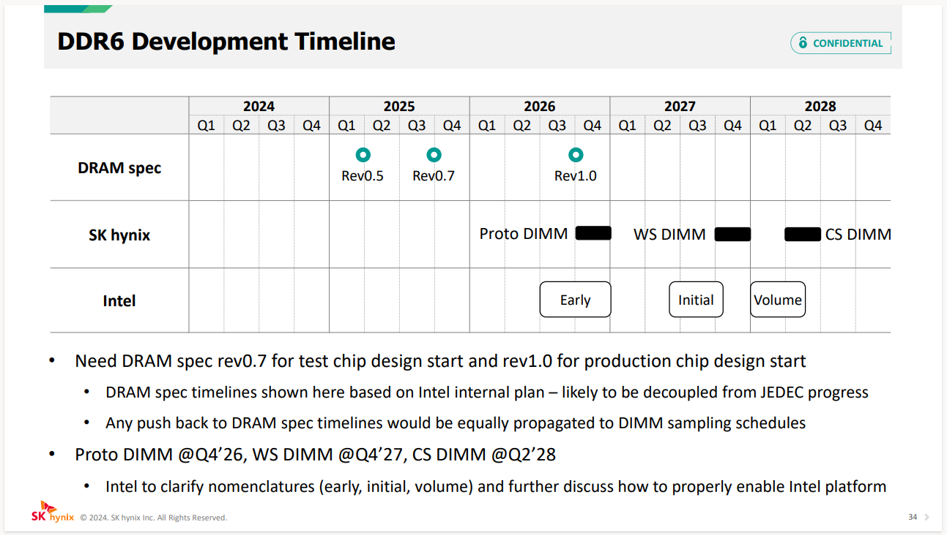

Slide 13
Outline
JEDEC Memory Summary
DDRx
HBMx
AI-PC

Slide 14
HBMx Summary
HBM3/3e:
Micron is aggressive from HBM3e,
Speed Bin extension to 9200 and Lower power.
Other 2 are also chasing Micron.
Speed Extension and Schedule got accelerated.
NVIDIA/AMD are enabling the products with HBM3e.
HBM4:
Mechanical item alignment was finished.
Rev 0.7 JEDEC Spec was released.
Sample Schedule was accelerated to 1H 2025.

Slide 15
HBM product roadmap (MAR. ’24)
HBM3 (16Gb)
HBM4/4K (24Gb)
HBM3e (24Gb)
HBM4/4E (32Gb)
 |  | ~‘23 | 2024 |  |  |  | 2025 |  |  |  | 2026 |  |  |  | 2027
 |  |  | Q1 | Q2 | Q3 | Q4 | Q1 | Q2 | Q3 | Q4 | Q1 | Q2 | Q3 | Q4 | Q1 | Q2 | Q3 | Q4
 | PVC/SPR/FLS1
 | Samsung
 | SKhynix
 | Micron
PVC (HBM2E)
SPRHBM
Gaudi3 (HBM2E)
FLS1 PRQ (HBM3E)
8H 8H 12H
12H 12H 16H
12H 12H
MP
ES
CS
CS
ES
CS
CS
ES
ES
HBM3 EOL ‘26
HBM3E 24Gb/8.0Gbps *2
HBM4 24Gb/<10.0Gbps
HBM4 32Gb/<10.0Gbps
HBM4E 32Gb/<12Gbps
8H 12H 12H
12H 12H 16H
12H
HBM2e/3/3e/4
MP
CS
ES
CS
ES
CS
CS
CS
HBM3 EOL ‘26
HBM3E 24Gb/8.0Gbps *2
HBM4 24Gb/6.4Gbps
HBM4E 32Gb/>8.0Gbps
8H 8H 12H 12H
12H 12H
12H
ES
CS
ES
CS
ES
CS
ES
HBM3E 24Gb/9.2Gbps+ *1
HBM4 24Gb/>6.0Gbps
HBM4K 24Gb/>8.0Gbps
*1. Micron HBM3e 9.2Gbps is POR
*2. Samsung HBM3e stretch goal 9.8Gbps, SKhynix stretch goal >9.0Gbps
HBM product cadence gets accelerating to ~1.5yrs in order to support growing performance demand
HBM3 (1st gen., 16Gb core die, ~6.4Gbps) is in production (Samsung, SKhynix)
HBM3E (2nd gen., 24Gb core die) pulled in and in sampling now (~2Q pull-in)
Speed target trending to go beyond 8.0Gbps, but requires system level collaboration and verify performance
HBM4 schedules pulled in >2-4 quarters to 2H ’25 sampling, plan of HBM4 follow-on vary among suppliers
JEDEC rev0.7 in Q1’24 on track, Targeting 6.0-6.4Gbps with 2K IO at launch
Primary configuration is 12H/24GB. 16H/36GB plan is TBD
Follow-on product plan vary among suppliers and no industry consensus
MTV4 alignment in Q1’24 is on track and ATTD is aligning about MTV4 sample delivery schedule with the vendors.

Slide 16
HBM3/3e/4/4e config/performance targets (Mar. ‘24)
*1 Hybrid bonding transition is uncertain and stay with uBump until truly required
*2 Trying to outpace max speed target with internal logic die
*2 Not proven and strong wish of SI/PI collaboration to achieve
HBM4/4E *1 | HBM4 generations | Speed target | Core die, # of stack | Base die | Sample Schedule | Comment
Samsung | HBM4 1st gen. | <10.0Gbps *2 | 24Gbit, 12H/16H | Samsung Foundry | 2H ’25 | POR
 | HBM4 shrink | <10.0Gbps *2 | 32Gbit, 12H/(16H) | Samsung Foundry | 2H ’26 | In planning
 | HBM4E | <12.0Gbps *2 | 32Gbit, 12H/16H | Samsung Foundry | 1H ’27 | In planning
SKhynix | HBM4 1st gen. | 6.4Gbps | 24Gbit, (8H)/12H/16H | TSMC N12 | end ‘25 | POR
 | HBM4E | >8.0Gbps | 32Gbit, 12H/16H | TSMC ? | 2H ’26 | In planning
Micron | HBM4 1st gen. | >6.0Gbps | 24Gbbit, 12H | DRAM process | 1H ‘25 | POR
 | HBM4K | >8.0Gbps | 24Gbit, 12H | Logic process (Conventional) | 2H ’26 | Same core/new logic die In planning
HBM3/3E | HBM4 generations | POR Speed (Stretch goal or PR) | Core die, # of stack | Base die | Sample Schedule | Comment
Samsung | HBM3 | 6.4Gbps | 16Gbit, 8H/12H | DRAM technology | Now | In production
 | HBM3E | 8.0Gbps POR (~9.8Gbps in PR) | 24Gbit, 8H/12H | DRAM technology | Q1 ‘24 | In sampling MP in 2H ‘24
SKhynix | HBM3 | 6.4Gbps | 16Gbit, 8H/12H | DRAM technology | Now | In production
 | HBM3E | 8.0Gbps POR (>9.0Gbps) | 24Gbit, 8H/12H | DRAM technology | Now | In sampling MP in 2H ‘24
Micron | HBM3E | 9.2Gbps POR/PR | 24Gbit, 8H/12H | DRAM technology | Now | In sampling MP in Q2 ‘24

Slide 17
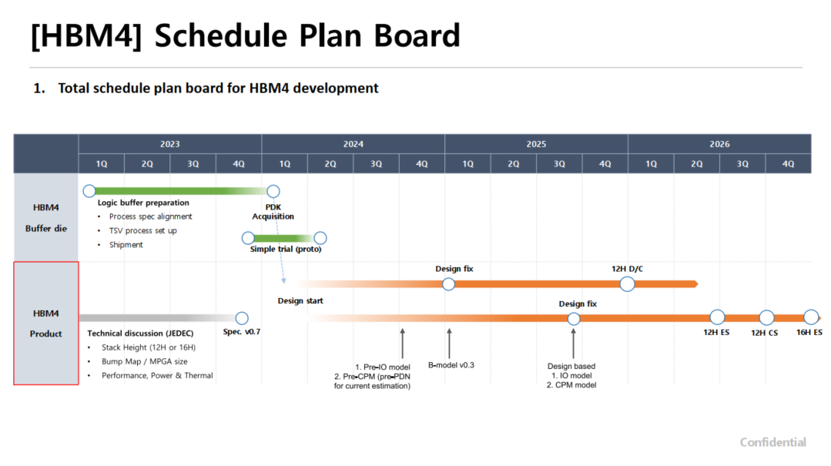
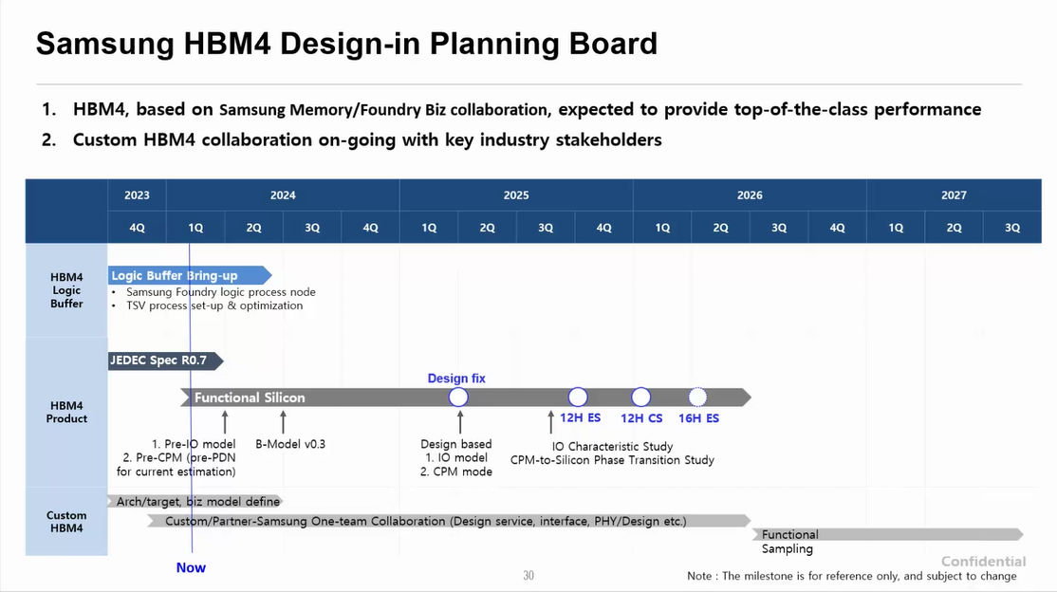
Samsung – Mar. ‘24

Slide 18
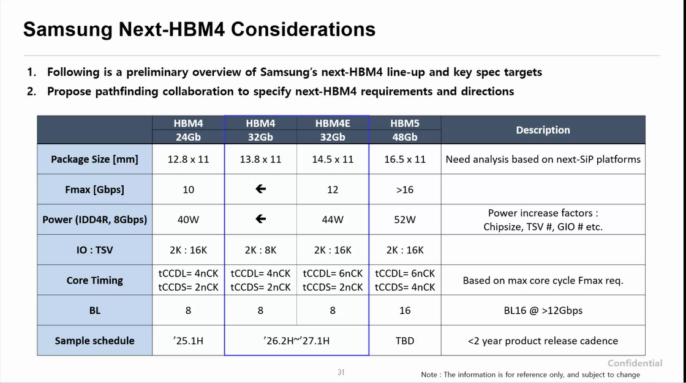
Samsung – Mar. ‘24
* Requires system level collaboration

Slide 19
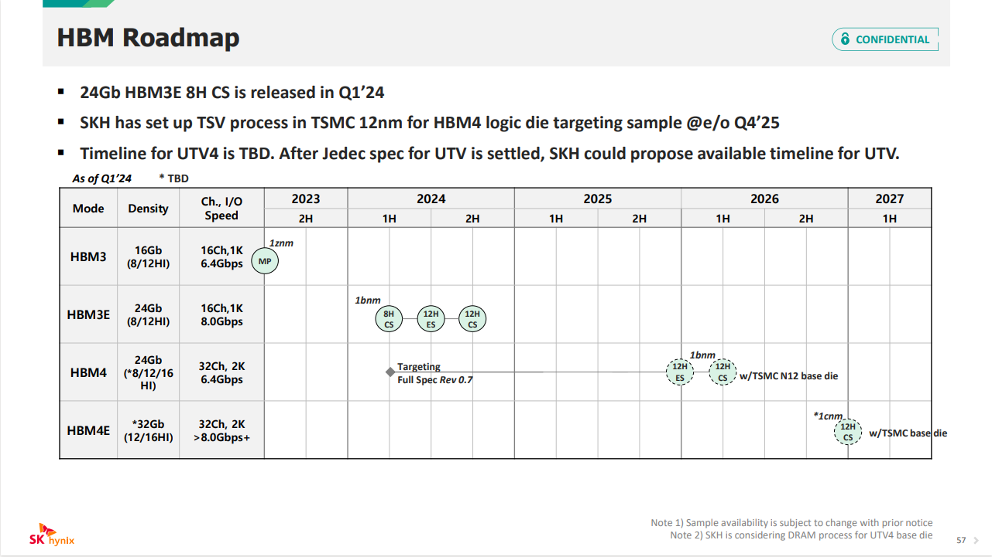
SKhynix – Mar. ’24

Slide 20
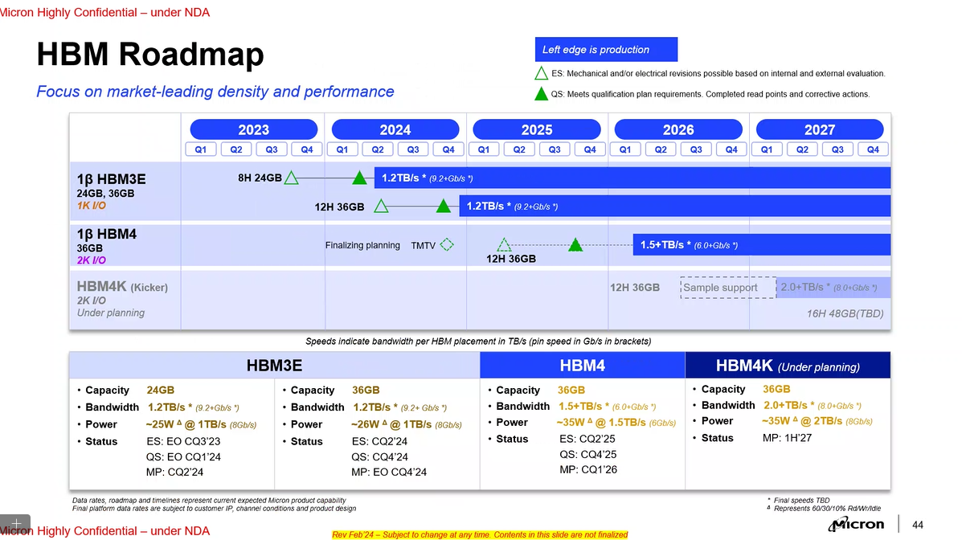
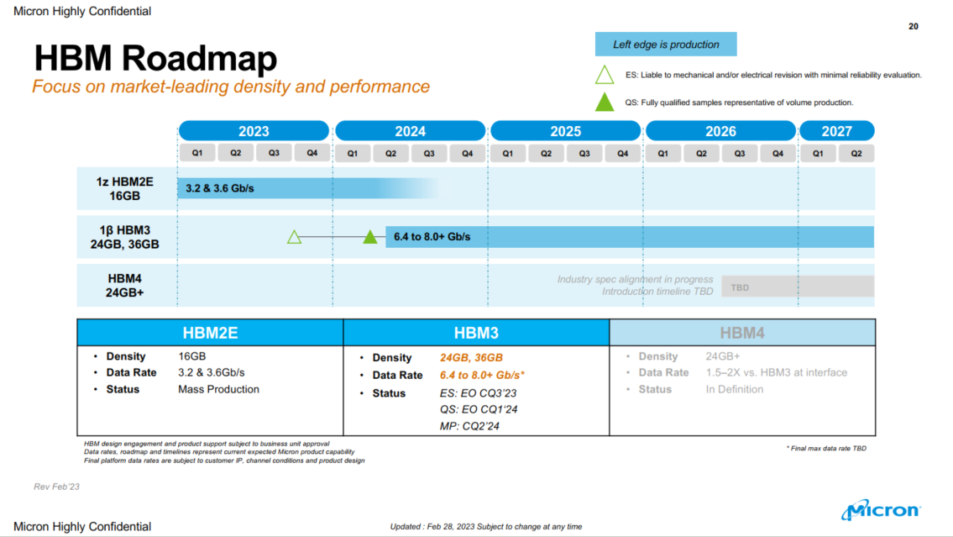
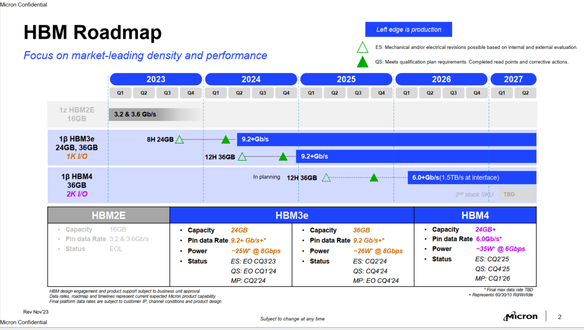
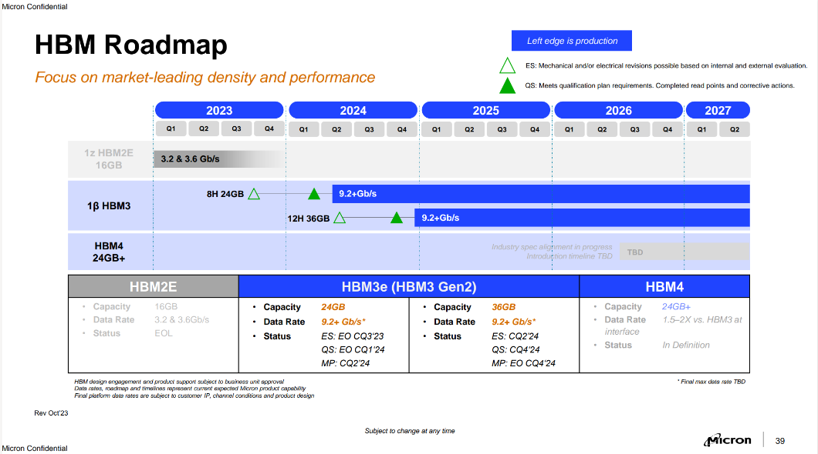
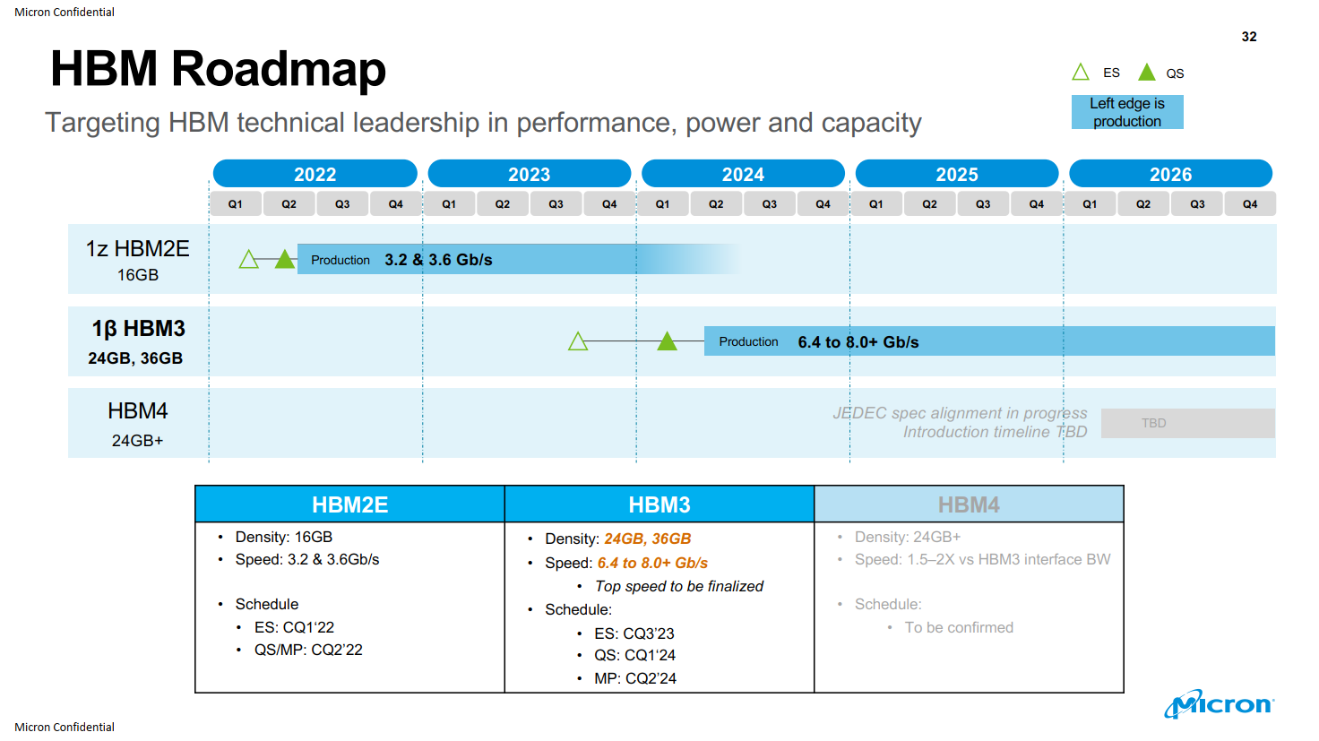
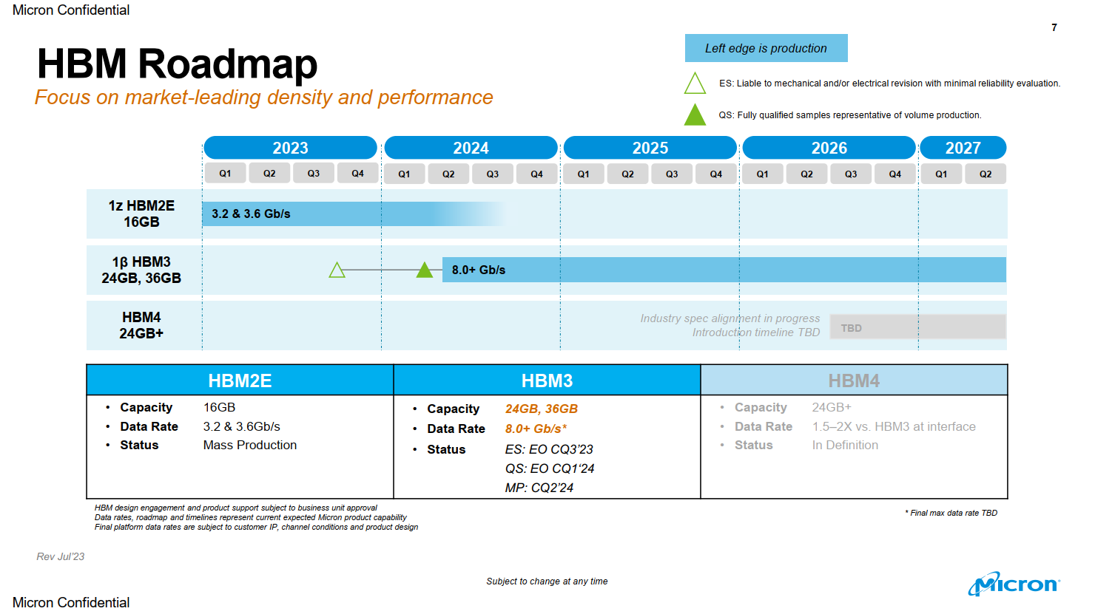
Micron –Feb. ’24
Micron – Oct.’23
ww41’22

Slide 21
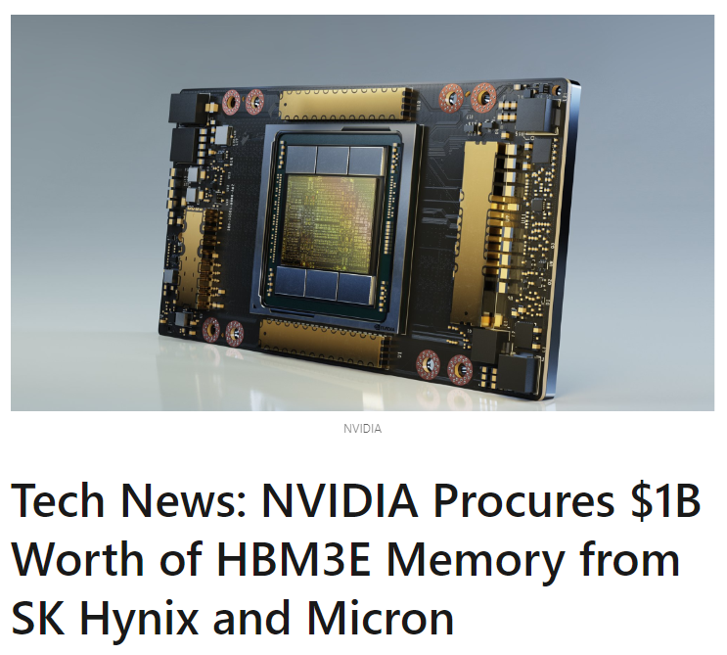
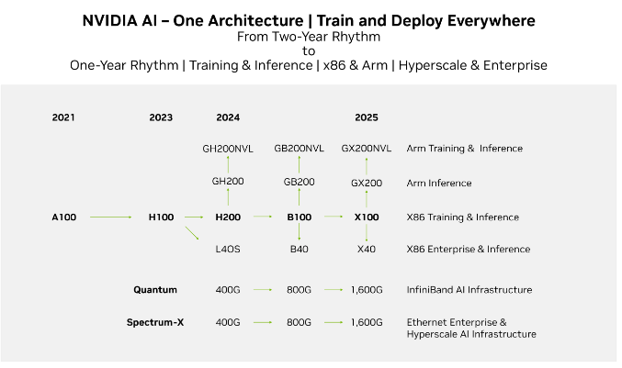
https://www.linkedin.com/pulse/tech-news-nvidia-procures-1b-worth-hbm3e-memory-from-sk-hynix-ufi2c/
https://www.anandtech.com/show/21078/micron-to-ship-hbm3e-to-nvidia-in-early-2024
https://www.trendforce.com/news/2023/12/04/news-sk-hynix-signs-prioritized-supply-agreement-with-nvidia-for-hbm3e-2023-q4-revenue-expected-to-surpass-krw-10-trillion-again/

Slide 22
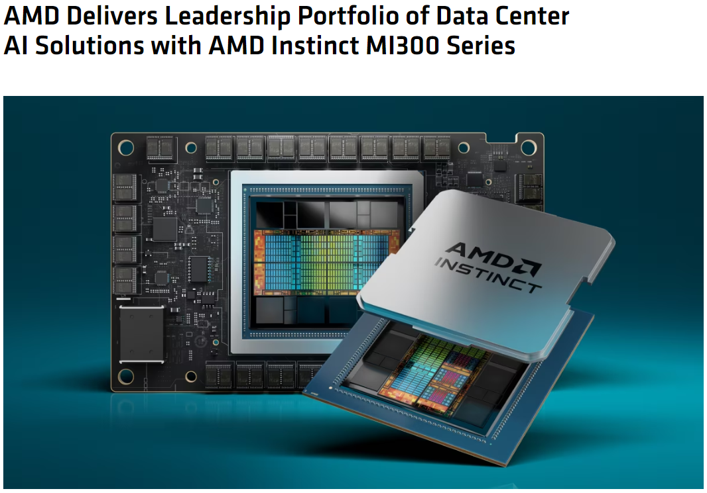
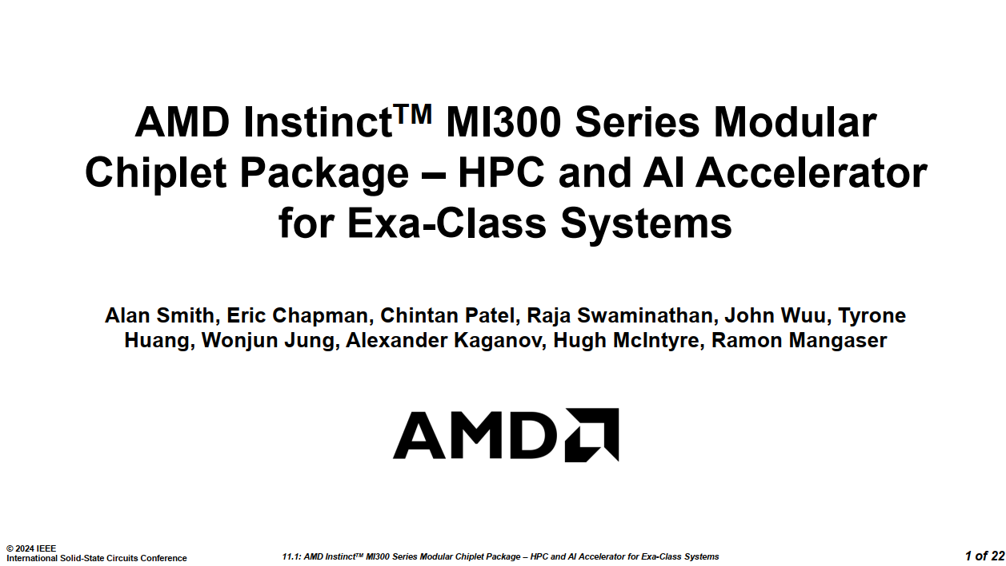
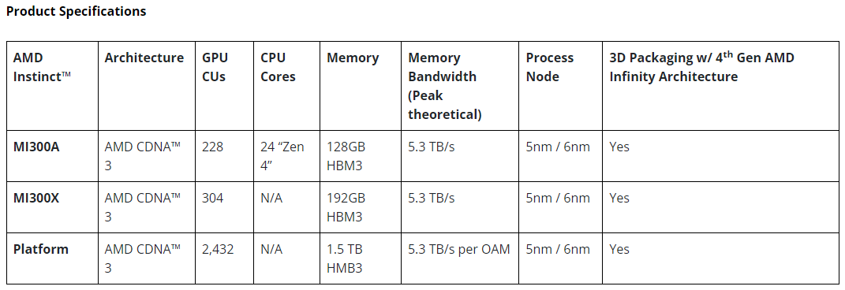
https://www.amd.com/en/newsroom/press-releases/2023-12-6-amd-delivers-leadership-portfolio-of-data-center-a.html

Slide 23
Accelerator Roadmap – Q1 ’24 (Draft-1)
2024
2025
2026
2027+
Dedicated AI
Server GPU
IFS/Custom Comp.
FPGA
HBM
Gaudi®3 (HBM2e)
Falcon Shores 1 (HBM3e)
Falcon Shores2 (HBM4e)
Ponte Vecchio (HBM2e)
IP development (HBM3e)
In planning (HBM3e)
Agilex-7M (HBM2e)
TBD
HBM2e 3.6GT/s, 16GB
HBM3e >8.0Gbps, 24GB
HBM4e >8.0GT/s, >24GB
Dotted line – product before Execution Commit (EC) or in planning
Intel remain committed AI training SKUs with ~2yrs new product cadence
Habana will lead Falcon Shores 1 design/development and work directly with suppliers
Falcon Shores 2 is in planning and targeting 2nd gen. HBM4e. What’ll be target speed and capacity of memory?
Multiple engagements of foundry service with HBM integration are ongoing but not ready to share. IP test chip development ongoing
FPGA continues HBM based products but lags new technology adoption
Intel HBM Engagement/Strategy is totally behind of NVIDIA/AMD.

Slide 24
Outline
JEDEC Memory Summary
DDRx
HBMx
AI-PC

Slide 25
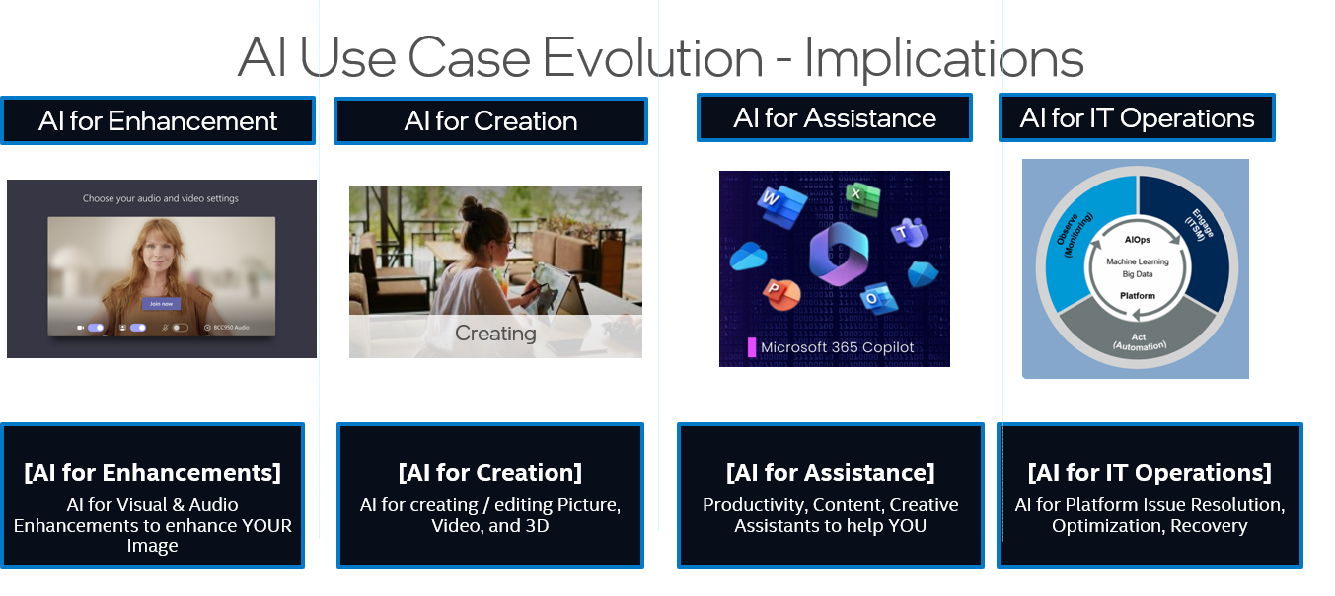
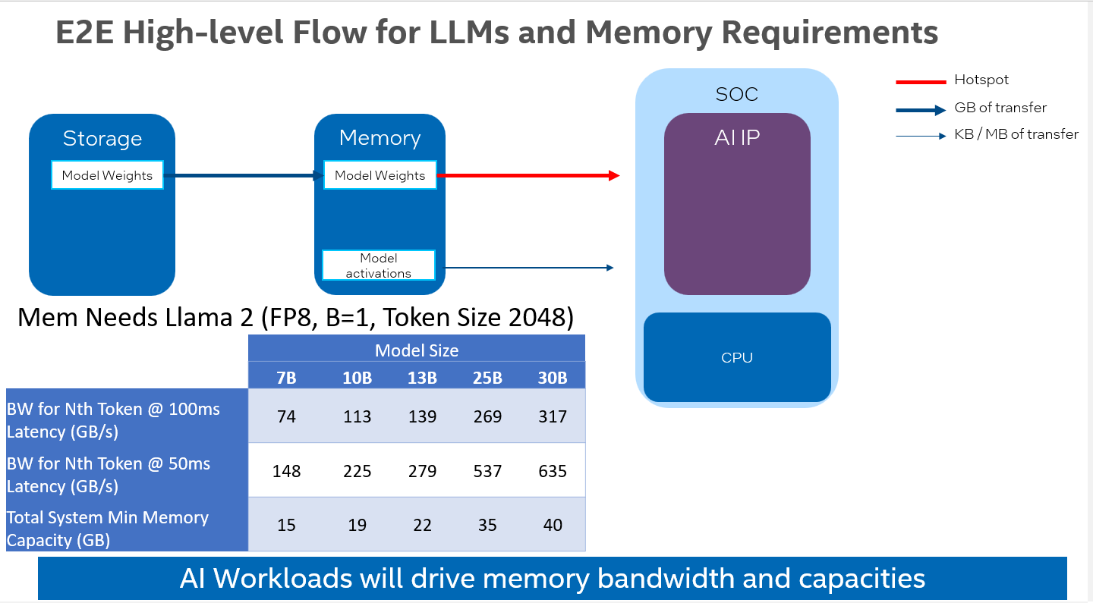
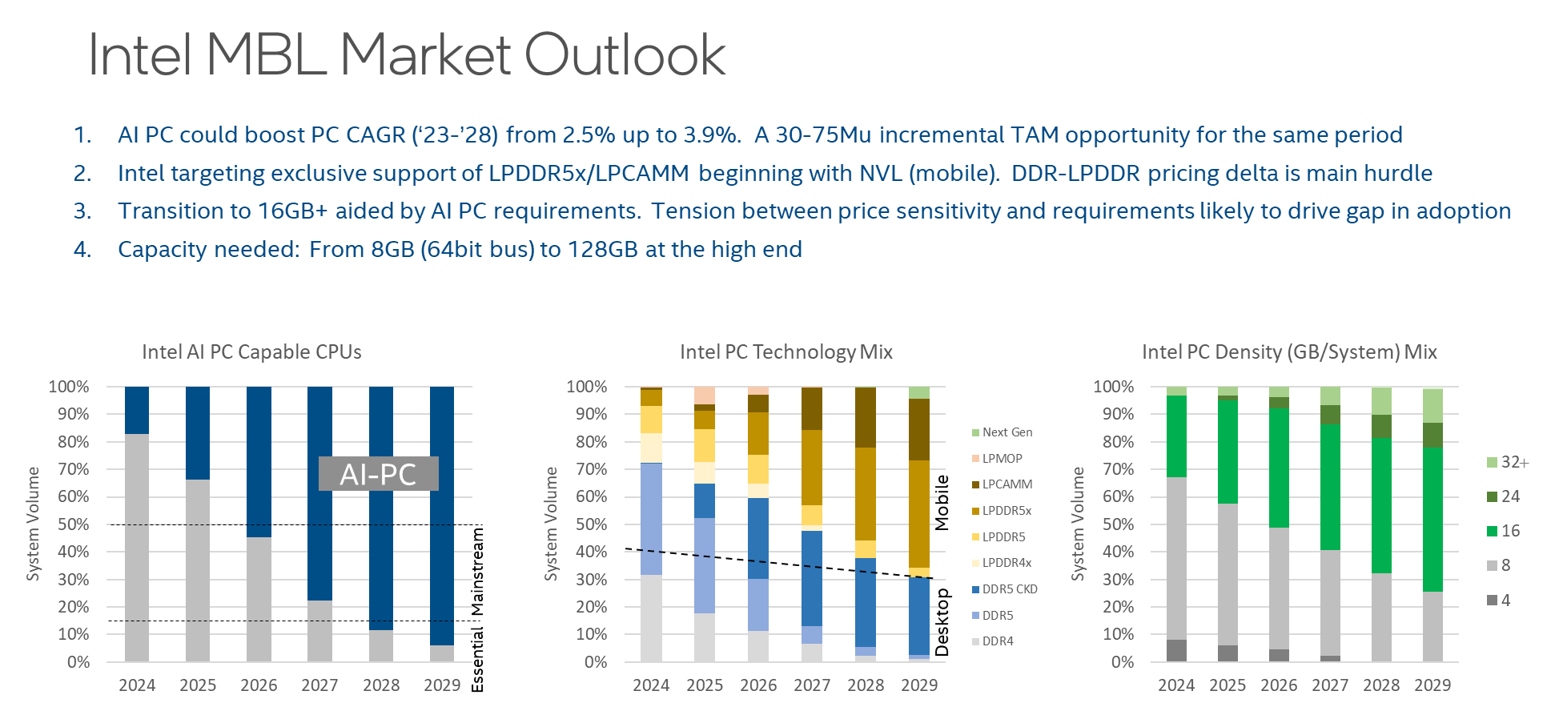
AI PC Brings New Era for Computing & Memory
AI PC: Increased TAM opportunity
Memory Supplier: Increased Value for Bandwidth, Capacity and power efficiency
Segmentation: AI PC goes beyond MSFT and will exhibit price segmentation
AI-PC is a mutually beneficial technology for both Intel/Suppliers

Slide 26
AI-PC
What Intel wants to have:
Larger Memory Capacity,
Higher BW,
But Lower Memory Cost and Lower Power.
What Intel is looking for:
LP or LP-like device with LP-like price on CAMM
Intel Confidential
26

Slide 27
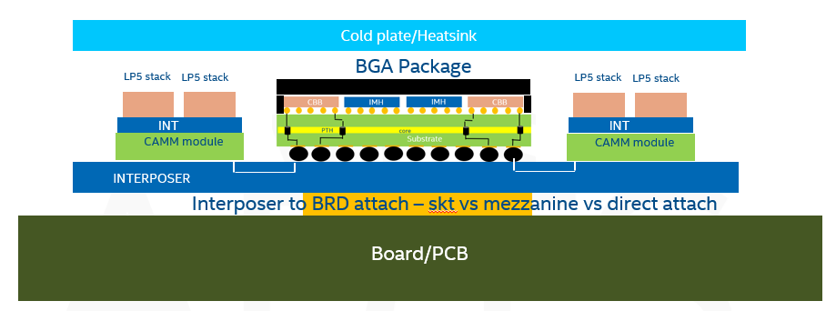
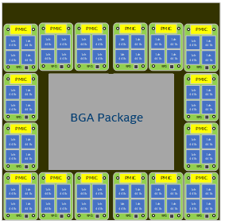
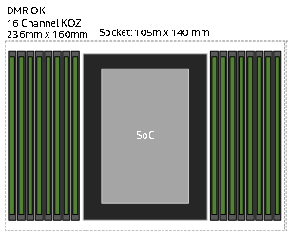
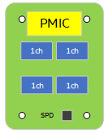
DMR-AI product concept
Leverage OKS platform and replace SKT/DIMMS with LPDDR interposer
Interposer Top view
CPU PWR - ~500W
LP module - ~10W
Compression Attached Memory Module (CAMM)
~200*220mm Interposer
CAMM Modules | 16
LP5/6 Channels | 64
Mem BW | 6.4TB/s
Mem Capacity | 512GB
Replace CPU/SKT/DIMM with LPDDR interposer
Intel Confidential

Slide 28
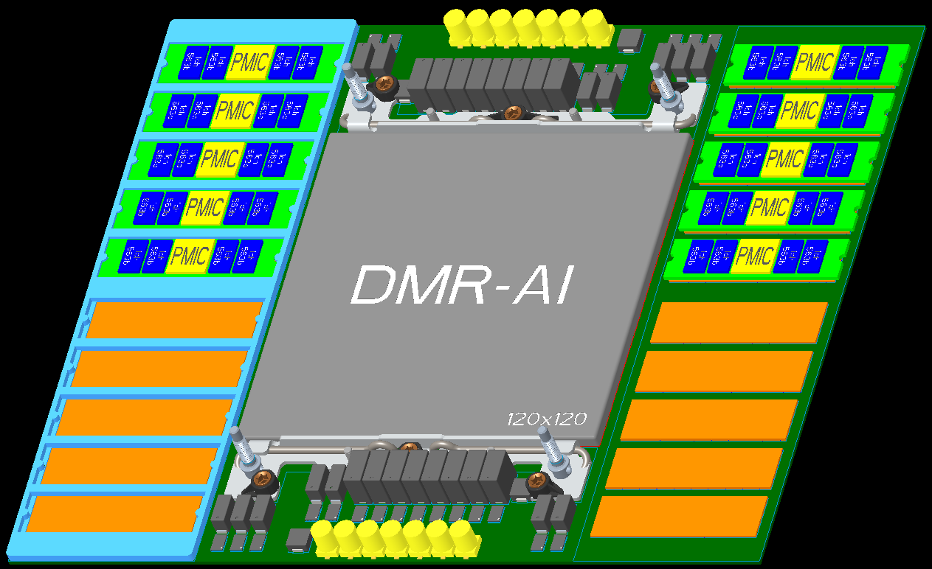
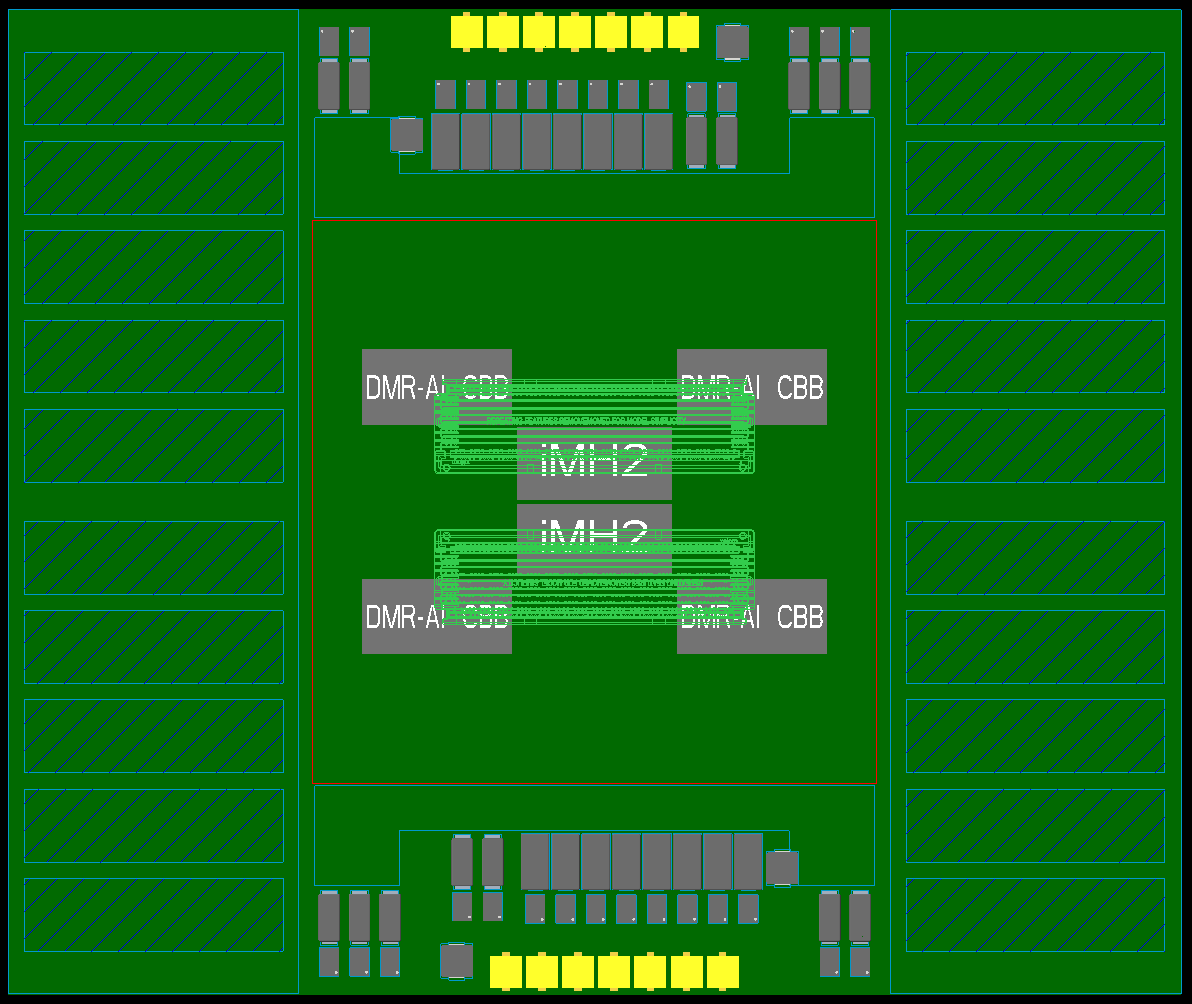
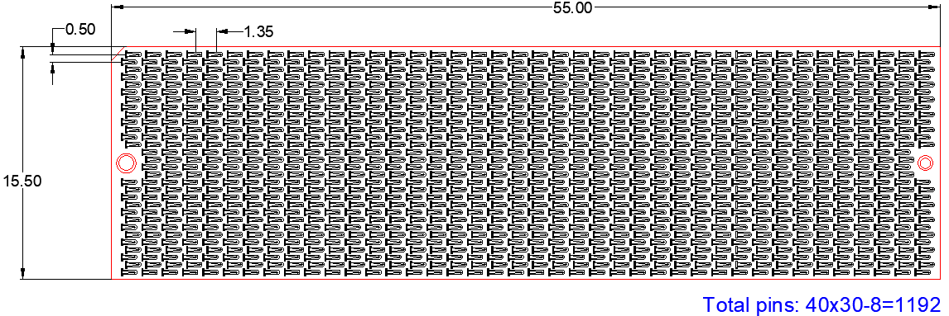
Snapshot of DMR-AI For Additional Context
HS load mechanism
(one side of BHS-SP)
250mm x 210mm
(very tight)
Memory Module 1
~15.5x55+
CAMM1
15.5x55
Memory attach frame
(3.5mm surround)
JC1 VR leveraged
(VCCin ~9mm closer plus BGA vs Skt)

Slide 29
Thank you!

