Slide 1
Terraced Chiplet Cubing in External Tech Pathfinding
Problem Statements, Model of Gap and Value Proposition
SoA Solutions & Research Publication
Researches, ideas and disclosure
(Beyond)
PoC Planning (WiP)

Slide 2
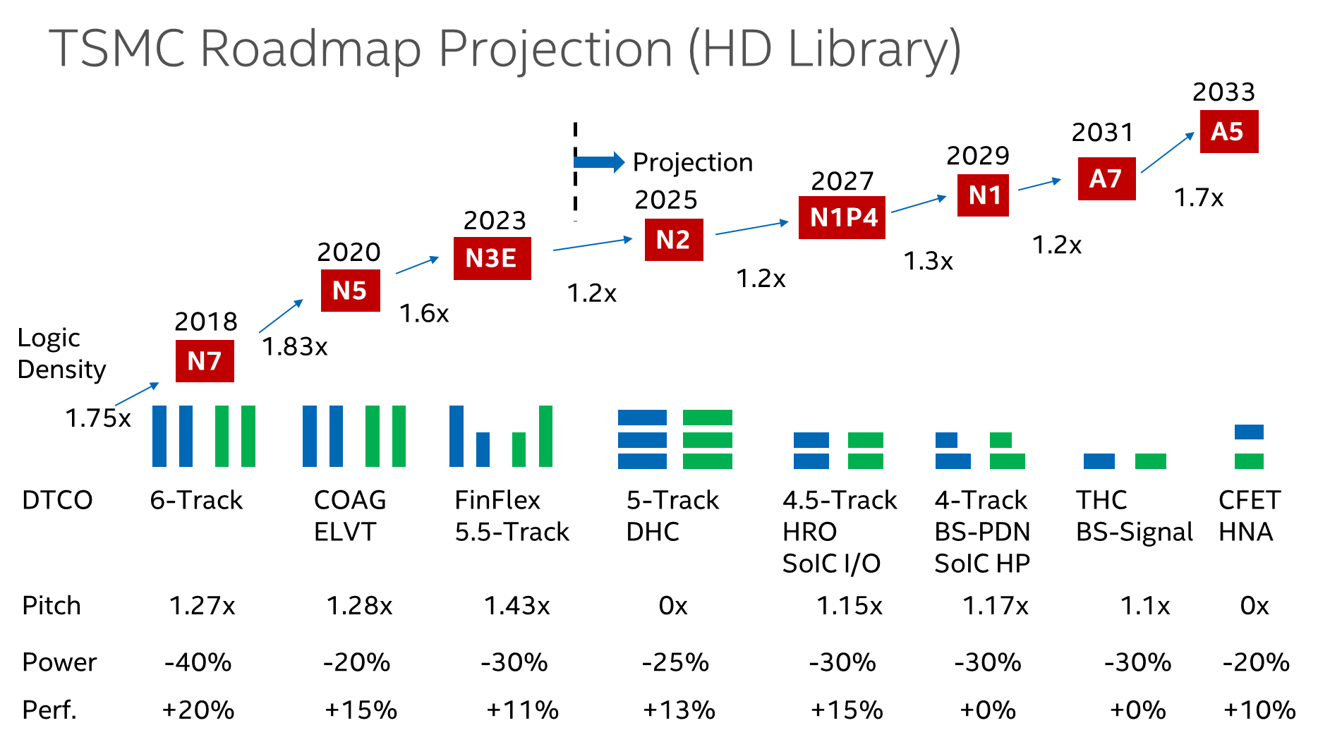
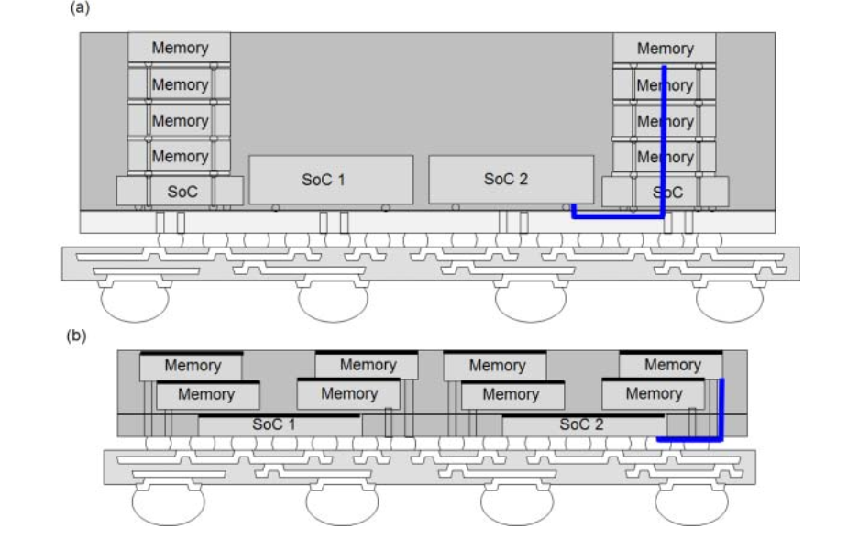
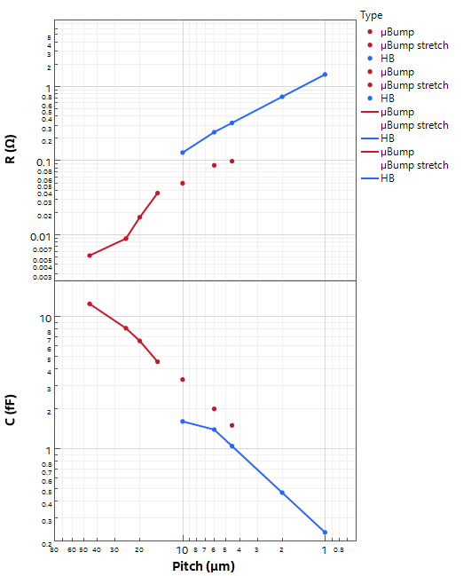
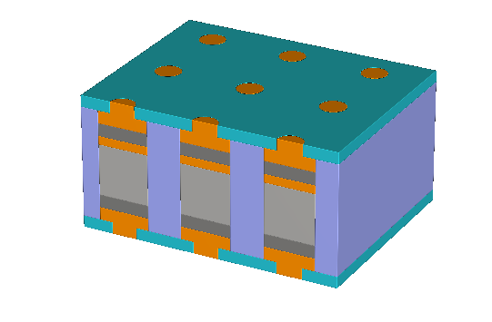

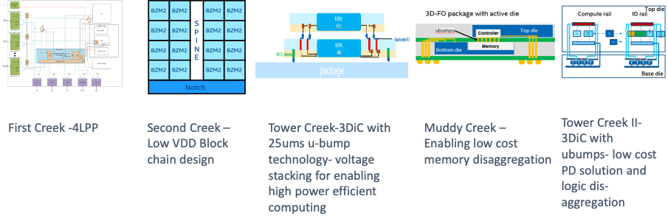
Holistic Technology Exploration in IDM2.0
Logic Technology
Decadal roadmap aligned with BU
Memory In Package
Economical, capacious SRAM cache
Specialty Technologies
Power, Analog, Radio, SiPh
System-in-Package
at
Ext. Tech Pathfinding
Terraced Chiplet Cubing
HBM/LPDDR displacement
Terraced Chiplet Cubing
HBM/LPDDR displacement
3DIC Scalability & Optionality
Cost-effective µB vs. high-density HB
At 1µm pitch, R <~ 1.5Ω
Common mid level metal R ~ 10 Ω/µm
Suppliers Enabling
PoC: Test Vehicles at SiFo & OSAT
V-cache
3DTV
µBump
5 µm interconnect C ~ 1 fF
EPOND
HB

Slide 3
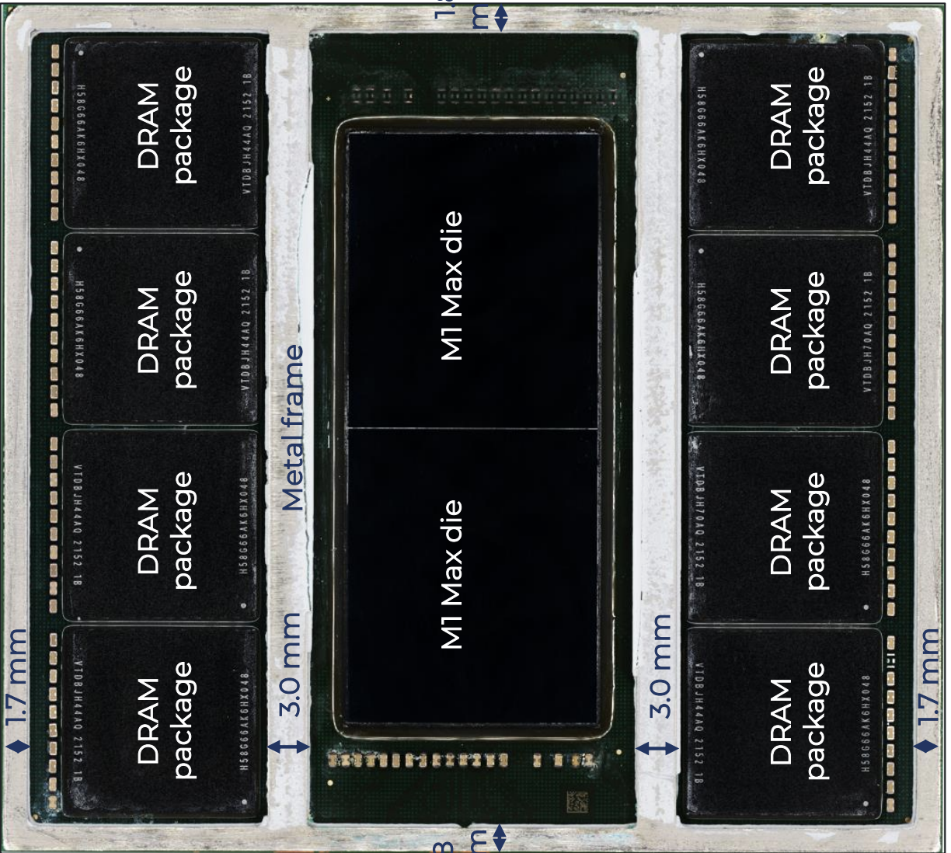
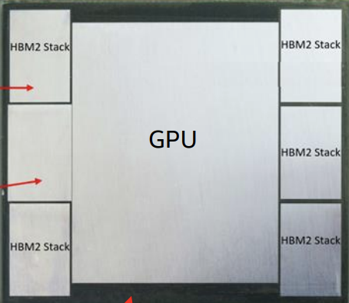
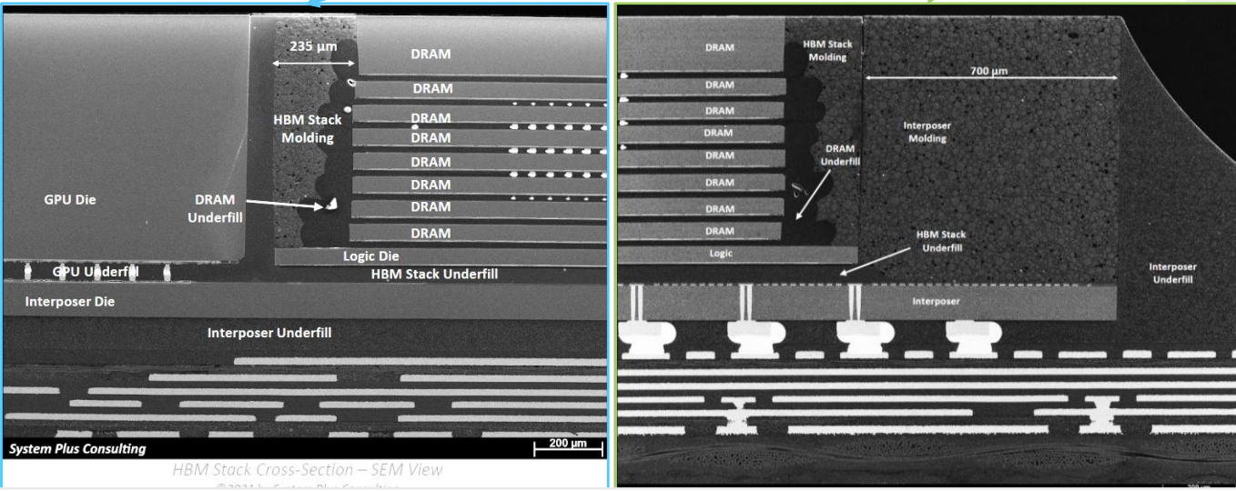
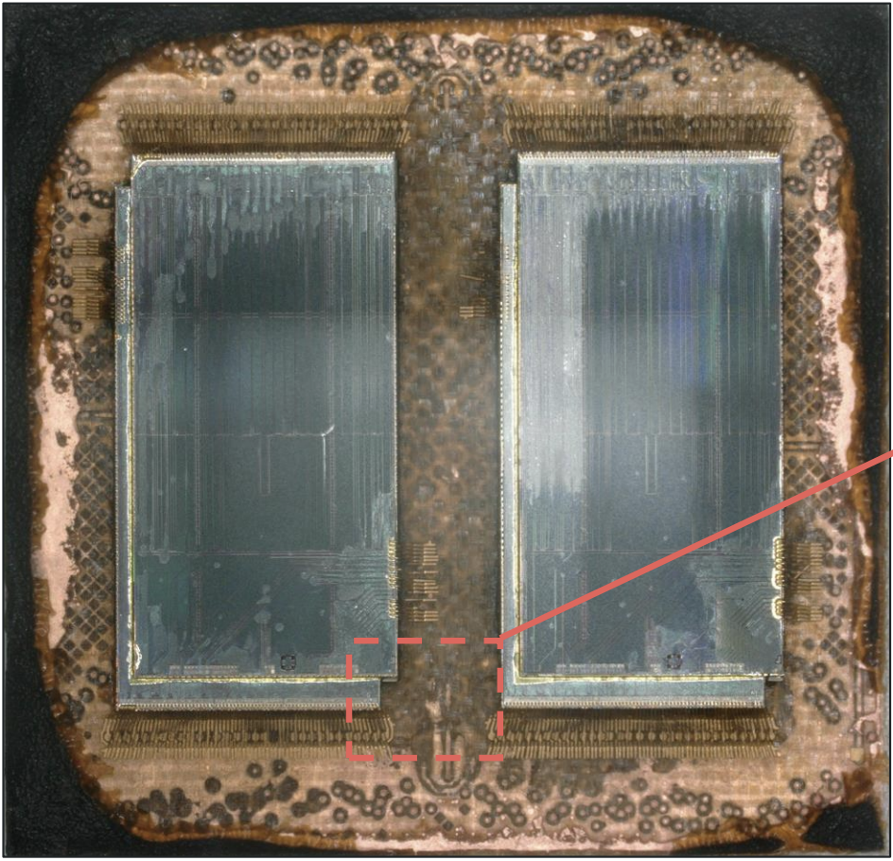
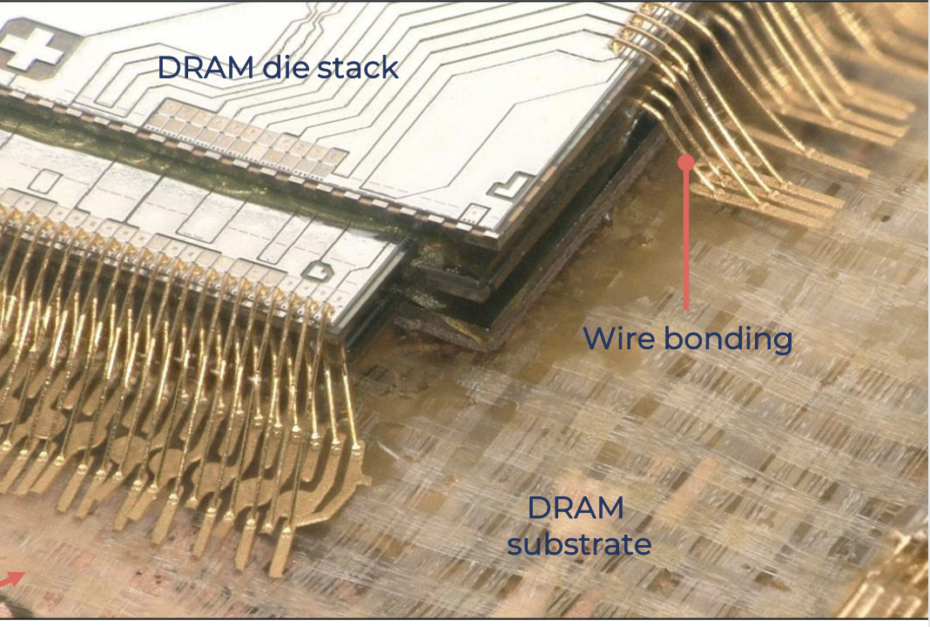
A100 HBM
M1 MoP (LPDDR)

Slide 4
Problem Statements
Packaging:
HBM Low silicon utilization
Shared TSV footprint in DRAM with dedicated vertical Interconnect
Active Si Interposer with <20% active circuits (DDR Phy, MBIST)
MoP: WB Scalability
Power dissipation/thermal management
HBM Phy consumes >80% of Power at worst thermal conductivity
STCO:
Memory/Logic Disag. Architecture
Large Footprint of data bank switching logic using DRAM technology (BW/Capacity↑)
Memory subsystem hierarchy gap between SRAM Cache (3ns) and DRAM main memory (35ns)
 | HBM2e | M1 PoP
Capacity | 16GB | 64 GB
BW | 400GB/s | 800GB/s
IO rate | 1.6GH DDR | 3.2GHz DDR
# DQ | 1024 | 1024
Chiplets | 8x16Gb + 1 Logic | 8X8X16Gb LPDDR
DQ/die | 1024 | 16
TSV
Fine Grain DRAM
10MB/mm²
tRD 35ns
Estimated > $10/GB
Act. Si Interposer: Phy+ MBISP
20MB/mm² tRD 35ns, WB

Slide 5
Terraced Chiplet Cubing Value Prop
Efficient, scalable 3DIC architecture
enabling
economical solutions from global technologies to bridge memory hierarchy gap in compute

Slide 6
Scratch Pad

Slide 7
Modular Implementation
Basic Module: Chiplet-Reconstitution:
Active chiplets (with or without TSV)
Chiplets include TSV/TDV, Interconnect (with or without passives)
Stacking and Interface
µB or HB
Active
TSV/TDV
Active
Active
TSV/
TDV
TSV/
TDV

Slide 8
Terraced Chiplet Cubing
HBM/LPDDR displacement

