Slide 2
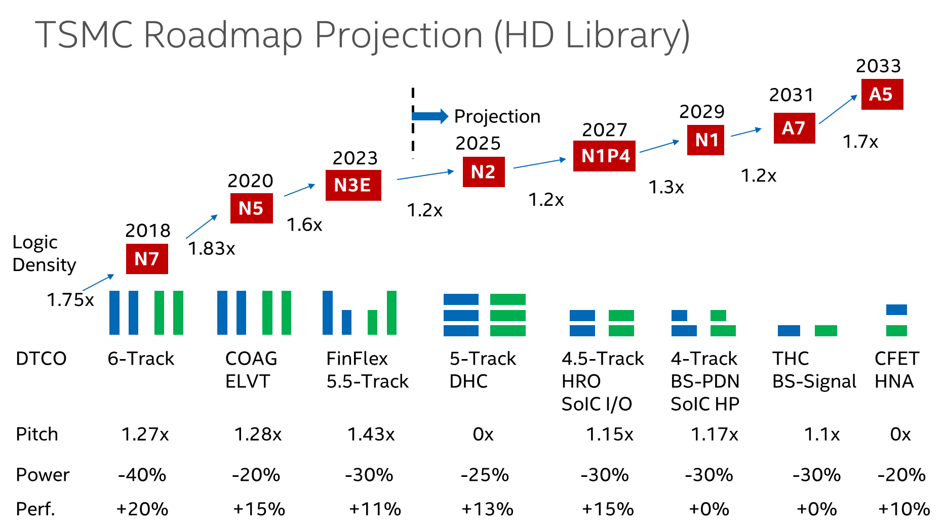
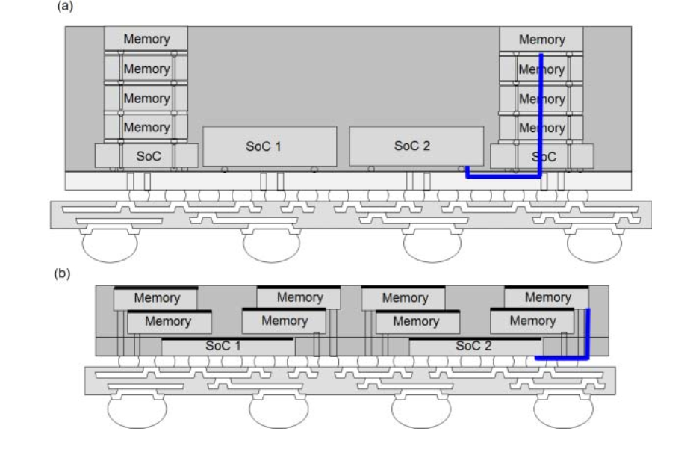
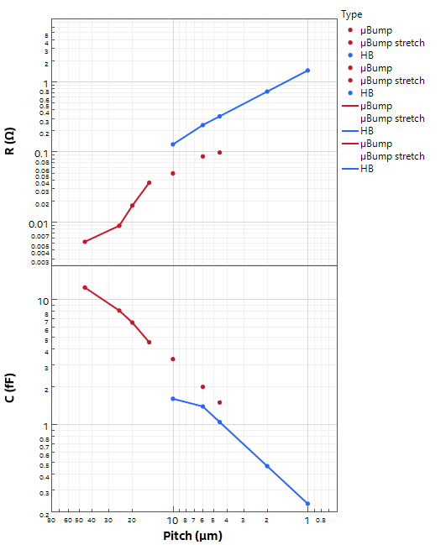
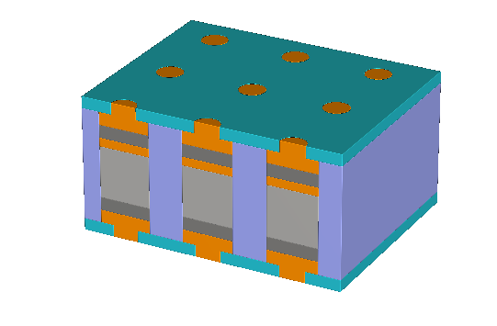

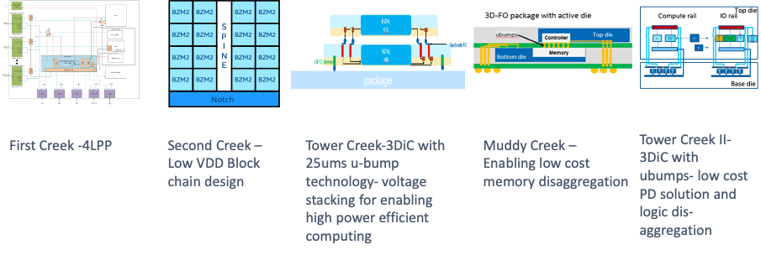
Holistic Technology Exploration in IDM2.0
Logic Technology
Decadal roadmap aligned with BU
Memory In Package
Economical, capacious SRAM cache
Specialty Technologies
Power, Analog, Radio, SiPh
System-in-Package
at
Ext. Tech Pathfinding
Terraced Chiplet Cubing
HBM/LPDDR displacement
3DIC Scalability & Optionality
Cost-effective µB vs. high-density HB
At 1µm pitch, R <~ 1.5Ω
Common mid level metal R ~ 10 Ω/µm
Suppliers Enabling
PoC: Test Vehicles at SiFo & OSAT
V-cache
3DTV
µBump
5 µm interconnect
C ~ 1 fF
EPOND
HB

Slide 3
Value Prop
Power efficient 3D DRAM with bandwidth on par or better than HBM at commodity DRAM price.
Example: HBM3 vs. M1 Ultra

Slide 4
Main Memory Scaling Issues
Quote from Dick Site
Latency Scaling ➔
  20 years of DDR Latncy
  Intel’s eDRAM solution: Smaller Array RC + Powerfull WL decoder, SA and Col mux
Bandwidth Scaling
  DDR to HBM
HBM issues
  Cost: density, Foveros
  Thermal

Slide 5
