Slide 1
TMC: Exploration and Beyond
DerChang Kau, Oct/25/2024
Introduction to TMC Objective: 2027 DC/AI Product Intercept
Business Proposition
TMC Q3 Summary
Roadmap and Beyond

Slide 2
Introduction to Terraced Memory Cube

Slide 3
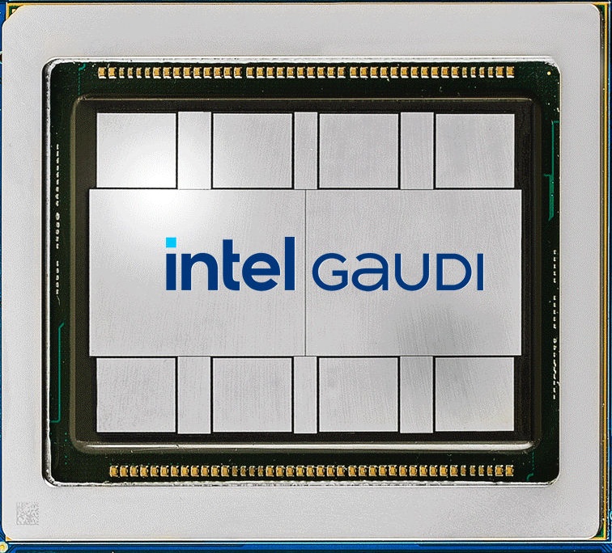
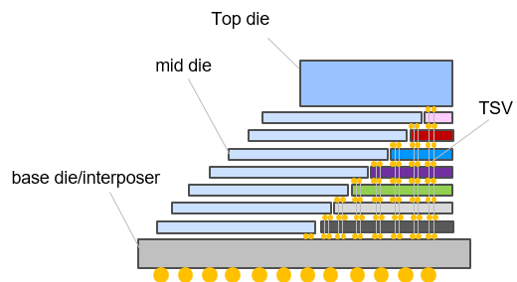

Circa 2027 DC/AI Product Intercept
Cross Sectional View
A
TMC
TMC
TMC
TMC
A
A’
TMC
DC-GPU
A’
DC - GPU
DTC/TSV
DTC/TSV
DTC/TSV
DTC/TSV
DTC/TSV
DTC/TSV
TMC
TMC
TMC
TMC
DTC/TSV
Bridge/DTC/PMIC/SPD

Slide 4
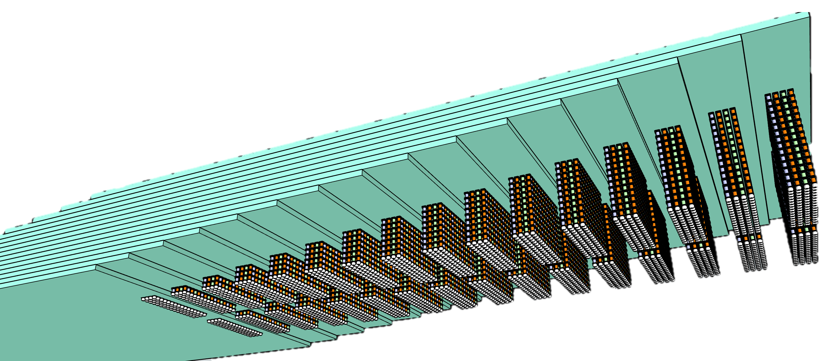
Introduction to Terraced Memory Cube
Objective: high bandwidth memory with significantly better costs & extend HBM scaling trajectory
Key Enablers:
  TSV-less + LPDDR PHY on mainstream DRAM: on par with or better than HBM in MB/mm², GB/s & pJ/b
    Density improvement: no TSV, smaller die size
    High BW & Low Energy: Low-Power Wide-IO mainstream DRAM
    Eliminate low utilization CMOS base die in Chip-on-Wafer advanced packaging
µBumped Memory module
  Readily available with wide options of adv. packaging integration solutions, including
  EMIB/ODI/Foveros (IF), FO-3D (SPIL/ASE), iCube family (SF) and CoWoS family (TSMC)
16 tiers of 32Gb LPW
64GB TMC 2K DQs
TMC – terraced stacking of memory chips interconnected vertically using low cost TSV chips to widen data width in a Terraced Chiplet Cubing (TCC) construction.
A TMC example for
3DS of Low-Power wide-IO, LPW, DRAM chips

Slide 5
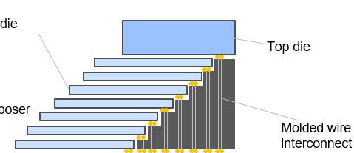
Terraced Chiplet Cubing without embedded TSV
  Disaggregated Through Silicon Via (D-TSV)
  CC Kuo et.al.
  Molded Wire Interconnect (MWI)
  Xiang Li et.al.
mid die

Slide 6
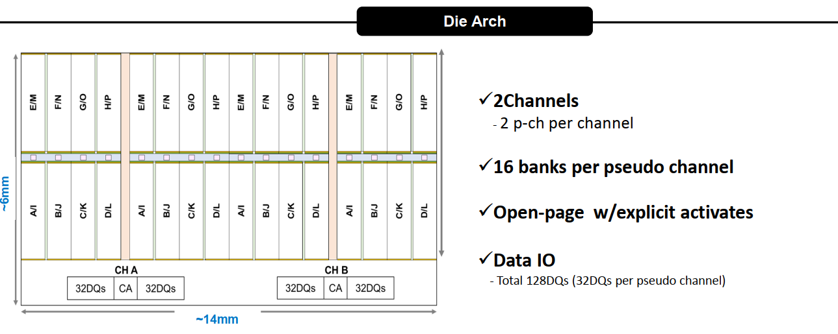
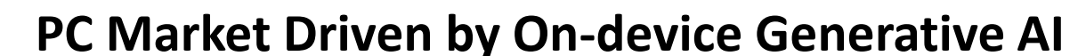
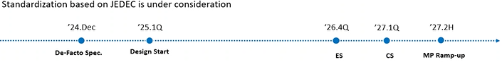
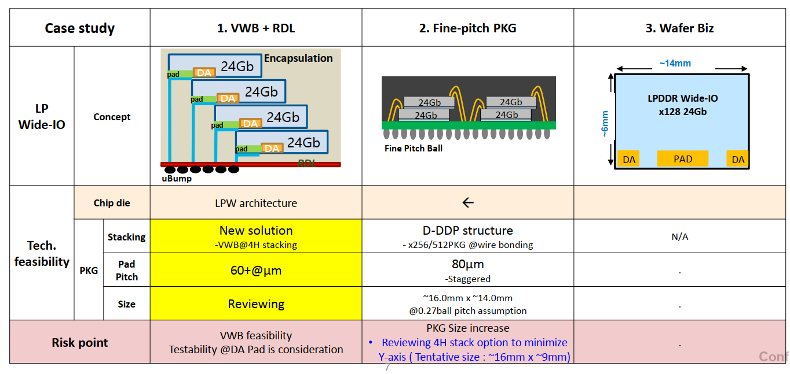
Intel-Samsung Meeting (Feb'24, Aug’24)
Samsung LPW Revision Aug. 5, 2024 |  | Mock-1 | Mock-2
 |  | Add DODT | 1c,2xCap/DQ
Technology | D1b | ⟸ | D1c
Capacity [Gb] | 16 | ⟸ | 32
# DQ | 64 | ⟸ | 128
# of Ch | 1 | ⟸ | 2
# of pCh or subCh / Ch | 2 | ⟸ | ⟸
Burst Length | 8, 16, 32 | ⟸ | ⟸
Data Rate [GT/s] | 3.2 | 10.7~14.4 | ⟸
[GB/s] | 25.6 | 85.6~115 | 171~230
#DQ/diffDQS | 32 | ⟸ | ⟸
tRC [ns] | 60 | ⟸ | ⟸
pJ/bit | 1.9 | 2.3 | 1.5

Slide 7
64GB TMC-LPW module Mockups and Benchmark
TMC Mock-1
64GB Module | Package-IF | Node | Gb/Die | Module Size [mm²] | Norm. Cost | GB/s | pJ/b | BW/mm | # Module | Height
HBM4E | 3DS-HBM | 1c | 32 | 14.2x11.0 | 100% | 3276.8 | 2.8 | 298 | 1 | 17
TMC Mock-1 | TMC-LPW | 1b | 16 | 14.9x14.0 | 55% | 3276.8 | 2.3 | 234 | 2 | 16
TMC Mock-2 | TMC-LPW | 1c | 32 | 14.9x10.5 | 62% | 3276.8 | 1.5 | 312 | 1 | 16

Slide 8
Business Proposition

Slide 9
Business Proposition
Key Asks
  Increase Data Transfer Rate on-par with LPDDR6
  Package development of Terraced Memory Cube Module
Collaborate on developing the solution with the aim of being first to market.
Lead industry adoption and open up to gain wide adoption and economies of scale
Potentially expanding TMC collaboration to wide range of DRAM
  PHY-less, TSV-less HBMx
  Small Outline LPDDRx

Slide 10
TMC Q3 Summary

Slide 11
Wrapping up TMC Focus Team Phase II
DerChang Kau and Team TMC, WW39
TMC MOR flow delivered and Costing passing success criteria
Speculative PDK is under development, electrical and thermal capability is above and beyond HBM4E requirement
Strong endorsement from the memory architects in MIO, DC-GPU and AI-PC
Memory and Packaging suppliers identified and engagement planned (Q4’24~Q1’25)

Slide 12
Terraced Memory Cube (TMC) Focus Team – Phase II
1. Ideation 2. Vetting 3. PoC
4. Definition 5. Change Control
7/11/2024
Rev 1.0
July’24 to September’24
Scope and Plan
Problem Statement | HBM’s low silicon utilization on all layers of DRAM chips due to shared TSV and low-density logic circuits in base die as a high-cost interposer. MoP formfactor constraint due to WB footprint scalability and # DQ as well as long trace length and variability impose data transfer limit in BW and power.
Key Results | TCC package MTS, DTS and thermal characteristics for Rev 1 package PDK R0.1 TMC-LPW Package Reference Design Rev 1.0 for TM-TV and IC-TV PoC validation
Team and Expertise | Team members’ disicipline covers MT, design enabling, DRAM & system. FT sizes of 4~8 persons at Idea vetting stage
Strategy | Critical Path and fast fail: package mechanical/thermal/electrical characteristics on par or better than HBM4+ as a scalable solutions to co-define and to deliver HBMi datasheet for product plan'27 and beyond
Logistics and Funding needs | Focus team technical repository share point: TMC Weekly meeting: Thursday 8-9am cal time zone.
Decision Process | Consensus within FT before Sponsors’ final ratification.
Feedback Plan Communication | Weekly FT mission-oriented meeting for technical feedback and alignment. Monthly Ops review to solicitate from and to align with Customers and stakeholders Ad hoc process-oriented meeting with sponsors for status update the ratification.
Guard Rail | These are constraints or expected conditions that should be met in project execution. Calling out assumptions and boundary conditions explicitly to prevent scope creep.
Sunset Clause & Sunset Plan | When graduate, (passing gate level, meeting success criteria), team will move on to PoC package design to validate technology scaling capability and technology line of sight limitation as well as and seek for the BU endorsement for LRP @ 2027. Or else, revisit landing and project direction for sunset postmortem..
“Technology-driven disruption” to displace incumbent
“Market creation disruption” as a potential compute memory hierarchy redefinition as in AI (Client to Cloud)
On-Board memory modules such as xDIMM and LPx are reaching scaling limit. In-package memory (IPM) enables bandwidth improvement while boosting capacity growth. SoA IPMs include LPx-MoP and HBM as well as custom eDRAM from Intel, APM, PSMC, SEC and SKH as well as many proprietary memory technology R&D.
The Objective of this project is to define and to deliver
IPM solutions for ’27 product and roadmap intercept to displace HBMx by exploiting mainstream DRAM technology and collaborating with tier-1 OSAT to deliver a low-cost low-power high-availability 3D packaged memory subsystem with bandwidth on par with HBMx.
Charter Group: FTE and MIO
Sponsors: Changhong Dai and Dimi Ziakas
Stakeholders: Percy Soto, Victor Cho, Mimi Ocampo,
Prashant Damle, Long Wang & Srini Rajagopalan
Customer: (to be finalized)
Accelerator: Rajat Agarwal
Cloud: Jim Mccall, Muntaquim Chowdhury
Client: Konika Ganguly, Chris Mozak
Suppliers: (wip)
OSAT: ‘tbd’ (ATTD), 'Cool Creek' (ASE), DRAM supplier
LPW: Saemi Song (SEC), (SKH), (MU)

Slide 13
Team TMC
Chair: DerChang Kau (retd.) ➔ Max Wu/Thomas Huber
Technology and Design Enablement
Product Architecture & Definition
CC Kuo (FTE), TMC-TSV Architect
  Module Target Spec, Design Rule and OSAT Engagement
Xiang Li (MIO), TMC-MWI Architect
  Alternative Process Flow Exploration, mechanical/thermal design
Dany Ly-Gagnon, (FTE), Memory Integraion
  IP Disaggregation, D2D interface, data path design (IO and buffering)
Po Yao Lin (FTE), Mechanical/Thermal Model
  3D FEM & analytical method (industrial standard and Intel proprietary), Thermal Spec
I Ko Li (FTE), PDK
  Device Target Spec, PI/SI
Xiang Li, memory product alignment
  TMC package definition
  Product alignment and planning
Percy Soto, DRAM supplier engagement
  work with DRAM Supplier Chain and management
  Prepare SEC/SKH/MU LPW alignment for LP6
Prashant Damle: Product Integration
  DC/AI and CC memory subsystem interface

Slide 14
Terraced Memory Cube
Valuation:
  “Technology-driven disruption” to displace/replace incumbent
  “Market creation disruption” as a potential compute memory hierarchy redefinition as in AI
Proposition:
  On-Board memory modules such as xDIMM and LPx are reaching scaling limit. In-package memory (IPM) enables bandwidth improvement while boosting capacity growth.
  SoA IPMs include LPx-MoP and HBM as well as custom eDRAM from Intel, APM, PSMC, SEC and SKH as well as many proprietary memory technology R&D.
Objective:
  To define and to deliver IPM solutions for ’27 product and roadmap intercept to displace HBMx by exploiting mainstream DRAM technology and collaborating with tier-1 OSAT to deliver a low-cost low-power high-availability 3D packaged memory module with bandwidth on par with HBMx.

Slide 15
Critical Path (Fast Fail)
2024: Ideation/Vetting concluded, meeting manufacturing 3Cs with DRAM/OSAT collaborator id’d
TMC Rev 1 flow and costing completed
  Line of sight technology feasibility with ¾ cost @ iso performance
TMC process flow and capability meeting performance and scalability success criteria
  HBM CoW package is the baseline
  OSAT short lists
  Cubing module OSAT supplier selected for TM-TV Tapeout
Package Module Electrical, Mechanical and Thermal assessed, defined to support 'HBM’ datasheet
  Memory Supplier engagement starts
2025: TM-TV and IC-TV Tapeout, PoC validated
TM-TV assessment meet success criteria
  Memory cubing module supplier selected for IC-TV Tapeout
Technology performance and reliability assessed using IC-TV
'27 Product PrePOR success criteria established for HBM4E replacement
  Test Chip planned starts (C-Spec, T-Spec, do we need MAS equivalent?)
‘TMC-LPW6’ spec & roadmap aligned; secure pre-POR position
2026: TMC at HBM4+ class demonstrated
Product intercept decision made
 | Q2'24 | Q3'24 | Q4'24~Q1'25
Objectives | TMC Process flow develop, cost | MTS and DTS covering Process, Electrical and Thermal characteristics, PDK Rev0.1 | TM-TV Tapeout
Tech Gate | Technology feasible Cost Lower than HBM | Mockup datasheet on par with HBM | MTS committed by OSAT

Slide 16
Terraced Chiplet Cubing Technology
Provides a generic, low-cost, scalable platform for in-package interconnect
Enables a high-efficiency pass-through physical layer no overhead to Data Link Layers
16 tiers of 32Gb LPW
64GB TMC 2K DQ
TMC – terraced stacking of memory chips interconnected vertically using low cost TSV chips to widen data width in a Terraced Chiplet Cubing (TCC) construction.
A TMC example for
3D stack of Low-Power wide-IO, LPW, DRAM chips

Slide 17
IP Disclosure and Harvest
IP Disclosure
IP Harvest
IDF 5223 “Terraced Chiplet Cube”, approved for filing.
AG2623 “Molded wire interconnect for stacked memory package” will not be filed as a patent application due to prior art.
  Xiang will continue drive to molded wire TMC MOR flow development and costing analysis of TMC-LP6 mockup for pre-POR candidate evaluation
Hybrid attachment scheme between mem-to-mem and mem-to-tsv to improve TTV spec tolerance and thermal conductivity.
  Jason Zhang and Xiang Li to lead authorship of IDFs
stacking of tiers – Use Fanout-3DS of multiple TCC to increase stack height and memory capacity and density
  Po Yao Lin to lead authorship of IDFs
  Introducing Known-Good-TMC-Module (KGM) method
manufacturing method for TCC to reduce cost. (non-TSV)
  Po Yao Lin to lead authorshiop of IDFs
Xiaorong Xiong will coordinate/consolidate all novel ideas for IDF filing.

Slide 18
Intel-Samsung Meeting
(Feb'24, Aug’24)

Slide 19
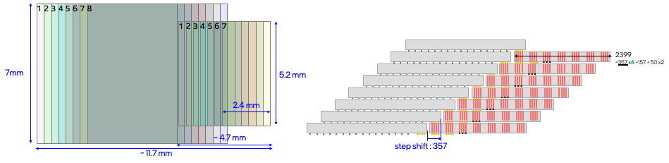
64GB TMC-LPW modules and Benchmark
TMC Mock-1
TMC Mock-2
64GB Module | Package IF | Size [mm²] | Cost | GB/s | pJ/b | BW/mm | Node | Gb/Die | # Module | Height | # Die
HBM4E | 3DS HBM | 14.2x11.0 | $281 | 3276.8 | 2.8 | 298 | 1c | 32 | 1 | 17 | 17
TMC Mock-1 | TMC LPW | 14.9x14.0 | $156 | 3276.8 | 1.9 | 234 | 1b | 16 | 2 | 16 | 32
TMC Mock-2 |  | 23.4x14.0 | $138 |  | 2.4 |  |  |  | 4 | 8
TMC Mock-3 |  | 11.7X28.0 |  |  | 1.9 | 117

Slide 20
Roadmap Direction and Ideas

Slide 21
Terraced Memory Scaling Roadmap
Capacity Scaling → number of die stacking
  Tier / Stack (rinse and repeat)
  Fusion bonded 3D memory such as Via-in-one
Bandwidth scaling → number of IO and pitch multiplication
Roadmap and opportunities:
  Gen 1: HVM 2H27
    TMC-LPW
  Gen 2: 27~28 intercept
    High bandwidth scaling: SKH PHY-less HBM4:
    High Capacity for volume drive: TMC-LP6
  Gen 3: 28~29 intercept
    Via-in-One

Slide 22
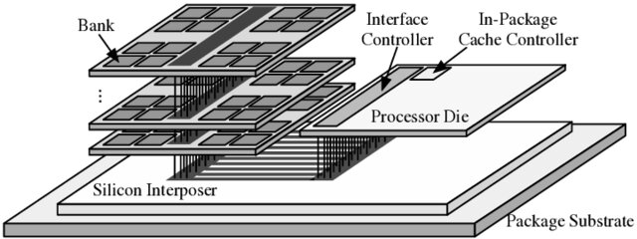
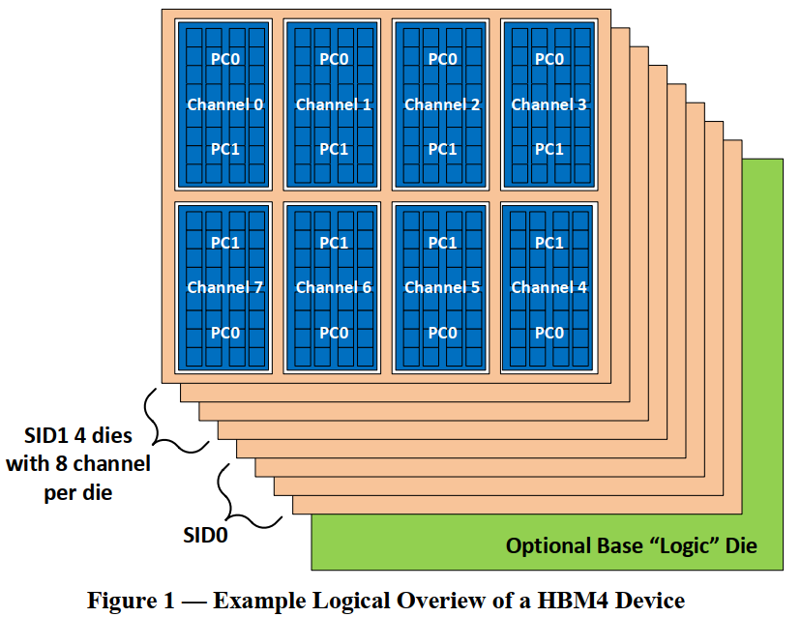
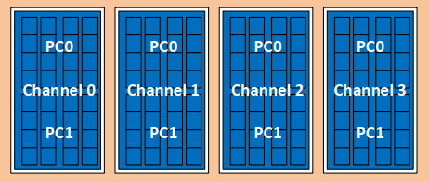
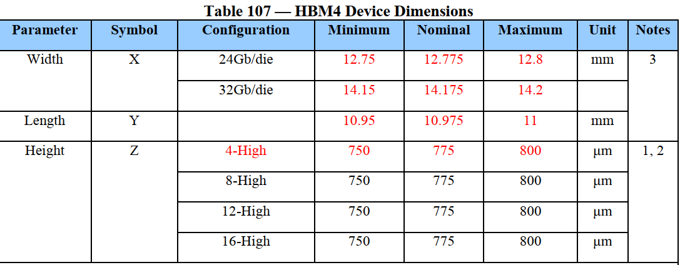
TMC-HBM4: TCC of PHY-less, TSV-less HBM
TMC-HBM4
½ HBM 16Gb die
  D1c node
  16Gb die
  TSV-less (Shoreline Bump)
  PHY-less (FD I/O)
  ~50MB/mm²
  4-Ch, 256 FD D/Q
  12.8 GT/s
TCC – 8-die mockup
  16GB module
  32-Ch, 2K FD D/Q
  Max 3.3TB/sec
  (9.4X9mm²)
TCC – 16-die mockup
  32GB module
  64-Ch, 4K FD D/Q
  Max 6.6TB/sec
  (12.6X9mm²)
HBM 3DS
HBM4
HBM 32Gb die
D1c node
40MB/mm²
8-Ch, 512 FD D/Q
Max 12.8 GT/s
3DS
4, 8, 12, 16-high (+1 base)
16, 32, 36, 64GB module
32Ch, Max 3.3TB/sec

Slide 23
Backup

Slide 24
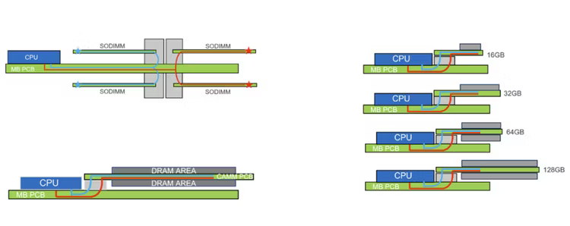
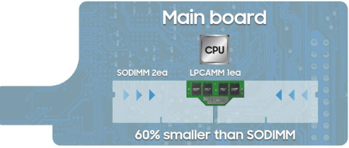
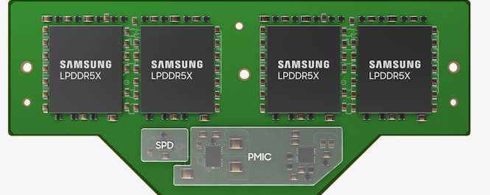
TMC-MWI-LP6 to succeed LPCAMM
Laptop Memory Module Standards
 | SO-DIMM | LPCAMM | TMC-LP5
Memory Type | DDR5 | LPDDR5X | LPDDR5X
Max Official Data Rate | 6400 MT/s | 7500 MT/s | 7500 MT/s
Current Max Capacity | 192GB (48GB x 4) | 128GB (Planned) | 32GB
Bus Width | 64-bit | 128-bit | 128-bit
Dimensions | 67.6mm x 30mm | 78mm x 23mm | 10mm x 7mm

Slide 25
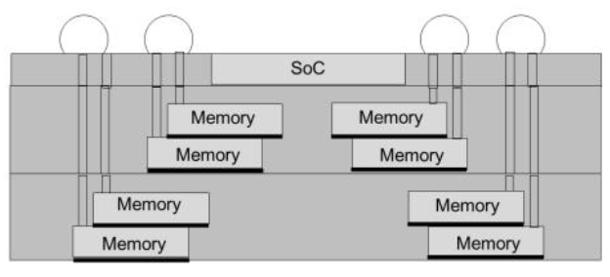
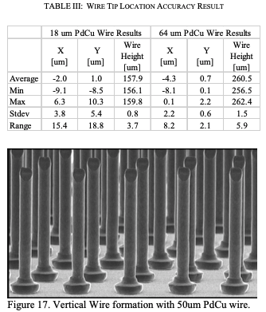
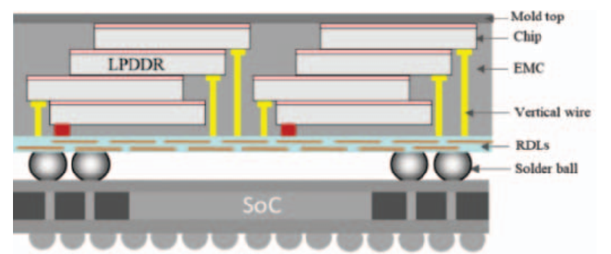
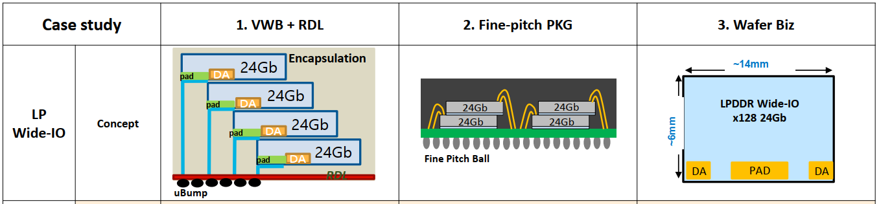
Best Known IPM Alternatives
  Vertical Wire Bonding
  K&S Capability: ETCT2017
  TSMC 3D MiM ECTC2020
  Multistack-in-Multistack
  Hynix VFO
  Vertical Fanout EDTM23 ﻿
  Vertical Fanout ECTC2024
  Samsung (Intel-Samsung Meeting, Feb/2024)

Slide 26
Circa 2027 DC/AI Product Intercept
Cross Sectional View
A
TMC
TMC
TMC
TMC
A
A’
TMC
DC-GPU
A’
DC - GPU
TMC
TMC
TMC
TMC
Bridge/DTC/PMIC/SPD

