Slide 1
TMC: LPW Exploration and Beyond
Intel-Samsung Meeting, Oct/3/24
Objective: 2027 DC/AI Product Intercept
Enabling Technology
KPI & Benchmark
Other Potential Opportunities
Business Proposition

Slide 2
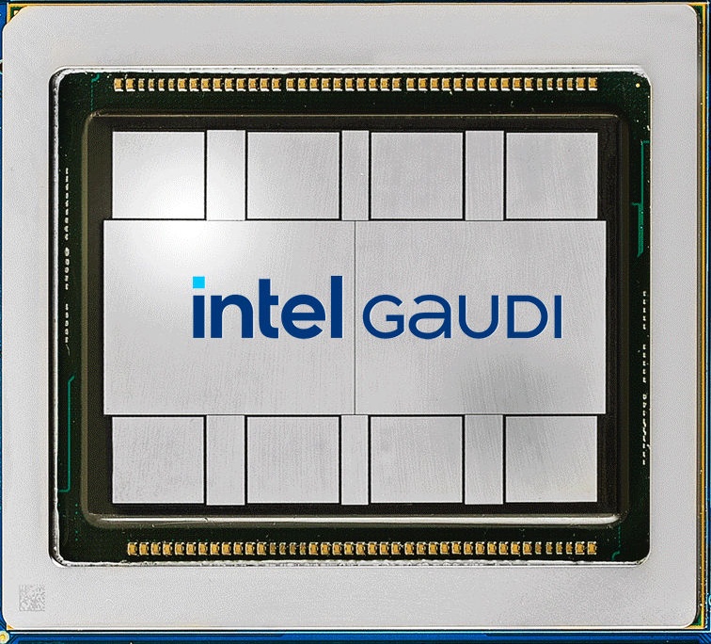
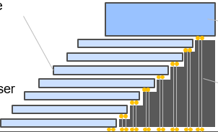
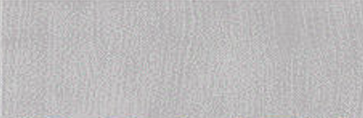
Circa 2027 DC/AI Product Intercept
Cross Sectional View
A
TMC
TMC
TMC
TMC
A
A’
TMC
DC-GPU
A’
DC - GPU
TMC
TMC
TMC
TMC
Embedded Bridge / Active

Slide 3
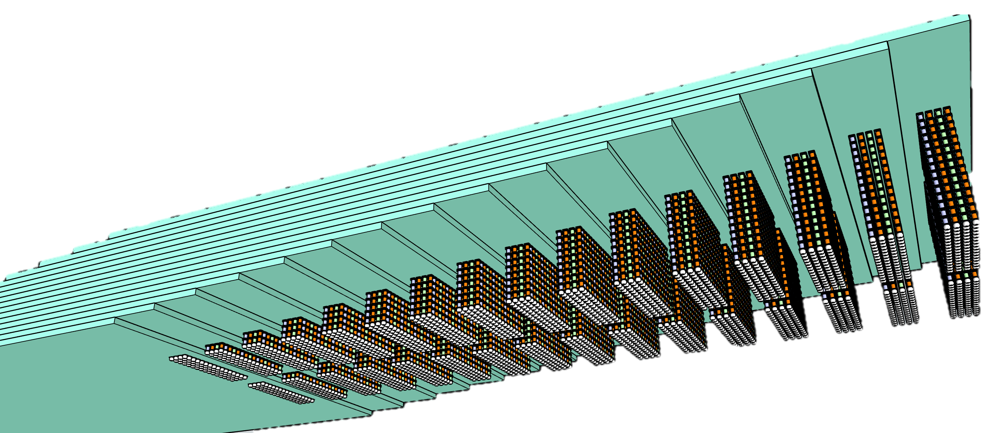
Introduction to Terraced Memory Cube
Objective: high bandwidth memory with significantly better costs & extend HBM scaling trajectory
Key Enablers:
  TSV-less + LPDDR PHY on mainstream DRAM: on par with or better than HBM in MB/mm², GB/s & pJ/b
    Density improvement: no TSV, smaller die size
    High BW & Low Energy: Low-Power Wide-IO mainstream DRAM
    Eliminate low utilization CMOS base die in Chip-on-Wafer advanced packaging
µBumped Memory module
  Readily available with wide options of adv. packaging integration solutions, including
  EMIB/ODI/Foveros (IF), FO-3D (SPIL/ASE), iCube family (SF) and CoWoS family (TSMC)
16 tiers of 32Gb LPW
64GB TMC 2K DQs
TMC – terraced stacking of memory chips interconnected vertically using low cost TSV chips to widen data width in a Terraced Chiplet Cubing (TCC) construction.
A TMC example for
3DS of Low-Power wide-IO, LPW, DRAM chips

Slide 4
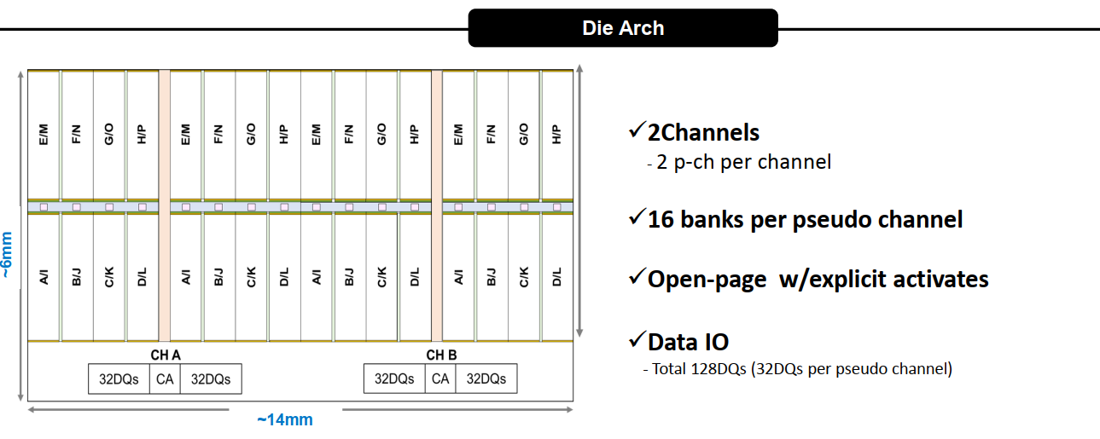
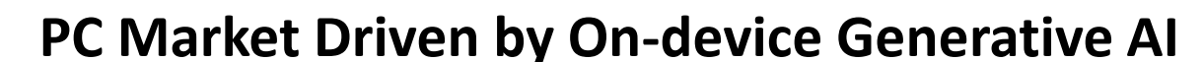
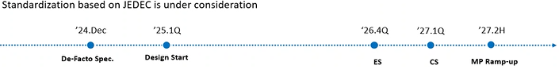
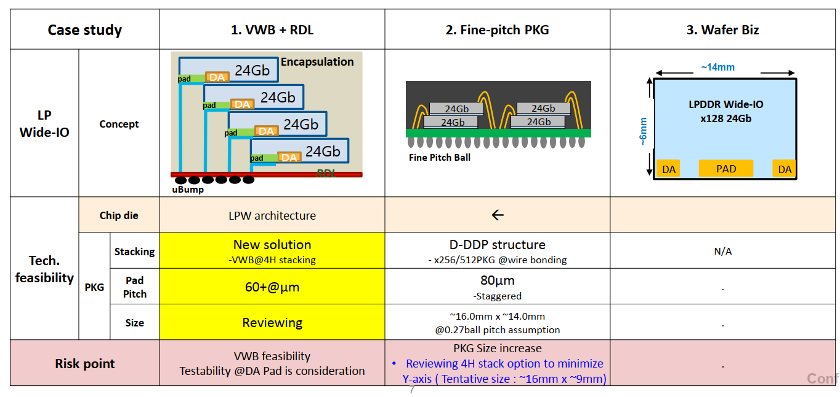
Intel-Samsung Meeting (Feb'24, Aug’24)
Samsung LPW Revision Aug. 5, 2024 |  | Mock-1 | Mock-2
 |  | Add DODT | 1c,2xCap/DQ
Technology | D1b | ⟸ | D1c
Capacity [Gb] | 16 | ⟸ | 32
# DQ | 64 | ⟸ | 128
# of Ch | 1 | ⟸ | 2
# of pCh or subCh / Ch | 2 | ⟸ | ⟸
Burst Length | 8, 16, 32 | ⟸ | ⟸
Data Rate [GT/s] | 3.2 | 10.7~14.4 | ⟸
[GB/s] | 25.6 | 85.6~115 | 171~230
#DQ/diffDQS | 32 | ⟸ | ⟸
tRC [ns] | 60 | ⟸ | ⟸
pJ/bit | 1.9 | 2.3 | 1.5

Slide 5
64GB TMC-LPW module Mockups and Benchmark
TMC Mock-1
64GB Module | Package-IF | Node | Gb/Die | Module Size [mm²] | Norm. Cost | GB/s | pJ/b | BW/mm | # Module | Height
HBM4E | 3DS-HBM | 1c | 32 | 14.2x11.0 | 100% | 3276.8 | 2.8 | 298 | 1 | 17
TMC Mock-1 | TMC-LPW | 1b | 16 | 14.9x14.0 | 55% | 3276.8 | 2.3 | 234 | 2 | 16
TMC Mock-2 | TMC-LPW | 1c | 32 | 14.9x10.5 | 62% | 3276.8 | 1.5 | 312 | 1 | 16

Slide 6
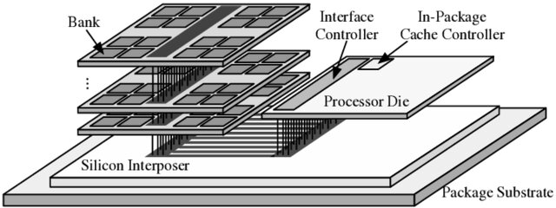
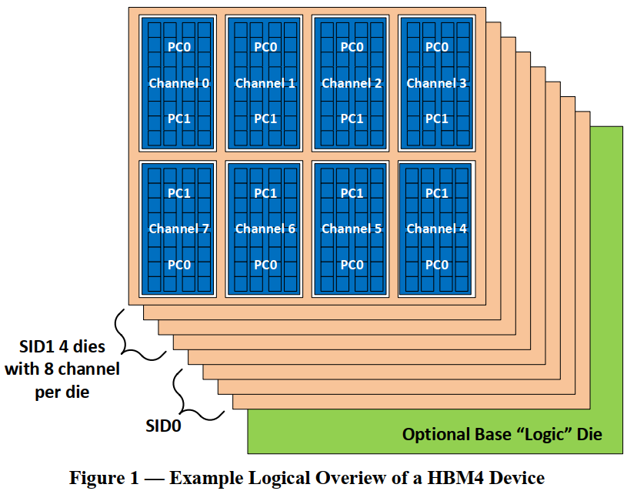
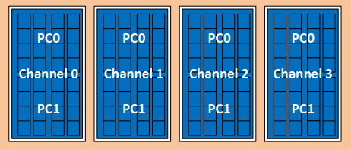
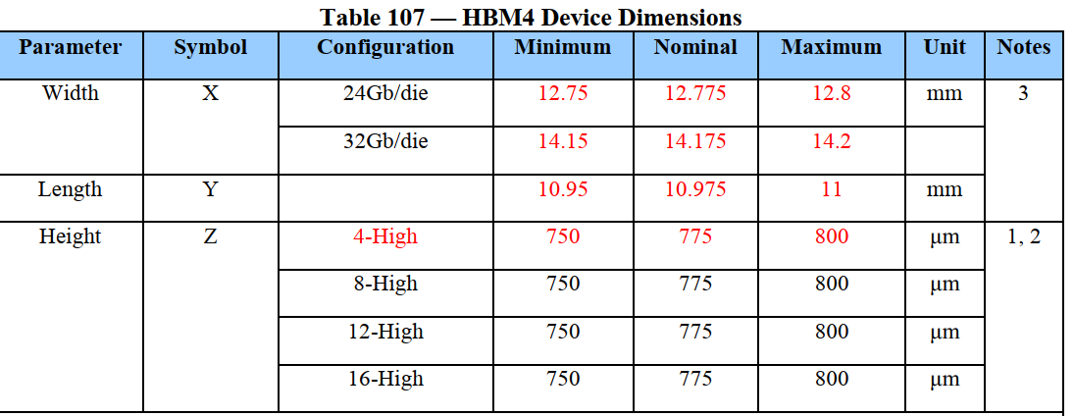
TMC-HBM4: TCC of PHY-less, TSV-less HBM
TMC-HBM4
½ HBM 16Gb die
  D1c node
  16Gb die
  TSV-less (Shoreline Bump)
  PHY-less (FD I/O)
  ~50MB/mm²
  4-Ch, 256 FD D/Q
  12.8 GT/s
TCC – 8-die mockup
  16GB module
  32-Ch, 2K FD D/Q
  Max 3.3TB/sec
  (9.4X9mm²)
TCC – 16-die mockup
  32GB module
  64-Ch, 4K FD D/Q
  Max 6.6TB/sec
  (12.6X9mm²)
HBM 3DS
HBM4
HBM 32Gb die
D1c node
40MB/mm²
8-Ch, 512 FD D/Q
Max 12.8 GT/s
3DS
4, 8, 12, 16-high (+1 base)
16, 32, 36, 64GB module
32Ch, Max 3.3TB/sec

Slide 7
Business Proposition
Key Asks
  Increase Data Transfer Rate on-par with LPDDR6
  Package development of Terraced Memory Cube Module
Collaborate on developing the solution with the aim of being first to market.
Lead industry adoption and open up to gain wide adoption and economies of scale
Potentially expanding TMC collaboration to wide range of DRAM
  PHY-less, TSV-less HBMx
  Small Outline LPDDRx

Slide 8
Backup Materials

Slide 9
Terraced Chiplet Cubing Process Flow
Memory
Memory
Memory
Memory
Memory
Memory
Memory
Memory
Memory
Memory
Memory
Memory
Memory
Memory
Carrier
Carrier
Carrier
Carrier
Carrier
Carrier
Carrier

