Slide 1
TMC: LPW Exploration and Beyond
Intel-Samsung Meeting, Oct/3/24
Objective: 2027 DC/AI Product Intercept
Enabling Technology
KPI & Benchmark
Cost of Making & Cost Model
Business Proposition

Slide 2
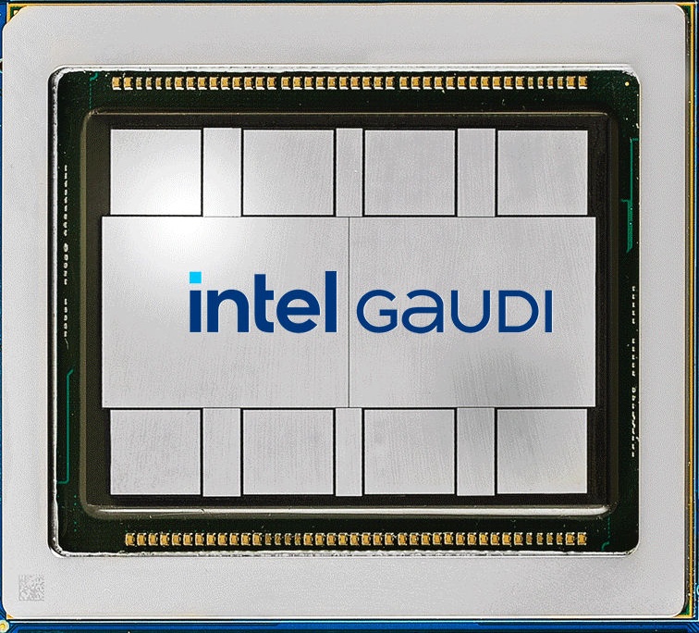
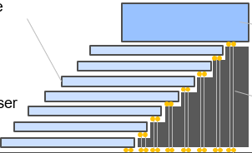
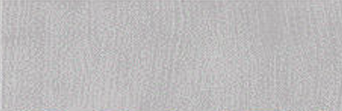
Circa 2027 DC/AI Product Intercept
Cross Sectional View
A
TMC
TMC
TMC
TMC
A
A’
TMC
DC-GPU
A’
DC - GPU
Shared with Samsung under NDA
TMC
TMC
TMC
TMC
Embedded Bridge / Active

Slide 3
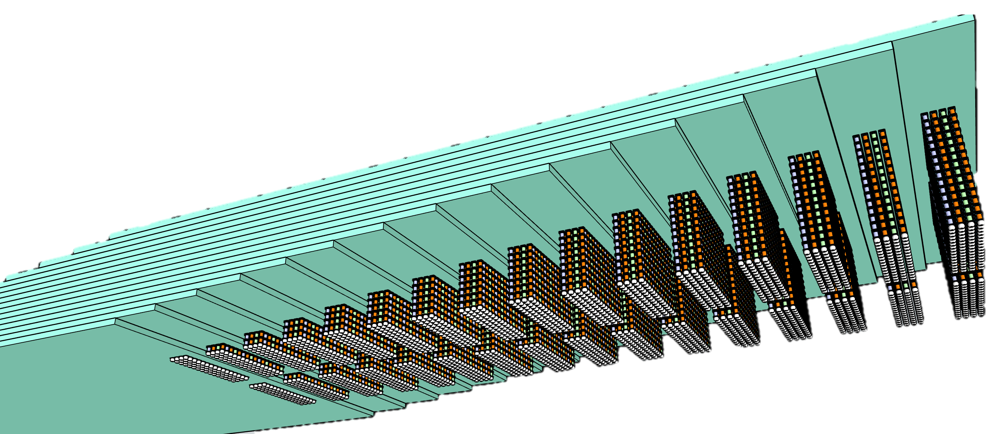
Introduction to Terraced Memory Cube
Objective: high bandwidth memory with significantly better costs & extend HBM scaling trajectory
Key Enablers:
TSV-less + LPDDR PHY on mainstream DRAM: on par with or better than HBM in MB/mm², GB/s & pJ/b
Density improvement: no TSV, smaller die size
High BW & Low Energy: Low-Power Wide-IO mainstream DRAM
Eliminate low utilization CMOS base die in Chip-on-Wafer advanced packaging
µBumped Memory module
Readily available with wide options of adv. packaging integration solutions, including EMIB/ODI/Foveros (IF), FO-3D (SPIL/ASE), iCube family (SF) and CoWoS family (TSMC)
Shared with Samsung under NDA
16 tiers of 32Gb LPW
64GB TMC 2K DQs
TMC – terraced stacking of memory chips interconnected vertically using low cost TSV chips to widen data width in a Terraced Chiplet Cubing (TCC) construction.
A TMC example for 3DS of Low-Power wide-IO, LPW, DRAM chips

Slide 4
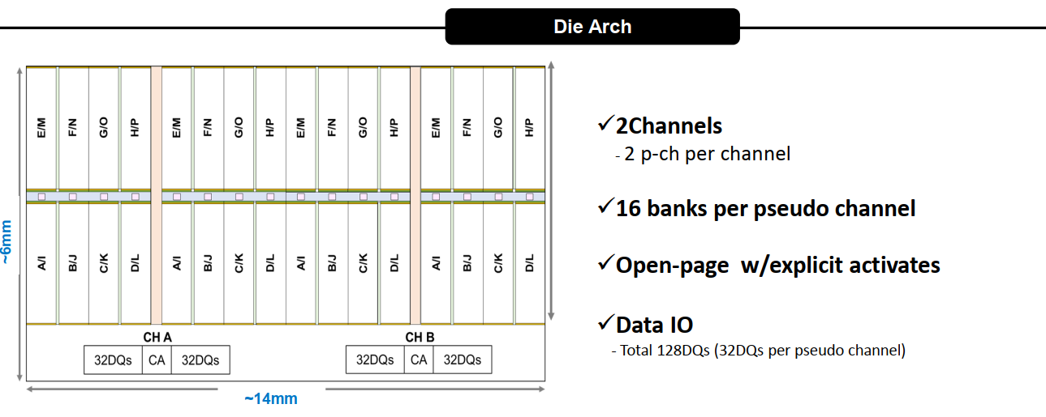
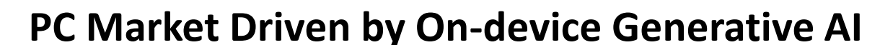
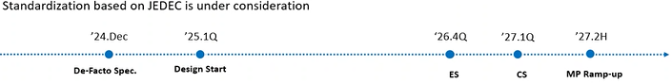
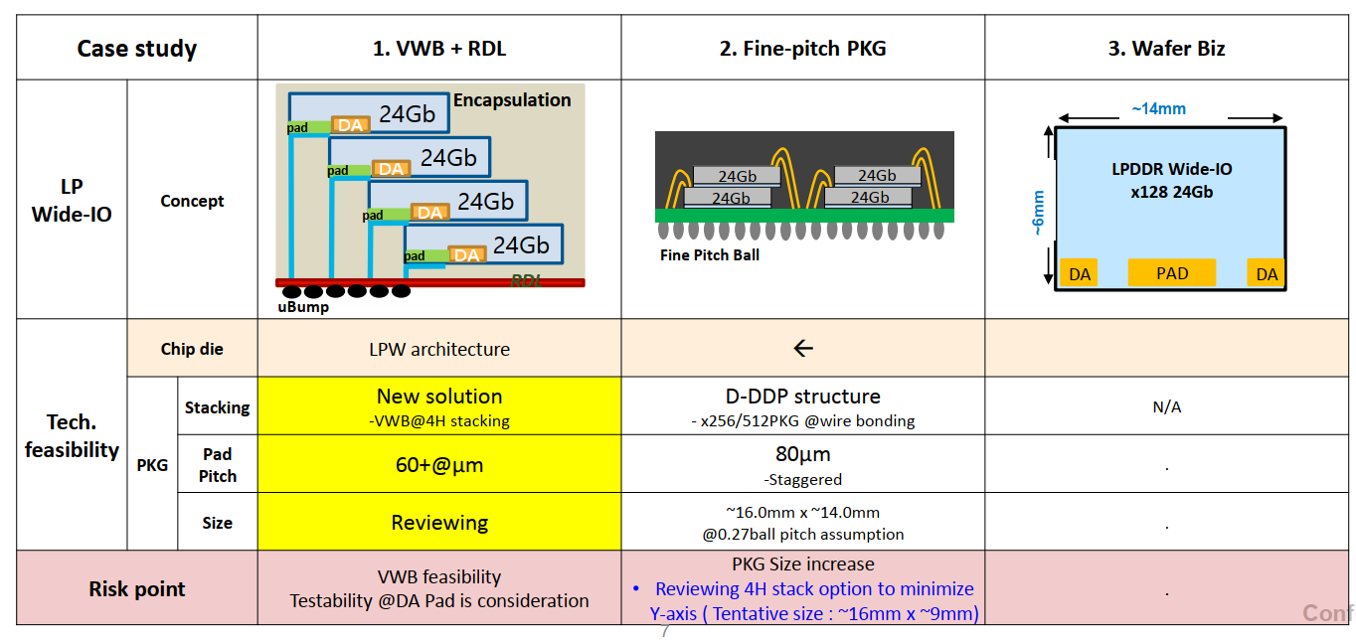
Intel-Samsung Meeting (Feb'24, Aug’24)
Shared with Samsung under NDA
Samsung LPW Revision Aug. 5, 2024 |  | Mock-1 | Mock-2
 |  | Add DODT | 1c,2xCap/DQ
Technology | D1b | ⟸ | D1c
Capacity [Gb] | 16 | ⟸ | 32
# DQ | 64 | ⟸ | 128
# of Ch | 1 | ⟸ | 2
# of pCh or subCh / Ch | 2 | ⟸ | ⟸
Burst Length | 8, 16, 32 | ⟸ | ⟸
Data Rate [GT/s] | 3.2 | 10.7~14.4 | ⟸
[GB/s] | 25.6 | 85.6~115 | 171~230
#DQ/diffDQS | 32 | ⟸ | ⟸
tRC [ns] | 60 | ⟸ | ⟸
pJ/bit | 1.9 | 2.3 | 1.5

Slide 5
64GB TMC-LPW module Mockups and Benchmark
TMC Mock-1
Shared with Samsung under NDA
64GB Module | Package-IF | Node | Gb/Die | Module Size [mm²] | Cost | GB/s | pJ/b | BW/mm | # Module | Height
HBM4E | 3DS-HBM | 1c | 32 | 14.2x11.0 | $281 | 3276.8 | 2.8 | 298 | 1 | 17
TMC Mock-1 | TMC-LPW | 1b | 16 | 14.9x14.0 | $156 | 3276.8 | 2.3 | 234 | 2 | 16
TMC Mock-2 | TMC-LPW | 1c | 32 | 14.9x10.5 | $176 | 3276.8 | 1.5 | 312 | 1 | 16

Slide 6
Mockups of Terraced Memory Cube and Cost Breakdown
Input Information |  |  | 1c-process w/ 4GB-die |  |  |  | 1b-process w/ 2GB-die
 |  |  | HBM4P –16Hi 64GB |  | TMC –16Hi 64GB |  | TMC – 4Hi 8GB |  | TMC – 8Hi 16GB |  | TMC – 12Hi 24GB |  | TMC – 16Hi 32GB
Memory | Memory component |  | 3DS-1c-32Gb/die |  | LPWIO-1c-32Gb/die |  | LPWIO-1b-2GB/die
 | Size |  | 11.5 x 9 mm² |  | 6 x 14 mm² |  | 7 x 7 mm²
 | Gross die/wafer |  | 595 |  | 721 |  | 1301
 | Yield |  | 76.5% |  | 79.7% |  | 85.7%
 | Incoming wafer $$ |  | $ 4463 |  | $ 3979 |  | $ 3586
 | $$ / die |  | $ 9.8 |  | $ 6.9 |  | $3.2
Controller | Size |  | 12.6 x 9.2 mm² |  | -- |  | --
 | Gross die/wafer |  | 525 |  | -- |  | --
 | Yield |  | 80% |  | -- |  | --
 | $$ / die |  | $ 18.3 |  | -- |  | --
TSV die | Scheme |  | -- |  | 0P1M + TSV |  | 0P1M + TSV
 | Size |  | -- |  | 2 x 5.2 mm² 5.3 x 5.2 mm² |  | 2.05 x 5.2 mm² |  | 2.4 x 5.2 mm² |  | 3.83 x 5.2 mm² 2.04 x 5.2 mm² |  | 5.26 x 5.2 mm² 2.4 x 5.2 mm²
 | Gross die/wafer |  | -- |  | 3033 |  | 5867 |  | 5023 |  | 3161 5867 |  | 2313 5023
 | Incoming wafer $$ |  | -- |  | $ 450 |  | $ 450
 | $$ / die |  | -- |  | $ 0.149 |  | $ 0.077 |  | $ 0.090 |  | $ 0.143 (need 6ea) $ 0.077 (need 5ea) |  | $ 0.195 (need 8ea) $ 0.090 (need 7ea)
Assembly | Stack Height |  | 1 + 16Hi |  | 0 + 16Hi |  | 0 + 4 Hi |  | 0 + 8 Hi |  | 0 + 12 Hi |  | 0 + 16 Hi
 | Size |  | 14 .5 x 11 mm² |  | 13.6 x 14 mm² |  | 9.9 x 7 mm² |  | 11.7 x 7 mm² |  | 12.8 x 7 mm² |  | 14.9 x 7 mm²
 | Gross die/wafer |  | 367 |  | 303 |  | 871 |  | 725 |  | 663 |  | 569
 | Process cost/wafer |  | $ 9460.2 |  | $ 6919.6 |  | $ 2776.5 |  | $ 4393.3 |  | $ 6057.0 |  | $ 7367.9
 | Process cost/unit |  | $ 25.16 |  | $ 22.8 |  | $ 3.27 |  | $ 6.45 |  | $ 10.13 |  | $ 15.22
 | Yield |  | 70.9% |  | 76.8% |  | 97.6% |  | 94.0% |  | 90.2% |  | 85.1%
Memory Cube Module Cost |  |  | $ 281.0 |  | $ 176.3 |  | $ 16.6 |  | $ 34.4 |  | $ 54.1 |  | $ 78.0
64GB Build Cost |  | # of modules | $ 281 | 1 | $ 176 | 1 | $ 133 | 8 | $ 138 | 4 | $ 163 | 3 (72GB) | $ 156 | 2
Shared with Samsung under NDA

Slide 7
Business Proposition
Key Asks
Increase Data Transfer Rate on-par with LPDDR6
Package development of Terraced Memory Cube Module
Collaborate on developing the solution with the aim of being first to market.
Lead industry adoption and open up to gain wide adoption and economies of scale
Potentially expanding TMC collaboration to wide range of DRAM
PHY-less, TSV-less HBMx
Small Outline LPDDRx
Shared with Samsung under NDA

