Slide 1
Terraced Memory Cube Development Opportunities and Proposal
DerChang Kau, Sep/17/24
TMC: Use Terraced Chiplet Cubing for scalable memory module solutions with shoreline connectivity (Slide 2)
High Bandwidth Memory development opportunities:
  Samsung LPW: De-facto Spec Dec/24, HVM 2H27 (Slide 3, 4)
  SKH PHY-less HBM4: 27~28 intercept (Slide 5, 6)
  PSMC Via-in-One: 28~29 intercept (WiP)

Slide 2
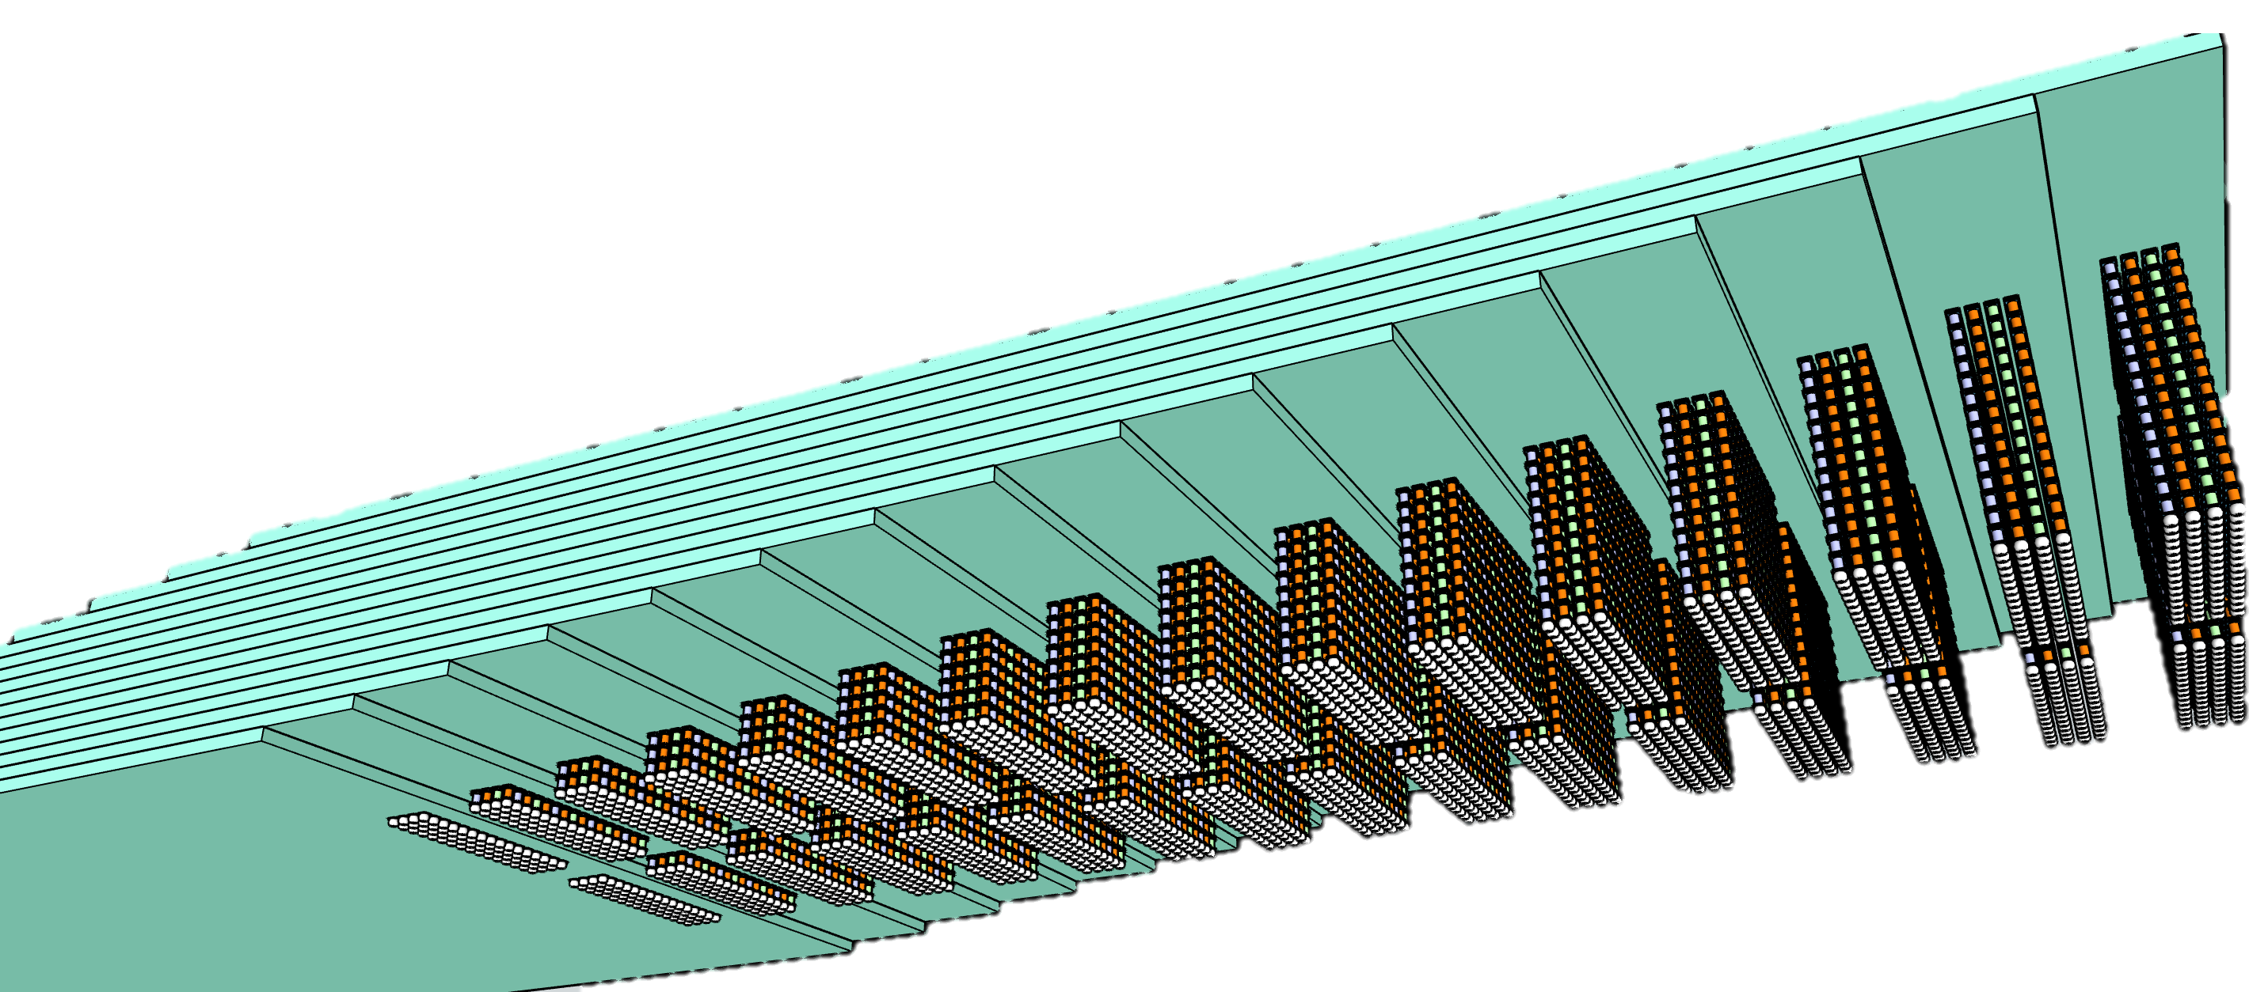
Terraced Memory Cube with TCC
16 tiers of 32Gb LPW
64GB TMC 2K DQ
TMC – terraced stacking of memory chips interconnected vertically using low cost TSV chips to widen data width in a Terraced Chiplet Cubing (TCC) construction.
A TMC example for
3D stack of Low-Power wide-IO, LPW, DRAM chips

Slide 3
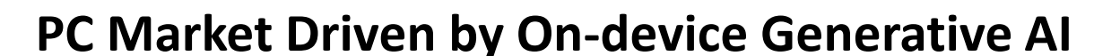
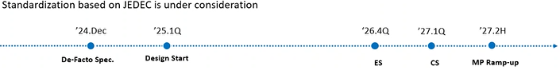
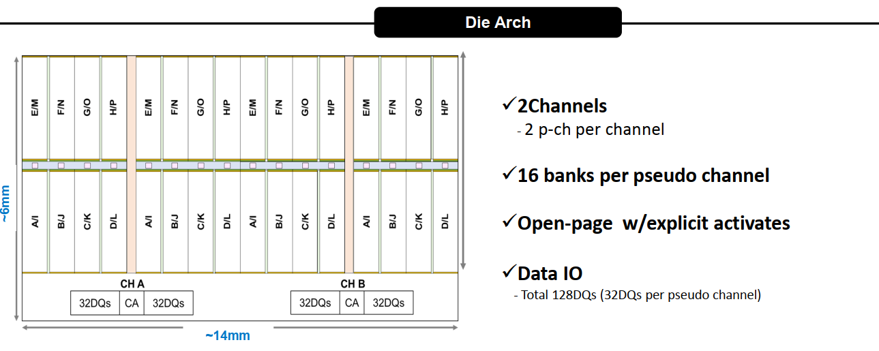
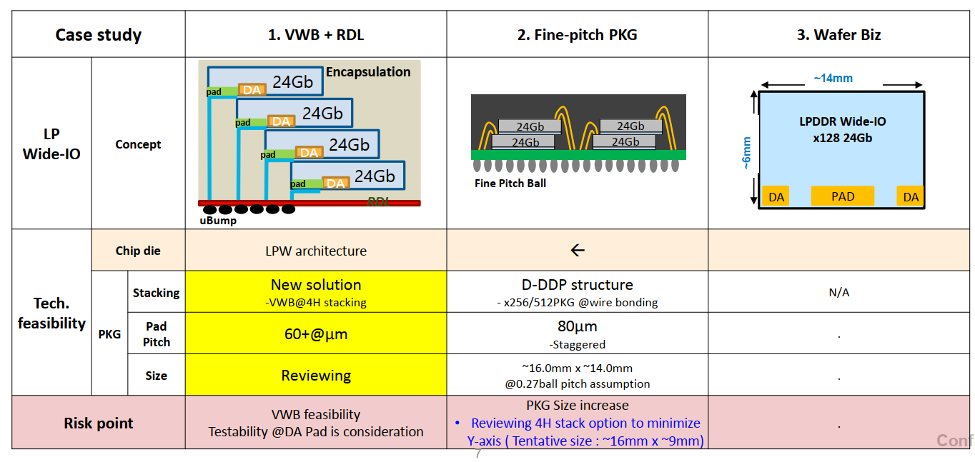
Intel-Samsung Meeting
(Feb'24, Aug’24)

Slide 4
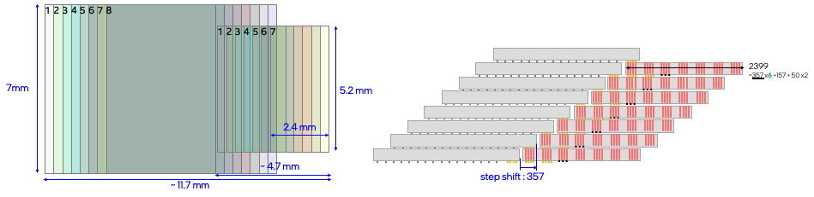
64GB TMC-LPW modules and Benchmark
TMC Mock-1
TMC Mock-2
64GB Module | Package IF | Size [mm²] | Cost | GB/s | pJ/b | BW/mm | Node | Gb/Die | # Module | Height | # Die
HBM4E | 3DS HBM | 14.2x11.0 | $281 | 3276.8 | 2.8 | 298 | 1c | 32 | 1 | 17 | 17
TMC Mock-1 | TMC LPW | 14.9x14.0 | $156 | 3276.8 | 1.9 | 234 | 1b | 16 | 2 | 16 | 32
TMC Mock-2 |  | 23.4x14.0 | $138 |  | 2.4 |  |  |  | 4 | 8
TMC Mock-3 |  | 11.7X28.0 |  |  | 1.9 | 117

Slide 5
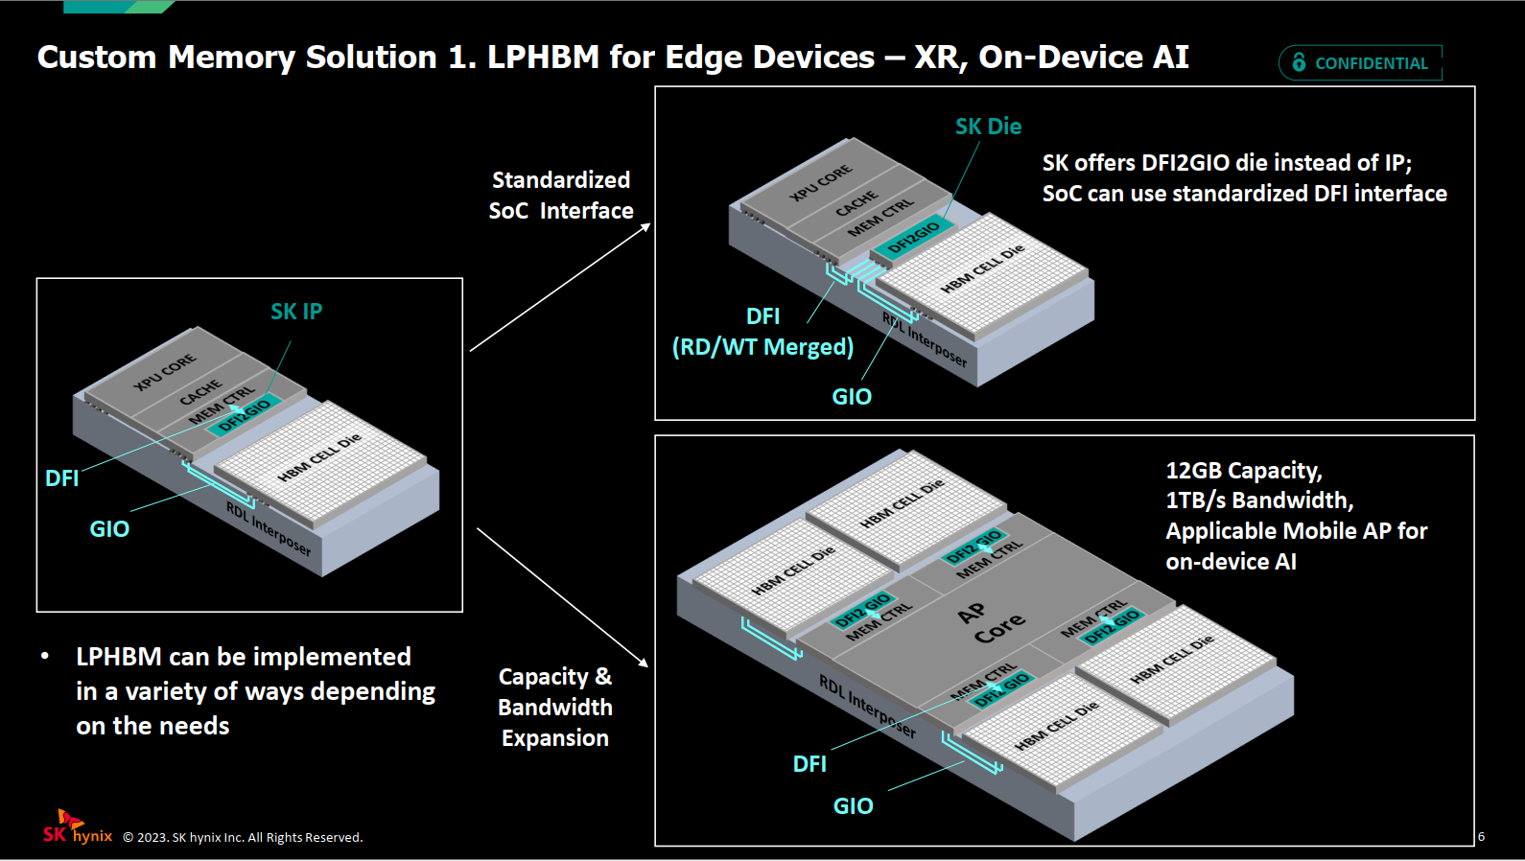
SK Hynix ﻿Custom Memory Solutions for AI Applications

Slide 6
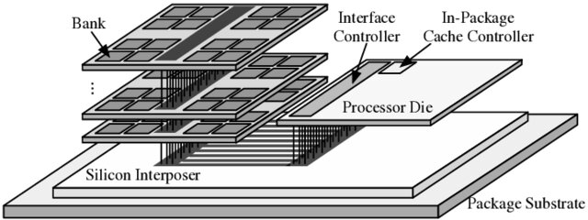
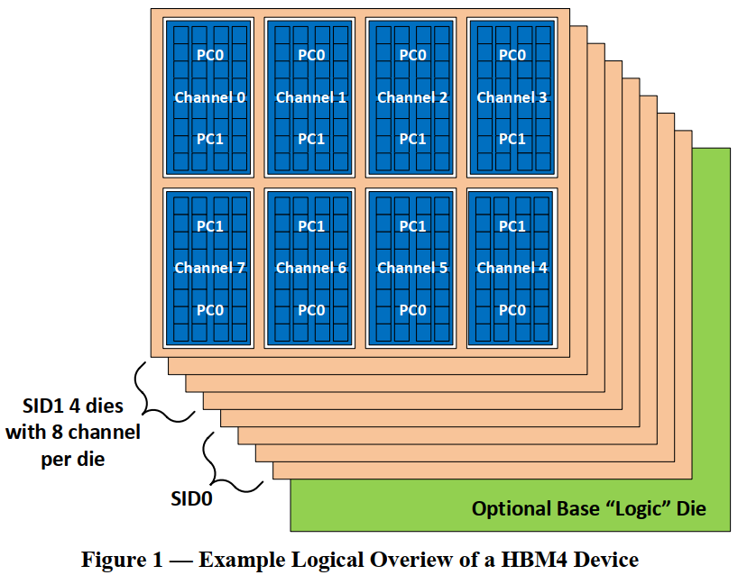
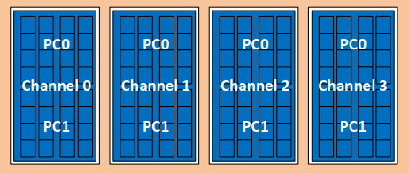
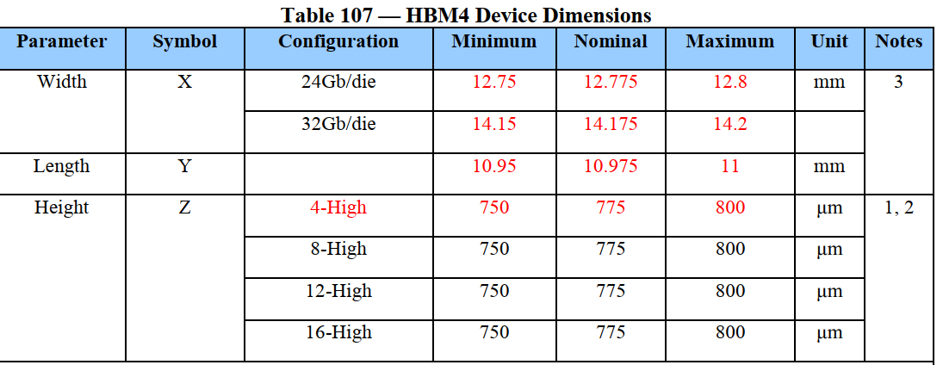
Collaboration Opportunity with SKH
TMC-HBM4
½ HBM
  D1c node
  16Gb die
  TSV-less (Shoreline Bump)
  PHY-less (FD DIO)
  ~42mm² (4.7x9mm²)
  ~50MB/mm²
  4-Ch, 256 FD D/Q
  12.8 GT/s
TCC – 8-die mockup
  16GB module
  32-Ch, 2K FD D/Q
  Max 3.3TB/sec
  (9.4X9mm²)
TCC – 16-die mockup
  32GB module
  64-Ch, 4K FD D/Q
  Max 6.6TB/sec
  (12.6X9mm²)
HBM 3DS
HBM4
D1c node
32Gb / 103mm²
40MB/mm²
8-Ch, 512 FD D/Q
Max 12.8 GT/s
3DS
4, 8, 12, 16-high
16, 32, 36, 64GB module
32Ch, Max 3.3TB/sec

