Slide 1
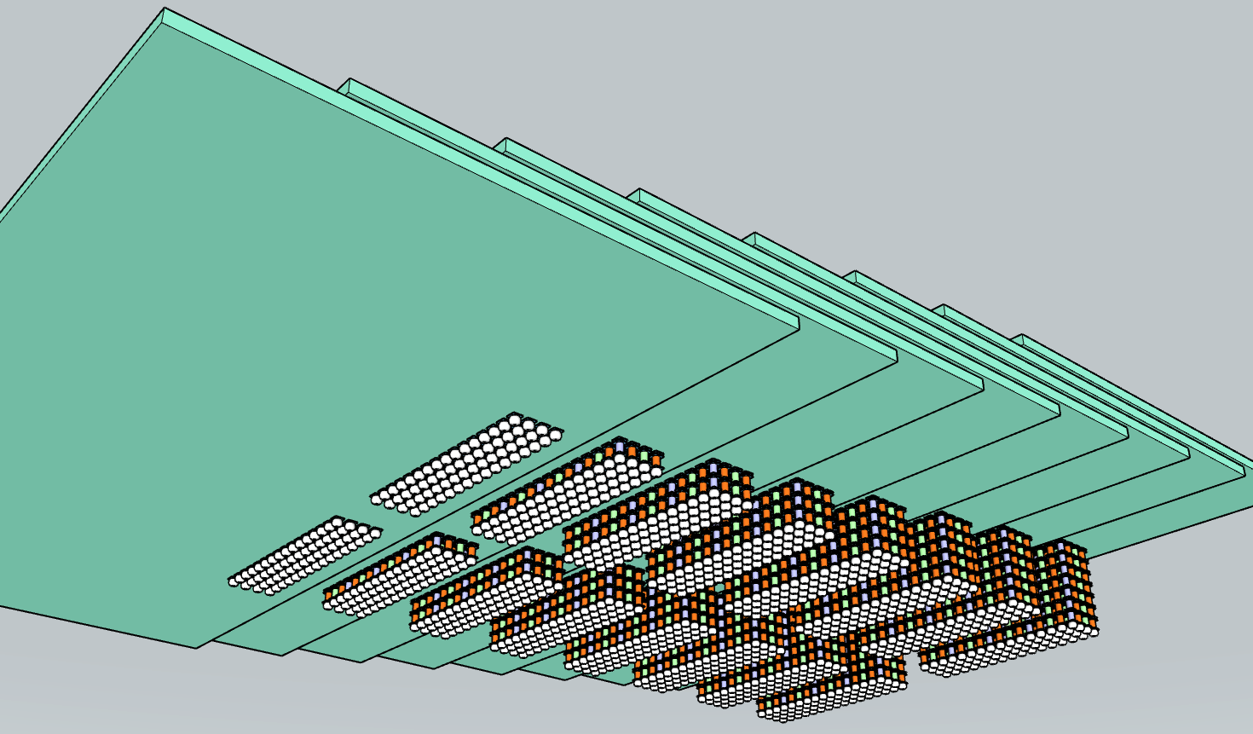
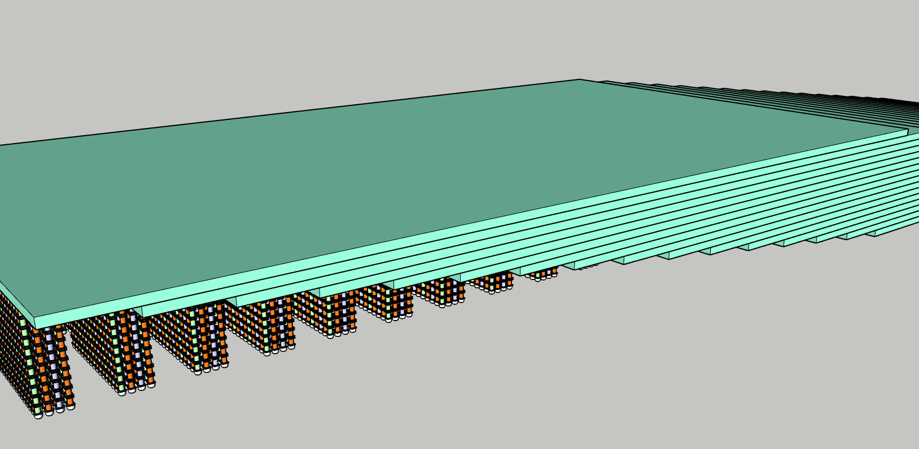
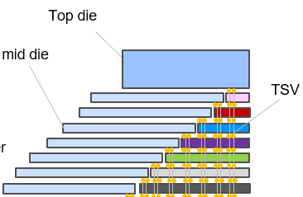
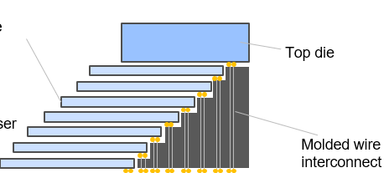
Memory 4th Tier
Memory 3rd Tier
Tier 3 TSV
(a)
8 tiers of 16Gb LPW 16GB TMC w/ 1K DQ
Memory 2nd Tier
Tier 2TSV
Memory 1st Tier
Tier 1 TSV
16 tiers of 32Gb LPW
64GB TMC 2K DQ
(b)
(a)
Mid die

