Slide 1
LPW 32Gb x128
14mm
7mm
5.16mm
150µm

Slide 2
Bump Pad
5.16mm X 150µm

Slide 3
Cross Section
Top die thickness > 150µm required
All other die 37µm
TCB height 7µm
…
410 x N-1
…
Up to 16 tiers
…
…
7µm gap
Up to 15 set of TSV
Die Thickness 37µm
…
Pad range
150µm
410 (shift pitch)
50 (30 + kerf)
100 D2D space
50 (30 + kerf)
50 (30 + kerf)
Shift pitch 410
410 x (N-1)

Slide 4
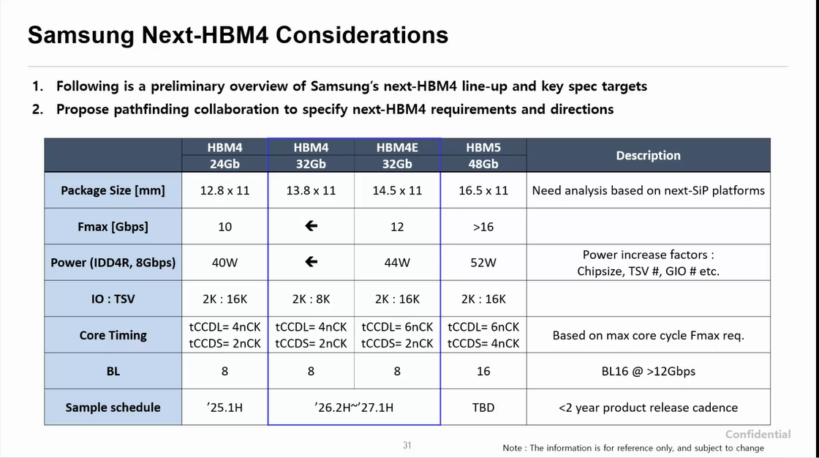
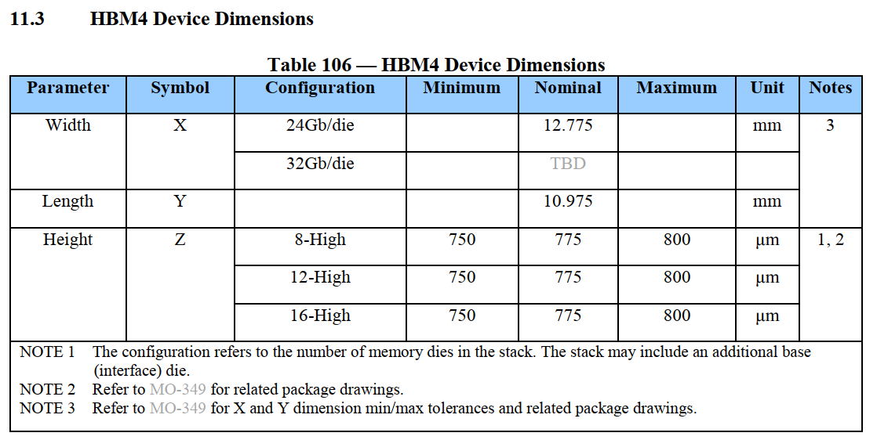
Module Dimensions
12.15mm
0
0
0
1
0
2
0
5
0
6
0
7
1
0
1
1
1
2
1
5
1
6
0
3
1
7
0
4
1
3
1
4
1
6
0
6
1
7
0
7
1
2
1
4
0
2
0
4
1
3
0
3
1
0
1
1
1
5
0
1
0
5
14mm
5.2mm
SKH HBM4 Rev0.71 Proposal Mar/27/24
6mm
6.15mm

